Slide 1
Common Neonatal Emergencies
By Dr. Chaitali Shah
Under Guidance of
Dr. Jayshri Desai

Slide 2
Key concepts
Compared with older children and adult, neonates and infants have larger head and tongue, narrow nasal passages, anterior and cephalad larynx, longer epiglottis and shorter trachea.
Neonates have fewer and smaller alveoli, reducing compliance , in contrast their cartilaginous rib cage makes their chest wall compliant.
These leads to chest wall collapse during inspiration and relatively low residual volume at expiration.
This resulting decrease in functional residual capacity (FRC) limits oxygen reserve during period of apnea (intubation attempt).

Slide 3
Key concepts
The greater minute ventilation – FRC ratio contributes to rapid increase in alveolar anesthetic concentration that speeds inhalational induction
Temperature must be closely monitored because of their greater risk of malignant hyperthermia and greater susceptibility for intraoperative hypothermia or hyperthermia
Laryngospasm can be avoided by extubating the patient either while awake or while deeply anesthetized.

Slide 4
Perioperative fluid Therapy
Goals:
Ensure adequate intravascular volume
Ensure good cardiac output and stable hemodynamics
Ensure adequate tissue perfusion
Prevent electrolyte disturbance and hypoglycemia
Correction of fluid deficit and replace ongoing loss
Compensate for autonomic changes under anesthesia
Challenges in Pediatric fluid therapy
Increased metabolic rate
Small surface area-volume ratio
Difference in total body water:
Preterm infant- 90% of body weight
Term infant- 75-80% of body weight
Adult- 60% of body weight

Slide 5
Complications of fluid therapy:
Fluid overload
Anasarca
Pulmonary edema
Bowel swelling
Laryngeal edema
Hyperchloremic metabolic acidosis from excess use of normal saline
Hyponatremia if large amount of ringer lactate
Coaguloapthy if colloids like dextran
NPO Guideline:
<6 months: Milk and solid - 4 hrs and clear fluid – 2 hrs
6 months- 3 yrs: Milk and solid - 6 hrs and clear fluid – 3 hrs
>3 yrs: Milk and solid - 8 hrs and clear fluid – 3 hrs

Slide 6
Metabolism and Temperature regulation
Pediatric patient have larger surface area per kilogram than adults
Thin skin, low fat content an da greater surface area relative to weight promote greater heat loss to environment in neonates
Neonate produce heat by metabolism of brown fat (nonshivering thermogenesis) and by shifting hepatic oxidative phosphorylation to more thermogenic pathway
Even mild degree of hypothermia can cause
Delayed awakening from anesthesia
Cardiac arrhythmia
Respiratory depression
Increased pulmonary vascular resistance
So active warming with warming blanket to ensure euthermia

Slide 7
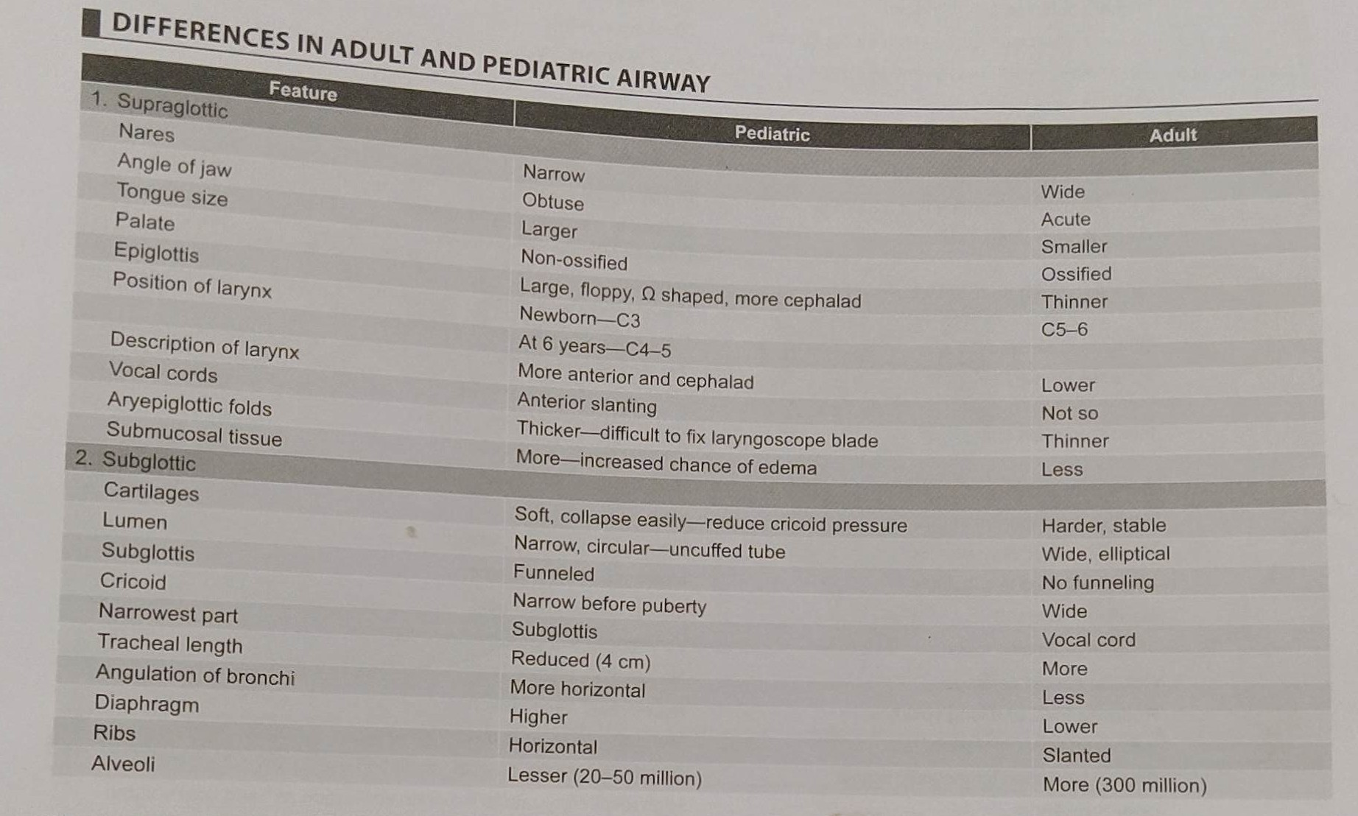

Slide 8
Induction with Sevoflurane
The aim of induction is to render the patient unconscious as rapidly as possible.
Sevoflurane is more suitable than Isoflurane for single- breath induction; because it produces a smoother induction with a lower incidence of complications and better patient acceptance.
Sevoflurane is the least irritant of all inhalation anesthetic agents
Full term neonate require lower concentration of volatile anesthetic than infant aged 1-6 month
Minimum alveolar concentration (MAC) in preterm neonates decreases with decreasing gestational age
The MAC of Sevoflurane in neonates and infants remains constant

Slide 9
Two techniques for induction with sevoflurane:
The Single Breath Vital Capacity Technique : Induction is performed after priming the circuit with 8% sevoflurane in 100% oxygen.
Before gently applying the mask, the patients are instructed to breath out to a residual volume and take a vital capacity breath and hold their breath as long as possible and take regular breaths until unconscious.
A successful vital capacity breath is defined as a complete expiration followed by a complete inspiration and an immediate period of apnea with inflated lungs.
Tidal Volume Technique :
Patients are instructed to maintain regular breathing even after application of mask, sevoflurane begun at 1% and increasing the concentration with increments of 1% every 3 breaths until unconscious.

Slide 10
Surgical Emergencies Of Newborn
Esophageal atresia and Tracheoesophageal Fistula
Congenital Diaphragmatic Hernia
Omphalocele and Gastroschisis
Necrotizing Enterocolitis
Anorectal Anomalies

Slide 11
Tracheoesophageal Fistula (TOF)
Introduction:
It is an abnormal connection between esophagus and trachea
First successful primary repair was done in 1941 by Cameron Haight
Incidence:
Most common type of airway fistula
Incidence of 1 in 3,500 to 4,500
Acquired TOF occurs in approximately 0.5% patients undergoing tracheostomy.

Slide 12
TOF Cont…
Etiology
Congenital: Associated with Trisomy 13, 18 and 21
Acquired:
Blunt Trauma, avulsion injury to neck
Post intubation/tracheostomy
Esophageal Carcinoma
Post radiation therapy
Impacted denture
More than 25% of infants with tracheoesophageal fistula have other congenital anomalies.
VATER (vertebral defect, anal atresia, TOF, esophageal atresia, renal dysplasia)
VACTERL (VATER with cardiac and limb defects)

Slide 13
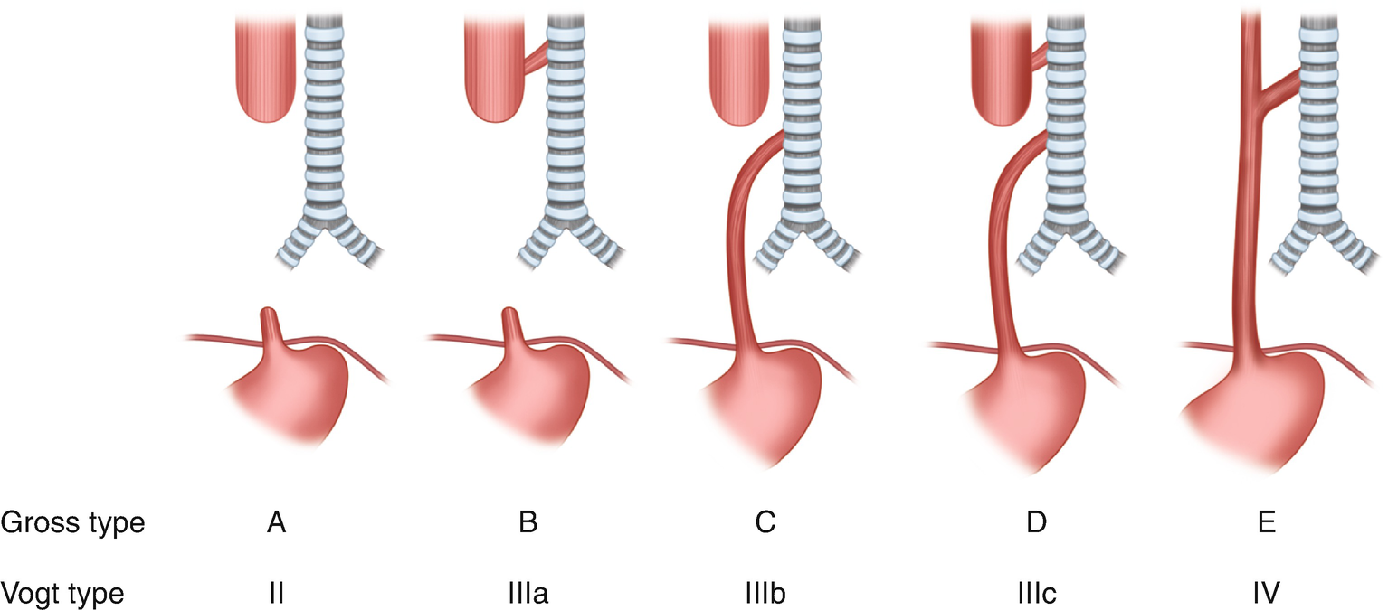
Classification

Slide 14
History and Examination
History:
Polyhydramnios in mother is suggestive of TOF
Presence of fundic gas shadow on prenatal USG
Presents with copius fine white frothy mucus in mouth
Secretions recur in spite of suctioning
Choking, coughing and cyanosis occur with first feed
Examination:
Signs of dehydration
Scaphoid abdomen in absence of fistula
If fistula present, abdominal distension due to air in stomach
Inability to pass feeding tube beyond 10-15 cm

Slide 15
Investigations
Chest Xray:
Pulmonary infiltrates, aspiration pneumonia
Coiled NGT in proximal esophagus pouch
Abdomen Xray
Intestinal malrotation
Intestinal obstruction
Esophageal endoscopy and bronchoscopy
CT scan
Echocardiography: to diagnose associated defects

Slide 16
Management
Primary closure is always preferably done as an emergency procedure
Staged repair several weeks after birth is preferred in
Premature babies
Severe respiratory distress syndrome
Aspiration pneumonia
Congenital cardiac disease
Forgarty balloon catheter is used to obliterate fistula if staged closure is planned

Slide 17
Anesthetic management
Induction:
Awake intubation with preservation of spontaneous respiration allows for optimal positioning of ETT while minimizing the risk of ventilatory impairment associated with gastric distension
IV induction:
Inj. Thiopentone 3-4mg/kg or Inj. Ketamine 2 mg/kg
Inhalational Induction:
Sevoflurane and oxygen are used
Avoid prolonged use of high sevoflurane concentration and watch for apnea

Slide 18
Anesthetic management
Intubation:
Ideal ETT placement is between carina and TOF, lying just above carina
Tip of ETT ideally lie just distal to TOF
Aim at ventilating the lungs without ventilating fistula
Hand ventilation is preferred during lung retraction
Maintenance:
O2 and Sevoflurane is used for maintenance
Atracurium for muscle relaxation

Slide 19
Congenital Diaphragmatic Hernia
Introduction:
Failure of closure of diaphragm allows abdominal contents to herniate into thorax
As a result of herniation, normal development of lung is hampered
First successful operative repair done by Heidenhain in 1905
Incidence:
1 in 2,500 to 3000
Six times more common on left than right hemithorax
Some associated congenital syndrome include:
Backwith-Wiedemann
CHARGE (coloboma, heart defect, atresia of choanae, retardation, genital and ear anomalies)
Trisomy 18 and 21

Slide 20
Clinical features
Routine prenatal screening may identify CDH at age of 24 weeks
Classical Triad:
Dyspnea and respiratory distress at birth
Cyanosis
Apparent Dextrocardia
Child usually has scaphoid abdomen with barrel shaped chest
Reduced air entry in chest
Bowel sounds audible in chest
Displaced heart sound
Hypoxia, acidois

Slide 21
Pulmonary hypoplasia and pulmonary hypertension are critical derangement in CDH
Hypoplasia occurs due to
Compression by bowel
Global embyopathy
Usually occurs on ipsilateral side of hernia
Results in reduced lung volume and impaired alveolarization
Pulmonary HTN: occurs due to
Reduction in total number of vessels per unit of lung
Pulmonary vascular remodeling with medical hyperplasia
Altered vasoreactivity due to imbalance in autonomic innervation

Slide 22
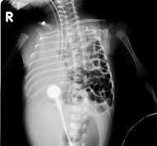
Investigations
Antenatal ultrasonography
Complete blood count
Serum electrolytes
Arterial blood gas
Chest x ray
Bowel loops in chest
Mediastinal shift
Absent lung markings

Slide 23
Medical management
Initial medical management followed by surgical correction improves survival
Goals of medical management:
Avoid bag and mask ventilation
Immediate intubation and gastric suction
Achievement of preductal oxygen saturation of 90% and correction of metabolic acidosis
Surfactant therapy
Other drugs: Sildenafil, Milrinone, Prostaglandin, Prostacyclin
Mechanical ventilation with low peak inspiratory pressure (PIP < 25 cmH2O)
High frequency oscillatory ventilation (HFOV)
Extracorporeal membrane oxygenation (ECMO)

Slide 24
Anesthetic management
Surgical repair is usually preferred 48-72 hours after birth
Induction:
Adequate preoxygenation followed by rapid sequence induction
Avoid positive pressure ventilation or mask ventilation
High dose fentanyl 2-5 mcg/kg to reduce pulmonary HTN
Maintenance:
Balanced anesthesia with o2, sevo/isoflurane and NDMR
Rocuronium or vecuronium are appropriate NDMR
Avoid N2O to avoid abdominal distension
Small tidal volume and rapid respiratory rate is used to maintain airway pressure <20-30 cm H2O and PaCO2 >30 mmHg

Slide 25
Omphalocele and Gastroschisis
Introduction :
They are fetal abdominal wall defects causing herniation of abdominal contents.
Failure of gut to return to abdominal cavity during fetall development causes persistent herniation of abdominal contents
Gastoschisis :
Is a full thickness abdominal wall defect
No sac is present to cover the abdominal content
Omphalocele:
Is a midline abdominal wall defect
Abdominal contents are covered by amnion and peritoneum

Slide 26
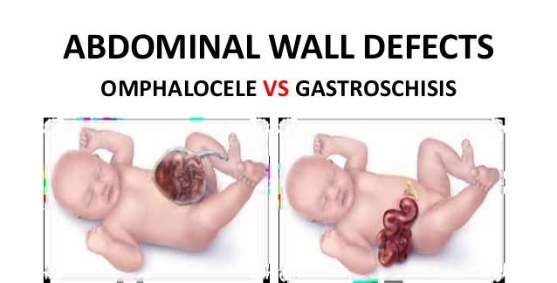

Slide 27
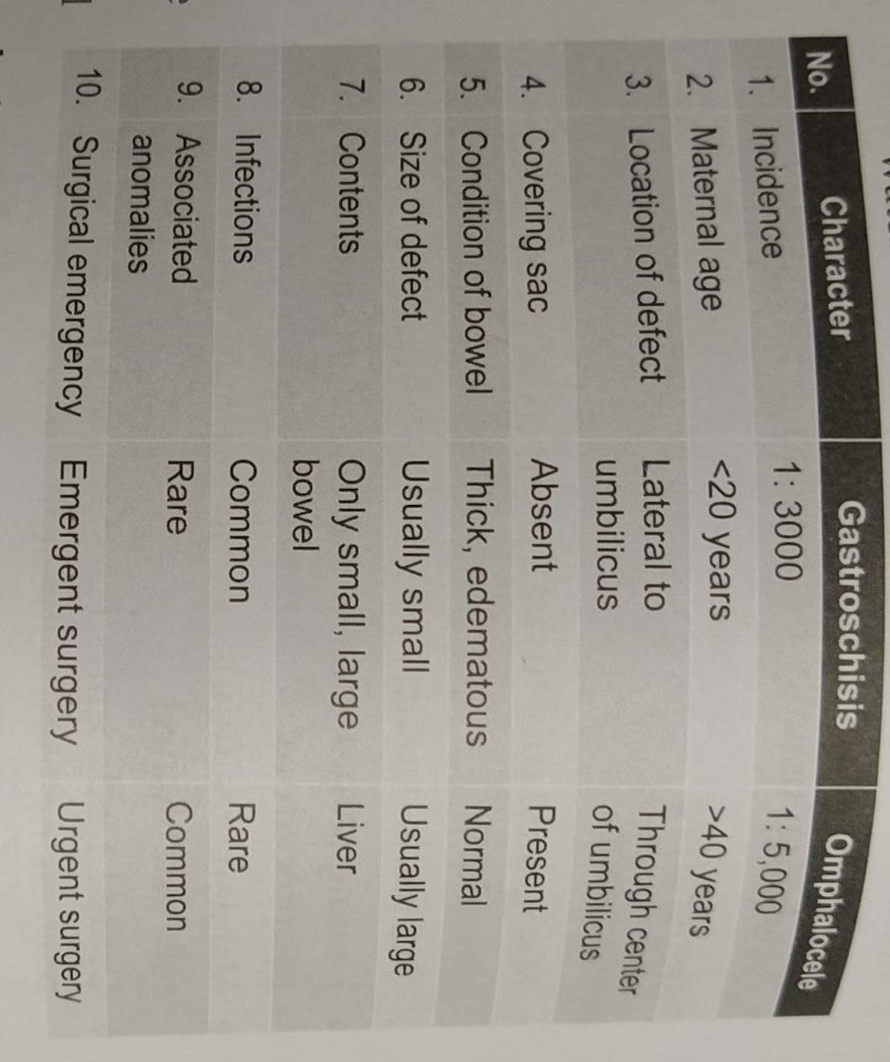

Slide 28
Anesthetic management
Prevention of infection and sepsis especially in gastroschisis
Fluid balance:
Correction of hypovolemia and electrolyte imbalance
Anticipation of massive fluid losses intra operatively
Prevention of hypothermia
Rapid sequence induction in view of associated intestinal obstruction

Slide 29
Induction:
Preoxygenation to maintain SPO2 >95%
Nasogastric or progastric tube inserted prior to induction
Rapid sequence induction with gentle pressure on cricoid
Difficult airway with large tongue is anticipated in Beckwith-Wiedemann syndrome
Maintenance:
Avoid nitrous oxide for maintenance of anesthesia
Balanced anesthesia with O2 and iso or sevoflurane
Increased dose of muscle relaxant is used to facilitate primary closure
Ventilatory requirement increase once bowels are placed in abdomen
Primary closure is not recommended if inspiratory pressure above 25-30 cm H2O or if intravesical or intrgastric pressure is above 20 cmH2O

Slide 30
Anorectal Anomalies
Incidence of anorectal malformation is approximately 1 in 5000 live births
Imperforated anus without fistula occurs in a small number of patients, especially in association with Down Syndrome
Associated with other congenital anomalies such as spinal and vertebral defects and congenital cardiac lesion
Clinical features:
Anorectal malformations are apparent upon examination of perineum
Neonate may fail to pass meconium in the first 24-48 hours
Male infants with imperforated anus usually require emergent surgery to relieve obstruction
In females, presence of rectovaginal fistula may allow for passage of stool

Slide 31
Anesthetic management
Anesthetic management of patients presenting for decompressive colostomy or primary repair should be performed as would be for any infant with distal bowel obstruction
Rapid sequence induction should be considered if abdominal distension is significant
Definitive anorectal reconstruction is performed 1-12 months later
NMDR should be avoided because electrical muscle stimulation is used through out the procedure to identify muscle structure.

Slide 32
Necrotizing enterocolitis (NEC)
Introduction:
It is charecterized byvarying degree of mucosal and transmural necrosis of intestine
Most frequently involves terminal ileum and distal colon
Incidence:
1-3 in 1000 live births, with 90% of cases seen in preterm neonates
Incidence and fatality rate are inversely related to gestational age and birth weight

Slide 33
Clinical features and Invetigations
Sudden feeding intolerance with gastric distension
Recurrent apnea
Lethargy
Temperature instability
Glucose instability
Abdominal distension
High gastric residuals after feeding
Bloody or mucoid diarrhea
Abdomen Xray :
Pneumonatosis intestianalis ( gas bubble in small intestinal wall)
Portal venous gas
Intraperitoneal free air

Slide 34
Anesthetic management
50%of the infants with NEC require surgical intervantion and these patients typically present with significant cardiovascular instabilty.
Aggressive fluid ressusitation should take place before induction of anesthesia
Induction should be performed with precaution due to full stomach
Ventilation with PIP >20 cm H2O because high intra abdominal pressure and decreased pulmonary compliance
There should be vigilant replacement of blood, evaporative and third space fluid loss
Postoperative mechanical ventilation is usually required because of intra abdominal distension and coexisting RDS.

Slide 35
Thank you

