Slide 1
Anatomy of retina
DR.BIRVA DAVE

Slide 2
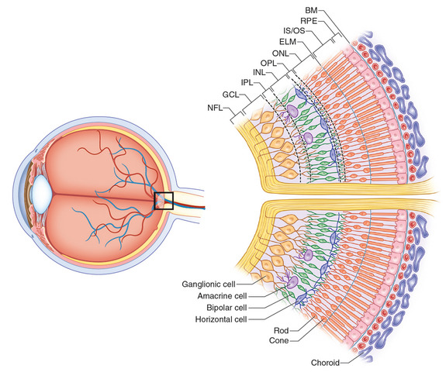

Slide 3
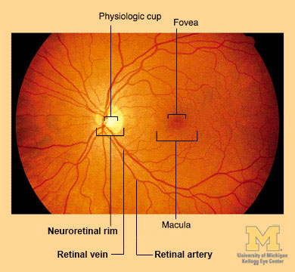
Normal Fundus

Slide 4
Retina is a thin, delicate and transparent innermost membrane of the eyeball.
It is the most highly developed tissue of the eye.
It extends from the optic disc to the ora serrata and surface area of about 266 mm^{2.}

Slide 5
Embryology
Retina consists of two layers developed from optic cup
Inter-retinal space between them that is continuous through optic stalk with the third ventricle.
Pigmented layer
Neural layer

Slide 6
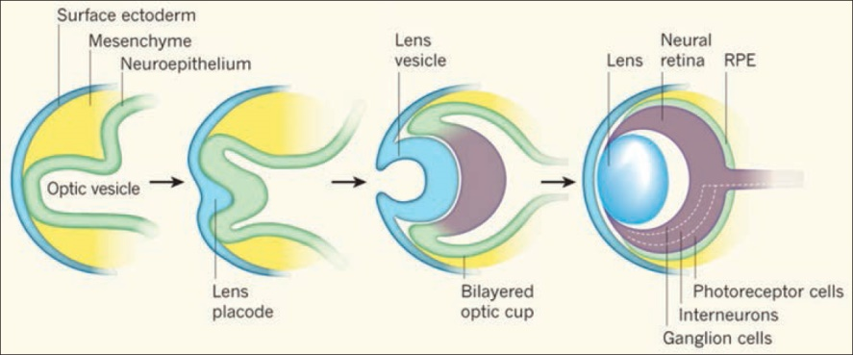

Slide 7
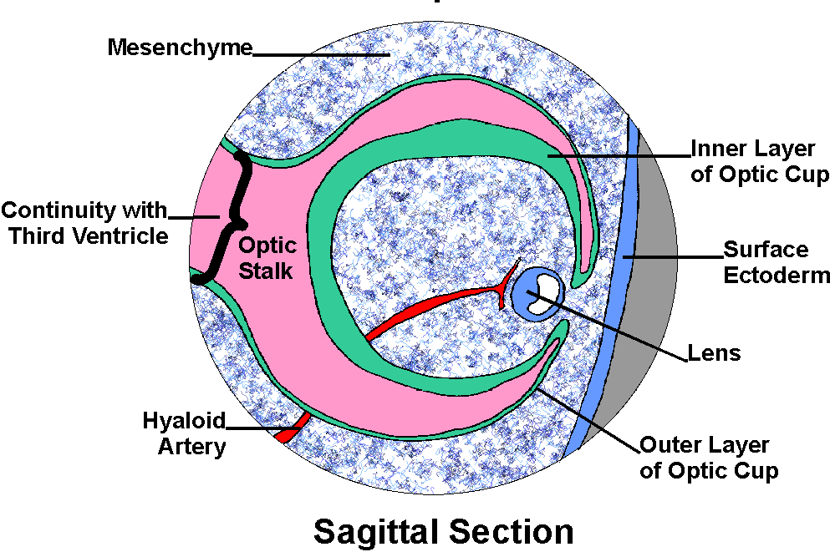
Pigmented layer(External): formed from the outer thinner layer of optic cup. By 6th week.
Neural layer(Internal): formed from the inner layer of optic cup. Start by 40 days continue until 7th month.

Slide 8
Retinal detachment
Fluid accumulation between the two layers of optic disc vesicle (potential space) wherein there is a separation of RPE and neurosensory retina causes retinal detachment.
Types: rhegmatogenous (break), exudative (tumor), tractional (diabetic).
Treatment: surgery

Slide 9
Examination of Fundus
Retina is divided by equator
Anterior Retina Posterior Retina
Indirect Ophthalmoscope
Three-mirror contact lens
Direct Ophthalmoscope
2. Slit lamp biomicroscopy
Peripheral Retina
Central retina

Slide 10
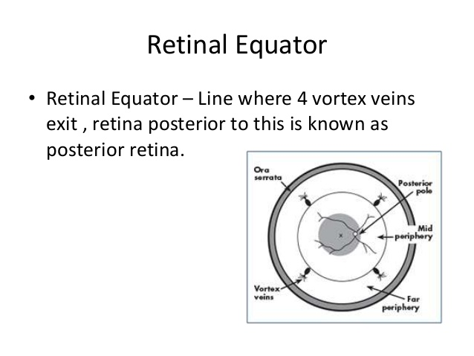

Slide 11
Gross Anatomy
Central Retina
Peripheral Retina
Foveola
Fovea
Perifovea
Parafovea
Macula
Rich in cones
Near periphery
Mid periphery
Far periphery
Ora serrata
Rich in Rods

Slide 12
Clinical functions
Central Retina
Fine visual acuity
Photopic vision
Stereopsis
Color vision
Peripheral retina
Gross vision
Scotopic/night vision
Sensitive to motion and stimulates turning of eye/head

Slide 13
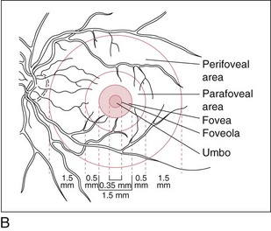
Central Retina
I

Slide 14
Area centralis / Macula
Specialised region of retina
Demarcated by superior and inferior temporal arterial arcuate
• Diameter- 5.5 mm
• Location- 2 DD – temporal margin of disc
• Color- Yellow; deep pigmented
• Corresponds 15⁰ of visual field
• Responsible for photopic and color vision

Slide 15
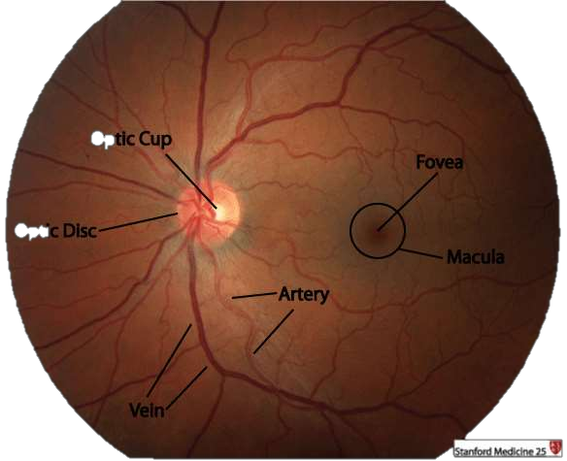
Macula-Dark area in the central retina
Protects central vision by following characteristics;
Highly pigmented tall epithelial cells of RPE(highest pigmentation of entire retina)- which give dark macula.
Dense pigmentation helps to reduce scattering of light.
The choroidal capillary bed also is thickest in the macula.
It has also yellowish hue due to highest concentration of xanthophyll pigments.

Slide 16
Fovea
Centre of area centralis
Appx. 4 mm temporal to optic disc and 0.8 mm below horizontal meridian
Diameter --1.55 mm (5° visual field)
Thickness -- 0.25 mm

Slide 17
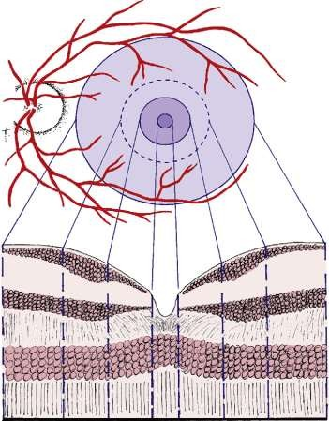
Fovea
At the centre of the fovea, the layers of the retina are thinner so that a Central concave indentation – foveola produced

Slide 18
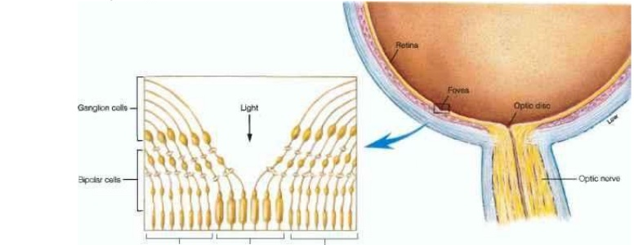
The inner nuclear layer and ganglion cell layer are displaced laterally and accumulate on the curved walls of the fovea called Clivus

Slide 19
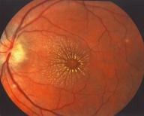
The photoreceptor fibers(cones) become longer as they deviate away from the center; these fibers are called Henle’s fibers
Chronic retinal oedema may result in the deposition of hard exudates around the fovea in the layer of Henle with a macular star configuration.

Slide 20
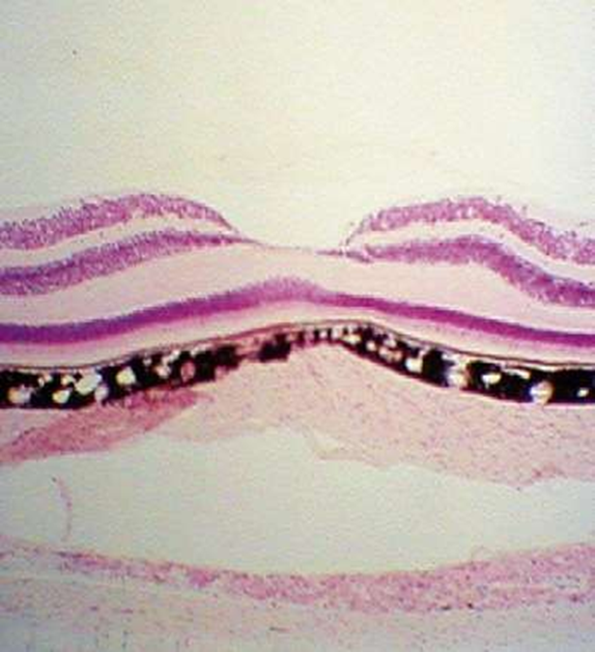
Six layers present in the foveola are ;
Internal limiting membrane
outer plexiform layer.
ONL (which contains about 10 rows of cone nuclei),
external limiting membrane,
photoreceptor layers
RPE

Slide 21
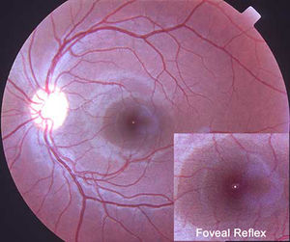
Foveal reflex is caused by the parabolic shape formed by the clivus/umbo
Loss of foveal reflux implies disruption of neural layers

Slide 22
Foveola
Diameter – 0.35 mm
Thickness – 0.13mm
represents the area of the highest visual acuity in the retina
even though its span corresponds to only 1° of the visual field

Slide 23
Sole presence of cone and partly avascular
Lack of blood vessels and neural tissue in foveola allows light to pass unobstructed into the photoreceptor outer segment

Slide 24
Appears deeper red – rich choroidal circulation of choriocapillaries which shines through it.
Cherry red spot : when surrounding retinal cloudy after obstruction to retinal vasculature or metabolic diseases.

Slide 25
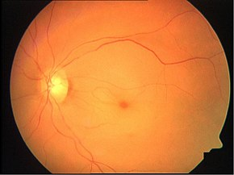
Cherry-red spot
D/D of cherry red spots:
Metabolic Storage Diseases
Leber's congenital amaurosis
central retinal artery occlusion
Quinine toxicity & Dapsone toxicity
Poisoning like carbon monoxide and methanol

Slide 26
Peripheral Retina
4 Regions:
Near Periphery: Circumscribed region of about 1.5mm around the area centralis.
Mid periphery: Occupies 3mm wide zone around the near periphery
Far periphery: Extends from the optic disc 9-10mm on the temporal side and 16mm on the nasal side in the horizontal meridian.

Slide 27
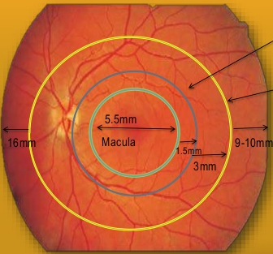
Near periphery
Mid Periphery
Far periphery

Slide 28
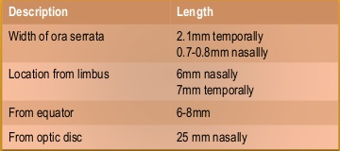
4. Ora serrata
Most anterior region of retina
It is transition zone between retina and par plana
Strong vitreous attachment
Safe zone for retinal procedures

Slide 29
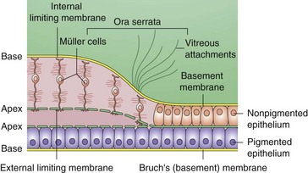

Slide 30
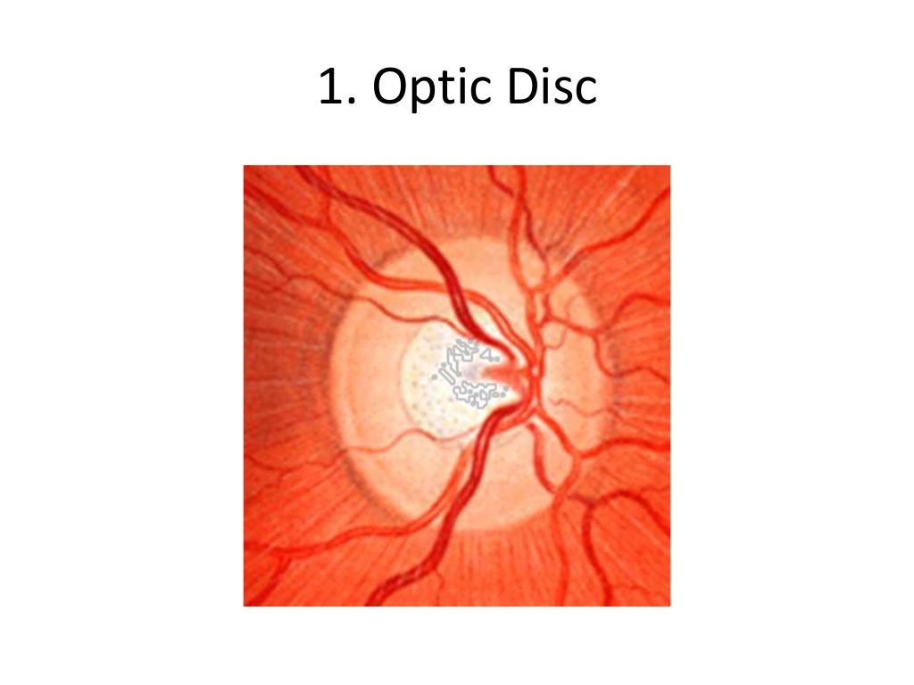
Optic disc
It is a pale-pink, well-defined circular area of about 1.5 mm diameter.

Slide 31
There is a central depression, of variable size, called the optic cup. This depression can be a variety of shapes
there are no rods or cones overlying the optic disc, it corresponds to a small PHYSIOLOGICAL blind spot in each eye.

Slide 32
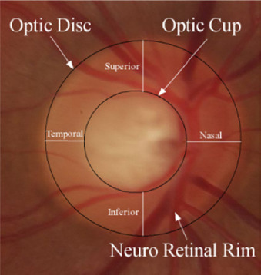
Around the optic cup is neuroretinal rim:
Pink and sharp peripheral margin
Contain nerve axon
Broad inferior rim followed by superior> nasal>temporal ( ISNT rule )

Slide 33
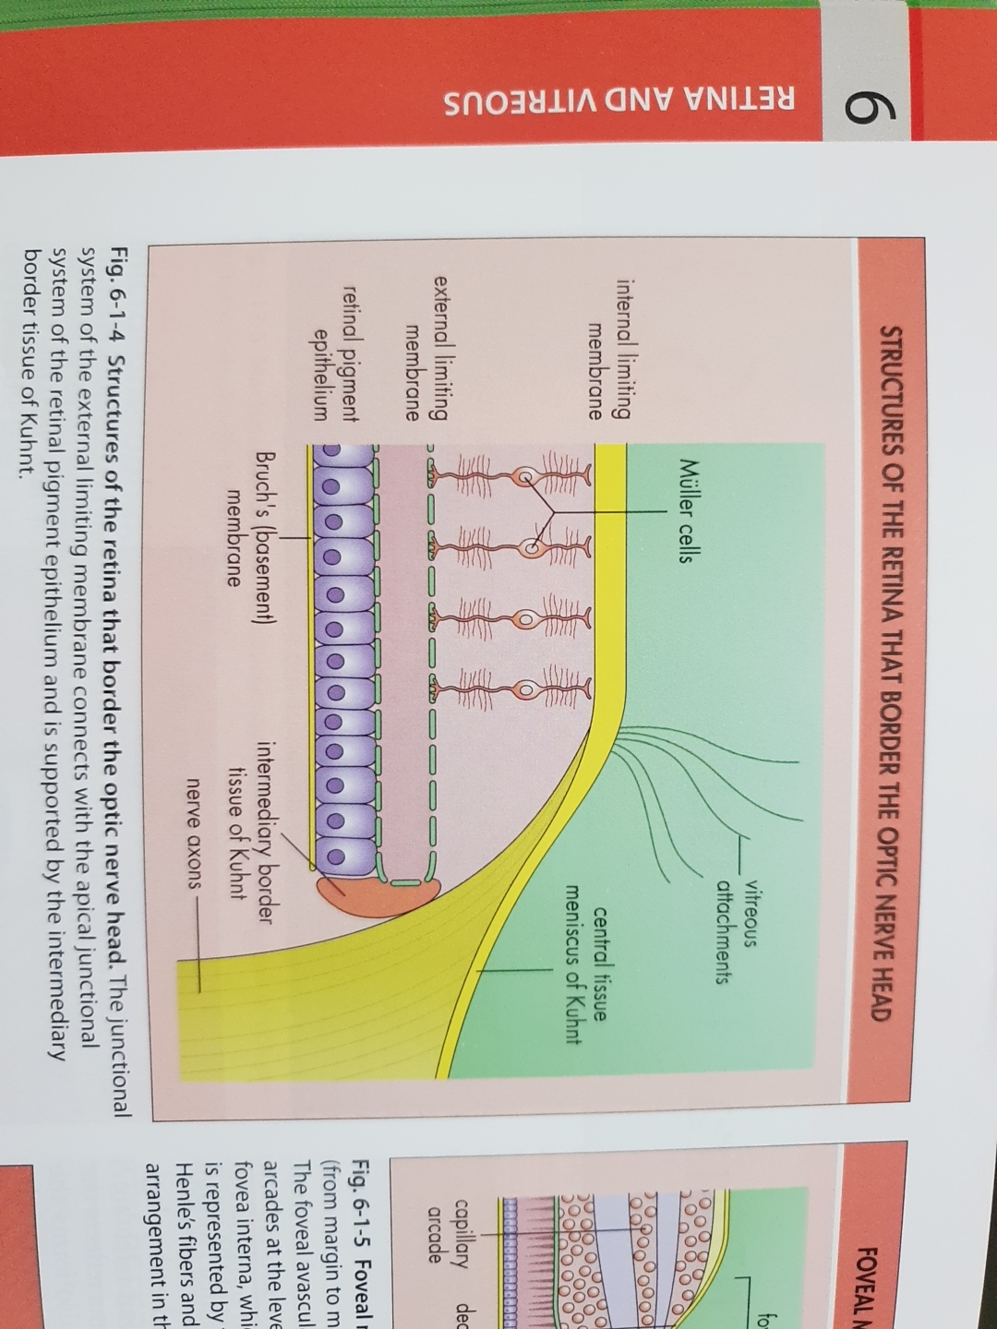
At the optic disc, all the retinal layers terminate except the nerve fibres, which pass through the lamina cribrosa to run into the optic nerve

Slide 34
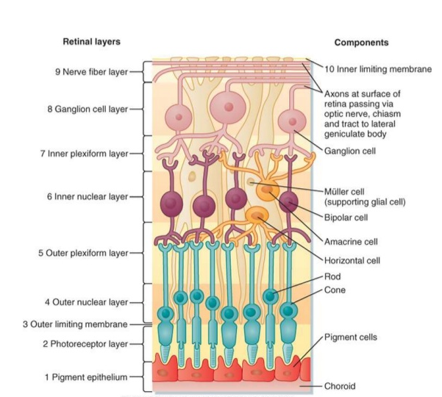
Microscopic structure of Retina

Slide 35
Microscopic structure of Retina
Pigment epithelium (RPE)
Photorececeptor Outer and Inner Segment Layers (OS & IS)
External Limiting Membrane (ELM)
Outer Nuclear Layer (ONL)
Outer Plexiform Layer (EPL)
Inner Nuclear Layer (INL)
Inner Plexiform Layer (IPL)
Ganglion Cell Layer (GCL)
Nerve Fibre Layer (NFL)
Internal Limiting Membrane (ILM)

Slide 36
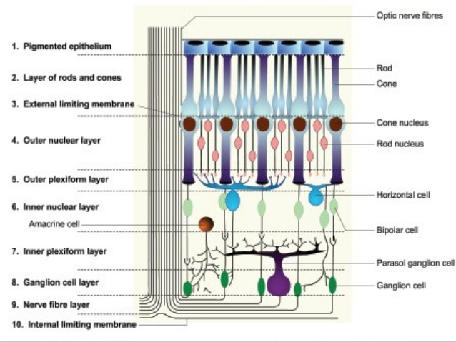

Slide 37
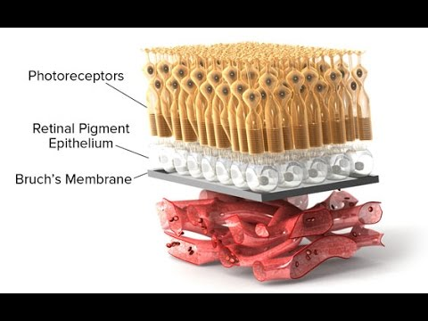
1. Retinal pigmented epithelium
Single layer of 4.2 – 6.1 million cells firmly attached to Bruch’s membrane (basal lamina of choroid)
Microfibrils originate here and extend to lamina elastica of bruch’s membrane

Slide 38
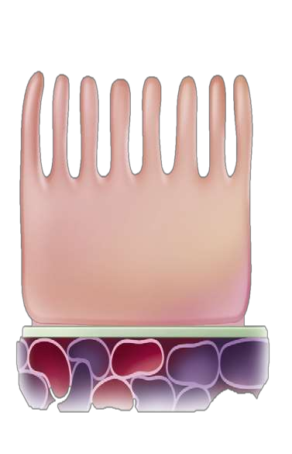
RPE- ULTRASTRUCTURE
RPE are Cuboidal cells with three Cell Surfaces characteristics
1.Apical surface –inner surface
2.Paracellular surface-intercellular surfaces
3.Basal surface – outer surface
Apical surface
Has microvillous processes- Increases Surface area
Interdigitate with outer segments of photoreceptor cells
Contains melanin granules – more in macular region

Slide 39
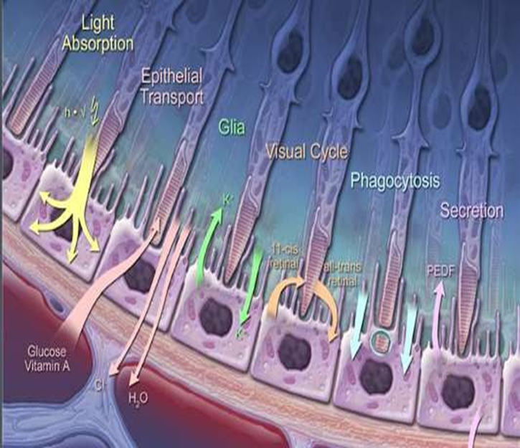
2. Basal surface;
Attached to its basal lamina, the
lamina vitrea of Bruch's membrane.
Nutrients from choriocapillaries difusess to RPE through basal lamina
3. Paracellular surface;
Contains tight junction( Zonula Occluden & adheran, gap junctions)
Junctional complex form blood-retinal barrier
Maintains retinal homeostasis and prevents from toxic damages

Slide 40
Nutrients diffuse from choriocapillaries
Through Basal lamina
Between paracellular spaces
Upto terminal bars
Zonnula occludens (external component of blood retinal barrier<BRB>)

Slide 41
Size and shape of the RPE cells
Cobblestone appearance
In area centralis each cell 12-18um in width 10-14 um in length
Peripherally flatter to 60um width

Slide 42
Functions
Plays an important role in photoreceptor renewal & recycling of vitamin A
RPE is involved with transport of nutrients & metabolites through the BRB & elaboration of extracellular matrix

Slide 43
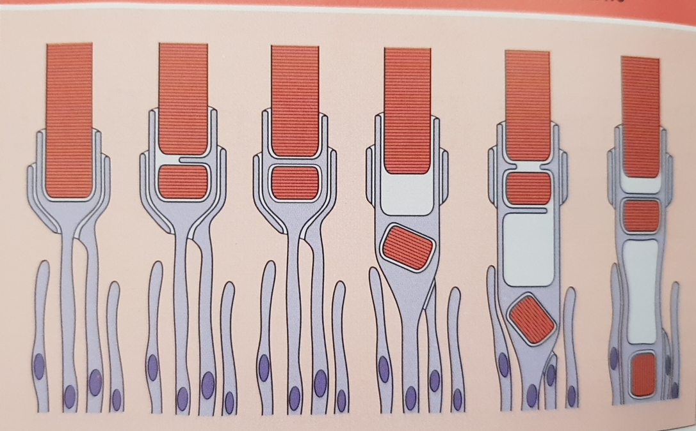
3. RPE cells have phagocytic action by phagocytosis and digestion of photoreceptors

Slide 44
4. Regenerative and reparative function after injury and surgery.
5. Provides mechanical support to the processes of photoreceptors.
6. Manufacture the pigment called melanin which helps in the absorption of scattered light by and thus is optically functional.

Slide 45
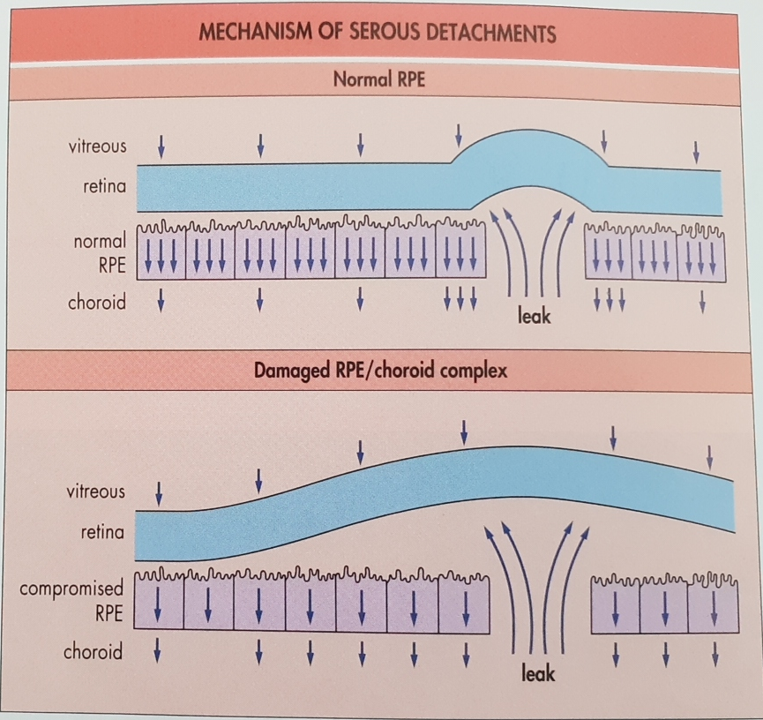
7. Maintains integrity of sub-retinal space by forming BRB and actively pumping out ions & water

Slide 46
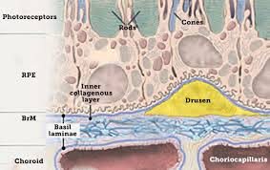
Clinical significance:
1. Failure of the RPE to process cellular debris associated with outer segment turnover cause deposition of Drusen in ARMD
2. Disruption of blood retinal barriers causes retinal edema eg. Macular edema

Slide 47
3. In the eyes of albinos, the cells of this layer contain no pigment.
4. Dysfunction of the RPE is found in
age-related macular degeneration and retinitis pigmentosa
5. Gardner syndrome is characterized by: FAP (Familial Adenomatous Polyps), osseous and soft tissue tumors,
retinal pigment epithelium hypertrophy and impacted teeth.

Slide 48
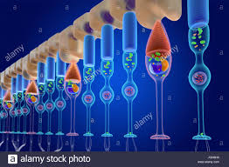
2. Layer of Rods & Cones
Photoreceptors are end organs that transform light into nerve impulses

Slide 49
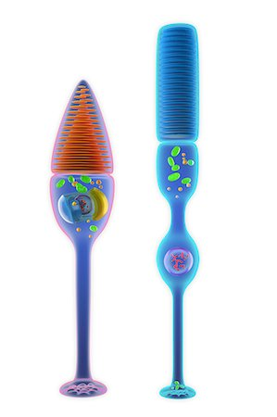
Cones are responsible for
  Photopic (highly discriminatory central vision)
  Color vision

Slide 50
Rods contain photosensitive visual purple.
  Peripheral vision and
  Scotopic vision

Slide 51
Density and distribution of photoreceptors
Cones:
Rodes:
6.5 million
density is maximum at fovea
(1,99,000 cones/mm2)
-minimum density- periphery
-light sensitive molecule- Iodopsin
( color vision-photopic vision)
3 types of iodopsin- trichromatic pigments
1. S wavelength cones- 440nm blue light)
M wavelenght cone- 540nm green
L wavelenght cone- 577nm red
120 million
maximum density in 20°(3mm) from the fovea
(160,000 rods/mm2)
rod-free at the fovea ; 0.35 mm
-minimum density- periphery
-light sensitive molecule- rhodopsin
( night vision- scotopic vision)
-rhodopsin is sensitive to blue-green light- 493nm

Slide 52
CLINICAL ASPECT
Mutation of rhodopsin in retinitis pigmentosa causes maximum pigmentation 3mm around the fovea.
With advanced of age there is progressive loss of photoreceptors (rods are affected more than
cone)- poor night vision in elderly.

Slide 53
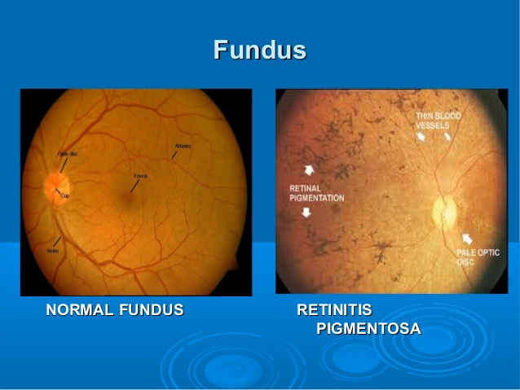

Slide 54
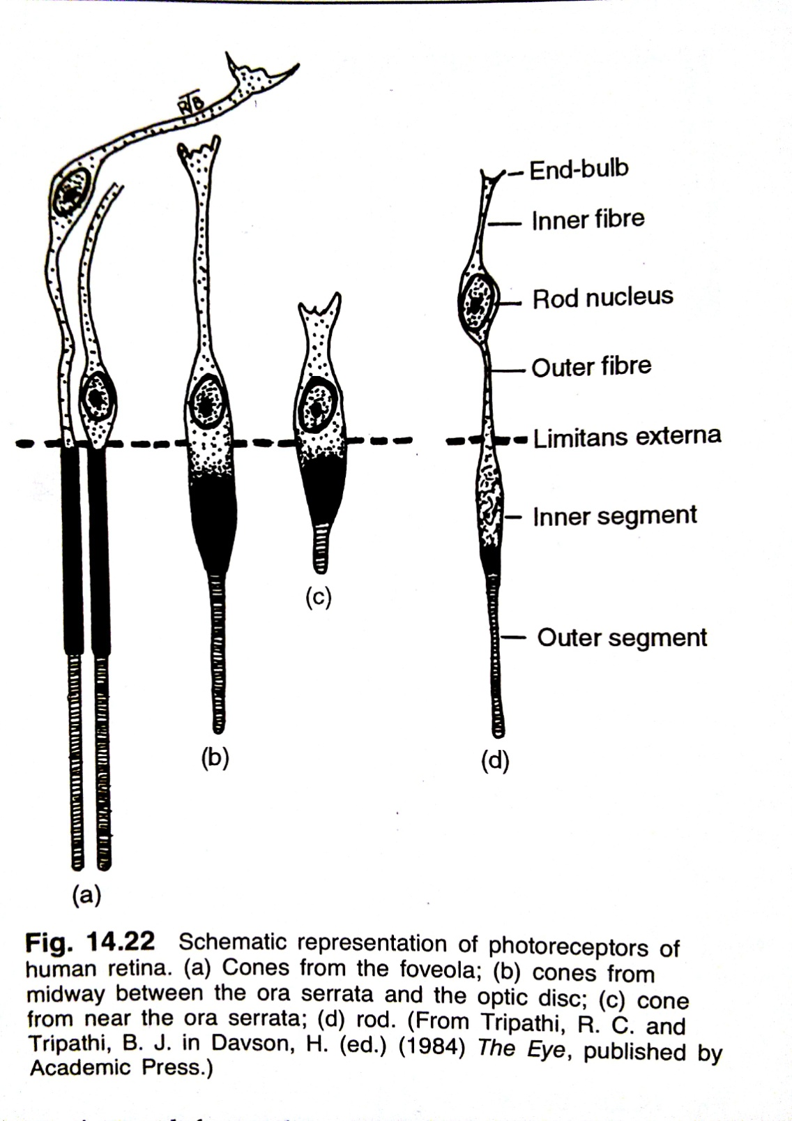

Slide 55
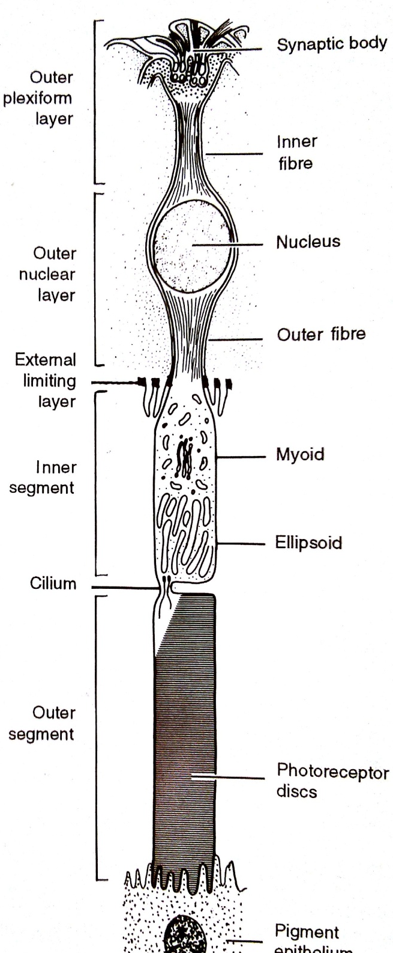
Photoreceptor
Cell body
Nucleus
Cell Process
Inner
Segment
Outer Segment

Slide 56
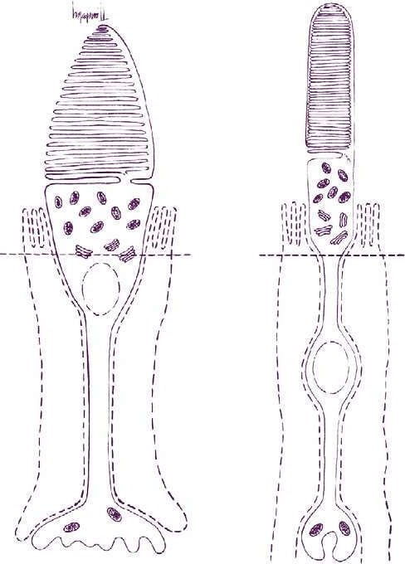
Rods and cones are composed of several parts- six main parts.
The outer segment, containing the visual pigment molecules for the conversion of light into a neural signal;
A connecting stalk, the cilium(cytoplasmic isthmus)
The inner segment, containing the metabolic
Apparatus.
The outer fiber;
5.The cell body- forms outer nucleated layers
6. The inner fiber, which ends in a synaptic terminal- outer plexiform layer

Slide 57
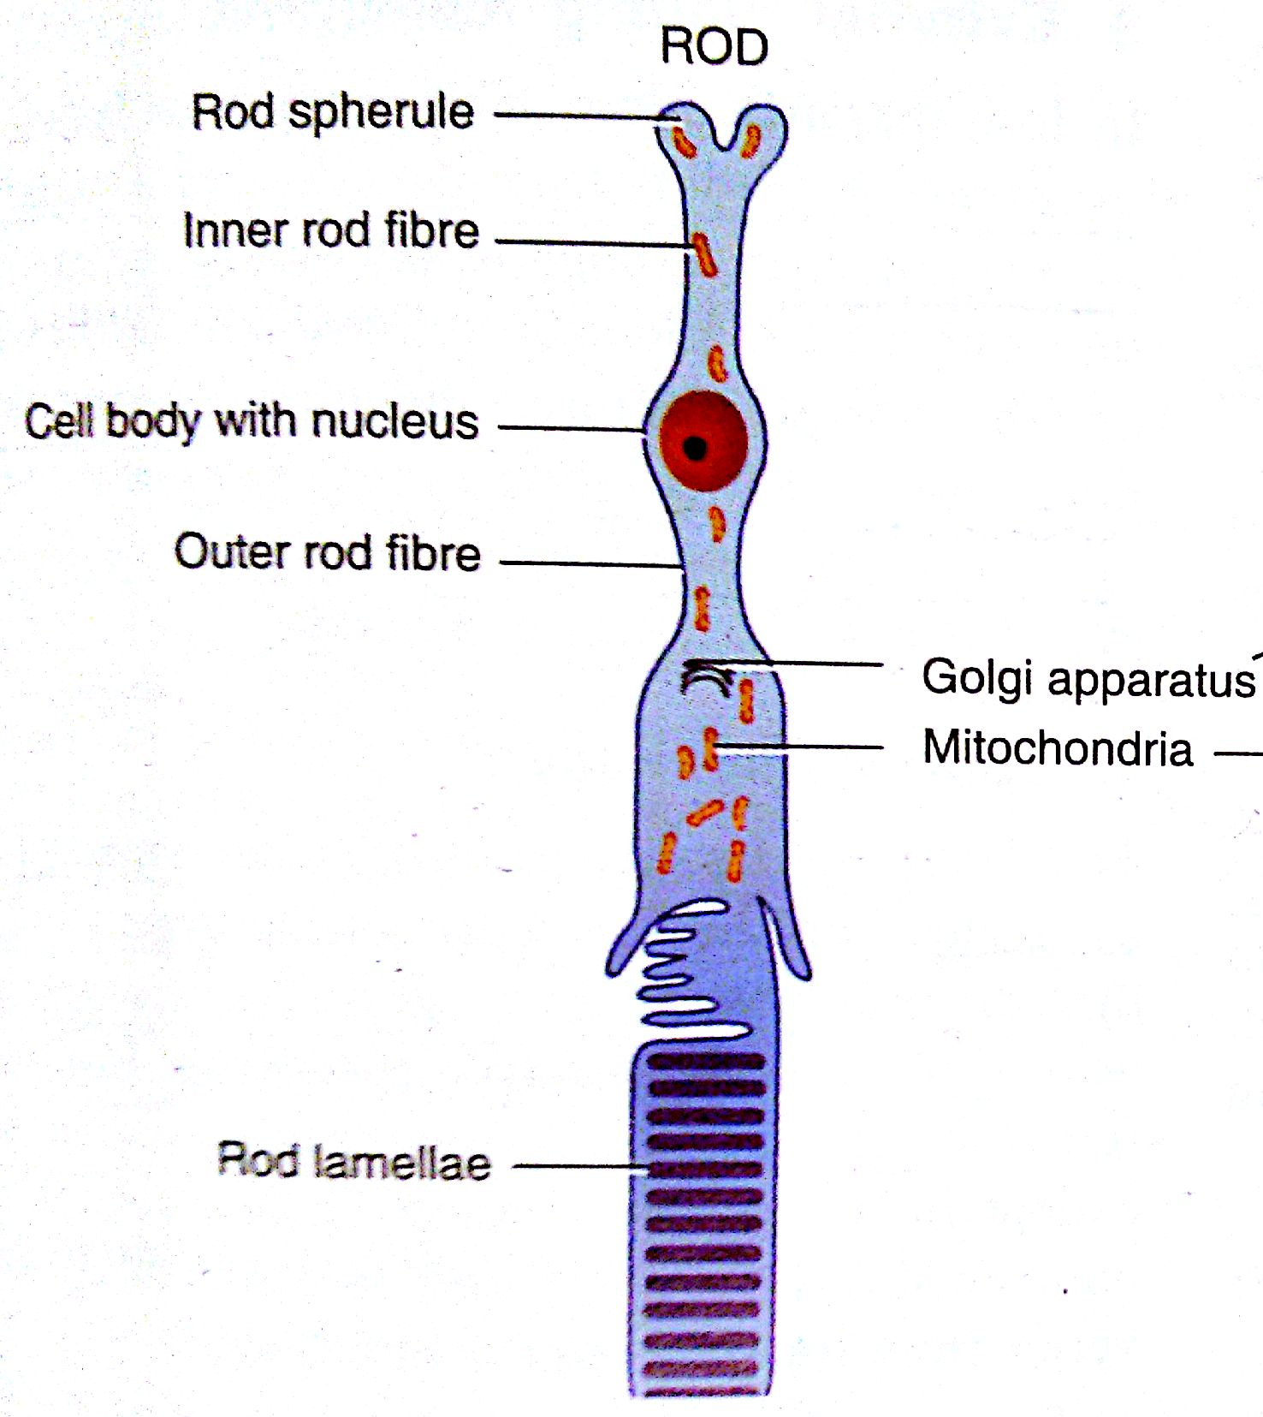
Rod cell

Slide 58

Cone Cell

Slide 59
3.External limiting membrane
In low magnification appears as a fenestrated membrane extending from ora serrata to edge of optic disc
Through this pass processes of rods and cones

Slide 60
EM shows it is formed by zonula adherentes (junctions) between cell membrane of photoreceptor cells and muller cells
Thus is not a basement membrane
Main function:
Selective barrier for nutrients
Stabilization of transducing portion of the photoreceptors

Slide 61
4. Outer Nuclear Layer
Primarily formed by nuclei of rods and cones
Cone nuclei 6-7 um are larger than rod nuclei 5um
Rods form the bulk of the thickness in all except cone dominated foveal region

Slide 62
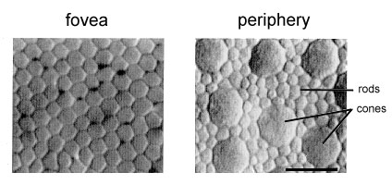
Complete absence of rods

Slide 63
Thickess and number of layers
Nasal to disc – 8 to 9 layers of nuclei –45um thickness
Temporal to disc – 4 layers of nuclei –22um thickness
Foveal region – 10 layers of nuclei – 50um thickness
Rest of retina except ora – one row of cones 4 rows of rods with a thickness of 27 um

Slide 64
5. Outer Plexiform Layer
Synapses between rod spherules and cone pedicles with dendrites of bipolar cells and horizontal cells
Basically marks the junction of end organs of vision and first order neurons
Thickest in macula (51um) consisting predominantly of oblique fibres that have deviated from fovea aka Henle’s layer

Slide 65
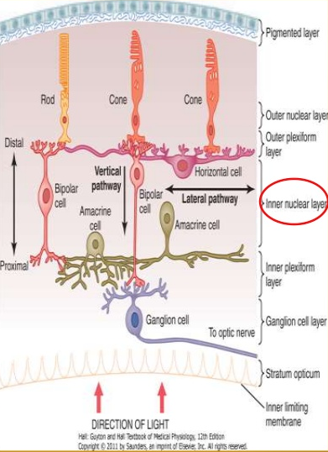

Slide 66
6. Inner Nuclear Layer
Resembles the outer nuclear layer except it is very thin
Disappeared at fovea otherwise contains
  Bipolar Cells
  Horizontal Cells
  Amacrine Cells
  The soma of the Muller’s cells
  Capilliaries of the central retinal vessel

Slide 67
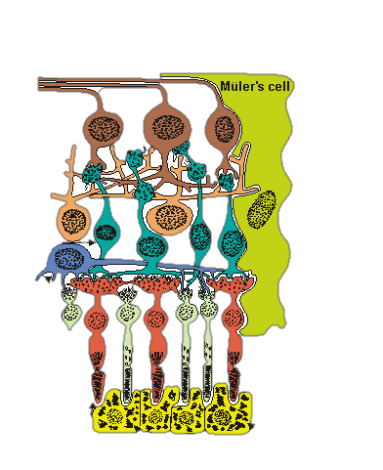
Horizontal cells
Flat cells,
Has numerous neuronal interconnections between photo receptor and bipolar cells in the outer plexiform layer.
highest concentration in fovea
Their processes branch extensively as one proceeds from the central retina towards the ora serrata.
Function:
Modulate and transform visual information received from the photoreceptors.

Slide 68
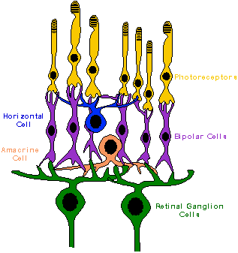
2. Bipolar cell
Oriented radially in the retina
1st order neurons
Located in the inner nuclear layers and their processes extend to the outer and inner plexiform layers
Receive extensive synaptic feedback from amacrine cells
Function:
Bipolar cells relay information from photoreceptors to horizontal, amacrine, and ganglion cells

Slide 69
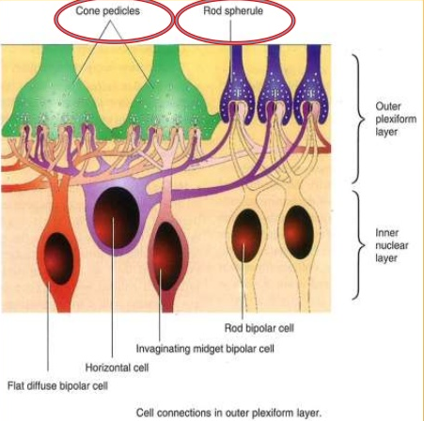

Slide 70
Clinical significance:
The OFF bipolar depolarizes in dark and hyperpolarizes in light- activated by cones.
The ON bipolar depolarizes in light and hyperpolarizes in dark- activated by rods.
Bipolar cells transfer information to retinal ganglion cells, which are the first cells in the visual pathway to respond with an action potential

Slide 71
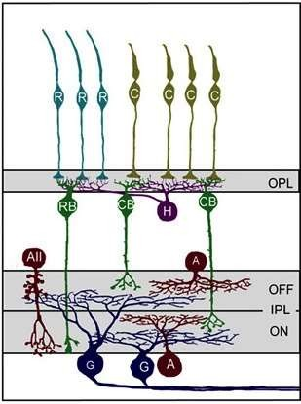
3. Amacrine cells
Amacrine cells are located in inner nucleated layer close to the inner plexiform layers
Upto 24 varieties has been described but two major types are based on their characteristics;
Diffuse Amacrine cells.
processes extend throughout the entire inner plexiform layer
Further subdivided into narrow, medium, or wide field types, depending on the width covered by their axonal fields
2. Stratified Amacrine cells.
fibers run in the outer half of the inner plexiform layer

Slide 72
The remarkable feature of amacrine cells is the broad distribution of their axonal processes through all strata of the inner plexiform layer.
Amacrine cell processes indicates that these cells play an important role in the modulation of electrical information reaching the ganglion cells.

Slide 73
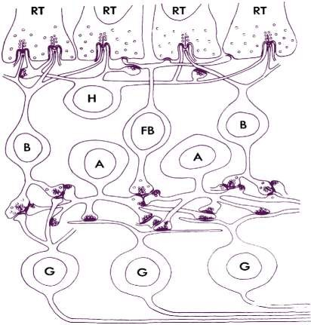
7. INNER PLEXIFORM LAYER
Consists of synapses bet. Axons of bipolar cells and dendrites of ganglion and amacrine cells.
Two elements are present at synapse in an arrangement that is known as a 'dyad'
Serial synapse
The reciprocal synapse

Slide 74
8.GANGLION CELL LAYER
₂nd order neurons
Single row in Peripheral Retina.
At the edge of foveola(macula) it is multilayer(6-8 layered) and on temporal side of disc it has two layers.
It is absent in foveola and optic disc.
Ganglion cells transmits signal from the bipolar cell to the lateral geniculate body
1.2 million ganglion cells are present in the retina each with a single axon.

Slide 75

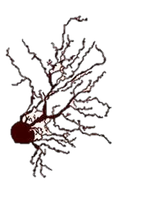
18 types of ganglion cells described- two main types are
1.P ganglion cells- The midget cells
Monosynaptic ganglion cells, show dendrites that synapse exclusively with axon terminals of midget bipolar cells and amacrine cell processes.
P cells are concentrated in central retina,
Constitute 80% of the ganglion cell population.
2.M ganglion -polysynaptic because they make synapses over a wide area.
They synapse with all types of bipolar cells except the midget bipolar cells.
M cells constitute 5% of the total ganglion cell population at the fovea and 20% at the periphery of the retina.

Slide 76
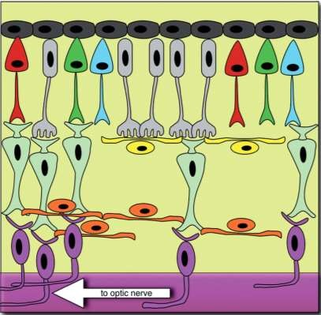
9. NERVE FIBER LAYER
Also known as stratum opticum
It contains axons of ganglion cells which passes through lamina cribrosa to form the optic nerve

Slide 77
10. Internal limiting membrane
Innermost layer of retina
Formed by the union of terminal expansions of muller’s fibres
Basement membrane
Separates retina from vitreous

Slide 78
Blood supply of retina
Outer four layers : choroidal vessels
Inner six layers : CRA
CRA : Branch of OA, end artery, four branches
Retinal veins : follows the arteries, drains into cavernous sinus / SOV

Slide 79
THANK YOU

