Slide 1


Slide 2
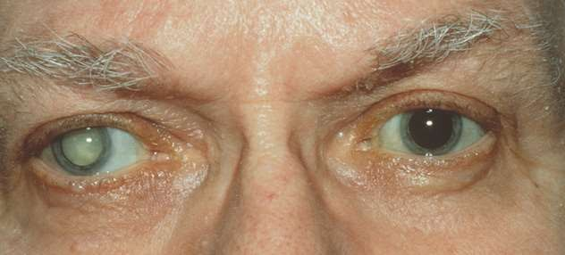
CATARACT

Slide 3
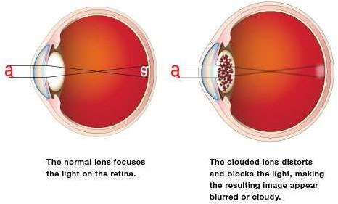
CATARACT
WHAT IS CATARACT?
Cataract is a clouding of the lens or any opacity within the lens which leads to a decrease in vision

Slide 4

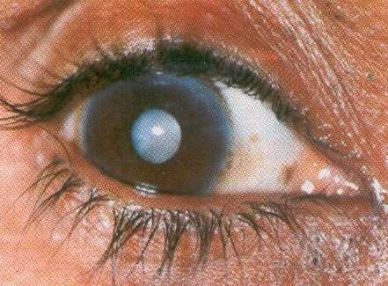
LENS OPACITY
Normal eye – Good
red reflex
Cataractous eye – Poor red
reflex

Slide 5

Hydration:
Due to degenerative changes there is change in permeability of the capsule of the lens hence, water permeates into the lens causing lens fiber separation (lamellar separation) leading to opacity of lens. ( Cortical cataract)

Slide 6
droplet of fluids
gather under capsule forming lacunae between fibres
Entire tissue swells
Become opaque
Hydration : Leading to cataract Development

Slide 7
Denaturation of lens proteins Sclerosis
Another change due to aging is denaturation of lens proteins and sclerosis causing opacification of lens ( nuclear cataract)

Slide 8

Heredity Age
•
•
UV radiation, Due to excessive exposure of sunlight.
Dietary deficiencies of Vitamins A,C,E Severe diarrhoea
Diabetes Smoking Corticosteroids
•
•
•
•
•

Slide 9
Classification:
◆
Etiological:
congenital,
Senile (age-related),
Complicated (Due to ocular diseases, like Uveitis, Retinal detachment, High myopia, Retinitis pigmentosa)
Metabolic ( Diabetes)
Traumatic
Toxic ( Corticosteroids therepy )

Slide 10
Senile cataract
Most common type
Most patients are beyond their 50’s. Occurs equally in men and women Earlier in tropical countries Considerable genetic influences

Slide 11
○ Congenital cataract
Pediatric cataract
 (present at birth)
○ Developmental cataract
 (develops soon after birth)
 Developmental opacity are usually partial & stationary
Etiology:
Maternal and infantile malnutrition
maternal infection
defective oxygenation

Slide 12
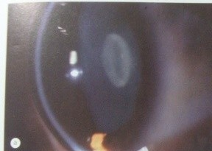
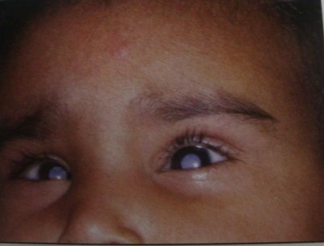
Nuclear Cataract
Associated with rubella
Incidence more if infection contracted in 2nd month
Development of lens inhibited at very early stage
Embyonal nuclear cataract
Progressive ,becomes total cataract
Associated microphthalmos, salt and pepper retinopathy, deafness, heart defects

Slide 13
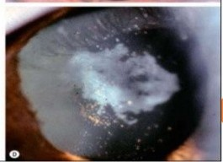
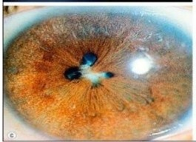
Complicated cataract
Cataract that develops secondary to a primary ocular disease.
Characterstic feature is polychromatic lustre and bread crumb appearance
Chronic anterior uveitis:
most common
Polychromatic lustre at posterior pole
If persists anterior and posterior opacities develop

Slide 14
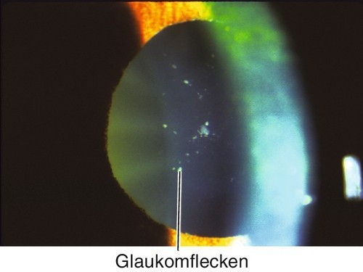
Acute congestive angle closure: focal infarcts of lens epithelium – small grey-white anterior subcapsular, or capsular opacities- glaukomfecken
Pathological myopia: posterior subcapsular opacities and early onset nucleur sclerosis that increase myopia
Heridity fundus dystrophies: Lebers: total cataract
Stickler syndrome: cortical cataract

Slide 15
Diabetic cataract:
Metabolic cataract
◻
Mech: hyperglycemia excess glucose to metabolize into sorbitol in lens osmotic overhydration
Is of 2 types
classic diabetic cataract : rare, fluid vacuoles in capsule then dense white subcapsular opacities in cortex : snowflake cataract
age-related cataract of diabetic patients: earlier and rapid progression of senile cataract

Slide 16
Myotonic dystrophy: fine dust like opacities with tiny iridescent spots in cortex- christmas tree cataract
◻
May progress to stellate opacity at posterior pole
◻
Atopic dermatitis: shield like dense anterior subcapsular plaque

Slide 17
Galactosemia: anterior and posterior subcapsular lamellar opacities- oil drop cataract
◻
◻
Wilsons disease: sunflower cataract
◻
Parathyroid tetany:
Children : lamellar opacities
Adults: anterior/ posterior punctate opacity

Slide 18
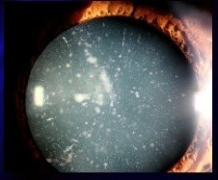
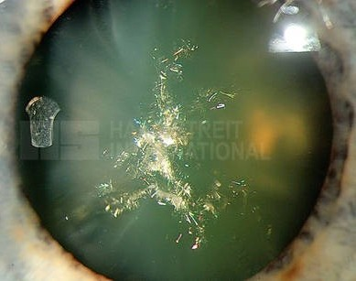
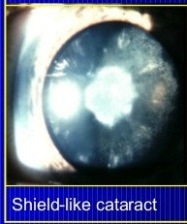
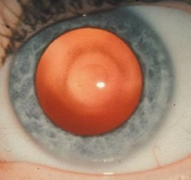
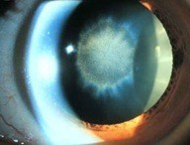
Snowflake cataract
Christmas tree cataract
Oil droplet cataract
Sunflower cataract

Slide 19
Corticosteroid cataract : posterior subcapsular cataract
Drug induced and Toxic cataract
◻
Chlorpromazine cataract
Miotic cataract : Anterior subcapsular cataract Trinitrotoluence cataract
Other drugs like busulfan, chloroquine, amiodarone
Metals like iron, gold, copper
◻
◻
◻
◻
◻

Slide 20
Causes:
Traumatic cataract
◻
Concussion– Rosette cataract Penetrating trauma
Heat cataract: seen in glassworkers and ironworkers, small posterior cortex opacity with zonular exfoliation
Radiation cataract: posterior subcapsular opacities near posterior pole
Electric cataract : anterior / posterior iridescent opacities with stellate pattern

Slide 21
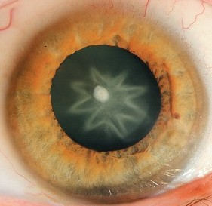
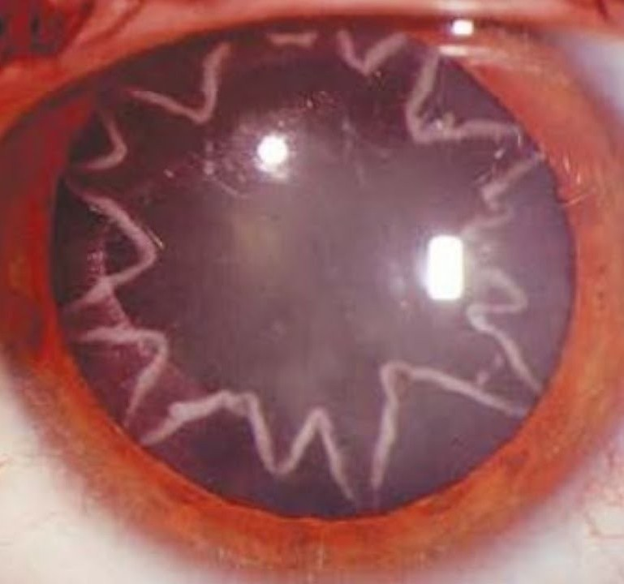
Traumatic cataract
Rosette cataract

Slide 22
Anatomical :
Cortical,
Nuclear,
Subcapsular

Slide 23
The most common type
Cortical cataract
◻
◻
Etiopathogenesis : Hydration followed by coagulation of proteins in the cortex.
◻
Stages:
Lamellar seperation
Incipient cataract
Immature stage
Mature stage
Hypermature stage

Slide 24
Etio-pathogenesis:- Intensification of age related degenerative changes associated with dehydration and compaction of nucleus ie nucleur sclerosis
Nuclear cataract
◻
▪
▪
▪
▪
▪
▪
Features:
start earlier, generally on 40’s Hard cataract is formed.
Significant increase in water insoluble protein.
Lens becomes in-elastic and looses power of accommodation. Changes begin centrally and slowly spread to periphery.
Cortex is clear

Slide 25
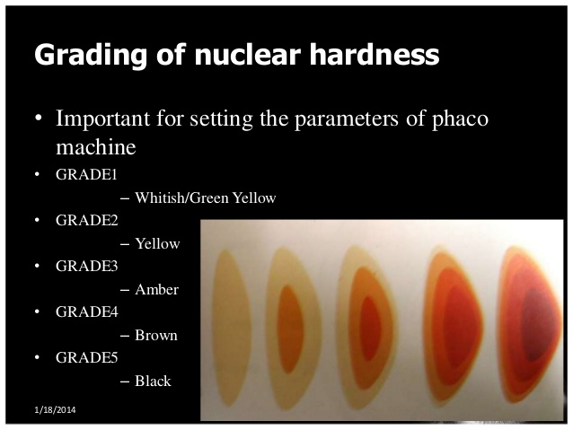
Nuclear Sclerosis:

Slide 26
▪ . slowly progressive, not likely to be mature.
▪
Deposition of tryptophan derived pigments that gives characteristic colour to nucleus
cataracta brunescens- brown cataracta nigra- black Cataracta rubra- dusky red
▪
Vision: no vision damage early, myopia due to increase in RI of nucleus

Slide 27
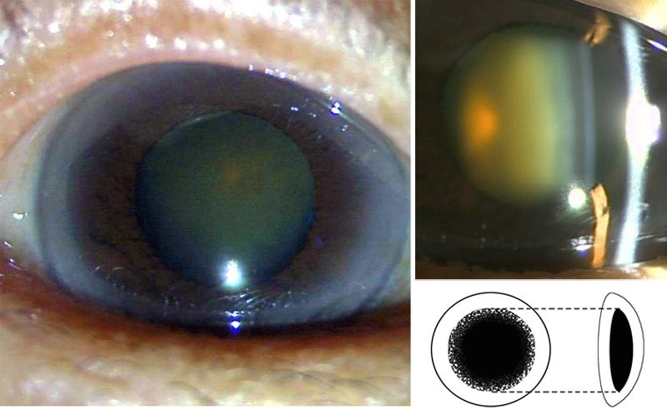

Slide 28
Degree of opacity
Immature,
Intumescent,
Mature,
Hypermature

Slide 29

Demarcation of cortical fibres owing to their separation by fluid.
▪
Demonstrated by Slit-lamp examination only.
Characteristic grey appearance of pupil due to scattering of light
Changes are reversible.
▪
▪
▪

Slide 30

Wedge shaped opacities with clear areas in between( Lens striae).
◻
◻
Most common in periphery and lower nasal quadrant.
Only seen in dilated pupil
Irregularities in refraction, visual deterioration and polyopia.
◻
◻

Slide 31
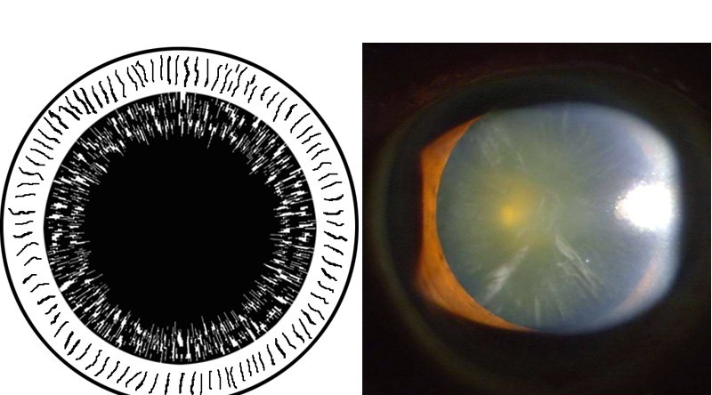

Slide 32

Opacification becomes more diffuse and irregular. Lens is swollen.
Iris shadow still visible.
❑
❑
❑
❑
Anterior chamber becomes shallow.

Slide 33
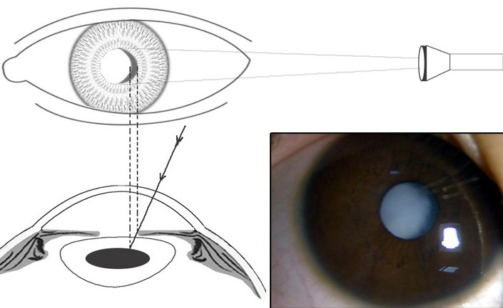

Slide 34
D/D
IMMATURE SENILE CATARACT
Painless, progressive loss of vision
Greyish colour of lens
Iris shadow is present
Black spot against red glow are observed on distant DO
SLE reveals area of cataractous cortex
Visual acuity not improve on pin hole testing
NUCLEAR SCLEROSIS
Painless, progressive loss of vision
Greyish colour of lens
Iris shadow is absent
No black spots are seen against red glow
SLE reveals clear lens
Visual acuity improves on pin hole testing

Slide 35

Complete opacification Whole cortex is involved
Lens appears pearly white in colour Also known as ripe cataract
❑
❑
❑
❑
❑
No iris shadow

Slide 36
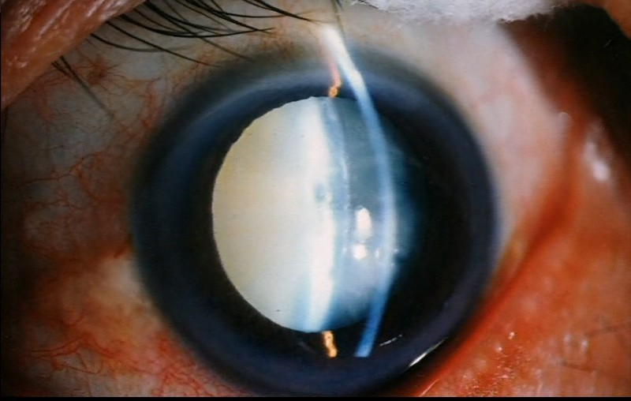

Slide 37

Cortex is disintegrated and transformed into pultaceous material.
Usually occurs in two forms:-
Morgagnian hyper–mature cataract
Sclerotic hyper–mature cataract

Slide 38
MORGAGNIAN CATARACT
Complete cortex is liquefied and appears milky white in colour.
◻
Nucleus settles at the bottom.
Calcium deposits may also be seen on the lens capsule.
◻
SCLEROTIC HYPER–MATURE CATARACT
Disintegrated cortex.
Shrunken lens sometimes appears yellow Wrinkled anterior capsule .
Dense white capsular cataract in pupillary area. Deep Anterior-Chamber.
Tremulous Iris .

Slide 39
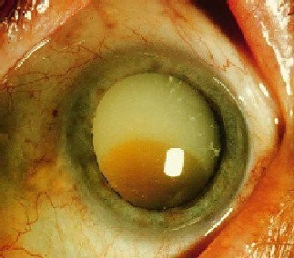
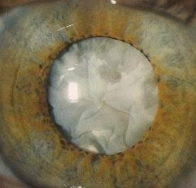
Shrunken cataract
Morgagnian cataract

Slide 40
Symptoms:
Decreased vision: Gradual, progressive, painless loss of vision.
Decreased contrast sensitivty.
Monocular diplopia.
Coloured halos due to irregular refraction by different parts of lens.
Glare due to scattered light rays.

Slide 41
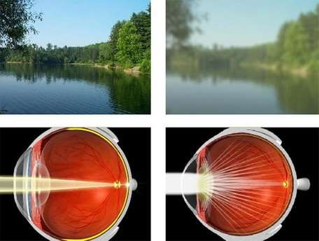
VISUAL ACUITY
Blurred vision due to scattering of light on the retina

Slide 42
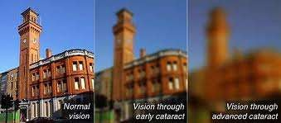
VISUAL ACUITY

Slide 43
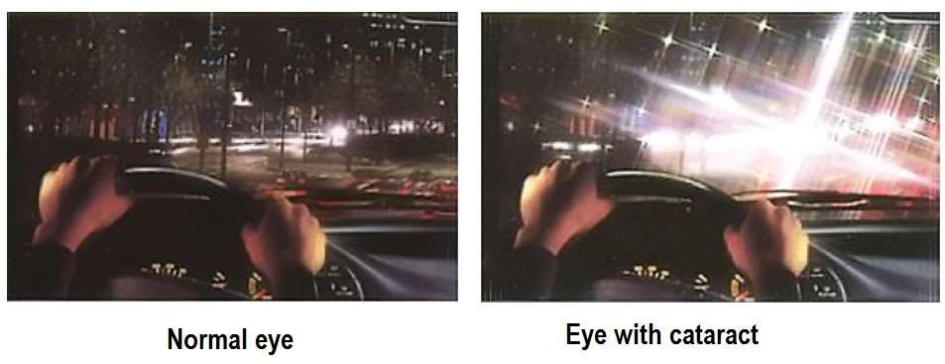
VISUAL ACUITY

Slide 44
THANK YOU

