Slide 1
Brachial Plexus Injury
Dr Sudhir Rawat
Associate Professor
Dept of Orthopaedics, Dhiraj Hospital
SBKS MIRC SUMANDEEP VIDYAPEETH

Slide 2
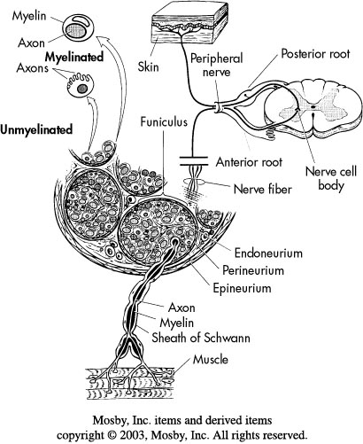
Microscopic anatomy

Slide 3
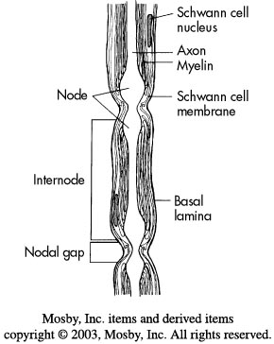

Slide 4
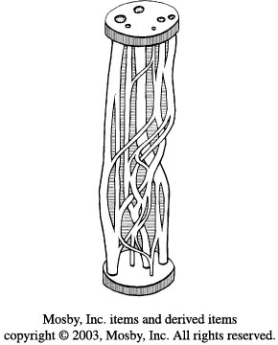
INTERNAL TOPOGRAPHY OF PERIPHERAL NERVES

Slide 5
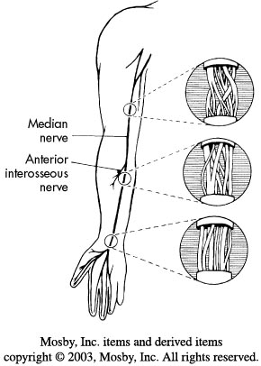

Slide 6
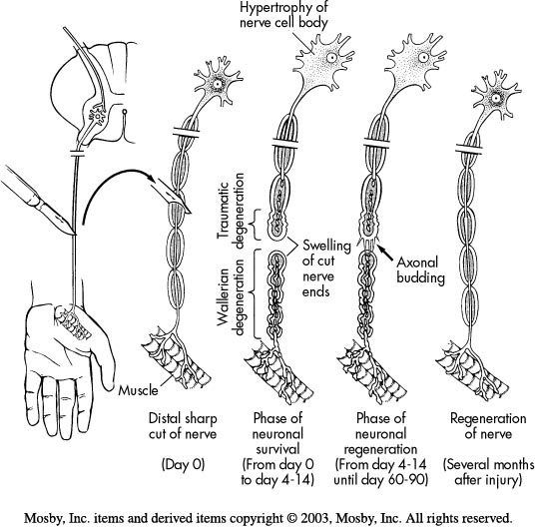
NEURONAL DEGENERATION AND REGENERATION:
Phagocytosis
Secondary or wallerian degeneration
Primary or retrograde egeneration

Slide 7
CLASSIFICATION OF NERVE INJURIES:
( Seddon1943):
Neurapraxia
Axonotmesis
neurotmesis
(Sunderland 1951) classification

Slide 8
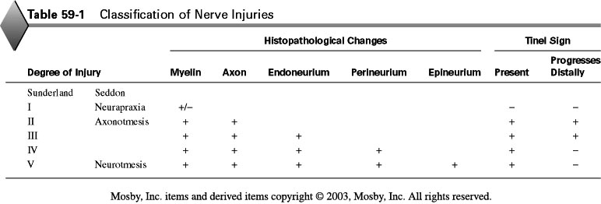

Slide 9
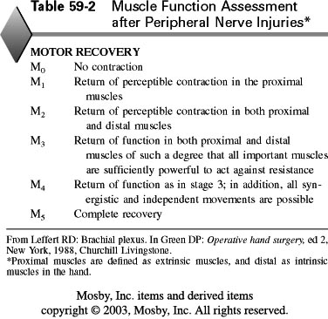

Slide 10
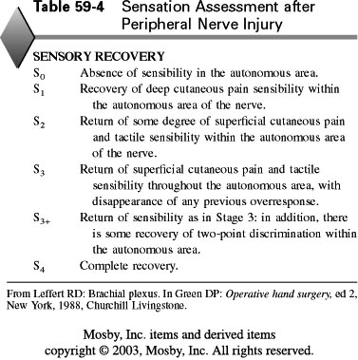

Slide 11
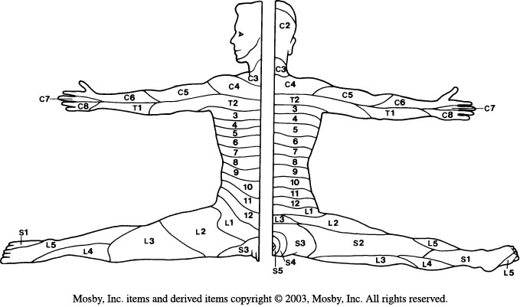

Slide 12
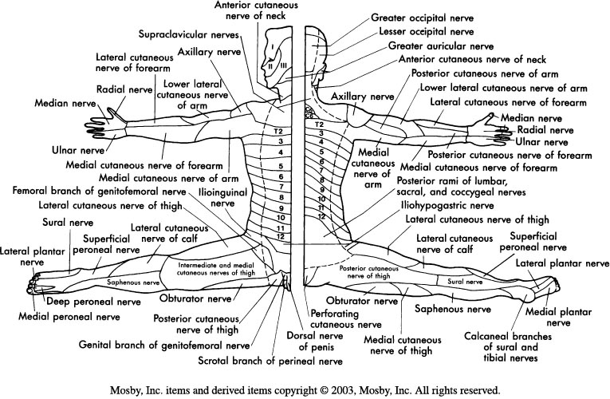

Slide 13
Etiology of peripheral nerve injuries:
- Metabolic or collagen diseases
- Malignancies
-Endogenous or exogenous toxins
-Thermal
-Chemical
-Mechanical trauma

Slide 14
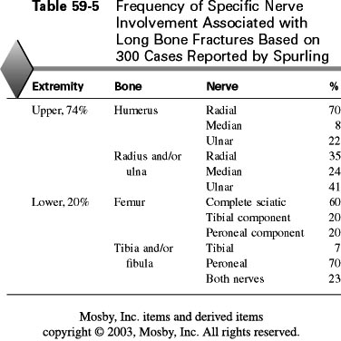

Slide 15
Clinical diagnosis of nerve injuries:
Highest Scale:
0 – total paralysis.
1- muscle flicker.
2-muscle contraction.
3- muscle contraction against gravity.
4- muscle contraction against gravity and resistance.
5-normal muscle contraction .

Slide 16
Diagnostic tests:
Electrodiagnostic studies provide the clinician with a base of knowledge as follows:
1-Documentation of injury
Location of insult 2 -
3-Severity of injury
4-Recovery pattern
5-Prognosis
6-Objective data for impairment documentation
7-Pathology
8-Selection of optimal muscles for tendon transfer 9-procedures

Slide 17
The most common electrodiagnostic methods used for the study of peripheral nerve injuries are :
@- nerve conduction studies and
@-electromyography (EMG)

Slide 18
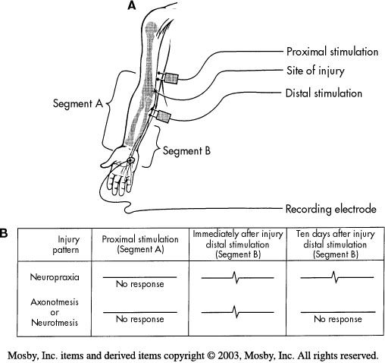

Slide 19
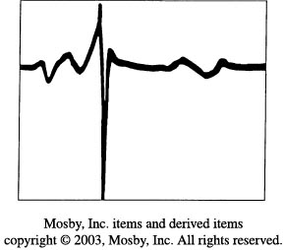
Diagram of EMG tracing depicting normal insertion activity, which also may be present immediately after denervation.

Slide 20
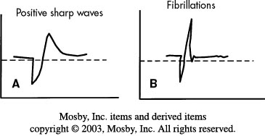
A: Diagram of EMG tracing demonstrating positive sharp wave consistent with denervation 10 to 14 days after injury. Rhythm is regular, amplitude is 100 to 400 uV, duration is 5 to 150 msec, and rate is 2 to 40 Hz.
B,
Diagram of EMG tracing demonstrating spontaneous denervation fibrillation potentials present within 14 to 18 days after injury. Rhythm is regular, amplitude is 50 to 1000 uV, duration is 0.5 to 2 msec, and rate is 2 to 30 Hz.

Slide 21
Tinel sign :
A positive Tinel sign is presumptive evidence that regenerating axonal sprouts that have not obtained complete myelinization are progressing along the endoneurial tube.
@- neuropraxia(sunderland1) -------negative Tinel sign.
@- axonotmesis (sunderland2,3) -------positive Tinel sign.
(sunderland4-------- negative Tinel sign )
@- neurotmesis (sunderland 5) ------- negative Tinel sign.
Other diagnostic test:
Sweat test.,skin resistance test, electrical stimulation

Slide 22
GENERAL CONSIDERATIONS OF TREATMENT.
FACTORS THAT INFLUENCE REGENERATION AFTER NEURORRHAPHY :
1-Age
2-Gap Between Nerve Ends
3-Delay Between Time of Injury and Repair
4-Level of Injury
5-Condition of Nerve Ends

Slide 23
TECHNIQUE OF NERVE REPAIR:
Endoneurolysis Internal Neurolysis
Partial Neurorrhaphy
Neurorrhaphy and Nerve Grafting

Slide 24
Methods of Closing Gaps Between Nerve Ends:
Mobilization
Positioning of Extremity
Transposition
Bone Resection
Nerve Stretching and Bulb Suture
Nerve Grafting

Slide 25
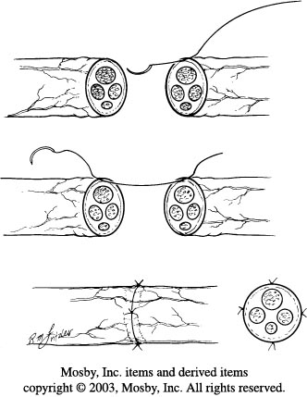
Techniques of Neurorrhaphy:
Epineurial Neurorhaphy

Slide 26
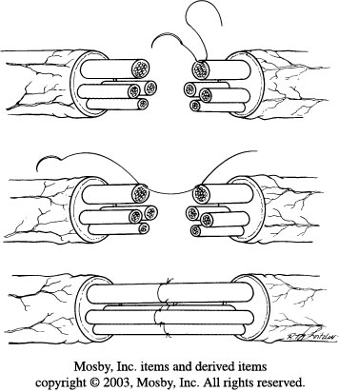
Perineurial (Fascicular) Neurorhaphy

Slide 27
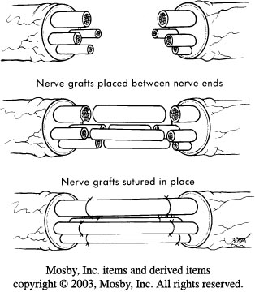
Interfascicular Nerve Grafting

Slide 28
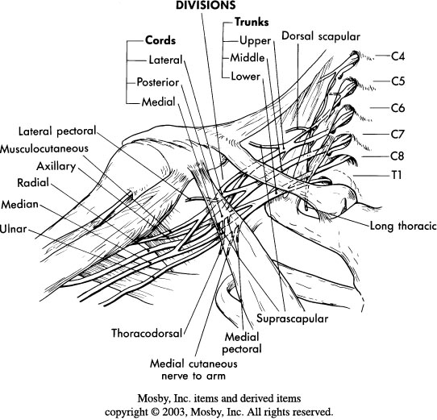
Brachial Plexus

Slide 29
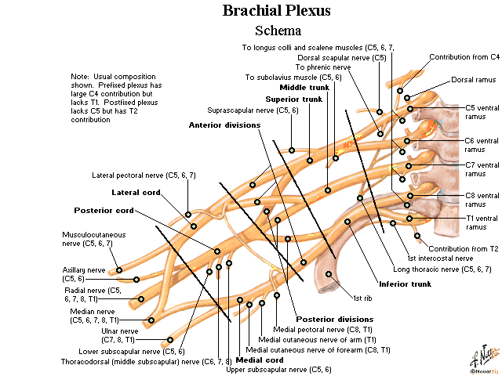

Slide 30
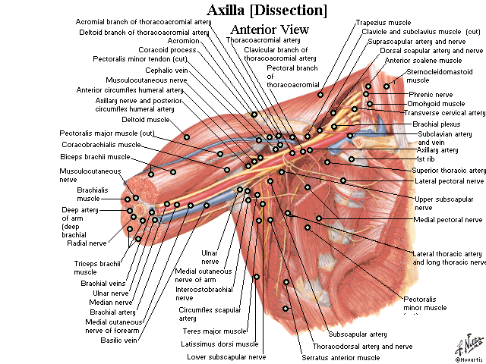

Slide 31
ETIOLOGY AND CLASSIFICATION OF BRACHIAL PLEXUS INJURIES :
-birth,
-missiles,
- stab wounds,
- traction applied to the plexus during falls,
-vehicular accidents,
- sports activities,
-as well as radiation.

Slide 32
Rupture of the axillary or subclavian artery occurs in 20% of patients.
Common associated injuries include:
@fractures of the proximal humerus, the scapula, the ribs, the clavicle, and the transverse processes of the cervical vertebrae
@dislocation of the shoulder, the acromioclavicular, and the sternoclavicular joints.
@ A torn rotator cuff also has been described in conjunction with brachial plexus injury.

Slide 33

ACKNOWLEDGEMENTS

Slide 34
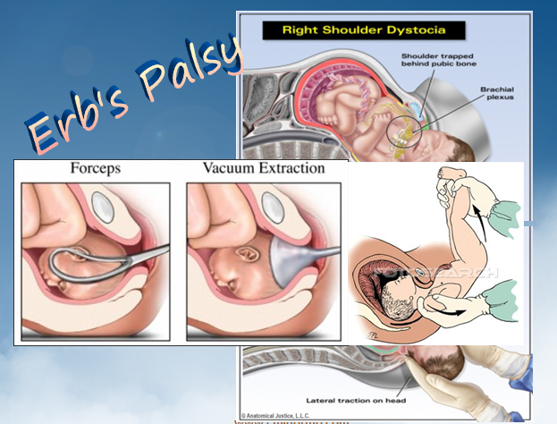

Slide 35
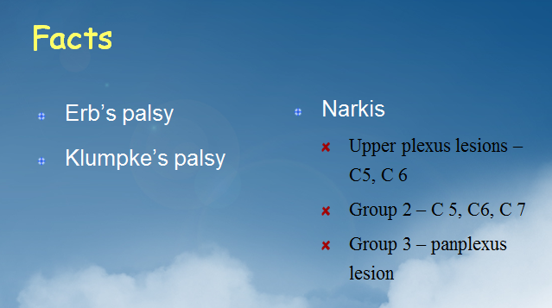

Slide 36
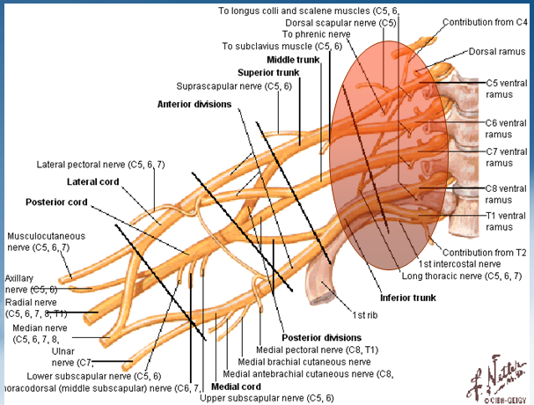

Slide 37
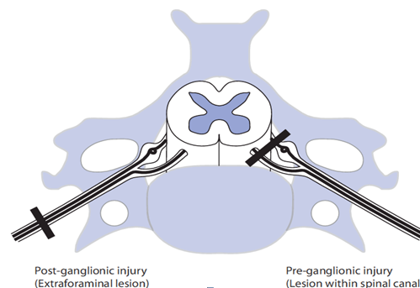

Slide 38
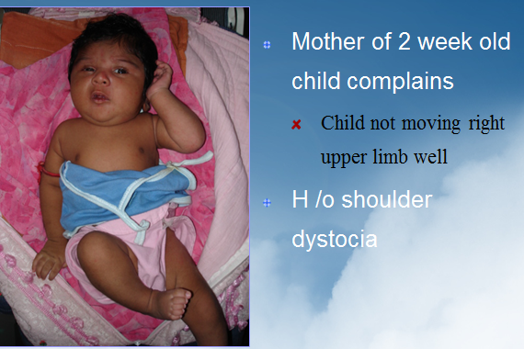
CLINICAL PRESENTATION

Slide 39
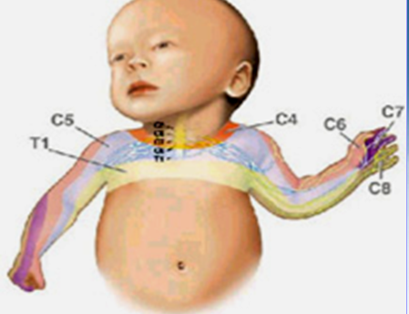
Brachial Plexus distribution

Slide 40
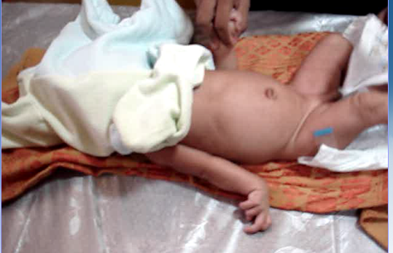
Examination

Slide 41
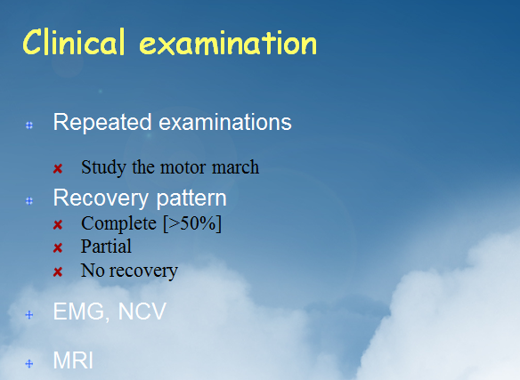

Slide 42


Slide 43
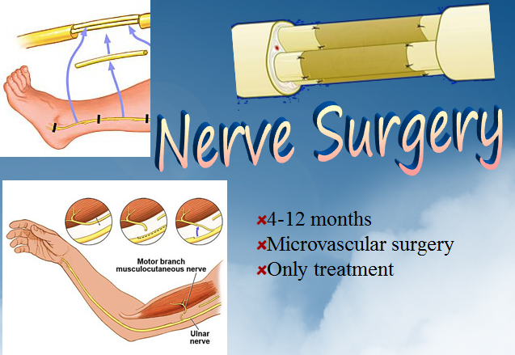

Slide 44
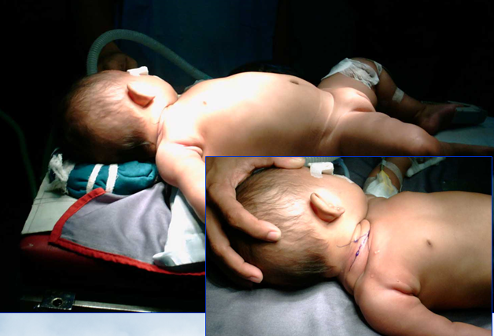

Slide 45
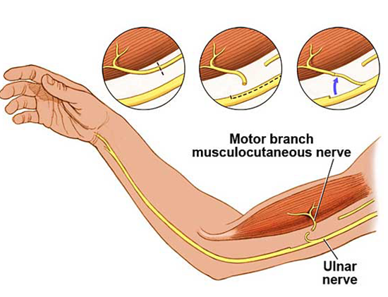

Slide 46
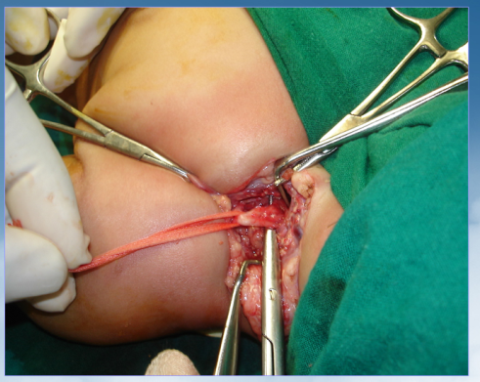
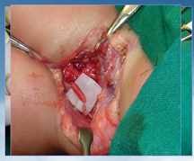
Microvascular Surgery

Slide 47
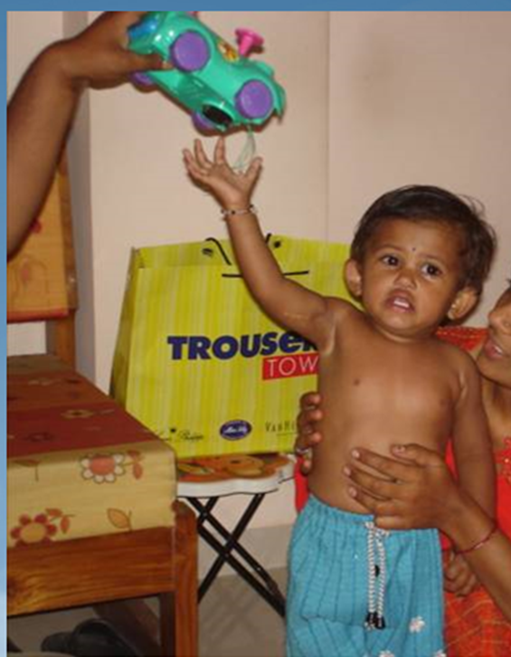

6 months after surgery

Slide 48
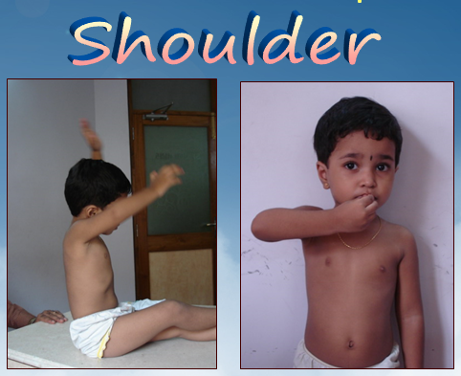
Late Cases
Most common residual problem

Slide 49
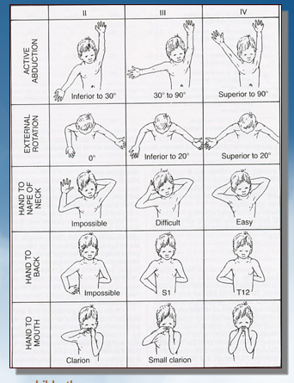
Mallet Scoring
Shoulder abduction weakness
Shoulder Internal rotation contractures
Elbow flexor weakness
Wrist drop
Flexor and thumb paralysis
No elbow FFD

Slide 50
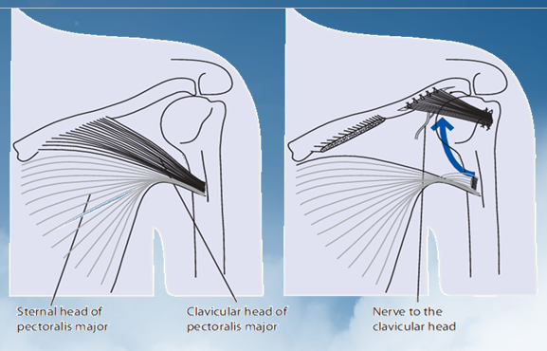
Surgery
Chuang Procedure
External Rotation osteotomy
Shoulder release
Tendon transfer

Slide 51
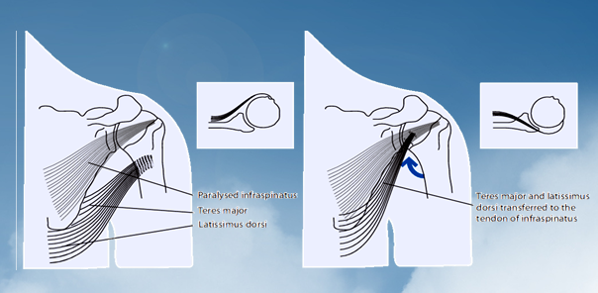
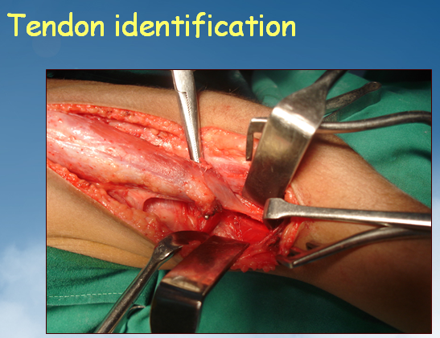

Slide 52
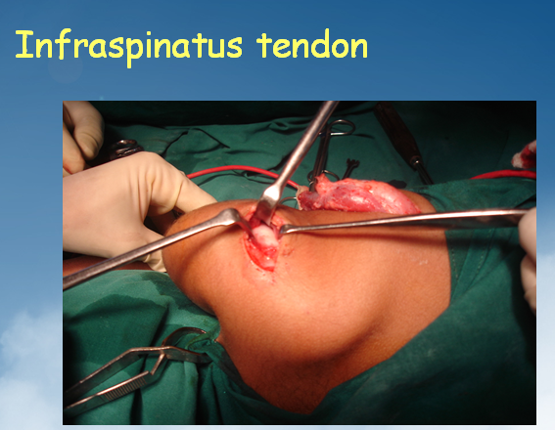
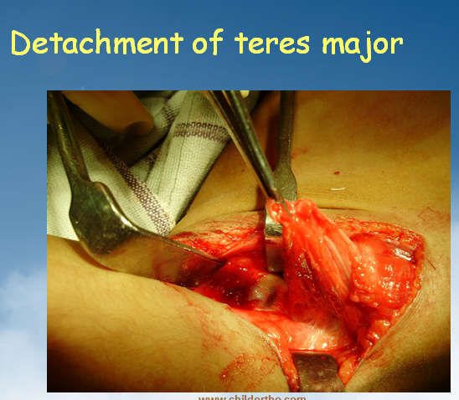
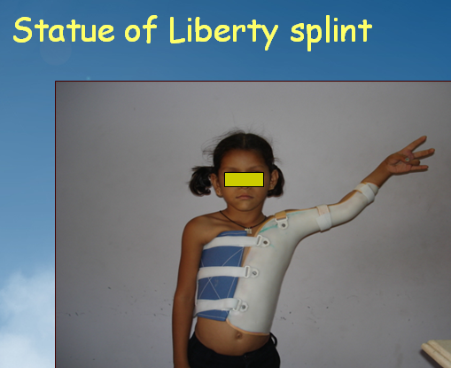

Slide 53
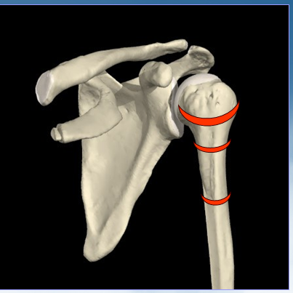
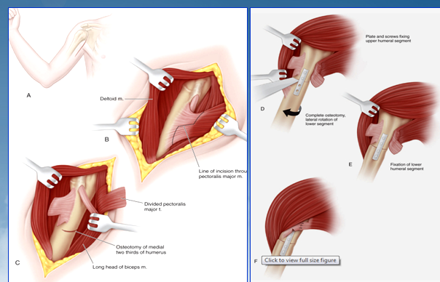
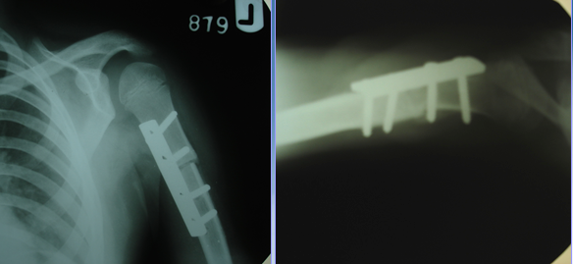
External rotation osteotomy

Slide 54
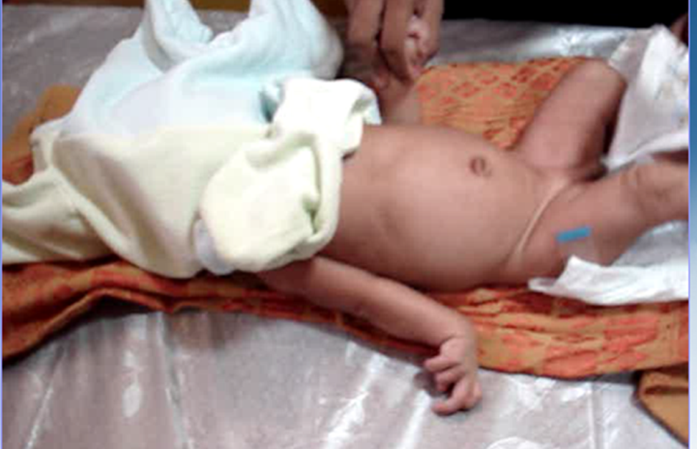
MCQ 1
Which palsy is this?
Erb’s palsy
Klumpke’s palsy
Radial nerve palsy
Ulnar nerve palsy

Slide 55
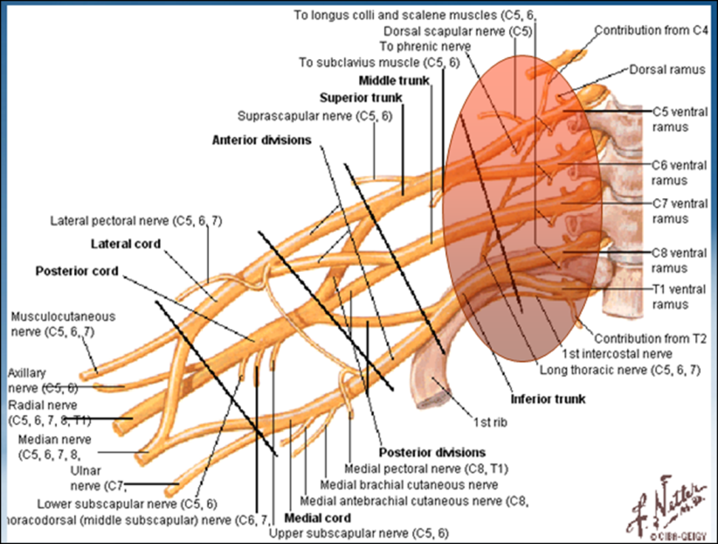
MCQ 2
What is the shaded area known as:
Brachial point
Erb’s point
Klumpke’s point
None of the above

Slide 56
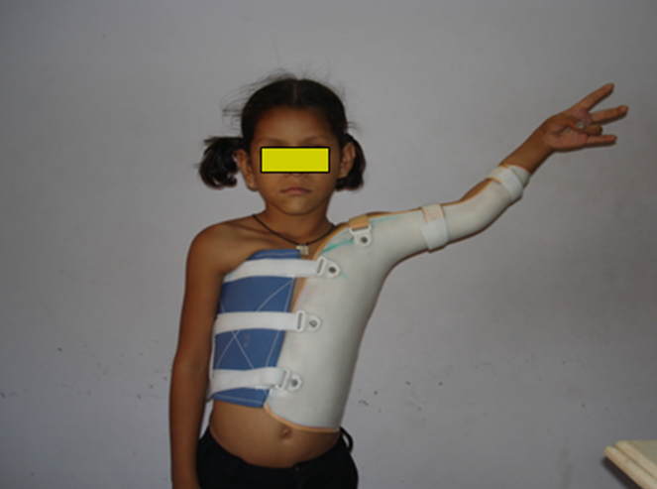
MCQ 3
What is the name of this splint?
Above elbow splint
Chest splint
Statue of liberty splint
None of the above

Slide 57
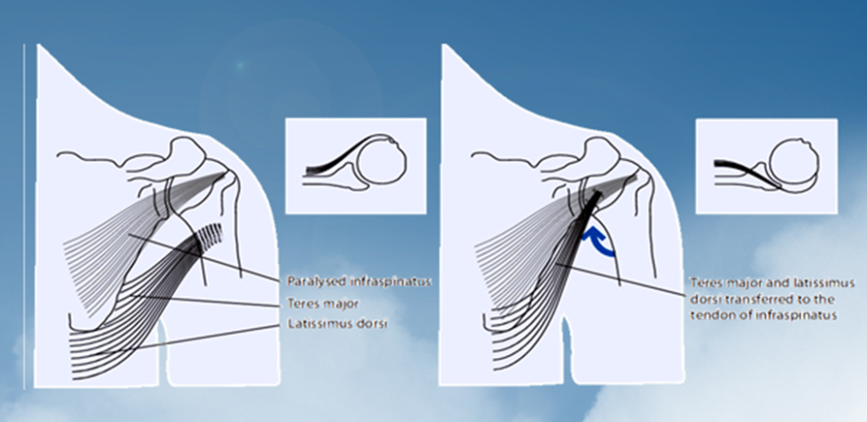
MCQ 4
Which muscle is paralysed here?
Infraspinatus
Teres minor
Teres major
Latissimus Dorsi

Slide 58
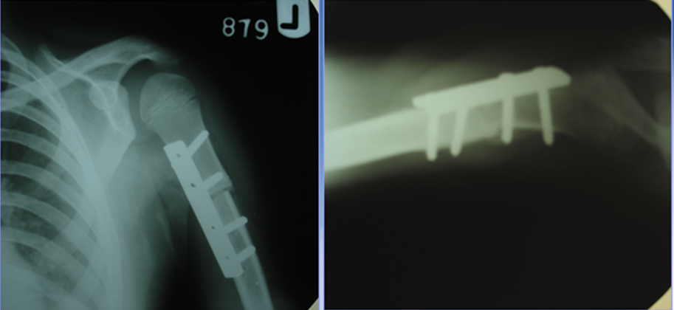
MCQ 5
Which osteotomy of humerus is done here?
Internal rotation osteotomy
Sugioka osteotomy
External rotation osteotomy
Abduction osteotomy

