Slide 1
Colle’s fracture, Barton fracture, Smith fracture
Dr Aditya K. Agrawal
Associate Professor
Dept. of Orthopaedics, Dhiraj Hospital
SBKS MIRC, Sumandeep Vidyapeeth
Vadodara

Slide 2
ACKNOWLEDGEMENTS
Dr. Bhavesh H. Jesalpura
Professor
Smt NHL Medical College
Sheth VS General Hospital
Ahmedabad

Slide 3
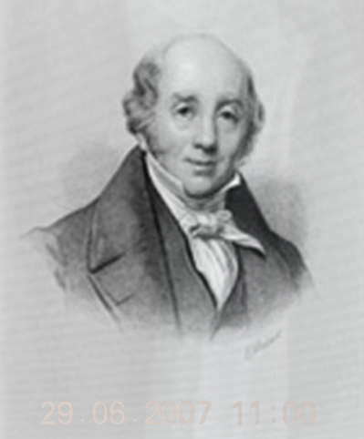
Colle’s fracture
Also known as Poteau’s Fracture 1783
Colle’s fracture in 1814
Smith/ reverse Colle’s fracture
Barton’s fracture – dorsal and volar

Slide 4
Distal end radius fractures
More than Colle’s
One of the most common fracture
1/6th of all fractures seen and treated in emergency
F:M = 3:1
Trimodal distribution
Complication rates as high as 31% in certain series
Myths and reality

Slide 5
Myths and Reality
Any treatment – they do well
Deformity – Darrach can be done
Non-wt bearing joint – arthritis is not a problem
External fixation – wrist stiffness
Fragments too small – surgical intervention difficult
Median nerve compression – improve in all cases

Slide 6
Tri modal distribution
Paediatric lower end radius fractures
Different patterns than adult fracture
Salter Harris classification
Very good remodelling potential
Bio absorbable pins when indicated
Growth arrest is a concern

Slide 7
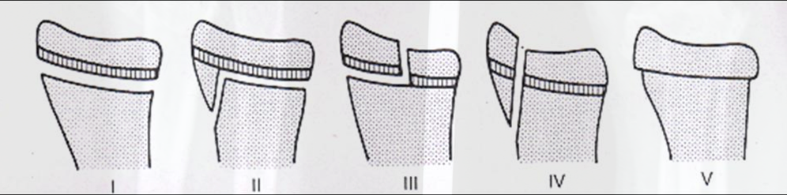
Salter Harris classification

Slide 8
Tri modal distribution
Geriatric lower end radius fractures
Low velocity trauma
Extra articular
Osteoporotic
Elderly females
Functional demands low
Physio therapy after conservative or minimally invasive treatment

Slide 9
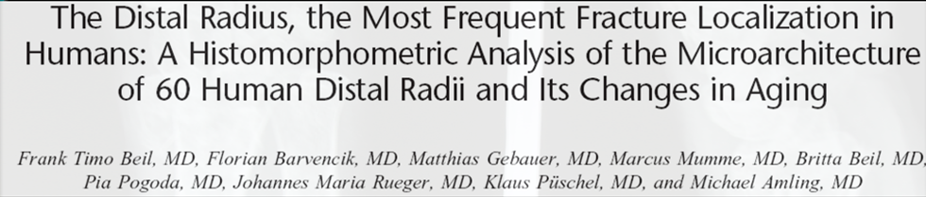
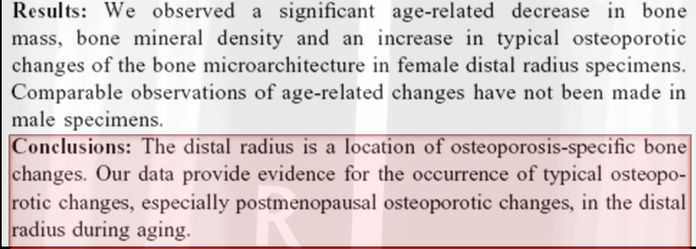

Slide 10
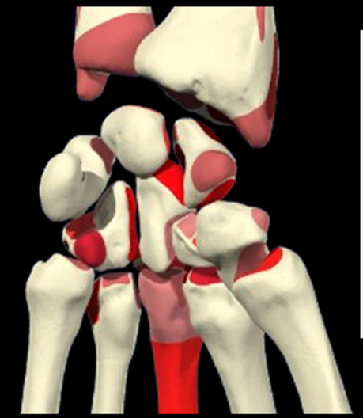
How to evaluate distal radius fracture
Functional anatomy
Radiographic evaluation
Classification
Treatment modalities
Complications and their management

Slide 11
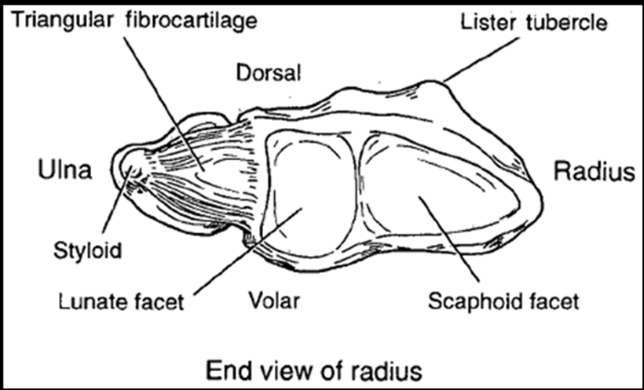
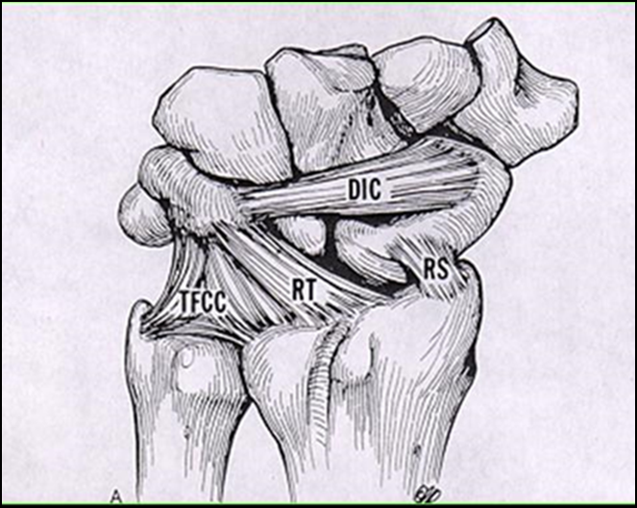
Functional Anatomy
Interplay of radius/ulna/ carpal bones
Articular surfaces, ligaments, tendons
Distal radius – trapezoidal shape
Scaphoid fossa
Lunar fossa
Sigmoid notch
Lister tubercle
Motion and transmission of load

Slide 12
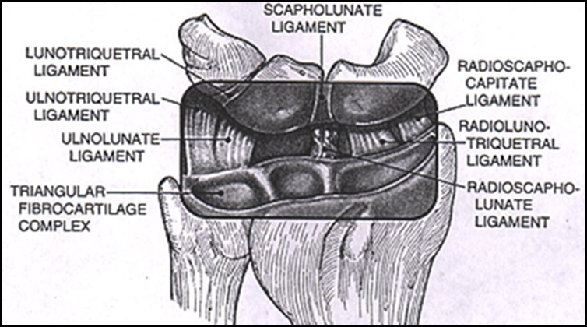
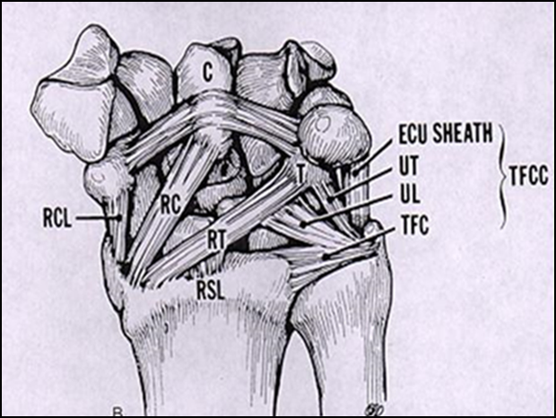
Weight transmission
46% lunate fossa
43% scaphoid fossa
11% triangular fibrocartilage
Apart from weight transmission
Pronation / supination
Ulnar deviation / radial deviation

Slide 13
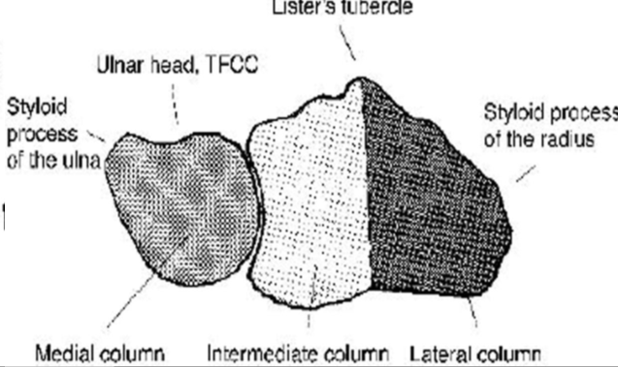
Column theory
Lateral column – osseous butress for carpus, ligament attachment
Intermediate column – load transmission
Medial column – axis for forearm / wrist rotation

Slide 14
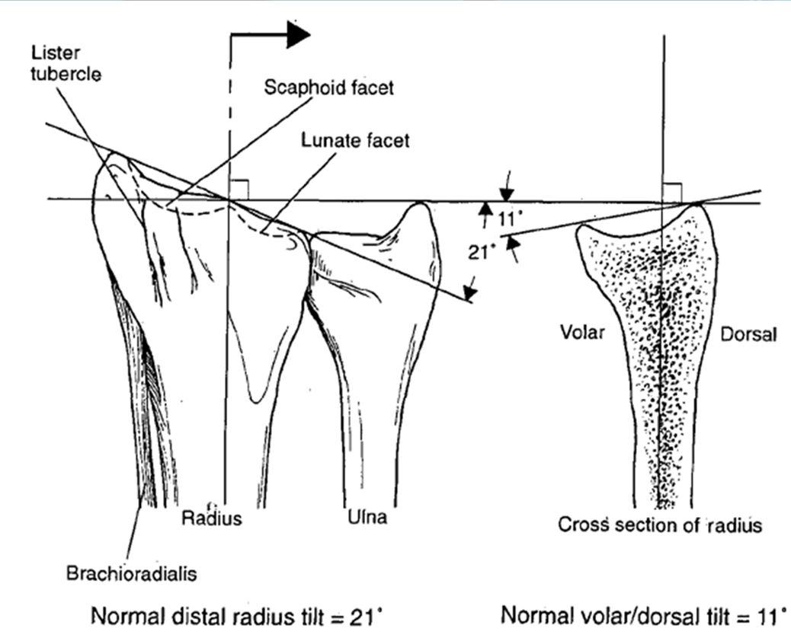
Radiology
Plain radiograph are sufficient in 95% cases
History / clinical examination are of equal importance

Slide 15
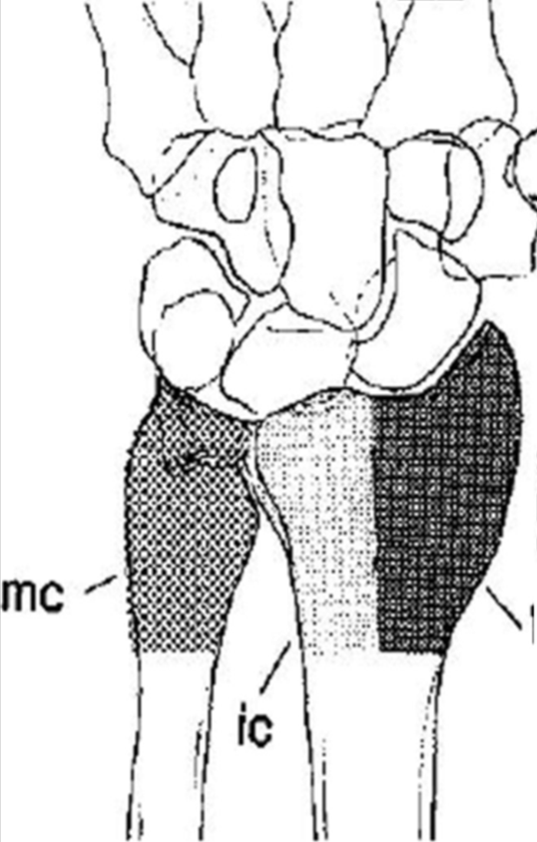
Management of fracture is based on
Fracture pattern
Bone quality
Associated comminution
Energy of injury
Soft tissue damage
Patient profile
Lifestyle
Phychologic outlook
Medical conditions

Slide 16
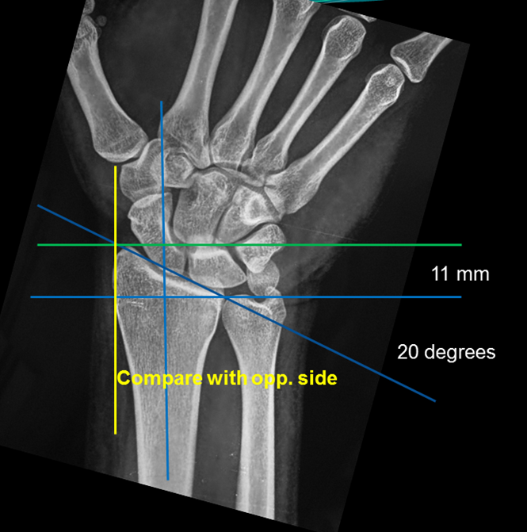
Plain radiography
PA view
Lateral view
Lateral view with 15° cephalad
PA view with ulnar deviation
Oblique view
Traction x ray – pre op/ per op

Slide 17
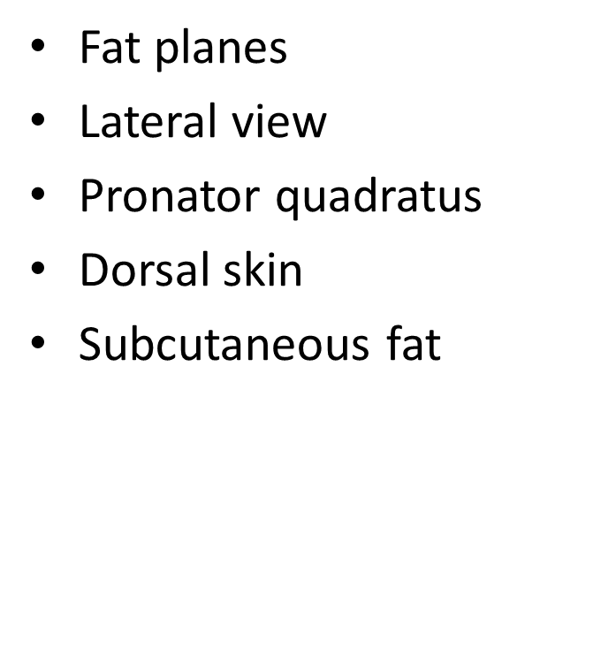
PA view
Thenar
Hypothenar
Pararadial
Paraulnar
b/w radial collateral and abductor pollicis longus

Slide 18
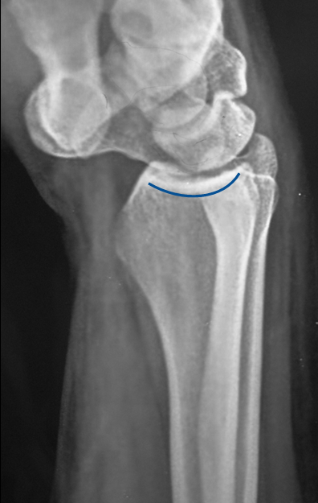
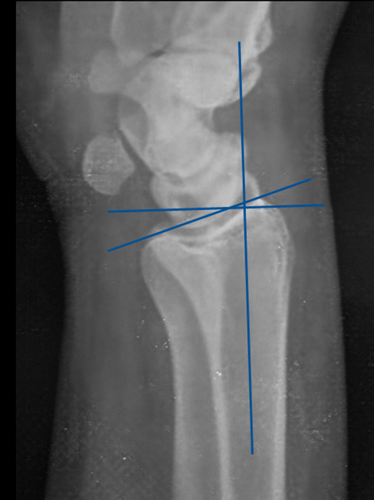
15 degree
Cephalad view
Intra articular fragments

Slide 19
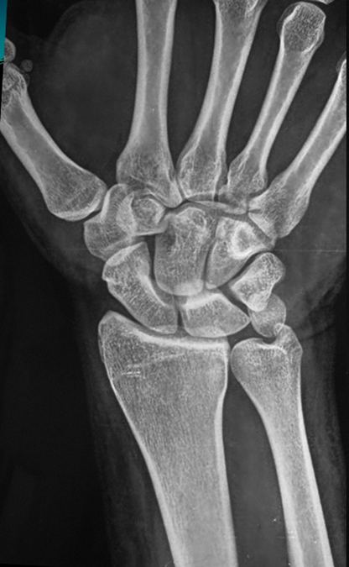
Carpal assessment
PA view
Articular surfaces – parallel
Joint spaces – same width
Gilula’s arcs – 1,2 and 3 smooth
PA ulnar deviation view
Scaphoid fracture

Slide 21
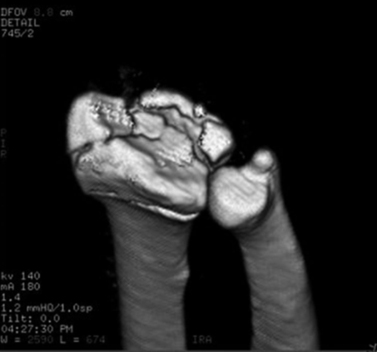
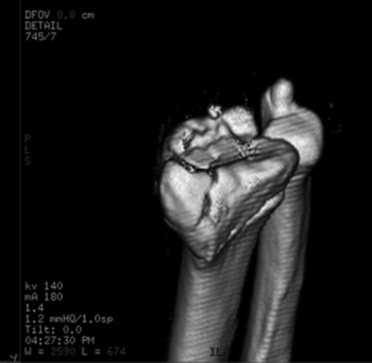
CT Scan
Complex or occult fracture
Evaluation of distal radio-ulnar joint
Distal radial articular surface
Assessment of fracture healing
Post surgical evaluation

Slide 22
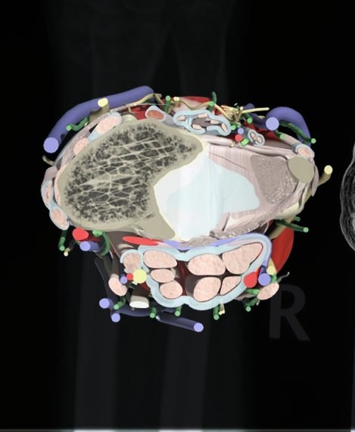
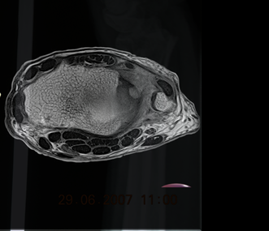
MRI
Not first choice of Ix
Ligamentous and soft tissue abnormalities
Carpal instability
TFCC injury
Median nerve compression
Rupture of tendon
AVN/ fracture of carpal bones

Slide 23
Ideal Classification System
Easy to remember
Easy to use by all orthopaedic surgeons
High intra observer and inter observer reproducibility
3 dimensional reconstruction

Slide 24
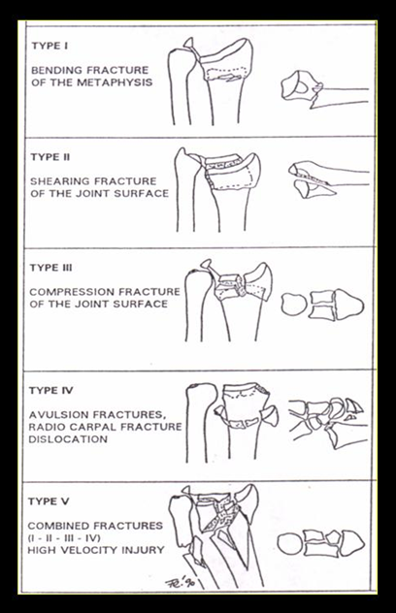
Classification of distal end radius fracture
Role
Mechanism of injury
Communication
Documentation
Treatment protocol
Long term expected outcome
Fernandez classification (Mechanism of injury)

Slide 25
Frykman Anatomical Classification
Distal radius fracture
Distal ulna fracture
Absent Present
Extra articular fracture
Intra articular fracture involving radio carpal joint
Intra articular fracture involving distal radio ulnar joint
Intra articular fracture involving both radio carpal and distal radio ulnar joint
I II
III IV
V VI
VII VIII

Slide 26
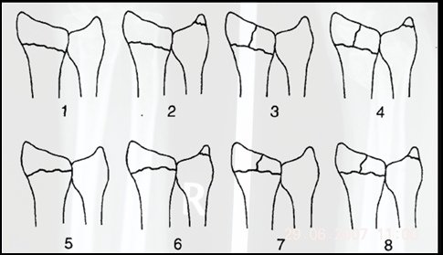
Frykman Anatomical classification

Slide 27
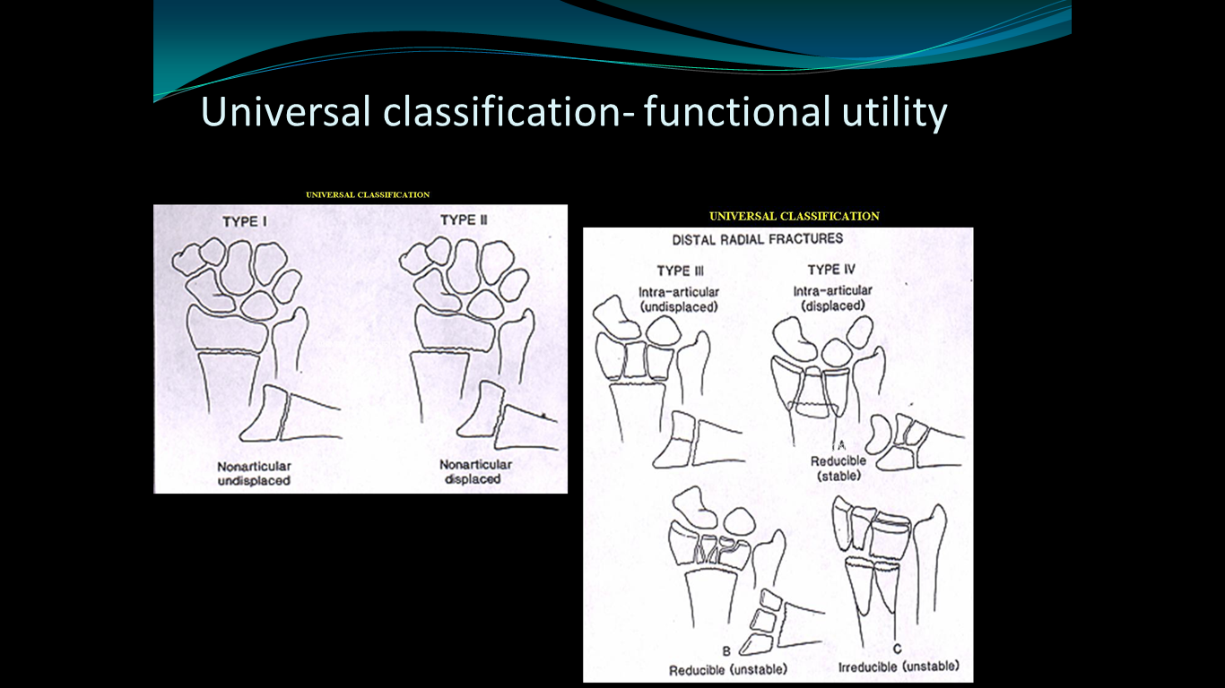
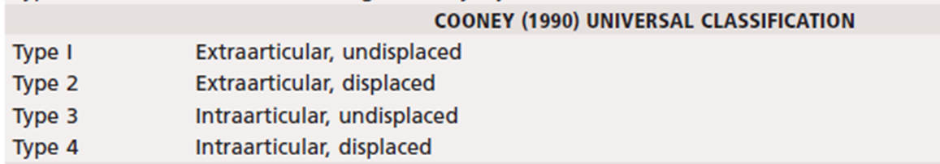
Universal Classification – Functional utility

Slide 28
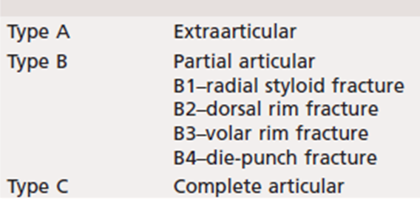
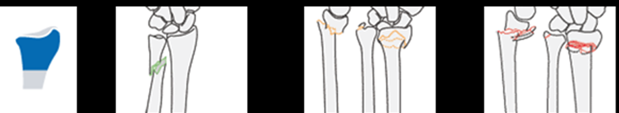
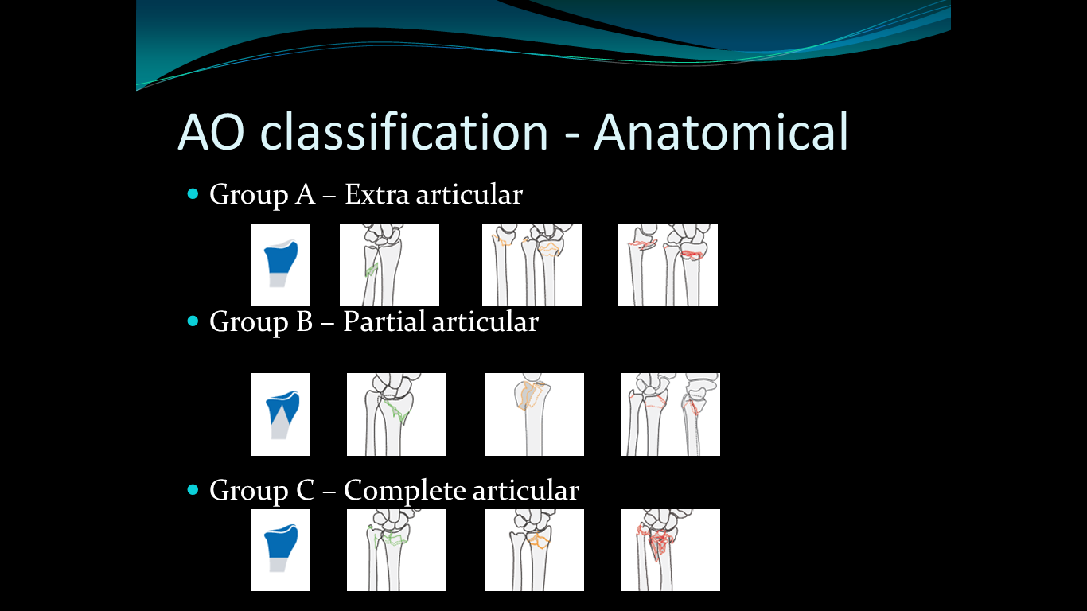
Modified AO Classification

Slide 29
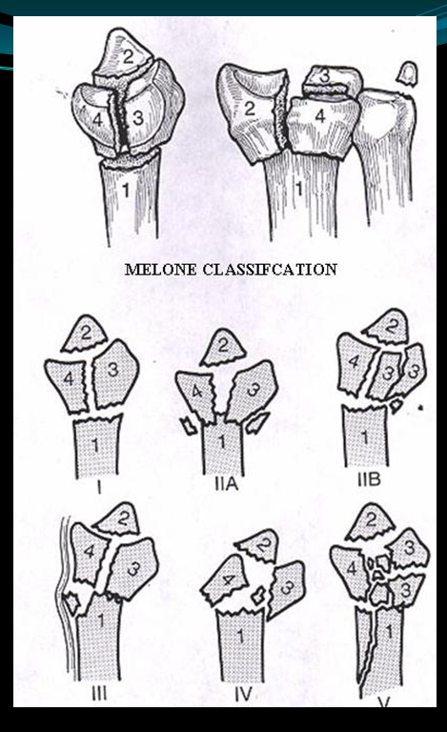
Melone’s Classification
Four part configuration
Extension of universal classification and intra articular classification

Slide 30
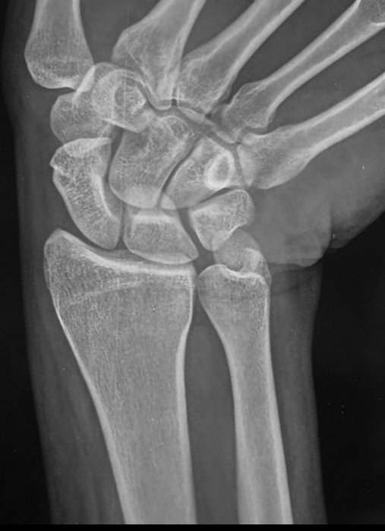
Treatment options
Conservative treatment
Surgical treatment
Per cutaneous pinning
External fixation
External fixation and direct pinning
Radius distractor
Plate fixation
Fragment specific
Wrist arthroscopy

Slide 31
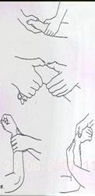
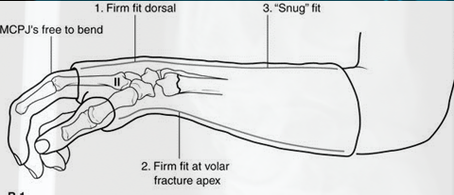
Non operative treatment
Closed reduction
Traction, counter traction
Manipulation
Cast immobilisation

Slide 32
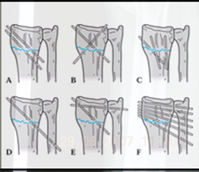
Per cutaneous pinning
Alone
In conjunction with external fixator
Lambotte 1908
Stein 1975
Kapandji 1976
De Palma 1952
Uhl 1976
Rahyack 1989

Slide 34
Open reduction and internal fixation with variable angle volar plate

Slide 35
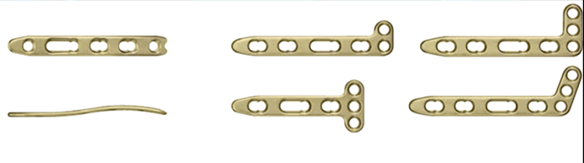


Slide 36
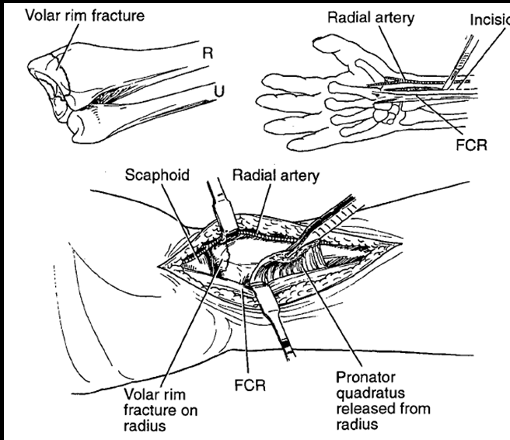
Volar Approach (Modified Henry’s Approach)

Slide 37
Complications
Injury to radial artery
Injury to median nerve
Injury to palmar cutaneous branch of median nerve
Injury to extensor pollicis longus
Injury to extensor tendons (Dorsal approach)
Reflex sympathetic dystrophy
Wrist stiffness (Arthritis)
Infection, hardware failure, malunion

Slide 38
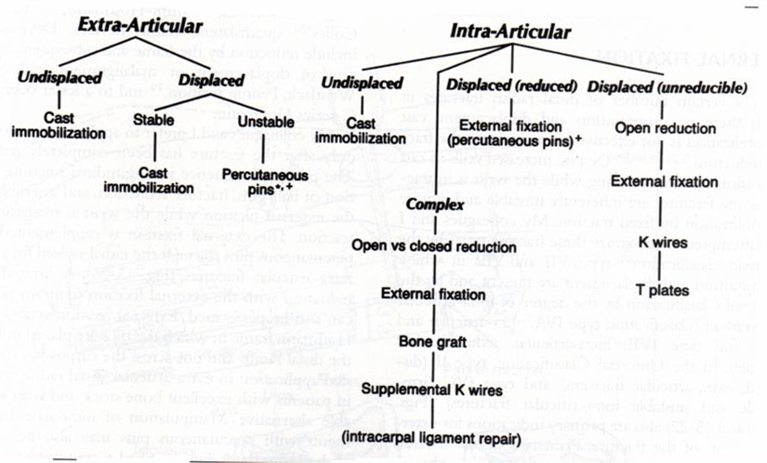
Treatment Algorithm

Slide 39
MCQ 1
Which of the following is not called distal end radius fracture
Colle’s Fracture
Dorsal barton fracture
Chauffeur’s fracture
Jone’s fracture

Slide 40
MCQ 2
Distal end radius fractures are treated by
Cast immobilisation
Volar plating
Pinning
All of the above

Slide 41
MCQ 3
Injury to which tendon occurs in volar plating
Extensor digiti minimi
Extensor pollicis longus
Extensor digitorum
Palmaris longus

Slide 42
MCQ 4
Classification of distal end radius include all except
Frykmann classification
Mayo’s classification
AO classification
Universal classification

Slide 43
MCQ 5
Complications of distal end radius fracture are all except
Injury to neuro vascular bundle
Injury to extensor tendons
Infection
None of the above

Slide 44
Thank you

