Slide 1
Venous system anatomy of the lower limb
Dr. Vishalkumar Bhardava
Associate Professor
Radiodiagnosi Departmetn
Dhiraj Hospital & SBKSMI&RC
Pipariya

Slide 2
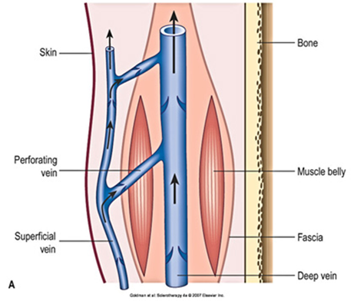
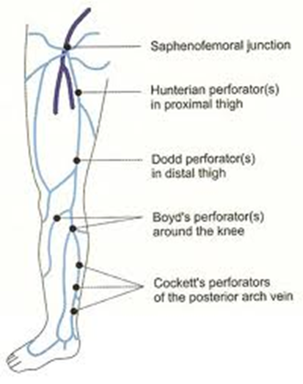
Configuration
Superficial venous system
Deep venous system
Intercommunicating veins

Slide 3
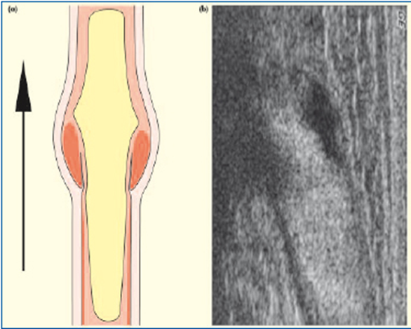
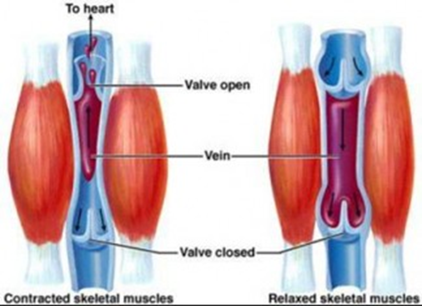
Blood flow mechanism
From superficial system to deep system
Soleal Pump Mechanism
Valves
Notes:
Valves in larger and communicating veins

Slide 4
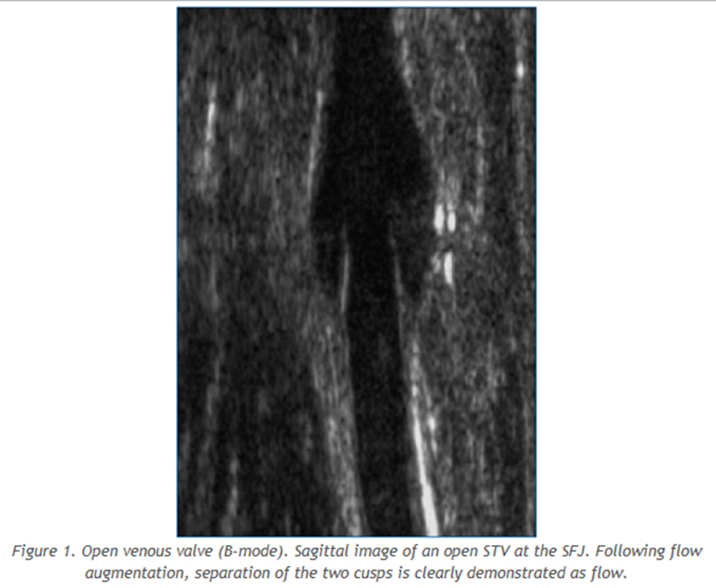
Venous valve on Ultrasound

Slide 5
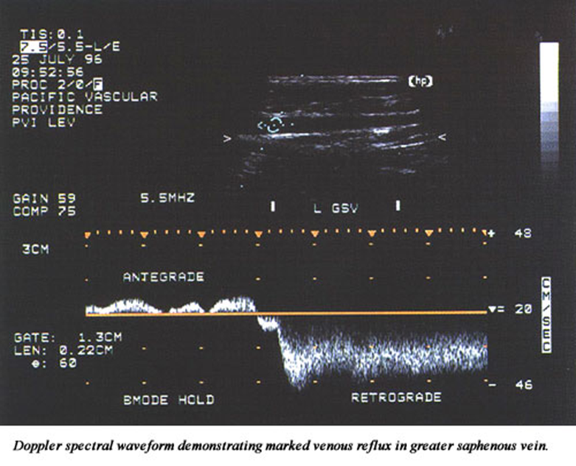
Doppler US – Incompetent valve in great saphenous vein

Slide 6
Superficial Veins
Drain subcutaneous tissues
Two main channels
Lesser (short) saphenous vein
Great (long) saphenous vein

Slide 7
Lesser saphenous vein
Arises at lateral side of dorsal venous arch
Passes posterior to Lateral Malleolus
Passes superiorly at posterior aspect of calf
Pierces fascia of popliteal fossa
Drains into Popliteal vein @ SP-junction
Short saphenous perforators continue superiorly -> Great saphenous and Deep femoral veins

Slide 8
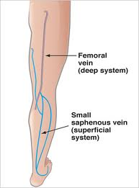
Lesser Saphenous vein

Slide 9
Great Saphenous Vein
Arises at medial aspect of dorsal venous arch
Passes anterior to Medial Malleolus
Courses superiorly in medial aspect of leg
Empties into Femoral Vein via Saphenous opening in lower part of inguinal triangle

Slide 10
Great Saphenous Vein cont..
Communicates with deep veins via a variable amount and arrangement of perforating veins
Inconstant except :
Above ankle at medial aspect
Above the knee at medial aspect

Slide 11
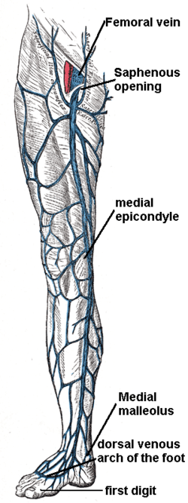
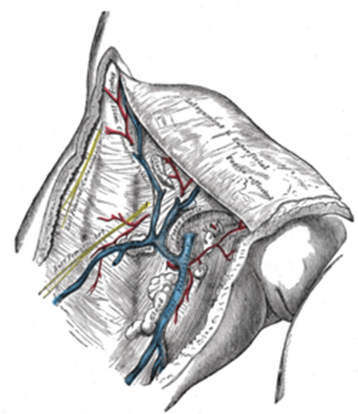
Geater Saphenous vein

Slide 12
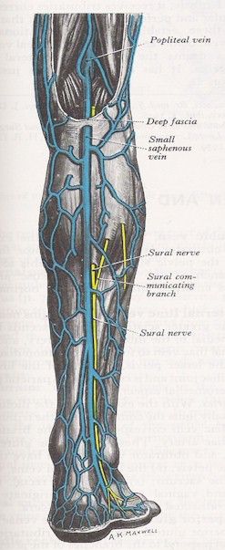
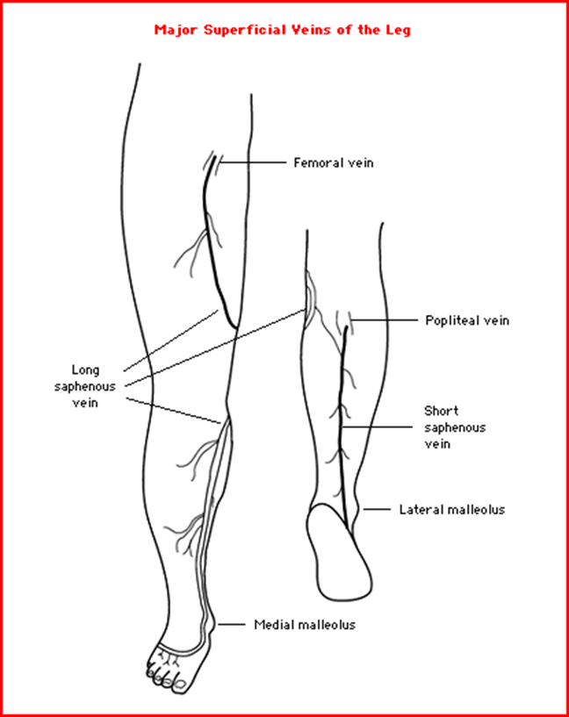
Superficial veins

Slide 13
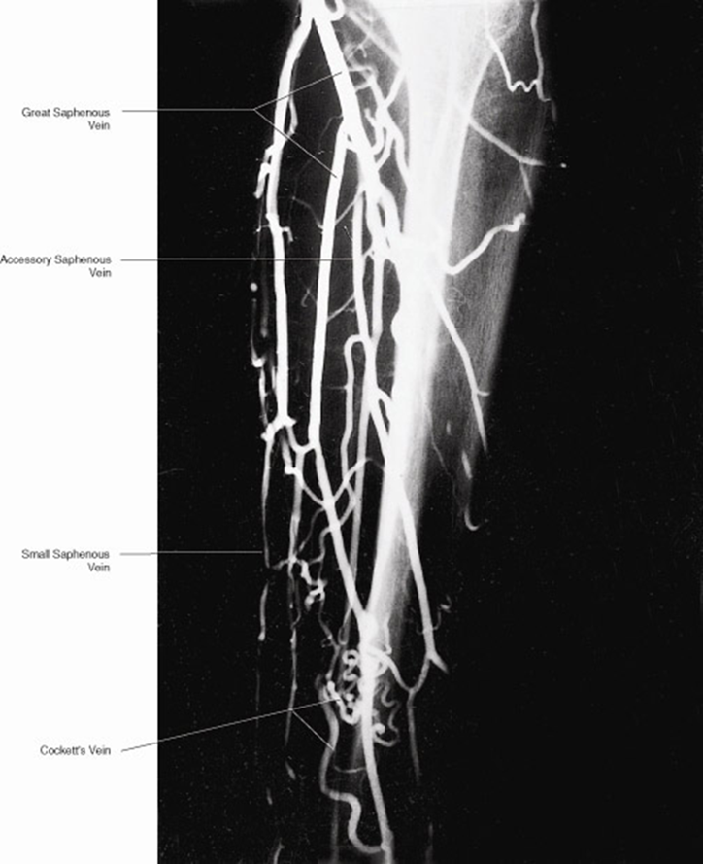
Venogram
(Superficial veins)

Slide 14
Deep Venous System
Paired with namesake arteries as venae commitantes
Arise as:
Digital and metatarsal veins in the sole
Medial and Lateral Plantar veins
Unite to form the Posterior Tibial Veins

Slide 15
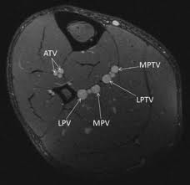
Deep Venous System cont…
Anterior Tibial Veins:
Arise as Venae commitantes of Dorsalis Pedis Artery
Pass posteriorly through upper interosseuous membrane
Join Posterior Tibial Veins to form the Popliteal Vein

Slide 16
Deep Venous System cont…
Popliteal vein traverses the Adductor Hiatus -> forms Superficial Femoral Vein
Superficial Femoral Vein passes under inguinal ligament -> External Iliac Vein
Deep Femoral Veins drain the posterior aspect of the thigh into the Common Femoral Vein

Slide 17
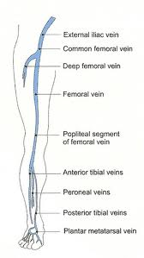
Deep Venous System

Slide 18
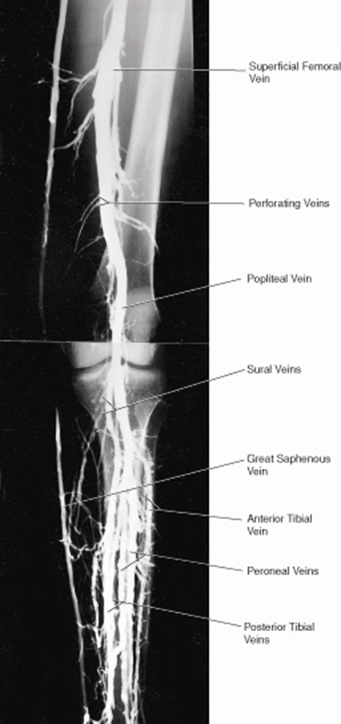
Venogram
(Deep venous system)

Slide 19
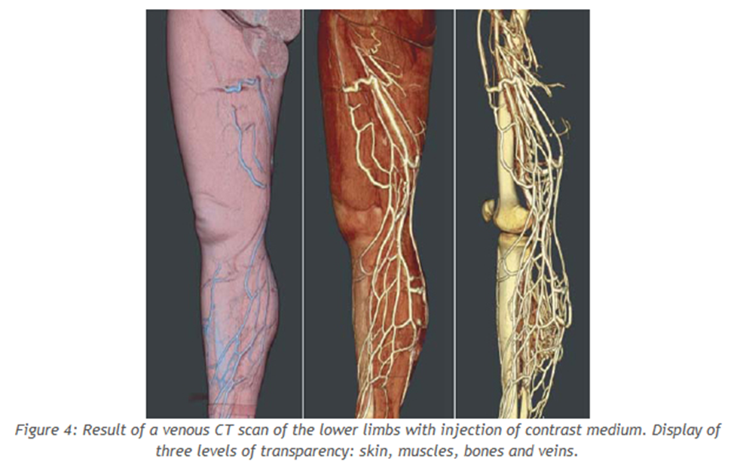
CT Venogram

Slide 20
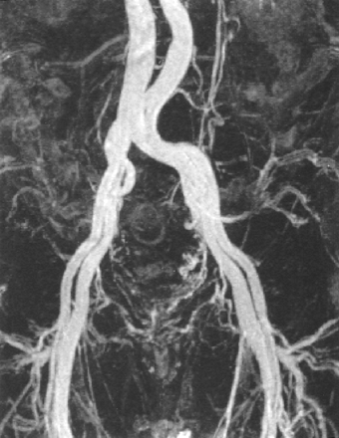
Iliac Veins
The Internal and External Iliac Veins accompany their namesake arteries
Lie postero-medially to the arteries

Slide 21
Iliac Veins
Common Iliac Vein
Forms anterior to the SI-joint
Unites with contralateral Common Iliac Vein - on right side of L5 vertebra -> IVC
The Right Common Iliac Vein lies posterolaterally to the Right Common Iliac Artery

Slide 22
Congenital Abnormalities
Sacrocardinal veins fromed @ 7th week
Left Common Iliac Vein anastomoses with the Sacrocardinal veins
The Right Sacrocardinal Vein later becomes the Sacrocardinal segment of the IVC

Slide 23
Congenital Abnormalities
Estimated 1% incidence
Most common is the Double IVC (0.2-3%)
Left sacrocardinal veins fails to disconnect from the Left Subcardinal Vein
Left Cava rejoins the Right Cava via the Left Renal Vein

Slide 24
Cockett’s Point
The left Common Iliac Vein is longer and is crossed by the Right Common Iliac Artery
Filling defects due to flow phenomenon in the Left Common Iliac Vein
Notes:
++++++++++++++++ TRIBS!!!!!!!!!!!

Slide 25
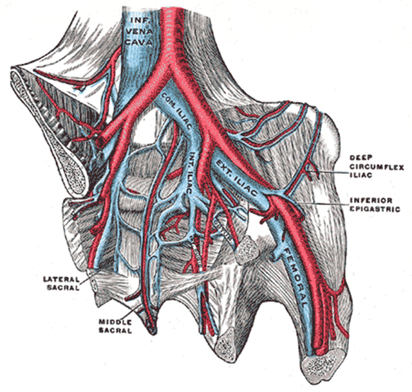
May-Thurner Syndrome
(Cockett syndrome; iliocaval compression syndrome)
Anatomical variant - Compression of Left common iliac vein by the Right common iliac artery
DVT formation may result
May be asymptomatic
DX on CT or MR venogram
May be missed on US

Slide 26
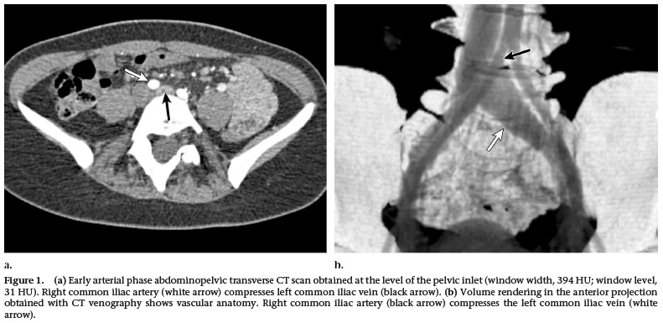
May-Thurner Syndrome

Slide 27
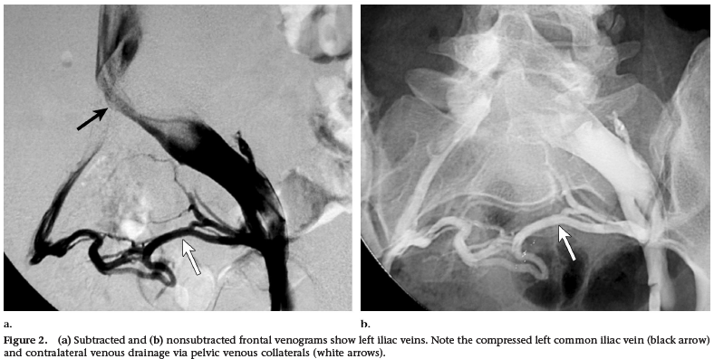
May-Thurner Syndrome

Slide 28
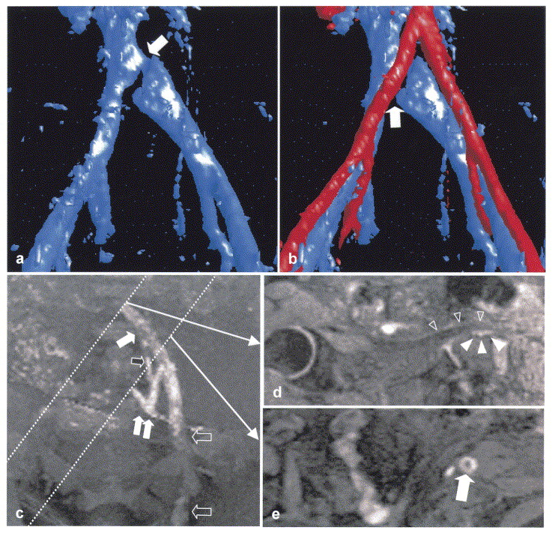
May-Thurner Syndrome MR-venogram
November 2004 Radiology,233, 361-365.

Slide 29
Thank you

