Slide 1
VENOUS DRAINAGE
OF BRAIN
Dr. Kalpesh Patel
Associate Professor
Radiodiagnosi Departmetn
Dhiraj Hospital & SBKSMI&RC
Pipariya

Slide 2
introduction
The cerebral venous system, somewhat unlike the majority of the rest of the body, does not even remotely follow the cerebral arterial system.
Cerebral veins have thin walls with no muscular tissue and possess no valves. They emerge from the brain and lie in the subarachnoid space, coursing over the surface of the brain, aggregating into larger channels until they pierce the arachnoid mater and the meningeal layer of the dura mater and drain into the dural venous sinuses.
The whole system may be divided into a number of sections:
cerebral veins
superficial
deep
dural venous sinuses

Slide 3
Dural venous sinuses
The dural venous sinuses are endothelium lined venous channels located intracranially between the two layers of dura mater (endosteal layer and meningeal layer).
Together they form the major draining pathways from the brain, predominantly to the internal jugular veins.

Slide 4
The dural sinuses contain ARACHNOID GRANULATION also known as PACCHINONIAN GRANULATIONS.
They are CSF containing projection that extended from the subarachnoid space into the dural venous sinuses.

Slide 5
Dural venous sinuses
Superior saggital sinus Cavernous sinus
Inferior saggital sinus Superior petrosal
Straight sinus Inferior petrosal
Sinus confluence sphenoparital
Transverse sinus
Sigmoid sinus
Jugular bulb
Postero-superior
Antero -inferior

Slide 6
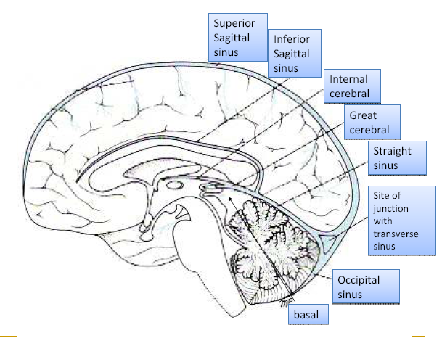

Slide 7
The main dural venous sinuses are:
Unpaired
superior sagittal sinus
inferior sagittal sinus
straight sinus
intercavernous sinus
Paired
transverse sinus
sigmoid sinus
inferior petrosal sinus
superior petrosal sinus
cavernous sinus
sphenoparietal sinus
basilar venous plexus

Slide 8
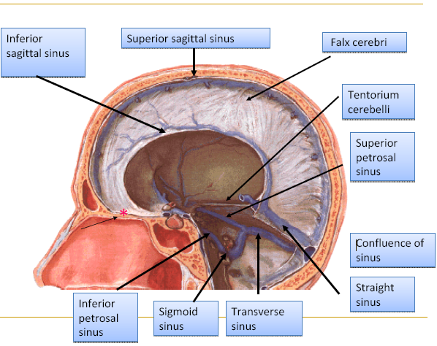

Slide 9
Superior sagittal sinus
The superior sagital sinus is the largest dural venous sinus.
Curvilinear sinus
Parallels the inner calvarial vault.
Originates from the ascending frontal vein anteriorly and runs in the midline at the junction of falx cerebri with the calvaria.
It receives venous blood from the cortical veins over the cerebral hemispheres.

Slide 10
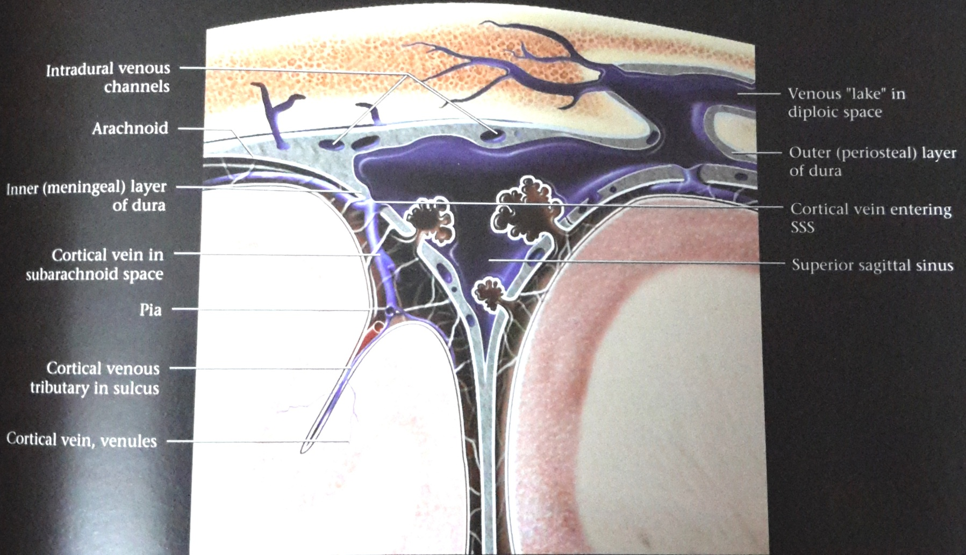

Slide 11
Inferior sagittal sinus
The inferior sagittal sinus is one of the dural venous sinuses and runs along the inferior edge of the falx cerebri.
It runs from front to back (same as the superior sagittal sinus) and drains into the straight sinus
. It receives tributaries from the falx itself as well as some small veins from the medial surface of the cerebral hemispheres.

Slide 12
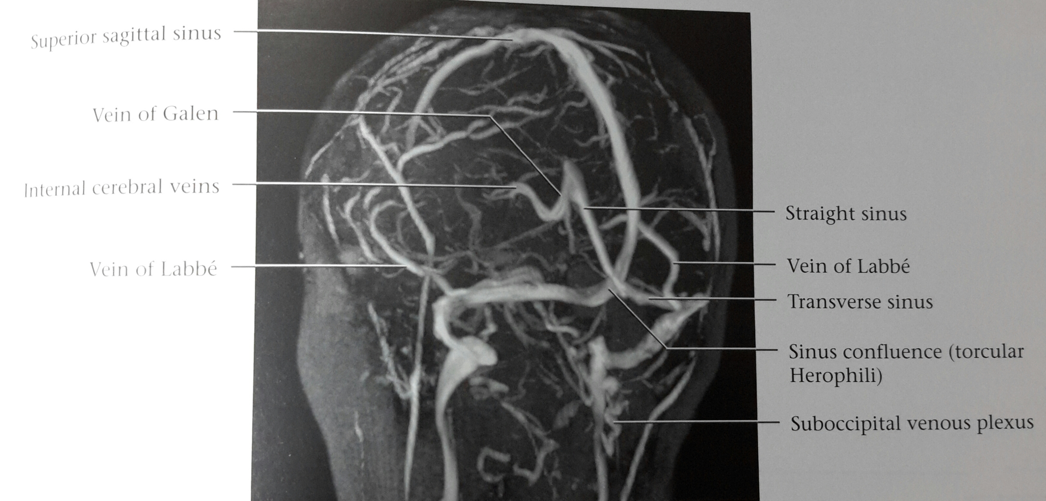

Slide 13
Straight sinus
The straight sinus is found at the junction between the falx cerebri and the tentorium cerebelli
triangular in cross section.
It receives the inferior sagittal sinus, the vein of Galen at its anterior end and runs posteroinferiorly towards the confluence of sinuses (trocular hereophili)
It is occasionally duplicated or hypoplastic. When absent a persistent falcine sinus is usually identified, draining directly into the superior sagittal sinus.

Slide 14
Intercavernous sinus
The intercavernous sinus (anterior and posterior) are dural venous sinuses and connect the left and right cavernous sinuses, along with the basilar sinus (plexus).
They lie in the anterior and posterior borders of the diaphragma sellae.

Slide 15
Transverse sinus
The transverse sinus is one of the dural venous sinuses and drains the superior sagittal sinus and the straight sinus, and empties into the sigmoid sinus which in turn reaches the jugular bulb.
The two transverse sinuses arise at the confluence of the three afore mentioned sinuses at the torcula herophili or confluence of sinuses.

Slide 16
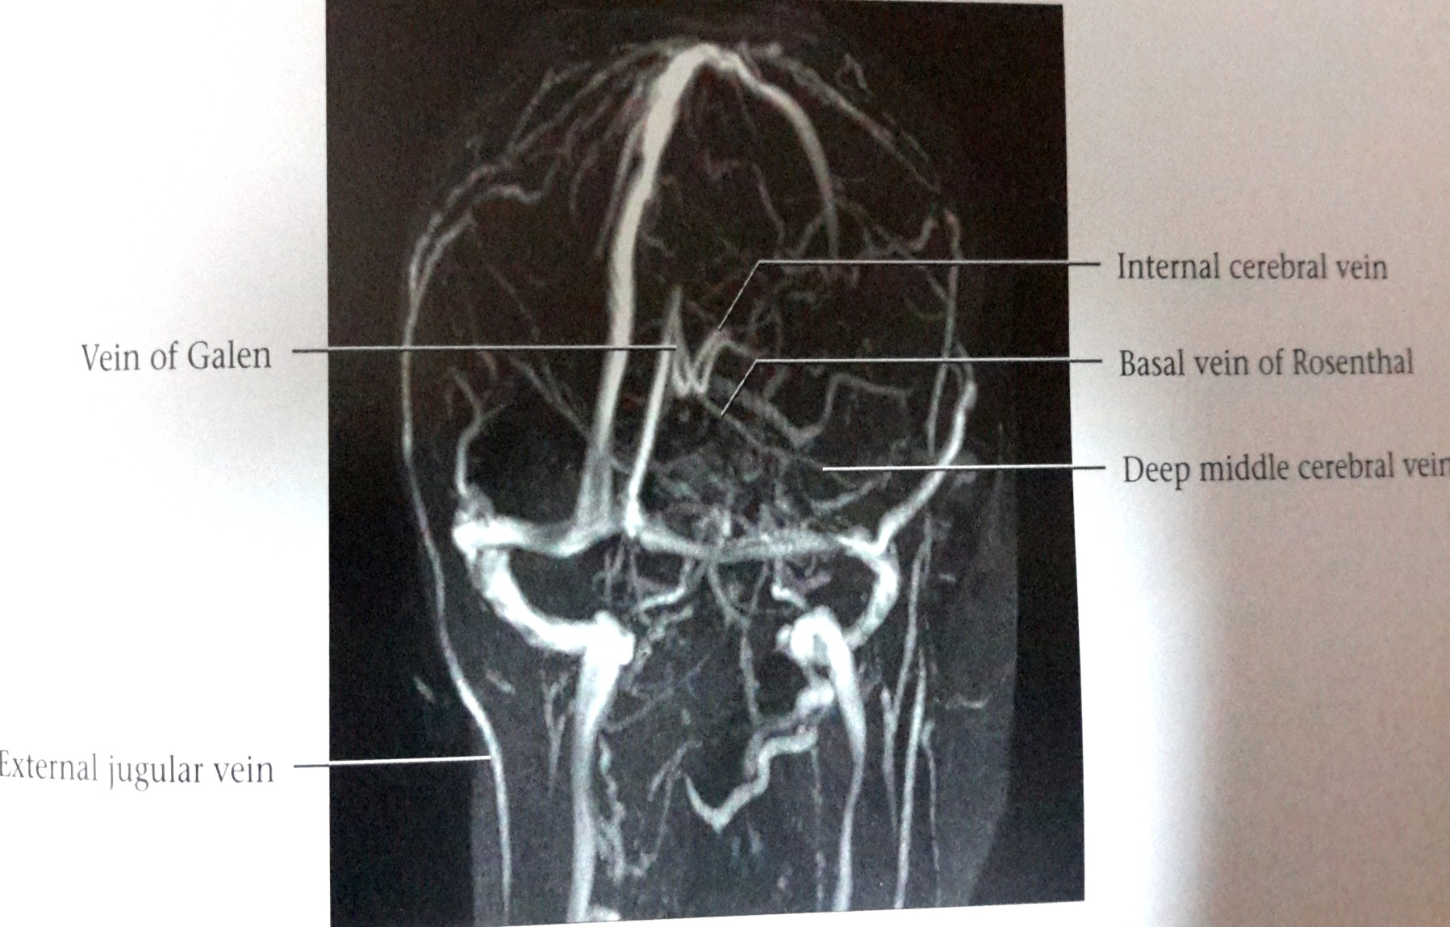
SUPERIOR SAGGITAL SINUS
TRANSVERESE SINUS

Slide 17
Sigmoid sinus
The sigmoid sinus is a paired sinuses.
It is the continuation of the transverse sinus (which is similarly variable in size) and becomes the sigmoid sinus as the tentorium ends.
It is here that the sinus receives the superior petrosal sinus.
It passes inferiorly in an S shaped groove posteromedial to the mastoid air-cells to thejugular foramen, where it ends in the jugular bulb, in the posterior half of the foramen (pars vascularis).

Slide 18
Inferior petrosal sinus
The inferior petrosal sinus is one of the dural venous sinuses. It is often a plexus of venous channels rather than a true sinus and drains blood from the cavernous sinus to the jugular foramen (pars nervosa)
It runs in a shallow groove between the petrous temporal bone and basilar occipital bone(on either side of the clivus).
It is connected across the midline by the basilar plexus.

Slide 19
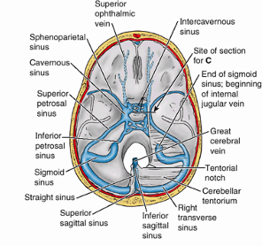

Slide 20
Superior petrosal sinus
The superior petrosal sinus is one of the dural venous sinuses and drains thecavernous sinus, posterolaterally to the transverse sinus. It runs along superior aspect of the petrous temporal bone. It receives:
cerebellar veins
inferior cerebral veins
labyrinthine vein - draining the inner ear structures

Slide 21
Cavernous sinus
The cavernous sinus is one of the dural venous sinuses.
Gross anatomy
It is located on either side of the pituitary fossa and body of the sphenoid bone between the endosteal and visceral layers of the dura.
Vascular connections
It receives blood from the
inferior ophthalmic vein (or a branch thereof)
superficial middle cerebral vein
inferior cerebral veins
sphenoparietal sinus
and occasionally
  central retinal vein
  frontal tributary of the middle meningeal vein

Slide 22
Drainage of the cavernous sinus is via:
superior petrosal sinus to the transverse sinus
inferior petrosal sinus directly to the jugular bulb
venous plexus on the internal carotid artery to the pterygoid plexus.
Depending on relative pressures the superior ophthalmic veins either drain to or drain the cavernous sinus.
Additionally the cavernous sinuses connect to each other via the intercavernous sinuses.

Slide 23
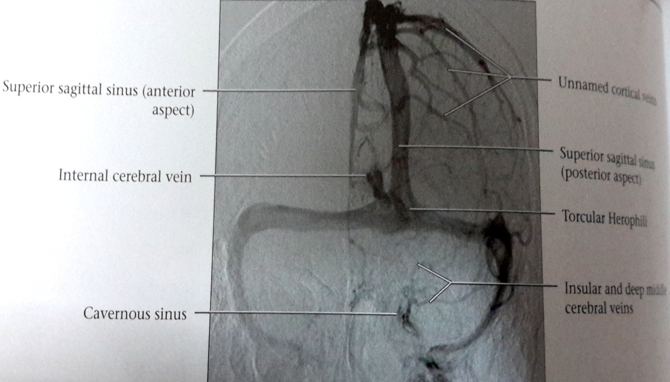

Slide 24
Contents
Nerve
The cavernous sinus transmits multiple cranial nerves to the superior orbital fissure and foramen ovale.
These are:
In the lateral wall from superior to inferior:
  oculomotor nerve (CN III)
  trochlear nerve (CN IV)
  trigeminal nerve (CN V) ophthalmic and maxillary divisions.
Traversing the sinus lateral to the ICA
  abducents nerve (CN VI)
Artery
The internal carotid artery enters the posterior inferior aspect of the sinus, and bends upon itself as the carotid siphon (cavernous segment - C4).
Two branches arise from this segment: meningohypophyseal trunk and inferolateral trunk.

Slide 25
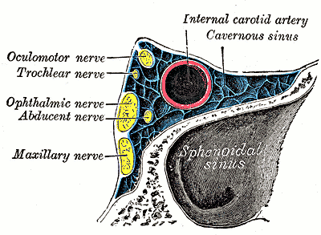
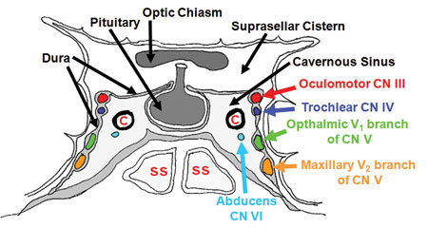

Slide 26
Tributaries
From orbit
Superior ophthalmic vein
Inferior ophthalmic vein
Central vein of retina
From brain
Middle cerebral vein
Inferior cerebral vein
Meningeal
Middle meningeal vein
Sphenoparietal sinus

Slide 27
SPHENOPARIETAL SINUS
The sphenoparietal sinus is one of the dural venous sinuses and is located along the posteroinferior ridge of the lesser wing of the sphenoid bone.
It drains into the cavernous sinus and receives tributaries from:
superficial middle cerebral vein
middle meningeal vein (frontal ramus)
anterior temporal diploic vein

Slide 28
Basilar venous plexus
The basilar venous plexus lies between the endosteal and visceral layers of the dura on the inner surface of the clivus. It connects the:
inferior petrosal sinuses
cavernous sinuses
intercavernous sinuses
superior petrosal sinuses
internal vertebral venous plexus
marginal sinus (around the margins of foramen magnum)

Slide 29
Cerebral veins
The cerebral veins drain the brain parenchyma and are located in the subarachnoid space. They pierce the meninges and drain further into the cranial venous sinuses.
The cerebral veins lack muscular tissue and valves. The cerebral venous system can be divided into:
superficial (cortical) cerebral veins
deep (subependymal) cerebral veins

Slide 30
Superficial venous system
There are numerous cortical veins and most of them are unnamed, however the large cortical veins can be identified and according to their locations cortical venous system can be subdivided into:-
superior
middle
inferior groups.
Important veins of superficial cerebral venous system are -
superficial middle cerebral vein
superior anastomotic vein of Trolard
vein of Labbé

Slide 31
Vein of tolard
The superior anastomotic vein of Trolard connects the superior sagittal sinus and the superficial middle cerebral vein (of Sylvius).
Its size is dictated by the relative size of the superficial middle cerebral vein and the anastomotic vein of Labbé.
The vein of Trolard is smaller than both of these.

Slide 32
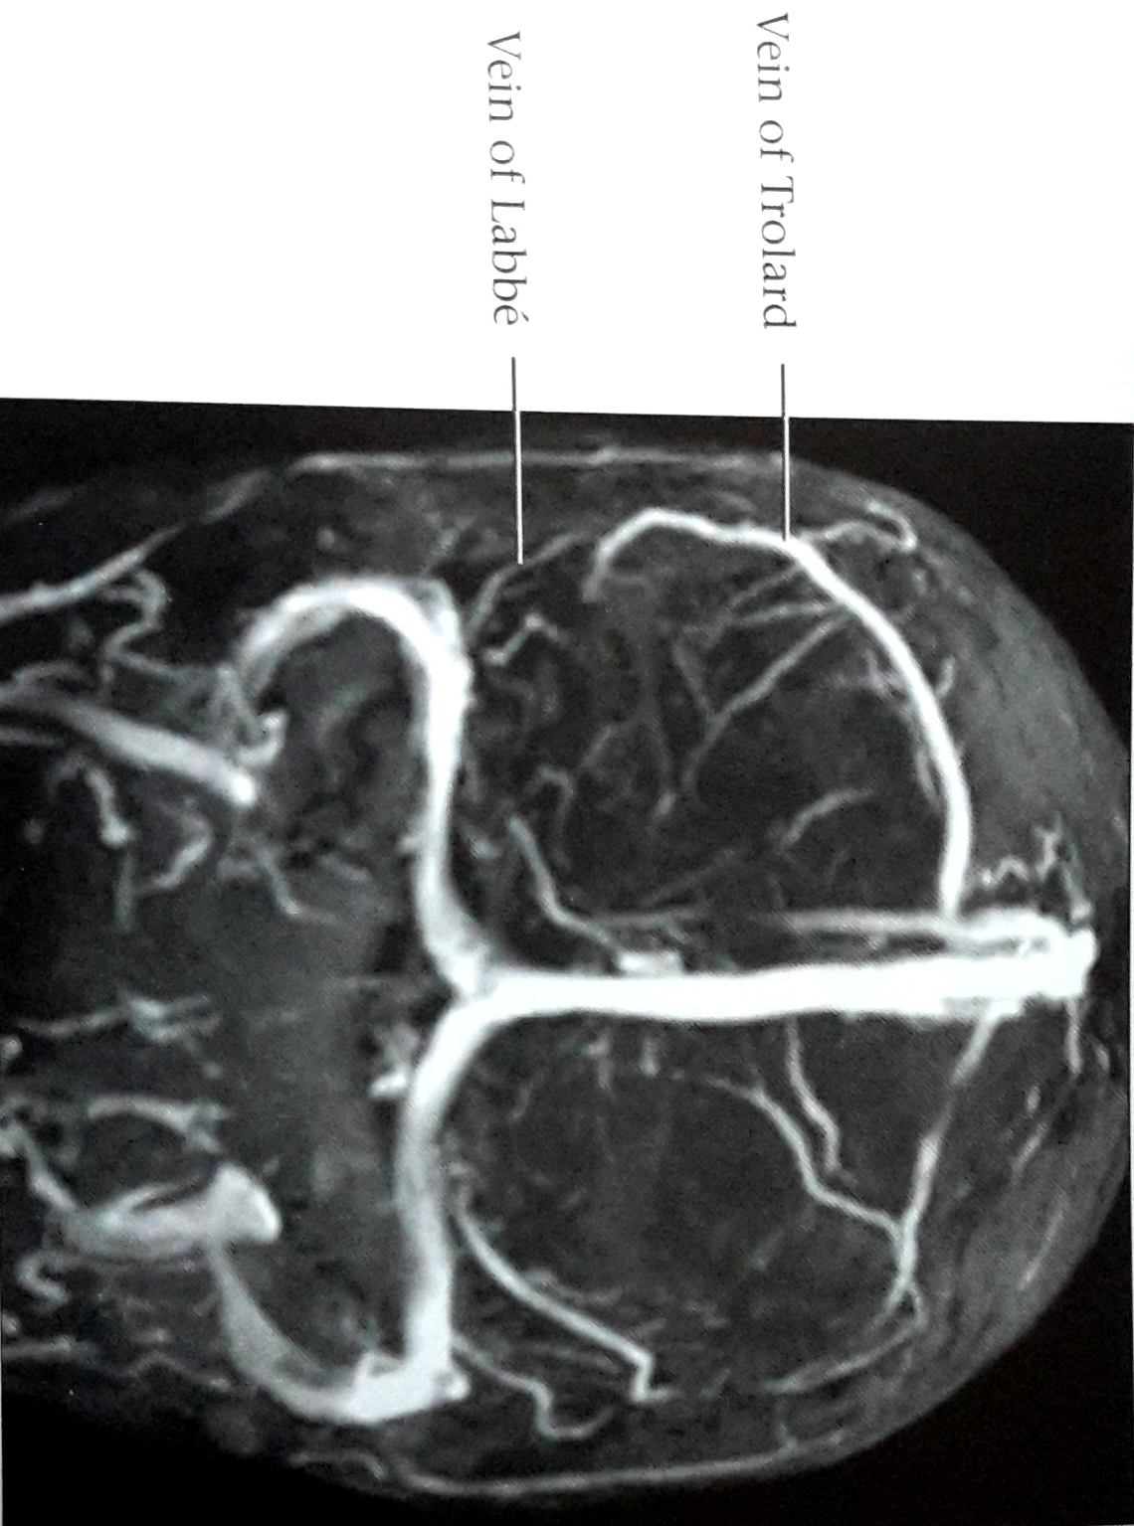

Slide 33
Superior middle cerebral vein
The superficial middle cerebral vein (SMCV) (also knwon as the Sylvian vein) is one of the superficial cerebral veins.
It usually passes along the Sylvian fissure posteroanteriorly and it curves anteriorly around the tip of the temporal lobe and drains into the sphenoparietal sinus or cavernous sinus

Slide 34
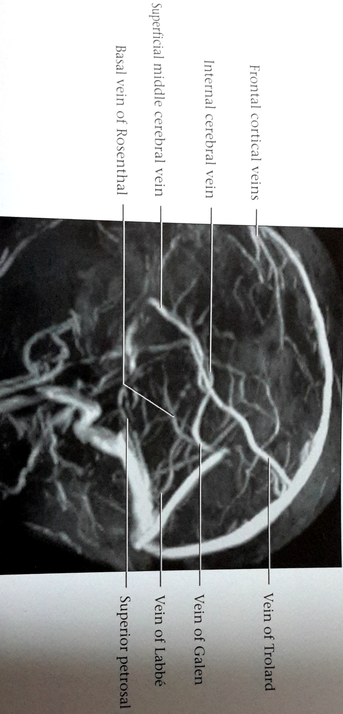

Slide 35
Inferior cortical veins
These veins drain most of the inferior frontal lobes and temporal lobes.
The DEEP MIDDLE CEREBRAL VEINS then anastomoses with the BASAL VEIN OF ROSENTHAL.
The

Slide 36
Basal vein of rosenthal
The basal vein of Rosenthal originates on the medial surface of the temporal lobe and runs posteriorly and medially. It passes lateral to the midbrain through the ambient cistern to drain into the vein of Galen. It is closely related to the posterior cerebral artery (PCA).

Slide 37
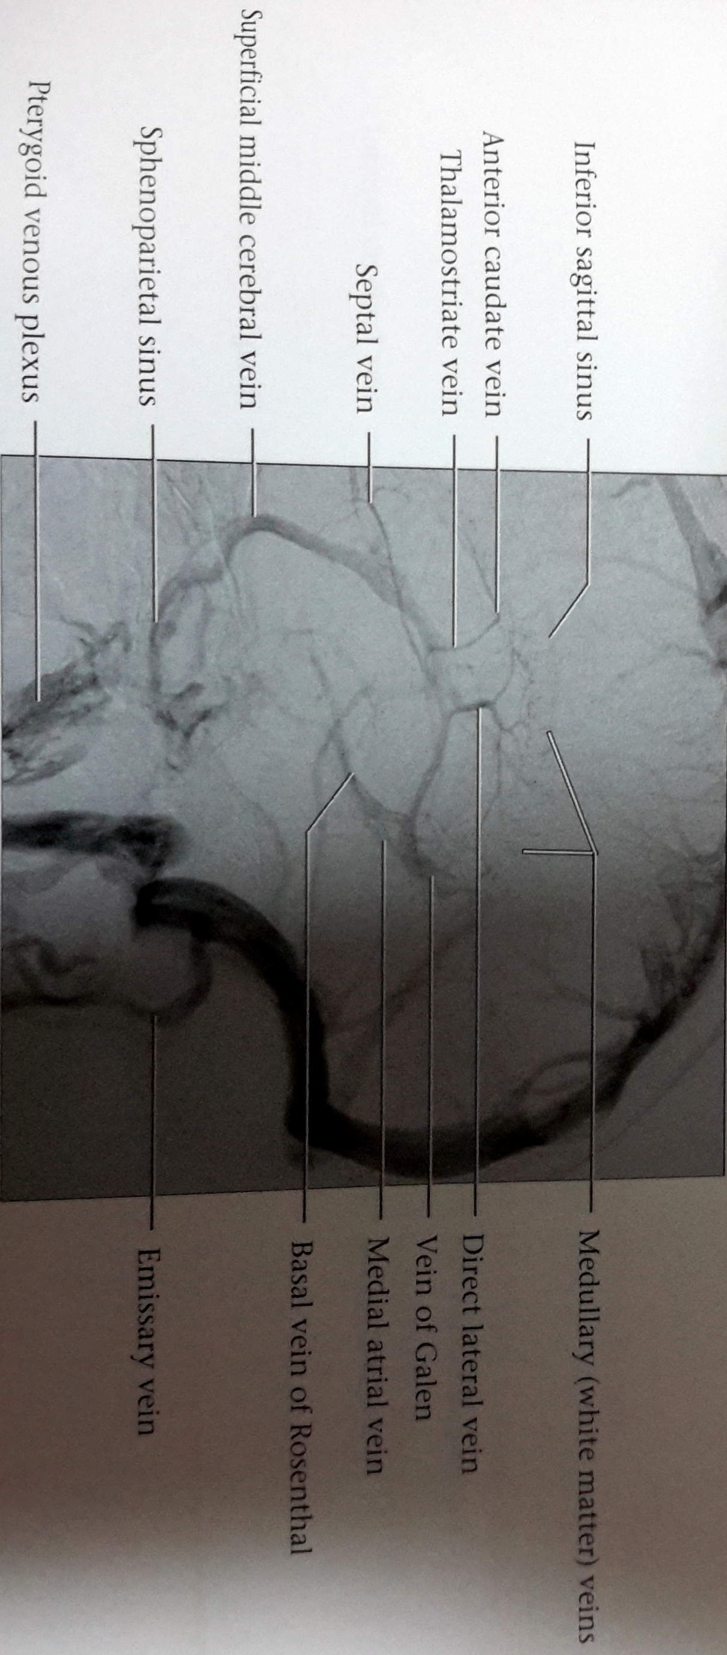

Slide 38
vein of Labbé
The vein of Labbé (inferior anastomotic vein) is part of the superficial venous system of the brain.
The vein of Labbé is the largest channel that crosses the temporal lobe between the sylvian fissure and the transverse sinus and connects the superficial middle cerebral veinand the transverse sinus.

Slide 39
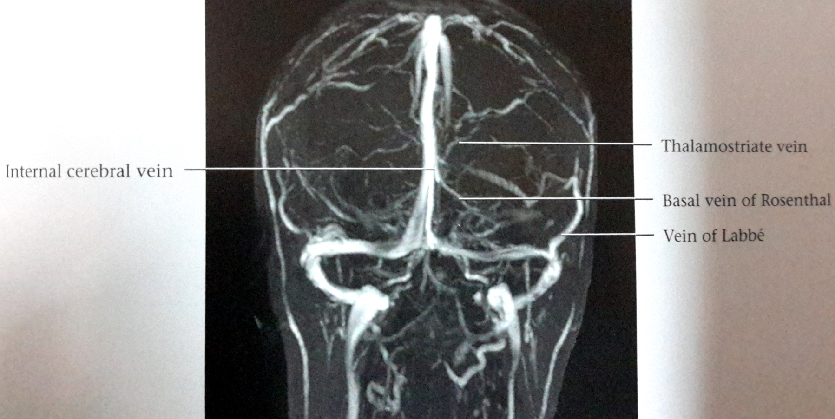

Slide 40
deep venous system
The deep venous consist of lateral sinuses, sigmoid sinuses, straight sinus and draining deep cerebral veins :-
MEDULLARY VEINS
SUBEPENDYMAL VEINS
DEEP PARAMEDIAN VEINS

Slide 41
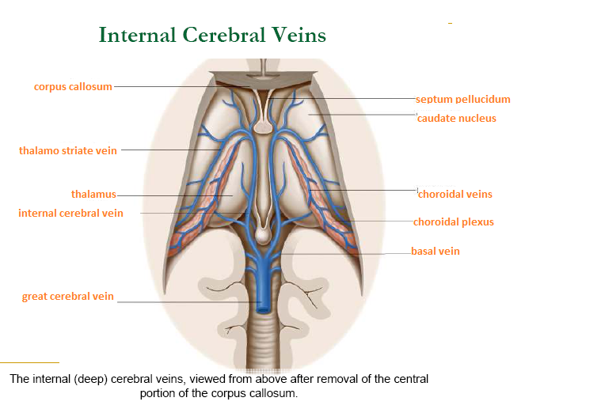

Slide 42
Medullary veins –
They are numrous and originate 1-2 cm below cortical gray matter and pass through deep medullary white matter and drain into subependymal veins.
The medullary veins are arranged in a wedge shaped manner and distributed at a right angle to subependymal veins.

Slide 43
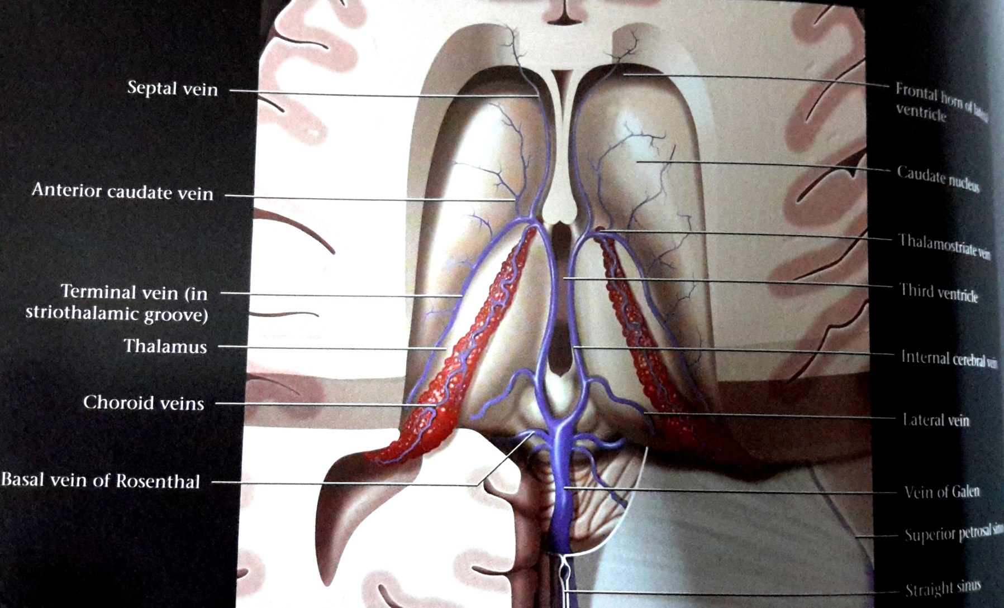

Slide 44
Subependymal veins - they receive medullary veins and aggregate into greater tributaries, mainly into :-
septal veins
thalamostriate veins- recieves tributaries from the caudate nuclei and the thalami.
Unite with the septal veins near the FORAMEN OF MONROE to form two INTERNAL CEREBRAL VEINS.

Slide 45
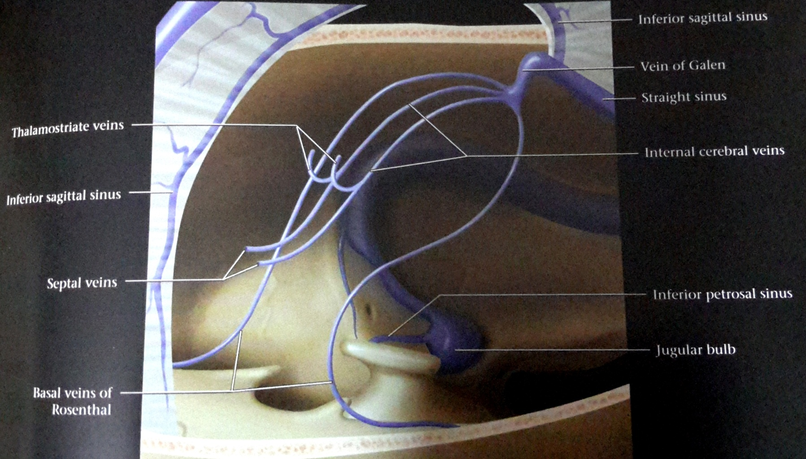

Slide 46
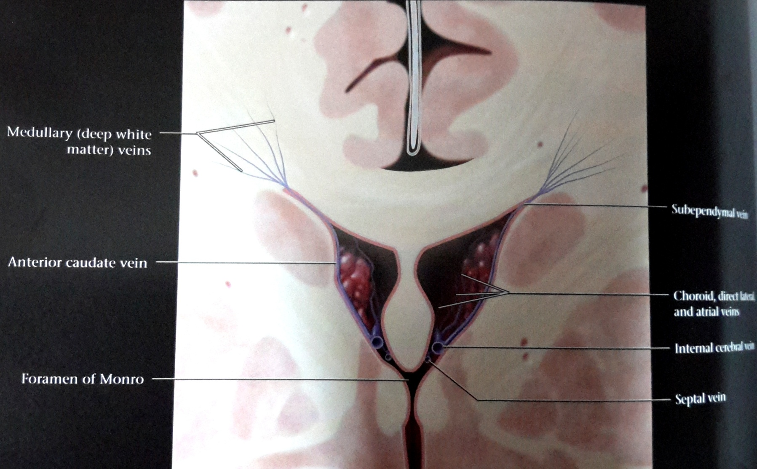

Slide 47
Vein of galen
The vein of Galen (also known as the great cerebral vein or great vein of Galen).
It curves backward and upward around the splenium of the corpus callosum and ends at the confluence of the inferior sagittal sinus and the anterior extremity of the straight sinus
BASAL VEIN OF ROSENTHAL
TWO INTERNAL CEREBRAL VEINS

Slide 48
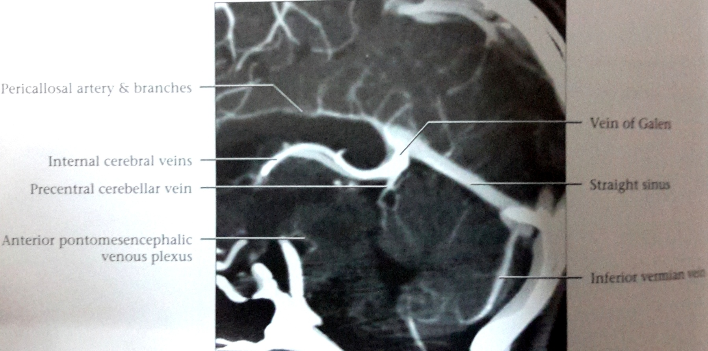

Slide 49
Posterior fossa veins
The veins that drain the posterior fossa and midbrain are divided into:-
Superior (galenic) group
Anterior(petrosal) group
Posterior group

Slide 50
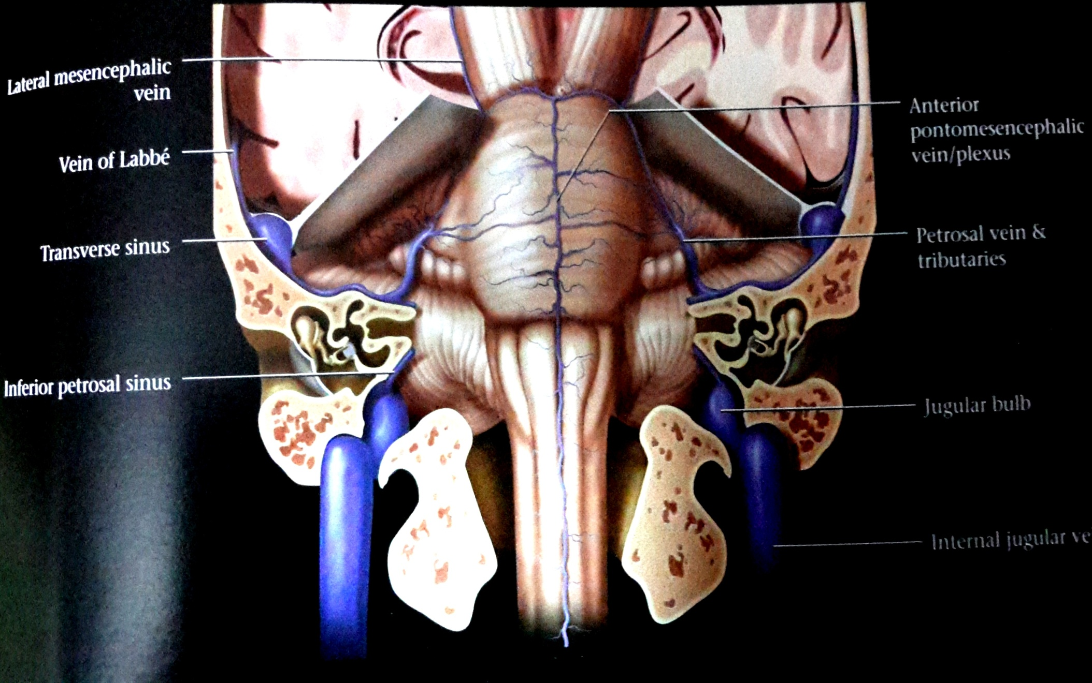

Slide 51
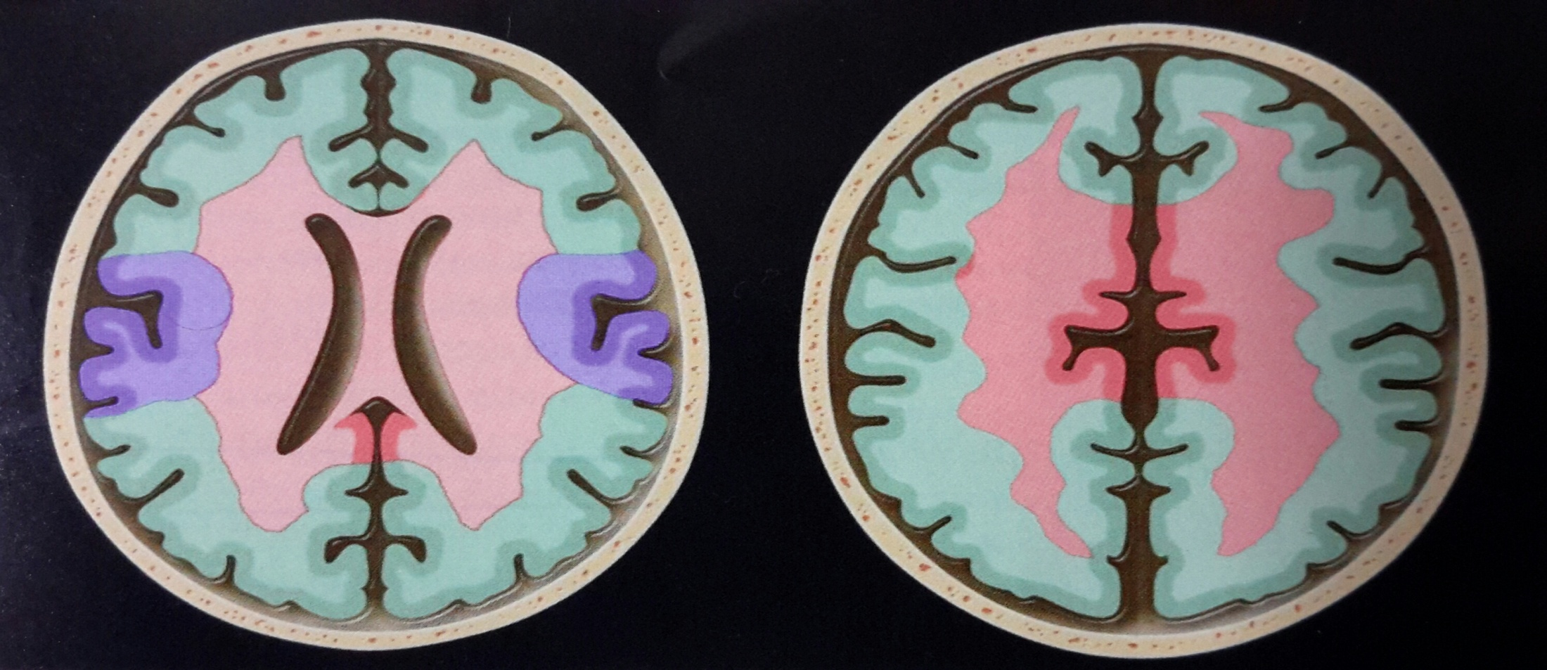
VENOUS DRAINAGE
TERRITORIES
Supeficial parts of the brain (cortex and subcortical white matter)
Central core of brain (basal ganglia,most white matter and ventricles)

Slide 52
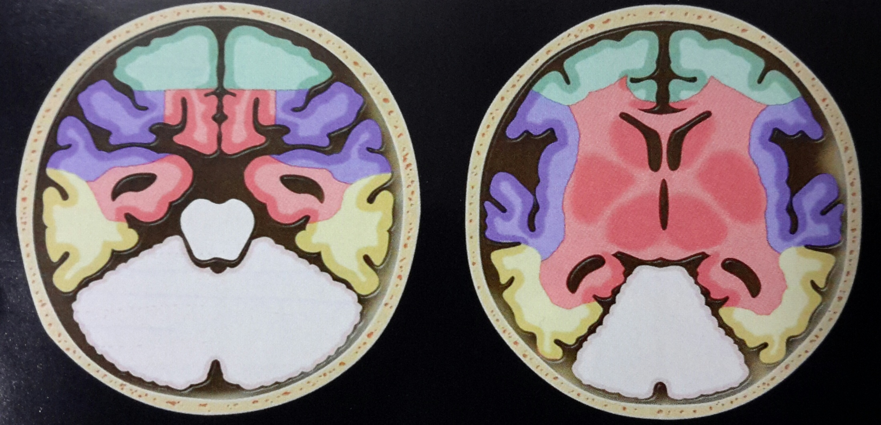
Sphenoparietal and the cavernous sinus drain the area around sylivian fissurre.
Veins of labbe and the transverse sinus drain the inferior parietal lobe and the posterior temporal lobe.

Slide 53
THANK YOU

