Slide 1
Physiology of Middle Ear
Dr payal chavada

Slide 2
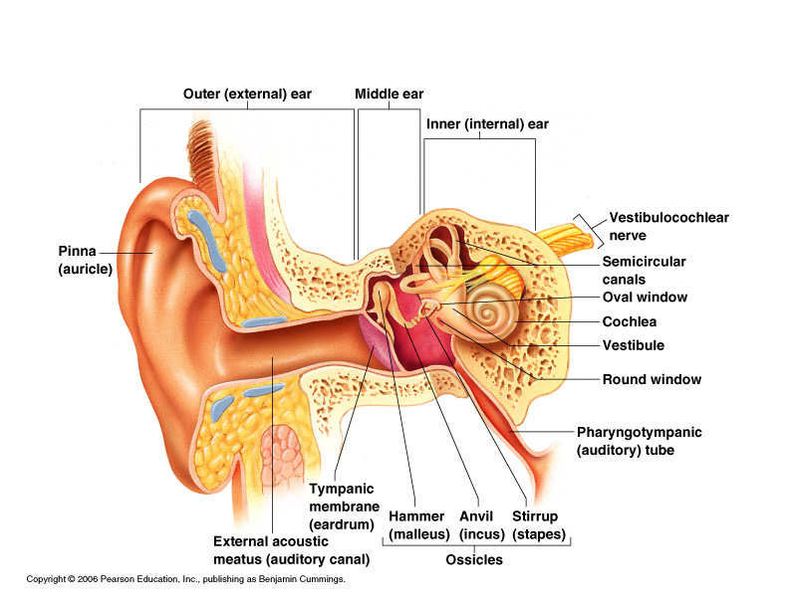

Slide 3
Levels of Evidence
Grade A – Systemic reviews, Meta analyses, RCT
Grade B – Non-randomised studies
Grade C – Observational studies
Grade D – Case Series, Expert opinion

Slide 4
Levels of Evidence
**** ~ Systematic reviews, meta analysis of randomized control studies
*** ~ Non randomised studies
** ~ Observational or non experimental studies
* ~ Expert opinion

Slide 5
Middle Ear
Couples sound energy to cochlea and
provides physical protection
Acoustic transformer – Impedance
matching
Acoustic Reflex
Movement of cochlear fluids

Slide 6
Mechanism of transmission
of sound
Tympanic Membrane
Ossicles: > Malleus
> Incus
> Stapes
Organ of Corti
Auditory Nerve

Slide 7
Impedance Matching
Two principles:
Reduction in area
lever action of ear ossicles

Slide 8
Reduction in Area
sound striking the tympanic membrane(larger area)
delivered to the (much smaller) stapes footplate
Areal Ratio = 18.6 to 1

Slide 9
Increase in force
Malleus and incus act like a lever
Arm of incus shorter
Decrease velocity at stapes

Slide 10
Measurement of Impedance matching
Bekesy
Khanna and Tondorf

Slide 11
Acoustic reflex
Protection from noise damage
Selective attenuation of low frequency components
Reduces resonance in middle ear

Slide 12
Middle ear muscles
Tensor tympani
Stapedius

Slide 13
References
1. Von Bekesy G. Experiments in hearing. New York : McGraw Hill, 1960

Slide 14
NAME OF STUDY | AUTHOR | REFERENCE | SAMPLE SIZE | RESULT | P Value | CONCLUSION
Ossicular resonance modes of the human middle ear for bone and air conduction | Kenji Homma and Yu Du Yoshitaka Shimizu Department of Otolaryngology-HNS, Stanford University, Stanford, California | J Acoust Soc Am. Feb 2009; 125(2): 968–979. | 50 | The dominant mode under AC excitation is the first mode, which occurs around 1.2 kHz and is characterized by a “hinging” ossicular motion, whereas the dominant mode under BC excitation is the second mode, which occurs around 1.7 kHz and is characterized by a “pivoting” ossicular motion. The results indicate that this second mode is responsible for the translational component in the malleus handle motion. | not more than 0.05 | The results indicate that the apparent difference in the primary resonance frequency between AC and BC is due to the presence of two distinct ossicular resonance modes whose natural frequencies are in the 1–2 kHz range.

Slide 15
1. Surface area of the tympanic membrane
55 mm2
70 mm2
80 mm2
90 mm2

Slide 16
2. Narrowest part of middle ear
Hypotympanum
Epitympanum
Attic
Mesotympanum

Slide 17
3. What is the areal ratio in the conduction of sound waves through tympanic membrane to stapes footplate
1: 13.6
13.6:1
1:18.6
18.6:1

Slide 18
4. Stapedial reflex is mediated by
V and VII nerves
V and VIII nerves
VII and VI nerves
VII and VIII nerves

Slide 19
5. The cough response caused while cleaning the ear canal is mediated by stimulation of
The V cranial nerve
Innervation of external ear canal by C1,C2
The X cranial nerve
Branches of the VII cranial nerve

Slide 20
THANK YOU

