Slide 1
Stridor

Slide 2
Levels of Evidence
Grade A – Systemic reviews, Meta analyses, RCT
Grade B – Non-randomized studies
Grade C – Observational studies
Grade D – Case Series, Expert opinion

Slide 3
Levels of Evidence
**** ~Systematic reviews, meta analysis of randomized control studies
*** ~ Non randomised studies
** ~ Observational or non experimental studies
* ~ Expert opinion

Slide 4
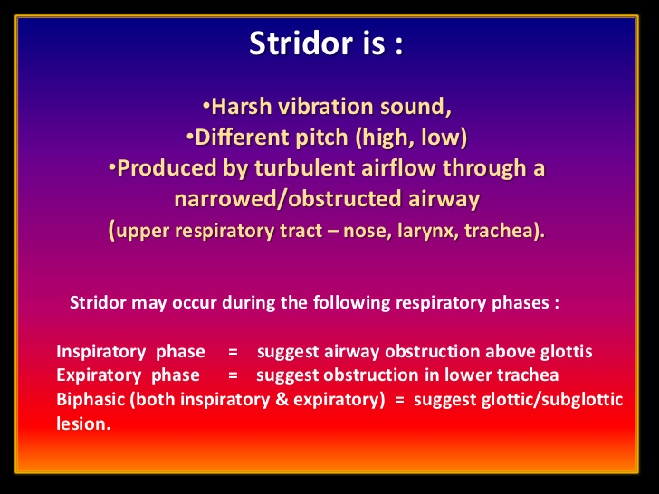

Slide 5
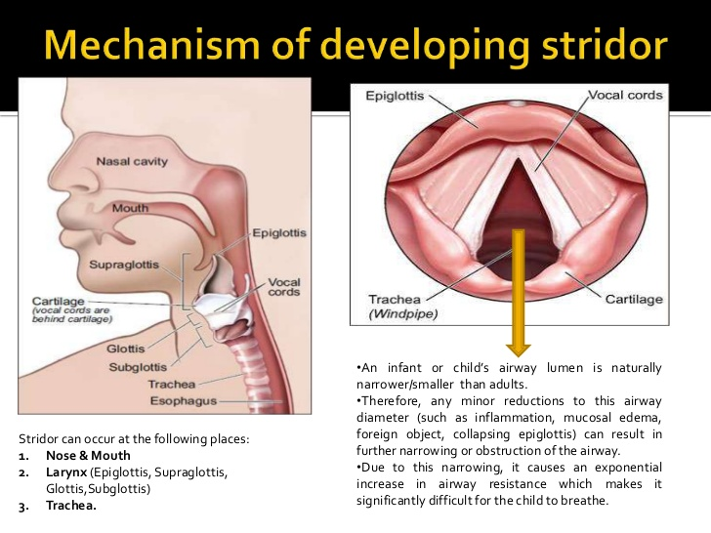

Slide 6
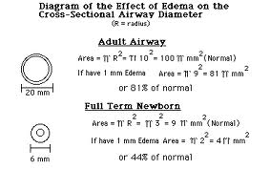

Slide 7
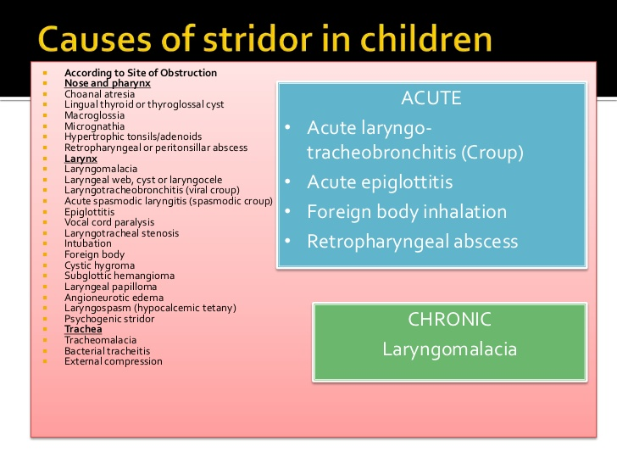

Slide 8
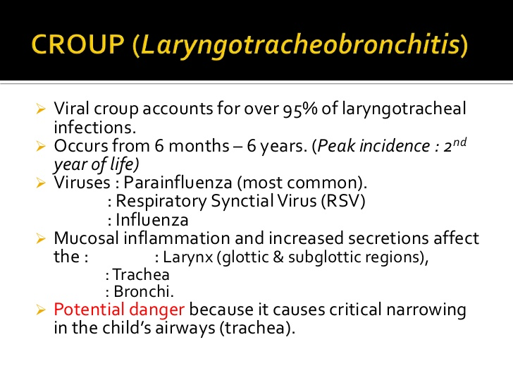
Notes:
High level of evidence

Slide 9
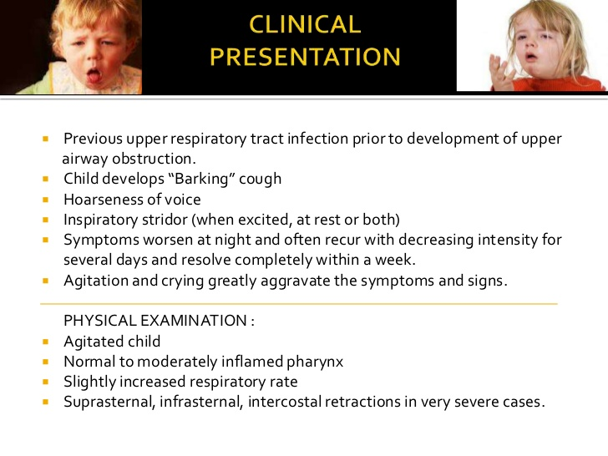

Slide 10
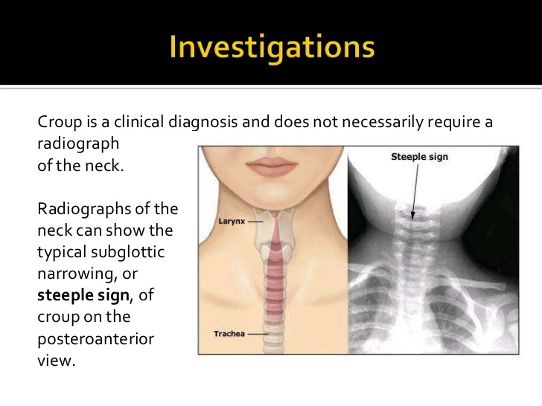

Slide 11
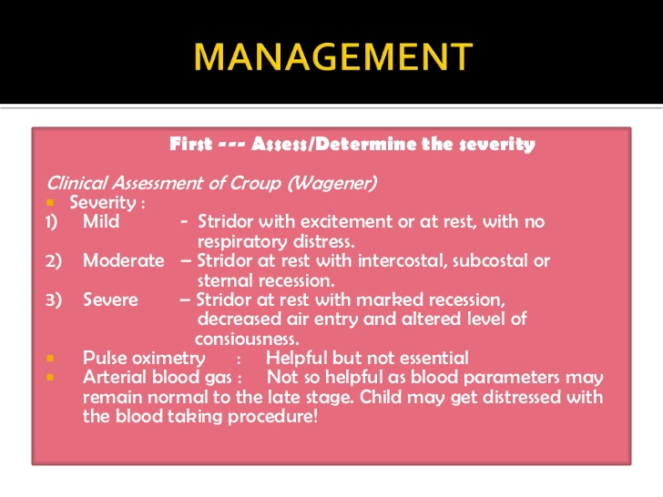

Slide 12
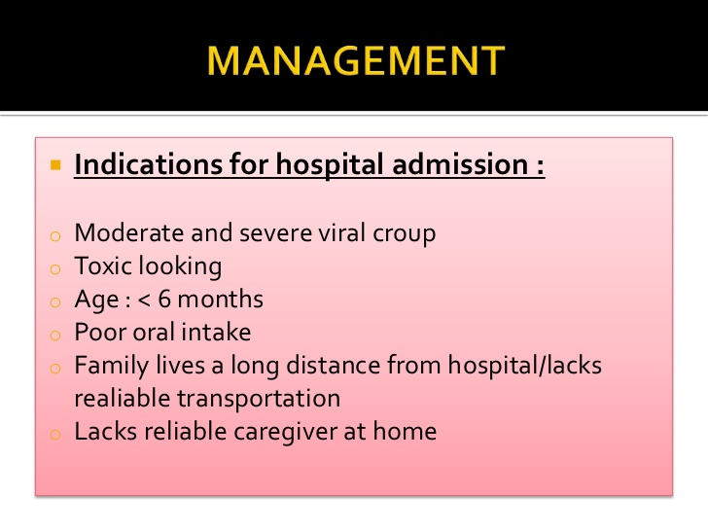

Slide 13
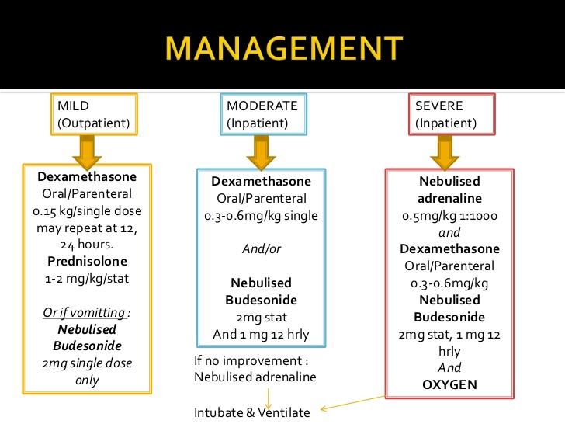
Klassen TP Good summary of evidence base for steroids in childhood airway obstruction. Croup A current prespective PCNA 1999; 46: 1167-78. (High level of evidence)

Slide 14
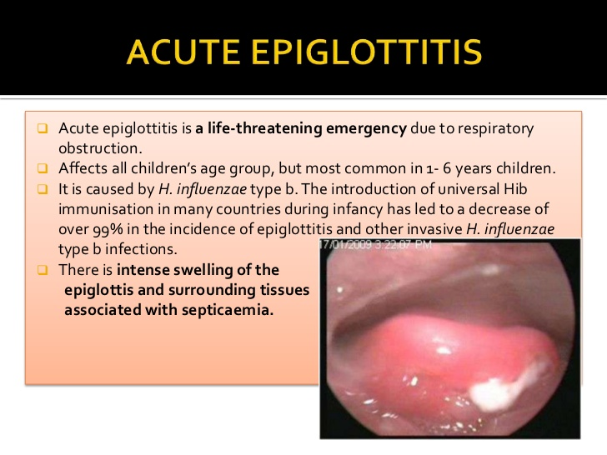

Slide 15
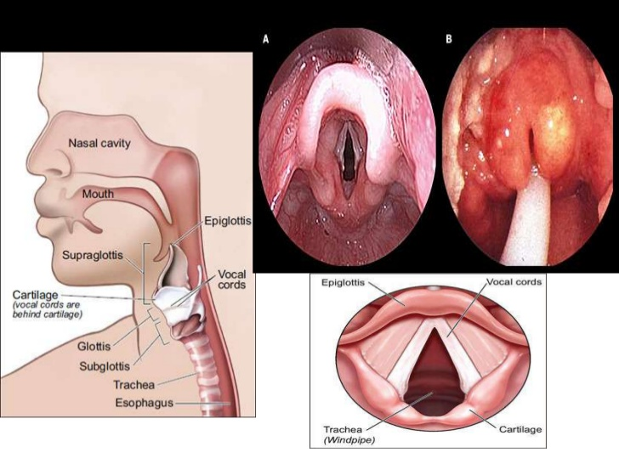

Slide 16
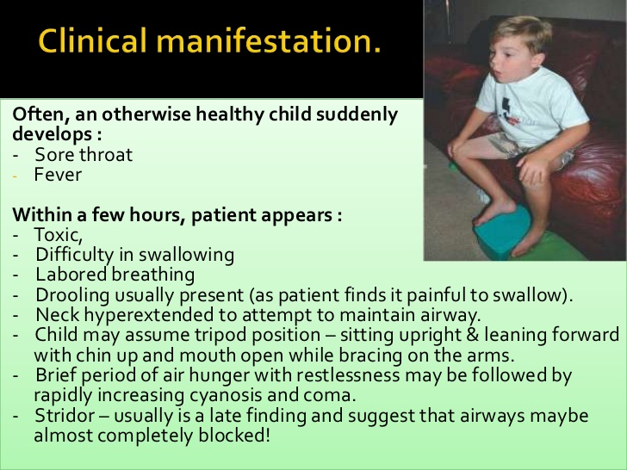

Slide 17
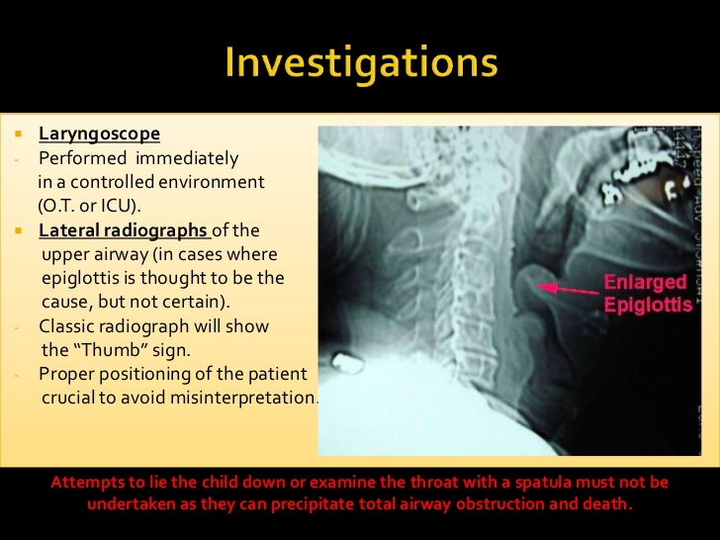
In suspected epiglottitis, instrumentation of the oral cavity and pharynx for examination must be minimal to avoid precipitation of distress ( low level of evidence).

Slide 18
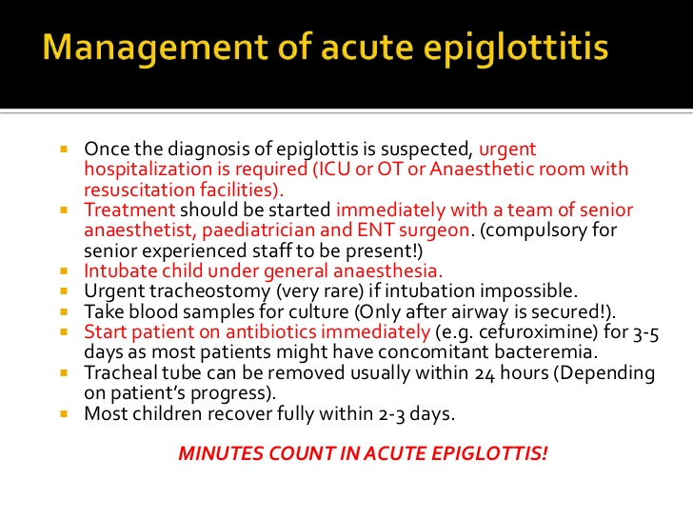

Slide 19
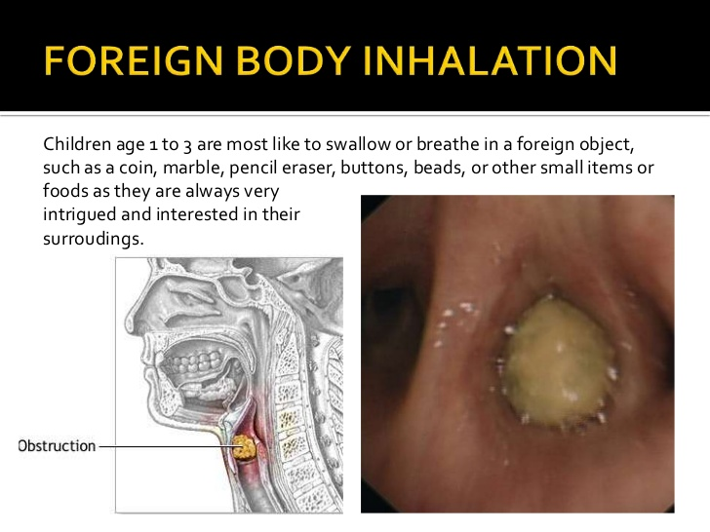

Slide 20
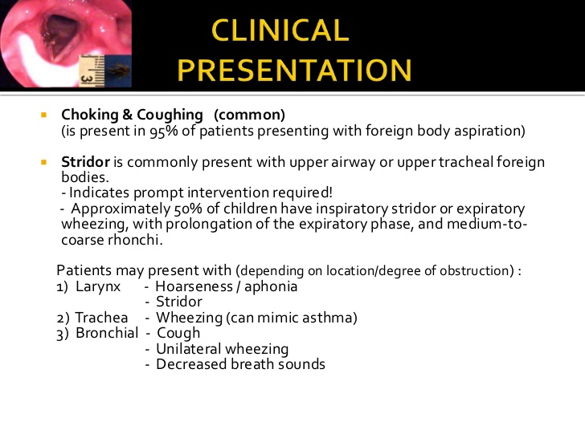

Slide 21
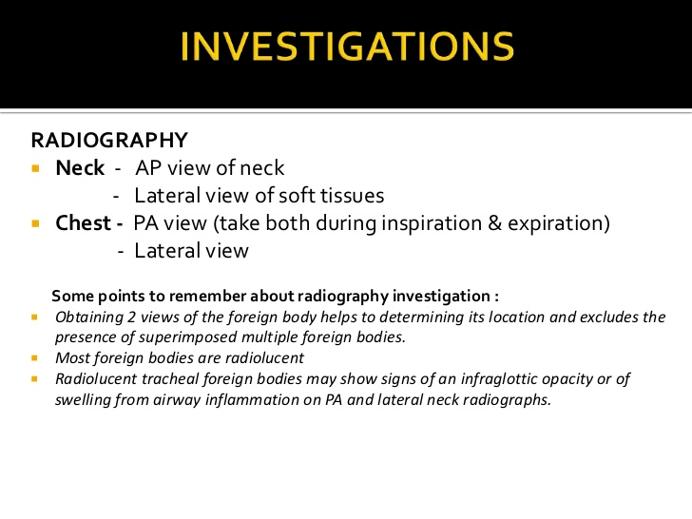

Slide 22
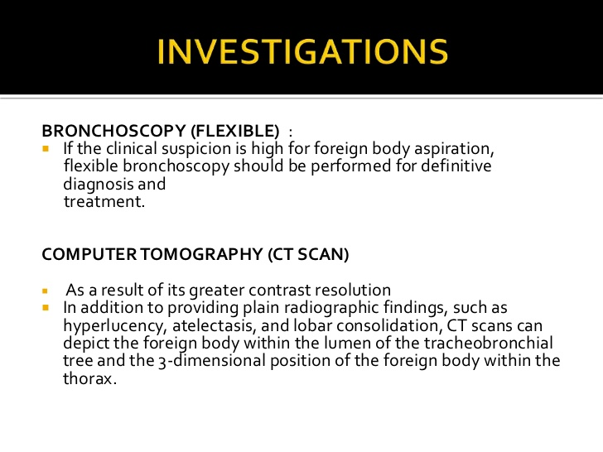

Slide 23
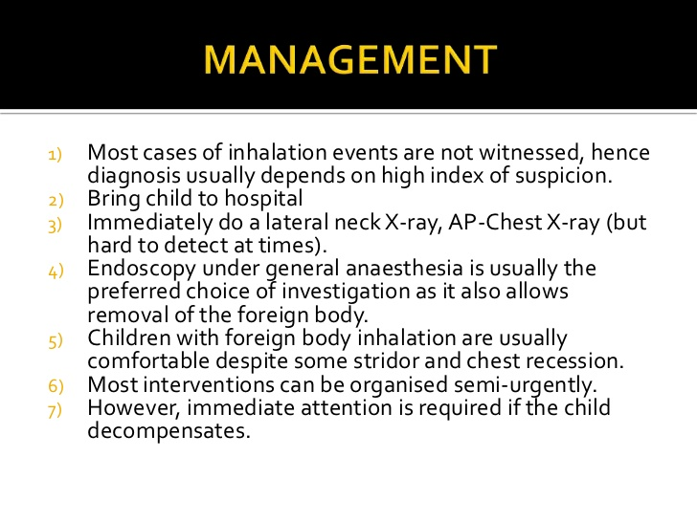

Slide 24
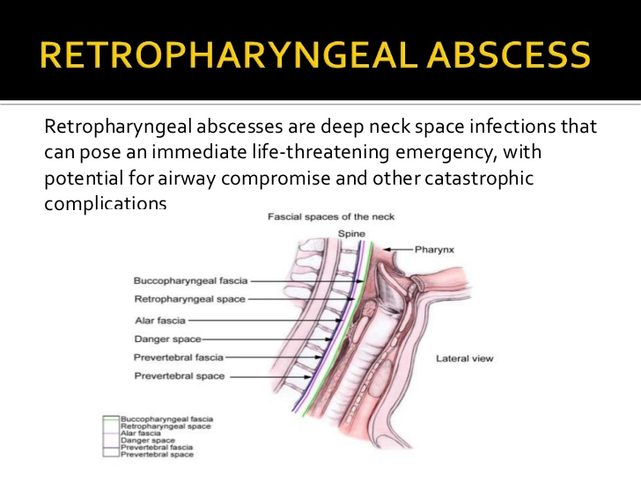

Slide 25
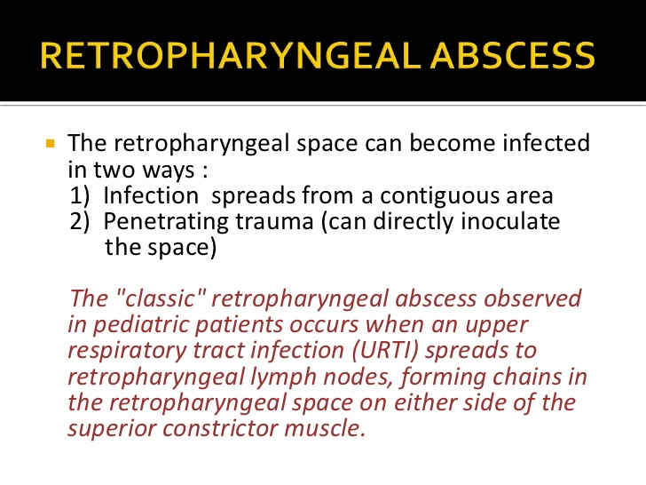

Slide 26
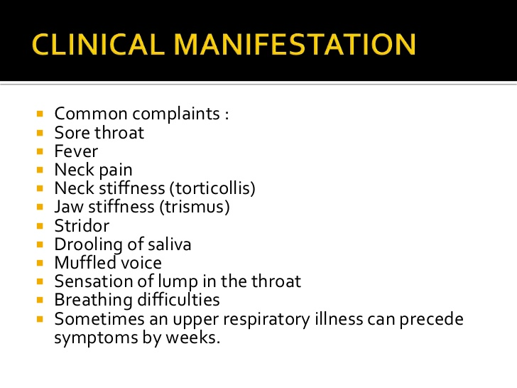

Slide 27
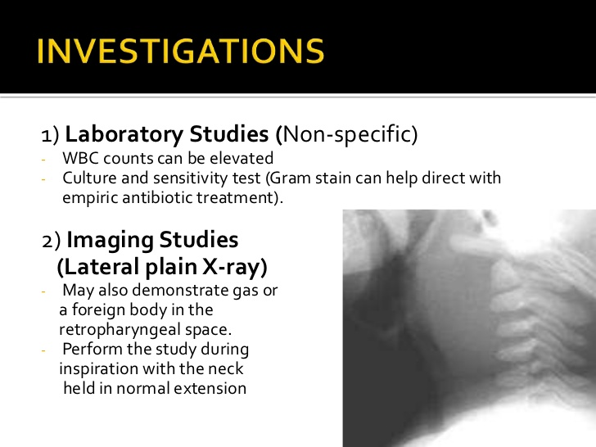

Slide 28
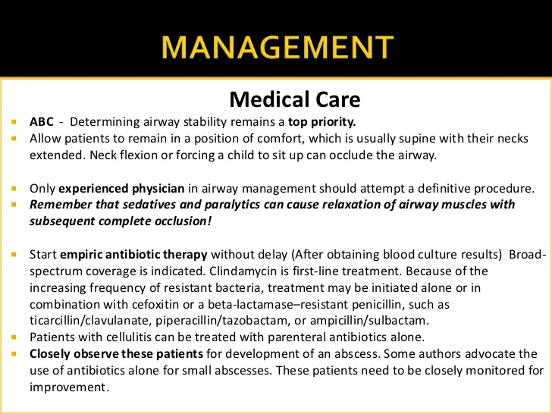

Slide 29
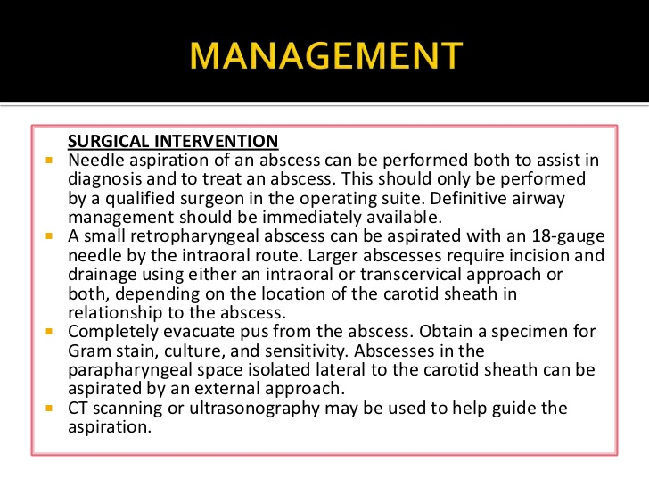

Slide 30
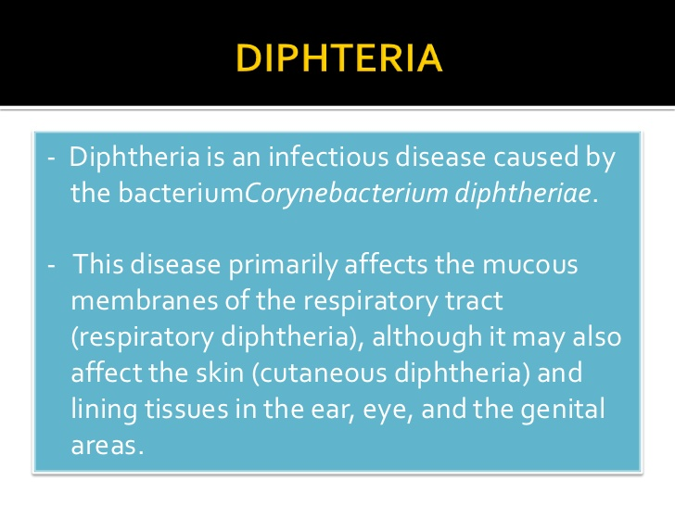

Slide 31
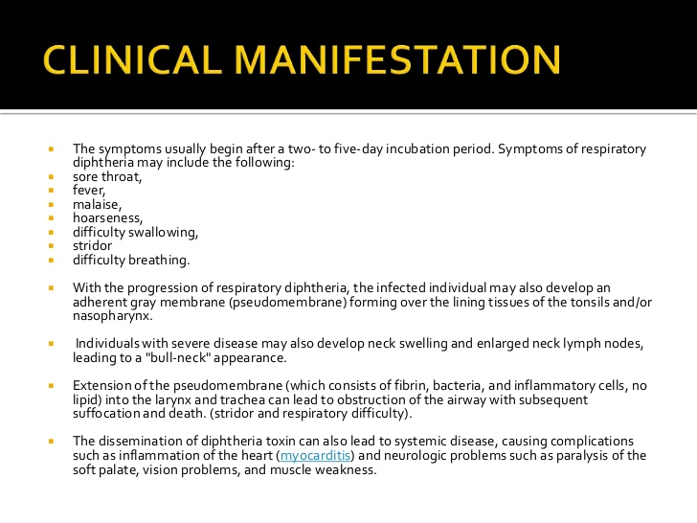

Slide 32
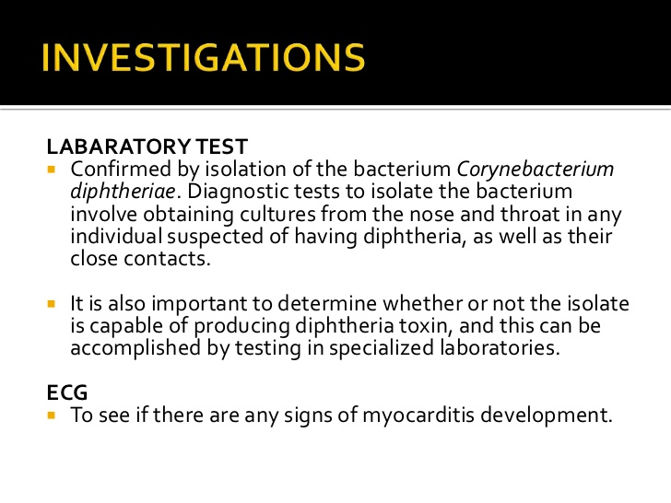

Slide 33
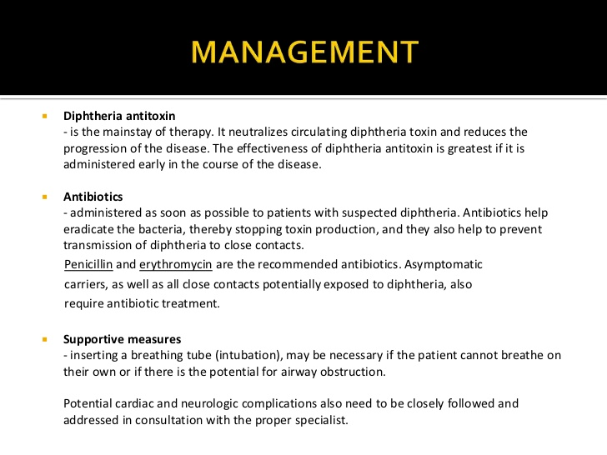

Slide 34
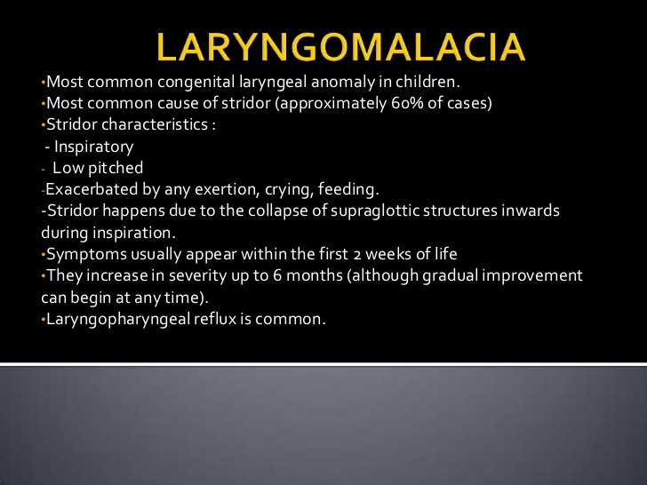
Laryngomalacia is common but it is important not to assign FTT to this without excluding other causes. (Medium level of evidence) Mancuso RF, Choi SS, Zalzal GH et al Laryngomalacia the search for the 2nd lesion. Arch. Of Otolaryngol. 1996; 122:302-6

Slide 35
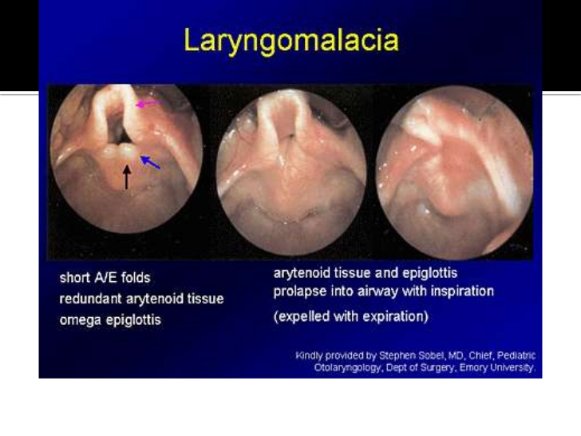

Slide 36
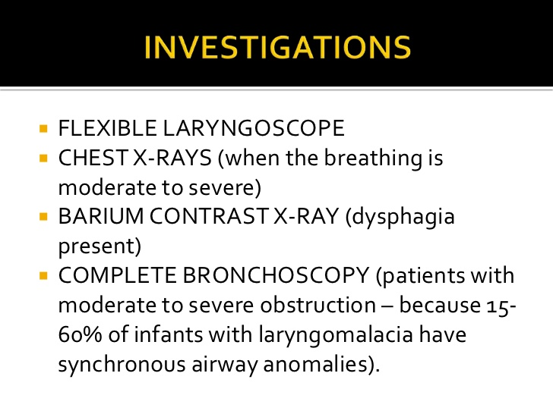

Slide 37
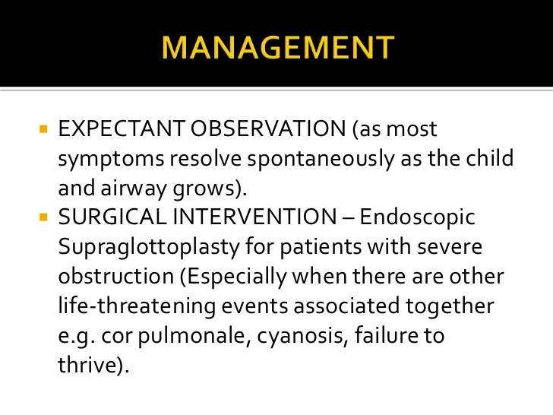

Slide 38
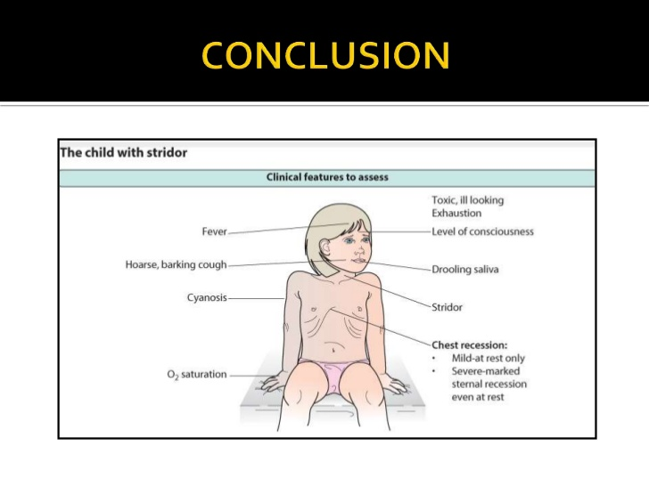

Slide 39
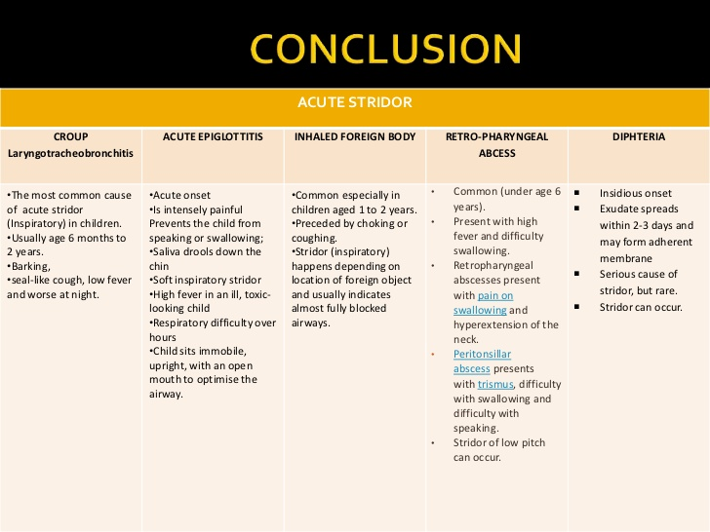

Slide 40
Best clinical practice
Rapid progression of airway obstruction typically occurs in acute infection and in foreign body inhalation. (medium to high level of evidence).
Improvement in stridor may paradoxically be due to worsening obstruction. (medium to high level of evidence).

Slide 41
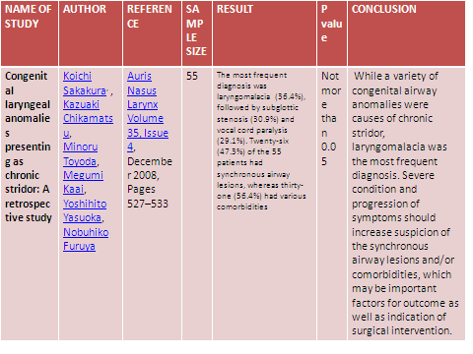

Slide 42
Q-1 stridor is caused by all except
Hypocalcemia
Asthma
Epiglottitis
Laryngeal tumour

Slide 43
Q-2 stridor in adults is most commonly caused by
Reinke oedema
Malignancy
Acute severe asthma
Toxic gas inhalation

Slide 44
Q-3 cause of congenital laryngeal stridor is
Laryngomalacia
Laryngeal papillomatosis
Subglottic papilloma
Haemangioma of larynx

Slide 45
Q-4 most common cause of stridor shortly after birth
Laryngeal papilloma
Laryngeal web
Laryngomalacia
Vocal cord palsy

Slide 46
Q-5 most common cause of stridor in children is
Laryngomalacia
Congenital laryngeal paralysis
Foreign body larynx
Congenital laryngeal tumours

Slide 47
