Slide 1
Left Heart Catheterization
Dr Cinosh Mathew, MD, DM, FACC
Professor & Interventional Cardiologist
SBKS MI & RC

Slide 2
Left Heart Catheterization
Left heart catheterization is advancing a catheter from the arterial access point to the left ventricle

Slide 3
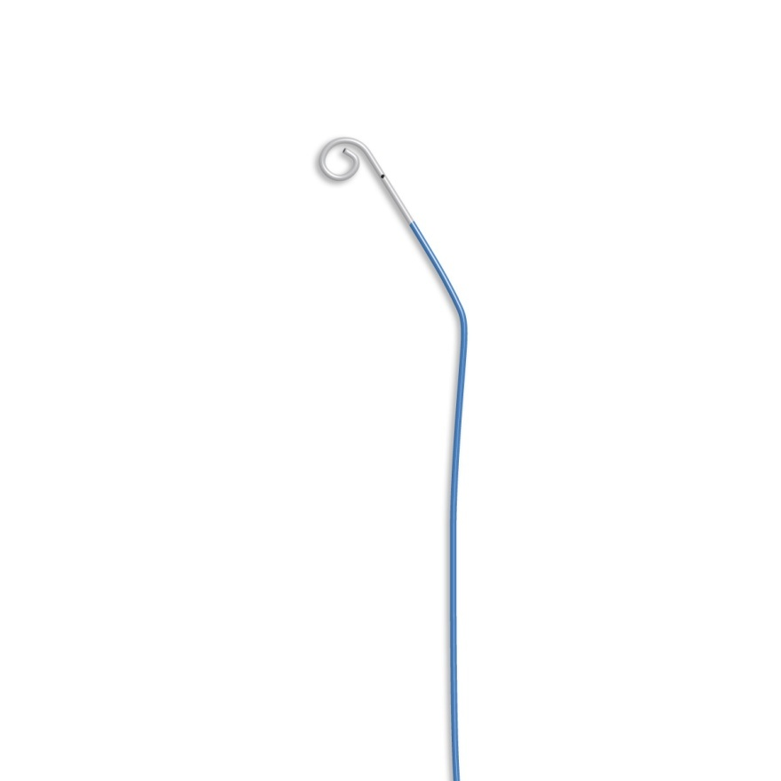
The typical catheter that will be used will be and 110 cm angled pigtail catheter

Slide 4
Left Heart Catheterization
From the femoral approach, the guidewire is left at the level of the aortic knob and the pigtail catheter advanced, allowing for exchange in the descending aorta
  This technique avoids the guidewire needing to traverse the great vessels and the rounded pigtail has less change of dislodging a plaque

Slide 5
Left Heart Catheterization
The catheter is advanced under pressure monitoring across the transverse aorta to the ascending aorta
  This technique allows the operator to screen for coarctation and this is why “Central Aortic Pressure” is not in the descending aorta

Slide 6
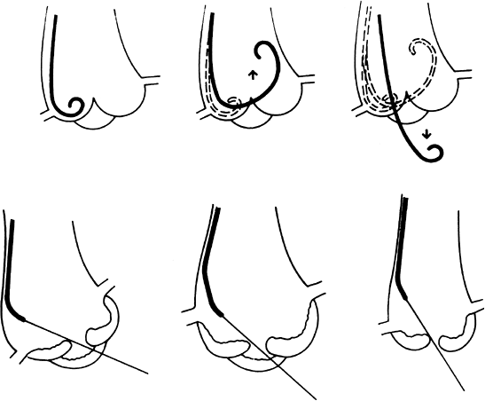
Left Heart Catheterization
If the aortic valve is normal and the pigtail is oriented correctly, it will usually cross the valve directly.
The aortic valve is crossed in the AP view
In many cases, however, it may be necessary to advance the pigtail down into one of the sinuses of Valsalva to form a secondary loop
Bioprosthetic valves can be crossed. Do not cross tilting disk valves

Slide 7
Left Heart Catheterization
If the aortic stenosis is present, an 0.38” straight tipped wire can be used to cross the valve with either AL-1, JR or pigtail catheters
Approximately 6 cm of wire is advanced beyond the catheter and then directed into the ventricle. The catheter is then directed over the wire
Care is taken to avoid perforating the ventricle and catheters aspirated and wires are wiped after every 3 minutes of attempts of crossing the valve

Slide 8
Left Heart Catheterization
After crossing into the ventricle, LV pressure tracing is recorded on 200 mm Hg scale
The paper speed is increased and the scale changed to 50 mm Hg, for measurement of LVEDP

Slide 9
Pigtail or End Hole Catheter
Do not perform left ventriculography using a power injector through an end hole catheter due to risk of intramyocardial injection and perforation
Do not use pigtail catheters for hemodynamic measurements involving outflow tract gradients or subaortic membranes as these catheters have 5 holes along the catheter and accurately localized pressure measurements cannot be obtained

Slide 10
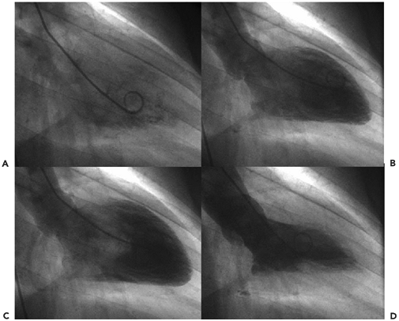
Left Heart Catheterization
Left ventriculography is performed in the RAO 30 degree projection
Use caution if LVEDP is substantially elevated
Confirm the catheter is not against the mitral valve apparatus or against the LV apex
A test injection is performed to assess the size of the ventricle
Standard injection volume is 30-36 cc at 10-12cc/sec
Pan up to aorta to get a look at CABG grafts

Slide 11
Left Heart Catheterization
Assessing wall motion
  Hyperdynamic (>70 %)
  Normal (50 to 69 %)
  Mildly hypokinetic (35 to 49%)
  Moderately hypokinetic (20 to 24%)
  Severely hypokinetic (<20%).
  Regional wall motion is graded qualitatively as normal, hypokinetic, akinetic, or dyskinetic for the segments seen in the RAO projection (anterolateral, apical, inferior, posterobasal)

Slide 12
Left Heart Catheterization
Calculate regurgitant volume
  Compare angiographic stroke volume (end-diastolic volume minus end-systolic volume) with the forward stroke volume (cardiac output divided by heart rate)
  Regurgitant fraction (the regurgitant volume, divided angiographic stroke volume
    Mild (1+) <30%,
    Moderate (2+) 30 to 39%,
    Moderately severe (3+) 40 to 49%
    Severe (4+) >50%

Slide 13
Left Heart Catheterization
Transducer is now ‘zeroed’ and pullback across the aortic valve is performed to screen for a tranventricular and/or transaortic systolic gradient
The catheter is exchanged over the wire in the descending aorta

