Slide 1
Restrictive vs. Constrictive Heart Disease
Dr Jayesh Rawal
Professor, Cardiology
SBKS MI RC

Slide 2
Restrictive cardiomyopathy
Disease of myocardium- Muscle disease
Represents an extreme form of Diastolic Dysfunction

Slide 3
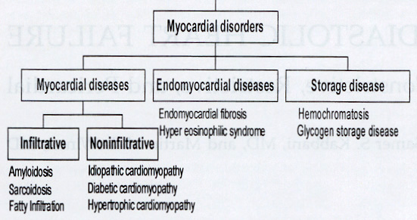
Restrictive Cardiomyopathy
Broad categories of diseases involved:

Slide 4
Chronic constrictive pericarditis
White described a “chronic fibrous or callous thickening of the wall of the pericardial sac that is so contracted that the normal diastolic filling of the heart is prevented . . . There may or may not be calcification . . . Parietal pericardium or epicardium may be preponderantly involved . . . one area may be involved, other areas free . . . Associated heart disease is extremely rare”

Slide 5
Why it is difficult to distinguish ?
Both these diseases have number of similar
Features.
Clinical presentation: Right heart failure > left side symptoms
Restrictive physiology – High E/A ratio, short DT, elevated filling pressure, square wave pattern
Preserved systolic function
Preserved ventricular size

Slide 6
Pathophysiologic Similarity of Restriction and Constriction
Abnormal increase in ventricular
pressure
impeding filling of the LV
Restriction
Constriction
Myocardial
Disorder
Pericardial
Disorder

Slide 7
Why it is important to distinguish?
Correct diagnosis has important therapeutic
implication.
RCM - Medical therapy/cardiac transplant
CCP - Surgery

Slide 8
 | CCP | RCM
Dissociation between intra thoracic and intracardiac pressures | Yes | No
Enhanced pericardial constrain- fixed total cardiac volume in late diastole | Yes | No
Enhanced diastolic interaction | Yes | No
Pulmonary artery hypertension | Mild | Mod - severe
Early ventricular filling | Rapid Normal early myocardial relaxation | Impaired
Late filling | impaired | Impaired

Slide 9
CCP vs. RCM
Hemodynamics of CCP
As compared to RCM, CCP has two important
hemodynamic characteristics.
Stiff noncompliant pericardium
Dissociation of intrathoracic pressure from intracardiac pressures.

Slide 10
Normal pericardium
Visceral pericardium - Single layer of mesothelial cells adherent to the epicardial surface of the heart
Fibrous parietal layer - about 2 mm thick, largely acellular and contains both collagen and elastin fibers
Collagen is the major structural component
Collagen appears as wavy bundles at low levels of stretch. With further stretch the bundles straighten, resulting in increased stiffness of the tissue.

Slide 11
Tensile properties of normal pericardium
The parietal pericardium has a tensile strength similar to rubber.
At low applied stresses --- Highly elastic- small forces result in large amounts of stretch.
As the stretch increase --- The tissue abruptly becomes stiff and resistant to further stretch .

Slide 12
Pressure-volume relation of the pericardial sac
This parallels the properties of the isolated tissue with relatively flat, compliant segment transitions relatively abruptly to a noncompliant segment

Slide 13
Pressure-volume relation of the pericardial sac
The point on the pericardial sac pressure volume curve where this transition occurs usually correspond to the upper range of normal total cardiac volume.

Slide 14
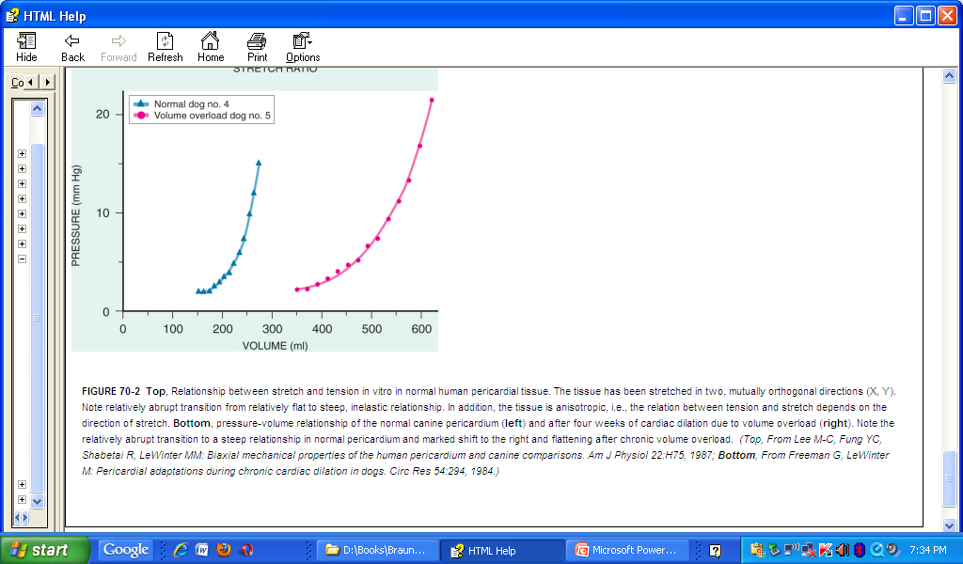
Transition point
Compliant segment
Noncompliant segment

Slide 15
Transition from compliant to non compliant segment
Acute cardiac dilatation
Accumulation of fluid in pericardial cavity
Stiff fibrosed pericardium – decrease in pericardial reserve volume – shift in curve to right.

Slide 16
Hemodynamic consequences
Enhanced pericardial constrain to ventricular filling – Increased filling pressure
Enhanced diastolic interaction – Tendency toward equalization of diastolic pressure in different cardiac chambers
Enhanced Ventricular interdependence – Fixed total cardiac volume → Reciprocal change in left and right ventricle volume with respiration.

Slide 17
Enhanced Ventricular interdependence
Total cardiac volume is fixed by the noncompliant pericardium. The septum is not involved and can therefore bulge toward the left ventricle when left ventricular volume is less than that on the right. As a result, ventricular interdependence is greatly enhanced.
In RCM, on the other hand, pericardial compliance is normal

Slide 18
Dissociation of Intrathoracic and Intracardiac Pressures
Effect of Inspiration
Under normal condition, Inspiratory decrease in intrathoracic pressure is uniformly transmitted to the lungs, PVs, LA, LV, RA, and RV

Slide 19
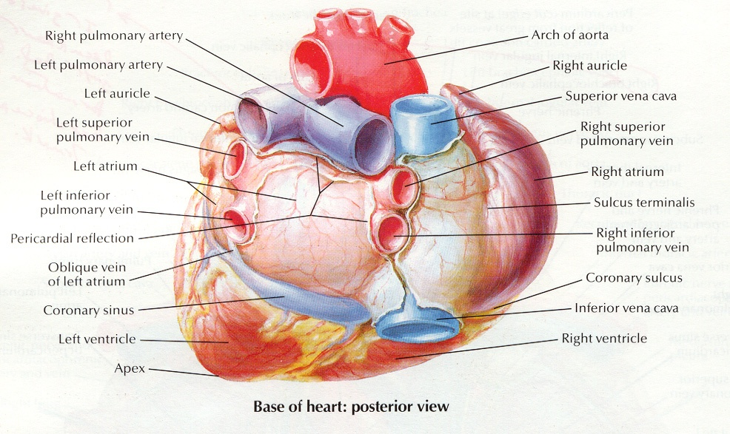
Anatomy
Lt. Atrium is not completely intrapericardial
All other cardiac chambers are completely intrapericardial
Pulmonary Veins are completely intrathoracic

Slide 20
Effect of Inspiration - CCP
Thickened pericardium isolates the heart form transmission of intrathoracic pressure changes
The decrease in intrathoracic pressure is not transmitted to the LV, RV, RA
Normal Inspiratory fall in pulmonary vein pressure and LA pressure

Slide 21
Dissociation of Intrathoracic and Intracardiac Pressures
First demonstrated to be present in CCP with Doppler techniques in 1989, by Hatle in her landmark study.
Circ. 1989;79357-370

Slide 22
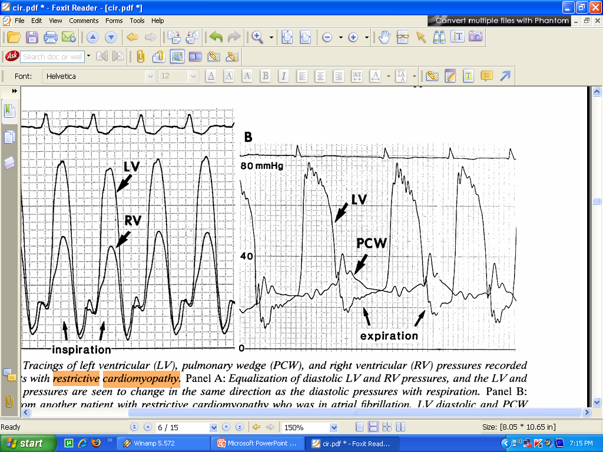
Normal individual/RCM
LV diastolic and PCW pressures show a similar degree of change with respiration so that the early diastolic PCW-LV gradient remains nearly constant.

Slide 23
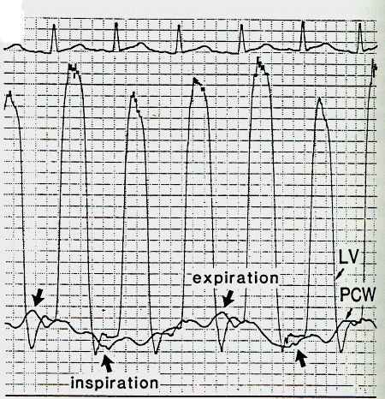
CCP
Respiratory variation in PCW pressure is larger than the respiratory variation in LV diastolic pressure, resulting in a decrease in early diastolic PCW-L V pressure difference at the onset of inspiration and increased difference at the onset of expiration .

Slide 24
So in CCP
With inspiration
PCW pressure decrease
Relatively less fall in LV diastolic pressure
Decrease PCW – LV gradient
Decreased LV filling
Decrease in LV volume, LVSP, filling velocities

Slide 25
A lower left ventricular filling pressure gradient with constrictive pericarditis also leads to a delay in mitral valve opening and therefore a longer isovolumic relaxation time during inspiration.
Prolonged isovolumic relaxation of the left ventricle is a feature of both conditions. This finding varies with respiration in constrictive pericarditis but not restrictive cardiomyopathy

Slide 26
So in CCP with inspiration
Due to enhanced ventricular interaction, since the septum can move normally, there is greater filling of the right ventricle and the right ventricular systolic pressure will rise
Reversal of sequence in expiration

Slide 27
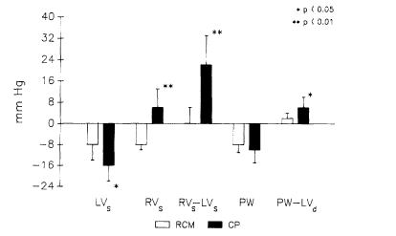

Slide 28
Stiff non compliant pericardium
Dissociation of intrathoracic pressure from intracardiac pressures.
Results in
Exaggerated ventricular Interdependence
Increased pericardial constrain to ventricular filling in late diastole
Increased diastolic interventricular interaction

Slide 29
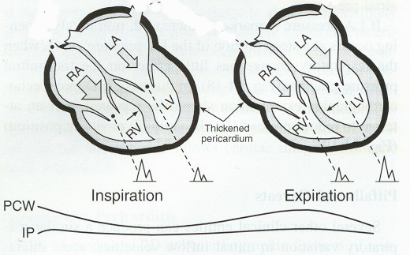

Slide 30
Exaggerated ventricular interdependence
Clinical evidence - Pulsus paradoxus
Cardiac cath - Reciprocal change in RV and LV systolic and diastolic pressures with respiration
M mode ECHO - LV size, septal position with respiration
Doppler assessment – MV, TV , PV and hepatic vein velocity pattern

Slide 31
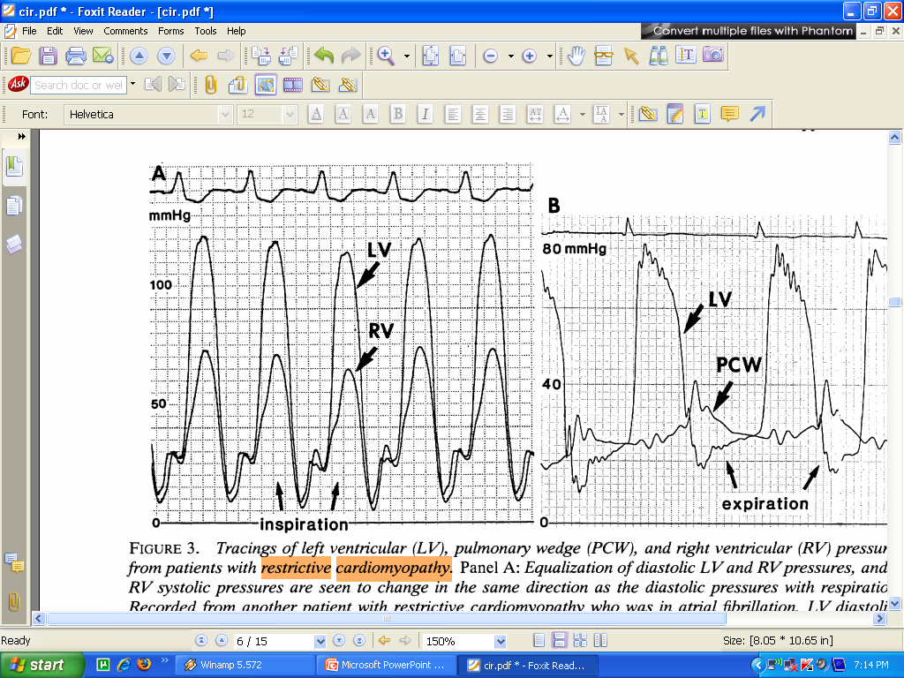
Ventricular interdependence cardiac cath
Normal individual and in RCM
Concordant change
LV and RV systolic pressures are seen to change in the same direction with respiration.

Slide 32
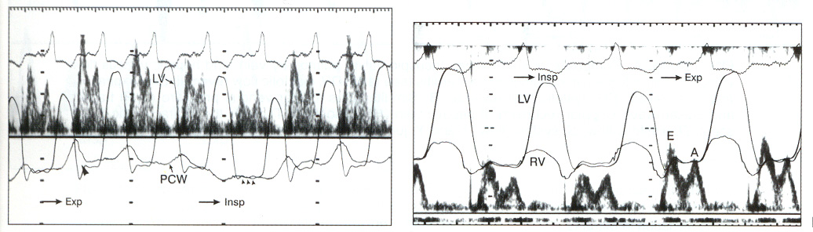
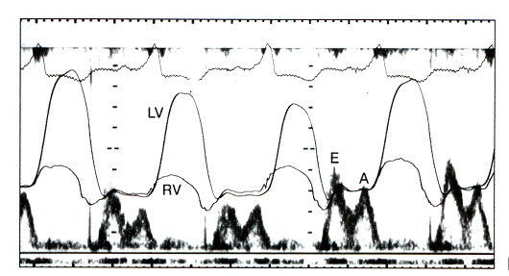
Effect of Inspiration: Constriction
Inspir.
Expir.
Insp.
Expir.
PCWP
PCWP
Inspir.
Expir.
PCWP decrease
No proportionate decrease in LV diastolic pressure
Decreased transmitral gradient => Transmitral flow
LV SV
RVSV

Slide 33
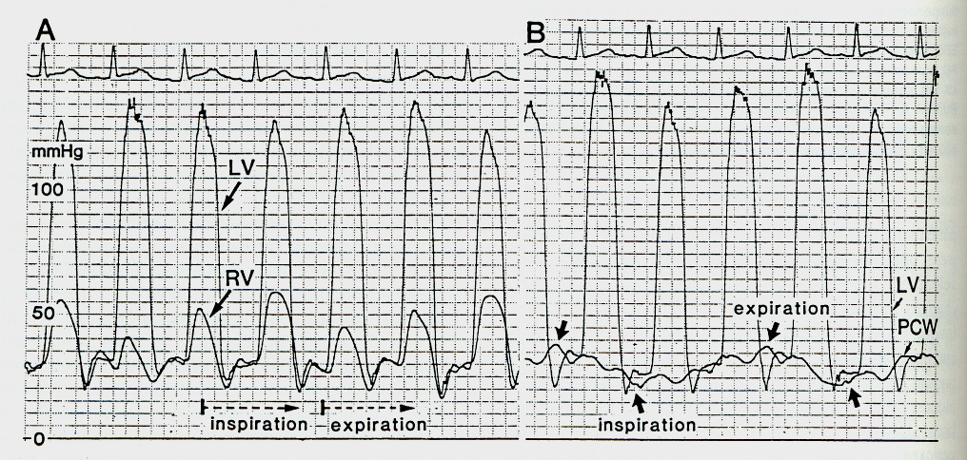
Ventricular Interdependence
CCP
Hatle LK, et. al.
Circ. 1989;79357-370
Ventricular Pressures
Are DISCORDANT
Insp
Expir
RV systolic pressure increases with inspiration while LV systolic pressure is decreasing. Opposite changes are seen during expiration

Slide 34
Ventricular interdependence
These measurements are only possible using
High-fidelity micro manometer systems (not a
common practice)

Slide 35
Ventricular interdependence
Use of a novel "systolic area index" ratio (right ventricular to left ventricular systolic pressure-time area during inspiration versus expiration) that estimated enhanced ventricular interdependence had a sensitivity of 97 percent and a predictive accuracy of 100 percent for the identification of patients with surgically documented constrictive pericarditis

Slide 36
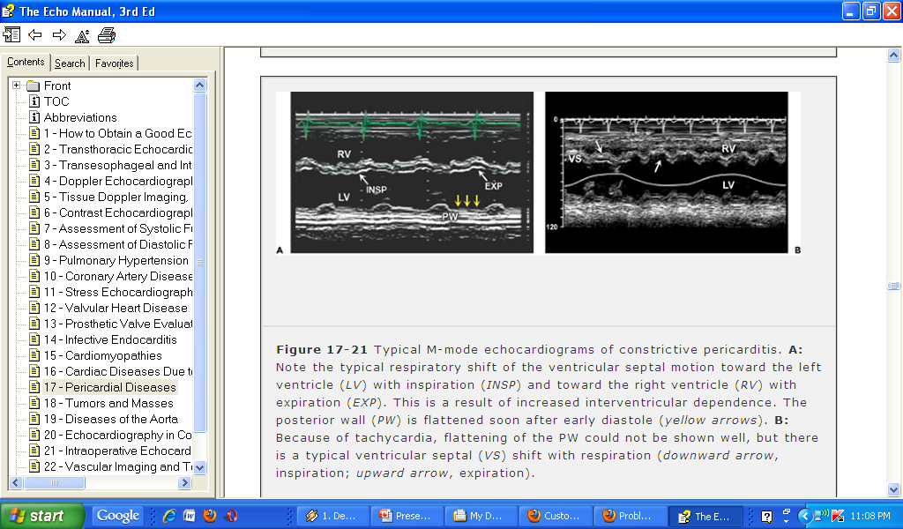
Ventricular interdependence
M Mode evaluation

Slide 37
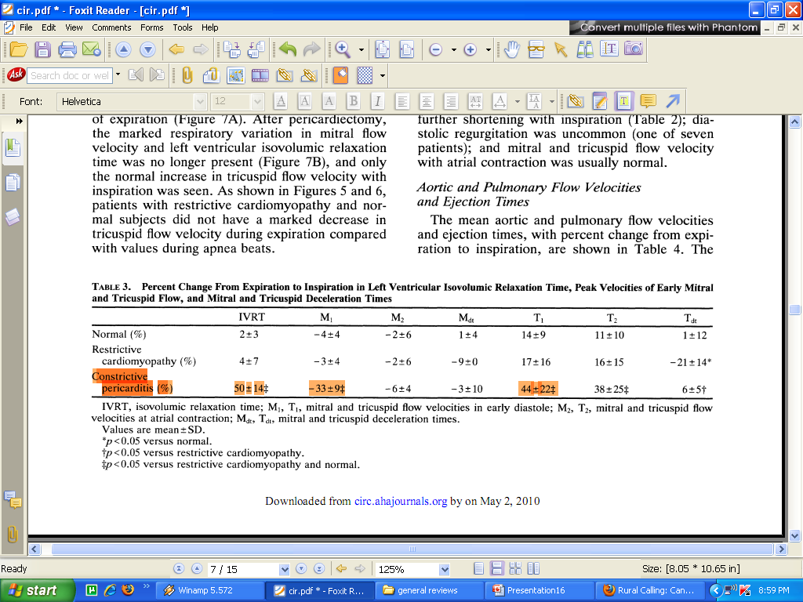
Ventricular interdependence
Doppler assessment
NO significant respiratory variation in RCM

Slide 38
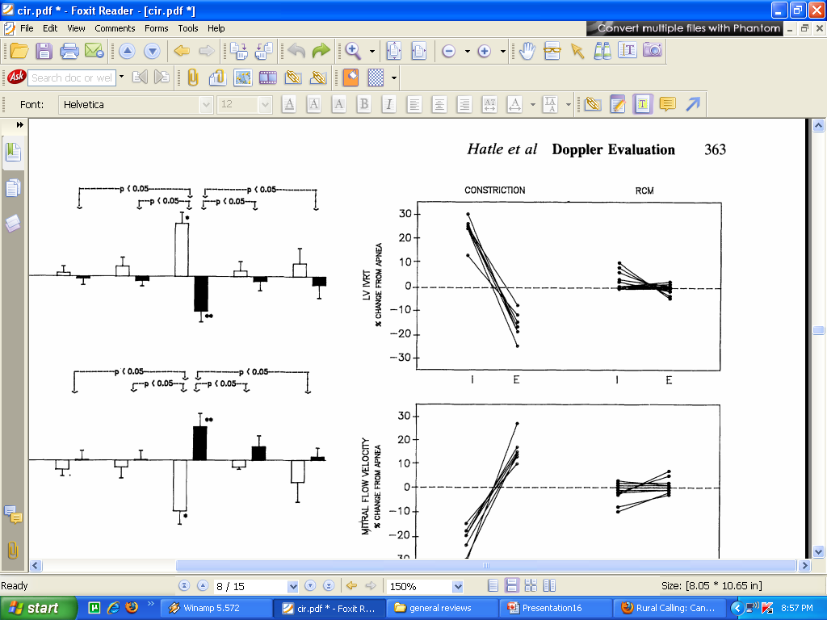
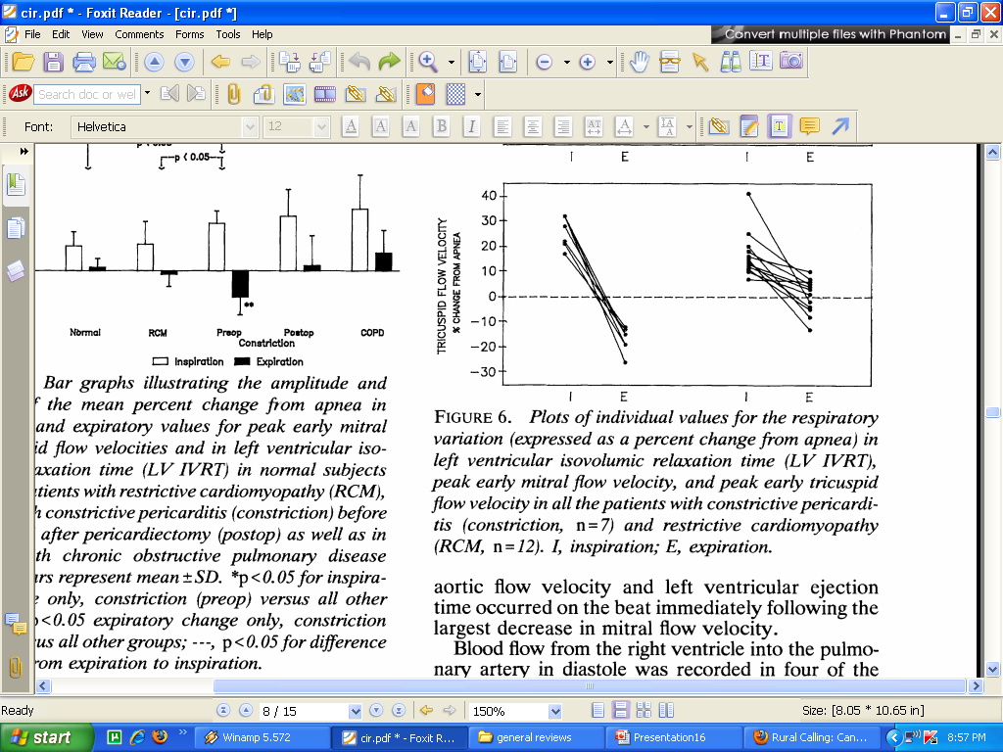

Slide 39
Doppler assessment
Parameters
Mitral valve E velocity
LV isovolumetric relaxation time
Pulmonary vein inflow velocity
Hepatic vein velocity
Tricuspid inflow velocity

Slide 40
Ventricular interdependence
Doppler assessment
RCM and normal subjects - Minimal respiratory variation (mean < 5%), with no individual showing a greater than 15%
CCP - Marked respiratory variation (mean >30%), no individuals showed less than 25% difference in MV inflow velocity and IVRT

Slide 41
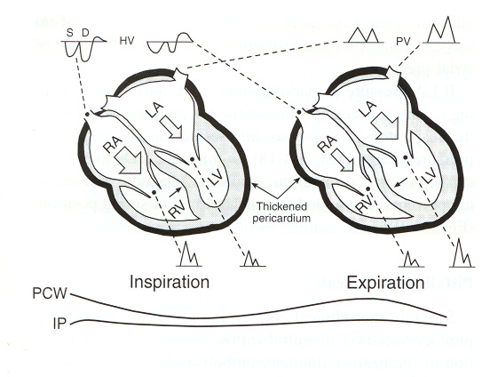
Constriction Doppler
Inspiration
Expiration

Slide 42
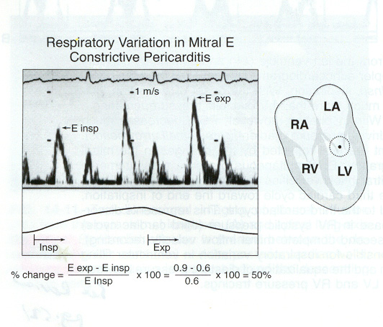
Mitral E wave
Criteria for Constriction
First beat after the onset of inspiration and expiration should be used for calculation

Slide 43
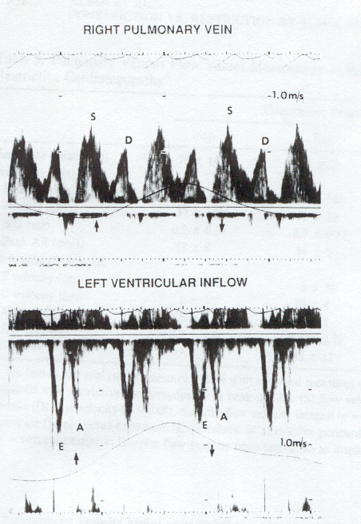
Normal pulmonary vein Flow-TEE
Rt. Upper PV
NO Variation from Inspiration to
Expiration
PV interrogation using TTE is often technically limited.
LV inflow
PVs are best assessed using TEE
Notes:
Kline-1937

Slide 44
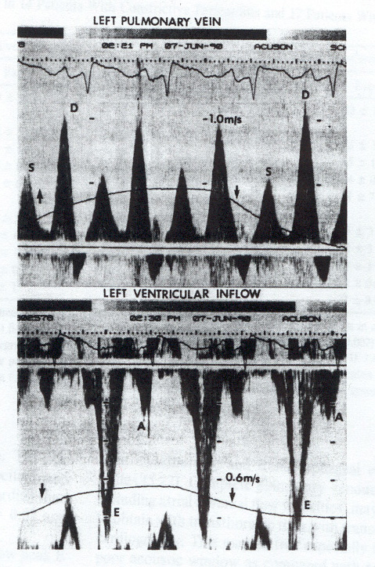
PV Doppler Patterns in Restriction-TEE
Lt. Upper PV
PV flow is not respirophasic
Systolic/Diastolic velocity is
markedly down in both inspiration
and expiration
LV Inflow
LV inflow Peak-E velocity is
not respirophasic
Notes:
Kline 1939, 1993JACC

Slide 45
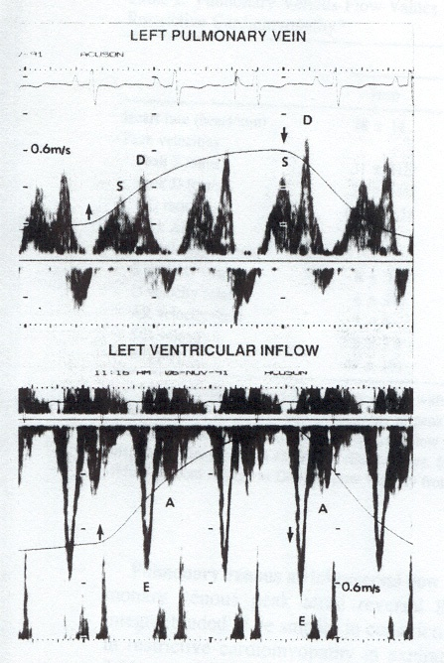
PV Dopplar Patterns in Constriction-TEE
Lt. Upper PV
PV flow IS Respirophasic:
> 25% variation of both the
Systolic and Diastolic components
Systolic/Diastolic
Ratio higher than for restriction
(0.7 v.s. 0.4)
LV Inflow
LV inflow Peak-E:
17% respiratory variation
(v.s. none for restriction)

Slide 46
Respiratory Cycle :Hepatic Vein Flow
IVC
Inspiration
Expiration

Slide 47
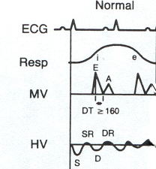
Hepatic Vein Doppler: Normal
Normal
Systolic and diastolic forward flow
S-vel. > D-vel.
Diastolic flow reversal
Expir.>>Insp.

Slide 48
Hepatic venous flow
In patients with CCP, there will be a reversal of forward flow during expiration, since the right ventricle becomes less compliant as the left ventricle fills more.
In contrast, reversal of hepatic vein flow occurs during inspiration in RCM

Slide 49

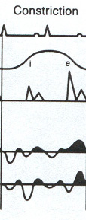
Hepatic Vein Doppler: Constriction
Constriction
Diastolic flow reversal is
augmented in expiration.
  DFR_{exp.}>25% forward
  diastolic velocity

Slide 50
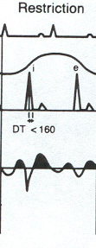
Hepatic Vein Dopplar: Restriction
Restriction
Forward flow primarily in
Diastole.
Inspiration increases both
systolic and diastolic flow reversals.

Slide 51
CCP – lack of respiratory variation
12% did not exhibit the characteristic respiratory variation
Although some studies have suggested that respiratory variation can be assessed in patients with atrial fibrillation the presence of highly variable R- R intervals makes the diagnosis of constrictive pericarditis difficult.

Slide 52
Two possible explanations
Combination of restrictive cardiomyopathy and constrictive pericarditis.
Ventricular filling velocity is highly influenced by preload- In a markedly elevated LA pressures - the normal Inspiratory intrathoracic pressure decline ( 5 mm Hg) may not produce significant variation in mitral inflow velocities

Slide 53
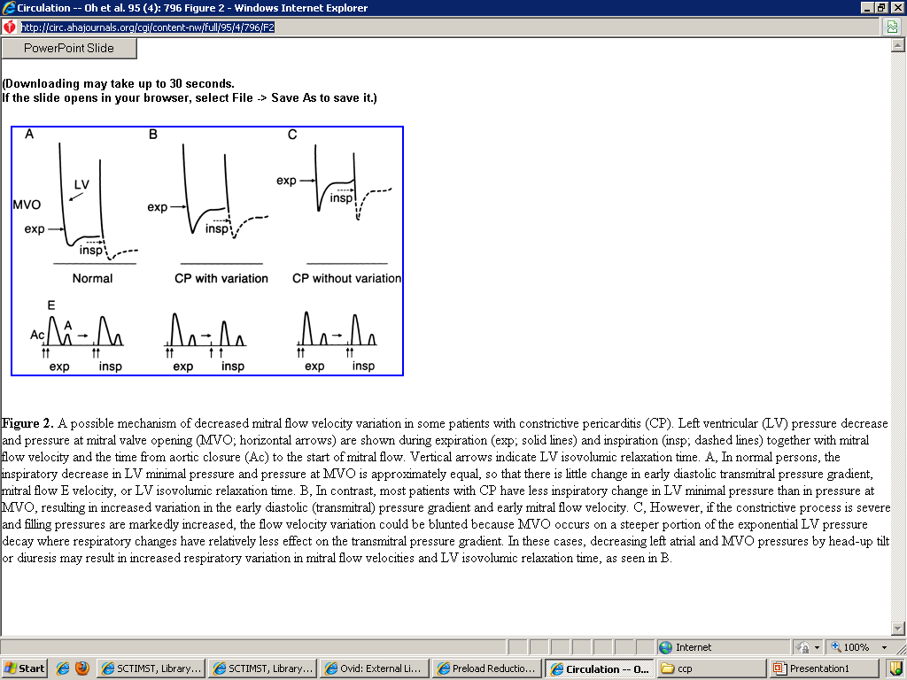

Slide 54
CCP without respiratory variation
Preload reduction may unmask the respiratory variation
Head-up tilt, upright position, or diuresis may be used

Slide 55
CCP without respiratory variation
12 patients with < 25% respiratory variation in mitral E velocity (confirmed CCP)
Mean percent respiratory change in E velocity was 5 ± 7% at baseline and 32 ± 28% with preload reduction.
Eight (75%) of the 12 patients developed respiratory variation of >25%.

Slide 56
Late mitral inflow velocity (MV a)
In late diastole, blood can transfer easily from atrium to ventricle because no change in total cardiac volume occurs.
In RCM, resistance to filling progressively increase throughout diastole
Although the E/A ratio is more than 1 in both conditions, a wave amplitude is better preserved in CCP ( >2 in RCM)

Slide 57
Diastolic interaction
The elevated intrapericardial pressure tends to be equally distributed to all the four cardiac chambers during late diastole
Tendency towards diastolic equalization of pressures
Diastolic equalization may not be present in patients with constriction due to diuresis and a low volume state
In such patients, fluid loading at the time of cath may be necessary to attempt to confirm the diagnosis of CCP

Slide 58
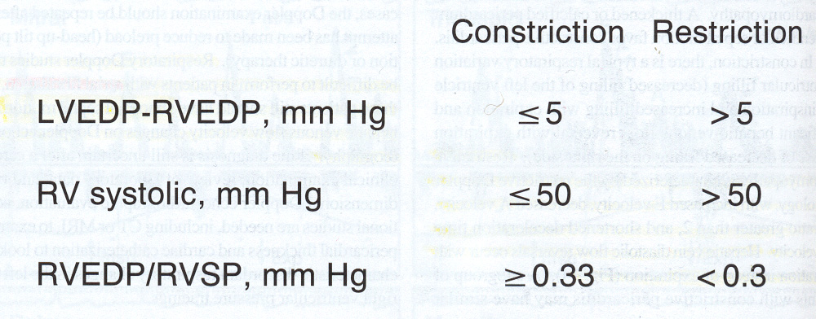
Traditional Hemodynamic Criteria

Slide 59
However, equilibration of diastolic pressures can occurs in some patients who have heart failure or an acute volume overload
Pericardial restraint from a dilated heart may cause hemodynamics simulating CCP.
RV dilation after RV MI or severe TR, and in acute MR may cause similar hemodynamics
A LV pressure exceeding that in the right ventricle by ≥5 mmHg may favor a diagnosis of RCM
However, neither of these findings carries enough specificity for either diagnosis

Slide 60
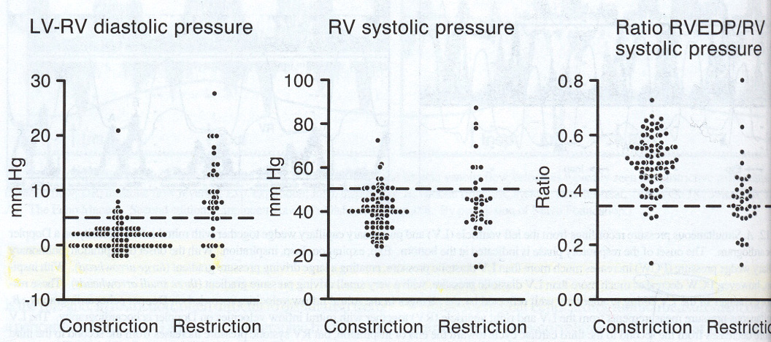
Traditional Hemodynamic Criteria
A significant number of patients with RCM have similar findings

Slide 61
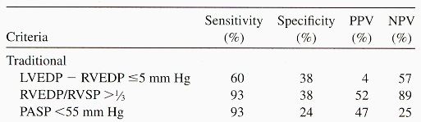
Traditional hemodynamic criteria
Limited utility
Circ. 1996; 93:2007-2013

Slide 62
Pericardial constrain during late diastole
Results in increased ventricular filling pressure
However as compared to RCM, early ventricular filling is well preserved in CCP – Normal myocardial relaxation
Rapid filling of ventricle occur in both the conditions ( MV E >>A)

Slide 63
Pericardial constrain during late diastole – Rapid early filling
Dip and plateau —(Also called the square root sign) during diastole
Although some disagree, most authors believe that the same dip and plateau waveform characterizes restrictive cardiomyopathy.

Slide 64
 | CCP | RCM
Restricted ventricular filling | Yes | yes
Early ventricular filling | Rapid Normal early myocardial relaxation | Impaired
Late filling | impaired | Impaired
Dissociatoion between intra thoracic and intracardiac pressures | Yes | No
Pericardial constrain- fixed total cardiac volume | yes | No
Exga ventricular interdependence | Yes | No
Diastolic ventricular interaction | Yes | NO

Slide 65
Pathophysiologic Differences
Constriction
Myocardial relaxation is normal
No impedance to Diastolic EARLY FILLING
Restriction
Impedance to filling increases
throughout the diastole
.
Early myocardial relaxation is assessed by MV annular velocity

Slide 66
Mitral annulus diastolic velocity
MV E – Depend on active myocardial relaxation
In cardiomyopathies E velocity progressively decrease with increasing severity of disease
In CCP this is either normal or increased

Slide 67
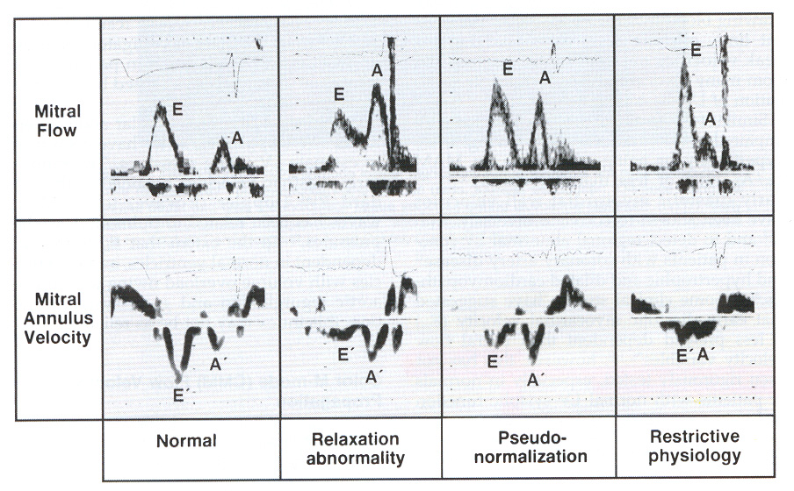
Tissue Doppler PW Analysis of Mitral Annular Motion
Physiologic Premise:
Assessment of VELOCITY of LV
  -Contraction, and
  -Relaxation
In RCM E velocity progressively decrease

Slide 68
Mitral valve annulus PW doppler
CCP vs. RCM
In CCP lateral expansion of the heart is impaired
Most of ventricular filling is accomplished by an exaggerated longitudinal motion of LV
Longitudinal motion and hence the MV septal annulus velocity, increases more as the constriction worsens with higher filling pressure, paradoxical to its change in myocardial disease.
This phenomenon has been termed annulus paradoxus

Slide 69
Therefore in CCP E/E’ is inversely proportional to the PCW pressure, but in RCM, E/E’ is directly proportional to wedge pressure
A MV E’ velocity of more than 7 cm/s, in the presence of restrictive filling pattern is highly suggestive of CCP

Slide 70
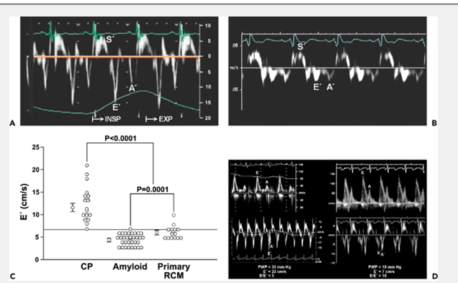

Slide 71
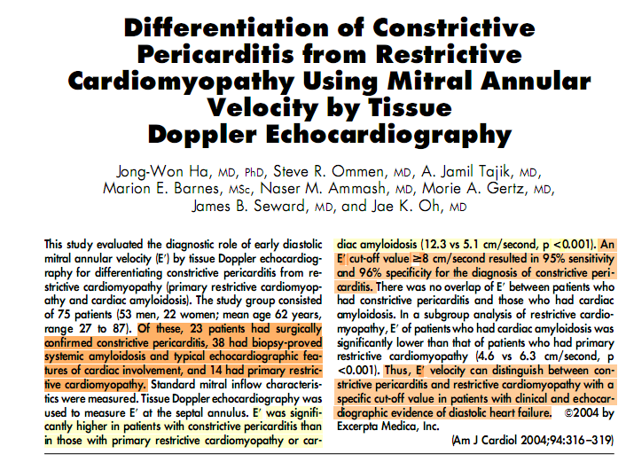

Slide 72
Tissue Doppler:
Restriction and Constriction
Mitral inflow E wave is elevated in both
Annular E wave
  Restriction, peak E-wave < 8 cm/sec
  Constriction, Peak E-wave > 8 cm/sec
  A cut-off value >8 cm/second resulted in 95% sensitivity and 96% speciﬁcity for the diagnosis of CCP
    Annular E wave is preload independent.

Slide 73
Color M mode doppler
Color M-mode Slow flow propagation in RCM and rapid flow propagation (100 cm/s) in CCP
This parameter is independent of preload and heart rate
Sensitive Indicator of early myocardial relaxation

Slide 74
Pulmonary artery hypertension
CCP -- Usually mild
RCM -- Mod - severe

Slide 75
Traditional Hemodynamic Criteria

Slide 76
Role of BNP
Released by ventricular myocyte in response to wall stretch.
Plasma BNP levels in both systolic or diastolic dysfunction
In constrictive pericarditis (CP) the myocardium is intrinsically normal, and myocardial stretch is prevented by the constraining pericardium.

Slide 77
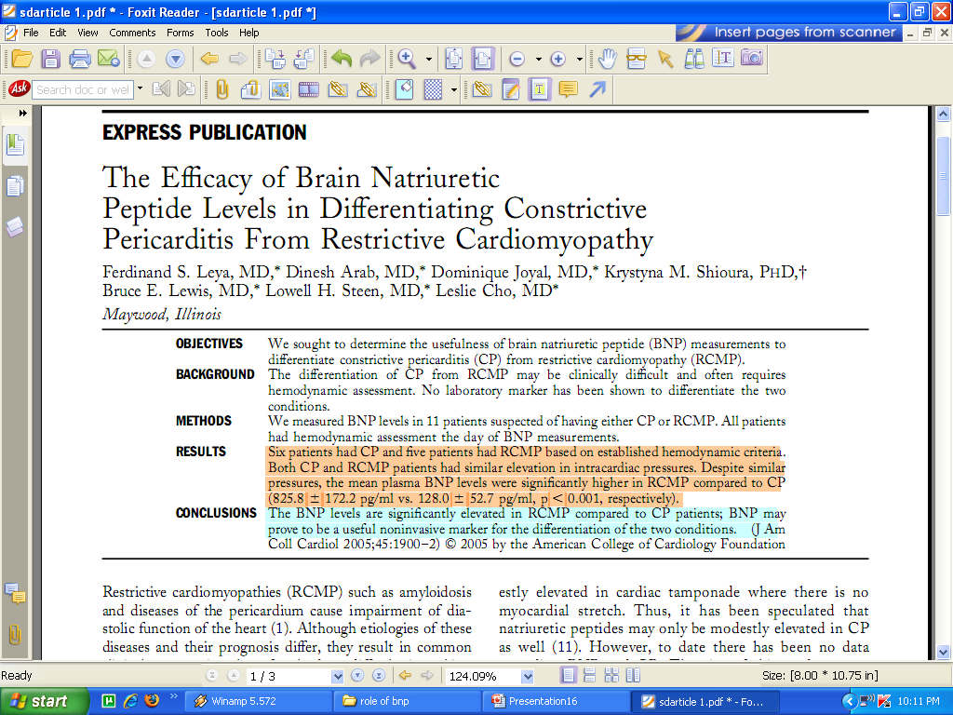
No signiﬁcant difference in the mean RAP, PAP, LAP, PCWP, and LVEDP between the two groups
The mean plasma BNP levels were signiﬁcantly higher in RCMP compared to CP (825.8 pg/ml vs. 128.0 52.7 pg/ml, p 0.001)
BNP was grossly elevated in patients with restriction while it is nearly normal in those with constriction despite nearly identical clinical and hemodynamic presentation

Slide 78
BNP
However in another study, moderate elevations in plasma BNP were also noted in patients with constrictive pericarditis due to overt etiologies (e.g. cardiac surgery or mantle radiation)
A plasma BNP measurement is advised early in the evaluation because a low or normal plasma BNP may help to exclude RCM

Slide 79
Past history
Past H/O acute pericarditis, cardiac surgery, radiotherapy, connective tissue disease, and thoracic trauma strongly favors CCP
H/O infiltrative disease (e.g. amyloidosis or sarcoidosis) favors restrictive cardiomyopathy.
Prior radiation therapy can result in both pericardial restriction and/or RCM
However many cases of CCP and RCM are idiopathic

Slide 80
JVP
The mean jugular venous pressure is usually markedly elevated in both conditions.
Usually it is not possible to distinguish between CCP and RCM based on JVP alone
Both diseases are characterized by dominant deep, steep Y descent

Slide 81
JVP
JVP in CCP has typically two dips per cardiac cycle: the outward movements are less conspicuous.
These features are also common in restrictive cardiomyopathy
Kussmaul's sign can be positive in any severe right failure condition

Slide 82
JVP
CCP – The brief duration of Y descent gives a “flicking” appearance in an otherwise continuously distended vein (Friedreich’s sign, considered by Paul Wood to be the most characteristic physical sign of CCP)
Sub acute (elastic) cases are more likely to have comparable X and Y dips, giving a “W” or “M” contour.
Outward pulsation are more prominent in RCM - caused either by large A wave or V wave due to TR

Slide 83
Paradoxical pulse
Usually absent or minimal in the classic chronic (rigid shell) constrictive pericarditis
More common with sub acute (elastic) cases
May occur with or without the presence of some pericardial effusion
Respiratory variation in RCM is rarely enough to raise a suspicion of CCP

Slide 84
 | CCP | RCM
Early diastolic sound | Pericardial knock 0.06–0.12 s after S2 High pitched and “snapping” in character | S3 Especially when TR or MR is prominent 0.12–0.18 s after S2 Thudding, low pitched character
Late diastolic sound | S4 does not occur in constrictive pericarditis. | S4 may be present.
Diastolic sounds

Slide 85
AV valve regurgitation
Mitral and tricuspid regurgitation are rarely prominent in constrictive pericarditis, but are often prominent in restrictive cardiomyopathy

Slide 86
ECG
P wave
Atrial abnormality less common with CCP
Probably because of the external compression by the pericardium, The raised atrial pressure causes less stretch of atrial myofibrils in CCP than in RCM
Presence of severe TR and MR in RCM

Slide 87
ECG – Conduction blocks
Both atioventricular and intraventricular, are more often features of RCM
20–30% of patients with RCM have bundle branch block but is rare in CCP

Slide 88
ECG -Low voltage ECG
Not critically helpful
Less common in RCM, but can occur in cardiac amyloidosis.
Dissociation between wall thickness and ECG voltage --important factor favoring RCM
Q wave – common with amyloidosis, but can occur in CCP, probably because of fibrosis invading the myocardium

Slide 89
CXR
Pericardial calcification
Mild cardiomegaly on chest X-ray is common in both conditions, but more prominent in restrictive cardiomyopathy.
It is due to atrial rather than ventricular enlargement

Slide 90
Pericardial calcification
Highly specific for CCP
Poor sensitivity -occurs in approximately 25% of cases
Calcification is usually absent in sub acute constrictive pericarditis, and is therefore less frequent overall than it was in the past
Electron beam CT and cine fluoroscopy are more sensitive modalities for calcification

Slide 91
Septal notch
Rapid filling of ventricle in early diastole is associated with rapid change of ventricular pressures
Slight asymmetry of RV and LV filling rate can result in rapid changes in the pressure differential between the two sides of the ventricular septum
This results in rapid shift of septal position very abruptly.

Slide 92
Atrial enlargement
Major enlargement of RA and LA is a hallmark of RCM
CCP- some enlargement of the atria often occurs, but rare to see the major enlargement
Presence of the constricting process around the atria and lack of significant MR /TR appears to account for this difference

Slide 93
Pericardial thickening
Specific for CCP
Rarely can be seen with amyloidosis.
Pericardial thickness exceeding 3 to 5 mm is highly suggestive of CCP.
However, constriction can also be caused by a thin tight peel of visceral pericardium.
Thus, a normal appearing parietal pericardium does not rule out constrictive pericarditis.

Slide 94
Pericardial thickening
TTE – Limited resolution- less sensitive and specific
TEE , CT and MRI have better specificity
A series of 11 patients with CCP pericarditis found an excellent correlation (r≥0.95) between measurement of pericardial thickness with TEE and that obtained by CT imaging

Slide 95
Constrictive Pericarditis Normal Pericardial Thickness
Out of total 143 patients with proven constriction undergoing pericardiectomy ,18%; had normal pericardial thickness
No difference in symptoms , physical findings or hemodynamic data
No patient had normal pericardium on histopathological, however changes were milder and focal in group without pericardial thickening
Pericardiectomy was equally effective irrespective of pericardial thickening

Slide 96
CT and MRI
Improved evaluation of pericardial thickening
Most cases of CCP do indeed show pericardial thickness of 3 mm or more, at least in some areas.
The thickening may be focal or uniform around the entire heart.

Slide 97
CT and MRI
False negative - Normal pericardium is less than 2.0 mm thick; and even a considerable increase may not exceed the threshold of abnormality in a CT or MRI
False positive - Finding of thickened pericardium does not necessarily indicate that constriction is present.

Slide 98
Endomyocardial biopsy
High specificity for certain infiltrative cardiomyopathies- amyloidosis, haemochromatosis and eosinophilic cardiomyopathy
Idiopathic RCM - Only non-specific abnormalities
Similar non specific abnormalities also seen in uncomplicated CCP
Biopsy is therefore helpful chiefly to rule out specific infiltrative diseases

Slide 99
Exploratory thoracotomy
Exploratory thoracotomy may be needed very rarely if ever in the current era.

Slide 100
Conclusion
The major pitfall in making accurate diagnosis is to expect that only one or two diagnostic methods can be regularly decisive.
The apparent urge to rely on one or two methods, to the relative neglect of other methods, may be a disadvantage and cause error.
Hence, a broad clinical viewpoint, in which the results of many diagnostic methods are synthesized, is necessary to achieve the optimal differential diagnosis

