Slide 1
IMMUNOPATHOGENESIS
AND IMMUNOTHERAPY
OF MULTIPLE SCLEROSIS
Dr. C. Rathore

Slide 2
IMMUNOPATHOGENESIS OF MULTIPLE SCLEROSIS
NEW INSIGHT

Slide 3
INTRODUCTION
  Multiple sclerosis (MS) is a chronic, mostly progressive, inflammatory, demyelinating, and neurodegenerative disorder of the CNS
  Exact role of each – still elusive
Genetic
factors
Environmental
factors
Immunological
factors
MS

Slide 4
Clinical disability seen in patients with early stages of MS - CNS axonal demyelination and inflammation.
The transient nature of neurologic signs and symptoms in patients with RRMS - resolving inflammation, remyelination of axons, and the relative plasticity of the CNS
Peterson LK, Fujinami RS. Inflammation, demyelination, neurodegeneration and neuroprotection in the pathogenesis of multiple sclerosis. J Neuroimmunol 2007;184(1-2):37-44

Slide 5
Once compensatory mechanisms are no longer effective, axonal and neuronal degeneration defines the advanced disease
For unknown reasons, the capacity to rebound from acute attacks diminishes with disease duration and age
Frohman EM, Racke MK, Raine CS. Multiple sclerosis: the plaque and its pathogenesis. N Engl J Med 2006;354(9):942-955.

Slide 6
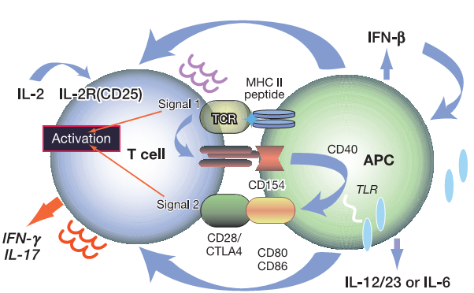
Role of antigen presenting cells
Pattern recognition molecules, called Toll like receptor (TLR) are found on the surface of APCs and identify very specific microbial ligands when activated.

Slide 7
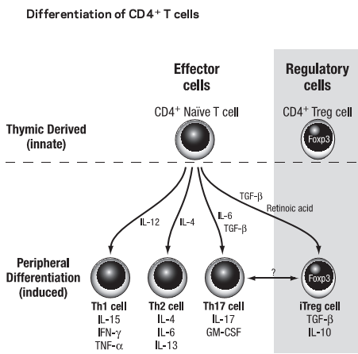
ROLE OF CELL MEDIATED IMMUNITY
T HELPER CELL SUBTYPES
Th1 CD4 + cells - IFNγ, TNF α, IL-2, and nitric oxide.
TH2 CD4 + cells- IL-4, IL-5, IL-6, IL-10, IL-13, and transfTGF
TH17 cells- proinflammatory IL-17.
lack of a clear distinct TH1-TH2 dichotomy in the human system- significant overlap

Slide 8
MS Disease Pathology
Circulation
Rolling
Adhesion
Extravasation
B L O O D F L O W
B cell
Activated T cell
LUMEN OF
VENULE
α4 Integrin
Proteases
VCAM
B A S A L L A M I N A
astrocytes
BRAIN
TISSUE
Cytokines and
chemokines
IL-1, IL-12,
chemokines
Antigen presenting cell
(Astrocyte or Microglial cell)
Activated microglia/macrophages
T CELL REACTIVATION
Activated
Macrophage
Proteases
TNF-α
O₂^{•-}
AXONAL
DAMAGE
Autoantibodies
NO•
Complement
Courtesy of Sergio Baranzini, PhD.
M Y E L I N
oligodendrocyte

Slide 9
STAGE DEPENDENT PATHOLOGICAL HALLMARKS OF MS
The Immunopathology of Multiple Sclerosis: An Overview Hans Lassmann, Wolfgang Brück; Claudia F.Lucchinetti Brain Pathol 2007;17:210–218.

Slide 10
Main feature- focal plaques of primary demyelination in the white matter of the brain and spinal cord
Inflammation is dominated by T cells and activated macrophages or microglia

Slide 11
In the progressive stage of MS (SPMS and PPMS)
focal demyelinated white matter lesions are still present
preexisting plaques show evidence for a slow and gradual expansion of the lesions at their margins

Slide 12
NAWM outside of plaques is highly abnormal
It is affected by a diffuse inflammatory process and generalized activation of microglia, which is associated with diffuse axonal injury and destruction, followed by secondary demyelination

Slide 13
cortex is also severely damaged
Extensive cortical demyelination -forebrain and the cerebellum
Active cortical demyelination is associated with inflammatory infiltrates in the leptomeninges

Slide 14
Compartmentalization of inflammation in the CNS may drive chronic progressive disease
inflammation in progressive MS may become trapped behind a closed or repaired blood brain barrier.

Slide 15
Inflammation - no longer is under the control of the peripheral immune system.
This may in part explain the ineffectiveness of current immunotherapies during this stage of the disease.

Slide 16
REMYELINATION
Occurs in MS lesions either at the peripheral margins of the plaques or even within the whole white matter lesion
Complete remyelination gives rise to so-called “shadow” plaques
stimulation of remyelination by growth factors or through (stem) cell transplantation is considered an attractive therapeutic option in MS patients

Slide 17
Therapeutic Approaches Based on Immunopathophysiology

Slide 18
The current anti-inflammatory, immunomodulatory or immunosuppressive treatments are at least partly effective in the early stages of the disease but are of limited benefit when patients have entered the progressive phase

Slide 19
The ideal treatment………
The ideal treatment of MS would induce tolerance to disease-causing/sustaining antigen(s) and consequently obviate long-term therapy.
But………….
None of the currently approved therapies appear to have this desirable effect.

Slide 20
The approach…
targeting both B and T cells

Slide 21
Approved Therapies

Slide 22
FIRST LINE DISEASE-MODIFYING THERAPIES
Drug | Approval year
Interferon beta-1b (Betaseron) | 1993
Glatiramer acetate (Copaxone) | 1996
IM interferon beta-1a (Avonex) | 1997
subcutaneous (SC) interferon beta-1a (Rebif) | 2002
all four reduce the number of relapses by approximately 30%

Slide 23
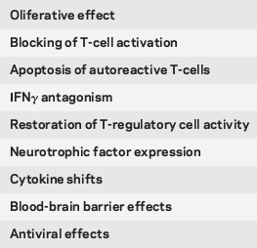
Interferon beta (IFN-β) Mechanism of action
Decreased expression of costimulatory molecules
reduced antigen presentation
Glycosylation, decreases immunogenicity, contribute to the diminished potency of the IFN-β1a formulation

Slide 24
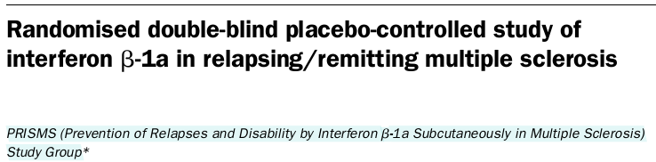
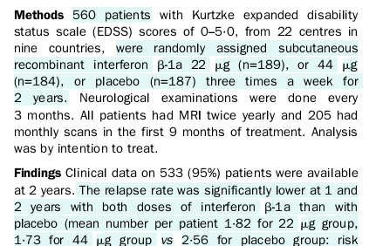
PRISMS Rebif Vs placebo
Lancet1998;352:1498–504
median increase of 10·9% of MRI lesions
in placebo gp whereas the 22 mcg group showed a median decrease of 1·2% and the 44 mcg group a median decrease of 3·8% (p<0·0001)

Slide 25
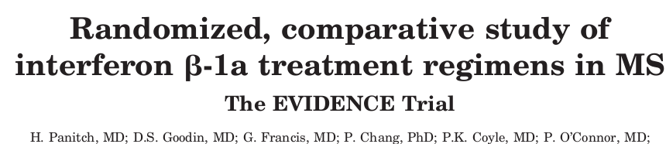
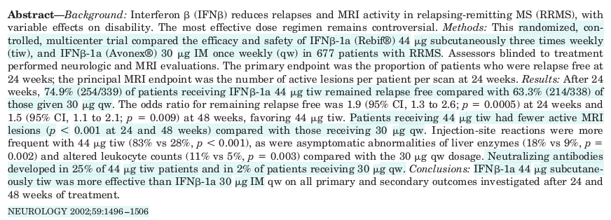
Rebif
Avonex

Slide 26
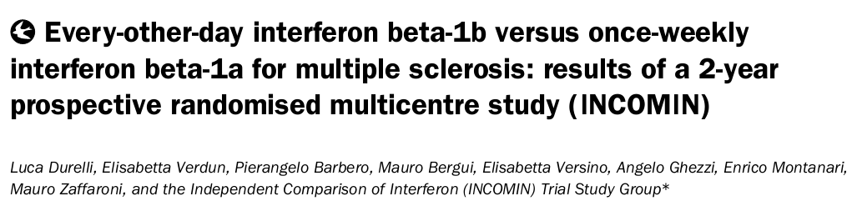
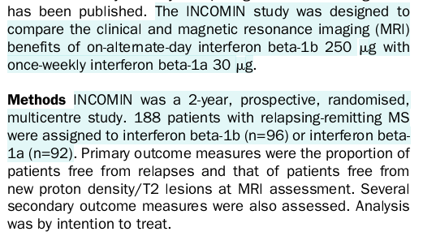

INCOMIN Betaseron vs Avonex

Slide 27
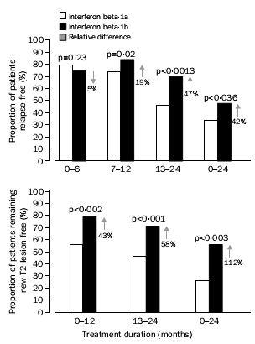
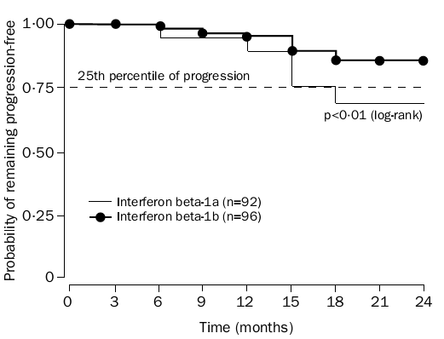
49 (51%) individuals administered
IFN beta-1b remained relapse-free compared with
33 (36%) given IFN beta-1a
42 (55%) compared with 19 (26%), remained free from new T2 lesions at MRI

Slide 28
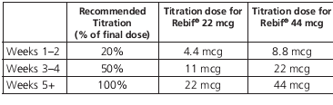
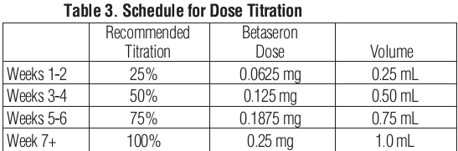
Rebif IFNβ1a
should be stored refrigerated between 2-8°C DO NOT FREEZE.
Betaseron IFN β1b
1 mL of reconstituted Betaseron solution contains 0.25 mg
Before reconstitution store at room temperature 25°C
After reconstitution, if not used immediately, the product
should be refrigerated and used within three hours. Do not freeze.

Slide 29
IFN Side effects
abnormal laboratory values hematological and elevated liver enzymes---either dose reduction or suspension before a second attempt at redosing is made
Flu like illness
Injection site reactions
depression
thyroid function abnormalities-rare

Slide 30
Contraindication MONITOR
CBC and LFT at 1, 3, and 6 months following
introduction of IFN
then periodically
TFT every 6 months
hypersensitivity to natural or recombinant interferon, human albumin
WARNINGS
Depression and Suicide
Hepatic Injury- Reduction of dose - if SGPT rises above 5X the upper limit of normal.

Slide 31
NEUTRALIZING ANTIBODIES
persistent high titers (greater than 100) of NAbs renders interferon biologically inactive.
controversy -- lack of consensus
  on the definition of NAb seropositivity
  possible reversion to NAb-negative status
  variability of testing from laboratory to laboratory
  varying degrees of immunogenicity among the interferon products.

Slide 32
The immunogenicity of the interferons in descending order is:
  SC interferon beta-1b (Betaseron)
  SC interferon beta-1a (Rebif)
  IM interferon beta-1a (Avonex)

Slide 33
Glatiramer acetate (GA)
synthetic amino acid polymer composed of a mixture of
  L-glutamic acid
  L-lysine
  L-alanine
  L-tyrosine in defined molecular ratio
is an immunomodulatory agent

Slide 34
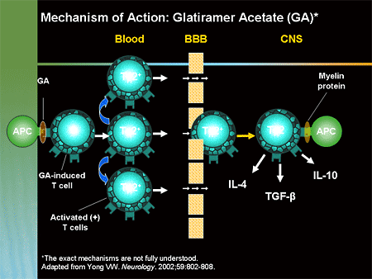
GA- Mechanism of action
promote differentiation of TH2 cells and CD4+CD25+ FOXp3 T regcells
Ragheb S et al. Long-term therapy with glatiramer acetate in multiple sclerosis: effect on T-cells. Mult Scler 2001;7(1):43-47

Slide 35
GA
GA has been demonstrated to reduce the relapse rate and to decrease the inflammatory lesion load in MS clinical trials.
Miller A, Spada V, Beerkircher D, et al. Long-term (up to 22 years), open-label, compassionate-use study of glatiramer acetate in relapsing-remitting multiple sclerosis. Mult Scler 2008;14(4):494-499.
46 patients with RRMS
Annualized relapse rate decreased to 0.1 ± 0.2 from 2.9 ± 1.4 pre study (P<0.0001)

Slide 36
More recent comparator trials of IFN beta-1b versus GA and IFN beta-1a versus GA showed no significant clinical differences between GA and the high-dose/high-frequency interferons.
  REGARD study - Rebif was compared to GA
  BEYOND study⁻ Betaseron was compared to GA
O’Connor P, Filippi M, Arnason B, et al. 250mcg or 500mcg interferon beta-1b versus 20 mg glatiramer acetate in relapsing-remitting multiple sclerosis: a prospective, randomised, multicentre study. Lancet Neurol 2009;8(10):889–89

Slide 37
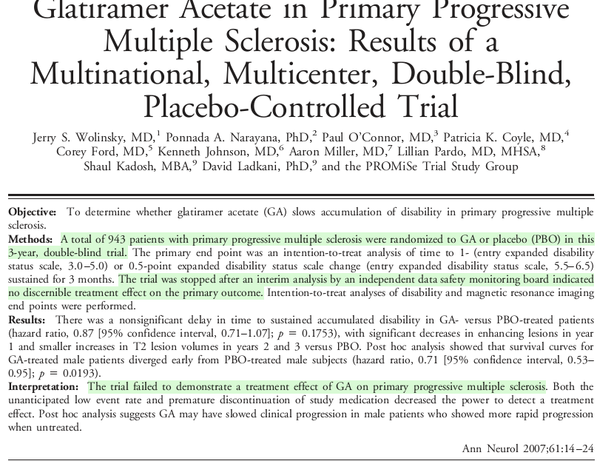
A recent study in patients with PPMS failed to demonstrate a significant benefit of GA treatment, probably because of the major differences in the immunopathogenesis between these two forms of disease.
Wolinsky JS, Narayana PA, O'Connor P, et al. Glatiramer acetate in primary progressive multiple sclerosis: results of a multinational, multicenter, double-blind, placebo-controlled trial. Ann Neurol 2007;61:14-24

Slide 38
GA- Adverse effects
injection site reactions, bruising, itching, and lipoatrophy.
Approximately 10% of patients - self-limited idiosyncratic systemic reaction characterized by chest pain, palpitations, anxiety, dyspnea, urticaria, flushing, and throat constriction that is not cardiopulmonary in nature, and usually develops within 15 minutes of the injection
Pregnancy Category B

Slide 39
GA -Capoxone
Each 1 mL of solution contains 20 mg of glatiramer acetate
prefilled syringes package- refrigerated 2°C to 8°C
Keep at room temperature for 20 minutes
GA- does not require regular blood monitoring

Slide 40
SECOND-GENERATION DISEASE-MODIFYING THERAPIES

Slide 41
MONOCLONAL ANTIBODIES AND MS

Slide 42
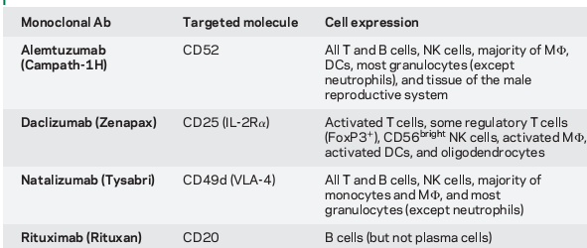
mAb and target cells

Slide 43
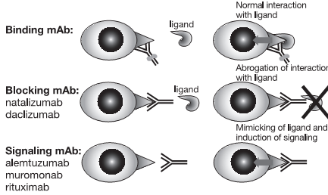
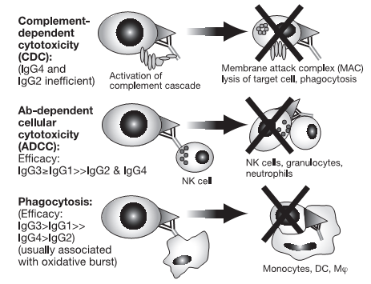
MECHANISM OF ACTION OF mAb

Slide 44
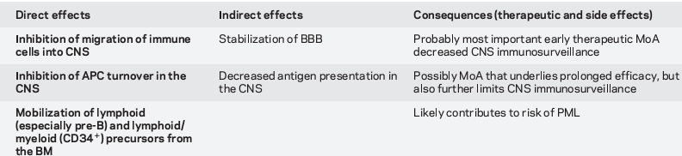
Natalizumab…..MOA
An anti-VLA-4 humanized monoclonal antibody, natalizumab, was designed to block α4β1-bearing cells from docking to VCAM 1 and consequently inhibit lymphocytes from crossing the blood-brain barrier.

Slide 45
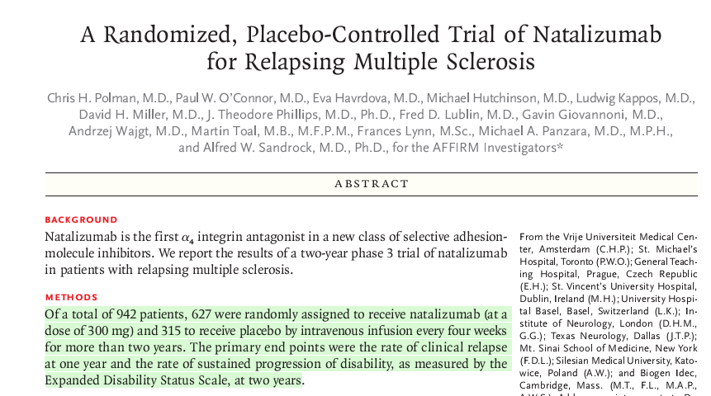
AFFIRM trial
Natalizumab Vs Placebo
N Engl J Med 2006;354(9):899–910

Slide 46
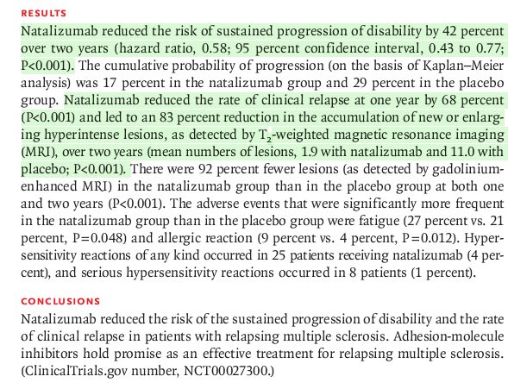

Slide 47
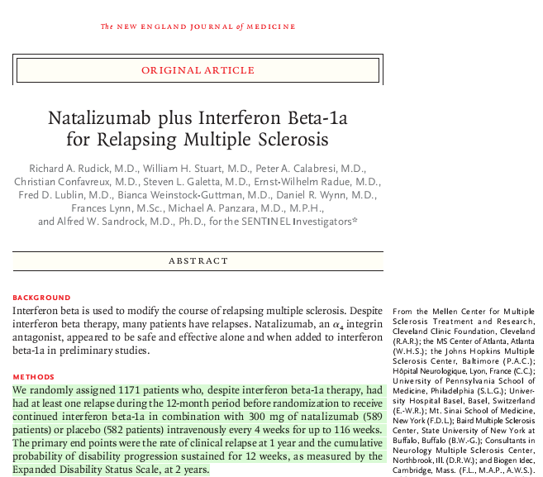
NEJM2006;354:911–923
SENTINEL trial
Rebif + Natalizumab
VS
Rebif + placebo

Slide 48
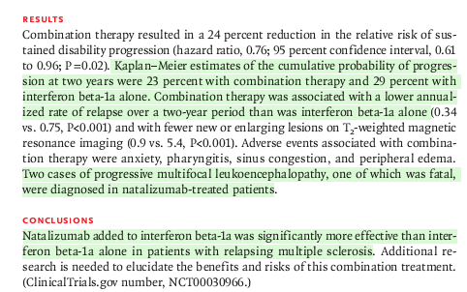

Slide 49
Natalizumab ……….Setback!!
withdrawn from the market in 2005
reintroduced in 2006, as no cases of PML were detected in the monotherapy trial.
Subsequently, as of May 2010, more than 50 cases of PML have occurred in patients on natalizumab monotherapy.
The risk of PML rises with duration of exposure to the drug
FDA → blood test assessing risk for PML in patients taking natalizumab

Slide 50
PML – natalizumab induced ….
How to manage?
high-volume PLEX therapy can effectively remove natalizumab from the circulation and reestablish the traffickng of lymphocytes across the blood-brain barrier within 11 days compared to approximately 90 days for normal drug elimination.
Khatri B, Man S, Giovannoni G, et al. Effect of plasma exchange in accelerating natalizumab clearance and restoring leukocyte function. Neurology 2009;72(5):402–409.

Slide 51
NAbs in Natalizumab
If a patient develops persistent NAbs -defined as two positive titers separated by 42 days then the clinical effect of the drug is similar to placebo
The incidence of NAb sero-positivity (6%) is lower for Natalizumab compared to the high-dose interferons.

Slide 52
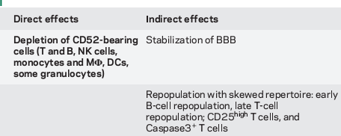
ALEMTUZUMAB

Slide 53
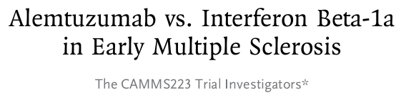
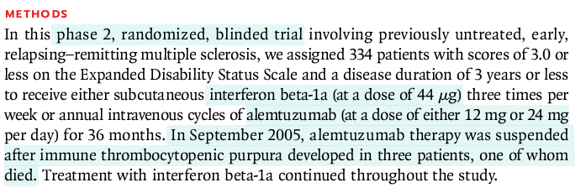
Rebif
N Engl J Med 2008;359:1786-801

Slide 54

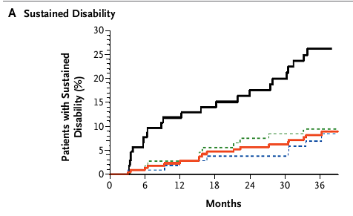
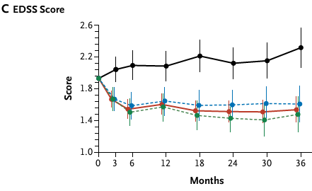
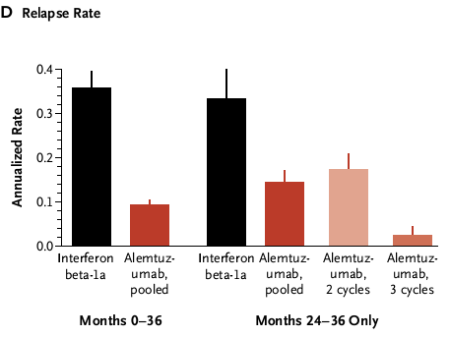
Adverse events in the alemtuzumab group, as compared with
the interferon beta-1a group
autoimmune thyroid disorders 23% vs.3%
ITP [3% vs. 1%])
infections (66% vs. 47%).

Slide 55
Alemtuzumab therapy was complicated by
  idiopathic thrombocytopenic purpura,
  Graves diseases
  Good pasteur syndrome
  Infusion related adverse events
Two large phase III trials of alemtuzumab are ongoing: in treatment-naïve
MS patients (CARE-MSSM I)
and in patients with inadequate response to current immunomodulatory
therapies (CARE-MSSM II)

Slide 56
Targeting B cells- RITUXIMAB
Rituximab, a chimeric (mouse/human) monoclonal antibody directed against CD20, a B-cell marker

Slide 57
HERMS trial
A 48 week double blind phase 2 trial
Rituximab treatment - 1,000 mg IV on days 1 and 15; N69
highly significant reduction in CELs on brain MRI at weeks 12, 16, 20, and 24 post infusion - 80.3% vs 51.4% of patients were lesion free
the mean number of lesions was 91%lower;p<0.001)compared with placebo (N35).
Hauser SL, Waubant E, Arnold DL, et al. B-cell depletion with rituximab in relapsing-remitting multiple sclerosis. NEngl J Med 2008;358(7):676-688.

Slide 58
A phase 2/3 clinical trial in patients with PPMS showed no statistically significant effect
In SPMS, meningeal lymphoid follicles may provide a regenerative source for the intrathecal B-cell response and limit the efficacy of peripheral B-cell depletion
Hawker KP, O'Connor MS, Freedman PA, et al. Rituximab in patients with primary progressive multiple sclerosis: results of a randomized double-blind placebo-controlled multicenter trial. Ann Neurol 2009;66(4):460-471

Slide 59
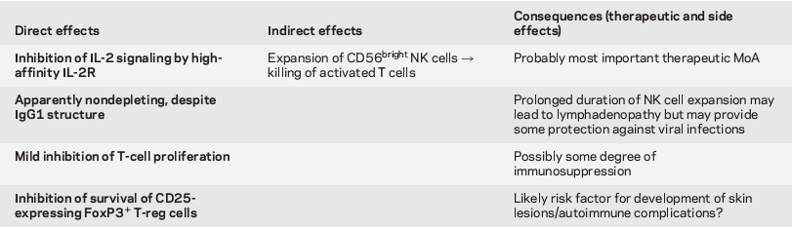
DACLIZUMAB
mAb directed against CD25 present over IL 2 receptor

Slide 60
Daclizumab in active relapsing multiple sclerosis (CHOICE study): a phase 2, randomised, double-blind,
Lancet Neurol. 2010 Aug;9(8):75
1. interferon beta and high-dose daclizumab group2 mg/kg every 2 weeks
2.interferon beta and low-dose daclizumab group 1 mg/kg ), every 4 weeks
3. interferon beta and placebo for 24 weeks.
72% reduction in ( contrast enhancing lesions) CELs compared with patients on placebo.
side effects - skin rashes and lymphadenopathy

Slide 61
CYTOTOXIC THERAPY
parenteral cytotoxic agents,
  Cyclophosphamide
  mitoxantrone
  cladribine.
Oral
  Azathioprine
  MMF
  Methotrexate
  Cyclosporine

Slide 62
MITOXANDRONE
anthracenedione - antineoplastic agent
Mechanism of action
  intercalates into DNA through hydrogen bonding, causing cross links and strand breaks
  Inhibits enzyme topoisomerase II.

Slide 63
FDA approved use in MS
SPMS
DOSE: 12 mg/m2 once every 3 months with a maximum total cumulative dose of 140 mg/m2
The efficacy of mitoxantrone was established in multiple randomized placebo-controlled trials
Fox EJ. Management of worsening multiple sclerosis with mitoxantrone: a review. Clin Ther 2006;28(4):461–473.

Slide 64
Side effect of Mitoxandrone
A recent report of the Therapeutics and Technology Assessment Subcommittee of the AAN concluded that the accumulated Class III and IV evidence suggests an
  increased incidence of systolic dysfunction
  therapy-related acute leukemia
Thus, many MS experts now consider mitoxantrone a third-line therapy for patients with very aggressive disease.

Slide 65
Azathioprine
Tthe utility of these agents is unproven in large clinical trials, and current data do not adequately support their use

Slide 66
Combination therapy
oral ISD/DMT combination has thus far not shown additional benefit in recent clinical trials

Slide 67
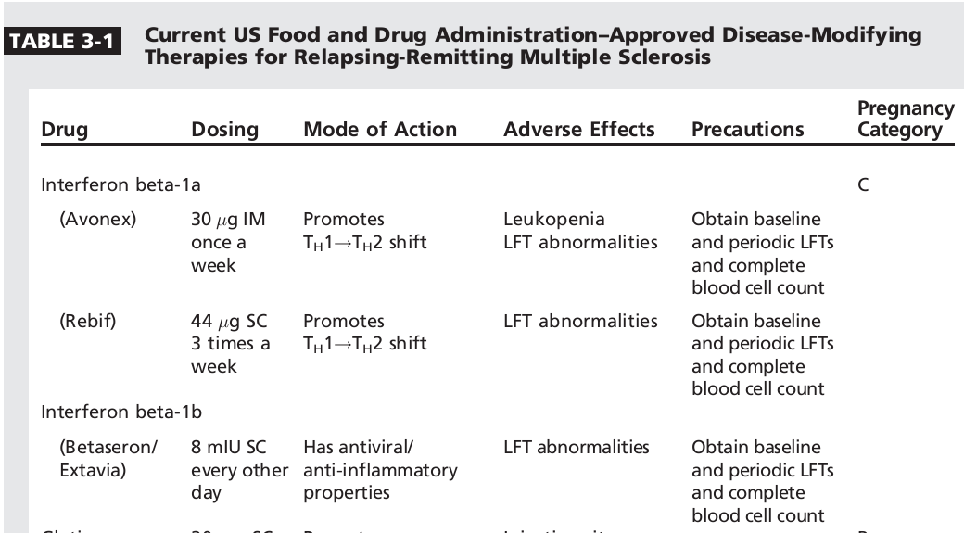
Continuum 2010

Slide 68
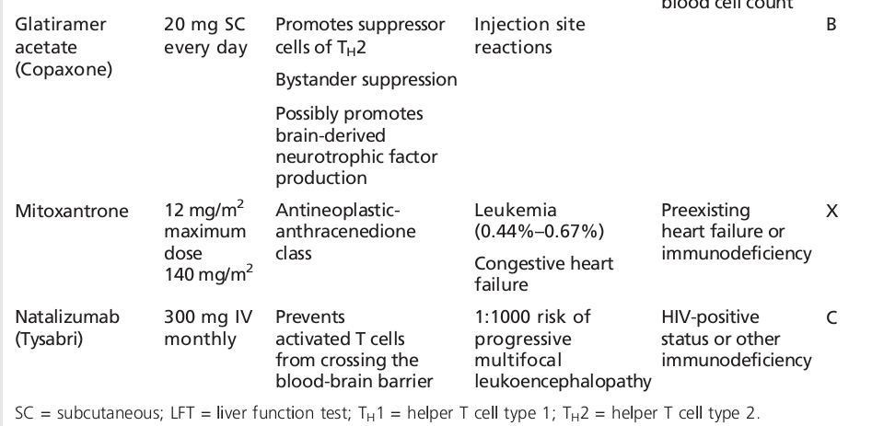

Slide 69
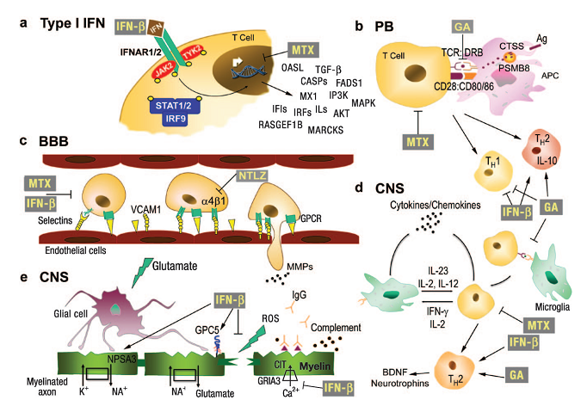

Slide 70
ORAL DMTs

Slide 71
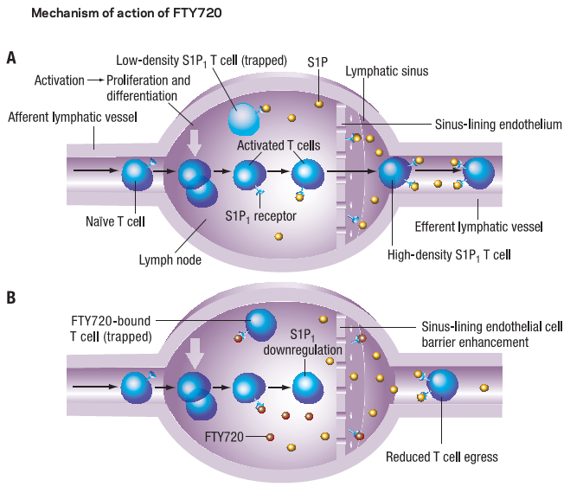
Fingolimod (FTY720)
Sphingosine-1-phosphate (S1P) receptor modulator that inhibits lymphocyte exit from lymphoid tissue and y limits autoreactive lymphocytes from entering the CNS.
Expert Rev Neurother 2008;8:699–714

Slide 72
In the placebo-controlled, 2-year trial of Fingolimod, the annualized relapse rate with a 0.5-mg dose was 0.18, the rate with 1.25 mg was 0.16, and the rate for placebo-treated patients was 0.40 (P<.001)
Kappos L, Radue E, O’Connor P. A placebo-controlled trial of oral fingolimod in relapsing multiple sclerosis. N Engl J Med 2010;362(5):387–401.

Slide 73
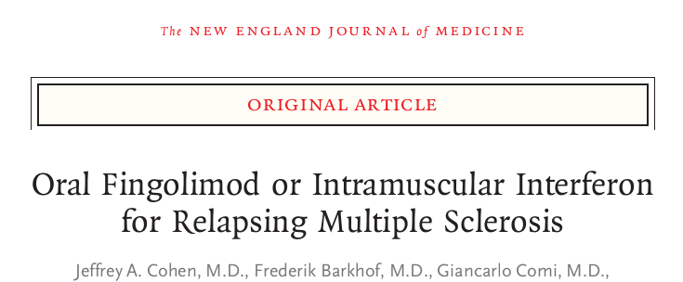
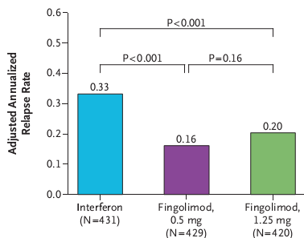
Trial Assessing Injectable IFN versus FTY720 Oral in RRMS (TRANSFORMS)
2010;362:402-15.
Avonex Vs Fingolimod

Slide 74
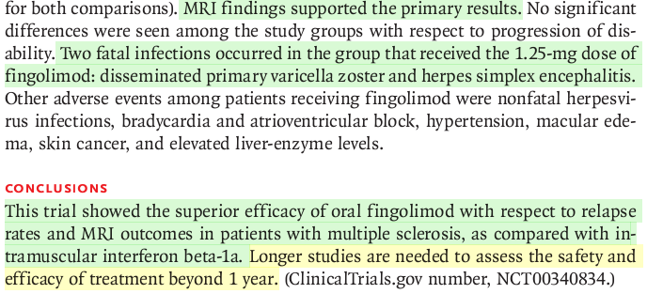

Slide 75
Adverse effects of Fingolimod
2 severe infections - death from a herpes simplex virus 1 encephalitis and disseminated varicella zoster
Bradycardia, AV block and HTN
Macular edema- 6 pts
Cutaneous malignancy- 10 pts

Slide 76
FDA approved first oral drug to reduce MS relapses – Sept 2010
Gilenya capsules 0.5 mg

Slide 77
Monitor
hourly pulse and blood pressure measurement for 6 hours
ECG - prior to dosing, and at the end of the observation period.

Slide 78
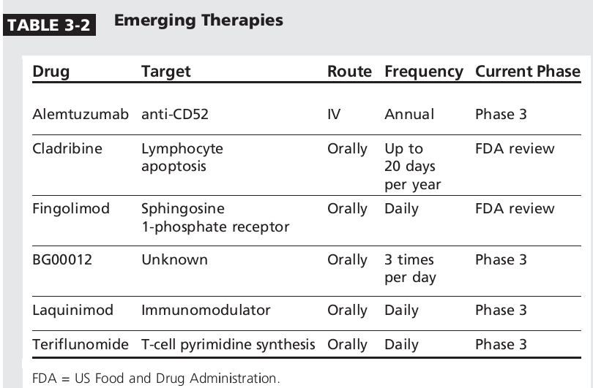
Continuum 2010

Slide 79
Stem cell transplantation
Patients treated for concomitant hematologic malignancy and MS who, after immunoablation and stem cell transplant, experienced stability or improvement in their MS symptoms.
Havrdova E. Aggressive multiple sclerosis: is there a role for stem cell transplantation? J Neurol2005;252(suppl 3):iii34-iii37.

Slide 80
The T-cell component of the immune system was shown to recover in two phases.
  In the first phase, preexisting T cells expanded in a thymus-independent manner.
  Subsequently, comprehensive T-cell immunity developed and matured in a thymus-dependent fashion that expanded from the transplanted stem cells.

Slide 81
MBP-specific T cells were initially depleted but re-expanded 1 year after the transplant.
These experiments show that HSCT alone without a strategy to reeducate emerging T-lymphocyte populations may not provide long-term benefits
Sun Wet al. Brain 2004;127(pt5):996-1008.

Slide 82
CIS - CLINICALLY ISOLATED SYNDROME
Patients with CIS and an abnormal MRI scan of the brain have an 85% chance of developing clinically definite MS within 10 years
Fisniku LK, Brex P, Altmann D, et al. Disability and T2 MRI lesions: a 20-year follow-up of patients with relapse onset of multiple sclerosis. Brain 2008;131(pt 3):808–8

Slide 83
Does the treatment of CIS affect the long-term outcome of MS?
Randomised placebo-controlled trials with interferon beta-1b, IM interferon beta-1a, and Glatiramer acetate showed a significant delay in the time to the next relapse
Kappos L, Polman CH, Freedman M, et al. Treatment in interferon beta-1b delays conversion to clinically definite and McDonald MS in patients with clinically isolated syndromes. Neurology 2006;37(7):1242–1249.
Comi G, et al. Effect of glatiramer acetate on conversion to clinically definite multiple sclerosis in patients with clinically isolated syndrome (PreCISe study): a randomized, double-blind, placebo controlled trial. Lancet 2009;374(9700):1503–1511.

Slide 84
radiologically isolated syndrome
patients who have a brain MRI performed for reasons other than a demyelinating event and have lesions highly suggestive of demyelination.
No controlled trials examining the value of treating patients with radiologically isolated syndrome have been done.

Slide 85
Treatment of RRMS
IFN β1a and IFN β1b
GA
Fingolimod
First line
monotherapy

Slide 86

Timing of Therapy Key to Preventing Disability
First Demyelinating Event
Pre-
clinical
Secondary
Progressive
Relapsing-Remitting
Transitional
First Clinical Attack
Time window for early treatment
Axonal loss
Clinical threshold
Demyelination
Inflammation
Time (years)

Slide 87
Treatment of SPMS
IFN β1a s/c
IFN β1b
First line
monotherapy
Mitoxandrone and Natalizumab are the only medication that has been approved by the FDA specifically for SPMS
PPMS – no approved drugs

Slide 88
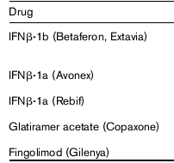
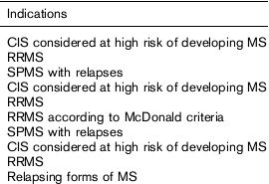
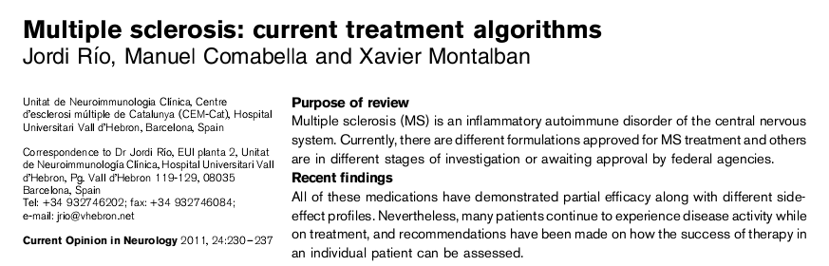
Approved indications of first line agent

Slide 89
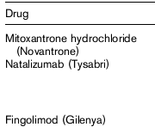
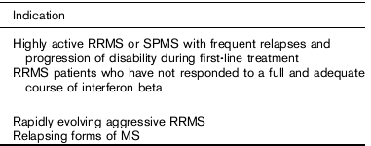
Approved indications of second line agents
No approved indications for combination therapy

Slide 90
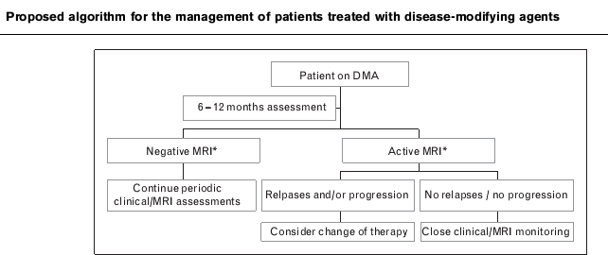

Slide 91
TREATING SUBOPTIMAL RESPONDERS TO DISEASE-MODIFYING THERAPIES

Slide 92
Factors responsible for the suboptimal response to DMTs
neurodegenerative aspects of the disease process
non compliance with DMTs
presence of neutralizing antibodies in interferon beta–treated patients
individually variability to treatment.

Slide 93
The following may suggest a suboptimal response in RRMS
Increase in relapses versus baseline after 6 to 12 months on a DMT; no decrease in relapses once on therapy, or relapse rate of greater than one per year;
EDSS progression (eg, 1 or more points confirmed over 6 months)
increase in MRI measures of disease activity (eg, new enhancing lesions, two or more T2 lesions annually, or new T1 hypointenselesions)
Cohen B, Khan O, Jeffery D, et al. Identifying and treating patients with suboptimal responses. Neurology 2004;63(12 suppl 6):S33–S40.
Roxburgh R, Seaman S, Masterman T, et al. Multiple Sclerosis Severity Score: using disability and disease duration to rate disease severity. Neurology 2005;64(7):1144–1151.

Slide 94
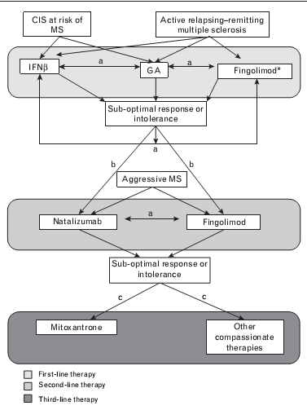


Slide 95
TREATMENT OF EXCACERBATIONS
An exacerbation is defined as a new or worsening symptom of MS, usually lasting 24 hours or longer, and not secondary to another medical condition (ie, infection, fever, heat exhaustion).
If the same symptom recurs within 30 days of the initial relapse, it is considered part of the same relapse.

Slide 96
Relapses pose a significant risk for the development of sustained disability.
In addition, the economic impact of exacerbations is significant.
Lublin F, Baier M, Cutter G. Effect of relapses on development of residual deficit in multiple sclerosis. Neurology 2003;61(11):1528–1532

Slide 97
If the patient’s symptoms are mild (eg, paresthesias), a watchful waiting period is usually appropriate.
More significant exacerbation symptoms (eg, motor weakness, vision loss) warrant the use of high-dose corti-costeroid therapy.

Slide 98
The dosing can range from 500 mg daily for 3 days up to 2000 mg daily for 7 days.
However, most RRMS trial today use 1000 mg daily for 3 days as a standard treatment protocol.

Slide 99
Corticosteroids- MOA
  anti-inflammatory drugs that reduce edema
  stabilization of the BBB
repair Treg function during acute exacerbations.

Slide 100
Pulse corticosteroid therapy can significantly reduce the rate of brain atrophy and also can reduce the relapse rate when used as an add-on therapy
Zivadinov R, Rudick R, De Masi R, et al. Effects of IV methylprednisone on brain atrophy in relapsing-remitting MS. Neurology 2001;57(7):1239–1247

Slide 101
PLEX
A retrospective analysis of 41 patients who underwent PLEX for treatment of severe attacks of CNS demyelination despite corticosteroid therapy interven-tion showed that 63% of patients had improved EDSS scores after 6 months
Llufriu S, Castillo J, Blanco Y, et al. Plasma exchange for acute attacks of CNS demyelination: predictors of improvement at 6 months. Neurology 2009;73(12):949–953.

Slide 102
HOT TOPIC: VITAMIN D
In a very large prospective study of nurses, women who took 400 IU or greater of vitamin D per day had a 40% lower risk of developing MS
Munger K, Zhang S, O’Reilly E, et al. Vitamin D intake and incidence of multiple sclerosis. Neurology 2004;62(1):60–65

Slide 103
KEY POINTS
infectious etiology – still a debate
Immune dysregulation - critical role in MS etiology.
CD4+T cells - main contributor.

Slide 104
immunomodulation - classic approach in treating MS.
Orally bioactive medications that could improve compliance and adherence to MS therapy will be soon available.

Slide 105
William Osler wrote, ‘‘A young physician starts life with twenty treatments for one disease while the old physician ends life with one treatment for twenty diseases.’’
In the world of MS therapeutics, we are still in the young physician mindset.
THANK YOU

Slide 106
REFERENCES
CURRENT AND EMERGING MULTIPLE SCLEROSIS THERAPEUTICS Benjamin M. Greenberg, Bhupendra O. Khatri, John F. Kramer Continuum 2010
Monoclonal antibodies in MS ; Mechanisms of action Bibiana Bielekova, MD Brenda L. Becker Neurology 2010 74 (Suppl 1):S31–S40
Interferon β mechanisms of action in multiple sclerosis NEUROLOGY 2010;74(Suppl 1):S17–s24

Slide 107
The Immunopathology of Multiple Sclerosis: An Overview Hans Lassmann, Wolfgang Brück; Claudia F.Lucchinetti Brain Pathol 2007;17:210–218

Slide 108
Which of the following treatments for multiple sclerosis is classified as US Food and Drug Administration category B for safety during pregnancy?
A. cladribine
B. glatiramer acetate
C. interferon beta-1b
D. mitoxantrone
E. natalizumaB

Slide 109
Which of the following agents under development as a potential therapy for multiple sclerosis is associated with an increased incidence of idiopathic thrombocytopenic purpura?
A. alemtuzumab
B. cladribine
C. daclizumab
D. fingolimod
E. laquinimod

Slide 110
Which of statement is true……….
1. Cladribine is approved by FDA
2. Glatiramer acetate requires regular monitoring
3. Fingolimod have cardiac side effects
4. In PPMS Natalizumab is approved
5. Mitoxandrone does not have cardiac side effects

Slide 111
Laquinimod
0.6 mg of laquinimod daily causes a 40.4% reduction in the cumulative number of Gd+ lesions compared to placebo
Comi G, Pulizzi A, Rovaris M, et al. Effect of laquinimod on MRI-monitored disease acti vity in patients with RRMS a multicentre, randomized, double blind, placebo-controlled phase IIb study. Lancet 2008;371(9630):2085–2092.

Slide 112
orally available immunomodulator
granted fast-track review status from the FDA
MOA
induces the release of transforming growth factor
Th2 shift

Slide 113
Side effect- minor
Headache
Pharyngitis
Elevated liver enzymes
backpain

Slide 114
BRAVO trial
randomized, phase III trials of laquinimod
a 2-year, multinational trial with 3 arms (0.6 laquinimod vs placebo vs 30µg IM IFN-1a),

Slide 115
ALLEGRO trial
2-year double-blind, multinational trial with 2 arms (0.6 mg laquinimod vs placebo),

Slide 116
Teriflunomide
Teriflunomide is an oral agent currently being studied in phase 3 trials with RRMS patients.
Mechanism of action – multifaceted
  via inhibition of lymphocyte expansion as a result of interference with the pyrimidine synthesis pathway by inhibiting dihydro-orotate dehydrogenase enzyme
  Inhibits NF k b
  Inh tyrosine kinase
  Prevent interaction of T cells with APC

Slide 117
the phase 2 trial did identify over a 60% reduction in contrast-enhancing lesions on MRI scans
  6 / 14 mg vs placebo
  An open-label extension of this study showed that the effects were sustained over 8 years.
O’Connor PW, Li D, Freedman MS, et al. A phase II study of the safety and efficacy of teriflunomide in multiple sclerosis with relapses. Neurology 2006;66(6):894–900.

Slide 118
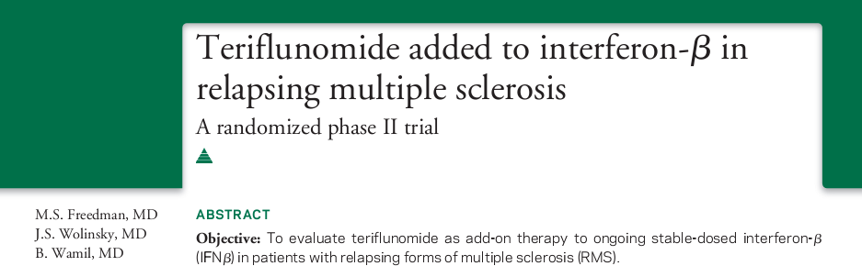
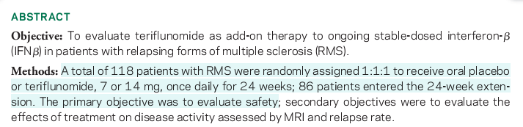
Neurology 2012;78:1877–1885

Slide 119
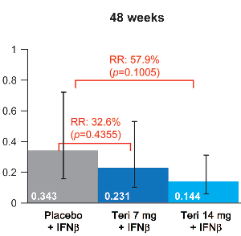
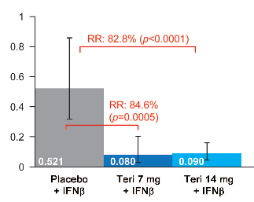
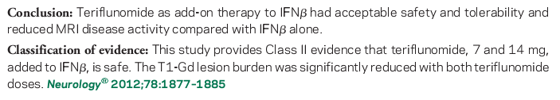
Results
T1 Gd+ lesions per scan
ARR

Slide 120
Side effects
Hepatotoxicity
Bone marrow suppression

Slide 121

BG00012- oral dimethyl fumurate
BG-12 activate the nuclearfactor-E2-related factor-2 (Nrf2) transcriptional pathway
have dual neuroprotective and anti-infl ammatory effects

Slide 122

Lancet2008; 372: 1463–72

Slide 123

48% reduction in new T2 HI
53% reduction in new T1 hypo
ARR by36%
In BG00012 VS placebo
Side effects- flushing. GI symptoms like diarrhoea, nausea and vomiting

Slide 124

DEFINE
Determination of the Efficacy and Safety of Oral Fumarate IN RRMS
was a randomized double-blind, placebo controlled, multicenter Phase 3 clinical trial

Slide 125
CONFIRM trial
Efficacy and safety study of oral BG00012 with active reference in RRMS
This phase III study with 1232 participants was similar to DEFINE, but with an additional group who took glatiramer acetate for comparison.
BG-12 reduced annual relapse rate by 44% for the twice-daily dose and by 51% for the three times daily dose, compared to placebo.
In contrast, glatiramer acetate reduced relapse rate by 29%.
BG-12 twice daily reduced the risk of disease progression by 21% and for three times daily by 24%. These results were not statistically significant.

Slide 126

CLADRIBINE
Cladribine(2chlorodeoxyadenosine) is a purine nucleoside that is resistant to adenosine deaminase.
Lymphocytes tend to have a higher ratio of
dCK to 5-NT and are targeted by cladribine. In cells that have equal levels of 5-NT and dCK, cladribine enters and leaves the cells without causing cell death
It targets CD4cells rather than CD8
T cells and spares other immune
cells such as B and NKcells.

Slide 127


Cladribine Tablets Treating Multiple Sclerosis Orally
(CLARITY) phase 3 RCT- 1326 patients
N Engl J Med 2010;362:416-26.
relapse-free - both cladribine groups 79.7% and 78.9%, respectively), as compared with the placebo group (60.9%) (P<0.001)

Slide 128
Adverse events were experienced by 82.4% of cladribine-treated patients and only 73.3% of placebo patients.
Side effects
Lymphocytopenia
Infections-40% - Herpes zoster in 20 pts
NOT FDA APPROVED

