Slide 1
VIEWS & REVIEWS
CLIPPERS
Faculty : Dr. C. Rathore

Slide 2
Case report
A previously healthy 56-year-old man was admitted
with a several week history of progressive ataxia
and binocular horizontal diplopia.
On initial neurological examination, he showed
dysarthria, left sixth nerve palsy, a right-sided
extensor plantar response, right-sided sensory loss
and and gait ataxia ,ophthalmoscopy was normal

Slide 3
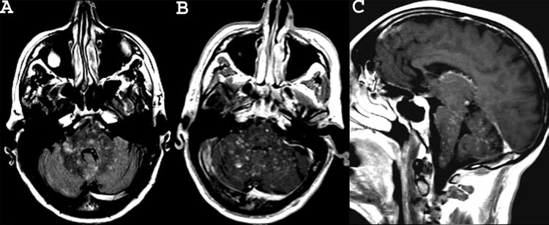

Slide 4
There was no clinical or laboratory evidence of
vasculitis.
CSF was normal except for elevated protein 0.89g/l
Paraneoplastic work up and detailed serological
investigations including paraneoplastic antibodies
anti NMO Ab,screening for chronic viral infections all
were negative

Slide 5
Because of the progressively worsening cerebellar
ataxia, he was given high parenteral corticosteroids
(1 g daily for 5 days), followed by oral prednisolone
(1 mg/kg body weight).
There was a dramatic clinical improvement within 1
week,followed by improvement of the MR imaging

Slide 6
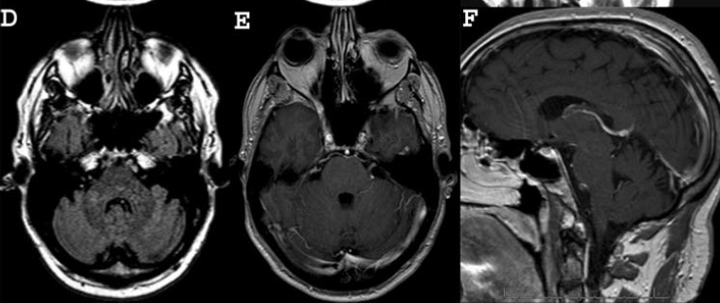

Slide 7
Started on azathioprine as a corticosteroid
sparing agent.
At the 7 month follow-up, there was no relapse
and only mild persisting ataxia
Practical Neurology 2011;11:349–351.

Slide 8
CLIPPERS

Slide 9
Introduction
The immunopathogeneses of most inflammatory
CNS disorders, including those with and without
accompanying demyelination remain poorly
understood

Slide 10
Advances in clinical radiological, serological and
pathological evaluation have facilitated disease
classification and differentiation of distinctive
Disease entities
Multiple sclerosis,NMO,Anti VGKC,Ani NMDA
encephalitis
CLIPPER is new addition to this category

Slide 11
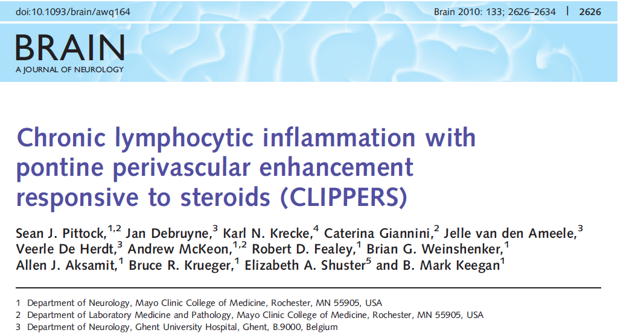

Slide 12
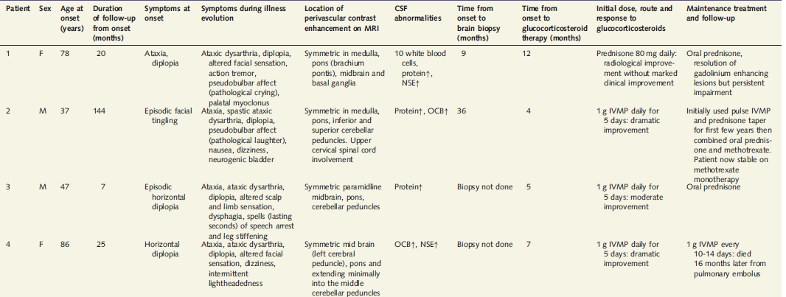

Slide 13
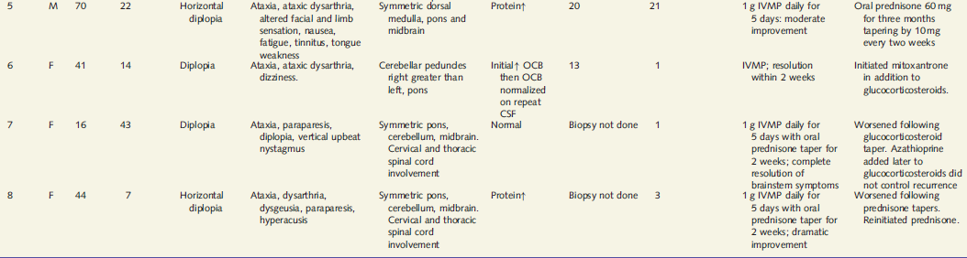

Slide 14
All patients had subacute gait ataxia and diplopia.
Seven patients also developed dysarthria (primarily
ataxic ).
An altered sensation or tingling of the face or scalp
was reported by five of eight patients
Half of them had sensory and motor long tract signs

Slide 15
2 patients had pseudobulbar affect
None had significant systemic symptoms nor
weight loss,fever, meningism, lymphadenopathy.
No features of systemic vasculitis/uveitis or
Orogenital ulcers

Slide 16
Neuroimaging
Brain MRI in all eight patients revealed a
characteristic pattern of punctate and curvilinear
enhancement peppering the pons.
Extends variably into the medulla, brachium pontis
and mid-brain

Slide 17
A subtler radiating pattern of similar enhancing
Lesions extended into the basal ganglia and inferior
cerebellar white matter in three patients
corpus callosum in one patient and
spinal cord in three patients .
Lesions were typically less numerous and smaller as
distance from the pons increased

Slide 18
The largest single punctate lesion was 9mm in
greatest dimension, but most lesions measured
between 1 and 3 mm.
One patient presented with asymmetric enhancement
in the left pons and right mesencephalon that
progressed over 6 months to become more extensive
and symmetric

Slide 19
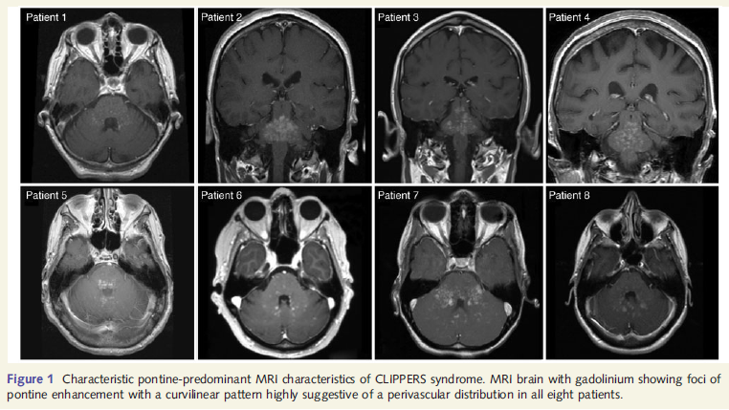

Slide 20
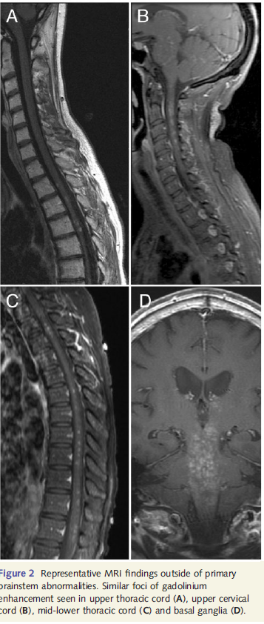

Slide 21
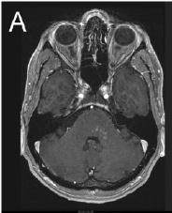
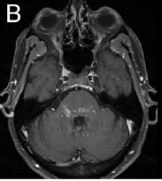

Slide 22
No supratentorial parenchymal white or grey matter
enhancing lesions, no hypothalamic-pituitary
involvement and no bony,meningeal or pial lesions.
Patchy non-specific increased T2 signal in the
corresponding regions of gadolinium enhancement.
None of the lesions had significant mass effect.

Slide 23
Intracranial magnetic resonance angiography
performed in two patients and conventional
angiography of neck and intracranialvessels in two
other patients were normal without angiographic
evidence of vasculitis.

Slide 24
Laboratory investigations
Blood investigations and ESR was normal
Vasculitic work up negative
Viral, fungal and syphilis serologies
CT chest (all eight patients), CT abdomen and pelvis
Whole body PET (two ), testicular ultrasound (two )
and mammogram (two).
Anti NMO Ab Negative in all

Slide 25
Cerebrospinal fluid analyses
CSF abnormalities were found in four of eight
Patients tested
Mildly elevated protein in four (47–65mgdl)
Pleocytosis in 1 ( 98% lymphocytes).
Elevated CSF oligoclonal bands were found in
three
All Cultures were sterile

Slide 26
Neuropathology
Four of eight patients were biopsied
[pons in one and cerebellum in three].
Marked lymphocytic infiltrate in the white matter with
perivascular predominance.
The lymphocytic infiltrate was composed
predominantly of CD3 reactive T lymphocytes and
some CD20 positive B lymphocytes

Slide 27
CD68 positive histiocytes and activated microglia
were present in moderate number.
Myelin was intact.
Characteristic findings of sarcoidosis, histiocytosis,
Lymphoma,multiple sclerosis or other diseases were
not found

Slide 28
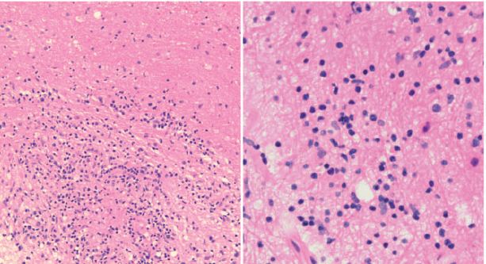

Slide 29
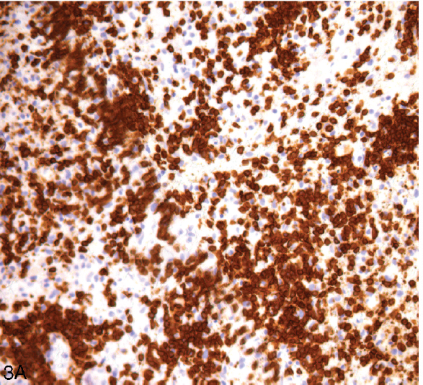
The lymphocytic infiltrate
was composed predominantly of CD3 positive (T) lymphocytes

Slide 30
Bickerstaff brainstem encephalitis deserves particular
attention as it is also a brainstem-predominant
inflammatory disease.
This diagnosis was excluded in these patients by the
observed neuropathology and radiological features and
lack of peripheral nerve involvement .
Diagnostic features of Bickerstaff brainstem encephalitis
include drowsiness or coma, progressive external
ophthalmoplegia, ataxia and corticospinal tract signs.
Most cases occur following viral illness and have a
monophasic course and a good prognosis.

Slide 31
MRI abnormalities occur in a minority (10–31%) of
patients with Bickerstaff brainstem encephalitis
Typically appear as a homogenous, non-gadolinium
enhancing lesions easily differentiated from the
pepper-like gadolinium enhancement seen as a
hallmark MRI feature in CLIPPERS

Slide 32
Peripheral polyneuropathy and serum anti
ganglioside GQ1b IgG antibodies are present in the
majority of patients with Bickerstaff brainstem
Encephalitis
BSE is now considered as a part of spectrum of
MFS

Slide 33
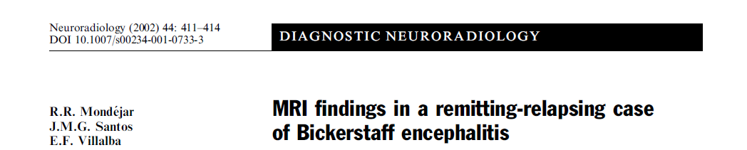
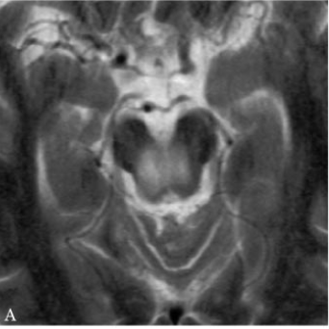
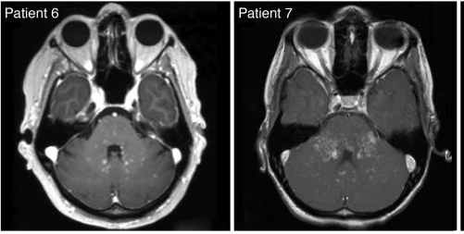
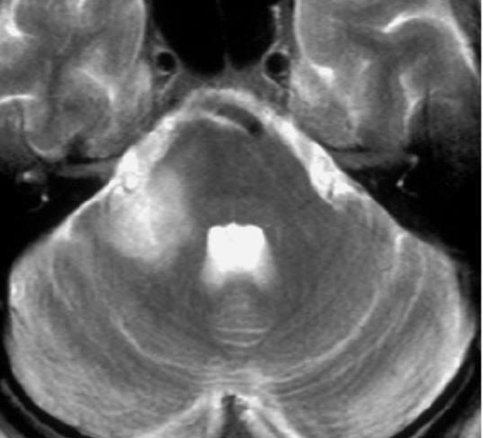

Slide 34
Treatment
Patients were treated initially with glucocorticosteroids
[IVMP (1 g daily for 5 days) in seven and oral prednisone
(80mg daily) in one].
All seven patients treated with IVMP showed
Improvements in gait, diplopia and dysarthria between
Days 2 and 4 of treatment.
One patient treated with 80mg oral prednisone did not
experience clinical improvement.

Slide 35
The number and size of perivascular enhancing
lesions was reduced on post-treatment MRI
in all patients .
All treated patients required maintenance
immunosuppression to sustain clinical improvements
In 6 cases in which withdrawal or reduction of
glucocorticosteroids was attempted, clinical
relapse ensued

Slide 36
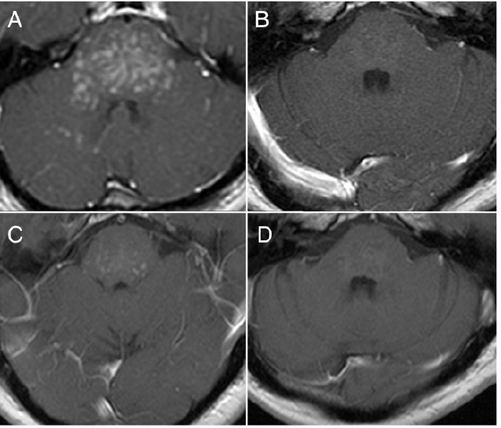
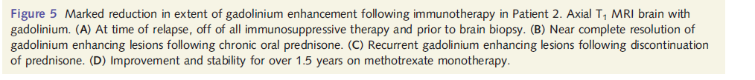

Slide 37
FOLLOW UP
Patients with the longest follow-up experienced
neither dissemination of the disease in the CNS
nor any underlying systemic illness
No evidence of idiopathic inflammatory demyelinating
disease such as multiple sclerosis despite follow up
as long as 12 years

Slide 38
The pathogenesis of CLIPPERS is unknown.
The presence of a inflammatory infiltrates and the
Clinical response to immunosuppressive therapies
suggests an autoimmune or other inflammatory
mediated pathogenesis.
The location of the inflammatory infiltrate suggests
that the target autoantigen is likely to be located in
perivascular regions.

Slide 39
Alternative diagnoses are rigorously excluded and
the clinical and radiological features may be
sufficiently distinctive,CLIPPERS could be diagnosed
and treated without pathological examination
Chronic lymphocytic inflammation with pontine perivascular enhancement responsive to steroids (CLIPPERS)
Sean J. Pittock et al Brain 2010: 133; 2626–2634

Slide 40
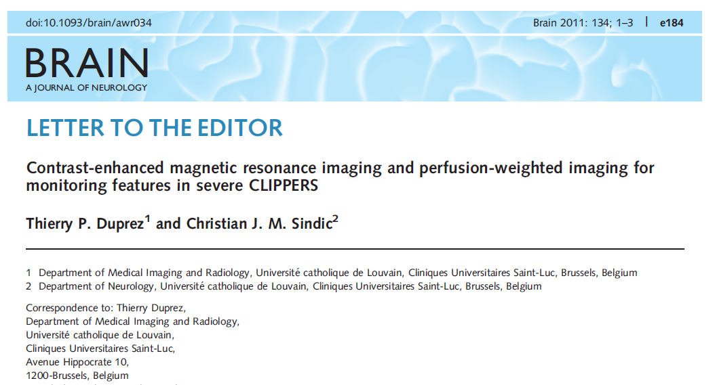

Slide 41
Perfusion-weighted imaging demonstrated an
increase in regional cerebral blood flow withithin the
lesions
200–300% of unaffected cerebellar white matter.
Perfusion images demonstrated a ‘trident-like’ pattern
Within pons suggesting relative sparing of the
direct corticospinal tracts, contrasting with severe
involvement of the adjacent white matter.

Slide 42
Perfusion weighted maps obtained 3 months after
treatment initiation failed to reveal a significant
decrease in regional cerebral blood flow values even
when the clinical signs were improving
These unexpected findings were interpreted as
resulting from persistent leakage of contrast agent
through unrepaired blood-brain barrier

Slide 43
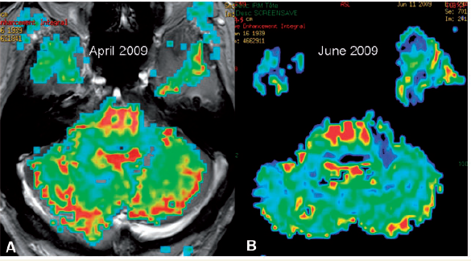

Slide 44
Another prominent feature of imaging monitoring
was a rapid atrophy leading to severe parenchymal
shrinkage of the pons.
Strong sign of non-malignant affection in spite of
persistent contrast enhancement and increased
regional cerebral blood flow values.

Slide 45
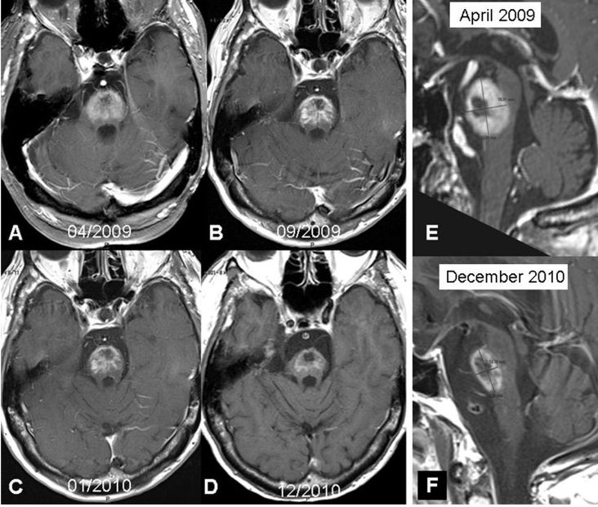

Slide 46
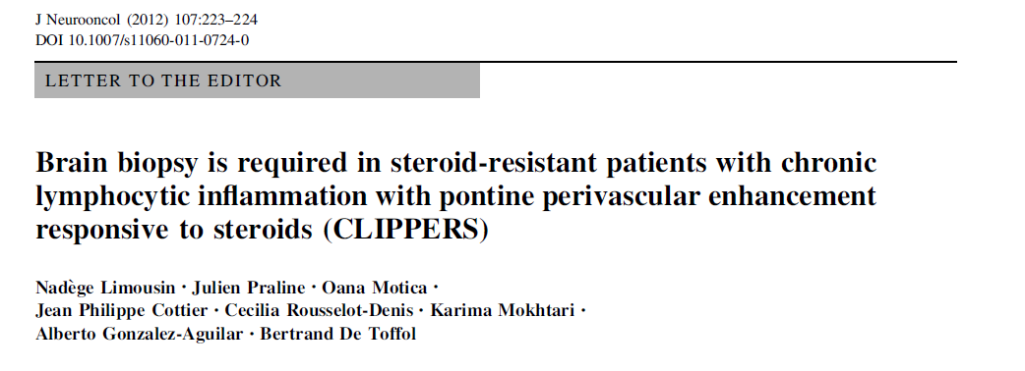

Slide 47
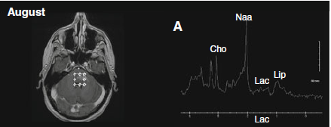
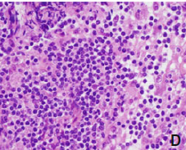
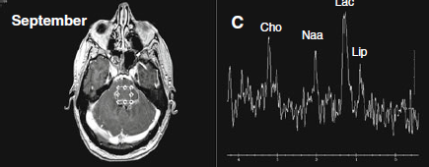
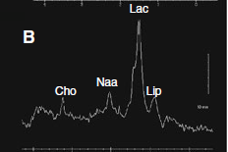
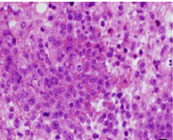
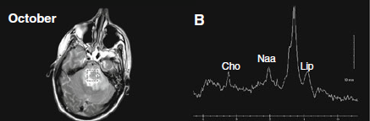
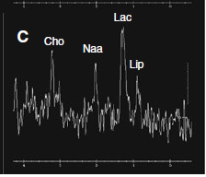
CLIPPERS
PCNSL

Slide 48
MRS profile in patients with CLIPPERS has not yet
been described
The case emphasizes the need to perform brain
biopsy in patients suspected of CLIPPERS if they
become steroid resistant.
Further studies are required to determine whether
MRS can discriminate PCNSL from CLIPPERS during
The early stages of the disease and during the follow
up period.
J Neurooncol (2012) 107:223–224

Slide 49
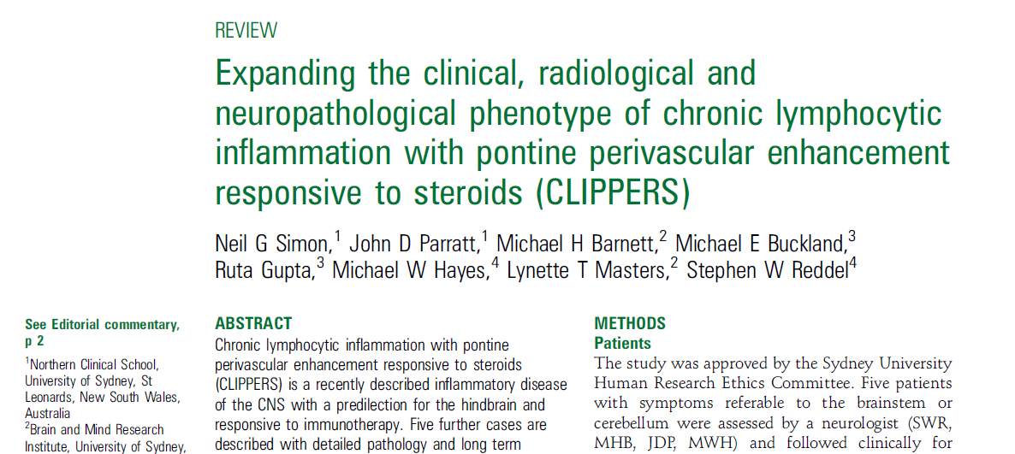
J Neurol Neurosurg Psychiatry 2012;83:15e22.doi:10.1136/jnnp-2011-301054

Slide 50
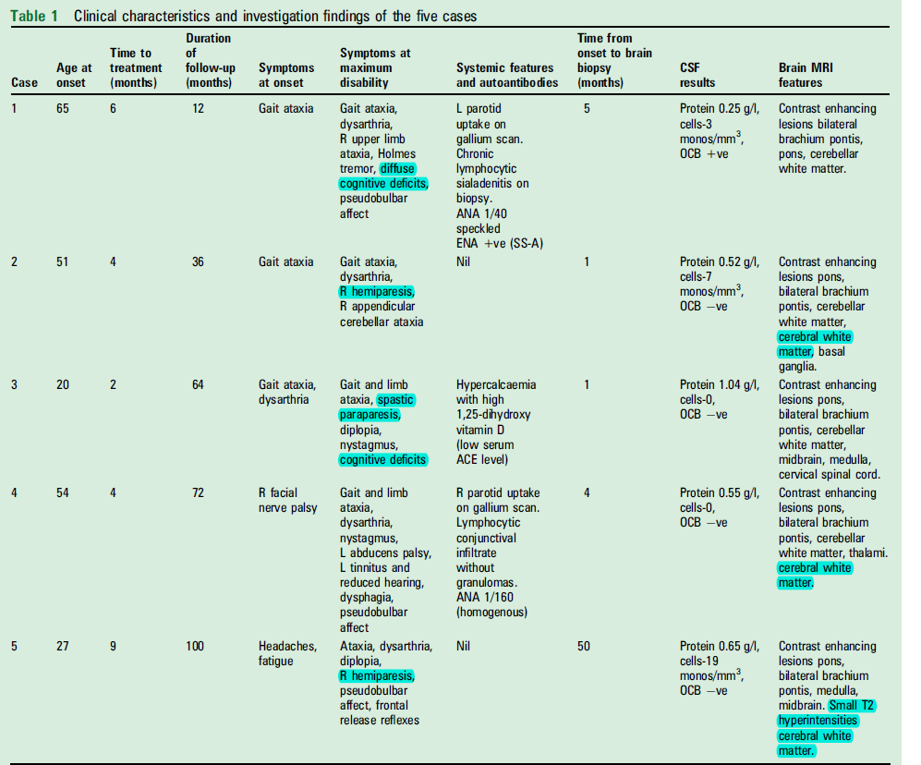

Slide 51
At the point of maximal disability, the ataxia
was accompanied by appendicular cerebellar signs
(4),pyramidal weakness ( 3), cognitive impairment (4)
Cognitive features included dysexecutive syndromes,
language disturbance, Perseveration.

Slide 52
Neuroimaging results
MRI of the brain showed punctate gadolinium
Enhancement with a perivascular pattern centred on
the brachium pontis in all cases, with variable
involvement of the pons and cerebellar white matter.
Lesions were also seen in the medulla, midbrain,
cervical spinal cord, basal ganglia, thalamus and
cerebral white matter in a number of cases

Slide 53
PET-CT of the brain showed no change or minor
hypermetabolism of contrast enhancing areas,
considerably less than seen in lymphoma

Slide 54
Contrast enhancing lesions were associated with
Mild to moderate hyperintensity on T2 weighted MRI,
including FLAIR sequences.
T2 weighted hyperintensity did not significantly
extend beyond the boundaries of the Contrast
enhancement of individual lesions.

Slide 55
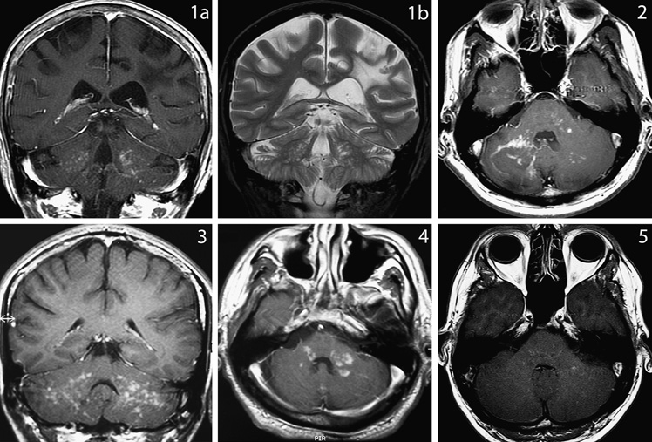

Slide 56
Extensive laboratory investigations
(including CSF) were negative as in the
index study by Sean J. Pittock et al

Slide 57
Evidence of systemic involvement
There was evidence of subtle systemic involvement on
Investigations without symptoms in three cases.
Whole body gallium scans were abnormal in two out of three
cases.
Two patients had abnormal uptake in the parotids.
The parotid biopsies, prior to treatment, showed chronic lymphocytic
sialadenitis without granulomas in one and the other was normal
The one with normal parotid had additional bilateral conjunctival
biopsies that showed chronic lymphocytic inflammation without
granuloma formation

Slide 58
Neuropathology
Five biopsies were analysed (four cerebellar, one
Basal ganglia).
All five cases showed a predominantly white matter
Based perivascular and parenchymal
lymphohistiocytic Inflammatory infiltrate .
Accompanying reactive gliosis was noted in all cases.

Slide 59
The severity of inflammation was variable among the
five cases and ranged from large nodules andsheets
of inflammation to scattered foci of inflammatory
cells.
Lymphocytes and histiocytes were observed in
Similar numbers in four of the cases while
lymphocytes were predominant in one case

Slide 60
The most striking histopathological feature in all five
Cases was perivascular lymphohistiocytic
inflammatory infiltrate involving both small arteries
and veins.
Occasional aggregates of histiocytes resembling
loose granulomas, without significant peripheral
lymphocytic cuffing or necrosis were observed

Slide 61
Characteristic histological features of vasculitis
(destruction of the vessel wall with fibrinoid necrosis,
leukocytoclasia, fibrin thrombi) were not identified in
any case.
In addition to perivascular inflammation,inflammation
of the white matter was also seen to a variable
extent in all cases

Slide 62
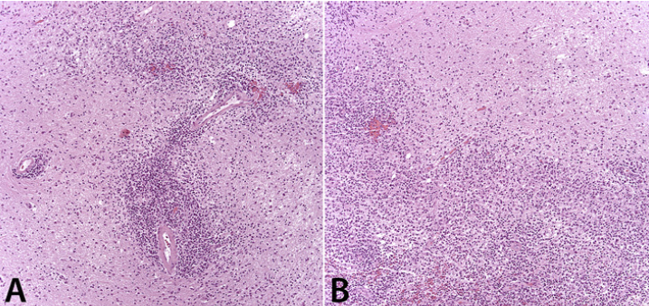
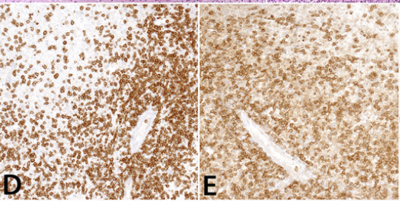
CD3 CD4

Slide 63
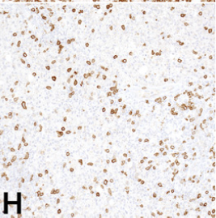
CD20 positive B cells comprise
a minority of lymphocytes

Slide 64
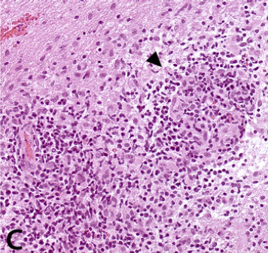
Abortive granuloma

Slide 65
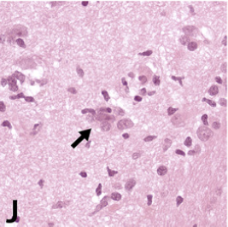
Neuronophagia ,histiocytes surrounding a shrunken neuron

Slide 66
There were small areas of demyelination present in
three of the cases.
Demyelination was associated with the most intense
inflammatory infiltrates and it appears to be a
secondary phenomenon.

Slide 67
The absence of Langerhans cells in the pathology
Specimens distinguishes this from LCH, which can
also involve the pons, cerebellum and brachium
Pontis.

Slide 68
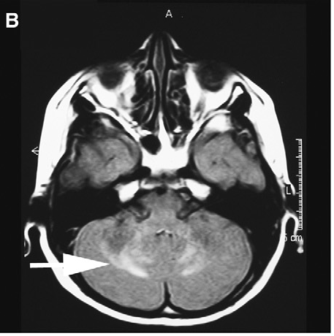
Mostbeck GH, et al. Central nervous system disease in Langerhans cell histiocytosis. Hemat Oncol Clin N Am 1998;12:287e305.

Slide 69
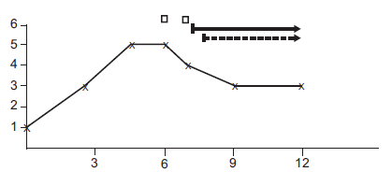
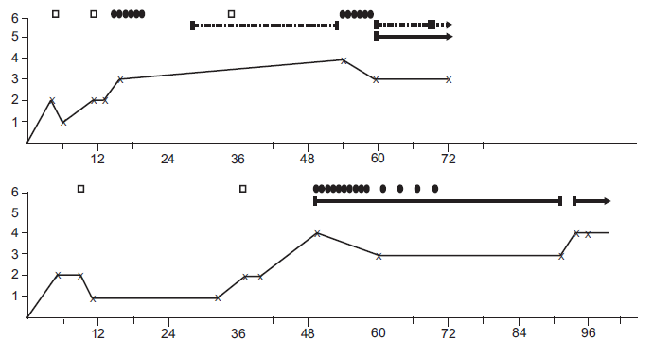
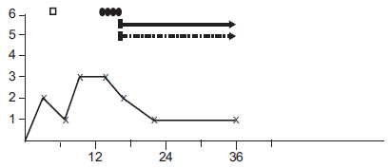
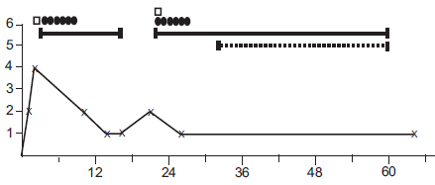
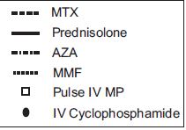

Slide 70
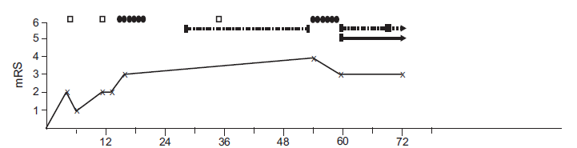
All patients received immunosuppressive therapy as
treatment for their condition
Cyclophosphamide or azathioprine given without
sustained corticosteroid in one case did not result in
clinical improvement

Slide 71
In the cases that progressed off therapy, intravenous
cyclophosphamide was generally effective at
Improving the clinical syndrome although did not
protect against subsequent relapse.
Independent benefit of steroid sparing therapies
without concurrent corticosteroid could not be
established

Slide 72
In general cyclophosphamide or antiproliferative
agent was withdrawn first, followed by a tapered
withdrawal of prednisone.
Symptoms and signs of relapse occurred soon after
final withdrawal of prednisone.
The clinical relapses correlated with radiological
reappearance of enhancing lesions.

Slide 73
Follow-up scans later in the course of the disease
demonstrated significant atrophy of the cerebellum
and brachium pontis in all cases.
Cerebellar atrophy was evident despite good clinical
response to treatment.

Slide 74
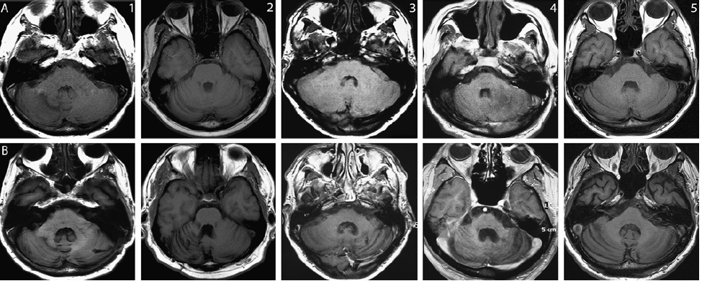
Mean follow up 5 years
Axial T1 weighted MRI of the cerebellum without contrast early in the course of the disease (row A) and at the last radiological follow-up (row B), showing cerebellar atrophy in all cases

Slide 75
Generalised cerebral atrophy was also evident on
follow-up scans of 3 cases,and cognitive dysfunction
was a component of the illness in the two most
severely atrophic cases .

Slide 76
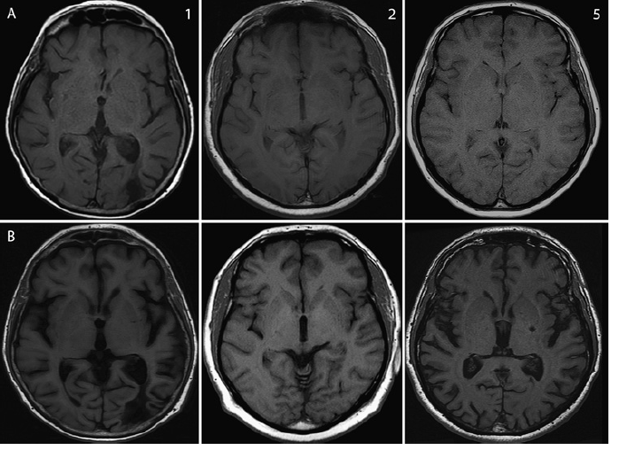
Mean follow up 5 years
MRI brain (axial T1) at the level of the Sylvian fissures early in the course of the disease (row A) and at the last radiological follow-up
(rowB),showing generalised cortical atrophy in three cases.

Slide 77
From this series, it appeared that early and vigorous
immunosuppressive treatment with continuing
maintenance immunosuppression resulted in the
best long term functional outcome.
This is particularly important given the development
of atrophy in CLIPPERS and the potential of fixed
neurological deficits

Slide 78
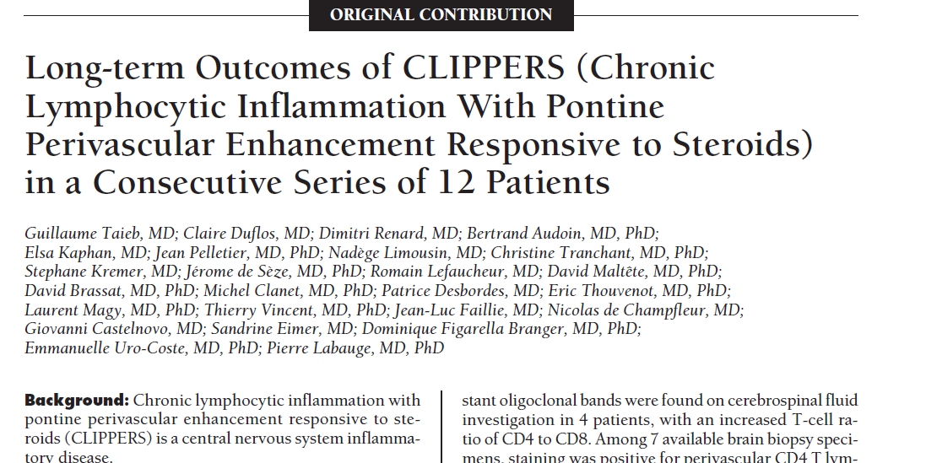
Arch Neurol. 2012;69(7):847-855

Slide 79
Largest series comprising of 12 patients
prior to this only 15 patients reported

Slide 80
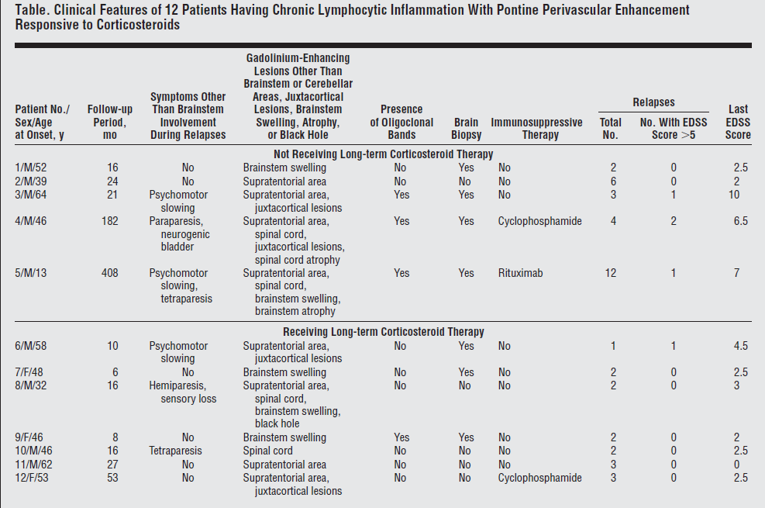
EDSS, Expanded Disability Status Scale.

Slide 81
After a mean follow-up period of 5.5 years,42 relapses
(mean, 0.63 annual relapses per patient) had occurred
During relapses, the mean time between the onset of
symptoms and the maximum EDSS score was 2.5
Months (range, 0.25-18 months).
The mean EDSS score during relapses was 4 (range,
3-10), and the mean residual EDSS score after
relapses was 1.9 (range, 0-7).

Slide 82
In 38 relapses treated with corticosteroids
Progressive EDSS score worsening was seen until
Pulse corticosteroid therapy was initiated
For all relapses, corticosteroid treatment was
successful. Clinical improvement was observed
within 2 weeks following the start of corticosteroid
therapy

Slide 83
Comparison was difficult because of a difference in the
mean follow-up period between patients not receiving longterm
corticosteroid therapy vs patients receiving long-term corticosteroid
therapy
In patients receiving long-term corticosteroid therapy, no relapse
occurred when the daily dose was 20 mg or higher
Severe relapses (defined as an EDSS score of 5) were morefrequent
In patients not receiving long-term corticosteroid therapy (severe
relapse occurred in 3 patients) than in patients receiving
long-term corticosteroid therapy (severe relapse occurred
in 1 patient)

Slide 84
Long-term disability was more severe in patients not
receiving long-term corticosteroidtherapy (3 patients
had a last EDSS score > 5) than in patients
receiving long-term corticosteroid therapy (All
patient had a last EDSS score < 5).
Relapsing-remitting evolution was constant in all 12
patients. No progressive form was observed

Slide 85
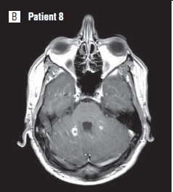
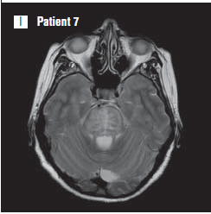
NEUROIMAGING
gadolinium-enhancing pattern as a closed ring
Pons swelling

Slide 86
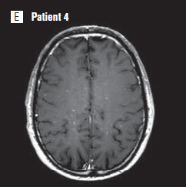

Signal is confluent Iin T2 and exceeds the size of the corresponding punctuate gadolinium-enhancing lesions
gadolinium-enhanced T1-weighted images show juxtacortical lesions

Slide 87

FOLLOW UP IMAGING
Pontine and spinal cord atrophy ,black hole

Slide 88


J Neurol Neurosurg Psychiatry 2012;83:15e22.

Slide 89
Thank you

Slide 90


