Slide 1
PRACTICE PARAMETER
Endovascular treatment of acute ischemic stroke
Faculty : Dr. Sanjay Prakash

Slide 2
SCHEME
  Role of iv TPA
  Effect of recanalisation
  Consideration of alternate therapy
  Various clinical trials
  Recommendations

Slide 3
The number of options for endovascular treatment of ischemic stroke has increased substantially over the past decade
  intra-arterial fibrinolysis
  mechanical clot retrieval Merci Retrieval System
  mechanical clot aspiration with the Penumbra System
  acute angioplasty and stenting

Slide 4
TREATMENT OF ACUTE STROKE- AHA –ASA RECOMMENDATIONS
Intravenous rtPA (0.9 mg/kg, maximum dose 90 mg) is recommended for selected patients who may be treated within 3 hours of onset of ischemic stroke (Class I; Level of Evidence A).
The door-to-needle time should be within 60 minutes from hospital arrival

Slide 5
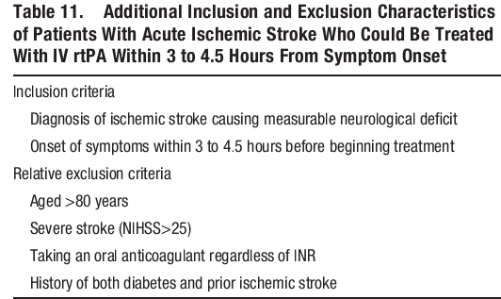
IV r tPA in the time period 3-4.5 hours

Slide 6
Recanalisation hypothesis
Thrombolytic stroke therapy is based on the “recanalization hypothesis,”
The reopening of occluded vessels improves clinical outcome in acute ischemic stroke through regional reperfusion and salvage of threatened tissues.

Slide 7
Recanalization of large arteries may not yield effective tissue reperfusion because of persisting distal emboli and microcirculatory occlusions
Adequate collateral circulation may have protected tissues even without recanalization.
Recanalization may exacerbate tissue injury by promoting reperfusion injury, excessive cerebral edema, and hemorrhagic transformation.

Slide 8
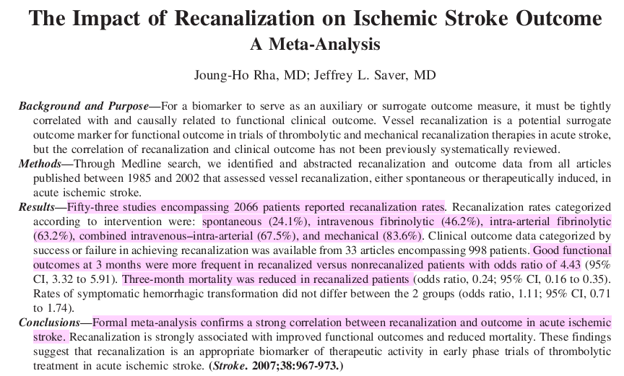

Slide 9
The meta-analysis was designed to address several issues
the rates of recanalization that occur with active therapy versus spontaneously
recanalization rate in various situations → interventions, different target vessels, and different stroke subtypes
the association of recanalization with the clinical outcomes of mortality and functional independence
the association of recanalization with the development of hemorrhagic transformation

Slide 10
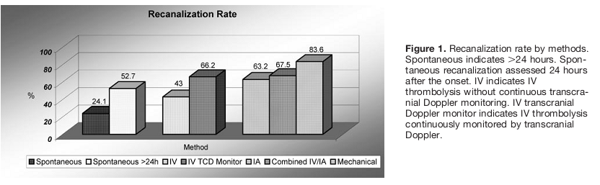
Fifty-three studies encompassing 2066 patients reported recanalization rates

Slide 11
Results of the metaanalysis
recanalization (partial or complete) with revascularization treatment → 977 of 1774 patients (55.1%)
spontaneous recanalization rate within 24 hours → 24.1% (61/253).

Slide 12
Rcanalisation rate
intravenous fibrinolytic → (46.2%)
IA fibrinolysis → 63.2% (549/868) (P <0.01)
The highest recanalization rate was observed with mechanical thrombolysis, 83.6% (92/110; P< 0.01)

Slide 13
Recanalisation depending on site of vessel occlusion
For MCA/ACA the recanalization rate was → 61 %
vertebral and basilar arteries vessels → 66.2%
internal carotid artery showed the lowest recanalization rate → 49.8%

Slide 14
Recanalisation and sICH
The hemorrhagic transformation rate for recanalized → 13.7% (49/358)
for non recanalized patients → 12.5% (40/320)

Slide 15
Good outcome was achieved in 58.1% of recanalized patients versus 24.8% of non recanalized patients
The frequency of fatal outcomes was 14.4% in recanalized patients versus 41.6% in non recanalized patients

Slide 16
IV- TPA : DISADVANTAGE
A major issue is that intravenous alteplase may be ineffective in patients with occlusions of the large arteries
  internal carotid artery,
  Carotid T segment
  proximal (M1) segment of the middle cerebral artery
  VA or basilar artery occlusion

Slide 17
Endovascular Interventions
INTRA ARTERIAL FIBRINOLYSIS
THROMBOEMBOLECTOMY
STENT RETRIEVER
BRIDGING THERAPY

Slide 18
IA THROMBOLYSIS

Slide 19
IAT offers some theoretical advantages over IVT
angiographic planning allows customization of treatment strategy
Loco-regional injection allows a much higher concentration of the drug where needed
the overall dosage administered to the patient is limited to the minimum necessary
mechanical devices may either speed up the recanalization process or make it possible in drug resistant cases

Slide 20
Direct comparisons of hemorrhage rates and clinical outcomes b/w IA fibrinolysis and IV tPA trial is difficult
Patients with acute ischemic stroke have a variety of arterial occlusion sites despite similar clinical presentations
the sites of arterial occlusion or the recanalization rates are known in the IV thrombolysis trials, including NINDS
So the efficacy of IV thrombolysis in patients with MCA occlusion cannot be specifically determined from those trials

Slide 21
Intra-arterial fibrinolysis
  PROACT II trial
  MELT

Slide 22
PROACT II TRIAL - JAMA 1999
PROACT II is the first randomized multicenter trial to demonstrate the clinical efficacy of IA thrombolysis in patients with acute stroke of less than 6 hours' duration caused by MCA occlusion

Slide 23
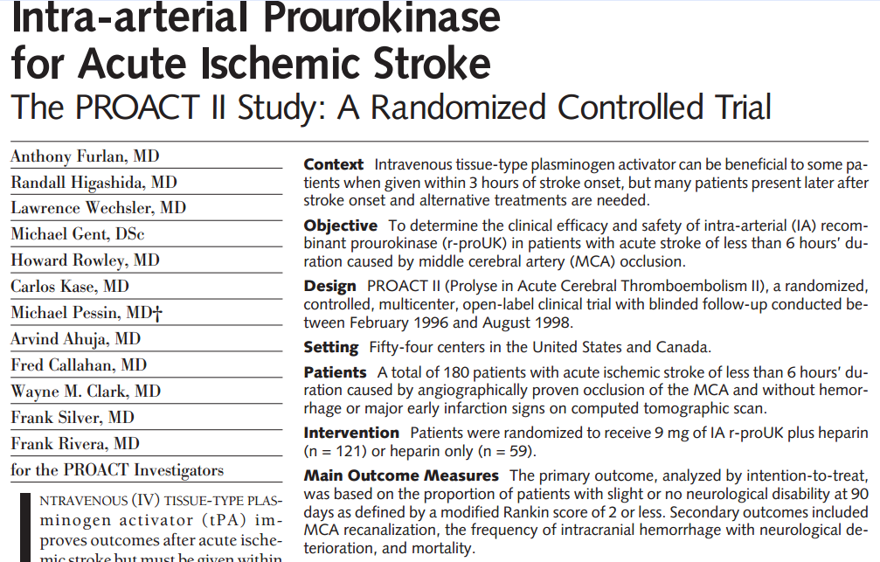
PROACT II TRIAL - JAMA 1999

Slide 24
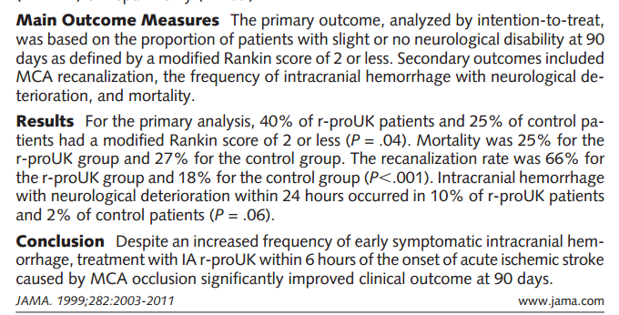

Slide 25
Results of PROACT II trial
The 15% absolute increase in favorable outcome with IA r-proUK (P = .04)
So on average, for every 7 patients treated with
IA r proUK, 1 will benefit.

Slide 26
IC bleed in ProUK arm → 10%
IC bleed in control arm→ 2%
Treatment with IA r-proUK was beneficial despite an increased risk of early intracranial hemorrhage with neurological deterioration.

Slide 27
There was no significant difference in the rates of total intracranial hemorrhage by day 10.
This may reflect delayed recanalization in the control group with hemorrhagic transformation
higher early rate of ICH with r-proUK reflected drug-induced recanalization and reperfusion hemorrhage.

Slide 28
The higher rate of intracranial hemorrhage with neurological deterioration with IA r-proUK (10.2%) compared with IV tPA
  NINDS (6.4%)
  Alteplase ThromboLysis for Acute Noninterventional Therapy in Ischemic Stroke (ATLANTIS) (7.2%)
  ECASS II (8.8)
  reflects the greater baseline stroke severity and time to treatment in PROACT II. -→ NIHSS of 17

Slide 29
Draw backs of IA thrombolysis
there was an average 3-hour delay between patient arrival at hospital and initiation of the IA r-proUK infusion
When the 2-hour drug infusion time is added, up to 5 hours elapsed in some patients during which brain infarction continued.
A door-to-drug time of 1 hour similar to that recommended for IV tPA is more difficult to achieve with IA thrombolysis

Slide 30
MELT
MCA embolism local fibrinolytic intervention trial
( Japan)

Slide 31
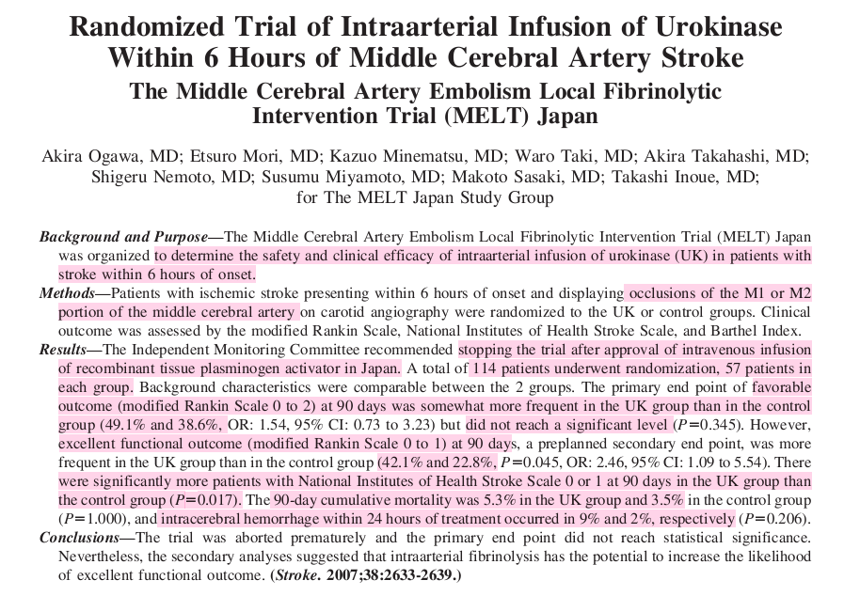

Slide 32
(PROACT) II trial of r-pro-UK was positive
2 trials are necessary for any new drug to receive FDA approval.
A second trial has not been completed, and thus,
r-pro-UK has not received FDA approval.

Slide 33
Comparison of IA fibrinolysis VS IV TPA

Slide 34
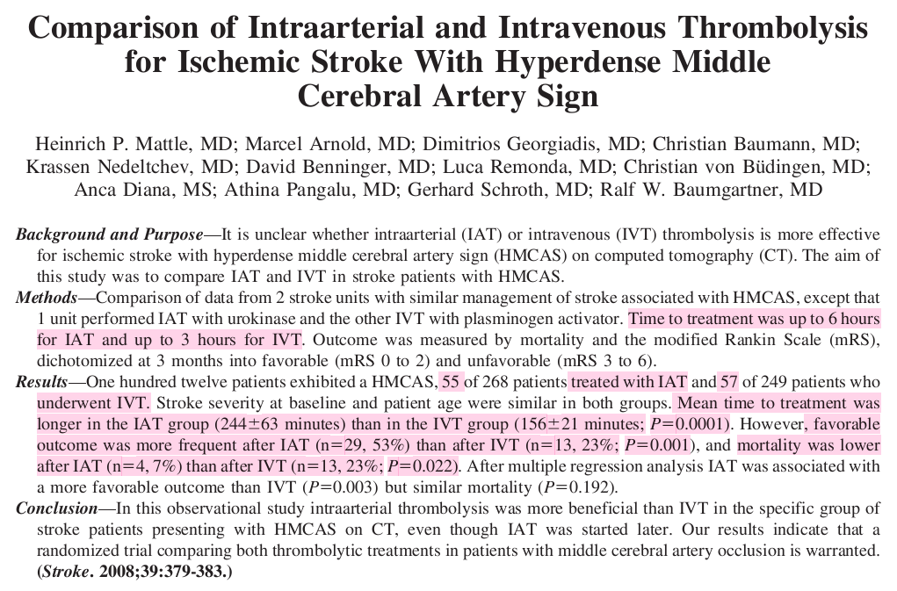

Slide 35
Mechanical recanalisation
Merci Retrieval System - 2004
Penumbra System - 2007
Solitaire Flow Restoration Device -2012
Trevo Retriever -2012

Slide 36
None of these devices have an FDA clinical indication because of the lack of RCT with medical therapy
They were cleared for use by the FDA as mechanical methods for restoring blood flow to occluded arteries

Slide 37
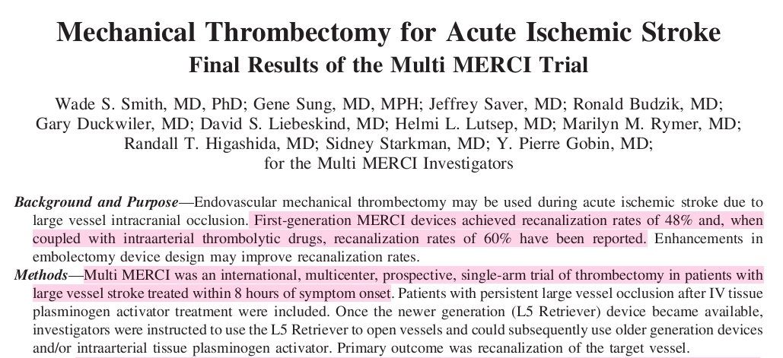
MERCI Trial
Stroke 2008

Slide 38
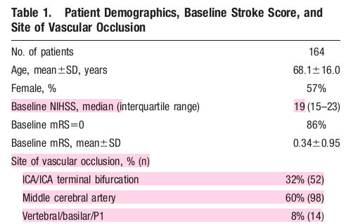

Slide 39
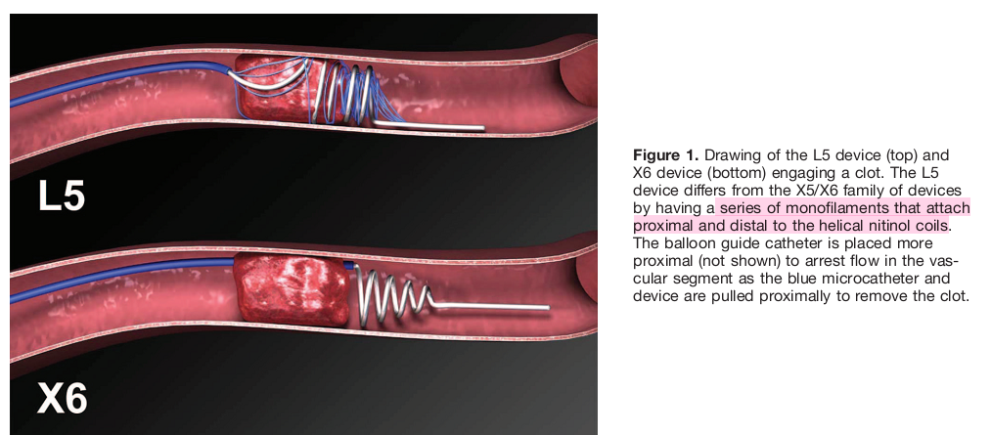

Slide 40
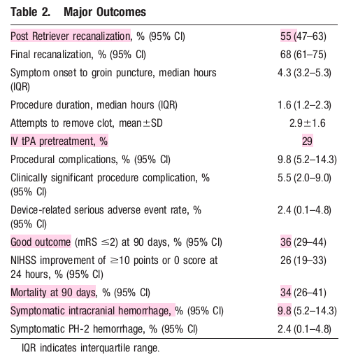

Slide 41
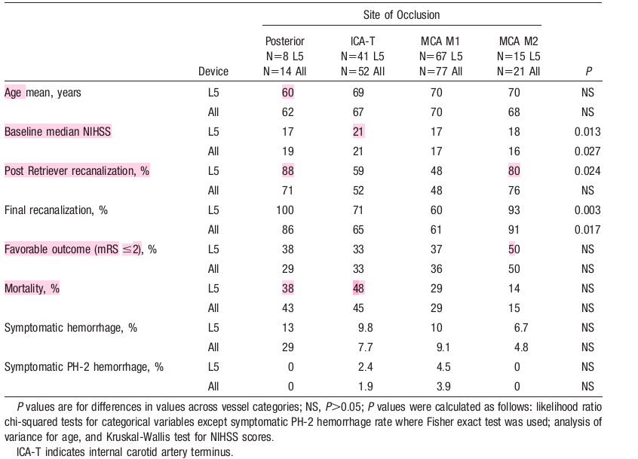

Slide 42
Conclusion – MERCI trial
successful recanalization → 75 of 131 (57.3%)
after adjunctive therapy (intraarterial tPA & mechanical) → 91 of 131 (69.5%)
favorable clinical outcomes (mRS 0 to 2) → 36%
Mortality → 34%
both outcomes were significantly related to recanalization.
sICH → 16 patients (9.8%) : 4 (2.4%) of these were PH- II.
Clinically significant procedural complications occurred in 9 (5.5%) patients

Slide 43
LIMITATIONS
the trial included adults with no upper age limit, nor an upper limit to NIHSS
14% of treated patient had prestroke mRS scores exceeding 0
The device is difficult to manipulate
Complication rate of this device is high

Slide 44
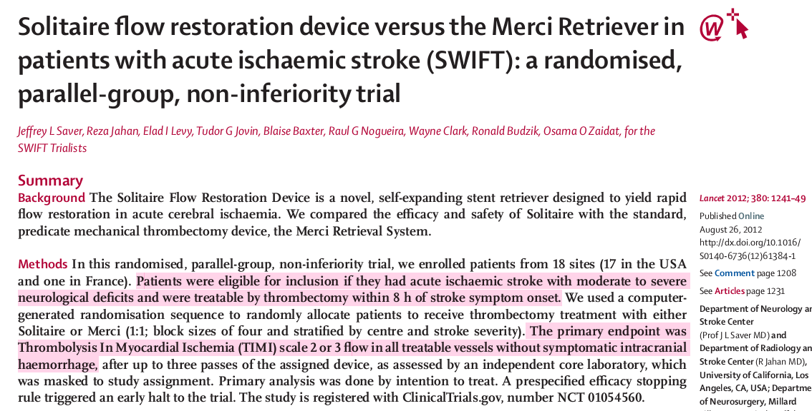

Slide 45
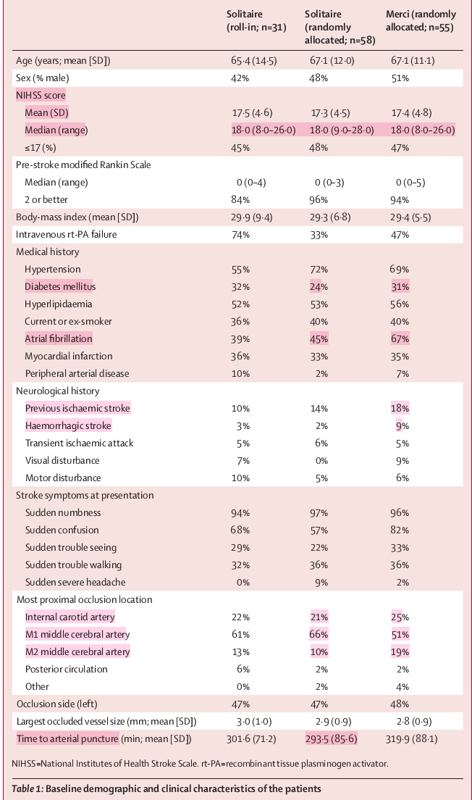

Slide 46
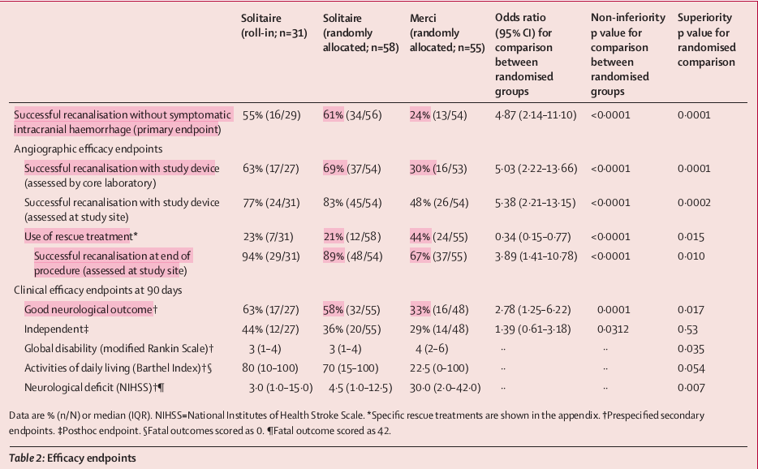
SWIFT

Slide 47
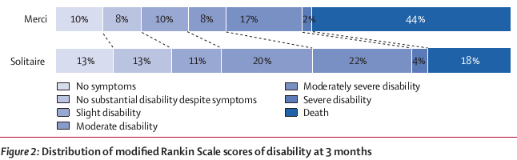

Slide 48
The primary efficacy outcome was achieved more often in the Solitaire group than it was in the Merci group (61% vs24%; p <0·0001)
good 3-month neurological outcome with Solitaire VS Merci → 58% vs33%;
90-day mortality was lower in the Solitaire group than it was in the Merci group (17 vs38 p= 0·0001
The Solitaire Flow Restoration Device achieved substantially better angiographic, safety, and clinical outcomes than did the Merci Retrieval System.

Slide 49
Advantage
Solitaire device pushes the clot against the vessel wall and traps it allowing substantial retrieval traction.
It also retains structural integrity during the pull.
The Merci retriever’s curved loops can slide through rather than engage target thrombus and the coil can unwind and lose structural integrity during the pull.
With regards to intracranial haemorrhage, the Solitaire device exerts less outward radial pressure on the vessel than the Merci Retriever, limiting injury to vascular integrity.

Slide 50
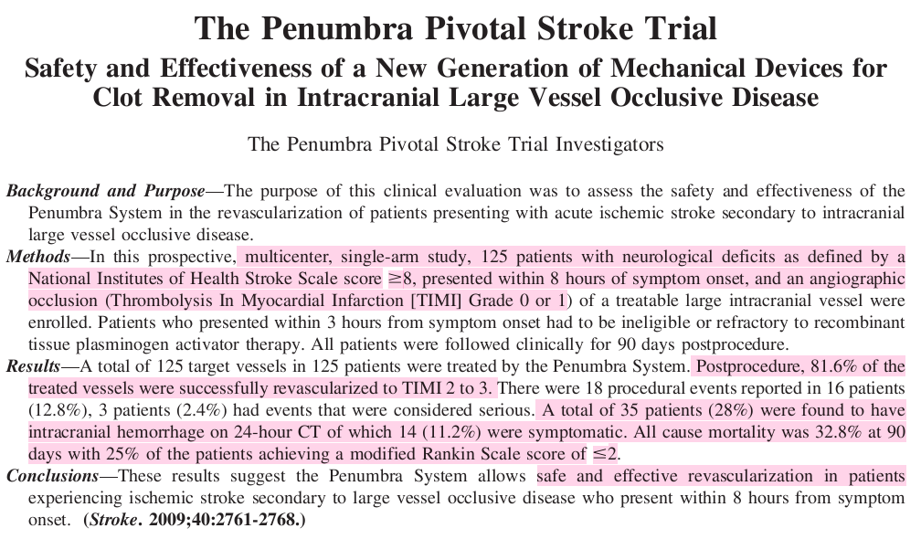

Slide 51
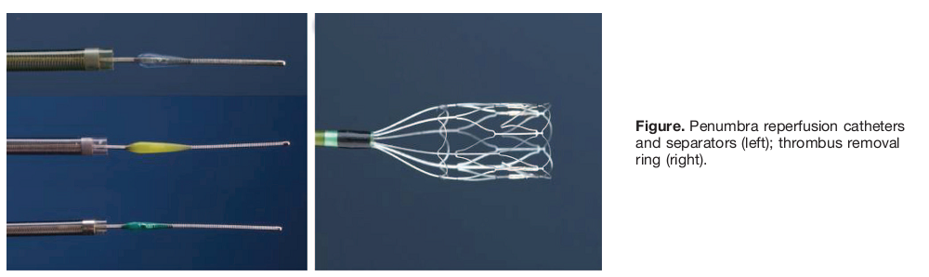

Slide 52
The system provided 2 revascularization options: first with thrombus debulking and aspiration followed by direct thrombus extraction if clots remained.

Slide 53
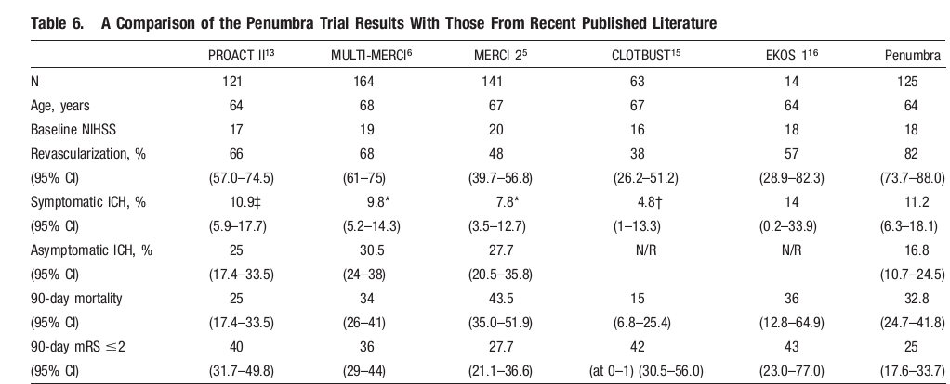

Slide 54
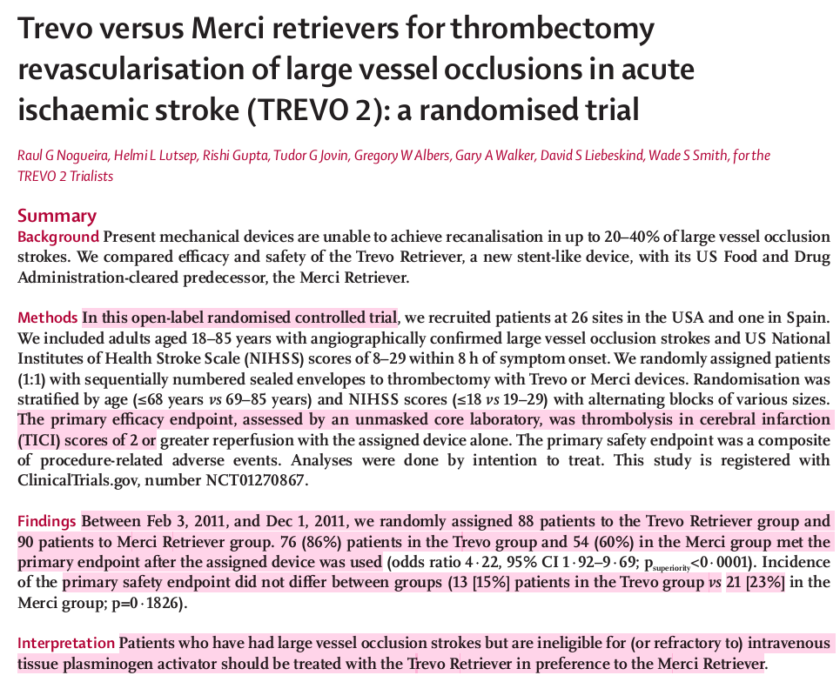


Slide 55
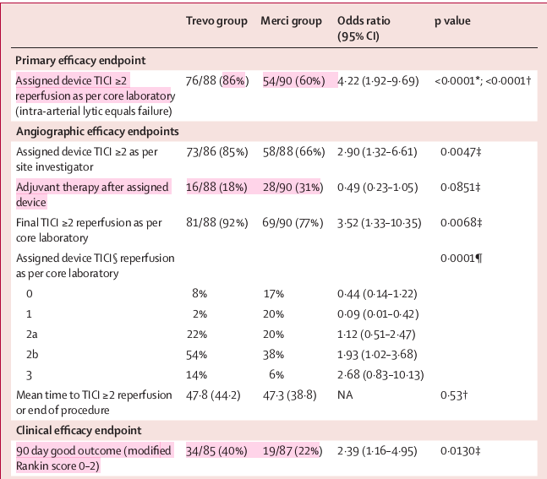

Slide 56
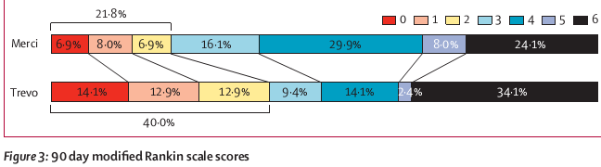

Slide 57
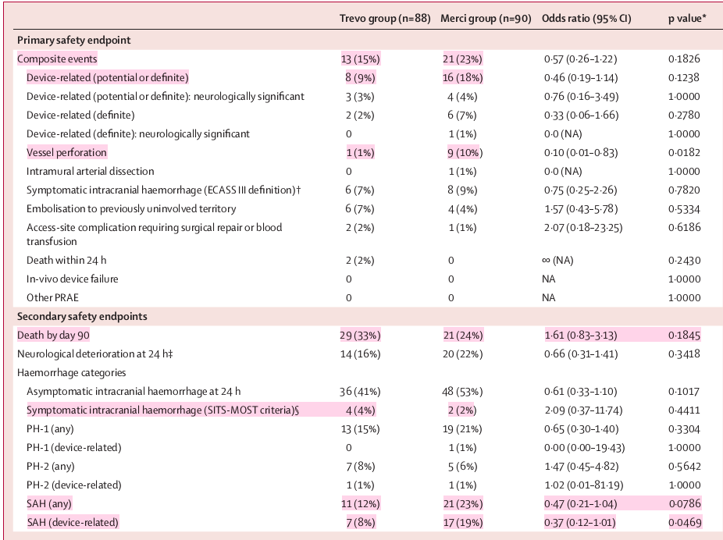

Slide 58
SYNTHESIS
SYNTHESIS is the first randomized controlled trial comparing IAT to IVT with alteplase in acute ischemic stroke.

Slide 59
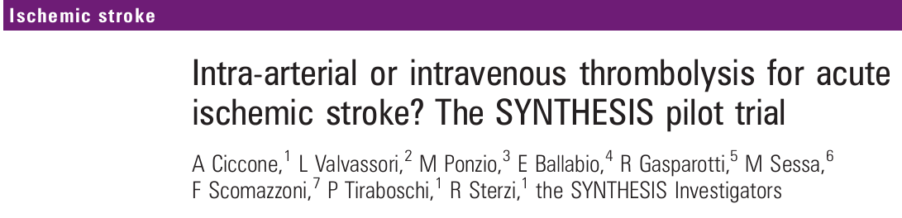

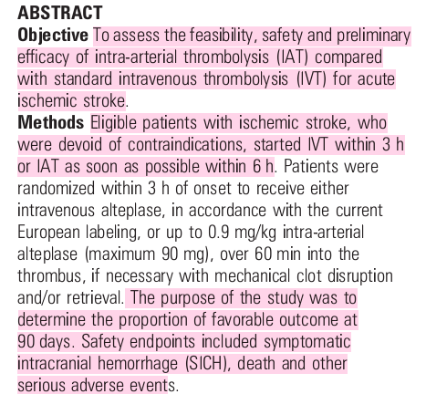

Slide 60
Recanalization rates have been related to improved clinical outcome and there are data suggesting that in patients with large vessel occlusions reperfusion rates with IAT are superior to those obtained with IVT

Slide 61
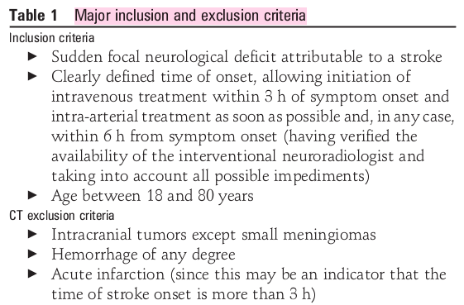

Slide 62
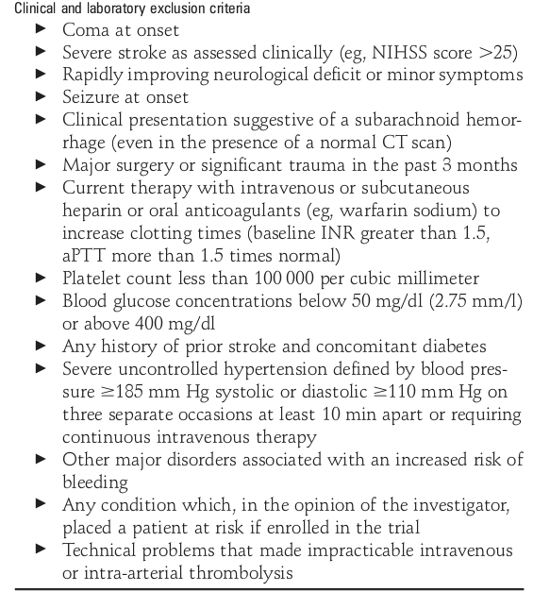
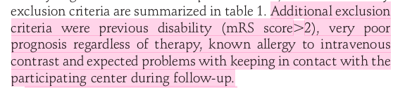

Slide 63
IAT- procedure
A preliminary angiogram is taken
Intravenous heparin was initiated with a 2000 U bolus followed by an infusion of 500 U/h until termination of the angiography.
An infusion microcatheter (3.0 F) placed into the middle of the thrombus
A angiogram performed through the microcatheter to document exactly where the catheter was placed

Slide 64
Alteplase infusion started at a rate of about 0.9 mg/kg/h (maximum 90 mg/h) while the catheter was withdrawn from the proximal surface of the thrombus.
Contrast was injected though the guide catheter every 15 min to verify the occurrence and progression of lysis so as to reposition the microcatheter when necessary

Slide 65
If complete lysis occurred, the infusion was stopped.
Mechanical thrombus disruption was possible during the procedure passing through the thrombus with the infusion microcatheter.
Clot retrieval, but not balloon angioplasty, was allowed

Slide 66
A second CT scan was performed on all patients day 2.
CT was repeated if a new stroke or neurologic deterioration
Neurologic deficit was re-scored with NIHSS on day 7 or discharge, whichever occurred first.

Slide 67
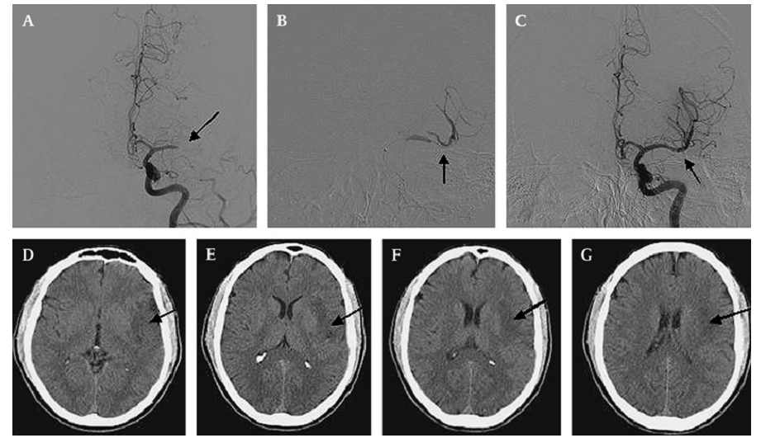
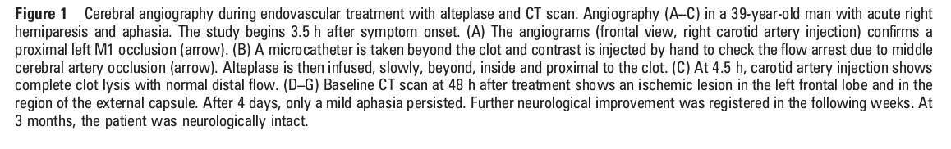

Slide 68
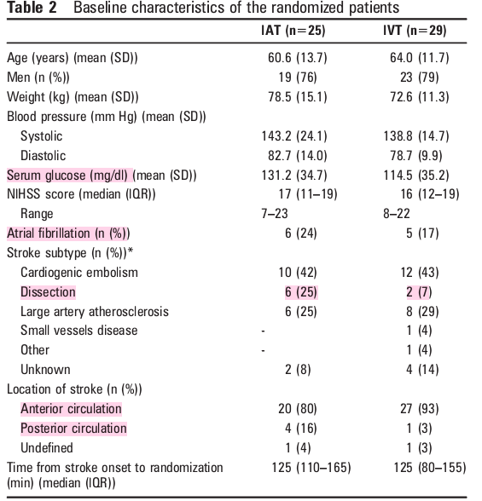

Slide 69
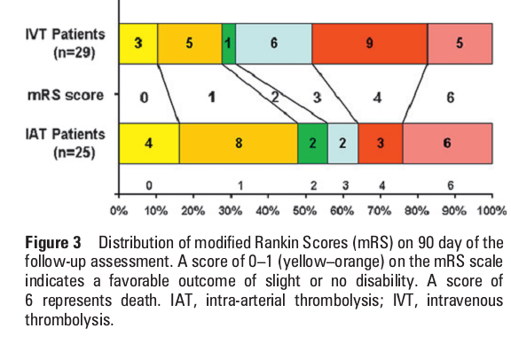

Slide 70
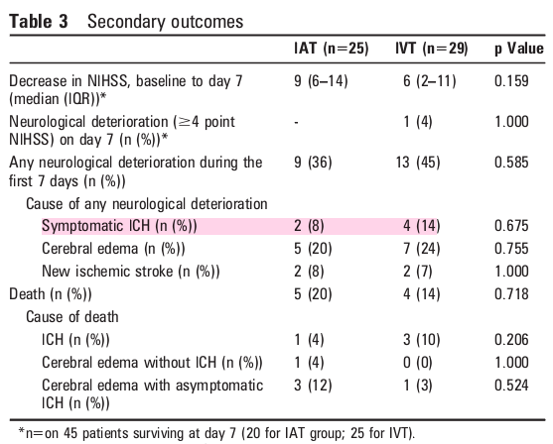

Slide 71
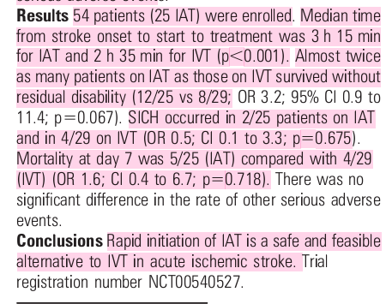

Slide 72
at present IAT cannot be substituted for IVT with alteplase for acute ischemic stroke.
The main question is to establish whether it is ethically and scientifically justified to proceed with further RCTs on IAT for stroke and in particular to randomize a patient to IAT versus IVT.

Slide 73
NINDS and ECASS III trials, ≤mRS 2 is used
Here mRS of 0/ 1 is used

Slide 74
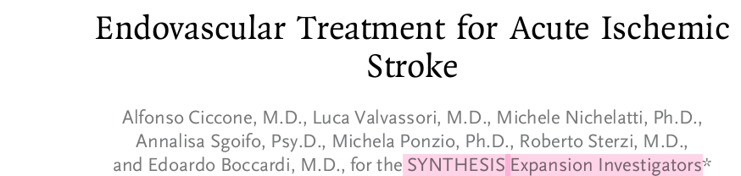
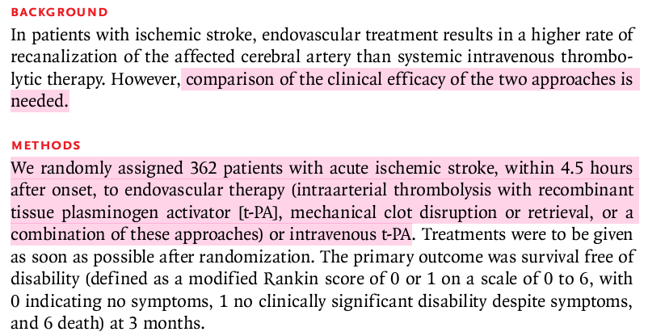

Slide 75
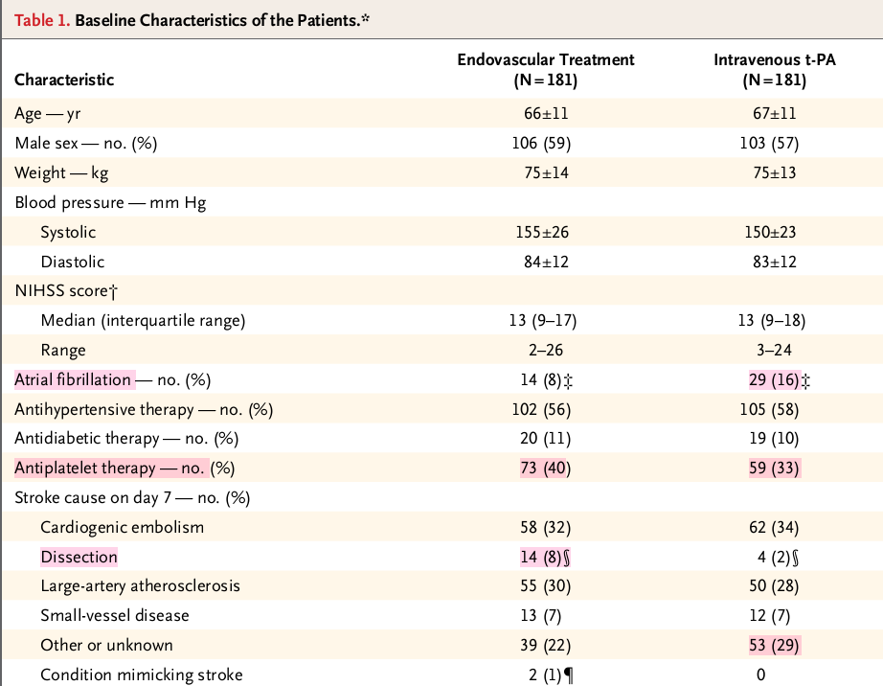

Slide 76
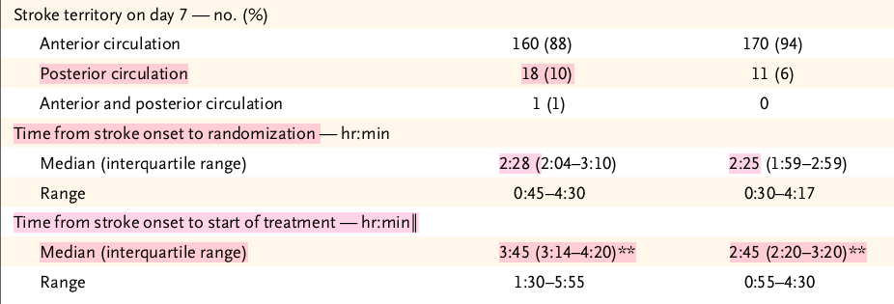

Slide 77
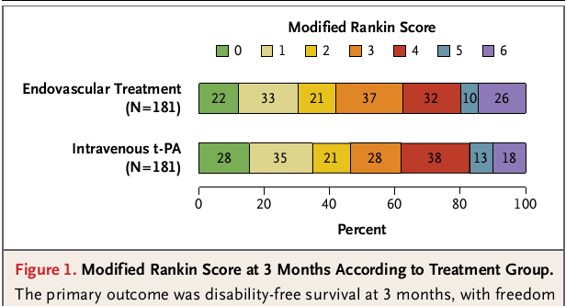

Slide 78
Complications in the 7 days in the endovascular-treatment group and the IV t-PA group included death, neurologic deterioration, fatal and nonfatal symptomatic ICH was similar in 2 groups

Slide 79
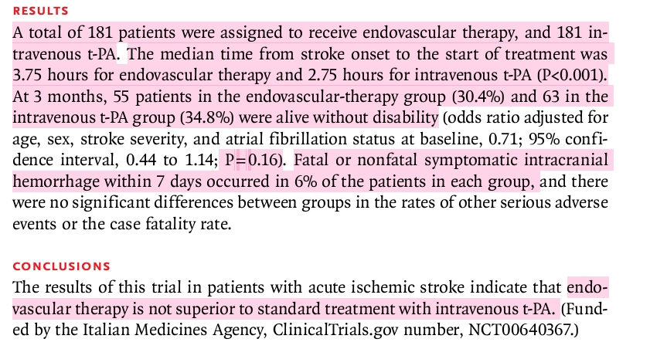
This trial failed to show the superiority of endovascular therapy as compared with intravenous t-PA.

Slide 80
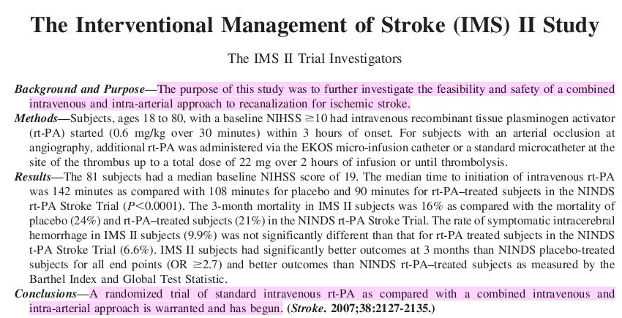

Slide 81
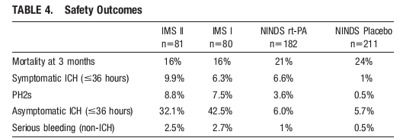

Slide 82
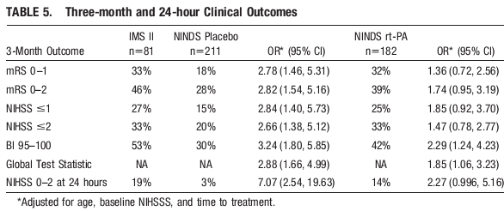

Slide 83
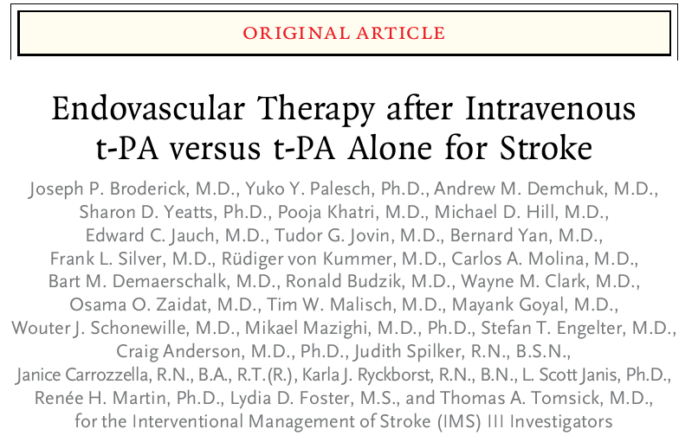

Slide 84
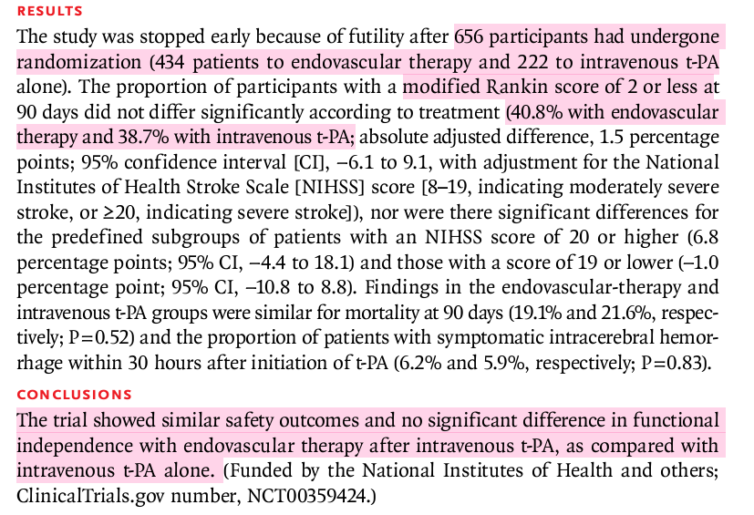

Slide 85
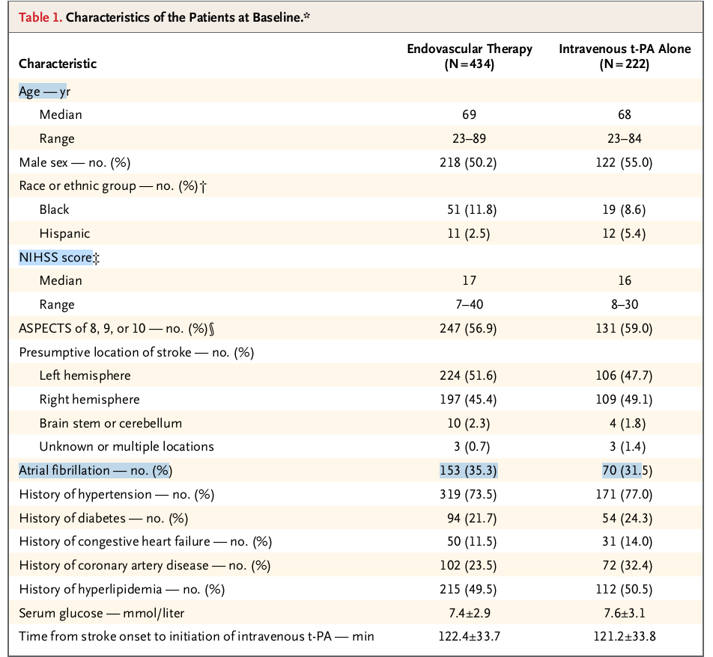

Slide 86
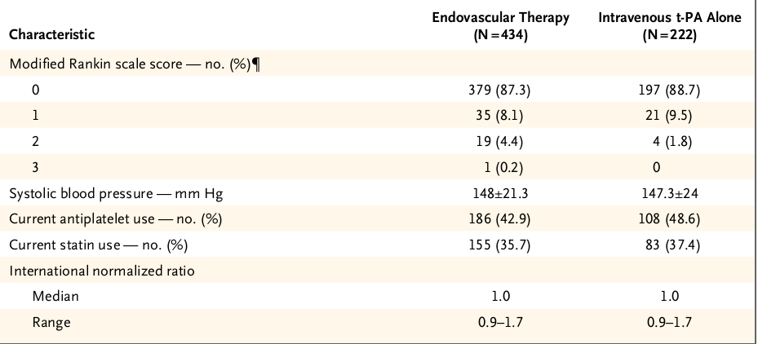

Slide 87
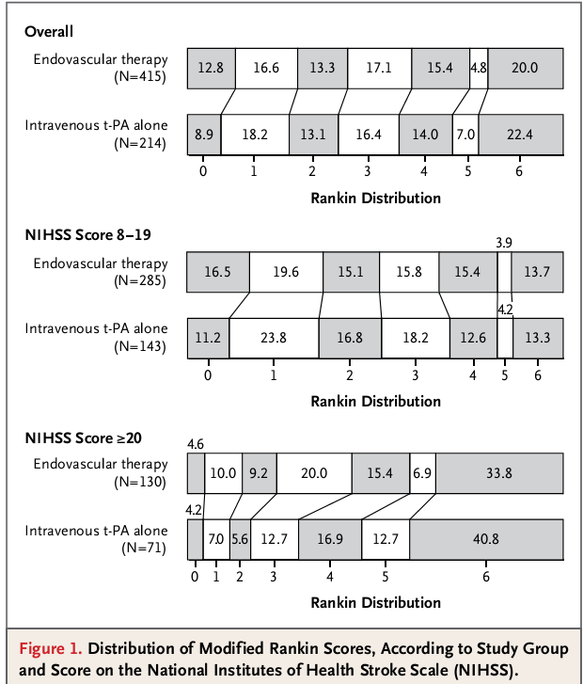

Slide 88
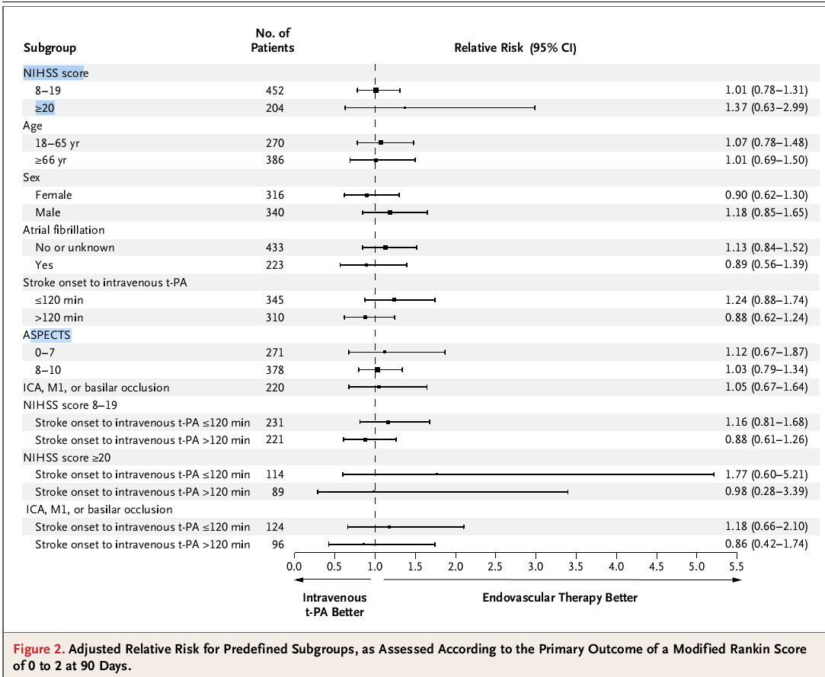

Slide 89
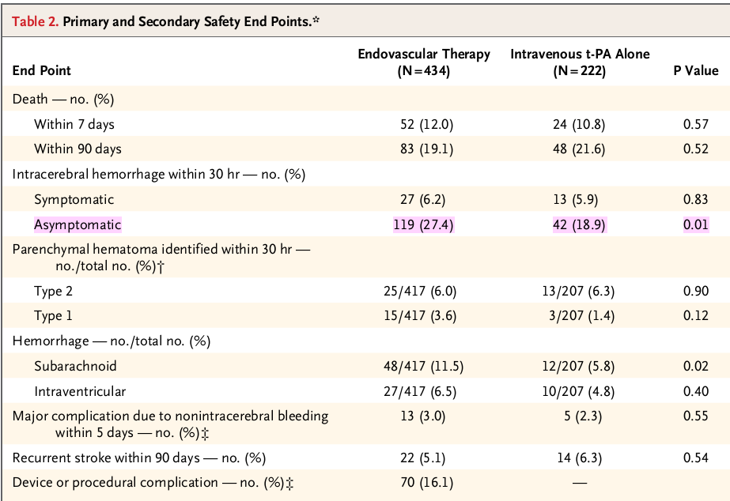

Slide 90
thrombectomy with the Merci
Penumbra System [Penumbra]
Solitaire FR revascularization device
endovascular delivery of t-PA by means of the Micro-Sonic SV infusion system [EKOS] or a standard microcatheter)

Slide 91
Among patients with an occlusion of the internal carotid artery, M1, or both
reperfusion rates, as measured by a TICI score of 2 to 3,
intraarterial t-PA (51 patients) → 71%
MicroSonic SV infusion system with intraarterial t-PA (14 patients)→ 71%
Merci retriever (77 patients)→ 73%
Penumbra System (39 patients)→ 85%
Solitaire FR revascularization device (4 patients)→ 75%

Slide 92
Conclusion
There were no significant differences in mortality at 7 days or 90 days, in the rate of symptomatic intracerebral hemorrhage, or in the rate of parenchymal hematoma, although the rate of asymptomatic intracerebral hemorrhage was higher in the endovascular-therapy group than in the intravenous t-PA group (P = 0.01)
The trial showed similar safety outcomes and no significant difference in functional independence with endovascular therapy after intravenous t-PA, as compared with intravenous t-PA alone.

Slide 93
Stent retrievers were used in only a small number of patients in the IMS III trial before the study was halted because of futility.
Hence, one limitation of our trial is that it did not compare the efficacy of the new stent retrievers with that of intravenous t-PA alone

Slide 94




Slide 95




Slide 96


Slide 97


Slide 98
Conclusion – MR RESCUE trial
A favorable penumbral pattern on neuroimaging did not identify patients who would differentially benefit from endovascular therapy for acute ischemic stroke,
embolectomy was not shown to be superior to standard care.

Slide 99
Limitations of MR – RESCUE trial
use of first-generation embolectomy devices – MERCI and Penumbra
extended time from imaging to embolectomy
the use of intra-venous t-PA in some patients in the standard-care group
Imaging - Patients who were evaluated on CT tended to have larger predicted core volumes than those evaluated on MRI

Slide 100
The trial was completed over an 8-year period, during which time there were advances in techniques and clinical practices
the time to groin puncture was more than 6 hours after the onset of symptoms, which is longer than in many previous trials

Slide 101
IA thrombolysis in post operative patients
Recent history of a major surgical procedure poses systemic bleeding risk in the setting of intravenous rtPA.

Slide 102


Slide 103


Slide 104

RECOMMENDATIONS

Slide 105



Slide 106


Slide 107


Slide 108



Slide 109
Thank you

