Slide 1
GENETICS AND MOLECULAR CLASSIFICATION OF DEGENERATIVE DEMENTIA
Faculty : Dr. Sanjay Prakash

Slide 2
Scheme of presentation
Introduction
Genetics of dementia
Molecular classification
Proteinopathies
Genetics and Molecular pathology of AD and FTD
Conclusion

Slide 3
Introduction
25% of the general population aged 55 years and older → family history of dementia involving a first-degree relative
family history of dementia does not necessarily mean mendelian form of dementia (or genetic mutation) in the family
share environmental and genetic influences,
familial diseases might not always be genetic in origin

Slide 4
Mendelian forms of dementia are rare
500 families with mendelian forms of Alzheimer’s disease reported
Most people with a family history of dementia do not need molecular genetic testing and can be reassured.

Slide 5
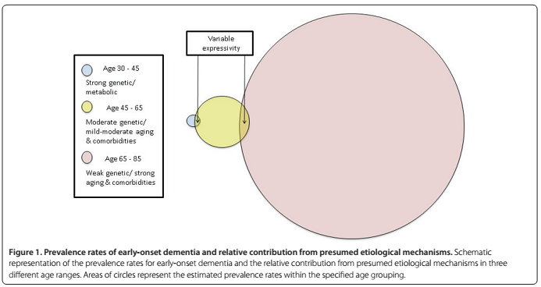

Slide 6
Genetic factors can contribute to familial dementia in two ways:
mendelian forms of dementia
contributing factor towards genetically complex disease

Slide 7
Mendelian diseases
Many genes were discovered in family genetic studies →linkage studies
Mendelian forms of dementia are autosomal dominant with high penetrance
Penetrance of a gene is defined as the probability that an individual who has inherited a mutation in a disease gene goes on to develop the disease phenotype.
Family trees for affected families usually show many affected members in consecutive generations

Slide 8
Mendelian diseases
People carrying pathogenic mutations have a 95% or greater lifetime risk of dementia
The exact risk varies depending on the associated age of onset within the family and on penetrance of the gene.
People not carrying the mutations → same risk of dementia as the general population

Slide 9
Complex diseases
Genetically complex ( polygenic or multifactorial) disease →genetic and environmental factors, individually and in interaction with each other
Genetic factors → genetic variations present in the normal population
A person with a genetically complex disease is unlikely to pass on every one of the many genetic variations to her or his offspring

Slide 10
Complex diseases
Genetically complex diseases can skip a generation,
There can be people affected on both sides of the family
The known genetic variations only account for a small proportion of the overall genetic risk
Genetic testing for any individual genetic variation has poor predictive power for dementia and is not recommended in clinical practice.

Slide 11
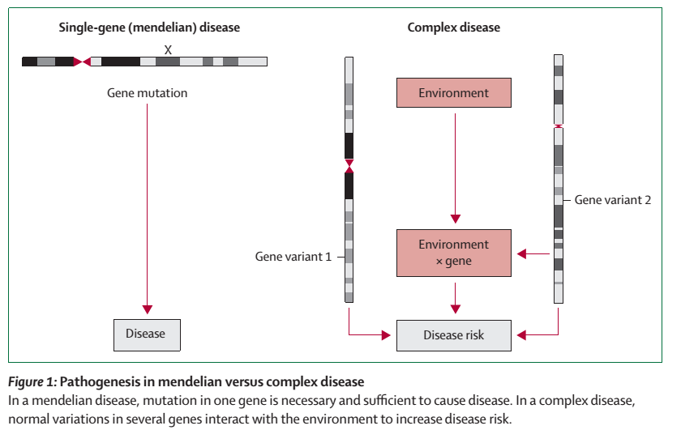

Slide 12
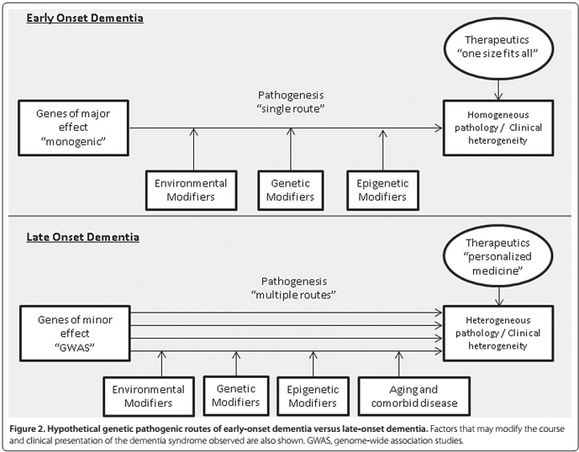

Slide 13
Autosomal dominant Inherited dementias
Alzheimer’s disease
Frontotemporal lobar degeneration spectrum disorders
Prion disease

Slide 14
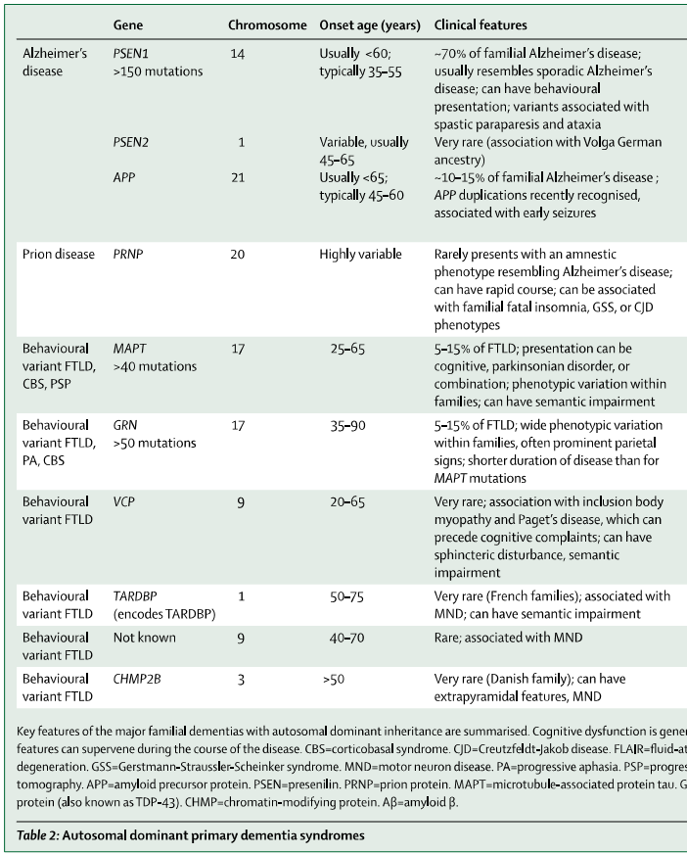

Slide 15
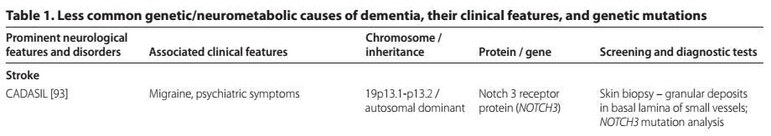
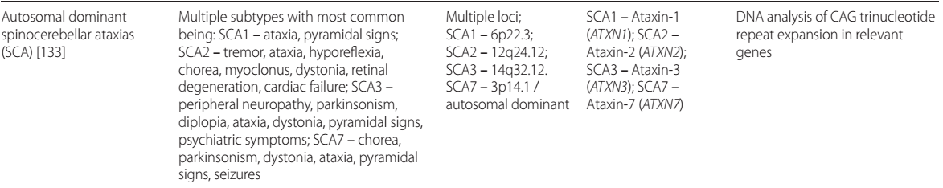

Slide 16
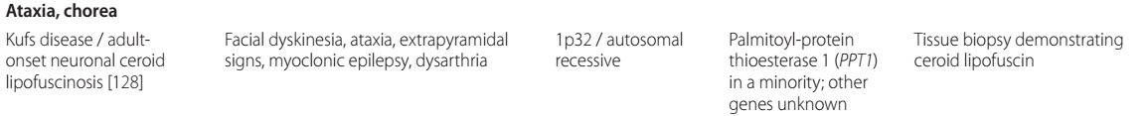
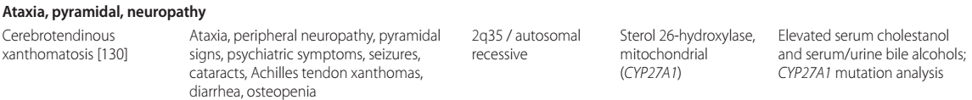
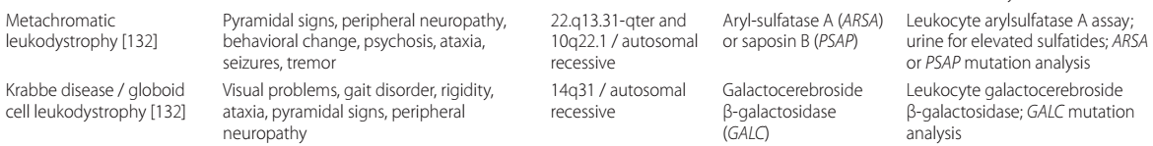
Autosomal recessive dementias

Slide 17
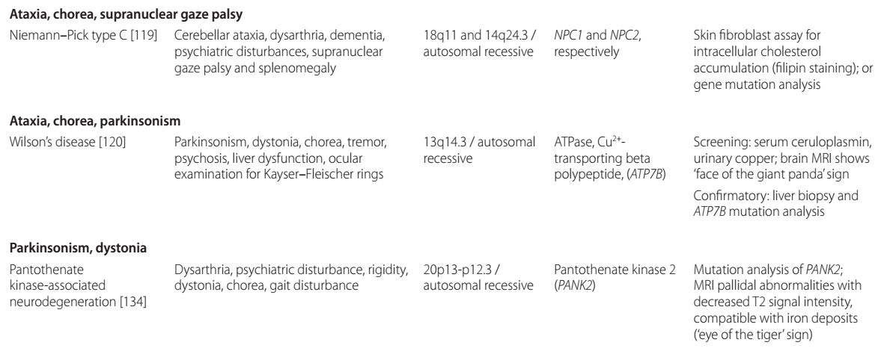
Autosomal recessive dementias

Slide 18
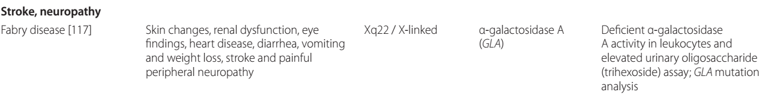
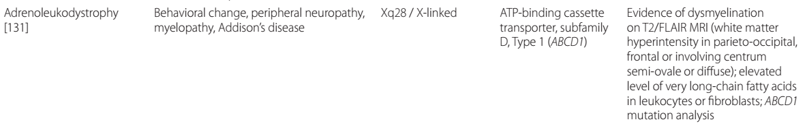
X-linked dementias

Slide 19

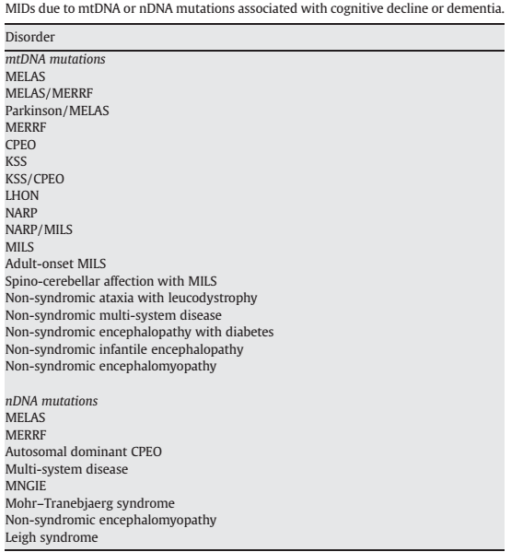
Mitochondrial dementia

Slide 20
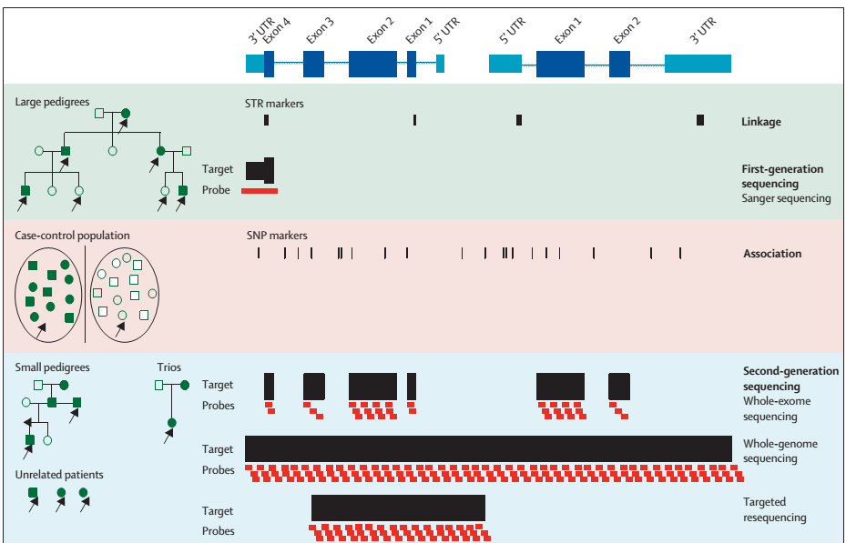
Genetic insights in Alzheimer’s disease;Karolien Bettens;
Lancet Neurol2013; 12: 92–10
Notes:
Linkage studies of large pedigrees are based on STR markers whereas SNP markers are mainly used in association studies of case-control populations . First-generation sequencing or Sanger sequencing consists of individual target amplification and sequencing (one primer set).
Second-generation sequencing (also called massively parallel sequencing or next-generation sequencing) enables the sequencing of several target fragments simultaneously.
Generally, the principle consists of shearing of genomic DNA into short pieces, ligation to adapters, hybridisation to probes, a capturing step (such as coding exons or fragments of choice), an enrichment step, and sequencing on commercially available platforms.
Sanger was mainly Applied in individuals from large families
next-generation sequencing can be applied in case-control populations (arrows, pink) and in patients from smaller pedigrees, trios, or unrelated sporadic Alzheimer’s disease patients.

Slide 21
Molecular classification of dementia

Slide 22
Based on the abnormally accumulated proteins
Amyloid,
Tau,
Synuclein ,
Huntingtin ,
prion protein

Slide 23
Proteinopthies
Aberrant intracellular or extracellular deposition of self aggregating misfolded proteins
Dense fibrillar morphology
High proportion of β-pleated sheet secondary structure
Ubiquitinated ,
Resistant to proteolytic degradation

Slide 24
Amyloidopathy
Taupathy
TDP-43 proteinopathies
FUS proteinopathies
Synucleinopathy
Prionopathy
Polyglutaminopathy

Slide 25
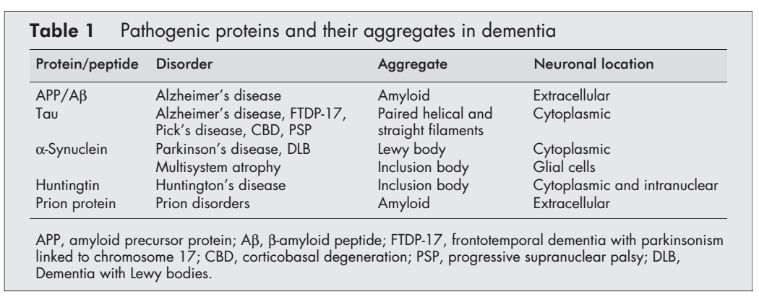

Slide 26
Tauopathies
Tau is a normal component of the neuronal cytoskeleton,
Microtubule associated protein,
Expressed predominantly in axons → stabilise microtubules
Essential for fast axonal transport
More phosphorylated tau and unphosphorylated tau →fails to bind and stabilise microtubules

Slide 27
Three isoforms with three microtubule- binding repeats(3R) excluding exon10
Three isoforms with four microtubule binding repeats (4R) including exon 10
3R :4R Equal amounts in the normal brain

Slide 28
The mutations in the autosomal dominant tauopathies are of two types
Intronic mutations that disrupt the splicing of tau
Missense mutations that alter the function of tau
Loss of normal regulation results in tau aggregation

Slide 29
Tauopathies
Group of disorders accumulation of insoluble hyperphosphorylated tau protein in the brain
Most tauopathies cause dementia,
Combined with extrapyramidal dysfunction
Prototypical tauopathies
Progressive supranuclear palsy(PSP)
Corticobasal degeneration (CBD)
Frontotemporal dementia with parkinsonism linked to chromosome 17 (FTDP-17)

Slide 30
Tauopathies
Alzheimer’s disease
Tauopathy with possible parkinsonism
Tauopathies with predominant parkinsonism
Parkinsonism-dementia complex of Guam
Postencephalitic parkinsonism
Dementia pugilistica
Pantothenate kinase-associated neurodegeneration (PKAN)

Slide 31
Other tauopathies
Pick’s disease
Down’s syndrome
Argyrophilic grain disease
Myotonic dystrophy
Dementia with tangles with or without calcification
Familial British dementia
Familial Danish dementia
Gerstmann-Straussler-Scheinker syndrome
Niemann-Pick type C disease
Subacute sclerosing panencephalitis

Slide 32
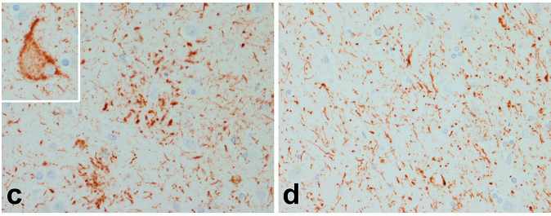
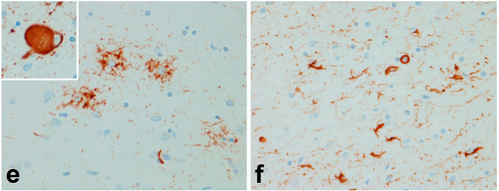
CBD --astrocytic
plaques, appears
as a cluster of short
Tau positive
Processes around a
Central astrocyte (c),
ballooned
neurons (inset)
and thread-like
processes in both
gray and white matter (d)
PSP
astrocytic lesion
tuft of abnormal
fibers (3),
Globose
Neurofibrillary
tangles
oligodendroglia
in white matter
have inclusions
referred to as
“coiled bodies

Slide 33
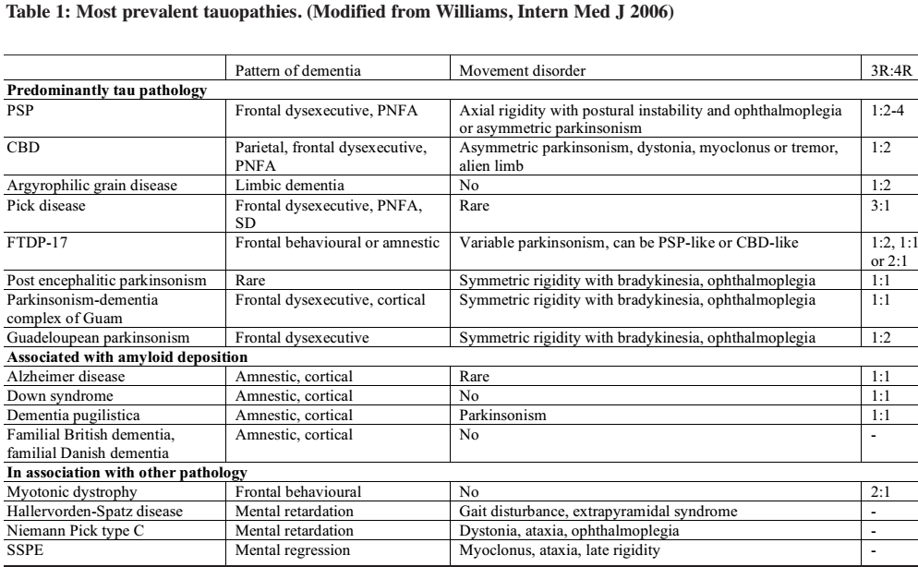

Slide 34
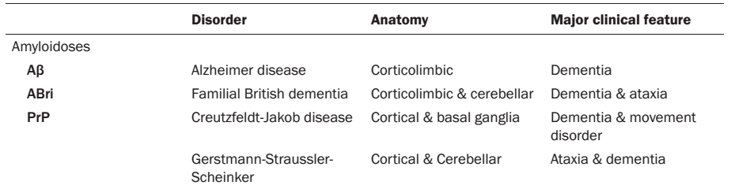
Amyloidopathy

Slide 35
Alzheimer’s disease
Alzheimer’s disease is defined by the presence of two types of abnormal protein deposits:
Extraneuronal amyloid β
Intraneuronal tau
Tangle -bearing cells die→ tau filaments remain in the extracellular space → ghost tangles

Slide 36
Alzheimer’s disease
FAD →Two forms:
Early -onset autosomal dominant -- associated with mutations in one of three genes * rare*
→multigenerational inheritance →young age of onset
Late -onset familial AD→ complex polygenic pattern →increased frequency in families.
Early -onset AD but no family history, mutations within the known Alzheimer’s disease genes →rare

Slide 37
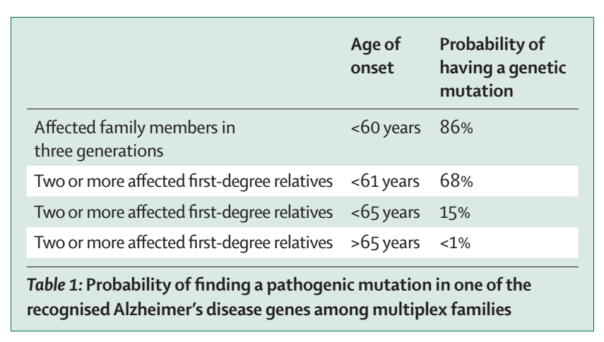

Slide 38
Mendelian inheritance
Three known causative genes for Alzheimer’s disease:
APP,
PSEN1,
PSEN2
86% of families with young-onset (<60 years) dementia in three or more generations have a mutation in the APP, PSEN1, or PSEN2gene

Slide 39
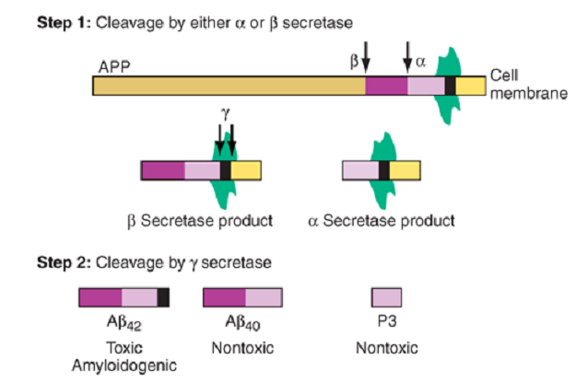

Slide 40
PSEN1 and PSEN2 are both homologous proteins
Active catalytic site aspartate residues needed for the proteolysis of substrates that enter the γ-secretase complex
The γ-secretase complex is composed of four proteins
PSEN1 or PSEN2,
Nicastrin ,
Presenilin enhancer 2
Anterior pharynx defective 1(APH1)→ APH1A or APH1B

Slide 41
PSEN1
Gene on chromosome 14
Mutation in PSEN1is the most frequent cause, accounting for about 60% of mendelian families
>180 FAD-linked PSEN1mutations

Slide 42
Amyloid Precursor Protein
APP gene , long arm of chromosome 21
15% have sequence mutations in APP,
8% duplication of the APP gene
>30 APP missense mutations have been identified 25 are pathogenic

Slide 43
PSEN2
Gene in chromosome 1
Mutations in PSEN2 are rare,
only 22 families reported
Age of onset for PSEN2 families can be as late as the 70s

Slide 44
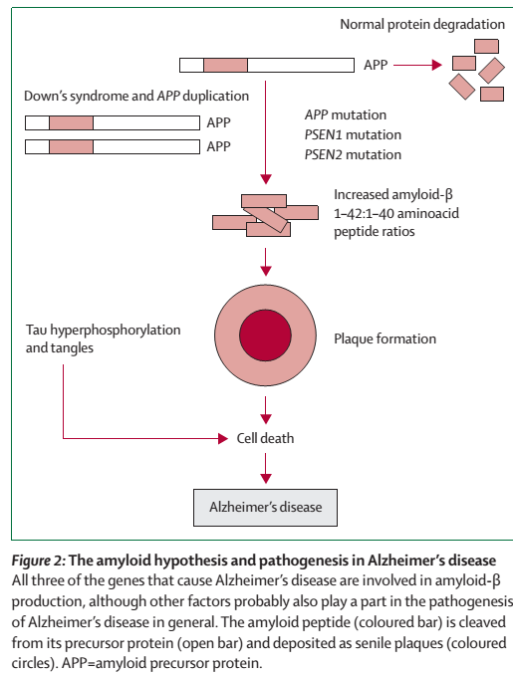
Accumulation
of amyloid β →
amyloid β oligomerisation
tau hyperphosphorylation
and aggregation,
synaptic dysfunction,
nerve cell death,
and brain shrinkage

Slide 45
β-AMYLOID PEPTIDE: AN UNDISPUTED TOXIC PROTEIN
Extracellular cerebral amyloid deposition →42 amino acid β-amyloid peptide (Aβ) hallmarks of Alzheimer’s disease
Neuritic plaques →insoluble dense cores of 5–10 nm thick amyloid fibrils with a paler staining “halo” →surrounded by dystrophic neurites, reactive astrocytes, and activated microglia

Slide 46
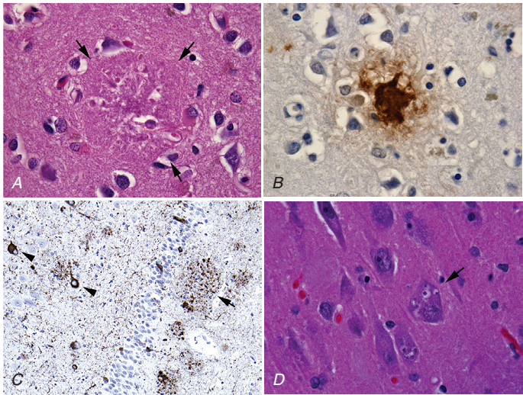
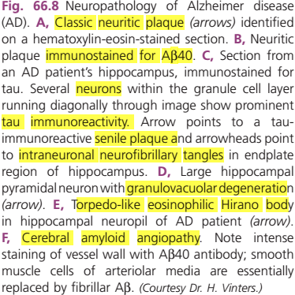
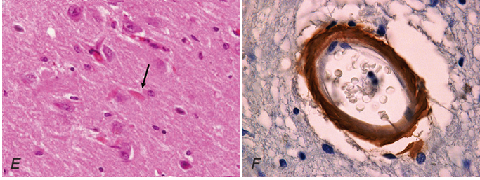

Slide 47
Aβ mediated neurotoxicity → proposed mechanisms
oxidative stress,
free radical generation,
altered calcium homeostasis,
induction of apoptosis,
chronic inflammation,
neuronal structural damage

Slide 48
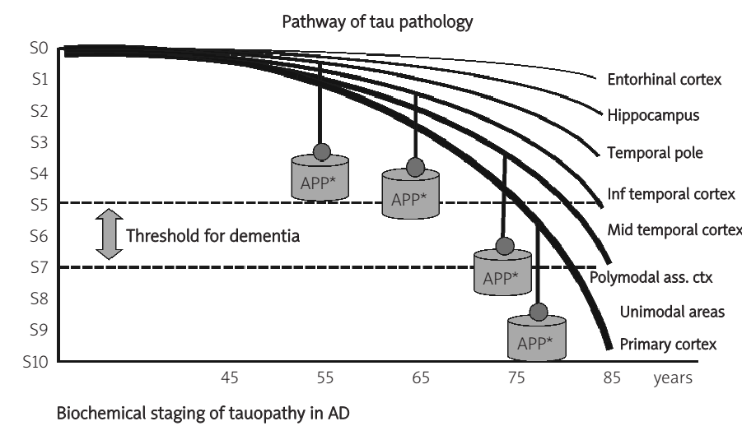
First accumulates in the locus coeruleus →,
Spreads to the entorhinal cortex and other brain regions

Slide 49
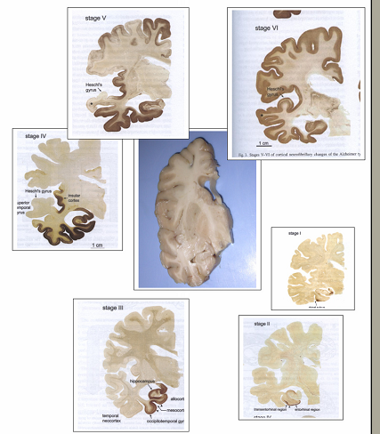
Propagation of tau pathology- Braak stages
Stages 1 and 2-- upper layers of the transentorhinal cortex
Stages 3 and 4-- severe transentorhinal and entorhinal regions, less severe hippocampus and several subcortical nuclei.
Stages 5 and 6-- neocortical association areas

Slide 50
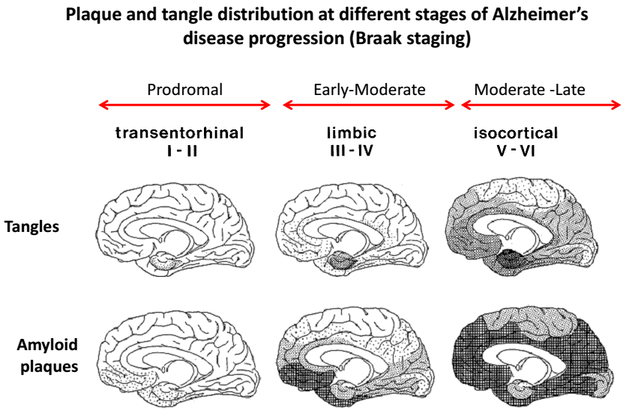

Slide 51
GENETIC TESTING
Screen for PSEN1 mutations first,
early age of onset,
Families with Alzheimer’s disease and spastic paraparesis
APP mutations→ second
APP mutations can also cause cerebral amyloid angiopathy with cerebral haemorrhage
Sequencing of all three genes is normal for a mendelian family → mutation of the APP gene duplication

Slide 52
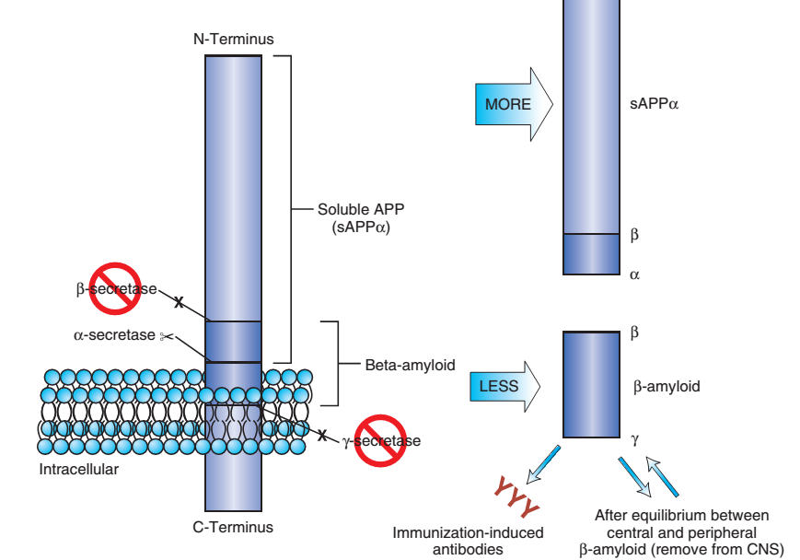
Therapeutic Strategies for amyloid and amyloid plaque reduction .
Notes:
Secretase inhibitors (for both β-secretase and γ –secretase)or enhancers of α-secretase would diminish production of β-amyloid fragments. Production of anti–β-amyloid antibodies by immunization or infusion of anti–β-amyloid antibodies might remove β-amyloid by allowing phagocytosis by microglia or altering equilibrium with the level of β-amyloid in the periphery and causing egress of β-amyloid to serum to be bound.

Slide 53
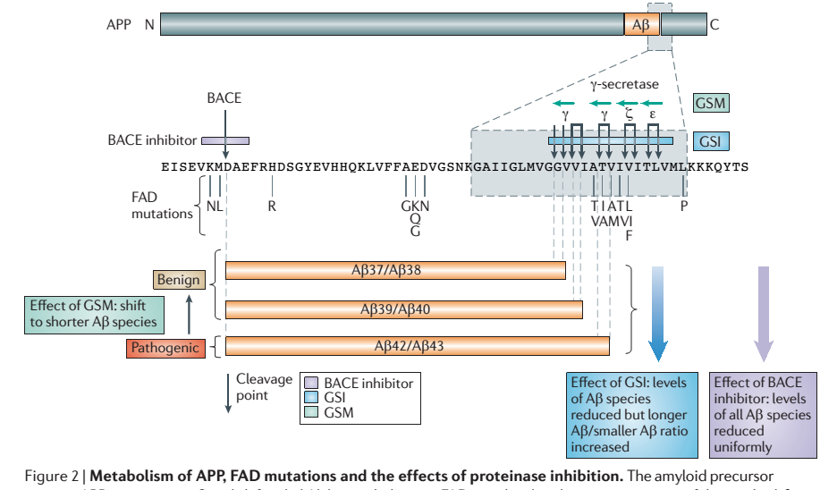
Notes:
β-APP cleaving enzyme (BACE); A γ-secretase modulator (GSM); γ‑secretase inhibitor (GSI)

Slide 54
Complex inheritance
Genetic variations that contribute to disease risk, in a genetically complex manner
ApoE has the greatest effect--confirmed as a “risk gene.”
Compared with people with the common ApoE E3/E3 genotype → ApoE E2/E2 → 0.5 times , →E3/E4 →3times , →E4/E4 →8times more likely to develop Alzheimer’s disease

Slide 55
75% of people carrying one copy of the high-risk E4 allele → free of Alzheimer’s disease
50% of people with Alzheimer’s disease →do not carry the high-risk E4 allele.
Only a risk factor →neither sufficient nor necessary for disease development
Testing of the ApoE genotype is not recommended.

Slide 56
New risk loci for genetically complex forms
GWAS, have identified several additional genetic variations associated with Alzheimer’s disease
Only a small proportion of these variations have been confirmed in replication studies,
The replicated variations have even smaller effects on disease risk than does ApoE

Slide 57
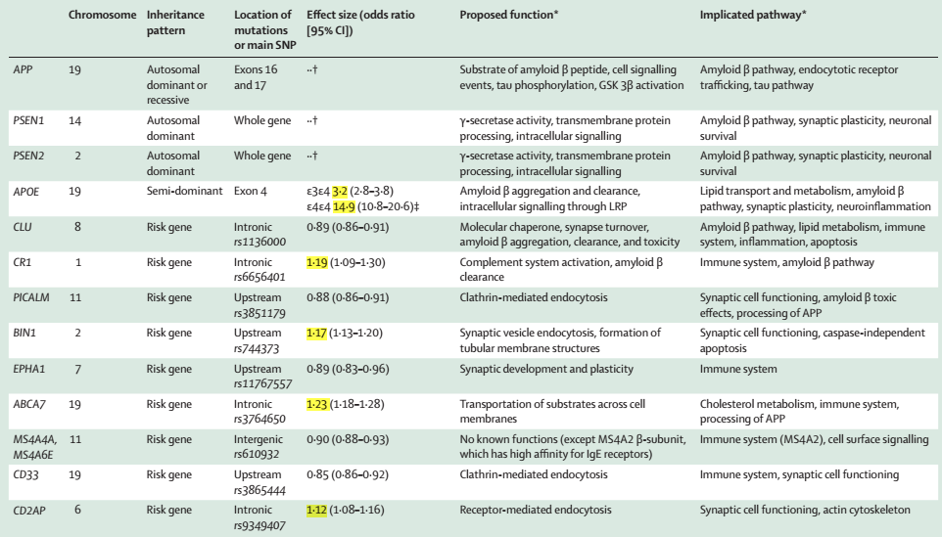

Slide 58
Identification of the novel risk genes increases understanding of the molecular underpinnings of Alzheimer’s disease by showing prominent roles of
lipid-processing pathway (APOE, CLU, and ABCA7),
immune system (CLU, CR1, ABCA7, CD33, and EPHA1)
synaptic-cell-functioning pathways (PICALM, BIN1, CD33, and CD2AP)
amyloid β pathways(CLU, PICALM, BIN1, and CD2AP)
tau pathway(BIN1)

Slide 59
Rare variant in the TREM2 gene→ significant association with AD
Rare variant is unlikely to be used for clinical testing
Notes:
Mutations in the TREM2gene are typically associated with the rare bone and brain disease Nasu-Hakola disease; however, they can also lead to early-onset dementia without bone lesions.

Slide 60
APOE → most important gene for complex Alzheimer’s disease
Lifetime risk of 35% (higher for ε3ε4 carriers at 85 years)

Slide 61
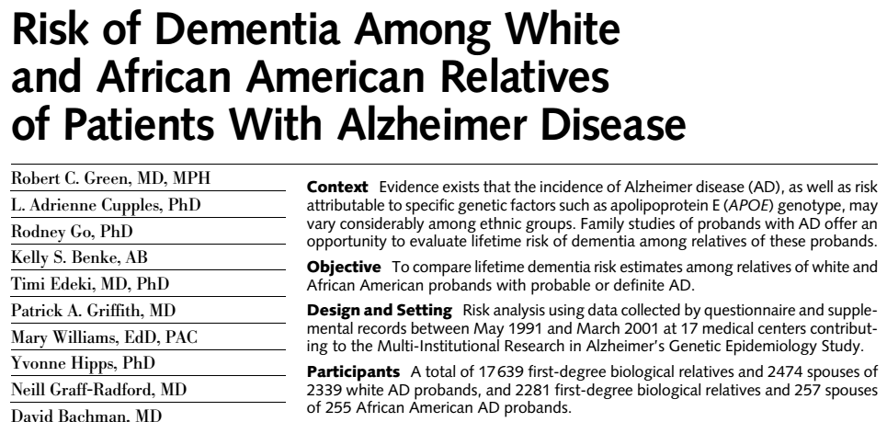
Cumulative dementia risk by age 80
 | white subgroup | African-American subgroup
probands’ first-degree relatives | 18% | 30%
probands’ spouses | 6% | 13%

Slide 62
Frontotemporal dementia
Heterogeneous in clinical presentation, imaging features, underlying histopathological subtypes, and genetics among the mendelian families

Slide 63
Clinical subtypes:
Behavioural -variant frontotemporal dementia,
Primary progressive aphasia →progressive non-fluent aphasia,
→semantic dementia →logopenic variant

Slide 64
Histopathological subtypes (FTLD)
Classified according to immunohistochemical reactivity to proteins
Tau (FTLD-tau),
Transactive response DNA binding protein-43 (FTLD-TDP)
Fused in sarcoma protein (FTLD-FUS)
FTLD-ubiquitin proteasome system (FTLD-UPS)

Slide 65
Relation between genetic mutations and histopathological abnormalities →predictable
Mutations in a specific gene only lead to one histopathological subtype
Clinical subtype and histological changes→ less predictable
overlap in the relation between causative gene and clinical presentation
Histopathological diagnosis in a family member is invaluable in genetic studies

Slide 66
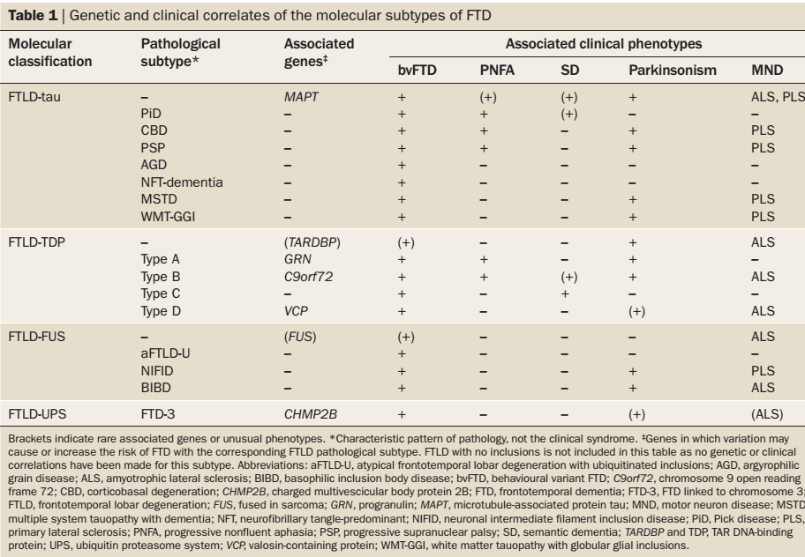
Advances in understanding the molecular basis of frontotemporal dementia;
Rosa et al ; Nat. Rev. Neurol. 8, 423–434 (2012)

Slide 67
Identification of mendelian families in frontotemporal dementia
40–50% of people FTD → family histories of dementia and related disorders, including other neurological or psychiatric diseases
10–30% → autosomal dominant family history

Slide 68
Strong autosomal dominant family history →80% cases →three causative genes
MAPT,
GRN,
C9ORF72.

Slide 69
Tau is a microtubule binding protein involved in the transport of organelles and other cellular components.
Mutation lead to impaired microtubule assembly, impaired axonal transport, and can promote pathological tau filament aggregation

Slide 70
MAPT
Chromosome 17q21.32
MAPT mutation
disrupt tau protein structure
or alter the proportion of different tau isoforms available

Slide 71
GRN (progranulin)
Mutations →null mutations
lead to nonsense-mediated decay of mutant GRN mRNA
reduced expression of progranulin
Mutation carriers can be identified by measuring serum progranulin concentrations

Slide 72
C9ORF72gene
Mutations in C9ORF72 → most common in FTD-MND families
Expanded GGGGCC hexanucleotide repeats in the intronic region of the C9ORF72gene
lower limit of the pathogenic range 65 repeats
Function of the C9ORF72-encoded protein is unknown

Slide 73
Rarer genetic causes of frontotemporal dementia
Chromosome 9 VCPgene
Chromosome 16 FUS gene
Chromosome 3 CHMP2Bgene

Slide 74
Molecular correlates of FTD phenotypes
Semantic dementia → sporadic and associated with FTLD-TDP type C
Sporadic PNFA → FTLD-tau than FTLD-TDP
Early-onset bvFTD with severe psycho behavioural abnormality, but with minimal motor features or aphasia, is characteristic of FTLD-U subtype of FTLD-FUS
FTD is combined with ALS, the pathology is FTLD- TDP
FTD with prominent parkinsonism is more often FTLD-tau

Slide 75
All three frontotemporal dementia genes
→cause behavioural variant frontotemporal dementia
→parkinsonism

Slide 76
Clinical and genetic correlation
Autosomal dominant bvFTD or PNFA without marked motor dysfunction → C9orf72, GRN or MAPT
FTD and Classical ALS →C9ORF72mutation
Motor neuron disease →GRN mutations
Parkinsonism or primary lateral sclerosis → MAPT mutation
Cortico basal syndrome →GRN and MAPT
Psychotic symptoms →38% with C9ORF72mutations
Hallucinations → GRN mutations

Slide 77
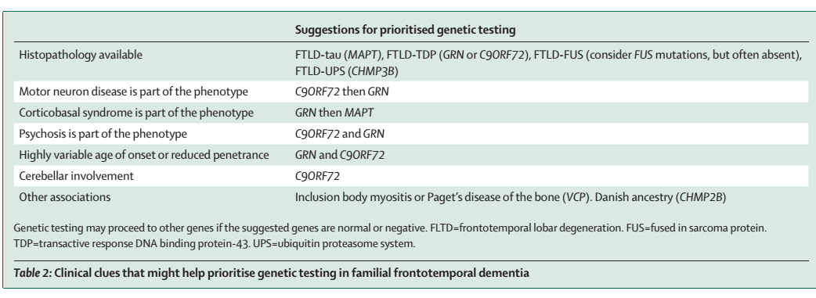

Slide 78
TDP-43
TDP-43 is a highly conserved, predominantly nuclear protein →shuttle between the nucleus and cytoplasm
Accumulation of TDP-43 in neuronal and glial inclusions →characteristic neuropathological feature in ~50% of FTD
Pathological modifications of TDP-43 → redistribution of the protein from the nucleus to the cytoplasm in cells with inclusions, →hyperphosphorylation, ubiquitination and N-terminal truncation of the protein

Slide 79
TDP-43 proteinopathies
Based on the morphology and anatomical distribution of TDP-43 pathology →four distinct FTLD-TDP subtypes
Sporadic and genetic forms
Mutations in GRN, VCP , TARDBP and C9orf72repeat expansion

Slide 80
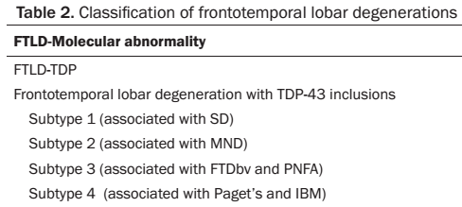

Slide 81
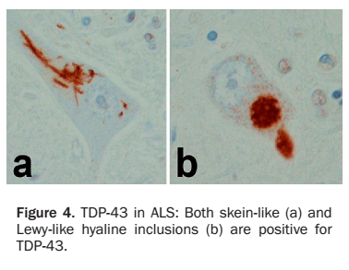

Slide 82
FUS proteinopathies
FUS belongs to the FET protein family
highly conserved, ubiquitously expressed,
Predominantly nuclear multifunctional DNA/RNA-binding proteins
Bind to a large number of partially overlapping RNA targets

Slide 83
FUS proteinopathies
FUS →most characteristic marker for the pathology Tau /TDP-negative FTLD cases,
Three closely related but distinct clinicopathological entities:
Atypical FTLD-U (aFTLD-U),
Neuronal intermediate filament inclusion disease,
Basophilic inclusion body disease

Slide 84
FTLD-FUS as a new molecular subgroup provided further evidence that FTD and ALS are closely related conditions
~3% of familial ALS →pathology was characterized by FUS-positive, TDP-43-negative inclusions
ALS with FUS pathology is almost always caused by a FUS mutation
FTLD-FUS tend to be sporadic

Slide 85
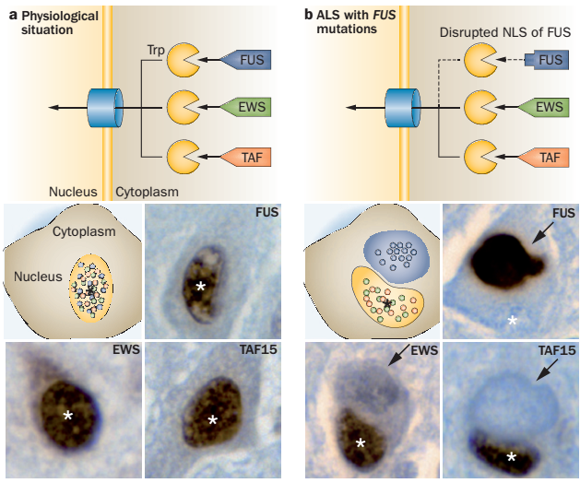
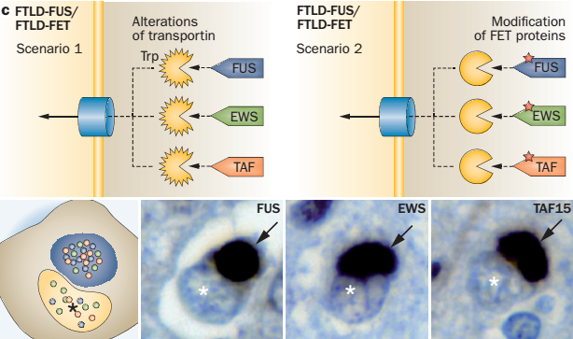
physiological conditions→ the FET proteins bind normally to Trp and all have predominantly nuclear localization
In ALS-FUS, the NLS of FUS is disrupted

Slide 86
Families without a mendelian family history of frontotemporal dementia
First -degree relatives of FTD → cumulative incidence of dementia before age 80 years 22%.
People with a non-mendelian family history of frontotemporal dementia have roughly twice the lifetime risk of dementia compared with the general population

Slide 87
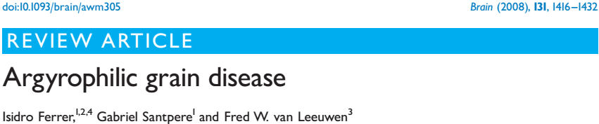
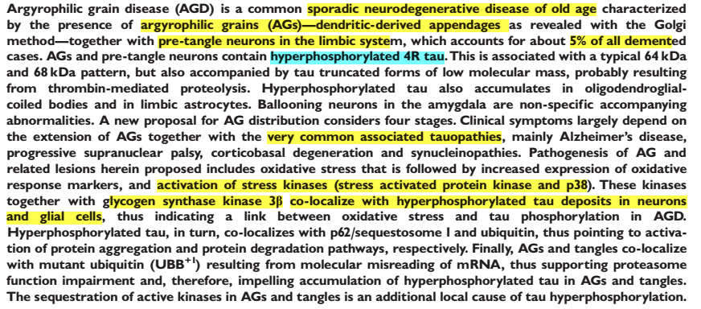

Slide 88
No specific test for a clinical diagnosis of AGD.
Involvement of structures similar --mild cognitive impairment and AD
Difficult to distinguish AD from AGD on neuroradiological data.
Neuroimaging studies--atrophy of the anterior part of the temporal and frontal lobes or non-specific cerebral atrophy

Slide 89
Synucleinopathies
Synucleinopathies commonly associated with dementia
Parkinson’s disease (PD)
Dementia with Lewy bodies (DLB)
Other synucleinopathies
Multiple system atrophy (MSA)
Pure autonomic failure

Slide 90
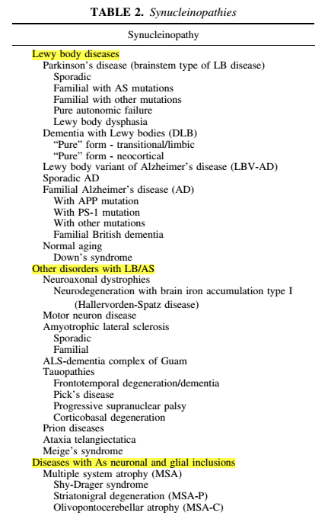

Slide 91
Synuclein
Synuclein → normal protein that is developmentally regulated →becoming associated with the synapse on maturity
Mutations in the synuclein gene result in protein self aggregates
Reduce turnover of synuclein by the proteosome

Slide 92
DEMENTIA WITH LEWY BODIES
The genetics of DLB has been poorly understood
Duplications in the α-synuclein (SNCA) gene on chromosome 4
the leucine-rich repeat kinase 2 (LRRK2) gene on chromosome 12
Mutations in the glucocerebrosidase (GBA) gene on chromosome 1

Slide 93
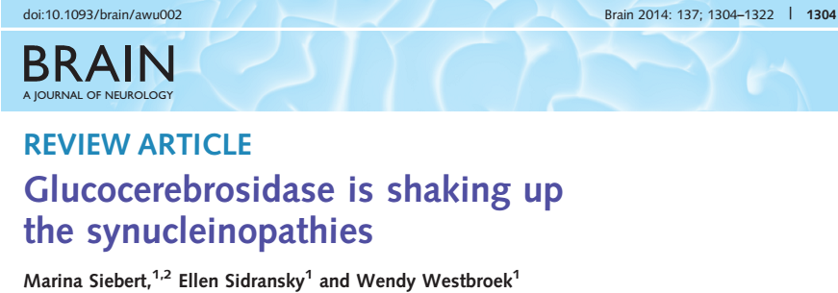
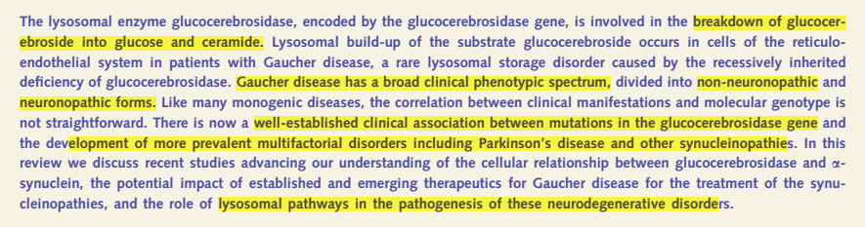

Slide 94
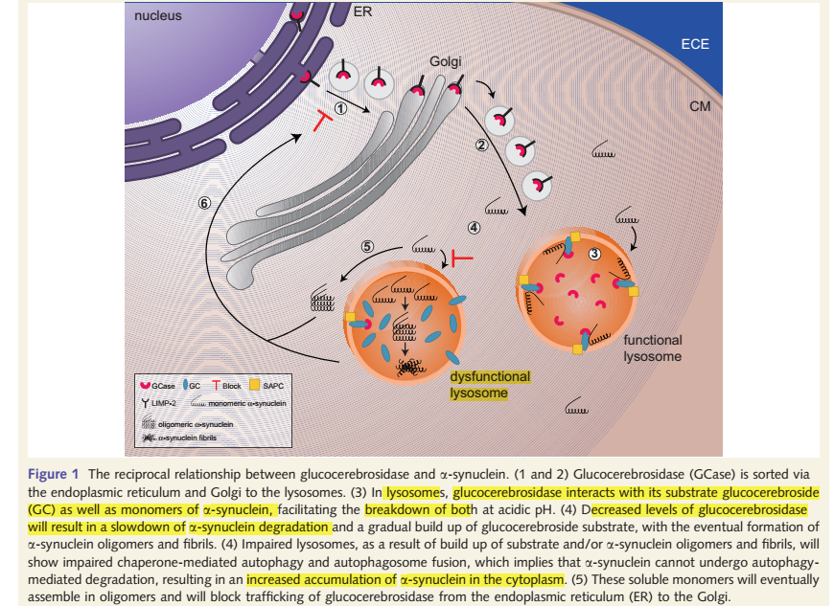

Slide 95
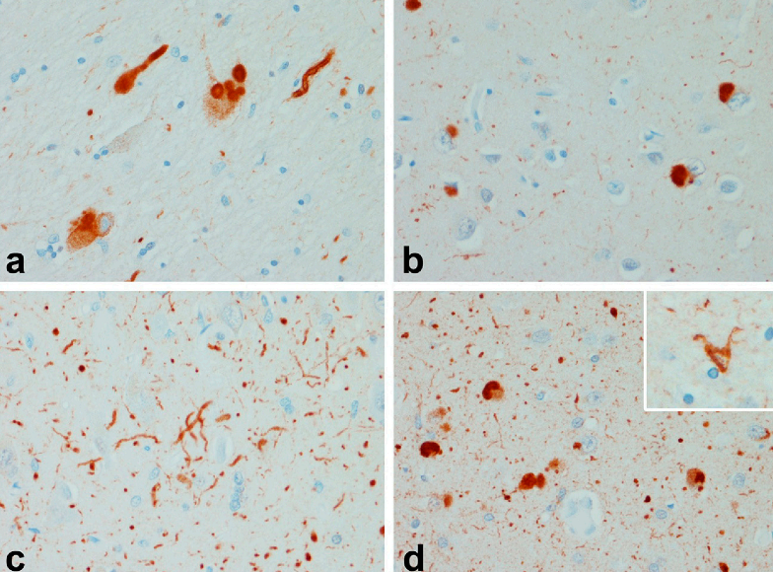
neurons in basal nucleus of Meynert (a) have dense round inclusions (Lewy bodies) ; Lewy bodies
with axons; neuronal inclusions in cortical neurons (b) neurites in the hippocampus (c) and
amygdala (d)

Slide 96
PRION PROTEIN AND TRANSMISSABLE SPONGIFORM ENCEPHALOPATHIES
Prion protein gene , PRNP, is located on chromosome 20.
Human PrPC → 253 amino acid membrane associated glycoprotein →expressed by neurons and lesser extent by astrocytes
Mutant PrPC → PrPsc, template for misfolding of the nonpathogenic PRP protein
10%−20% of human prion disease is inherited as autosomal dominant .
wide range of point mutations and insertions in PRNP gene

Slide 97
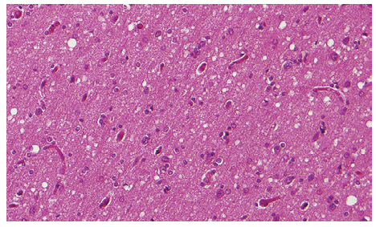
Prion Dementias
CREUTZFELDT-JAKOB DISEASE
Altered conformation makes them pathogenic
(1) spongiform degeneration of neurons,
(2) severe astrocytic gliosis out of proportion to neuron loss,
(3) amyloid plaque formation,
(4) lack of inflammatory reaction

Slide 98
HUNTINGTIN AND THE POLYGLUTAMINE TOXIC PROTEINS
Mutated huntingtin aggregate →change in structural properties resulting from increased polyglutamine length
Whether it is the nuclear or the cytoplasmic accumulation of huntingtin that results in neuronal toxicity is not entirely clear

Slide 99
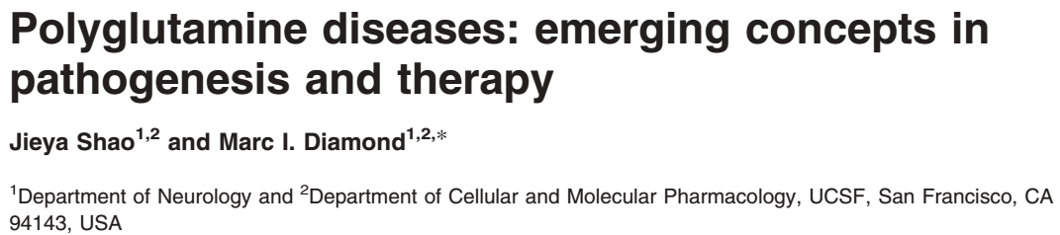
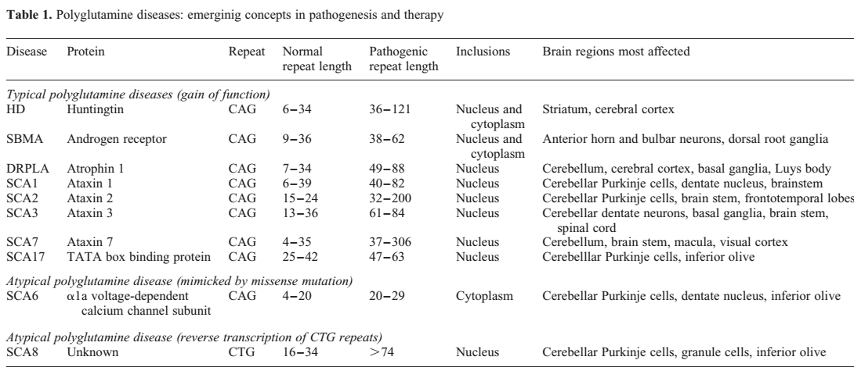

Slide 100
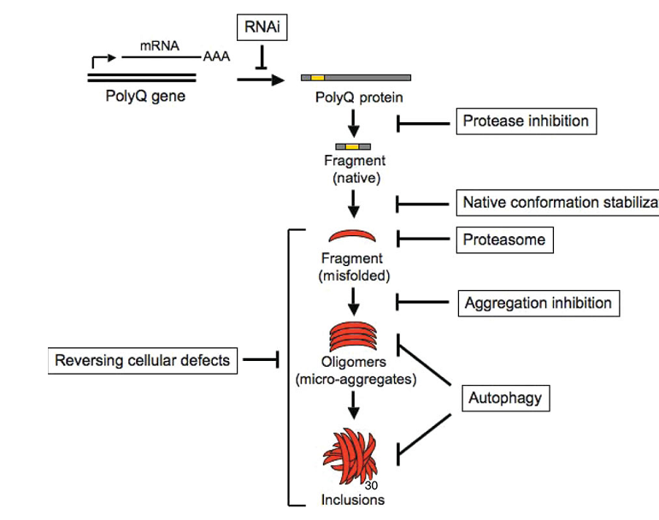

Slide 101
CADASIL
Notch3 gene product →transmembrane receptor,
limited to vascular smooth muscle cells.
Accumulation of the protein in eosinophilic deposits → media of the small cerebral artery
angiopathy of small arteries and capillaries
Recurrent strokes and cognitive loss (Subcortical dementia syndrome)
seizures, migraine-type headaches with aura, and clinical and subclinical strokes

Slide 102
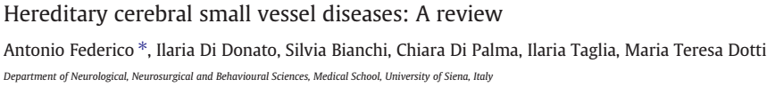


Slide 103
Familial dementia with additional neurological features
Cognitive impairment is common in neurogenetic disorders
Familial dementia often presents with additional neurological features

Slide 104


Slide 105


Slide 106
Framework for genetic testing in dementia
The first step in considering molecular genetic testing for dementia is to obtain a detailed and accurate family history,
Identify families with family histories consistent with mendelian rather than complex inheritance

Slide 107
The second step is to obtain an accurate phenotype for the family to inform the choice of genetic test.
Genetic testing can then be considered, ideally starting with an affected family member

Slide 108
Obtaining an accurate phenotype
Validated retrospective informant based questionnaires that might be helpful
Psychiatric history is an integral part of the family history of disease, especially for frontotemporal dementia
Accurate record of age of onset is particularly helpful for families with a history of Alzheimer’s disease
Histopathological diagnosis in a family member can be invaluable.

Slide 109
Considerations for genetic testing
The first person to be tested in a family must be an affected individual
Pathogenic mutation is detected, this will confirm the diagnosis at the molecular level and makes testing available for other family members
Negative result for a genetic test in patients with a strong family history of disease→ possible strategy participate in genetic research

Slide 110
THANK YOU

Slide 111
References
Bradley ;6th edition
Harrison’s Principles of Internal Medicine ; 18th
Genetics of dementia ;Clement T Loy, Lancet2014; 383: 828–40
Tau pathology and neurodegeneration;Maria Grazia Spillantini; Lancet Neurol2013; 12: 609–2
Early-onset dementias: diagnostic and etiological considerations Masellis et al. Alzheimer’s Research & Therapy2013, 5(Suppl 1):S7
Glucocerebrosidase is shaking up the synucleinopathies; Marina Siebert ;; Brain 2014: 137; 1304–1322
Clinic, neuropathology and molecular genetics of frontotemporal dementia: a mini-review;Xiao-dong Pan ; Translational Neurodegeneration2013,2:8
Tauopathies:OneDiseaseorMany? ManonBouchard,; Can. J. Neurol. Sci. 2011;38:547-556

Slide 112
References
Neuropathology of non-Alzheimer degenerative disorders Dennis W. Dickson; Int J Clin Exp Pathol 2010;3(1):1-23
Advances in understanding the molecular basis of frontotemporal dementia ;Rosa Rademakers; Nat. Rev. Neurol. 8, 423–434 (2012);
Green RC, Cupples LA, Go R, et al. Risk of dementia among white and African American relatives of patients with Alzheimer disease. JAMA2002; 287:329–36.
Pan and ChenTranslational Neurodegeneration2013,2:8
Protein aggregates and dementia: is there a common toxicity?;S Lovestone; J Neurol Neurosurg Psychiatry2002;72:152–161
Neuropathological Spectrum of Synucleinopathies ;Kurt A. Jellinger ; Movement Disorders ;Vol. 18, Suppl. 6, 2003, pp. S2–S12

Slide 113
All are Taupathies except
PSP
CBD
MSA
AGD

Slide 114
GBA1 mutation causes
PSP
CBD
DLB
FTD

Slide 115
Autosomal recessive disorder with dementia
Fabry’s disease
Fragile X ataxia tremor syndrome
Cerebrotendinous xanthomatosis
Dentatorubral pallidoluysian atrophy

