Slide 1
CLINICAL APPROACH TO DYSTONIA
Faculty : Dr. Kaushik Rana

Slide 2
Scheme of presentation
Introduction
Classification of dystonia
Clinical approach
Investigations
Treatment

Slide 3
Definition
Dystonia is a movement disorder that causes sustained muscle contractions, repetitive twisting movements, and abnormal postures of the trunk, neck, face, or arms and legs
Phenomenology and Classiﬁcation of Dystonia: A Consensus Update; Movement Disorders, May 2013

Slide 4
Dystonic movements are typically patterned, twisting, and may be tremulous.
Dystonia is often initiated or worsened by voluntary action and associated with overﬂow muscle activation
Phenomenology and Classiﬁcation of Dystonia: A Consensus Update; Movement Disorders, May 2013

Slide 5
History
Term “dystonia” was coined by Oppenheim in 1911
Described four young patients with a disorder causing variable muscle tone and recurrent muscle spasm.
Initially called ‘dystonia musculorum deformans’
Later termed primary torsion dystonia

Slide 6
Characteristics of dystonia
Concurrent contractions of agonist and antagonist muscles
Contractions follow a directional pattern but the speed and intensity may vary
Worse during action and in certain postures
Improves with relaxation and sleep.

Slide 7
Geste antagoniste or sensory trick
Voluntary actions that speciﬁcally correct the abnormal posture or alleviate the dystonic movements.
Usually simple movements (“gestes”) involving, or directed to, the body region affected by dystonia
Does not consist of a forceful opposition to the phenomenology of dystonia.

Slide 8
Tremor in dystonia
Dystonic tremor
Tremor associated with dystonia (TAD)

Slide 9
Dystonic tremor
Tremor in an extremity or body part that is affected by dystonia
Focal tremors, usually with irregular amplitudes and variable frequency (mainly less than 7 Hz).
Mainly postural/kinetic tremors and usually not seen during complete rest.
Null point – tremor may disappear when dystonic posture is allowed to develop fully

Slide 10
Tremor associated with dystonia
Tremor occurs in a body part not affected by dystonia, but the patient has dystonia elsewhere.
Patients with cervical dystonia may have upper limb postural tremor similar to essential tremor
Tremor could be an isolated finding in families with dystonia

Slide 11
Dystonic myoclonus
Rapid jerky dystonic movements
Occurs in the site affected by dystonia
Not a ‘plus’ sign

Slide 12
Other phenomena
Motor overﬂow
  Unintentional muscle contraction which accompanies, but is anatomically distinct from the primary dystonic movement
  Occurs at the peak of dystonic movement
Mirror dystonia
  Unilateral posture or movement that is similar in character to a dystonic feature that can be elicited, usually in the more severely affected side, when contralateral movements or actions are performed

Slide 13
CLINICAL APPROACH TO DYSTONIA

Slide 14
Classification of dystonia
Three axes by Fahn, Marsden, and Calne
  Age of onset
  Distribution
  Etiology
Fahn S. Concept and classiﬁcation of dystonia. Adv Neurol 1988;50

Slide 15
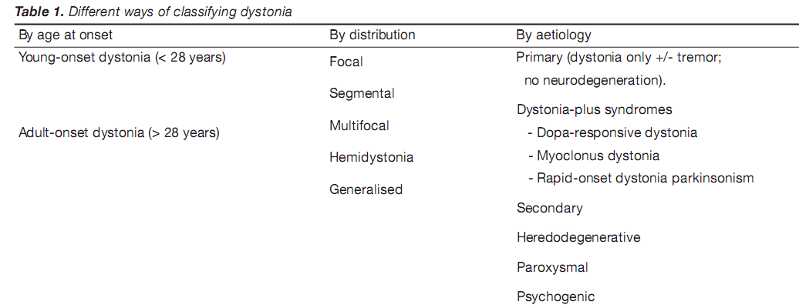

Slide 16
Revised classification : 2013 update
2 axes
Axis II
Etiology
Axis I
Clinical characteristics

Slide 17
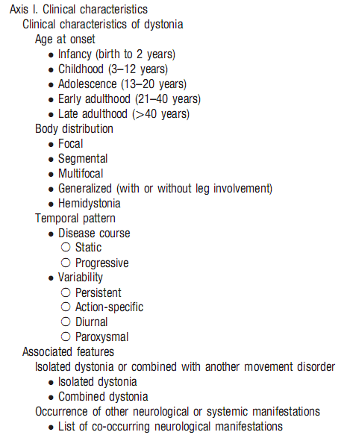

Slide 18
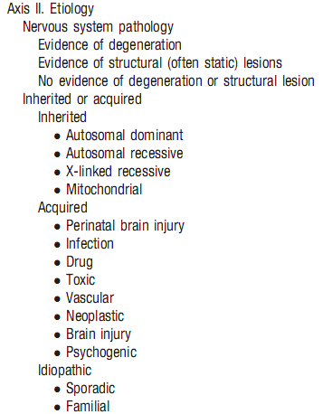

Slide 19
Age of onset
Age of onset gives a clue to the etiology
  Infancy (birth to 2 years)
  Childhood (3–12 years)
  Adolescence (13–20 years)
  Early adulthood (21–40 years)
  Late adulthood (>40 years)

Slide 20
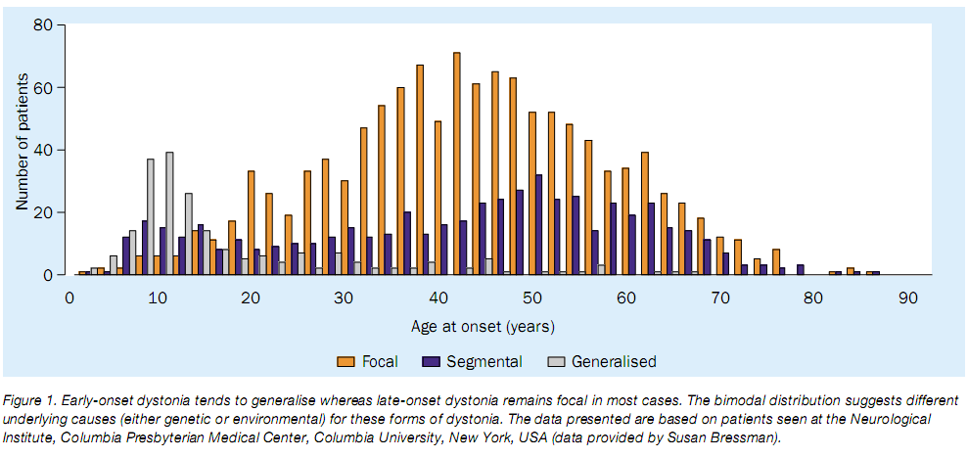
Distribution of dystonia with age of onset

Slide 21
Body Distribution
Focal
Only one body region
Segmental
Two or more contiguous body regions
Multifocal
Two noncontiguous or more (contiguous or not) body regions
Generalized
Trunk and at least 2 other sites (with or without leg involvement)
Hemidystonia
Regions restricted to one body side

Slide 22
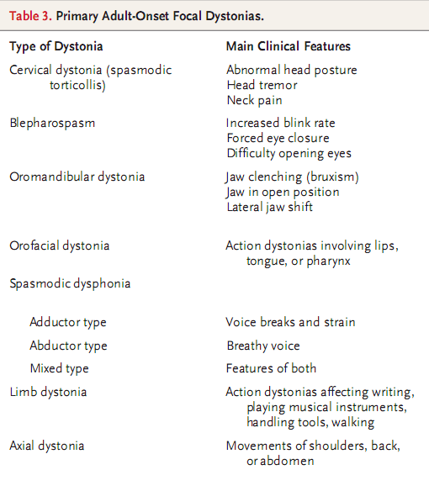

Slide 23
Cervical dystonia/ Spasmodic torticollis
Most common focal dystonia
Onset between 30 and 50 years
Presentation
  Neck stiffness and restricted head mobility
  75% have pain of neck or shoulder
Sensory tricks common – lightly touching the face or chin

Slide 24
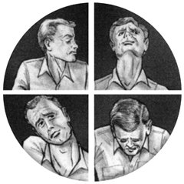
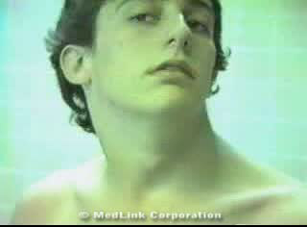
Cervical dystonia

Slide 25



Slide 26
Spasmodic dysphonia
Action dystonia in which speaking precipitates adduction or abduction
Adductor dysphonia
  90 percent of the cases
  Due to overcontraction of the thyroarytenoid muscles
  Causes strained speech and voice breaks
Abductor dysphonia
  Posterior cricoarytenoid overcontraction
  Causes an intermittent, breathy voice

Slide 27
Hemidystonia
Dystonia restricted to one side of body
75% cases associated with a structural lesion in the contralateral hemisphere
Putamen is the commonest site
One-third cases due to ischemia or hemorrhage
Other causes are perinatal trauma, head trauma, thalamotomy, encephalitis, AIDS, neurodegenerative disorders, arteriovenous malformation, and porencephalic cyst

Slide 28
Temporal Pattern
Persistent
Dystonia that persists to approximately the same extent throughout the day
Action-speciﬁc
Dystonia that occurs only during a particular activity or task
Diurnal ﬂuctuations
Recognizable circadian variations in occurrence, severity and phenomenology
Paroxysmal
Sudden self-limited episodes of dystonia usually induced by a trigger

Slide 29
Task specific dystonia
Primary focal dystonias characterized by excessive muscle contractions producing abnormal postures during selective motor activities that often involve highly skilled, repetitive movements
Disappears as soon as the task is stopped
Condition may progress to occur during other activities or even at rest

Slide 30
Types
Can involve upper limb, lower limb and orofacial muscles
Commonest is writer’s cramp
Others include occupational and craft related dystonias like musician’s dystonia

Slide 31
Associated features
Isolated dystonia
Dystonia is the only motor feature, with the exception of tremor
Combined dystonia
Dystonia is combined with other movement disorders

Slide 32
Etiological classification of dystonia
PRIMARY
Primary torsion dystonia
Dystonia-plus syndromes
Paroxysmal dystonia
DYT 1,2,4 6,7
DYT 5,12
DYT 8,9,10

Slide 33
SECONDARY
Acquired
Heredo-degenerative

Slide 34
Etiological classification – pathology
Degeneration (progressive structural abnormality, such as neuronal loss)
Static lesions (non-progressive neurodevelopmental anomalies or acquired lesions)
No evidence of degeneration or structural lesion.

Slide 35
Inherited dystonias
Autosomal dominant | DYT1, DYT5, DYT6, DYT11, rapid- onset dystonia-parkinsonism (DYT12), neuroferritinopathy (NBIA3), DRPLA, Huntington disease
Autosomal recessive | Wilson disease disease, PKAN (NBIA1), PLAN (NBIA2), type 2 juvenile Parkinson disease (PARK2), metabolic disorders
X-linked recessive | Lubag (DYT3), Lesch-Nyhan syndrome, and Mohr-Tranebjaerg syndrome
Mitochondrial | Leigh syndrome, Leber optic atrophy and dystonia

Slide 36
Acquired dystonias
Perinatal brain injury
Infection
Drug
Toxic
Vascular
Neoplastic
Brain injury
Psychogenic

Slide 37
Genetic non-degenerative dystonias
DYT loci assigned to indicate genomic regions that had been linked to a specific hereditary disorder, but where the actual causative gene was not yet known (Kramer et al., 1990)
Currently 23 loci identified

Slide 38
Pure dystonia/ Primary torsion dystonia
Syndromes in which dystonia (accompanied sometimes by tremor) is the only phenotypic manifestation
There is no secondary cause evident
Brain imaging will be normal
No pathologic change – no degeneration

Slide 39
Distribution of dystonia
Early-onset PTD
  Begins in a leg or an arm
  Develops into severe generalised form in most cases.
Late-onset PTD
  Usually involves the upper part of the body (cranial–cervical region)
  Remains focal or segmental

Slide 40
DYT 1 (Oppenheim’s dystonia)
Commonest primary dystonia
Severe early onset dystonia
Autosomal dominant
30 – 40 % penetrance
Develops before age 26 years
Normally begins in a limb (leg >> arm) and rapidly generalizes

Slide 41
Genetics
Mapped to chromosome 9q34
Codes protein TORSIN A
GAG deletion responsible for 90% cases
Results in the deletion of one of a pair of glutamic acid residues from the carboxyl terminal of TORSIN A
Function – role in protein processing and trafficking

Slide 42
DYT 4
Whispering dystonia – primary laryngeal dystonia
May generalize
Childhood or young adult (13 – 37 yrs)
May have psychiatric symptoms
Autosomal dominant

Slide 43
DYT 6
Adolescent onset
Focal (cervical, cranial or limb) or segmental
Autosomal dominant
60% penetrance
Gene identified – THAP 1 ((thanatos associated protein domain containing, apoptosis associated protein 1) mutation in 8p

Slide 44
DYT 7
Adult onset (28 – 70 yrs)
Focal dystonia (cervical dystonia, writer’s cramp, laryngeal dystonia)
Hand tremors
Autosomal dominant

Slide 45
Dystonia plus syndromes
Dystonic syndromes with other neurological features in addition to dystonia, in which clinical and laboratory findings suggest neurochemical disorders, with no evidence of neurodegeneration
Dystonia with parkinsonism
  Dopa responsive dystonia
  Rapid-onset dystonia parkinsonism
Myoclonus dystonia
  DYT 11, 15

Slide 46
Myoclonus dystonia
DYT 11
Average age at onset is 6 to 8 years with action-induced myoclonus or dystonia
Alcohol responsive
May develop psychiatric symptoms
Stabilizes in adulthood

Slide 47
Dopa responsive dystonia
Presents during early childhood (onset 1 to 12 years)
Foot dystonia during walking or running
Later signs of parkinsonism may develop
50% have diurnal variation, characterized by worsening of symptoms as the day progresses and relief after sleep
Often are misdiagnosed initially as having cerebral palsy or parkinsonism

Slide 48
Genetics
Autosomal dominant transmission
90% due to mutations in the GTP-cyclohydrolase 1 (GCH1) gene – multiple mutations possible
GCH1 catalyzes the first step in the synthesis of tetrahydrobiopterin
Results in impaired synthesis of dopamine by nigral neurons

Slide 49
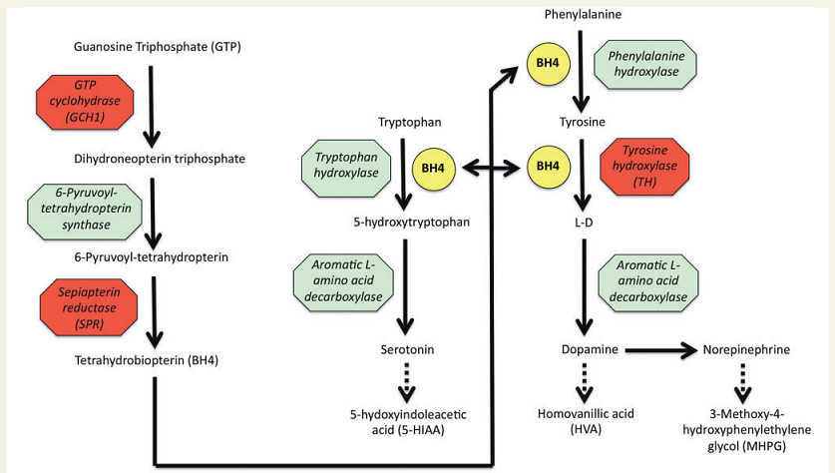

Slide 50
Treatment
Respond extremely well to relatively low doses of levodopa (100 – 300 mg/day)
No motor fluctuations
All young onset dystonia with uncertain diagnosis should be given a trial of L-dopa

Slide 51
Paroxysmal dystonia
Paroxysmal nonkinesiogenic dyskinesia (DYT 8)
Paroxysmal kinesiogenic dyskinesia (DYT 10)
Paroxysmal exercise induced dyskinesia (DYT 18)

Slide 52
Paroxysmal dyskinesias
 | PKD | PND | PED
Male/female ratio | 4:1 | 3:2 | 1:2(?)
Age at onset (yr) | 5 -15 yrs | <5 yrs | 2 – 20 yrs
Inheritance | AD, sporadic | AD, sporadic | AD
Duration of attacks | <5 min | Minutes to hours | 5 - 30 min
Frequency of attacks | 100/day - 1/month | 3/day to 2/yr | 1/day to 1/month
Associated features | Dystonia, chorea, epilepsy | Chorea, dystonia, ataxia | Dystonia, chorea
Asymmetry | ++ | +
Ability to suppress attacks | +++ | +++
Inducing or precipitating factors | Sudden movement; startle; hyperventilation; fatigue; stress | Alcohol; caffeine; exercise; excitement | Prolonged exercise, stress, caffeine, fatigue
Medical therapy | Phenytoin; carbamazepine; barbiturates; acetazolamide | Clonazepam; oxazepam

Slide 53
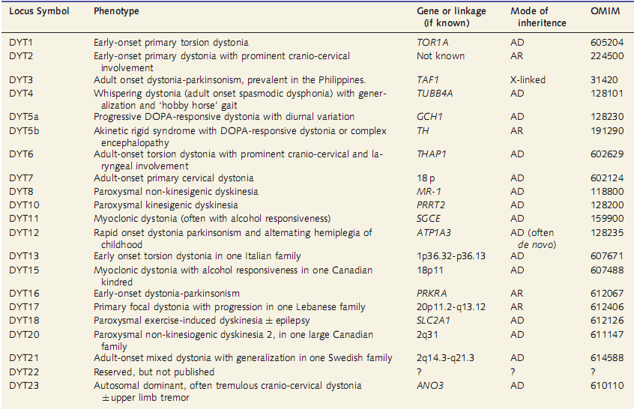

Slide 54
Epidemiology
Study based on medical records from Minnesota, USA, prevalence was 3·4 per 100 000 for generalised dystonia and 29·5 per 100 000 for focal dystonia
Nutt JG, Muenter MD, Aronson A, Kurland LT, Melton LJ III. Epidemiology of focal and generalized dystonia in Rochester, Minnesota. Mov Disord 1988; 3:188–94

Slide 55
Secondary dystonias
Can result from an acquired structural lesion
Neurodegenerative diseases in which dystonia is a prominent feature
Sporadic degenerative conditions like atypical parkinsonian syndromes
Present with other neurological symptoms besides dystonia

Slide 56
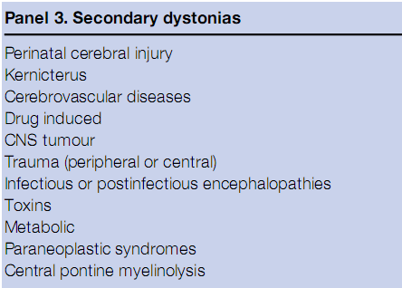

Slide 57
Localization
Dystonia appears after a latent period from the insult
Changes in the neuronal circuits
Sites
  Thalamus – Hand dystonia
  Brainstem – Cranial dystonias like blepharospasm
  Putamen – Hemidystonia or limb dystonia

Slide 58
Drug induced dystonia
Dopamine receptor-blocking agents
Antiepileptic agents
Levodopa
Dopamine agonists
Calcium-channel blockers (cinnarizine, ﬂunarizine)
Can be acute dystonic reaction or tardive dystonia

Slide 59
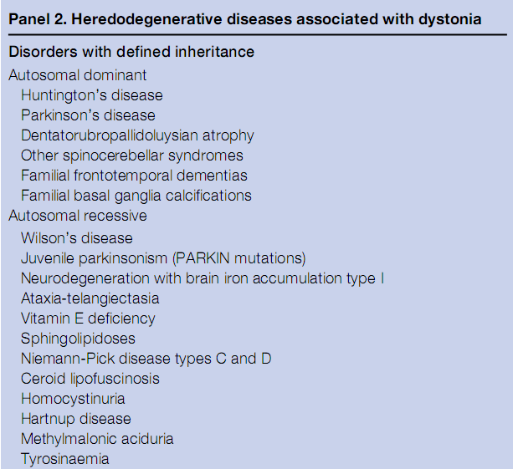

Slide 60
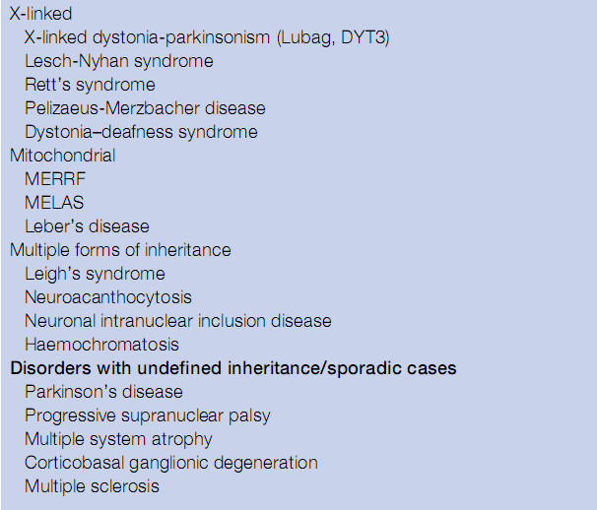

Slide 61
Psychogenic dystonia
Dystonia frequently misdiagnosed as psychogenic – 40% cases
Less than 5% cases are psychogenic
Diagnosis of psychogenic dystonia must be based on positive criteria
Relief with psychotherapy, suggestion, placebo, or physiotherapy virtually excludes a neurological cause
Complete and permanent remissions are rare in organic dystonia

Slide 62
Psychogenic dystonia
Incongruous (nonpatterned) movements and postures
Markedly fluctuating or intermittent dystonia
Inconsistent weakness
Inconsistent sensory deficit
Multiple somatizations (pain)
Self-inflicted injuries
Psychiatric disturbance
Response to placebo and suggestions
Marked distractibility
Other abnormal movements, including bizarre gait

Slide 63
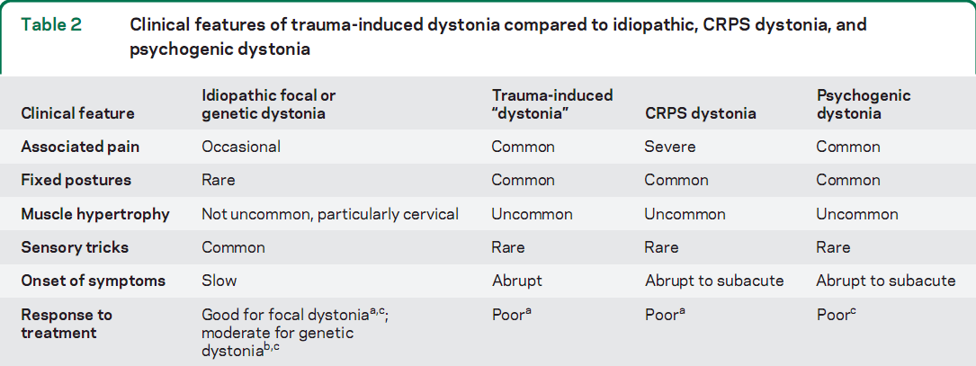
Neurology 2011;77:496–502

Slide 64
CLINICAL APPROACH TO DYSTONIA

Slide 65
Clinical questions
Is it dystonia?
Is it primary or secondary dystonia?
How to pinpoint the diagnosis?
What are the relevant investigations?
Which mode of management?

Slide 66
Is it dystonia?
Consistent directionality
Patterned, repeatedly involve the same muscle groups
Causes twisting of body parts
More sustained
No urge to perform the movements

Slide 67
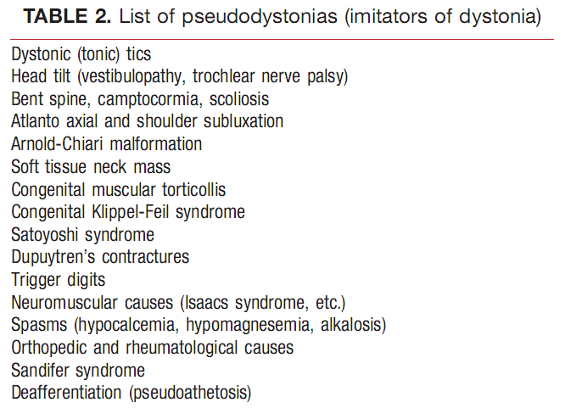
Mimics of dystonia/ pseudodystonias

Slide 68
Clues suggesting primary dystonia
Gradual onset and progression
Onset in lower limbs in childhood
Progression to generalized dystonia in young onset
Onset in head, neck and arm in adults
Restriction to focal or segmental dystonia in adults
Mobile spasms
No other neurological or systemic signs

Slide 69
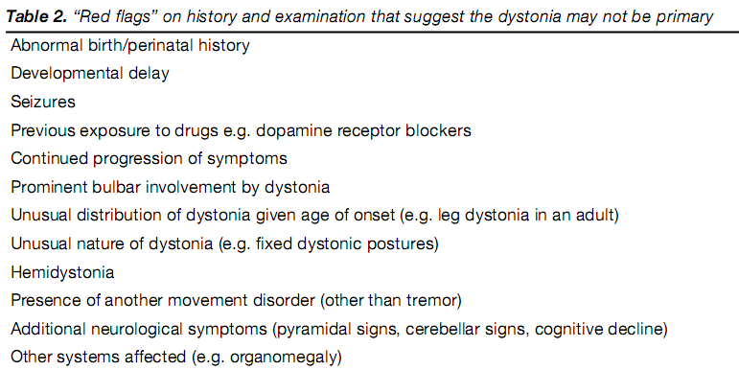
Points suggesting a secondary dystonia

Slide 70
Dystonias are diagnosed based on the associated findings
Dystonia
Degenerative
Static
Non degenerative/ Primary

Slide 71
Associations of dystonia
Parkinsonism
Eye movement disorders
Ophthalmological abnormalities
Deafness
Peripheral neuropathy
Dementia
Ataxia
Systemic features

Slide 72
Parkinsonism
Sporadic degenerative
Progressive supranuclear palsy – Frontalis contraction, blepharospasm, axial dystonia
Corticobasal syndrome – Dystonic limbs
Multiple system atrophy – Anterocollis, facial dystonia
Parkinson’s disease – Drug induced
Inherited degenerative
Wilson’s disease
Familial parkinsonism
NBIA
Primary – DRD, DYT 12

Slide 73
Dystonia with prominent oro-bulbar involvement
Secondary
  Neuroleptic intake
  NBIA 1
  Neuroacanthocytosis
  Neuroferritinopathy
  Lesch-Nyhan syndrome
Primary
  DYT 6, DYT 4, DYT 12, DYT 17

Slide 74
Associated manifestations in dystonia
Associated findings | Differential diagnosis
Optic atrophy | Mitochondrial disorder (LHON with dystonia) Leukodsytrophy
Retinitis pigmentosa | PKAN / HARP syndrome GM2 gangliosidosis Metachromatic leukodystrophy
Supranuclear gaze palsy | Progressive supranuclear palsy Niemann-Pick type C NBIA 1
Deafness | Mohr-Tranebjaerg syndrome Mitochondrial disorders

Slide 75
Associated findings | Differential diagnosis
Peripheral neuropathy | Spinocerebellar ataxias – SCA 3, 2 Friedreich’s ataxia Young-onset Niemann-Pick type C disease Metachromatic leukodystrophy GM2 gangliosidosis
Dementia | Huntington’s disease Neuroacanthocytosis NBIA Creutzfeldt-Jakob disease HIV encephalopathy
Ataxia | Spinocerebellar ataxia Wilson’s disease Huntington’s disease DRPLA Multiple system atrophy Neuroacanthocytosis Cervical dystonia and ataxia GM2 gangliosidosis

Slide 76
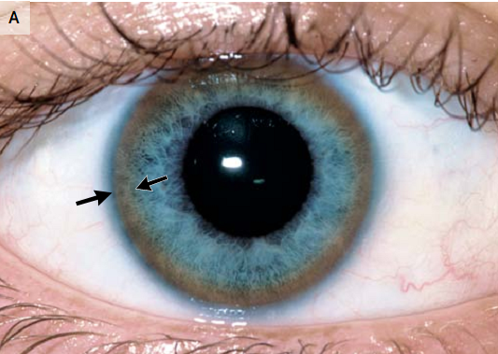
Systemic manifestations

Slide 77
Metabolic
Disease | C | P | I | E | V | N | H | S | Other features
Cu metabolism disorder
Wilson’s disease | + | + | + | - | - | - | + | - | KF ring
Aceruloplasminemia | - | - | - | - | + | - | - | - | Blepharospasm
Lipid storage diseases
GM1 gangliosidosis | + | + | - | - | - | - | - | + | Dysphasia, dysarthria, oculogyric crisis, resp tics
Tay-Sach’s disease | + | + | + | + | + | - | - | - | Cherry red spot, myoclonus, startle
Sandhoff’s disease | + | + | - | + | - | + | - | - | Hemiparesis
Gaucher’s disease | + | + | - | - | - | - | + | - | Hypotoni, cranial neuropathy, pulmonary infiltrates, parkinsonism
Metachromatic LD | + | + | + | + | - | + | - | - | Psychiatric

Slide 78
Disease | C | P | I | E | V | N | H | S | Other features
Krabbe’s disease | + | + | - | + | + | + | - | - | Irritability, bouts of hypertonia
AdrenoLD | + | + | + | - | + | + | - | - | Adrenal insufficieny
Niemann Pick C | + | + | + | + | - | - | + | - | Supranuclear gaze palsy, head thrusts, blinking
NCL | + | + | + | + | + | - | - | - | Myoclonus (A), tics, chorea (B)
Carbohydrate disorders
Mucopolysaccharadosis | - | - | - | - | - | - | - | + | Hypertonia, dysarthria, corneal opacities
Galactosemia | + | + | + | + | - | - | + | - | Neonatal jaundice, cataract
Pyruvate DH deficiency | + | + | - | - | + | - | - | + | Peculiar odour, devt delay, hypotonia
Pyruvate DC deficiency | - | - | + | - | - | - | - | - | Intermittent attacks
Leigh’s disease | + | + | + | + | + | + | - | - | Nystagmus, cranial neuropathies, resp failure

Slide 79
Disease | C | P | I | E | V | N | H | S | Other features
Amino acid and organic acidurias
Lesch-Nyhan syndrome | + | + | - | - | - | - | - | + | Self mutilation, gout
3-methylglutaconic aciduria | - | - | - | - | - | - | - | - | Failure to thrive
Propionic acidemia | + | + | - | + | - | + | - | + | Hypotonia, vomiting
Methylmalonic acidemia | + | + | - | - | - | - | - | - | Tremor
Phenylketonuria | + | - | - | + | - | - | - | - | Hypotonia, vomiting
Glutaric aciduria | + | - | - | - | - | - | - | - | Stepwise deterioration
Homocystinuria | + | - | - | - | - | - | - | + | Thromboses, lens dislcoation
Cystinuria | + | - | + | + | - | - | - | - | Hemiparesis
Hartnup disease | + | + | + | - | - | - | - | - | Skin rash

Slide 80
Degenerative
Disease | C | P | I | E | V | N | H | S | Other features
Pelizaeus Merzbacher disease | + | + | + | - | + | - | - | - | Developmental delay, nystagmus
SCA | - | + | + | - | - | + | - | - | Varied phenotypes
Familial spastic paraplegia | - | + | - | - | - | - | - | - | Tremors, amyotrophy
Huntington’s disease | + | - | - | + | - | + | - | - | Chorea dominant
Ataxia telangiectasia | - | - | + | - | - | - | - | - | Telangiectasia, OMA
PKAN | - | - | - | - | + | - | - | - | Retinitis pigmentosa, parkinsonism
Familial BG calcification | + | + | + | + | - | - | - | - | Chorea, parkinsonism
Neuroacanthocytosis | - | - | - | + | - | + | - | - | Chorea
Mitochondrial | + | + | + | + | + | + | - | -

Slide 81
MRI brain
Structural lesions
  Putamen, globus pallidus, caudate
  Thalamus
  Brainstem
  Cerebellum
  Cortical areas - parietal and frontal
Tumors, trauma, bleeding, inflammation, atrophic changes of neurodegeneration or accumulation of metals (such as iron, copper, manganese etc.)

Slide 82
MRI findings in secondary dystonia
MRI findings | Neurological disorders
Symmetrical hyperintensities in putamen, thalamus, brainstem, face of giant panda | Wilson’s disease
Hypointensity of globus pallidus with central hyperintensity | NBIA 1
T2 hypointensity of globus pallidus | Neuroferritinopathy
Basal ganglia calcification | Fahr’s disease
Caudate atrophy | Huntigton’s disease Neuroacanthocytosis
White matter hyperintensities | Leukodystrophy
Widening of the sylvian fissures, mesencephalic cistern, and enlarged pretemporal subarachnoid spaces | Glutaric aciduria type 1
Bilateral GP hypointensity | Methyl malonic aciduria

Slide 83
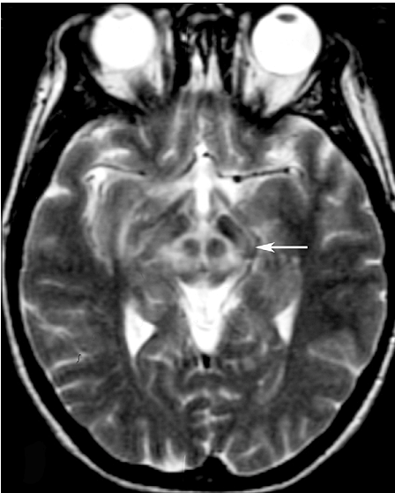
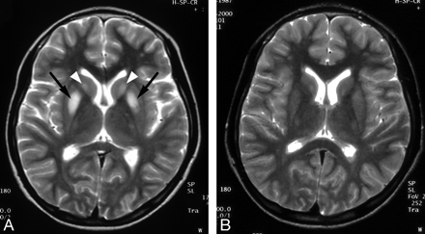
Wilson’s disease

Slide 84
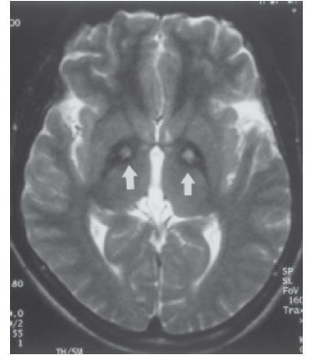
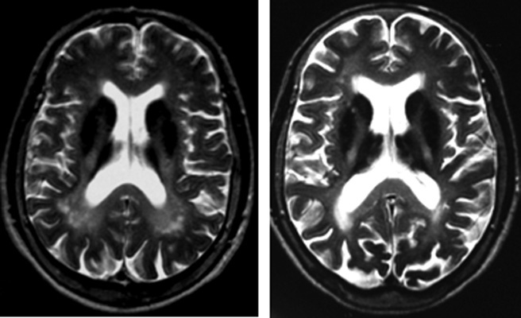
NBIA
NBIA 1
Neuroferritinopathy

Slide 85
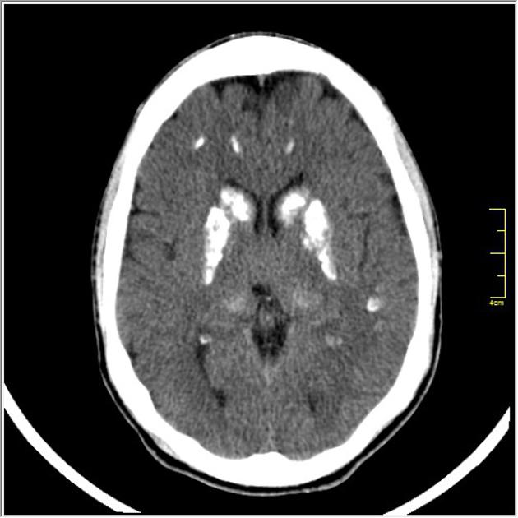
Basal ganglia calcification
Fahr’s disease
NBIA 1
Hypoparathyroidism
Infectious
  AIDS
  TORCH
  Cysticercosis
Radiation

Slide 86
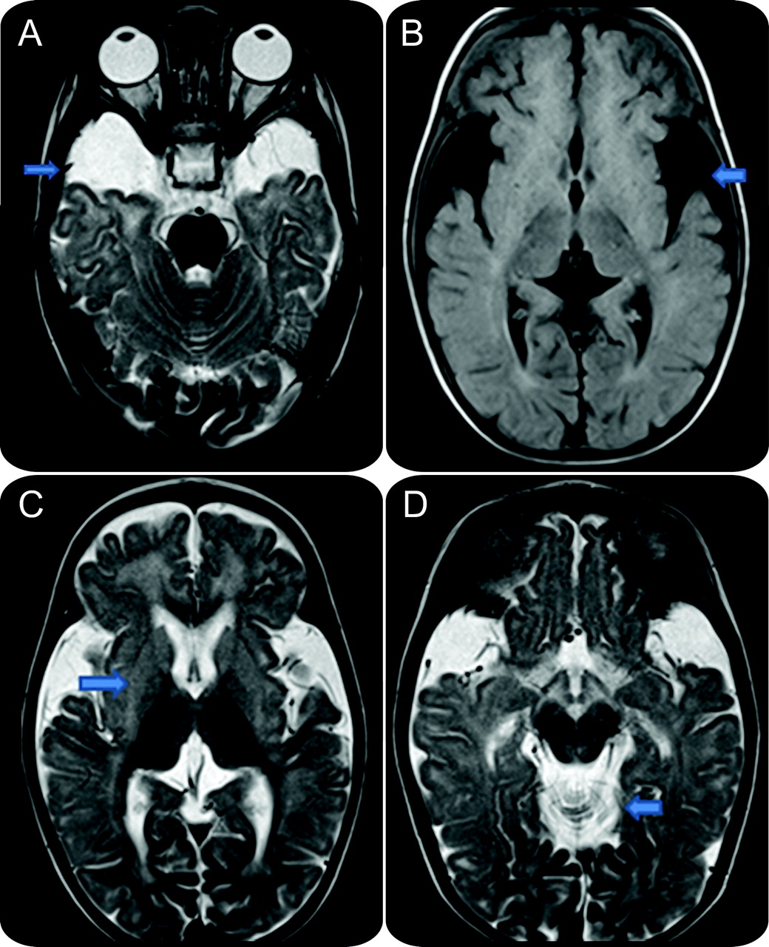
Glutaric aciduria I
Notes:
Hypoplasia of bilateral temporal lobes with enlarged subarachnoid spaces, squared appearance of enlarged sylvian fissures due to underoperculization, hyperintense basal ganglia deep and subcortical white matter.,widened mesencephalic cistern

Slide 87
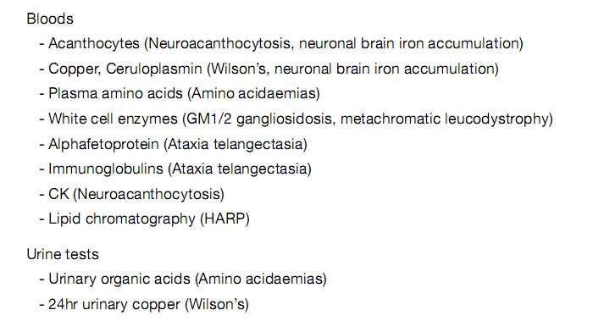
Blood and urine investigations

Slide 88
Additional investigations
Investigation | Diseases
Slit lamp test Liver biopsy | Wilson’s disease
Nerve conduction studies | SCA, metachromatic leukodystrophy, neuroacanthocytosis
Muscle biopsy | Mitochondrial myopathy
Bone marrow biopsy | Niemann-Pick C
Fibroblast lysosomal enzyme screening and filipin staining (skin biopsy) | Lysosomal storage disease Niemann-Pick C

Slide 89
Genetic testing – Available genes
Disease | Gene | Chromosome location
DYT 1 | Torsin A | 9q34
DRD (DYT 5 a) | GTP cyclohydrolase I | 14q22
DRD (DYT 5 b) | Tyrosine hydroxylase | 11p15
Myoclonus dystonia | ε-sarcoglycan (SCGE) | 7q21
DYT 6 | THAP1 | 8p21-22
DYT 12 | ATP1A3 (Na-K channel subunit) | 19q12-13
PARK 2 | Parkin | 6q26
NBIA 1 | PANK2 | 20p13

Slide 90
Dystonia in infants
Etiological history
Family history
Consanguinity
History of drug/toxin exposure
History of perinatal injury
History of CNS infection
History of head/neck trauma
Differential diagnosis
  Primary stereotypies, paroxysmal tonic upgaze of infancy, secondary infantile torticollis, seizure

Slide 91
Etiology
Onset < 1 yr – Metabolic
Onset after 1 year – Perinatal insult
MRI brain is the essential investigation
If structural lesions are ruled out, the children need to be worked up for metabolic causes

Slide 92
Investigations
ABG analysis
Serum ammonia
Urine ketone analysis
Serum amino acid analysis
Urine organic acid screen for organic acidurias
Serum uric acid analysis for Lesch-Nyhan syndrome
Serum and CSF lactate and pyruvate testing for mitochondrial encephalomyopathies
Serum and CSF glucose for GLUT1
CSF studies of neurotransmitters in infantile parkinsonism-dystonia

Slide 93
Genetic study for GCH 1 mutation
Trial of levodopa

Slide 94
Investigation
Young onset dystonia,clinically primary type
  Copper study, ceruloplasmin, KF ring
  MRI brain
  DYT1 gene
  Rx-Trial of L-dopa

Slide 95
Adult onset dystonia clinically primary type
Wilson’s work up if below 50 yrs
Consider MRI brain
MRI spine if painful or fixed dystonia
Paraspinal EMG & antiGAD antibodies if painful axial spasm to rule out stiff person syndrome

Slide 96
For secondary dystonia
MRI brain
NCV
Wilson’s work up
Huntington gene
WBC enzymes
AFP, Immunoglobulin
Lactate, pyruvate, muscle biopsy, mitochondrial mutation
Retinal examination,PANK-2 gene

Slide 97
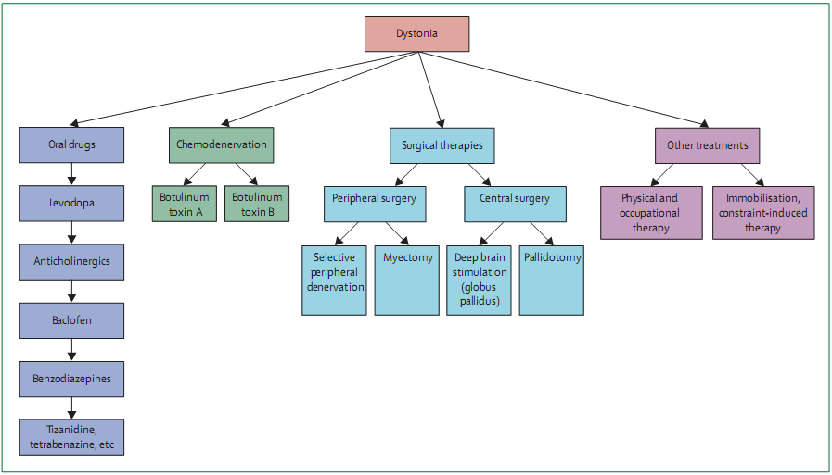
Treatment of dystonia

Slide 98
Algorithm for treatment of dystonia
Generalized
Focal
Levo dopa trial upto 1000 mg x 1- 3 months
Anticholinergic medication trial x 6 months
GPi DBS to prevent fixed deformities
Botulinum toxin injection
Gpi DBS very rarely

Slide 99
Doses of medications
Medication | Typical Starting Dosage (mg/day) | Typical Therapeutic Dosage (mg/day)
Trihexyphenidyl | 1 - 2 | Up to 120
Benztropine | 0.5 -1 | Up to 8
Baclofen | 5 -10 | Up to 120
Clonazepam | 0.5 -1 | Up to 5
Levodopa | 100 | Up to 800
Tetrabenazine | 25 | Up to 75

Slide 100
Botulinum toxin
Botulinum toxin for focal dystonia
70-80% improvement in symptoms esp blepharospasm and cervical dystonia.
Limb dystonia-botox results are inconsistent
Repeat every 3-4 months
S/E-excessive weakness & spread of weakness to near by muscles

Slide 101
Surgical treatment
DBS- globus pallidus internum good results for DYT1 (level A) , less favourable for secondary dystonia (level B)
Surgical treatment-ramiscectomy or peripheral nerve denervation done earlier
Thalamotomy or pallidotomy-effective but surgical risk

Slide 102
Summary
Dystonia is a clinical diagnosis
Classiﬁcation of dystonia is important for providing appropriate management, prognostic information, genetic counselling and treatment
A trial of levodopa should be given to all young patients (< 40 years) with typical and atypical presentations

Slide 103
THANK YOU

Slide 104
References
Phenomenology and Classiﬁcation of Dystonia: A Consensus Update. Albanese et al. Movement Disorders, 2013
The diagnosis of dystonia. Howard L Geyer, Susan B Bressman. Lancet Neurol 2006; 5: 780–90
Dystonia. Tarsy et al. N Engl J Med 2006;355:818-29
Dystonia: A clinical approach. Mark J Edwards. Acta Neurol Taiwan 2008;17:219-227
The genetics of dystonia: new twists in an old tale. Charlesworth et al. Brain 2013: 136; 2017–2037

Slide 105
MCQ
Which of the following points is a feature of psychogenic dystonia?
Patterned movement
Presence of irregular tremor
Fixed abnormal posture
More evident during activity

Slide 106
Which of the following presents with dystonia and supranuclear gaze palsy?
GM2 gangliosidosis
Niemann Pick type C disease
Metachromatic leukodystrophy
Hartnup disease

Slide 107
Which of the following suggests a secondary cause of dystonia?
Presence of tremor and myoclonus
Early involvement of speech
Onset of dystonia in lower limbs below 30 years of age
Normal MRI brain

