Slide 1

SEMINAR
MIGRAINE- PATHOPHYSIOLOGY AND TREATMENT
Dr. Sanjay Prakash

Slide 2
Scheme of presentation
Introduction
Evolution of migraine theories
Anatomy of migraine
Pathophysiology of migraine
Acute and preventive treatment
Non pharmacological treatment
Conclusion

Slide 3
Introduction
Migraine - very common primary headache disorder
One of the 20 most disabling diseases - WHO
Cost -18.5 billion Euros per yr
Public health problem of significant impact

Slide 4
ICHD II Criteria of Migraine
Migraine without aura
Migraine with aura(typical)
Headache 4-72hrs
2/4 of- U/L, pulsating, mod to severe, aggravated by exertion
During headache 1/2of- nausea/vomiting, photo&phonophobia
5 or > attacks
No other cause
a. Aura of 1/3 of- 1. fully reversible positive or negative visual symptoms 2. fully reversible positive or negative sensory symptoms 3. fully reversible dysphasia
b. 2/3 of- 1. homonymous visual symptoms and/or unilateral sensory symptoms 2. aura sequentially over 5mts 3. >5mts <60mt
c. 2 or more attacks
Notes:
Except motor weaknss

Slide 5
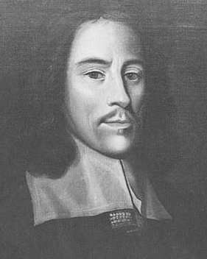
Evolution of Migraine theories
During 17th century Thomas Willis described cases of migraine
Suggested headache to be due to dilatation of carotid vessels
An observation that echoes the vascular theory
Notes:
Mi kranion

Slide 6
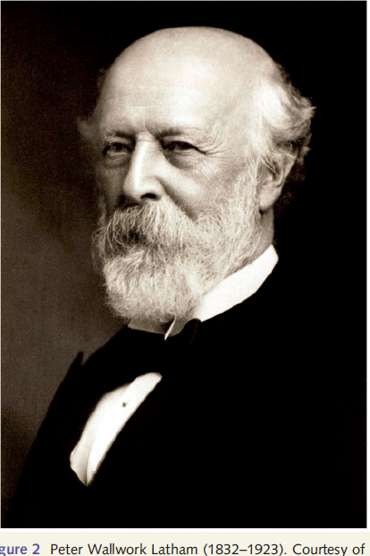
Vascular Theory
Latham(1873) proposed vascular theory
Explaining that aura resulted from contraction of vessels by the excitation of the sympathetic
Exhaustion of sympathetic causes dilatation and headache
Notes:
Peter Wallwork

Slide 7
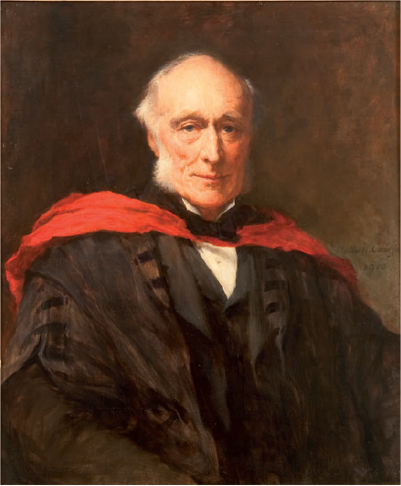
Neural theory
Leveing(1873) “nerve storms”
Originated from ‘sensory tract and ganglia of sensory nerves from the optic thalamus above to the nucleus of vagus below.’
Notes:
Edward

Slide 8
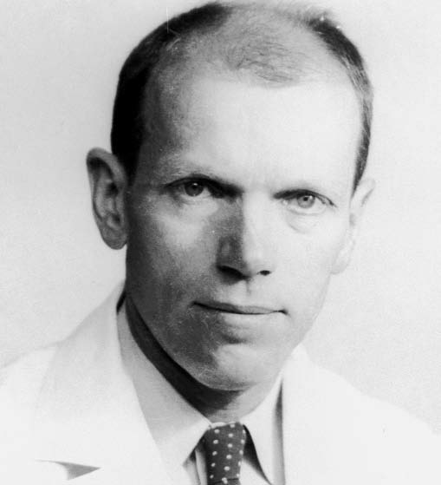
Theories of migraine
Harold Wolff - first researcher to place migraine on a scientific basis
Measured diameter of temporal arteries in patients found to be dilated
These patients were then treated with vasoconstrictors (ergotamine) which relieved the pain (Graham and Wolf, 1938).

Slide 9
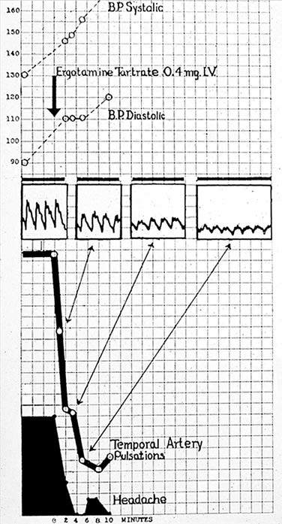
Theories of migraine
Graham and Wolff ’s ‘‘smoking drum’’ experiment
IV DHE rapidly reduced the arterial pulsation amplitude
Corresponding reduction in headache severity
As the effect wore off, the headache began to return.

Slide 10
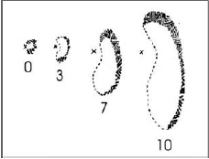
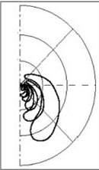
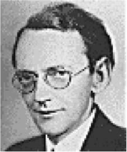
Spreading Depression
In 1941, Karl Lashley described his own ‘‘scintillating scotoma”
Examining the progress over time, from length of the striate cortex being 67 mm, he suggested that a wave of intense excitation spreading at about 3mm/min from occipital pole

Slide 11
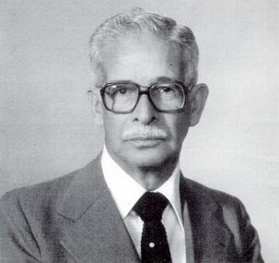
Spreading depression
In 1944 Aristides Leao, working in Harvard- ‘‘spreading depression”
The rate of spread of the depolarization fitted with Lashley’s description

Slide 12
The great debate: vessel versus brain
Vasogenic theory- aura due to transient ischemia → headache due to rebound vasodilatation
Alternate neurogenic theory- vascular changes followed neuronal dysfunction
Neither alone can account for all
Notes:
Marriage of two ,Clnical and treatment response

Slide 13
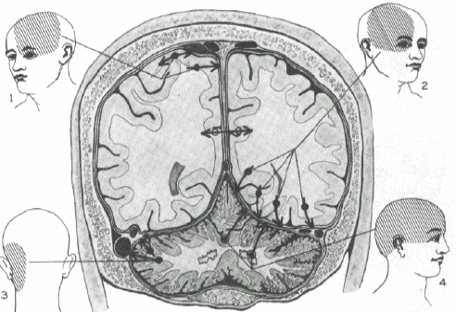
Anatomy of Migraine
Pain sensitive structures in brain
Large cerebral vessels, venous sinuses and blood vessels of pia and dura mater
Large plexus of unmyelinated fibers from V1
Notes:
Ray and Wolff

Slide 14
Anatomy of migraine
Meningeal vessels innervated by V1
Nerve endings are unique
Has axonal varicosities that contain nociceptive transmitters/peptides- serotonin, histamine, bradykinin, PG and sub P

Slide 15
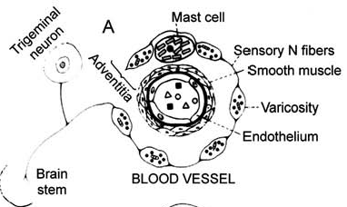
Anatomy of Migraine
Nerve terminals bear varicosities
Contain NT & NP
When nerves are activated, released into walls of vessels
Central projection of these fibres- TCC

Slide 16
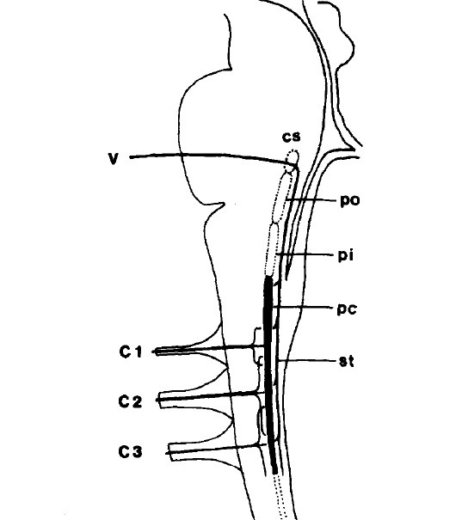
Trigeminocervical complex
C1 and C2 dorsal horns & caudal division of spinal trigeminal nucleus
TCC → brain stem → hypothalamic and thalamic nuclei→ ascending connections with the cortex

Slide 17
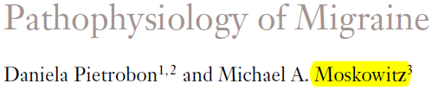

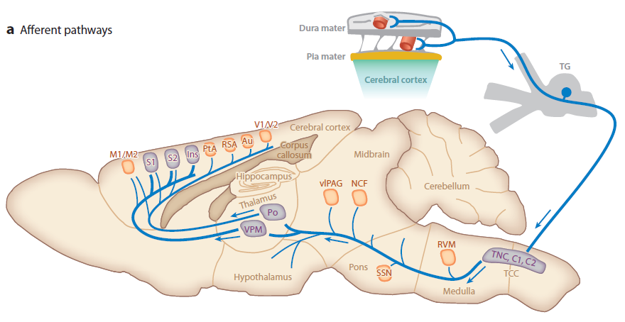

Slide 18
Cortical projections
VPM thalamic neurons→ trigeminal S1, S2 & insular cortex - perception of headache
Po thalamic neurons→ auditory, visual, retrosplenial, entorhinal cortices- vision, audition, memory, limbic and cognitive symptoms
Hypothalamic and brain stem nuclei - loss of appetite, fluid retention, sleepiness, irritability, stress, pursuit of solitude, and autonomic symptoms

Slide 19
Mechanism of photophobia
Dura-sensitive thalamic neurons in Po thalamus receive monosynaptic input from retinal ganglion cells (non-image-forming)
Light enhances the activity of dura-sensitive thalamic neurons located in the same area

Slide 20
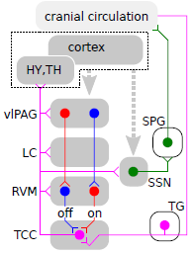
Descending modulatory network
TCC receives descending projections from cortex, brain stem and hypothalamus
Shifting of balance to facilitation of TCC→ central sensitisation.
Notes:
Migriane generator

Slide 21
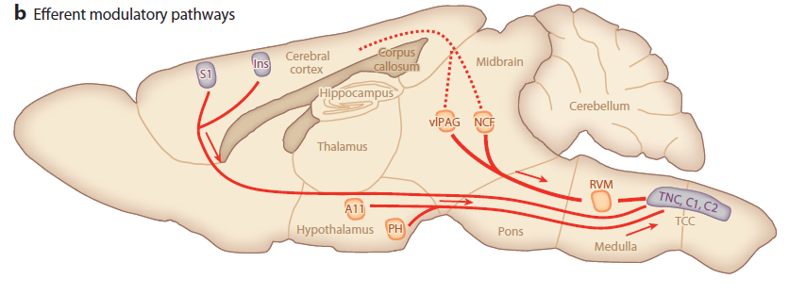

Slide 22
Clinical features
Moderate to severe, recurrent, unilateral, throbbing headache lasting hours to days
Generally accompanied by nausea, photophobia, and phonophobia
Worsened by routine physical exertion

Slide 23
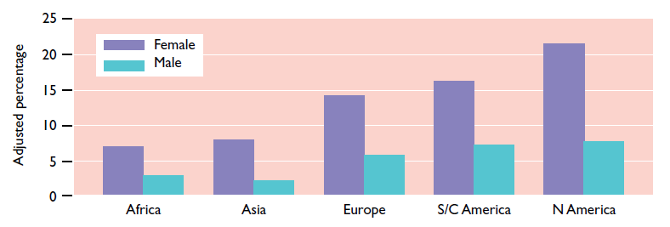
Epidemiology
*JAMA 1992
Prevalence have varied widely, ranging from 3% to about 22%

Slide 24
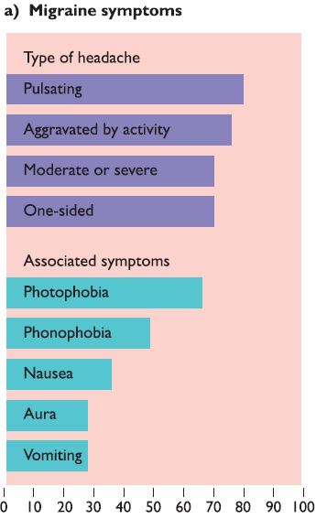
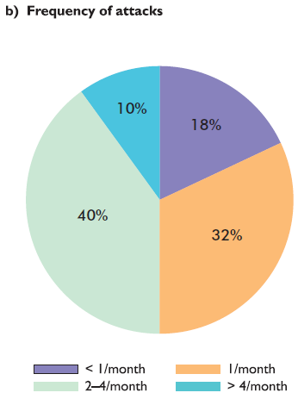

Slide 25
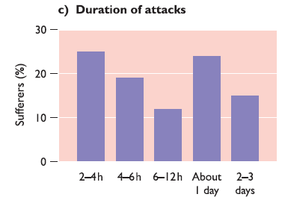
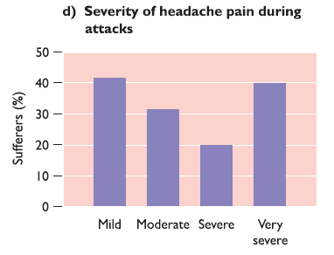

Slide 26
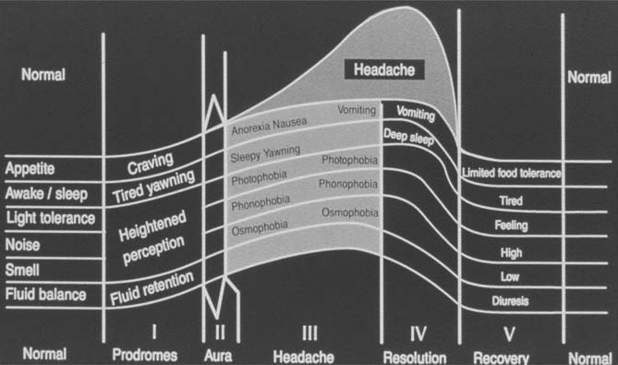
Migraine stages

Slide 27
Pathophysiology of aura
Migraine aura defined as a focal neurological disturbance manifest as visual or sensory
Enough evidence that Cortical Spreading Depression is the correlate of aura

Slide 28
Cortical spreading depression
Aristides Leao initially described cortical spreading depression (CSD)
Observed in ECoG following stimulation of exposed rabbit cortex
Transient complete suppression of neural activity at focus of stimulation
Spread of depression at 3-5mm/min

Slide 29
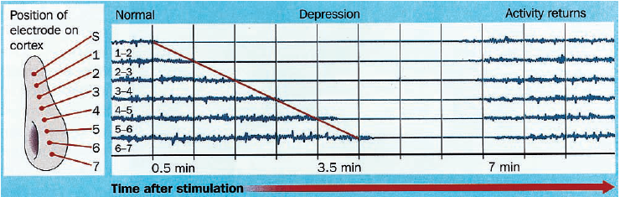


Slide 30
CSD
Short-lived positive wave of neural excitation, upto depth of 5mm of cortex, without regard to vascular boundaries, followed by a negative phase of neural depression
Unfolded primary visual cortex - 60mm long; CSD takes 20 minutes to traverse
Fits with the typical duration & characteristics of aura

Slide 31
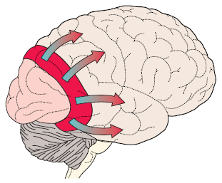
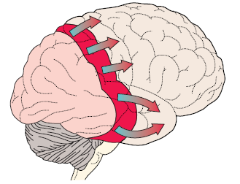
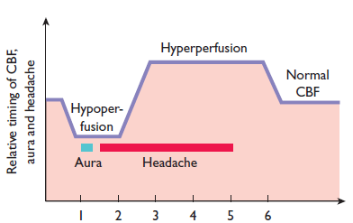

Slide 32
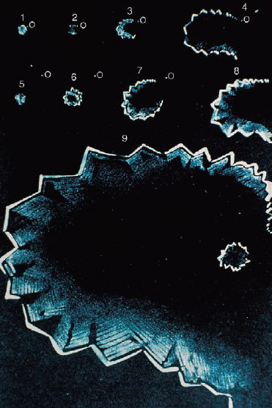
CSD
Rate of expansion and size of teichopsic arc increases as it becomes more peripheral
Cortical volume representing fovea at calcarine pole is large, while more anterior cortical is small

Slide 33
Mechanism of CSD
Ignited by local elevations of extracellular [K+]
Initiated by triggers→ disruption of E/I balance→ hyperactivity of cortical circuits→
initiation of CSD
Slowly propagating wave of strong neuronal/ glial depolarization accompanied by depression
Notes:
triggers-dysregulation may in certain conditions (e.g., in response to migraine triggers such as
intense, prolonged sensory stimulation

Slide 34
How CSD triggers headache?
During CSD BBB becomes more permeable
Allows glutamate, K+, H+, NO, AA, Serotonin release
From cortical surface to meninges
Trigger nociceptive afferents around blood vessel

Slide 35
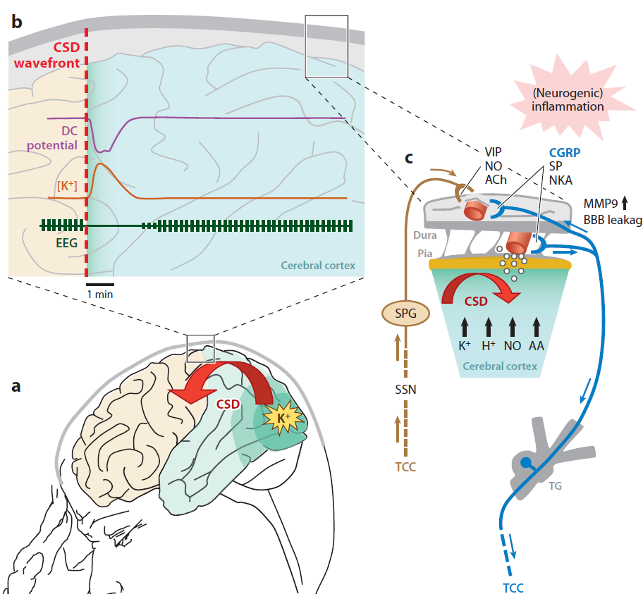

Slide 36
Mechanism of headache
The headache phase- involve 3 main neural activation processes
Cranial blood vessels & TVS
Activation of TCC
Activation of cortical and brain stem regions

Slide 37
Central feature of migraine is recurrent activation of Trigeminocervical pain system

Slide 38
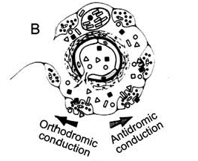
Peripheral mechanism/Nociceptor activation
CSD activates the perivascular trigeminal axons→ release of NP from varicosities
Nociceptive signals taken orthodromically to the brainstem, while antidromic conduction results in the release of sub P/CGRP into vessel wall
Cause vessel dilatation and neurogenic inflammation
Notes:
Or antidromic inputs from brainstem

Slide 39
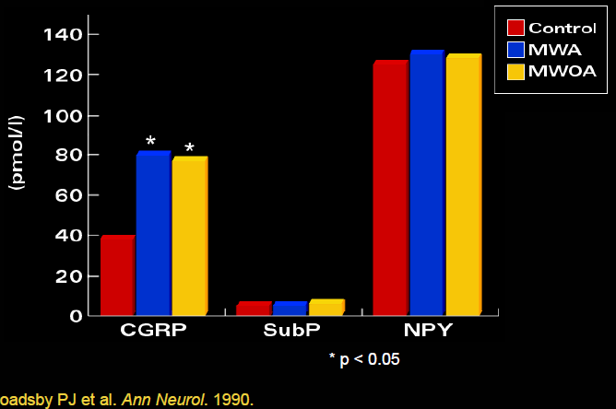

Slide 40
Peripheral mechanism
Activation of meningeal nociceptors → release of vasoactive CGRP and SP
Produce vasodilation (CGRP), plasma extravasation, mast cell activation→ release of cytokines/ inflammatory mediators→ neurogenic inflammation

Slide 41
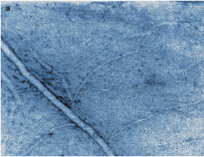
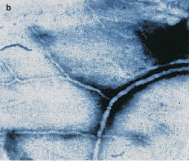
Peripheral mechanism
This sterile meningeal inflammation is considered one key mechanism that may underlie the sustained activation

Slide 42
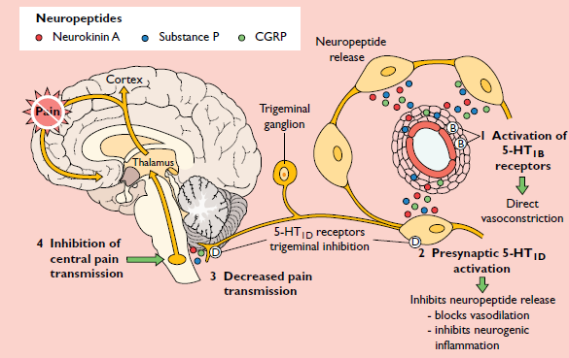

Slide 43
Central Sensitization
Sensitization- stimulus needed decreases; while response increases
Peripheral sensitization- neurogenic inflammation
CS- abnormal neuronal excitability in the TNC(2nd order)
TNC- convergent input from the meningeal nociceptors and facial skin
Notes:
of the dural and meningeal trigeminal nociceptors

Slide 44
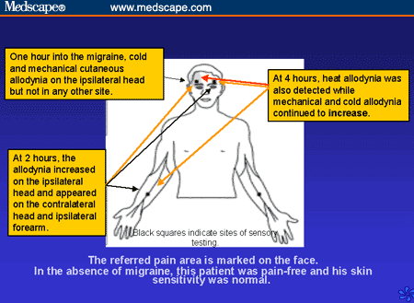

Slide 45
Central sensitization
Progressive sensitization; 2nd order→ 3rd order
Extracephalic allodynia- sensitization of trigemino thalamic neurons(3rd order) → converging sensory information from extracephalic skin

Slide 46
Trigeminal autonomic reflex
Parasympathetic symptoms and signs
‘Red Migraine‘- skin flushing, sweating, painful vasodilation, eyelid edema
‘White Migraine’- facial pallor during (more common)

Slide 47
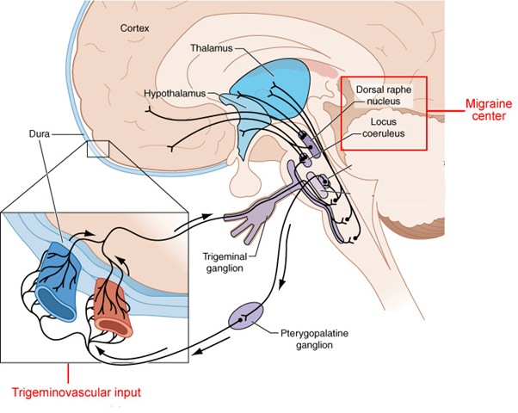
Trigeminal autonomic reflex
The efferent- superior salivatory nucleus in the pons
via the parasympathetic outflow – GSPN→ to pterygopalatine and otic ganglia.

Slide 48
Treatment

Slide 49
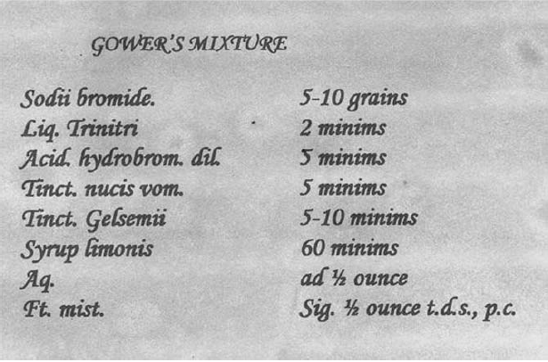
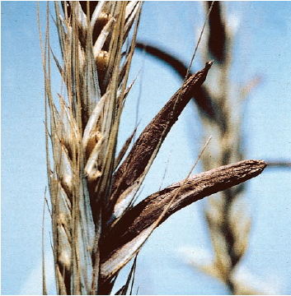
Evolution of treatment
Trepanation survived for as late as 17th century
Gower separated treatment for a/c & c/c
Isolation of Ergotamine by Stoll in 1920

Slide 50
Origin of Triptans
Large amts of 5-HIAA excreted during attack
Monoamine depletors can provoke attack
Slow infusion of 5HT aborted attack
Search for tryptamine derivatives – Sumatriptan 1984
Subsequent research 2nd generation

Slide 51
Pre requisites of treatment
Accurate diagnosis
Detailed patient information- expectation needs
Education & reassurance
Non pharmacological treatment
Acute and prophylactic treatment

Slide 52
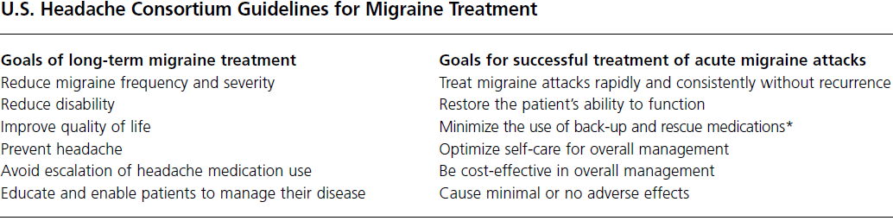

Slide 53
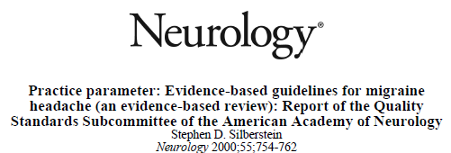
Treatment of acute migraine attack
Treat as early as possible
Can be specific or non-specific
Non specific- NSAIDs and combination, antiemetics, opioids, DA agonists
Specific- Ergotamine, DHE, triptans

Slide 54
Acute treatment
Step care and stratified care
Step care- across or within an attack
Step1
Simple analgesics
Step2
Analgesics+ antiemetic
Step3
Migraine specific

Slide 55
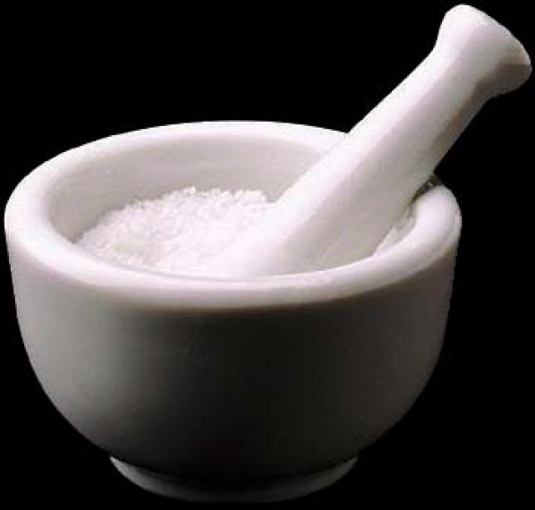
Acute treatment
Stratified care- based on initial assessment of severity
More cost effective
Better acute treatment efficacy
Hence class I evidence in support of stratified care
Notes:
Significant disability go direclty for specfic trreatment

Slide 56
Acute treatment- General principles
Use specific agents in patients with mod/severe migraine or poor response to NSAIDs or combination
Non-oral route in severe nausea or vomiting
Antiemetics should not be restricted
Guard against MOH; limit acute therapy to two headache days per week
Notes:
The US Headache Consortium published its recommendations for the treatment of migraine in 2000 (Silberstein 2000)
”). Frequent use of acute medications (ergotamine [not DHE], opiates, triptans, simple analgesics, and mixed analgesics containing butalbital, caffeine, or isometheptene) is generally thought to cause medication-overuse headache

Slide 57
Acute treatment
1. Specific: a. Triptans b. Ergot and its derivatives
2. Nonspecific: a. Antiemetics b. NSAIDs and non narcotic analgesics c. Narcotics – Opiate analgesics
3. Miscellaneous: a. Steroids b. Isometheptene
4. Nonpharmacological: a. Biofeedback c. Icepack d. Relaxation therapy e. Yoga, meditation

Slide 58
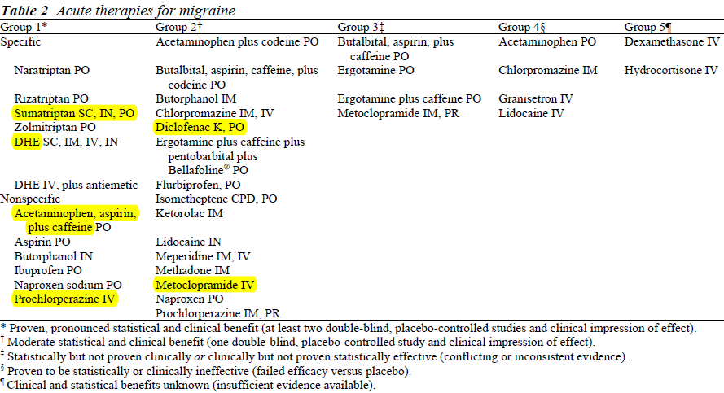

Slide 59
Triptans
5-HT 1B/1D agonists with class I evidence in treatment of acute migraine
Have become the standard of care in acute migraine attack

Slide 60
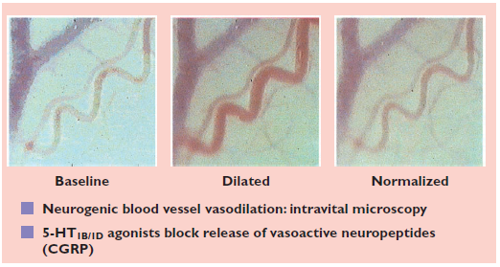
Triptans-Mechanism
Triptans constrict dilated arteries through stimualtion 5-HT1B receptors on vessel wall
Notes:
Results from a preclinical intravital microscope dural plasma protein extravasation (DPPE) assay that was used to investigate
the anti-migraine action of rizatriptan. These videoframes show a branch of the middle meningeal artery embedded within the
dura mater (running bottom left to top right of each section). The sequence shows the artery at baseline (left panel), in a dilated state
after electrically evoked vasoactive neuropeptide release from the perivascular nerves (middle panel) and when normalized by drug
treatment.

Slide 61
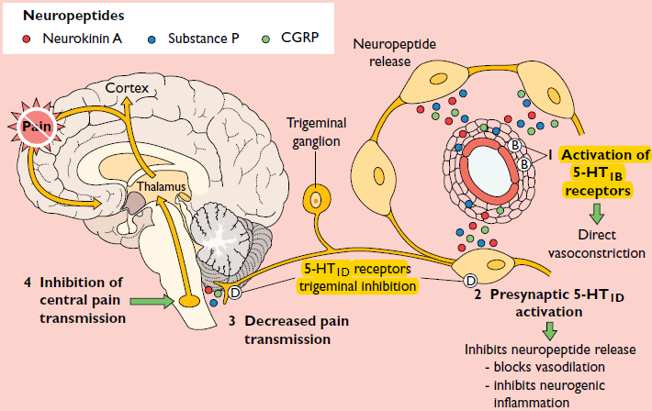
Notes:
Also inhibit NT release and nociceptive transmission by stimulating 5-HT1D receptors on central and peripheral trigeminal sensory nerves. unable to block ongoing sensitization in the second order trigeminovascular

Slide 62
Triptans
First selective 5-HT 1B/1D agonist developed was Sumatriptan, followed by
- Zolmitriptan,
- Naratriptan,
- Rizatriptan,
- Eletriptan
- Frovatriptan

Slide 63
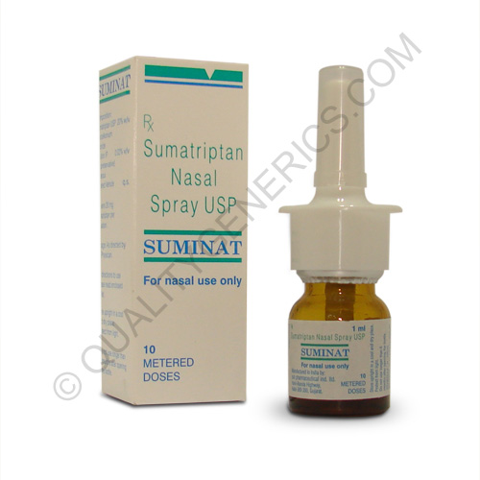
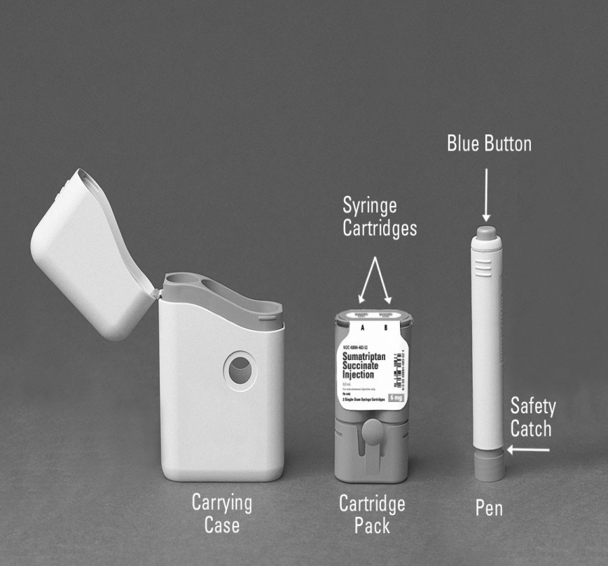
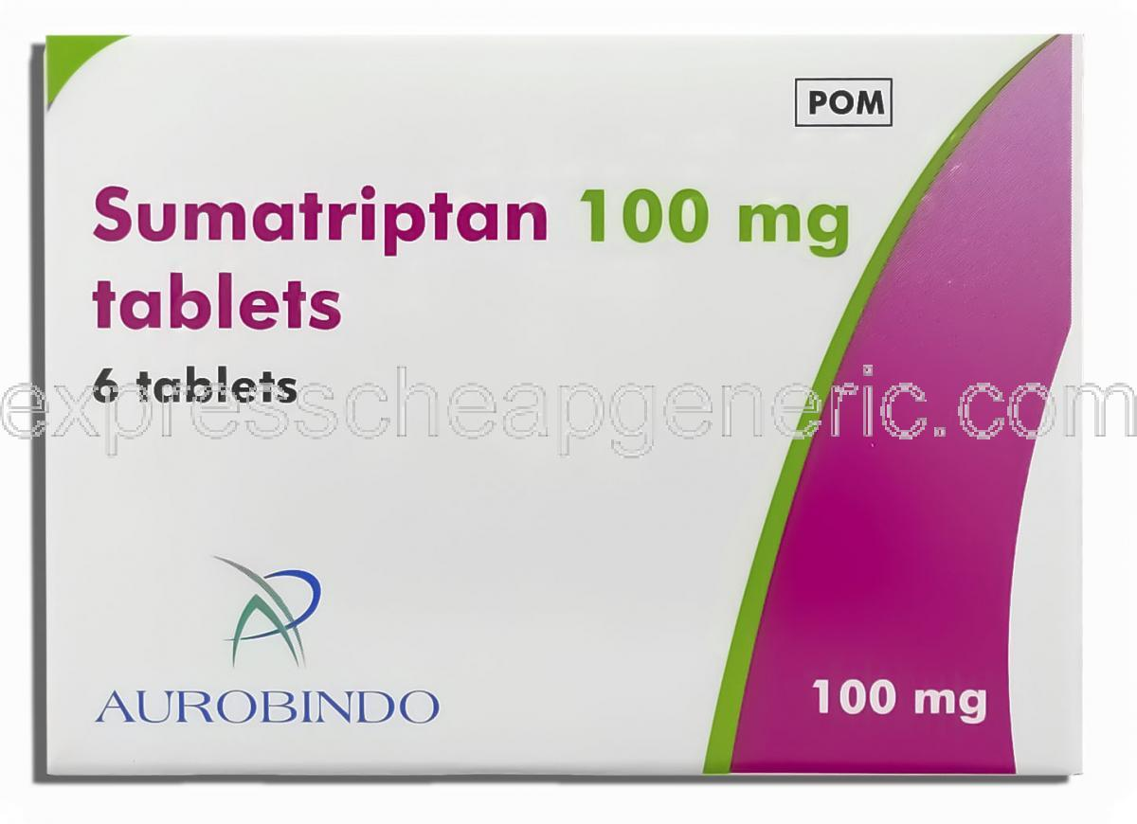
Notes:
Sumatriptan available in SC, oral, Nasal spray and dispersible forms,
Oral or nasal form is extensively metabolized by liver MAO

Slide 64
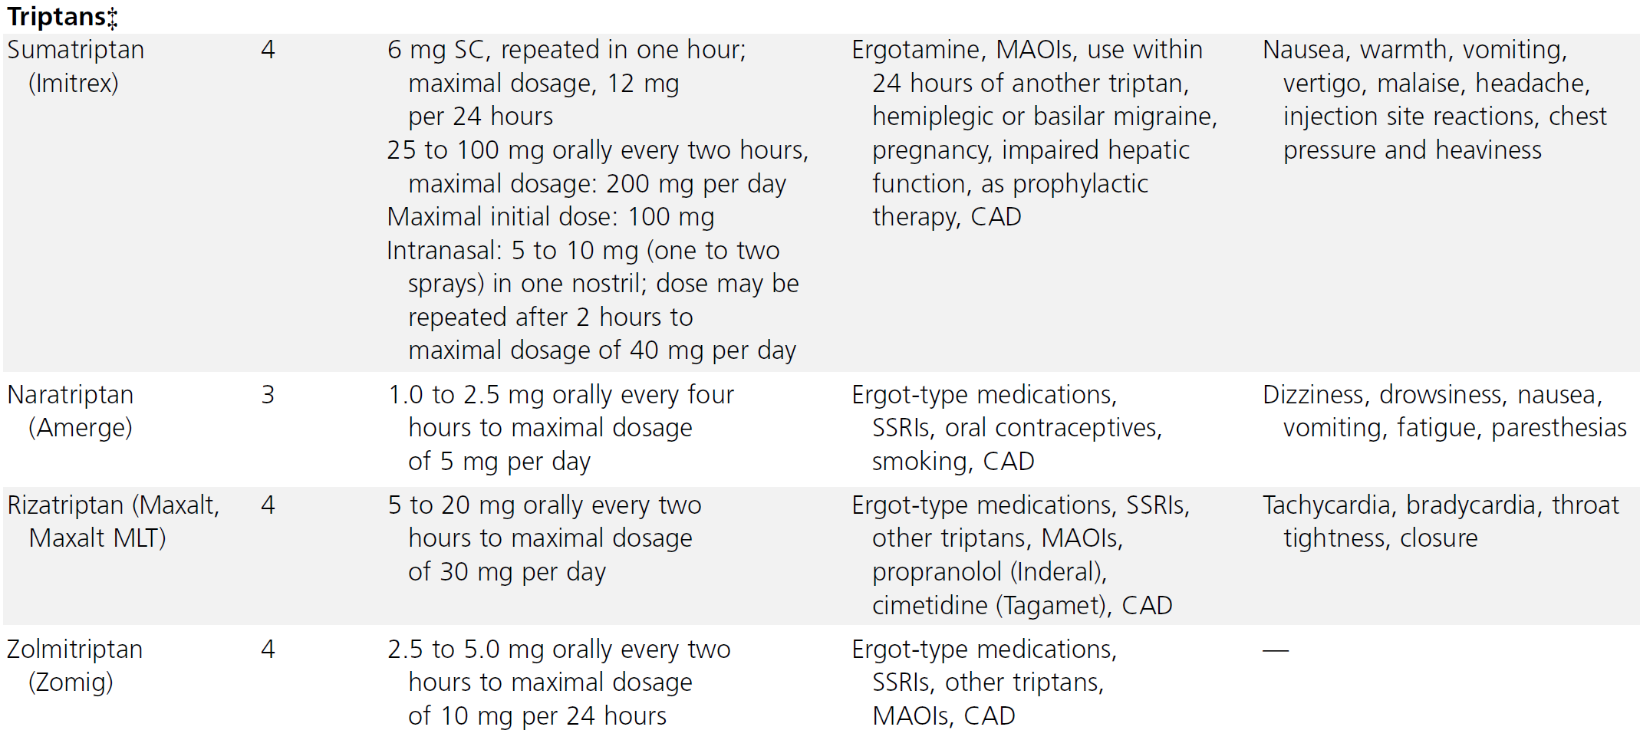

Slide 65
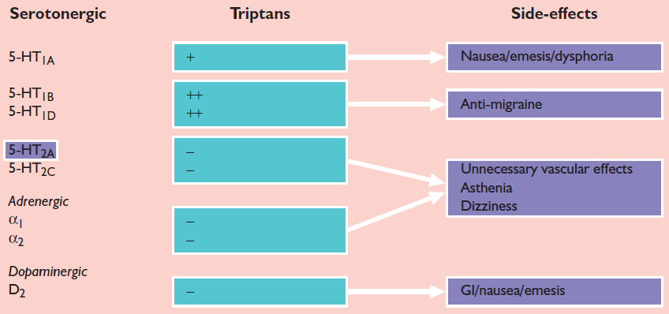
Side effects
Notes:
Triptans are effective & safe for the acute treatment; initial treatment choice in mod to severe migraine(with no contraindications)(Grade A).
Initial treatment with any triptan is a reasonable choice when nonspecific medication has failed to provide adequate relief in the past (Grade C)
Patients with nausea and vomiting may be given intranasal or subcutaneous Sumatriptan (Grade C).

Slide 66
Ergotamine and derivatives
Ergotamine tartrate (ET) – 1st ergot alkaloid to be isolated and used for migraine treatment
DHE- semi-synthetic derivative; greater α antagonistic, reduced emetic/vasoconstrictor
Safe & effective for acute attack; 1st line drug in acute mod-severe migraine

Slide 67
Mechanisms
Vasoconstrictor action
Due to their agonist activity at 5-HT1B/ID and 5-HT 1F receptors
Role in blocking NI as well as centrally in the TNC

Slide 68
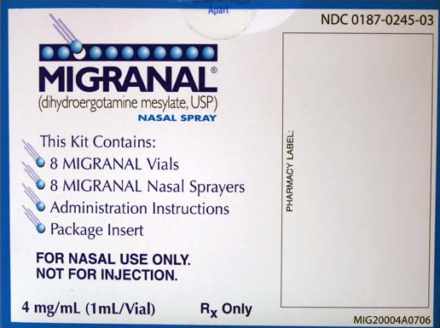
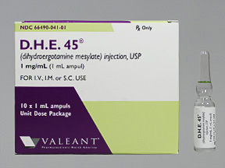


Slide 69


Slide 70

Notes:
Subnauseating dose: 0.25mg every 15 mts until patient develops nausea or 1mg reached
Pretreatment with antiemetics
DHE test dose of 0.5mg iv over 3-5minutes
If persisting, another 0.5mg given
Max 1mg iv Q8H, reduce to 0.25mg if nausea persists
Tapered off after 3 days

Slide 71

Side effects
Notes:
Ergotamine PO/PR) in selected patients with mod to severe migraine(Grade B).
DHE nasal spray is safe & effective for the treatment of mod to severe migraine (Grade A)
DHE SC/IV/IM and nasal spray may be given to patients with nausea and vomiting (Grade C).
DHE IV plus antiemetics IV is an appropriate treatment choice for patients with severe migraine (Grade B

Slide 72
Non specific treatment
NSAIDs
2. Anti emetics
3. Narcotic analgsics
4. Miscellaneous

Slide 73


Slide 74


Slide 75


Slide 76
Recommendations
Acetaminophen alone is not recommended for migraine (Grade B)
NSAIDs (Grade A) and antiemetics(Grade C) recommended in acute mild to moderate
Opioids risk of abuse & sedation to be addressed(Grade A)

Slide 77
Others
Corticosteroids (dexamethasone or hydrocortisone) as rescue therapy in status migrainosus (Grade C)
Insufficient evidence for a defined role for intranasal/IV Lidocaine

Slide 78

Preventive treatment
The goals of preventive therapy are
Reduce attack frequency, severity, and duration
Improve responsiveness to treatment of acute attacks
3) Improve function and reduce disability

Slide 79
Preventive treatment
Can be :
Pre-emptive
Exercise/Sex
Single dose
Short term
Menstruation
Just before/during
Chronic

Slide 80
Indications for chronic preventive
Recurring migraine significantly interfering with daily routines
Frequent headaches (>4/mnth)
Contraindication/failure/intolerance/overuse of a/c rx
Very long/uncomfortable aura
Presence of uncommon migraine conditions(hemiplegic/basilar migraine)
Notes:
Or migranous infraction and pt preference

Slide 81

Avoiding triggers
Notes:
’Triggers” are specific factors that may increase your risk of having a migraine attack

Slide 82



Slide 83


Slide 84
RECOMMENDATIONS
Level A:
Antiepileptic drugs (AEDs): VPA, TPM
Beta Blockers: Metoprolol, Propranolol, Timolol
Triptans: Frovatriptan for short-term MAMs prevention

Slide 85
RECOMMENDATIONS
Level B:
Antidepressants: Amitryptilline, Venlafexine
Beta blockers: Atenolol, Nadolol
Triptans: Naratriptan, Zolmitriptan

Slide 86
RECOMMENDATIONS
Level C:
ACE inhibitors/ARB
Beta blockers: Nebivolol, Pindalol
Alpha agonists: Clonidine, Guafenacine
AEDs: Carbamazepine

Slide 87
General Principles
Start chosen drug at low dose, increase slowly until:
- therapeutic effects develop
- intolerable side effects
- ceiling dose
Give adequate trial- a full trial may take 2-6 months; efficacy noted at 4 weeks & dose can be increased upto 3 months

Slide 88
General Principles
Consider co-morbidities
Avoidance of overuse of acute treatment
Involve pt preferences and set realistic goals
But initiate therapy with drug having highest efficacy

Slide 89
AEDs
Both Divalproex /Valproate and Topiramate are class I drugs for migraine prophylaxis

Slide 90
Mechanism of Valproate
Increase GABA level
Increase Ca conductance
Decrease Pl extravasation
Reduce NI
Decrease CS

Slide 91
Mechanism
Increase of GABA-ergic transmission as well as reduction of the level of excitatory AA
Reduce plasma extravasation and NI

Slide 92
Guidelines of VPA use in Migraine
Obtain baseline LFT & BRE
Start at 250mg HS(enteric coated), increase upto 500-750mg/day(Max dose 60mg/kg/day)
Not necessary to monitor blood
Tremor if bothersome, decrease dose or add Propranolol
Silberstein et al

Slide 93
Topiramate
Topiramate is the recent drug approved by the FDA for migraine prevention

Slide 94

Topiramate at dose of 100mg/day was similar in respect to Propranalol in migraine
TPM at 200mg/day less tolerated
Started at 25mg/day and increased weekly to target dose(100mg/day)

Slide 95
Mechanism of Topiramate
TPM blocks:
- voltage-dependent Na channels
- potentiates GABA activity
- inhibits AMPA/KA receptors
- blocks L- and N-calcium channels
Modulates trigeminovascular transmission

Slide 96
Beta-blockers
Anti migraine effect by inhibition of NE release by blocking prejunctional Beta receptors
Also central sensitization is inhibited

Slide 97
Beta Blockers
Agent | Daily Dose | Comments
Propranolol | 40-400mg | Short acting- TID or QID Long acting- BD 1-2mg/kg in children
Metoprolol | 100-200mg | Short acting- QID Long acting BD
Atenolol | 50-200mg | QID, Fewer side effects than Propranolol
Nadolol | 100-200mg | QID, Fewer side effects than Propranolol

Slide 98
Antidepressants
TCAs- most commonly used medications for prophylaxis
Amitryptilline & Venlafexine(SNRI) has level B recommendations, rest incuding Nortryptilline, Gabapetin level U

Slide 99
Antidepressants
Preferred in migraine and comorbid depression
But S/E: sexual dysfunction, increased appetite & weight gain, sedation, orthostatic hypotension, and cardiotoxicity

Slide 100
Mechanism of action
Enhancing antinociceptive neurons, by Amitriptyline’s SNRI properties
Blocking Na channels; relevance to peripheral sensitization
Indirectly increasing GABA levels by inhibiting GAT-1

Slide 101
Dose
Amytryptilline: a low initial dose(10 mg) and dose built up slowly (10 mg every week or every two weeks)
Maximum dose : 100mg-300mg per day
Venlafexine: 75mg-150mg per day

Slide 102
ACE inhibitors/ARBs
In the 2000 guideline, no studies available
In 2012, Lisinopril & Candesartan are possibly effective for migraine prevention (1 Class II study each)
Telmisartan is ineffective for reducing the number of migraine days (1 negative Class II study)

Slide 103
Lisinopril
Open-label study significantly reduced frequency
Exact antimigraine effect unknown
Target dose is 20mg/day
S/E: cough, hypotension and fatigue

Slide 104
Candesartan
1 RCT with decreased mean headache and migraine days versus placebo
AT1 receptors act presynaptically to inhibit GABA release
Target dose: 16mg/day
Few adverse effects compared to Lisinopril
Notes:
Candesartan increasing GABA inhibitory from the rostroventromedial nuclear complex

Slide 105
Triptans
Frovatriptan, Naratriptan and Zolmitriptan for short-term prevention of menstrually associated migraine (MAM)
Given for 5 days, starting 2 days before onset
Drug | Dose
Frovatriptan | 2.5 mg OD/BD
Naratriptan | 1mg OD
Zolmitriptan | 2.5mg BD/TD

Slide 106

Others
Have only modest efficacy, not considered as first line always, but Level A
Butterbur 75 mg BD
Riboflavin 400mg/day
Mg 300 mg (elemental) BD
Co-enzyme Q10 100 mg TDS

Slide 107
Drugs with insufficient data
Level U. (Evidence is conflicting or inadequate to support/refute)
• AEDs: Gabapentin
• Antidepressants: Fluoxetine, Protriptyline
• Antithrombotics: Acenocoumarol, Coumadin
• Beta Blockers: Bisoprolol
• Calcium-channel blockers: Nicardipine, Nifedipine, Nimodipine, Verapamil
• Acetazolamide

Slide 108
Drugs with no effect
Level A negative(established ineffective):
Lamotrigine
Level B Negative(Probably ineffective):
Clomipramine
Level C Negative(Possibly ineffective):
Acebutolol, Clonazepam, Nabumetone, Oxcarbazepine, Telmisartan

Slide 109

Role of Flunarazine

Slide 110



Slide 111


Slide 112
Guidelines
Initiate therapy most efficacious at lowest effective dose, increase slowly until clinical benefits/adverse events
B. Adequate trial- 2 - 3 months
D. Avoid interfering medications
E. Use of a long-acting formulation

Slide 113
Guidelines
Evaluation:
Monitor the patient’s headache through a headache diary
Re-evaluate therapy. If after 3 to 6 months headaches are well controlled, consider tapering or discontinuing treatment

Slide 114

Future trends
Inhibitors of CSD such as sigma-receptor agonists Dextromethorphan, Carbetapentane
Glutamate receptor modulators: Ketamine
Migraine-specific calcium channel antagonists
Selective acetylcholine receptor modulators
Notes:
Lanepitant, a very potent antagonist of the receptor for substance P was not clinically effective
CGRP antagonist, inhibited vasodilation induced by electrical stimulation of the trigeminal ganglion; but failed in clinical studies

Slide 115
Non Pharmacological treatment
Relaxation training
Biofeedback therapy
Cognitive-behavioral training
Aerobic exercise
Notes:
Poor tolerance/contraindication to medications, Insufficient or no response to pharmacologic treatment, Pregnancy, planned pregnancy, or nursing
Medication over use headache, Significant stress or deficient stress-coping skills

Slide 116

Bio feed back therapy
Most common are EMG, thermal, electrodermal activity or cephalic pulse feed back
Information fed back as blinking light/audible tone
Coupled with relaxation technique to control physical state
Often referred to as "mind over migraine"

Slide 117
Role of Botox
FDA approval in 2010
Indicated in chronic migraine, failed response to 3 prophylactic trials, not having MOH
Dose- 155-195 units, im 0.1 ml (5 units) to 31 - 39 sites around the head and neck
Every 12 weeks

Slide 118
Conclusion
CSD initiate headache mechanisms
Headache phase- activation and sensitization of trigeminal nociceptors
Sequential activation 2nd→3rd order neruons→ cortical centres
Triptans in acute and AEDs/Beta blockers as preventive recommendations

Slide 119

Thank You

Slide 120
Principle References
Wolff’s textbook of migraine and other headaches
Atlas of migraine and other headaches
History of migraine: Paul Davies
Practice parameters: Standards Subcommittee of the American Academy of Neurology headache (an evidence-based review): 2000
The 2012 AHS/AAN Guidelines for Prevention of Episodic Migraine

Slide 121
Questions
Ipsilateral allodynia over forehead during migraine attack is due to sensitization of
Trigeminocervical complex
Trigeminothalamic complex
Sensory cortex
Peripheral sensitization

Slide 122
Questions
Ipsilateral allodynia over forehead during migraine attack is due to sensitization of
Trigeminocervical complex
Trigeminothalamic complex
Sensory cortex
Peripheral sensitization

Slide 123
Questions
2. Which of the following AEDs does not have Level A recommendation in migraine prophylaxis
a. Topiramate
b. Carbamazepine
c. Divalproex
d. Valproate

Slide 124
Questions
2. Which of the following AEDs does not have Level A recommendation in migraine prophylaxis
a. Topiramate
b. Carbamazepine
c. Divalproex
d. Valproate

Slide 125
Questions
3. Which of the following Triptans have no role in migraine prophylaxis
Zolmitriptan
Naratriptan
Rizatriptan
Frovatriptan

Slide 126
Questions
3. Which of the following Triptans have no role in migraine prophylaxis
Zolmitriptan
Naratriptan
Rizatriptan
Frovatriptan

Slide 128
Genetics? Of Migraine
FHM - model for migraine
Three genes have been identified
The first was CACNA1A located on chr 19p13
Encodes α1 subunit of neuronal Ca_{V}2.1 (P/Q-type) voltage gated Ca channel
Neuronal calcium channels mediate
serotonin (5-HT) release within the midbrain (2).
Therefore, dysfunction of these channels might impair serotonin release and predispose
patients to migraine or impair their self-aborting mechanism

Slide 129


Slide 130
Status Migranosus
The principles of treatment for status migrainosus include the following:
Fluid and electrolyte replacement (if indicated)
Drug detoxification
Intravenous pharmacotherapy to control pain
Treatment of associated symptoms of nausea and vomiting
Concurrent implementation of migraine prophylaxis (if indicated)

Slide 131
Detoxification guidelines (Silberstein et al 2001
Fluid replacement for 24 to 48 hours
Ergotamine tartrate & Non-opioids can be stopped abruptly if DHE is administered
Opioid withdrawal must be carried out slowly or through replacement with methadone and subsequent rapid taper
Side effects can be reduced by giving clonidine hydrochloride, phenobarbital, or a BZD

Slide 132


