Slide 1
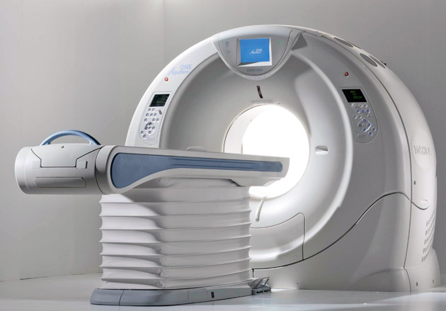
PRINCIPLES AND GENERATIONS OF CT
Passang Doma Sherpa
Tutor
Department of Paramedical Science, SBKSMI&RC

Slide 2
Contents
History
Principle
Data acquisition
Generations

Slide 3
History
The invention of CT scan by sir G. N. houns field.
Invented in 1972 .
Godfrey Hounsfield and Allan Cormack shared Nobel prize for medicine in 1979

Slide 4
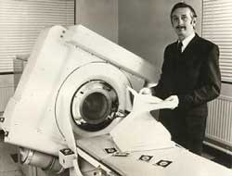
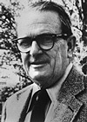
1967 - Sir. Godfrey N. Hounsfield an engineer at EMI
ALLEN CORMACK

Slide 5
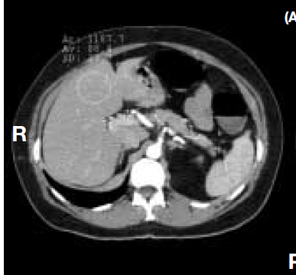
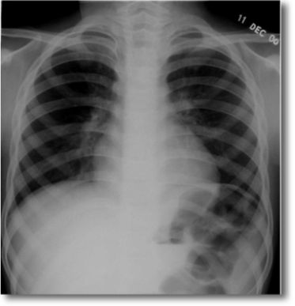
Tomographic image the image had a remarkable characteristic one never before seen in an x- ray image
                CT scanner technology today is used not only in medicine but in many other industrial applications such as nondestructive testing and soil core analysis.
Notes:
Nondestructive testing is a wide group of analysis techniques used in science and technology industry to evaluate the properties of a material

Slide 6
It had different names.
1 . Computerized Axial Tomography (CAT)
2. Computerized reconstruction tomography.(CRT)
3. Computerized added tomography. (CAT)
4. Computerized tomography. (CT)

Slide 7
Principles
The basic principle behind CT is that the internal structure of an object can be reconstructed from multiple projections of the object.

Slide 8
10
 |  | 6
10 | 9 | 7 | 9 | 10
9 | 8 | 6 | 8 | 9
7 | 6 | 4 | 6 | 7
9 | 8 | 6 | 8 | 9
10 | 9 | 7 | 9 | 10
intensity of x-ray at the source (i0)
Relative transmission = Log -------------------------------------------------
intensity of x-ray at the detector (i)

Slide 9
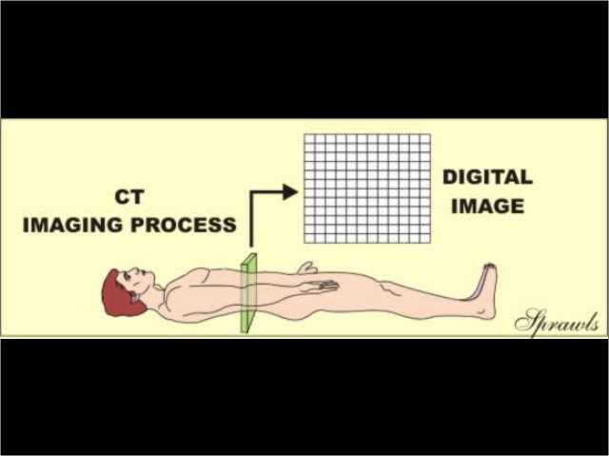

Slide 10
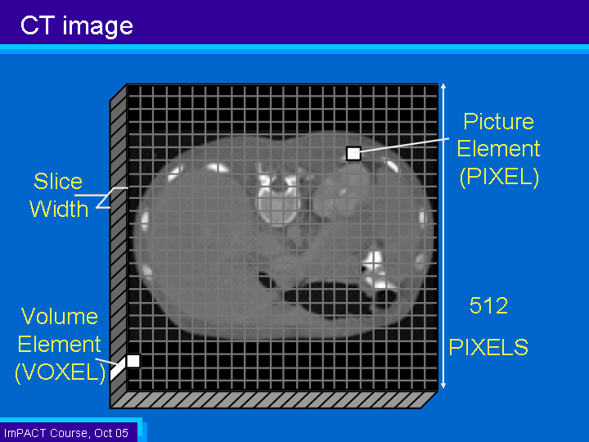

Slide 11
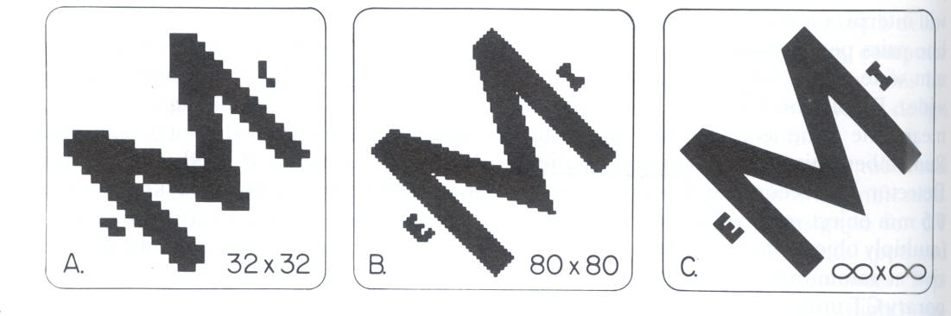
Spatial resolution improves with increasing matrix size and smaller pixels

Slide 12
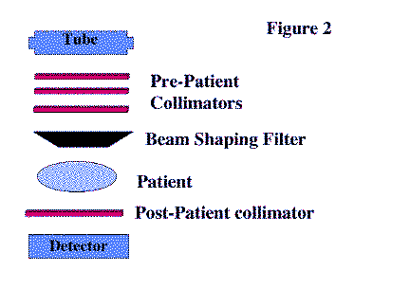
Data acquisition
In CT transmission measurements or projection data are systematically collected from the patient several schemes are available for such data collection each based on a specific “geometrical pattern of scanning” .

Slide 13
At each tube position a fan beam of x-ray pass through patient(eg: 50 cm beam for abdomen imaging)
A ray is measured of total x-ray attenuation along a line from the focal point to a single detector.
Transmitted x-ray intensity is measured by array of detectors (each detector detects one ray)
CT x-rays are highly filtered
Intensity depends on how much of the beam was attenuated/absorbed by tissue along the ray ( ray sum)
A projection is all the rays at a given x-ray tube angle or series of rays that pass through the patient at the same orientation

Slide 14
MDCT concept
Number of slice makes number of projection per tube rotation
Beam width= # slice X slice thickness
Image reconstruction
Linear attenuation coefficient(LAC)
-measurement of how well x-rays move through a given tissue( fat, water, bone etc)
Graphic plot of projection data forms a raw data ‘sinogram’
Computer makes images by determining the linear attenuation coefficient for each pixel-back projection
Notes:
Linear attenuation coefficient (µ) is a constant that describes the fraction of attenuated incident photons in a monoenergetic beam per unit thickness of a material ¹. ... Linear attenuation coefficient increases with increasing atomic number and increasing physical density of the absorbing material.
sinograms, which are simply a display of all of the different projections for a given slice stacked together

Slide 15
How do we get this raw sinogram data into a picture?
If you have this 4 pixel image and know the projection values, you can use algebra to solve for the value of each pixel.
CT image derived from mathematical manipulation of sinogram data.
In CT, Kernel used refers to :
Mathematical reconstruction filter
For lungs , bone, small and discrete feature- use hard( sharp) kernel to accentuate above feature
For soft tissues such as brain, abdomen, liver lesion- use soft kernel that will the noise

Slide 16
Mathematical Technique- with a given mathematical filter or convoluted kernel to remove the blur- Filtered back projection
Spatial resolution:
Ability to distinguish small objects that are close together (eg: lines pairs per cm
CTs have different mathematical filters for different purposes

Slide 17
Contrast resolution:
Ability to determine small difference in object density from its surroundings
Newer CTs use iterative reconstruction(IR) rather then filtered back projection(FBR)
Iterative reconstruction(IR)- Selectively remove noise to make better out of low dose
(There for iterative reconstruction(IR) can correct for noise, so you can use low dose)
Patient dose reduced with IR technique

Slide 18
Hounsfield unit(HU)
The Hounsfield unit (HU) is a relative quantitative measurement of radio density used by radiologists in the interpretation of computed tomography (CT) images.
The absorption/attenuation coefficient of radiation within a tissue is used during CT reconstruction to produce a greyscale image.

Slide 19
CT image is a map of linear attenuation coefficient.
Given CT no : HU
Based on arbitrary definitions of air as -1000 and water as 0.
HU are approximate, and can vary depending on kV and filtration used.

Slide 20
Hounsfield unit for different material
Material | HU
Air | -1000
Lung | -500 to -200
Fat | -200 to -50
Water | 0
Blood | 25
Muscle | 25 to 40
Bone | 200 to 1000

Slide 21
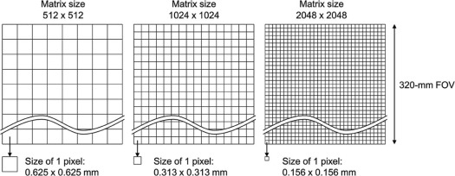
CT Display: FOV, Matrix and slice thickness
FOV is area scanned ( Head= 250mm, body=500mm)
Matrix : it is an rectangular arrangement of numbers in row and columns.
CT matrix is usually 512X512

Slide 22
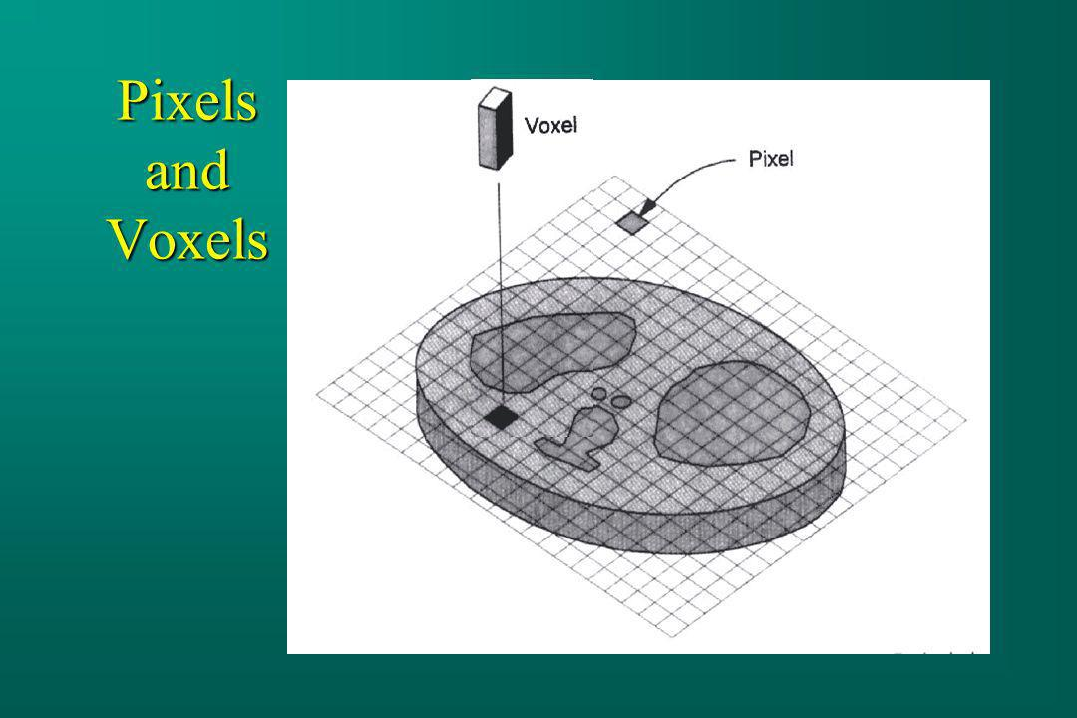
Pixel: Two dimensional picture element that makes up the matrix. Each pixel represents a CT number and is the building block of the matrix and image
Pixel size=FOV/Matrix
Spatial resolution can be improved by making pixels smaller- to do this either decrease FOV or increase the matrix

Slide 23
Window width and window level affects the image display by assigning different HU numbers each gives brightness level
Level- what you are looking for
Width range of what you can see
 | Window width | Window level
Head | 80 | 40
Chest ( mediasternum) | 450 | 40
Chest ( lung) | 1500 | -500
Abdomen (liver) | 150 | 60

Slide 24
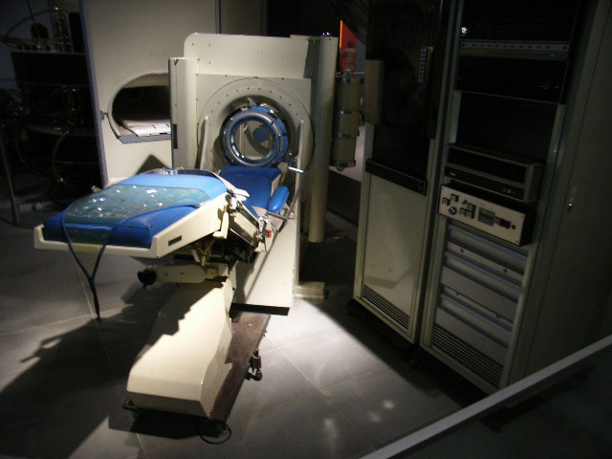
Generations
First generation
Second generation
Third generation
Fourth generation
Fifth generation
Spiral CT
Multi detector CT

Slide 25
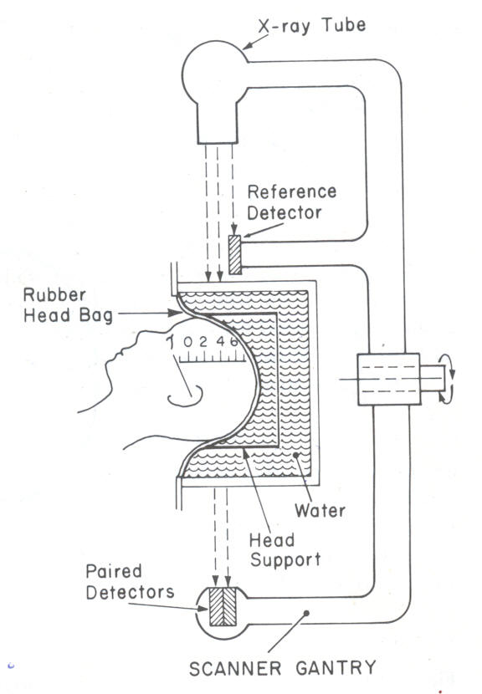
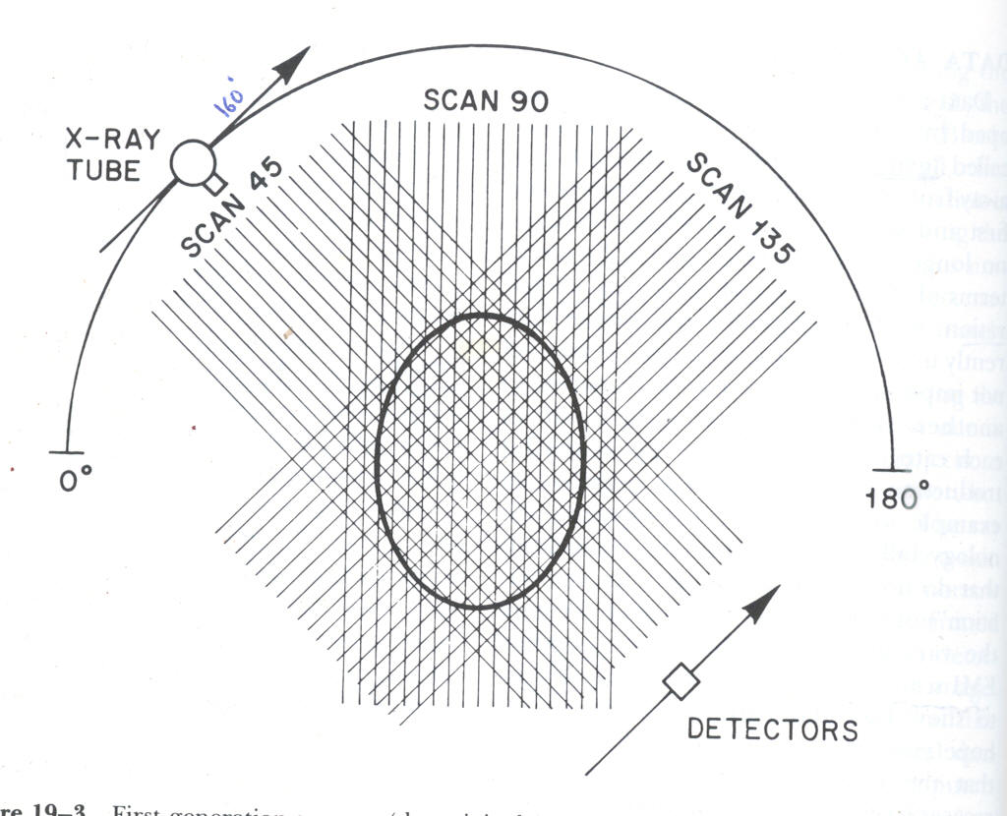
First Generation
180x160=28800

Slide 26
Translate- Rotate Technique
One X-ray beam and one detector
Moved one degree at a time until 180 Degree were covered
Take 4-5 minutes to perform a head CT
To lone to mage chest and abdomen
Each tomogram required 5 min & total study time
of 25-30 min.

Slide 27
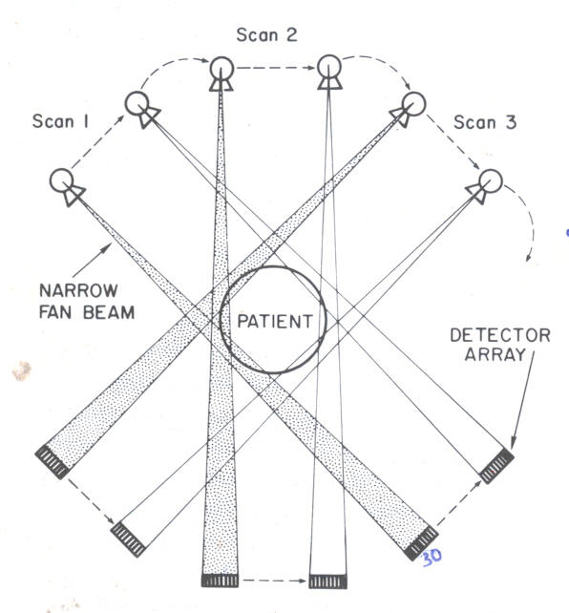
Second Generation

Slide 28
Rotate- translate configuration
Introduction of Fan Beam and multi detectors
Added 3 detectors at 1 degree apart, so could rotate 3 degree at a time
Cut down the time to scan by a factor of 3
Eventually added up to 55 detectors
Started to image the trunk

Slide 29
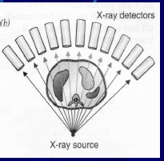
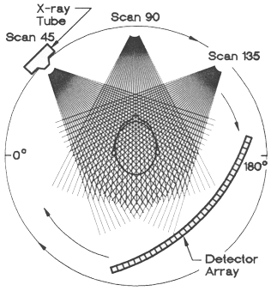
Third Generation

Slide 30
This type has only rotation movements-
Rotate- rotate type- fan shaped collimated X-ray tube with multiple (over 700) detectors
loaded on gantry which moves completely around the patients.
Fan beam completely cover the object
Currently used

Slide 31
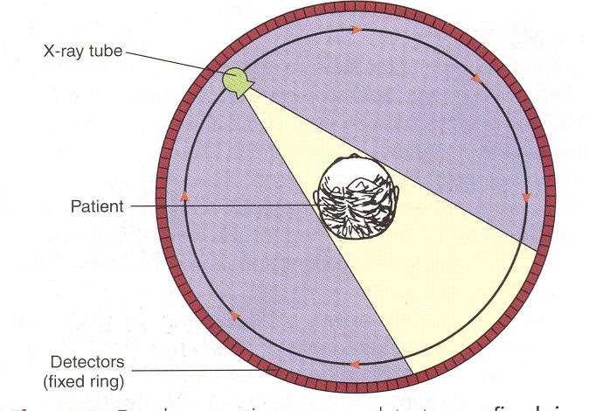
Fourth generation

Slide 32
Rotate-fixed configuration
In this type the detectors form a ring that completely
surrounds the patient and are fixed.
X-ray tube rotates around in circle inside the detector ring and has fan shaped collimated x-ray beam.
Scan time is lesser than 1 sec for each section.
Advantage– speed
Disadvantage– increased amount of scattered radiations
Cost prohibited

Slide 33
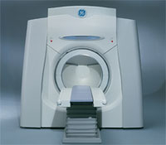
Fifth generation scanner

Slide 34
Electron Beam CT
Heart scan.
Electron gun [320cm long]with focusing and deflecting coils.
4 tungsten target rings (fixed) 180cms in diameter.
Ring of detectors (two rows of 432 each).
Scan time: 50ms
8 contiguous tomographic images obtained without moving the patient

Slide 35
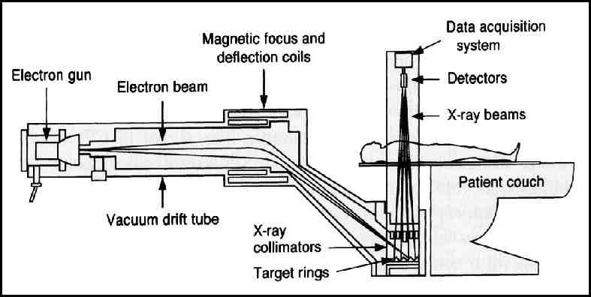

Slide 36
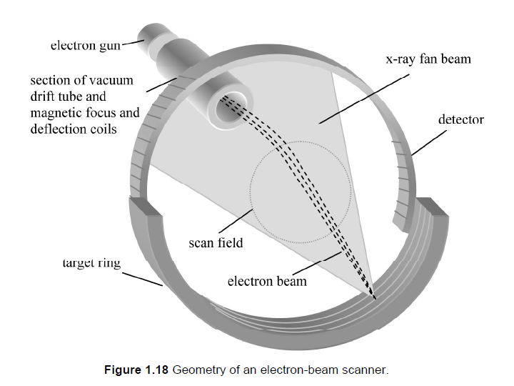

Slide 37
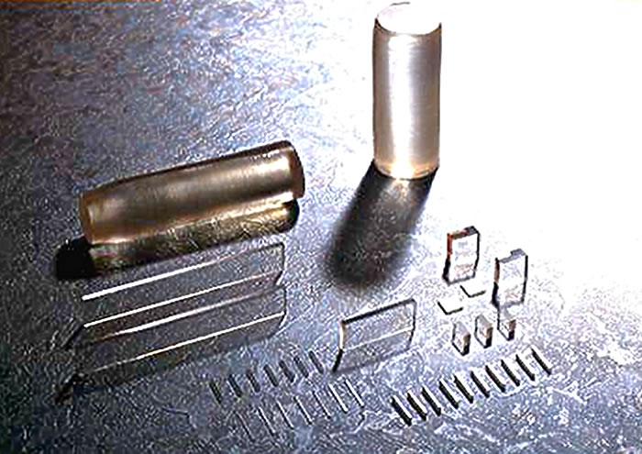
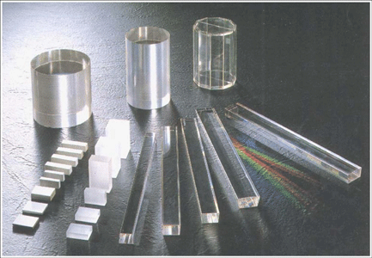
Cdwo4 crystals
Bismuth germinate
Notes:
Cadmium tungstate (CdWO4)

Slide 38
  Types of detectors
Types
1. Scintillation crystals- Bismuth germinate crystals coupled with photomultiplier or sodium iodide crystals, are more efficient and has less afterglow .
2. Ionization chamber containing xenon gas under
pressure, they have no afterglow but are slightly less efficient.
3. Solid state detectors

Slide 39
Detectors are designed to have quick temporal resolution and little afterglow/ rapid decay
High efficiency more the 90% incident x-ray absorbed
Computer magic -electronic signal made proportional to incident radiation.
Common modern materials: Cadmium tungstate, CsI, Calcium fluoride, Bismuth Germanate

Slide 40
Detector pitch
Pitch is the relation between patient movement and tube rotation (rate of table move in per tube rotation)
Detector pitch is divided table movement per 360 degree rotation divided by the collimator width at isocentre
Pitch = Table movement/rotation
X-ray beam width
Pitch 1 = there is no gap
Pitch 2= that means beam width is smaller than the rate of table movement (so there is gap)
Pitch 0.58 = table speed is less than beam width
So there overlap in a image

Slide 41
Increasing the pitch will decrease scan time and radiation dose
Low pitch values gives really good spatial resolution
But at the same increase in radiation dose

Slide 42
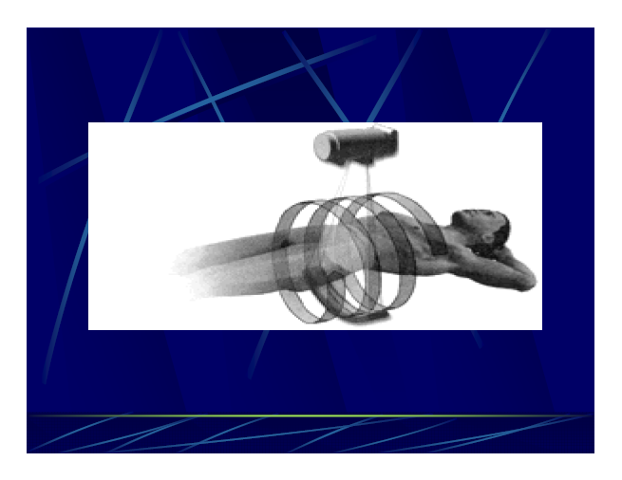
Spiral CT

Slide 43
X-ray tube moves continuously with slip-ring technique.
Ring having brushes that remain in electrical contact with the inside of outer ring.
X-ray tube moves continuously with patient moving
cephalad with constant rate producing a spiral or helix
around the patient.

Slide 44
Tube is energized quickly as compared to conventional
Thermal capacity 8MHU.
Cadmium tungstate is used preferred crystal photo iodides used.
Reconstruction is by interpolation I.e. calculation of intermediate values in a series.
It has 3 dimensional image constructed

Slide 45
Advantages of spiral over conventional CT
Shorter scanning time
Reconstruction along z axis with overlapping of
successive images leading to detection of small
lesions
Reduced motion artifacts
3D reconstruction of image

Slide 46
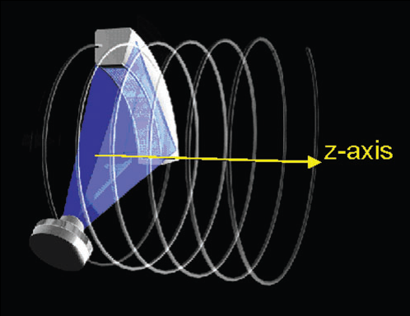
MULTIPLE DETECTOR CT SCAN
Characterized by
    Continuous gantry rotation
    Continuous data acquisition
    Patient table is moving at constant speed

Slide 47
These scanners are intended to facilitate to image moving structures.
Fast image acquiring.
Multi image in single expose.

Slide 48

Thank you

