Slide 1

PACS
Passang Doma Sherpa
Tutor
Department of Paramedical Science, SBKSMI&RC

Slide 2
What is PACS?
PACS (Picture Archival & Communication System) provides Radiology departments optimal storage of patient data and radiographic images.
PACS enables the acquisition, storage, output, display of digital images and reports throughout the facility to many users simultaneously.

Slide 3
IMAGING AT RADIOLOGY
DEPARTMENT
P A C S
IMAGE
ARCHIVAL / STORAGE
COMMUNICATION
TO THE ENTIRE HOSPITAL

Slide 4
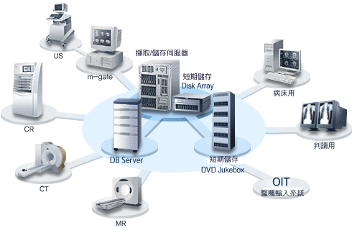
PACS is a system for storage and distribution of digital medical images over a networked environment.

Slide 5
ROLE OF PACS
Digital images viewed on monitors in conjunction with:
Clinical details
Radiological report displayed in electronic format
Main aim : EFFICIENCY OF DATA MANAGEMENT

Slide 6
Features of PACS
Once the image is digitally acquired PACS allows quick & easy electronic transmission of the images to computer workstations across the hospital departments and outpatient centres
Physicians can view the exam via computer at any time from any location.

Slide 7
It is a family of products for:
Digitizing (computerizing) medical images.
Displaying and manipulating medical images.
Transferring medical images within the hospital area or to other locations.
Permanently archiving medical images.

Slide 8
Full-PACS : PACS system where all imaging modalities in radiology are connected to the PACS system, with the ultimate goal of eliminating film.
Mini-PACS : PACS system limited to one modality or some other subset of the medical imaging equipment in radiology.

Slide 9
Why do we need PACS ?
Easy comparison of patients current and historical examinations
Comparison of different examination techniques used for imaging the same body part
Simultaneous multilocation viewing of the same image
Image retreival is infinitely quicker
Allows numerous post-processing soft-copy manipulation

Slide 10
Images are automatically chronologically ordered
Some direct cost savings
Time saving for non-radiological clinicians
No image can be lost / misfiled
No patient is re-irradiated
Introduction of teleradiology over a wide area network

Slide 11
PACS consists of five major
subsystems:
Patient/Exam data entry
Image acquisition
Image output and display.
Image database management & storage.
Network and communications.

Slide 12
Step 1 : PATIENT EXAMINATION AND DATA ENTRY

Slide 13
HIS
Hospital information system (most imp computer system in the hosptl)
Stores demographic data of all the patients whether or not they have any imaging procedures performed
Also records the admission and discharge dates, outpatient appointments etc
Othe modules : laboratory reports

Slide 14
RIS
Radiology information system
A separate system or a part of HIS
Stores information specific to the radiology department

Slide 15
HIS-RIS-PACS
Bidirectional integration is preferred :
1) input of demographic data only once minimizes human error
2) any scheduling or status data is distributed to all systems automatically
3) PACS propagated to all systems automatically, ensures that all systems contain accurate information

Slide 16
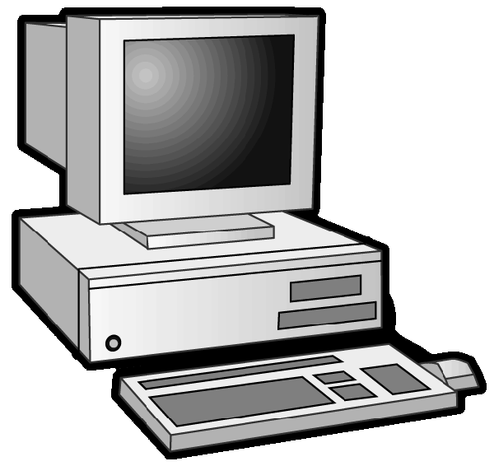

HIS
PACS
RIS

Slide 17
STEP 2 : IMAGE ACQUISITION

Slide 18
MRI
P
A
C
S
CT
Digital images
USG
IMAGE
DIGITIZATION
CONVENTIONAL
RADIOGRAPHY

Slide 19
Digital image acquisition prior to PACS
DIGITISING CONVENTIONAL ANALOGUE FILM
PHOTOSTIMULABLE PHOSPHOR PLATE TECHNOLOGY
DIRECT DIGITAL RADIOGRAPHY

Slide 20
Digitisation of analogue film
Time consuming process
Digitization on a large scale is not a practical option
Digitised image retains any intrinsic limitations
Requires skilled operators
Nondusty working conditions

Slide 21
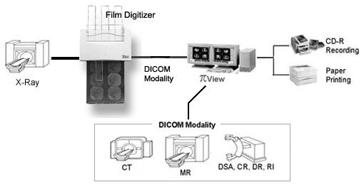

Slide 22
Computed radiography
Photostimulable phosphor plates replace the conventional film/ screen combination
X-ray photons falling on phosphor plate produce a latent image by promoting electrons to metastable traps of higher energy level

Slide 23
Plate is read out by scanning laser beam : electrons gain sufficient energy to fall back to basal energy level and emit photons of visible light which is converted to a final digital signal

Slide 24
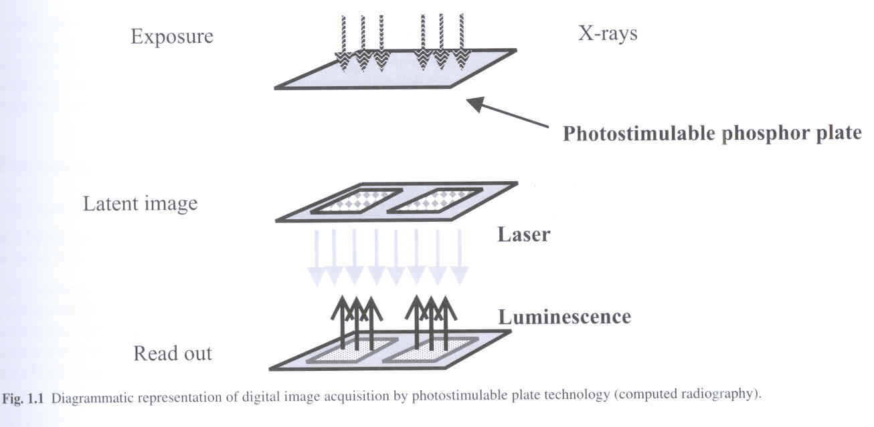

Slide 25
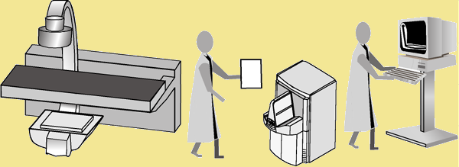
What is the Computerised radiography Process?

Slide 26
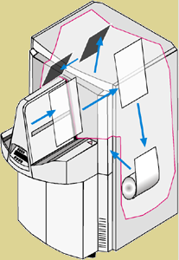
2. Image plate is removed from cassette
1. Cassette and image plate enter the reader
5. Image plate is returned to cassette and ejected
3. Latent image is scanned by laser
4. Image plate is erased with high intensity light

Slide 27
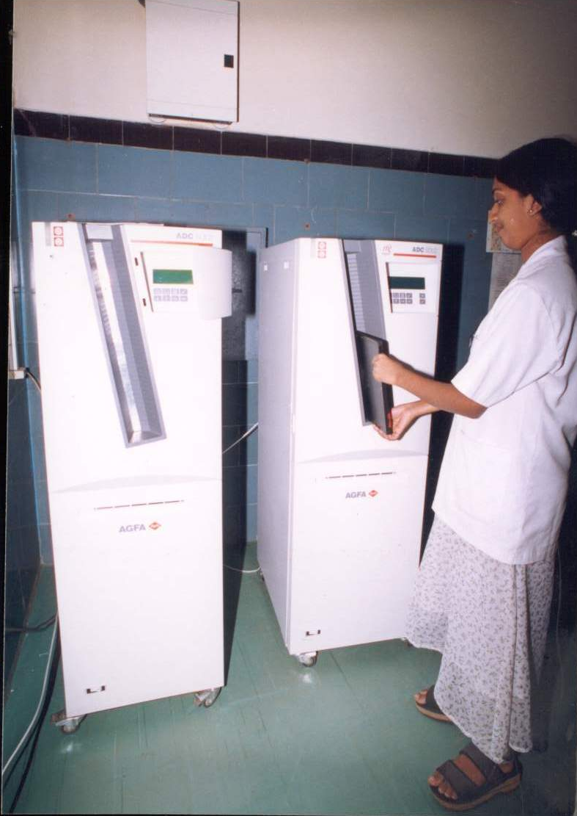

Slide 28
advantages
Allows a greater latitude of exposure
Reduction in the number of repeat images taken due to errors in selecting correct exposure
Superior contrast resolution
Phosphor is reusable

Slide 29
Direct digital radiography
Amorphous silicon used with digital detectors
Amorphous silicon used to make plates consisting of an array of photodiodes
Digital detectors :
1) cesium iodide: emit light photons
2) selenium: produces electrical signal

Slide 30
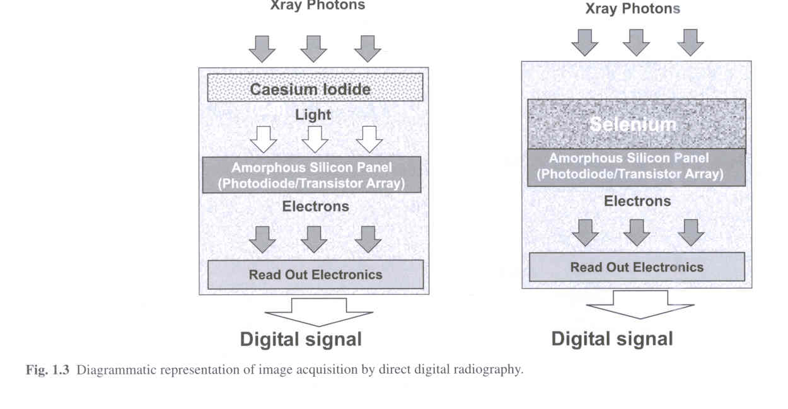

Slide 31
Spatial resolution equals that of a film
Lower patient exposure
HIGHLY EXPENSIVE

Slide 32
IMAGE ACQUISITION
PATIENT INFORMATION
PACS

Slide 33
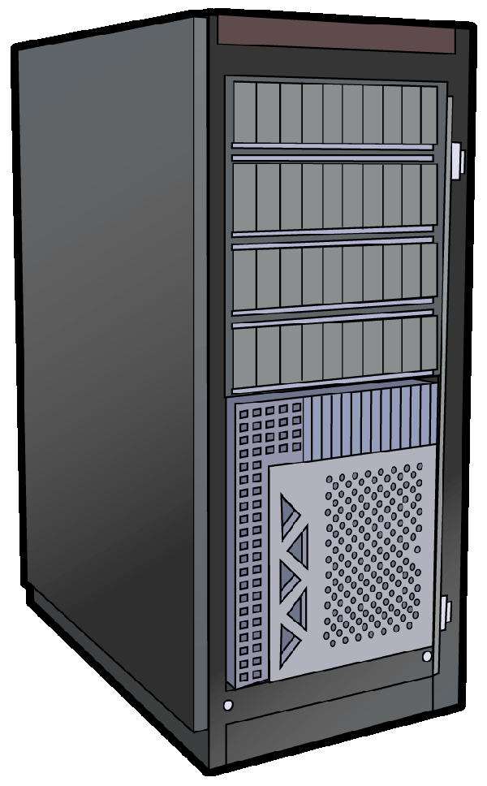
B
R
O
K
E
R
ORDER ENGINE
PACS SERVER

Slide 34
What is DICOM?
DICOM stands for "Digital Imaging Communications in Medicine" is a standard that is a framework for medical imaging communication world wide.
It is based upon the Open System Interconnect (OSI) reference model, which defines a 7-layer protocol.

Slide 35
DICOM : is a standard protocol for operation in a networked environment using industry standard networking protocols such as OSI .
The first version was published in 1985. The current version is DICOM Version 3.0.
DICOM provides standardized formats for images, a common information model, application service definitions and protocols for communication.

Slide 36
Why is DICOM important?
Customers today do not want to be 'locked into' only one manufacturer for their image acquisition equipment, image display equipment, archive equipment and hardcopy equipment. Rather they want to be able to choose among manufacturers for these products.

Slide 37
STEP 3 : DATABASE MANAGEMENT AND STORAGE

Slide 38
Data base server
Brains of the system
Point of integration between HIS and PACS
Allows acsess to prefetching and patients demographic and historical information
Creates and manages patient folders
Manages the flow of images and patient data

Slide 39
Data base management
IMAGES
DEMOGRAPHIC DATA
DATABASE MANAGEMENT
P A C S

Slide 40
STEP 4 : SERVER
1) SHORT TERM STORAGE
2) LONG TERM STORAGE

Slide 41
Image server
On line (rapid access) storage and distribution device
Supports simultaneous exam input and output transfer operations
Upto 1-2 months of storage capacity

Slide 42
Short term storage
Provided by RAID devices containing magnetic disks
Expensive but have high performance
Larger the RAID : greater the number of examinations that can be retained online for image retrieval and display
Modern PACS allows retrieval of images within 2 sec from STS

Slide 43
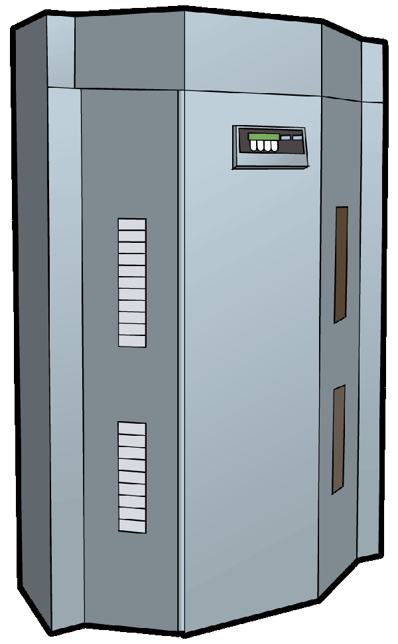
Long term storage
Used to store digital data for longer periods of time
COMPACT DISKS :cheap but storage capacity is too low (650 MB)
MAGNETO OPTIC DISK: most commonly used (6 GB )
DIGITAL VERSATILE DISK: 16 GB , cheaper than MODS but very fragile

Slide 44
STEP 5 : NETWORKS AND COMMUNICATION

Slide 45
Networking is a set of computers connected to each other ,usually through a cable. This helps user to share data, communicate, use a common resource.
LAN: Networks connected within a building/campus .
WAN: Networks connected across countries and continents.

Slide 46
SERVER
Medicine
Surgery
Pediatrics
OBG
WORKSTATIONS

Slide 47
PACS workstations
1) DISPLAY workstation : located within the radiology department for interpretation of films
2) REVIEW workstations : located everywhere else in the hospital for viewing by physicians and staff

Slide 48
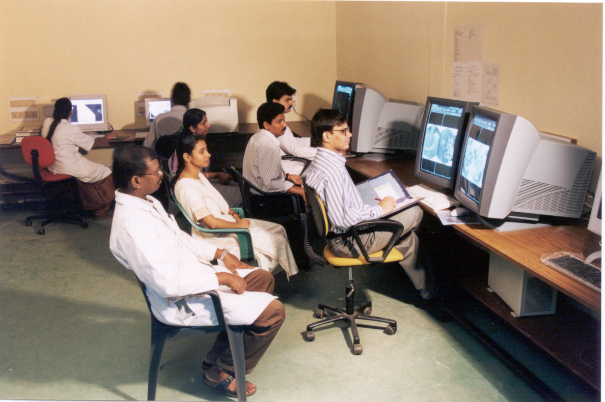
Display workstation

Slide 49
High resolution monitors
1K resolution (1000 lines) : are adequate for CT, MRI, USG and digital angiography
2K : are necessary to view whole of a plain radiographic image at full resolution
Greys scale and color monitors available

Slide 50
Soft copy tools
Contrast width and level
CT density values
Grey scale inversion
Stack / cine mode
Image orientation
Magnification
Measurement

Slide 51
Web browser workstation
Makes it unnecessary to invest in expensive specialist PACS workstations at majority of sites throughout the hospital
Displays radiologists report in conjunction with the displayed image

Slide 52
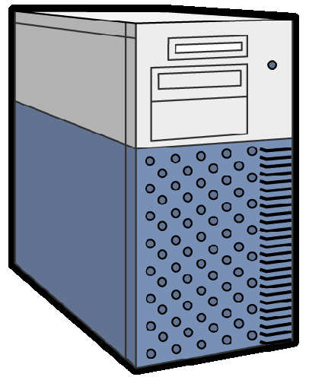
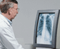
W
A
R
D
S
CT
Dicom modalities
Web
MRI
IV2
O
P
D
USG
Dicom standards
reports
PACS
images
broker
X-RAYS
Reporting room

Slide 53
Data compression

Slide 56
PACS architecture
Centralised PACS
Distributed PACS

Slide 57
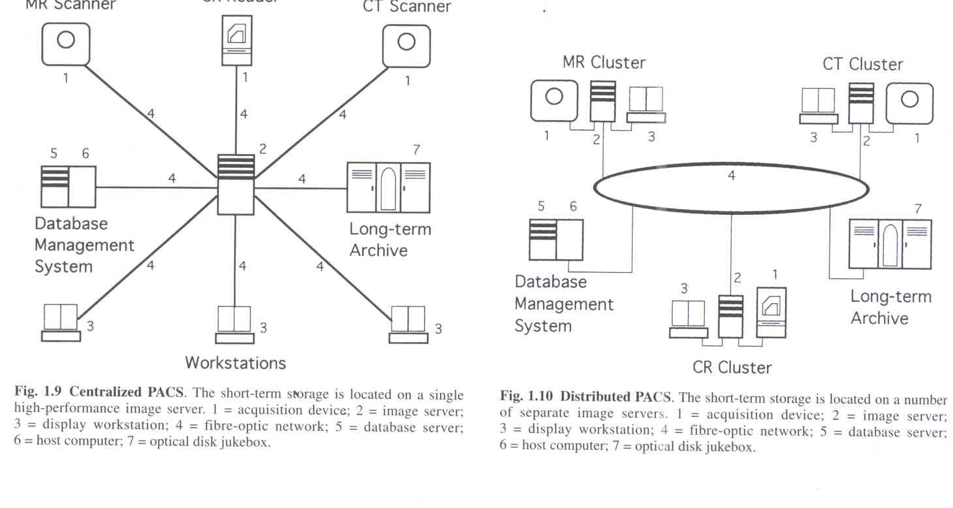
Centralised PACS
Short term storage is located on a single high performance image server

Slide 58
advantages
Excellent speed of retreival of all imaging examinations
All images are equally accesible at any workstation in the hospital
User is completely location independent

Slide 59
Disadvantages
Necessary to upgrade RAID or replace it with a larger RAID
Its vulnerable to a single point failure ( failure of short term storage device )

Slide 60
Distributed PACS
Short term storage is located on a number of separate image servers

Slide 61
Advantages
Built-in redundancy (when one of the server fails, only a part of the PACS is down)
Easier to extend it to finally become a hospital-wide PACS

Slide 62
Disadvantages
Expensive hardware device
To some extent is user-location dependent
User cannot view all image with the same speed at any one workstation
Elaborate preloading algorithms are essential

Slide 63
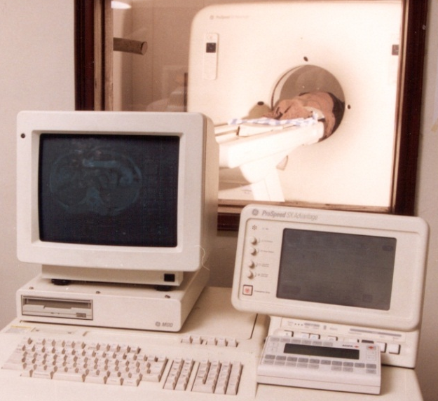
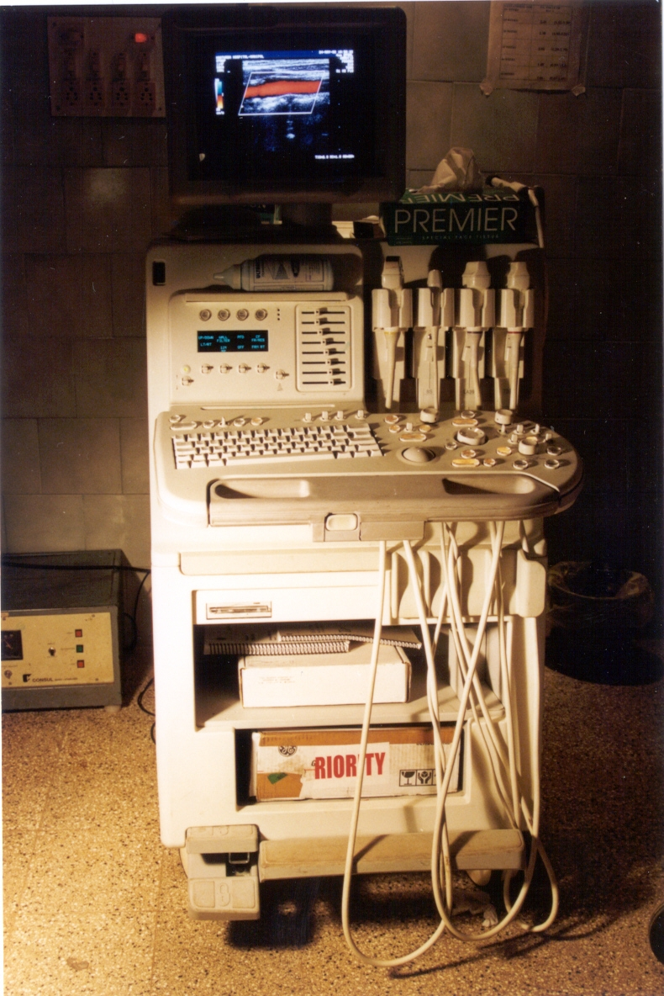
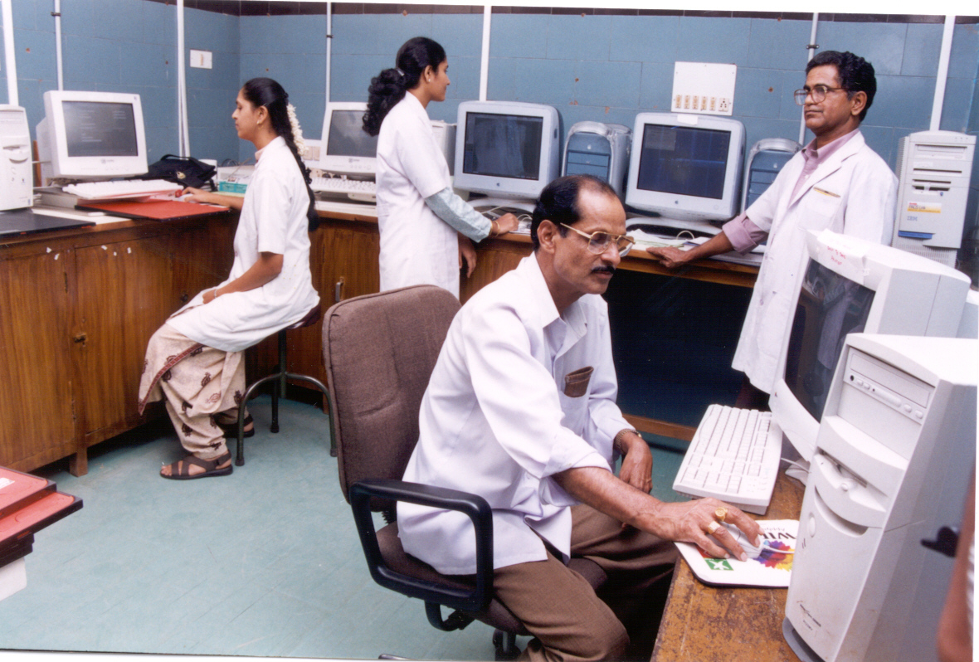
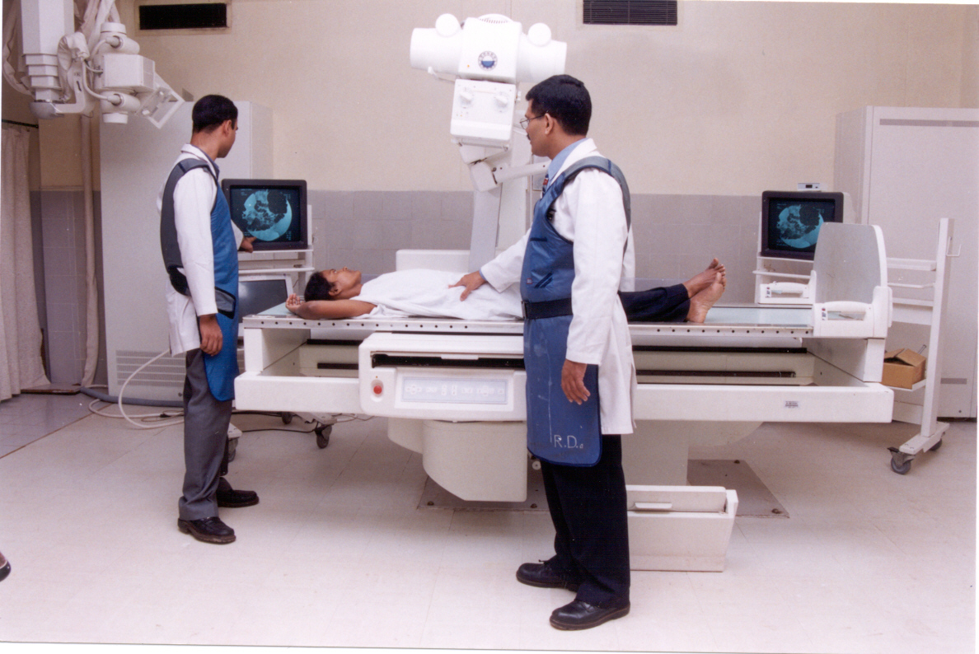
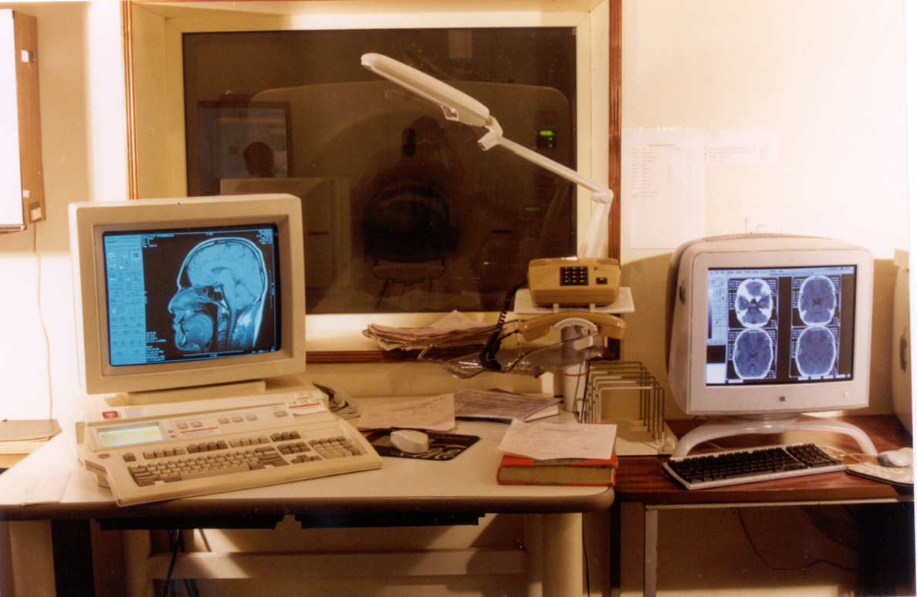
PACS IN OUR DEPARTMENT

Slide 64
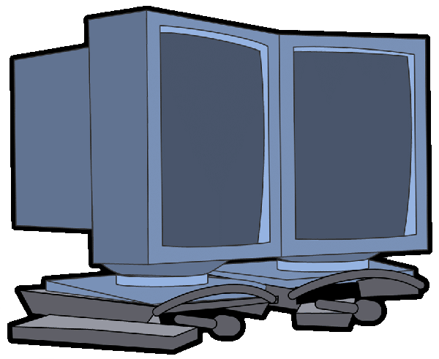
Films
ID tablet
AGFA digitizer
Diagnostic workstation
PACS Server
Preview station
Workstation

Slide 65

LOGIQ 700
CT
MRI
PACS SERVER
Prestige machine

