Slide 1
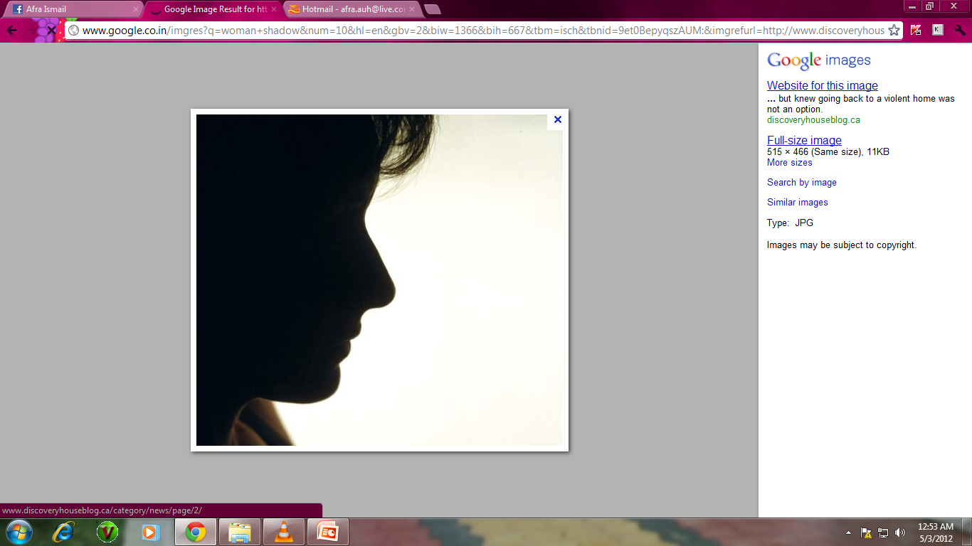
Mammography
Passang Doma Sherpa
Tutor
Department of Paramedical Science, SBKSMI&RC

Slide 2
Definition
Radiological examination of the human breast using low energy x-rays to detect pathologies.

Slide 3
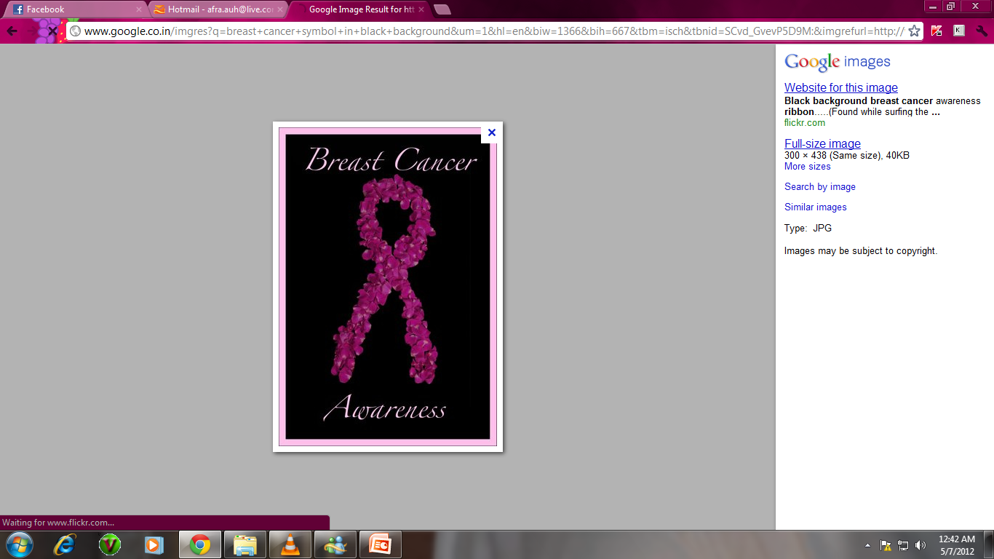
Indications
Symptomatic women
Post menopausal women
Post hysterectomy patients
Gynaecomastia-Gynaecomastia is a common condition that causes boys' and men's breasts to swell and become larger than normal

Slide 4
Contraindications
Pregnancy
Lactating Mother
Post FNAC or FNAB
Below 40 yrs of age…

Slide 5
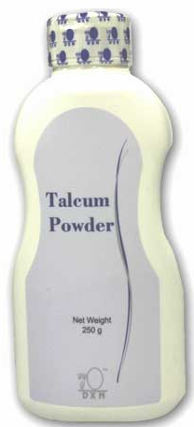
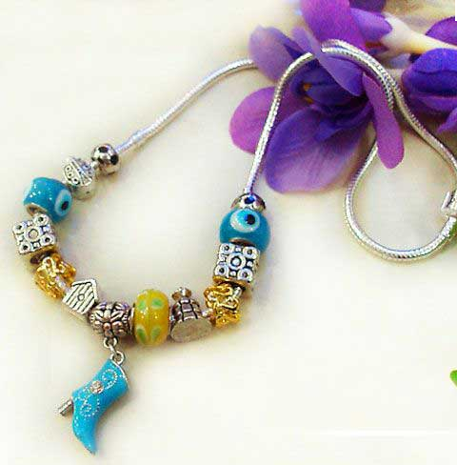
Patient Preparation
Clinical and Family History considered
Patient instructed to avoid deodorant, talcum powder or lotions under arms and breast
Jewelary and clothing in the region of examination are removed prior to examination

Slide 6
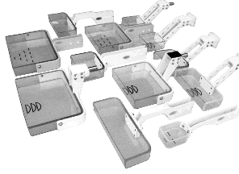
Most important criteria 4 breast compression…
Radio translucent paddles
Discomfort and pain

Slide 7
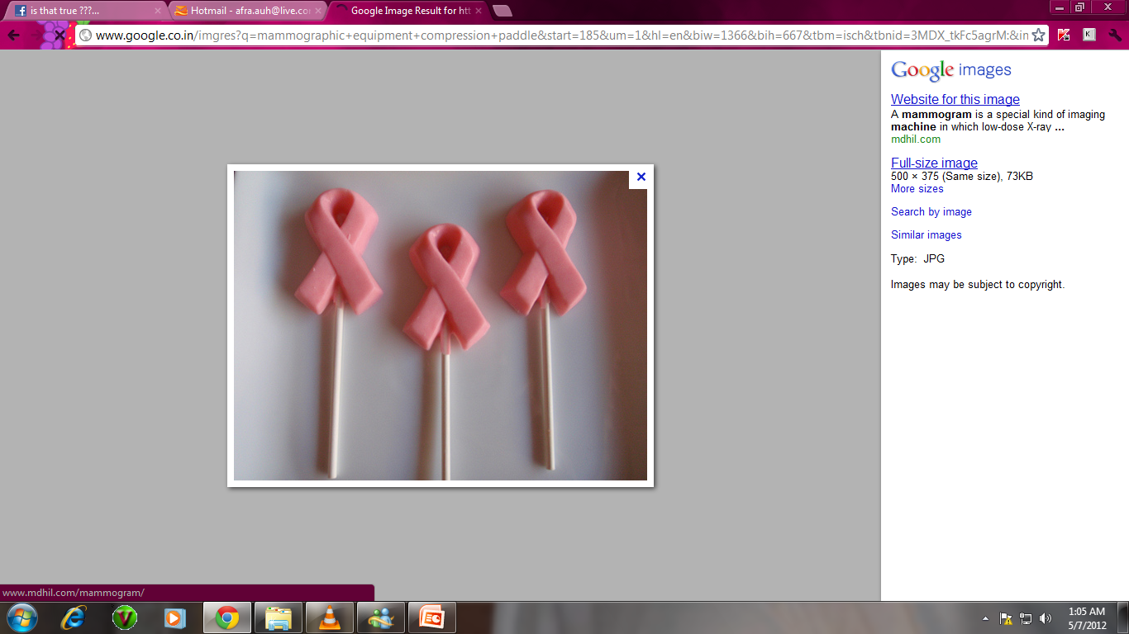
Need for breast compression….
Improved contrast by reducing scatter
Reduced radiation dose since lesser thickness of the breast tissue is to be penetrated.
Reduced motion unsharpness
Super imposition of breast tissues avoided
Lesions seen better
Increased geometric sharpness / because of less OID

Slide 8
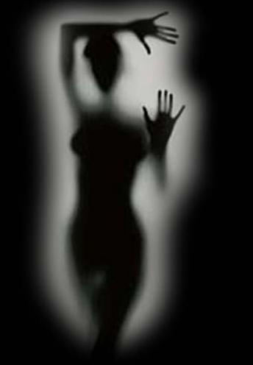
Criteria for evaluating breast compression…
The fibroglandular tissues are separated rather than overlapping
The fibroglandular tissues are adequately exposed and evenly penetrated

Slide 9
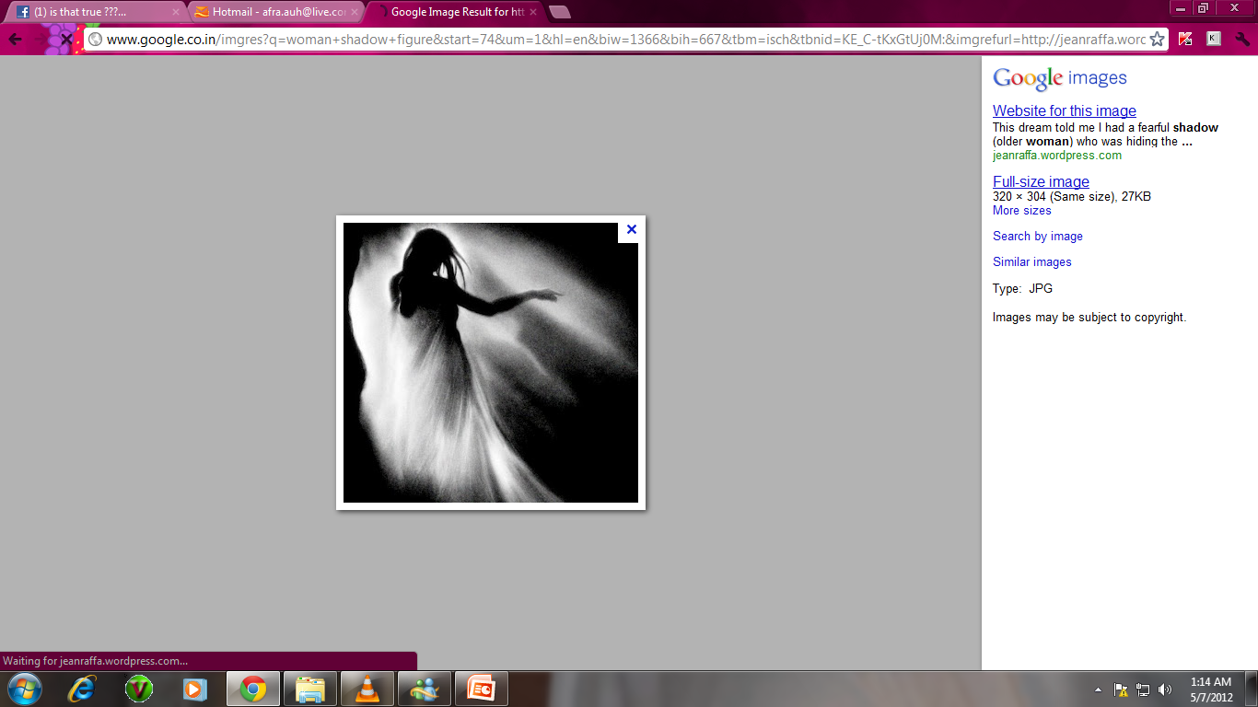
Routine Views taken …
Cranio – caudal
Medio – lateral oblique
Lateral

Slide 10
Supplementary Views taken …
Axillary tail view
Cranio caudal extended view (kleopatra view)
Cleavage view (valley view)
Tangential view
Rolled views
Spot magnification view
Caudocranial view
Reverse oblique
Implant imaging

Slide 11
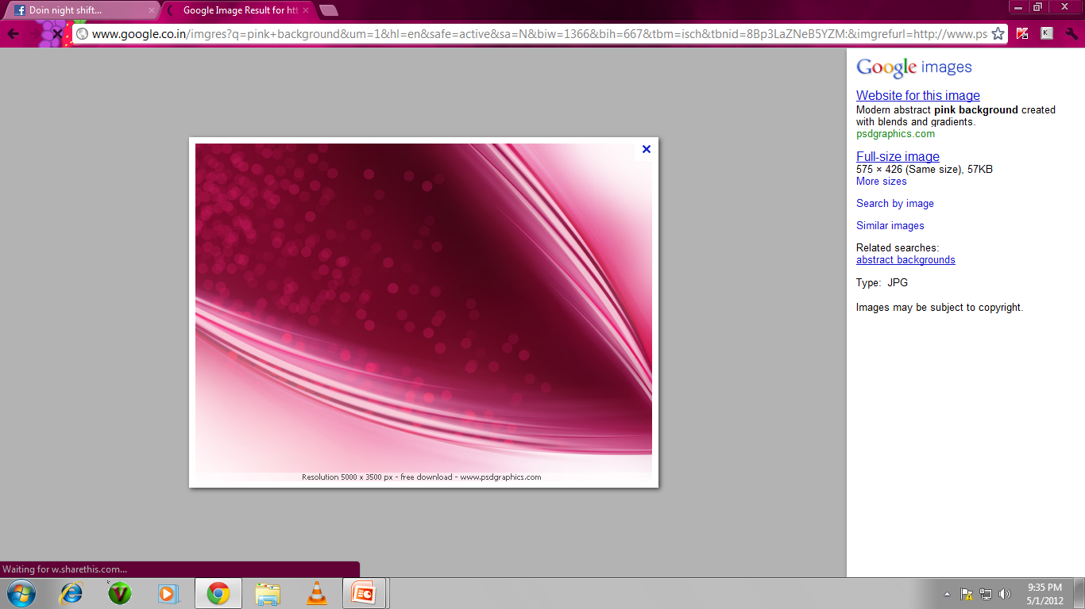
Cranio Caudal Projection
Lateral part of the breast as much as possible must be demonstrated
The nipple in profile
Central part of the retroglandular fat tissue
Pectoral muscle on the posterior edge of the breast must be demonstrated
Medial part of the breast must be demonstrated

Slide 12
Cassette holder is raised to the level of elevated inframammary fold
The breast is pulled on to the plate using both hands
Compression is applied from the top of the breast
Nipple in profile
The X ray beam is perpendicular to the floor

Slide 13
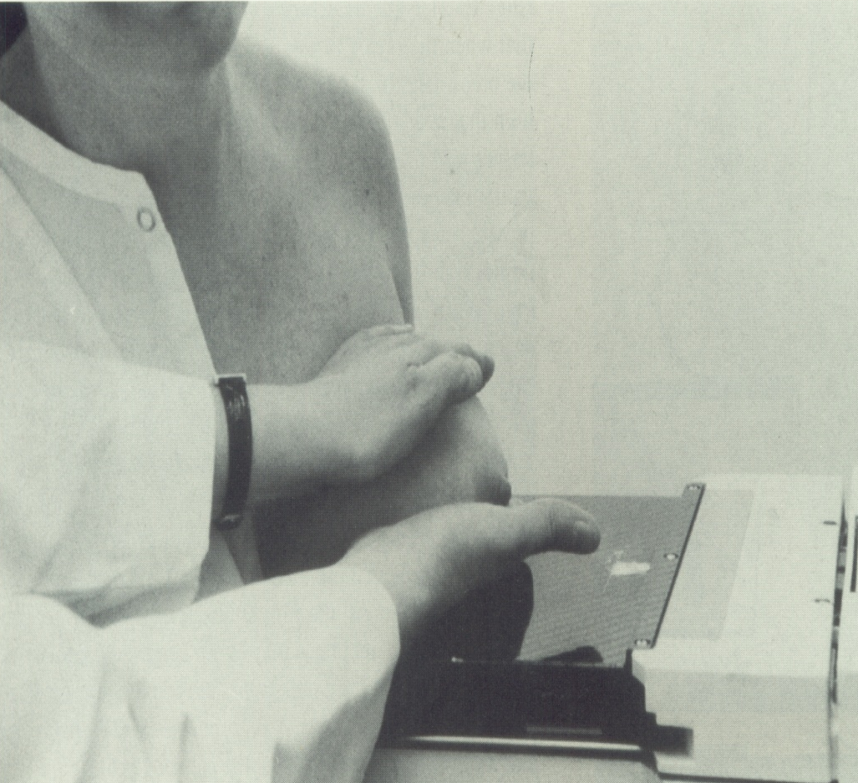
Compression is applied gradually while pulling the lateral tissues into the field of view without displacing the medial tissues avoiding skin folds.

Slide 14
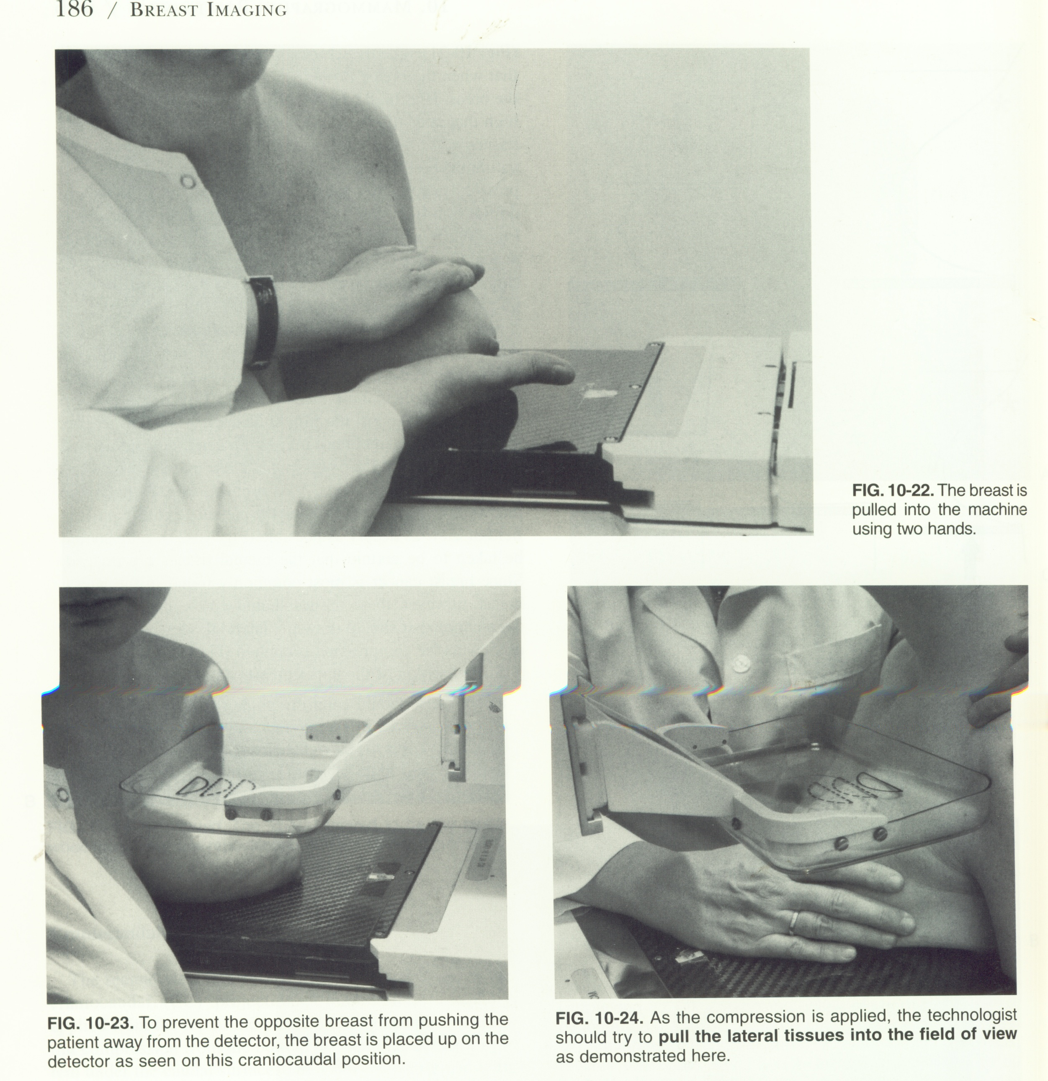


Slide 15
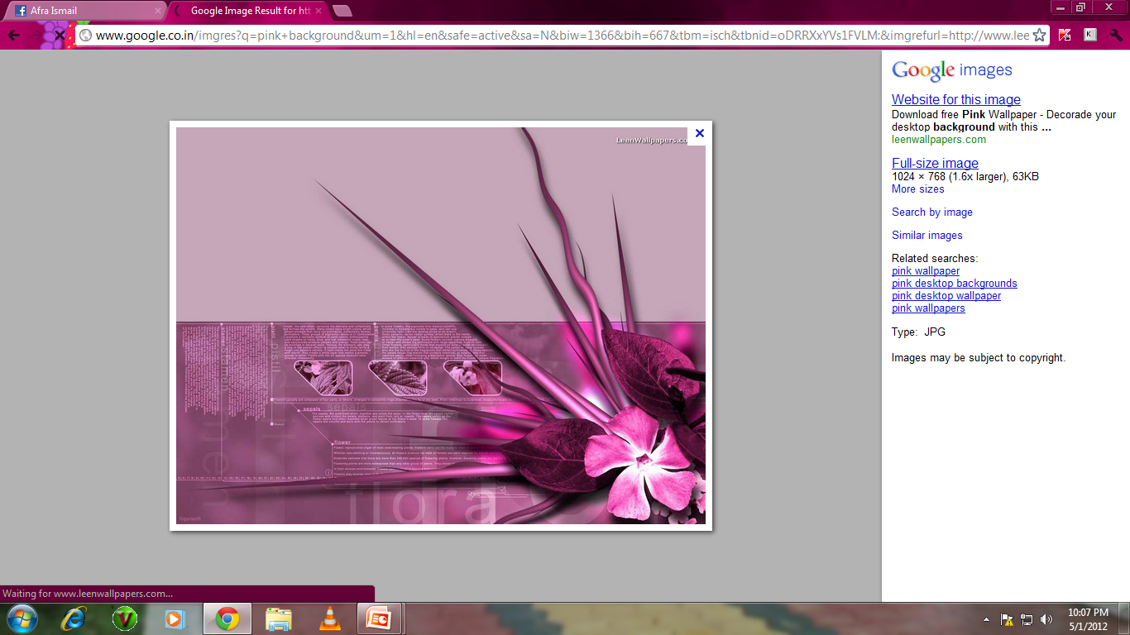
Medio - Lateral Oblique Projection
Purpose
Best view to image entire breast tissue
Demonstrated Details
Nipple in profile
Pectoral muscle extending to or below the nipple line
Inflamammary angle

Slide 16
Positioning of MLO
The patient is slowly turned towards the cassette holder
The breast should be pulled up and away from the chest wall (medially & anteriorly)
Apply compression with upper corner of the paddle just below the clavicle
Move hands towards the nipple as the compression holds the breast
Pull the abdominal tissue down to open the inframammary fold

Slide 17
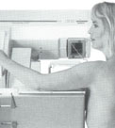
The edge of the detectors should be placed high in the axilla ( level of the technologist’s fingers)
The compression paddle will be at the level of the technologist’s thumb

Slide 18
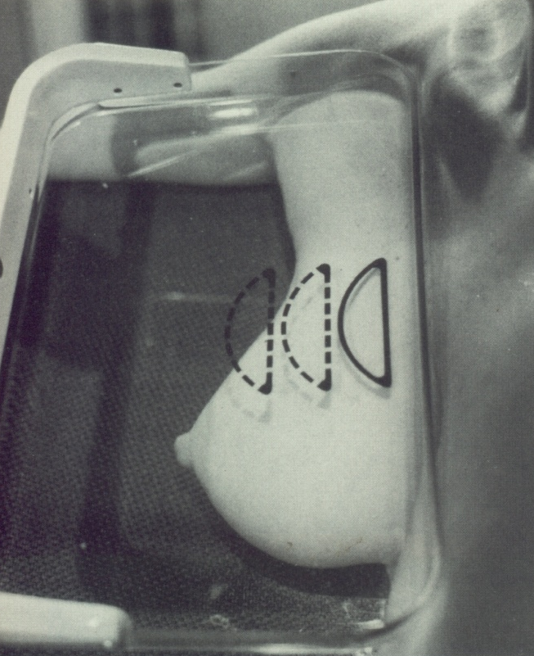

X-ray tube angulated to 45 degrees
Cassettes is parallel to the pectoral muscle
Angulation adjusted according to individuals

Slide 19
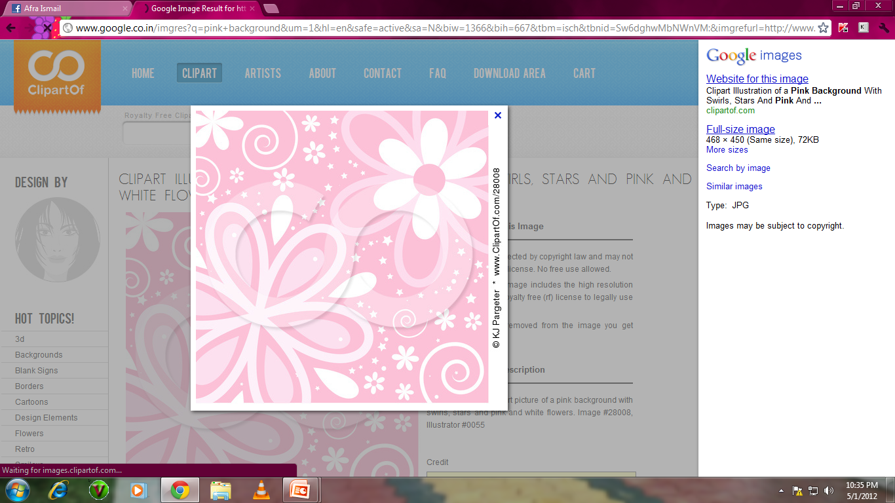
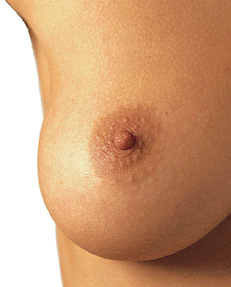
Lateral Projection
Purpose
Taken to localize the exact site of a lesion
To demonstrate gravity dependent materials
Demonstrated details
Majority of the breast tissue
Pectoral muscles
Nipple in profile
Infra mammary angle

Slide 20
Positioning of Lateral Mammogram
Tube arm rotated 90 º
Patients sternum positioned against edge of bucky
Neck extended, chin resting on top of bucky
Elbow is flexed to relax pectoralis muscle

Slide 21
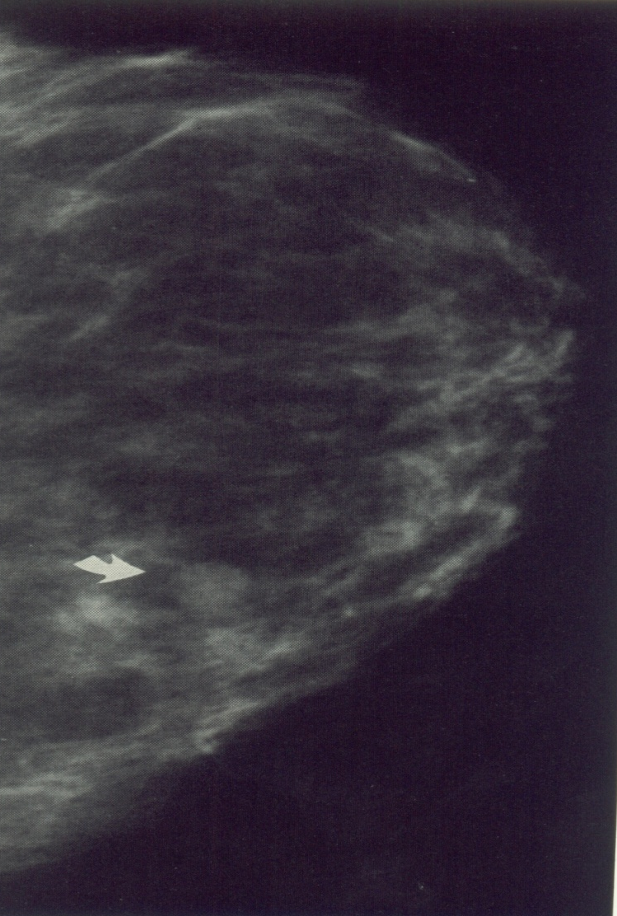
Apply compression rotating the breast until in true lateral position
The arm is gently raised out of the field of view
Open the inframmary fold by pulling the abdominal tissue down

Slide 22
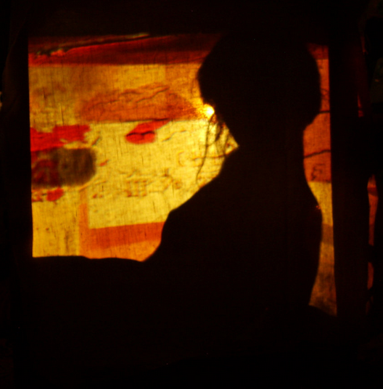
Supplementary Projections …

Slide 23
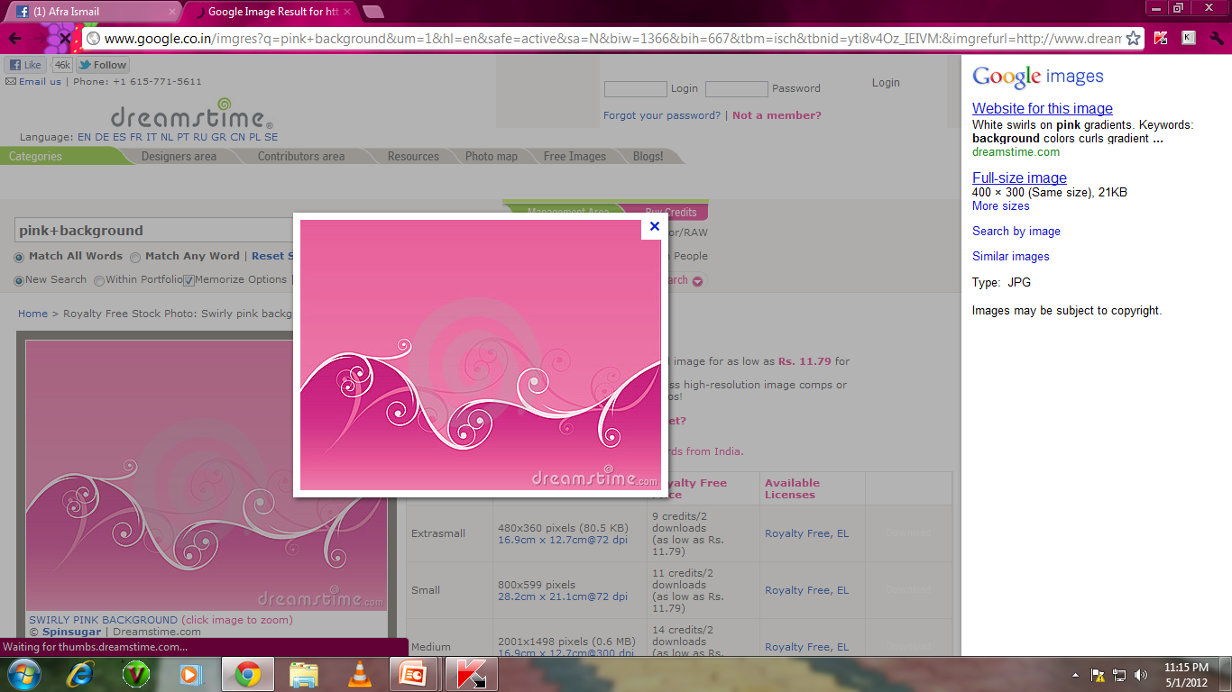
Axillary Tail View
PURPOSE
Performed in post mastectomy patients
To demonstrate entire axillary tail & most of the lateral aspect of breast
Tube arm rotated
Patient turned to bring the axillary tail in contact with bucky
Patient’s elbow flexed, hand resting on the handle bar
Axillary aspect pulled out and away from the chest wall
Compression applied holding the axillary tail in place

Slide 24
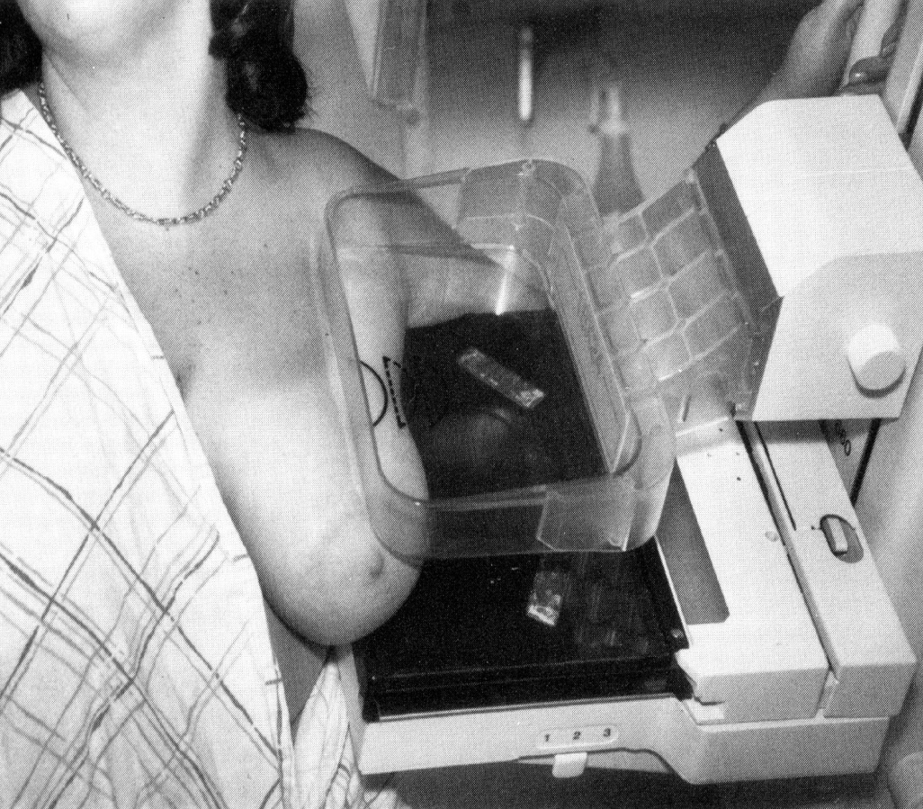
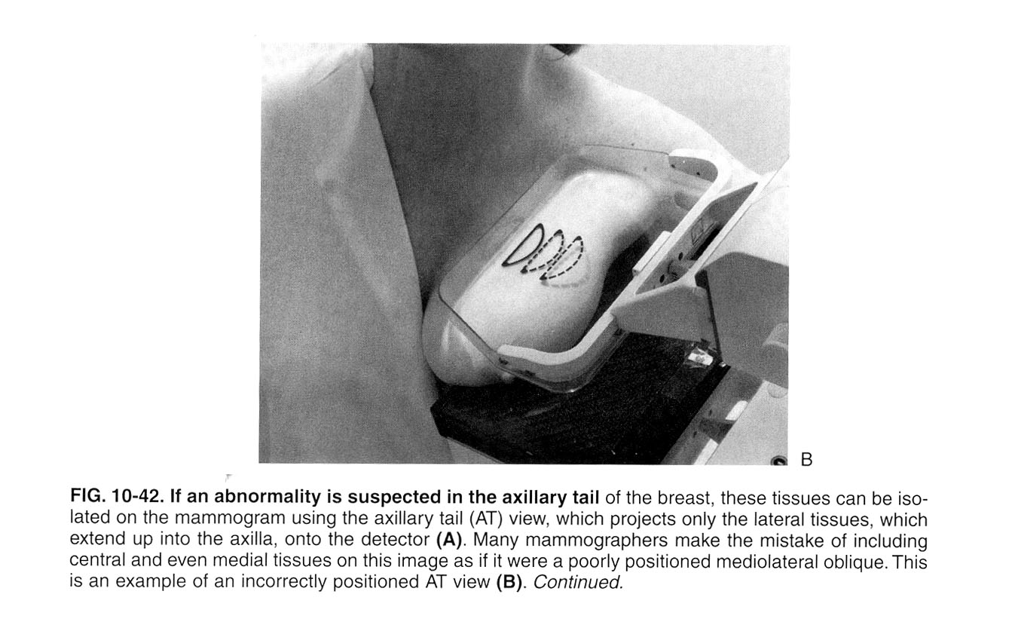

Slide 25
Extended Cranio caudal Projection
(Kleopatra View)
Purpose
Better imaging of the lateral part of the breast and the axillary tail
To depict posterior lesions seen on MLO projection but not on a CC projection
Position as for a cranio-caudal view
Elevate the inframammary fold
Rotate the patient to include the lateral aspect of the breast
5º tube angulation laterally to avoid the shoulder joint

Slide 26
Lateral tissues are not completely imaged and are off the edge of the film.
Lateral tissues are imaged

Slide 27
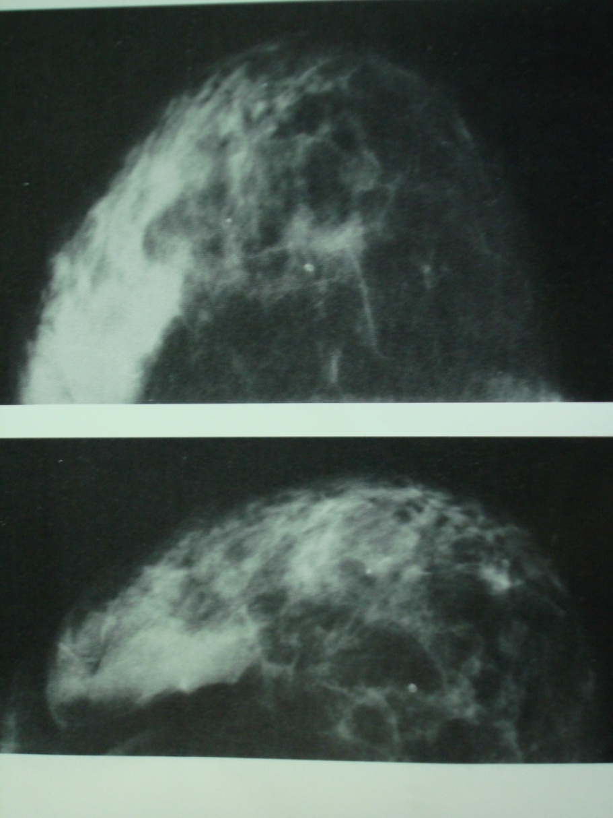

Slide 28
Cleavage View (Valley View)
The infra mammary folds of both the breasts are elevated and positioned on the imaging plate
The medial tissue of both the breasts are pulled anteriorly to image the cleavage
Purpose
Performed to visualize deep lesions in the posteromedial aspects of the breast
Portion of the breast tissue in the valley between the two breast
A medial lesion is demonstrated well in this position

Slide 29
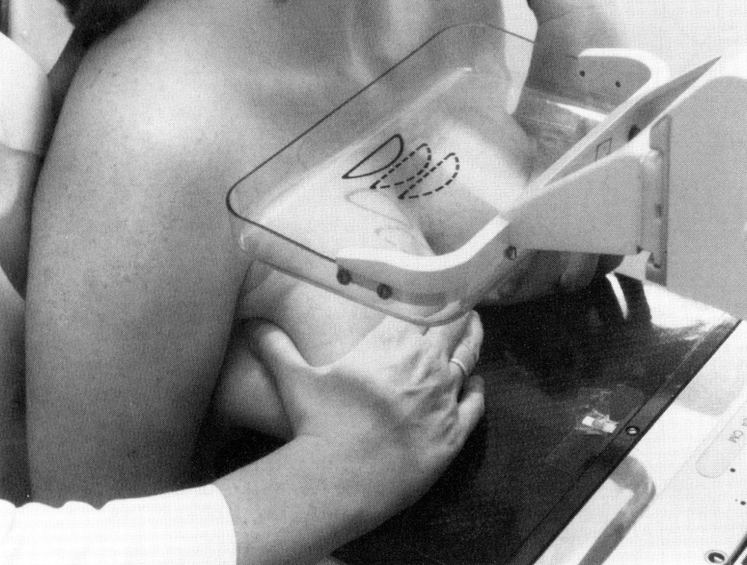
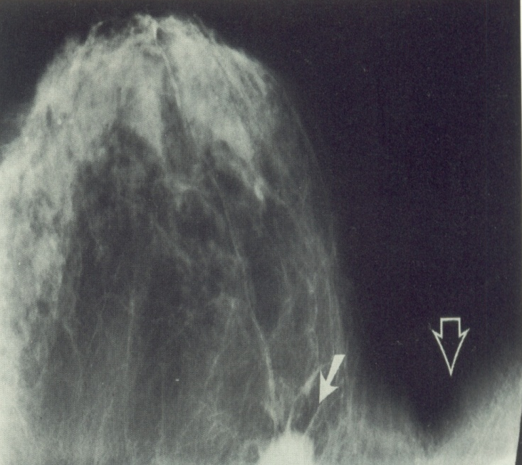
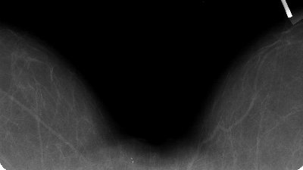

Slide 30
Rolled View
Front To Back
The compression will maintain the breast in the rolled position
If the top of the breast is moved laterally a lesion in the bottom moves medially
If the top of the breast is rolled medially, a lesion in the bottom will move laterally
If the top of the breast is rolled medially, a lesion in the top will move medially

Slide 31
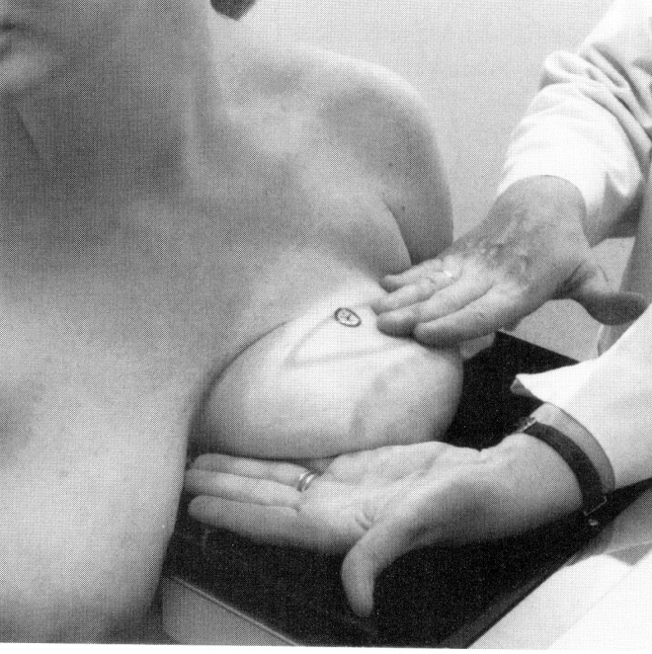


The technologist places the hands on either sides of the breast and “rolls” the tissue either medially or laterally.

Slide 32
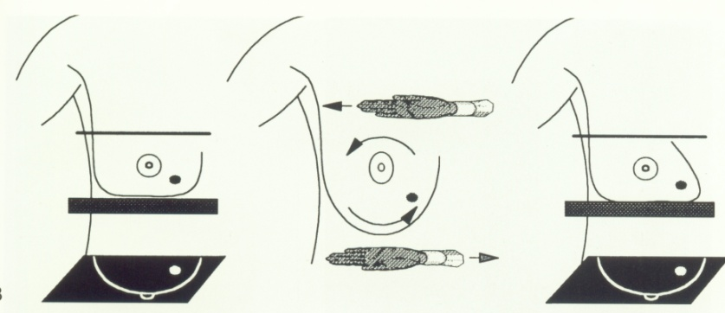

Craniocaudal RL = “craniocaudal rolled laterally”
( lesion is located inferiorly)
Craniocaudal RM = “craniocaudal rolled medially”
( lesion is located superioly)

Slide 33
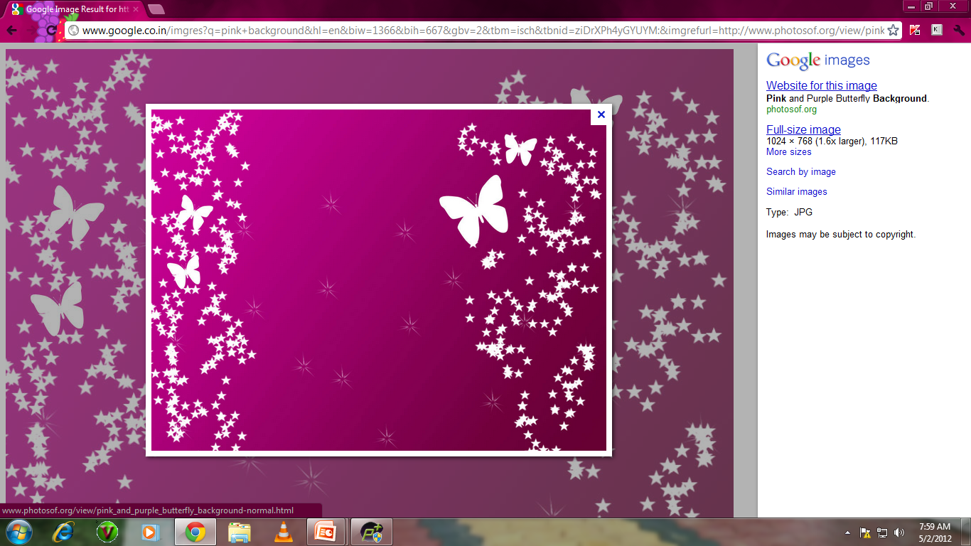
Spot Magnification View
( Spot Compression View )
Purpose
To demonstrate a lesion by displacing overlying parenchymal tissues
Magnification radiography added to visualize calcifications or mass margins better
A small compression device is placed on the estimated region of interest which is marked on the overlying skin
Collimation depends on the size of the lesion

Slide 34
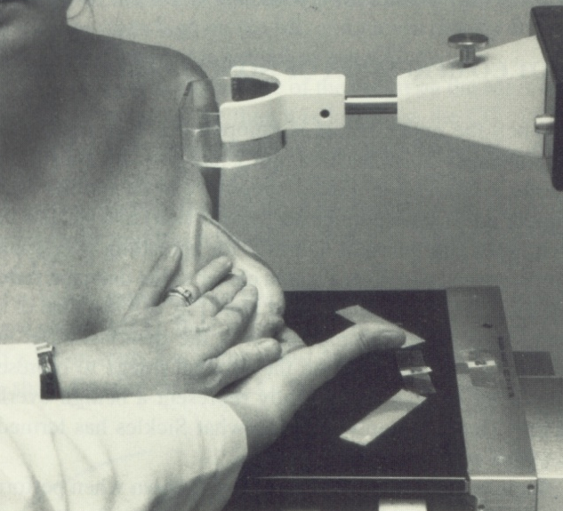
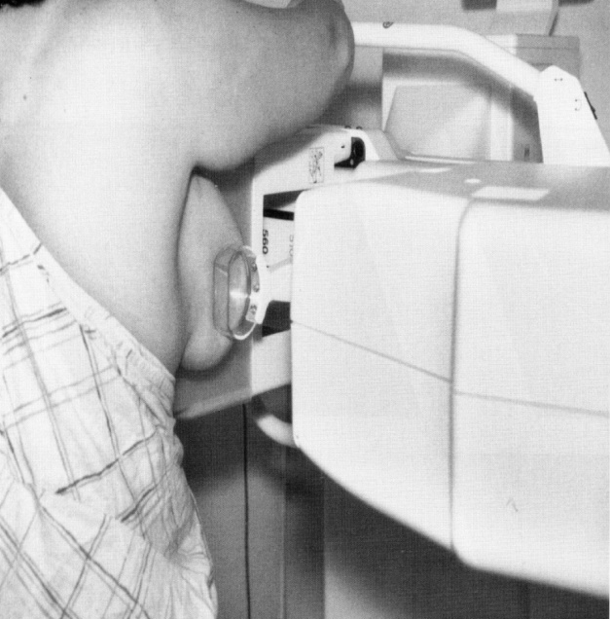
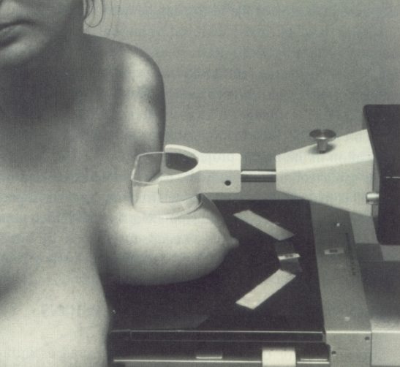
Spot compression separates different parts of the breast which might mimic a lesion.
Spot compression reduces blur by pushing the tissue closer to the detector reducing geometric unsharpness.

Slide 35

Tangential View
Purpose
To demonstrate superficial lesions
To demonstrate interdermal calcifications
Palpable lump to be demonstrated
Film angled parallel to an imaginary line from the lump to the nipple
To image a palpable mass better a marker is placed over the palpable mass

Slide 36
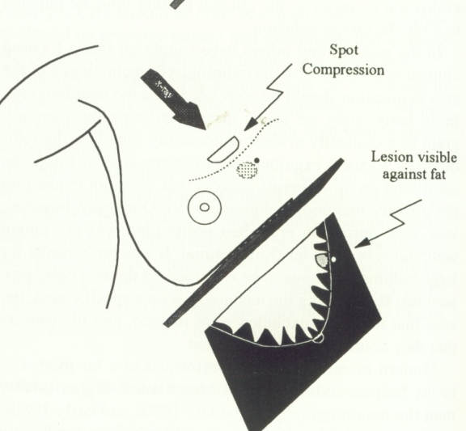
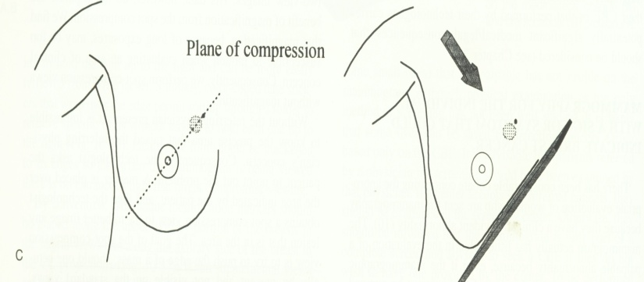

An imaginary line is drawn between the mass and the nipple
The gantry is then rotated so that the plane of the detector is parallel to the imaginary line

Slide 37
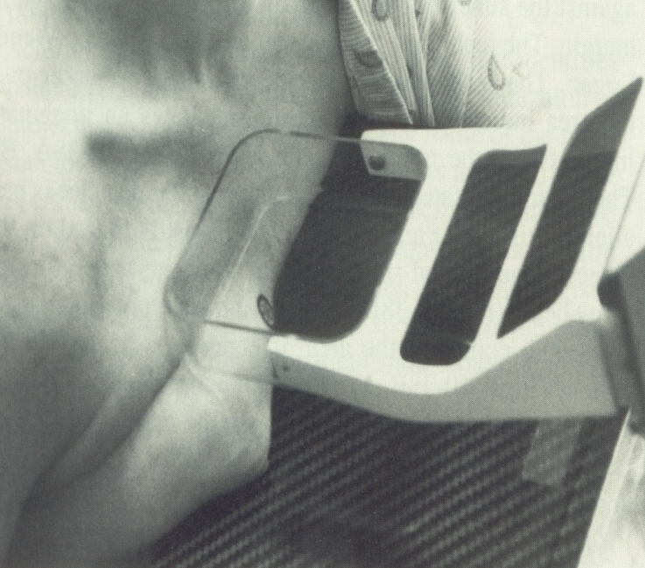

Compression is applied so that the skin marker is viewed tangentially
This pushes the margin of the mass against the subcutaneous fat

Slide 38
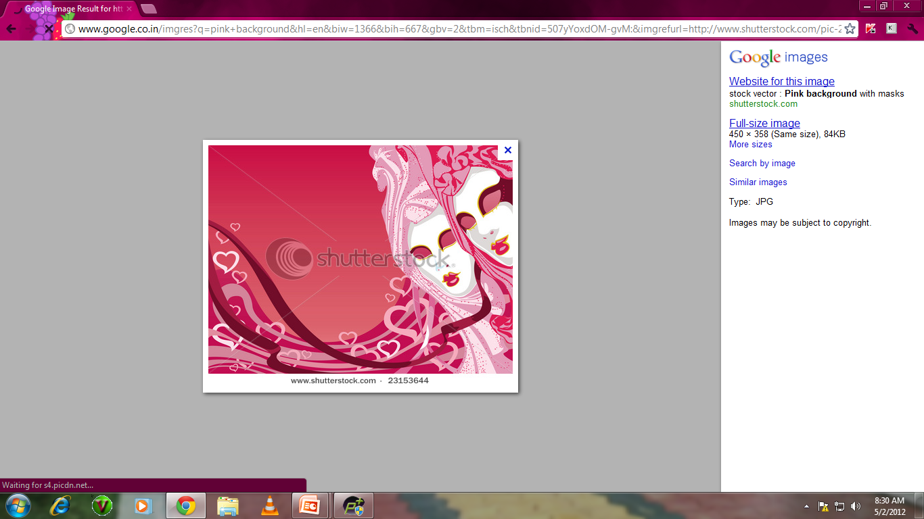
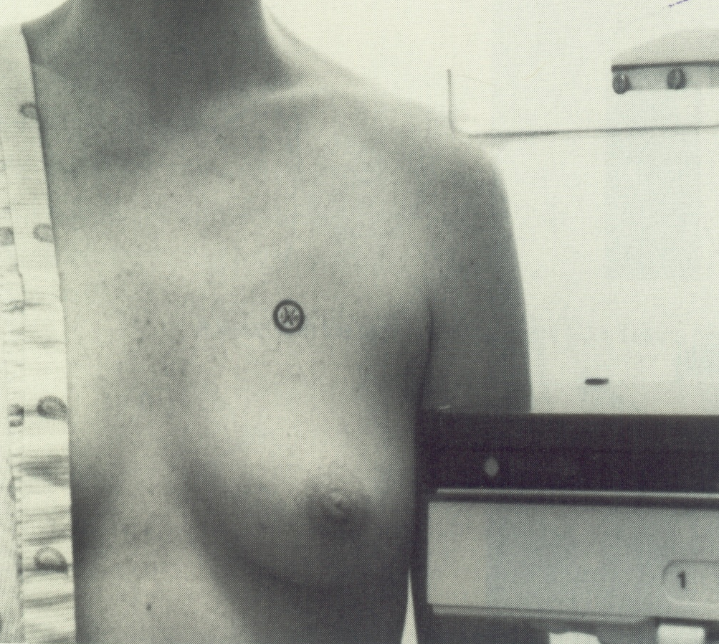

Lumpogram
A lesion in the upper breast is isolated by a marker and only the tissues containing the lesion are compressed.

Slide 39
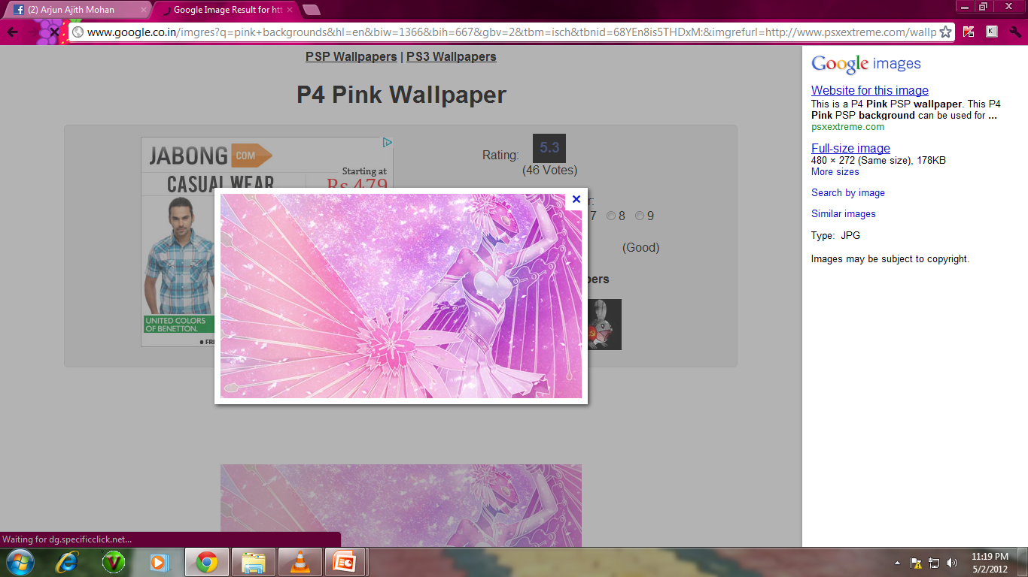
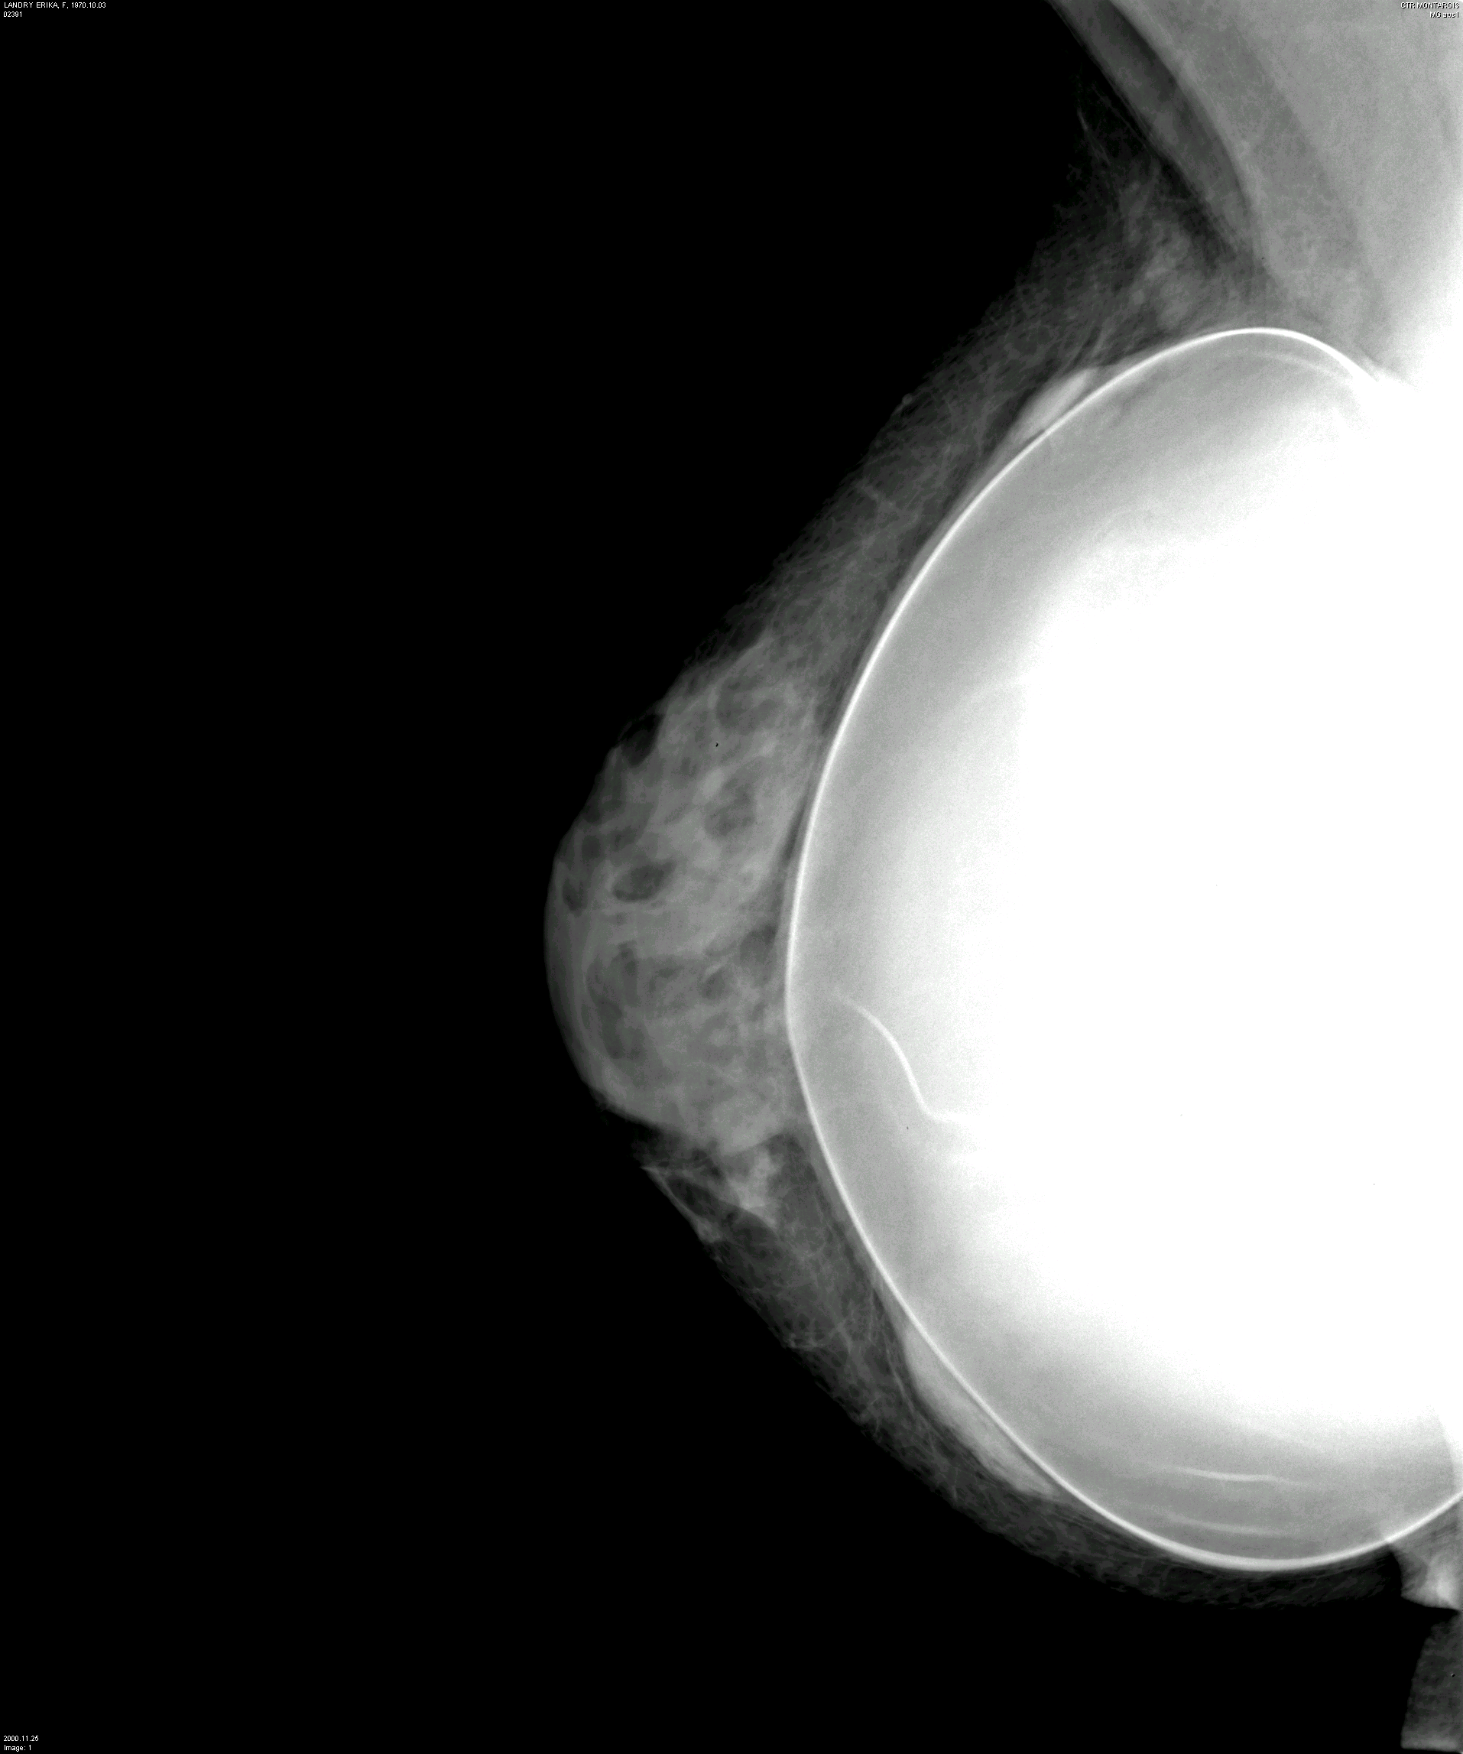
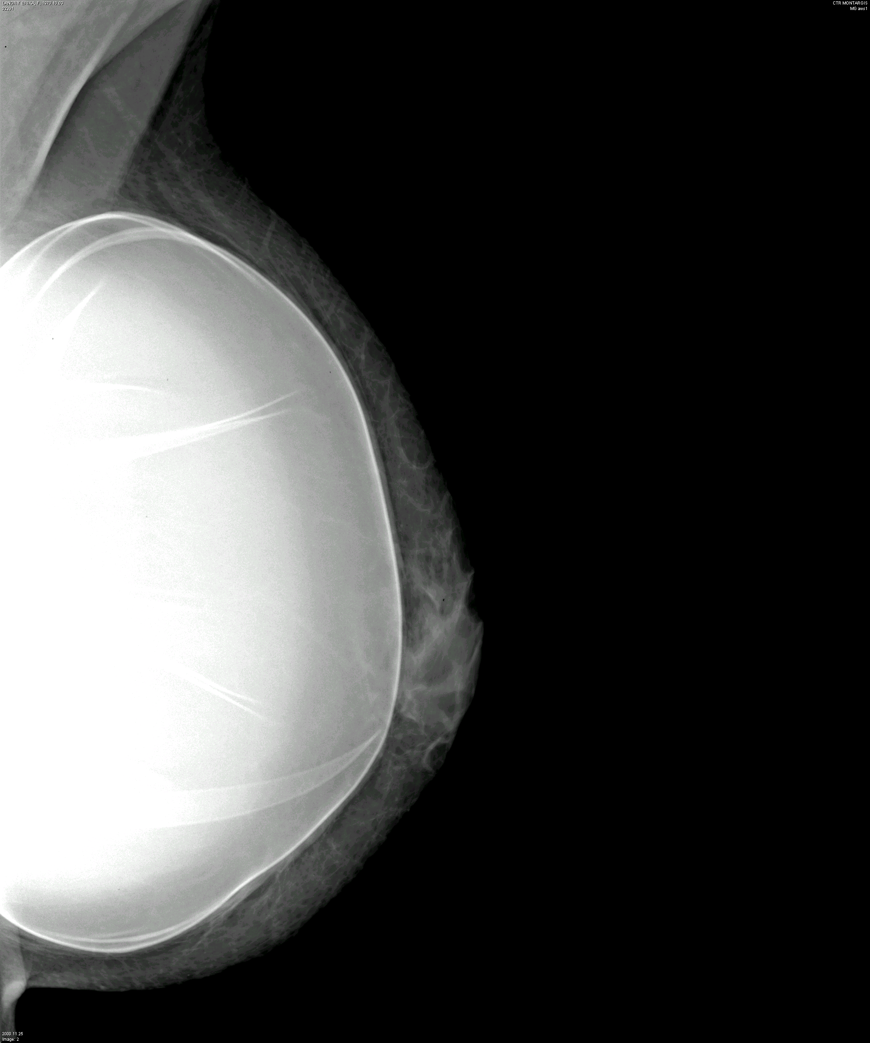
What if there are Implants ??
Standard views
Cranio caudal
Medio-lateral oblique

Slide 40

< ~Mammography in males..>~

Slide 41
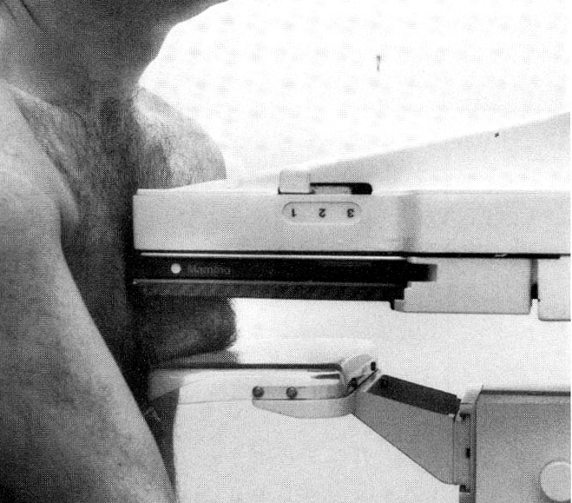
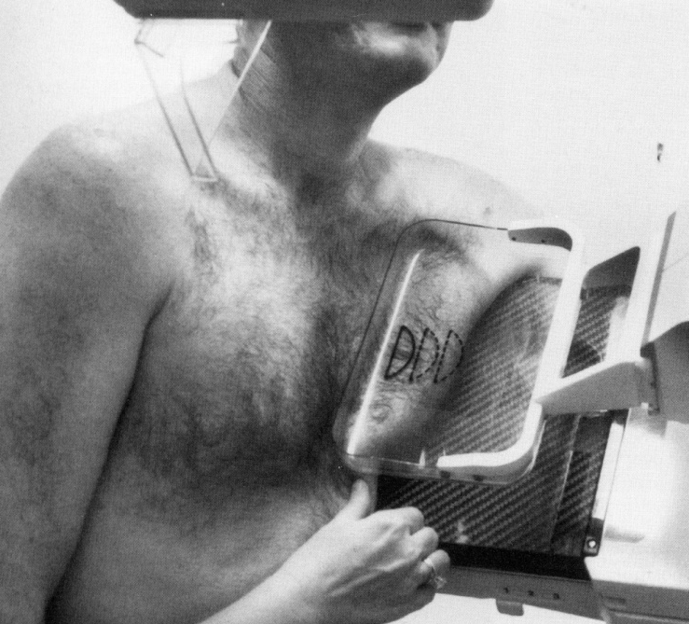
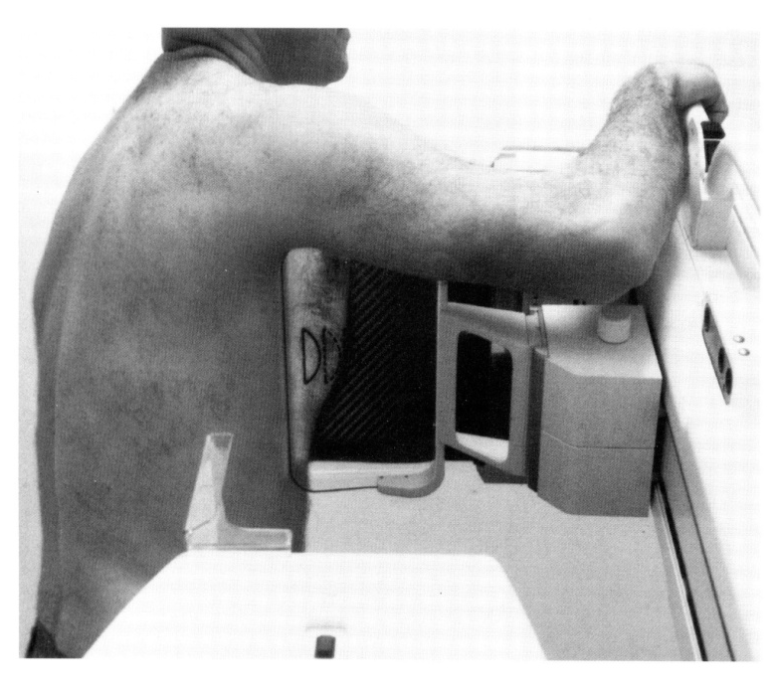
Mammography in males..
Craniocaudal view
Mediolateral oblique view
Lateral view

Slide 42
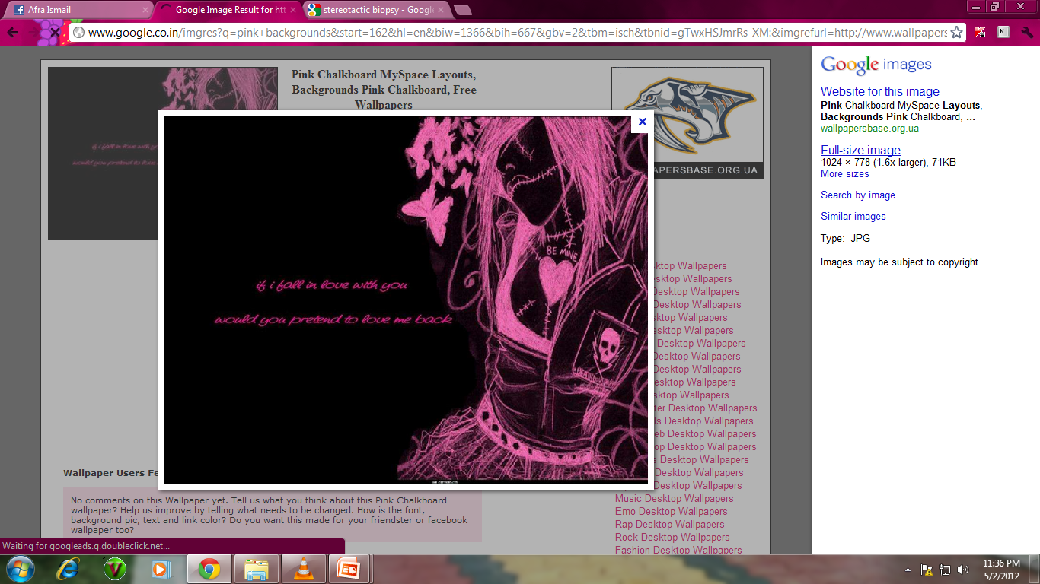
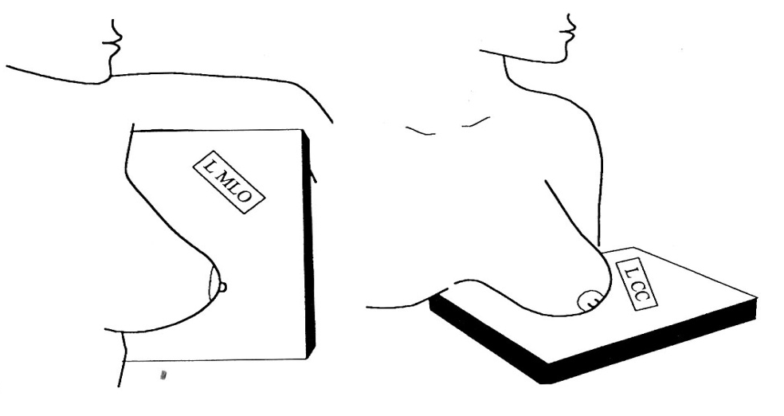
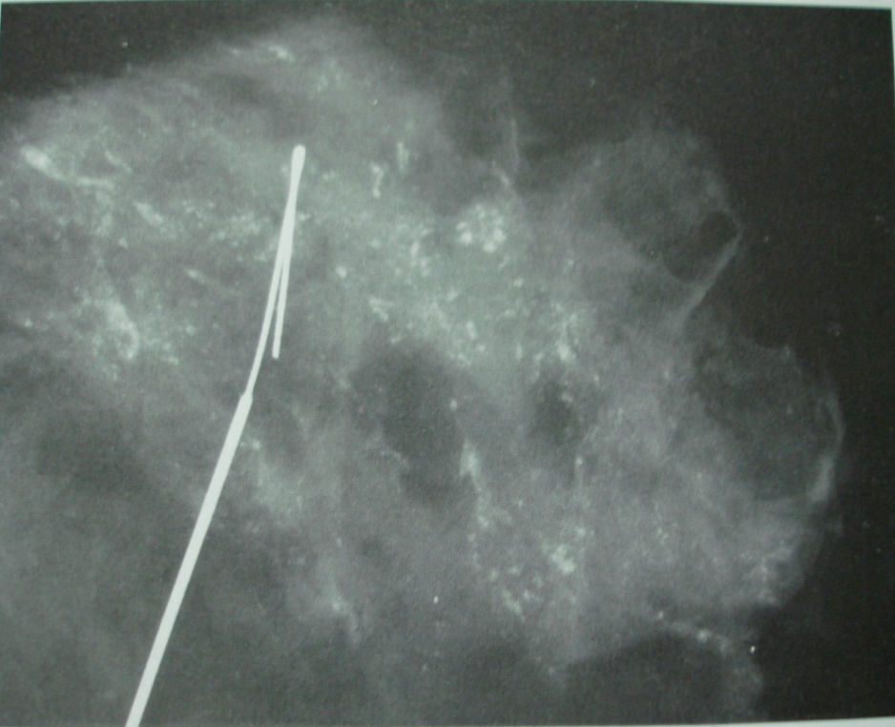
Stereotactic Biopsy
Markers
To verify removal of lesions localized and non palpable lesions after wire localizations
Compression must
Minimum exposure factors
Only on a dedicated mammo unit

Slide 43
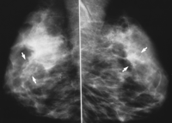
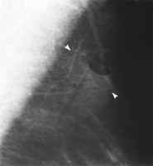
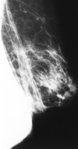
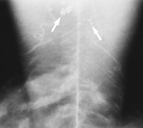
Patient Related Artifacts
POWDER ARTIFACT
PHARMACEUTICAL PATCH
CONTRALATERAL BREAST OVERLAPPING
Deoderant artifact

Slide 44
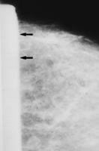

Equipment Related Artifacts
IMPROPER ALIGNMENT OF COMPRESSION PADDLE
Collimation failure

Slide 45







Technologist Related Artifacts
DIRTY SCREEN ARTIFACT
Finger Print Artifact
LOADING OF TWO FILMS
Poor screen-film contact
ROLLER MARKS

Slide 46


Stereotactic Biopsy
Performed in at least two planes to localize a target
lesion (such as a tumor or microcalcifications in the breast) in three-dimensional space and guide the removal of tissue for makes use of the principle of parallax to determine the depth or "z-dimension" of the target lesion.
Parallax is a displacement or difference in the apparent position of an object viewed along two different lines of sight…
Notes:
Stereotactic biopsy, also known as stereotactic core biopsy
Stereotactic core biopsy is extensively used by radiologists specializing in breast imaging to obtain tissue samples containing microcalcifications, which can be an early sign of breast cancer.

Slide 47



Slide 48





Slide 49
To Summarize . . .
Correct positioning
Correct exposure
Correct processing of film
Appropriate compression technique
Spread breast tissue
Accurate markers
Symmetrical images
Absence of
  Skin folds
  Overlying anatomy (shoulders)
  Movement
  Pre – post processing artifacts

Slide 50

Thank you

