Slide 1
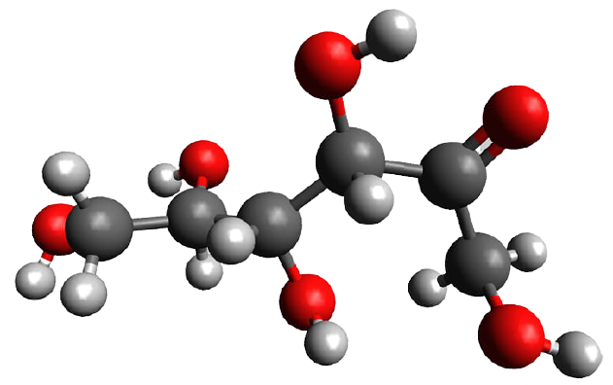
UNIT:2
Meghana Patel
Assistant Professor
Department of Clinical Nutrition

Slide 2
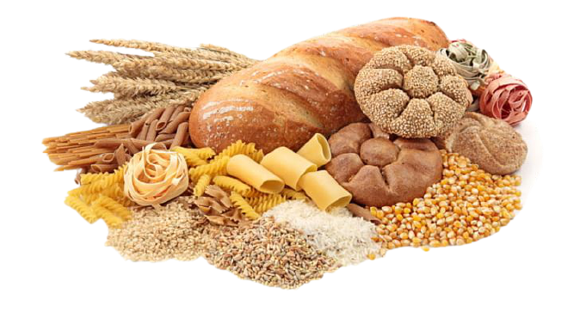
DEFINITION:
A biological compound containing carbon, hydrogen, and oxygen.
Carbohydrates are the most abundant of all the organic compounds in nature.
Carbohydrates are the chief, cheapest and main source of energy.
In plants, energy from the Sun is used to convert carbon dioxide and water into the carbohydrate glucose.

Slide 3
Many of the glucose molecules are made into long-chain polymers of starch that store energy.
Glucose is physiologically significant among carbohydrates.
Our body uses carbohydrates to make glucose which is fuel that gives your body energy.
Glucose can be used immediately or stored.
About 65% of the foods in our diet consist of carbohydrates.
Each day we utilize carbohydrates in foods such as bread, pasta, potatoes, and rice.

Slide 4
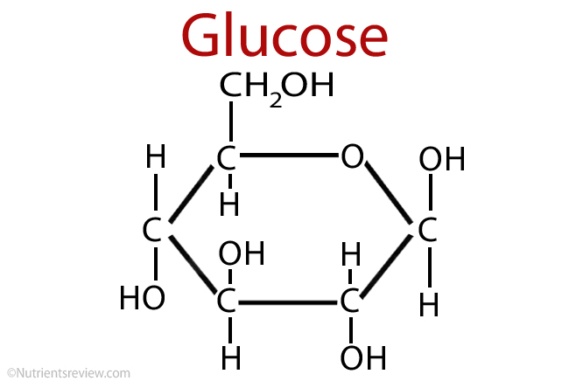
COMPOSITION
Carbohydrates are organic compounds composed of carbon, hydrogen and oxygen with the later elements in the ratio of 2:1.
The general formula is Cn H2n On.

Slide 5
TWO TYPES OF CARBOHYDRATES
Complex Carbohydrates:
  Starch & dietary fiber
  Starch is in certain vegetables like potatoes, dry beans, cereals, and corn.
  Fiber is in vegetables, fruits, & whole grain foods.
  There are two different types of fiber -- soluble and insoluble. Both are important for health, digestion, and preventing diseases.
Simple Carbohydrates:
  Can be found naturally or as added sugars
  Added sugars have fewer nutrients than foods with naturally-occurring sugars
  Examples of ingredients as added sugar: brown sugar, corn sweetener, corn syrup, dextrose, fructose, fruit juice concentrates, glucose, high fructose corn syrup, honey.

Slide 6
CHIEF FUNCTIONS OF CARBOHYDRATE
Carbohydrates Supply Energy
Carbohydrates Provide Fuel for the Central Nervous System
Carbohydrates Provide Fuel for the Muscular System

Slide 7
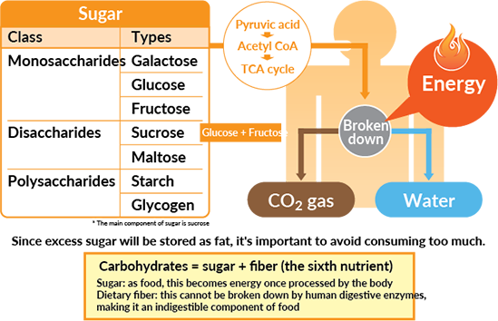
1. Carbohydrates Supply Energy
One basic role of carbohydrates in the human diet: to supply energy.
The body uses carbohydrates directly from the monosaccharide glucose.
Glucose is in the blood and extracellular fluids (lymph) and can be made from glycogen.
Glycogen is stored in the liver and muscles and in smaller amounts in the other organs and tissues of the body.

Slide 8
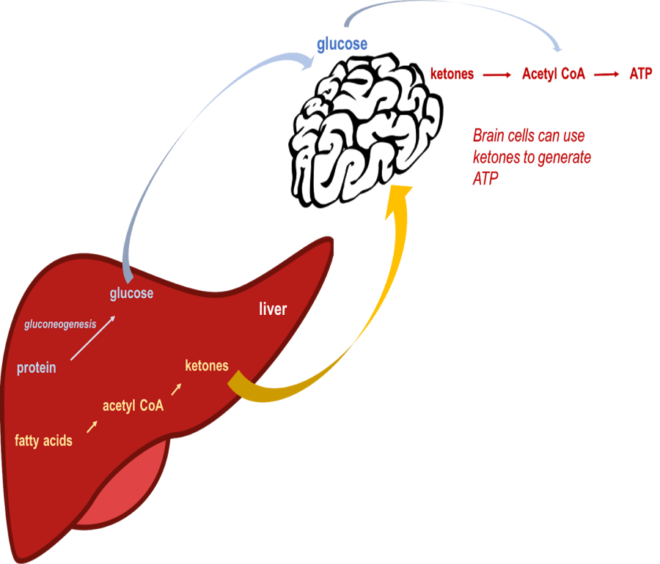
2.Carbohydrates Provide Fuel for the Central Nervous System
When carbohydrates needed for the functioning of the central nervous system, the muscles and the other body systems and functions are insufficient in the diet (as during a fast or on a weight-loss diet), stored adipose tissue (fat) is broken down into glucose to make up the caloric deficit.
Some amino acids, instead of being used to make proteins, are deaminated and used as carbohydrates to supply energy.
The formation of glucose from amino acids is called gluconeogenesis.
This phenomenon enables one to maintain normal blood sugar levels during a fast.

Slide 9
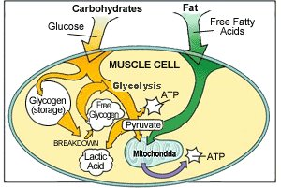
3.Carbohydrates Provide Fuel for the Muscular System
Carbohydrates provide the major fuel for muscular exercise.
For this reason, a proper diet should consist primarily of carbohydrates—not primarily of proteins and fats .
If a diet high in carbohydrates is not consumed, tremendous muscular exertion over long periods and/or extreme stress can result in breakdown of body protein and stored body fat.
Resulting in an increased excretion of nitrogen in the urine, and the fat breakdown is evidenced by a rise in the level of ketone bodies in the urine and in the blood.

Slide 10
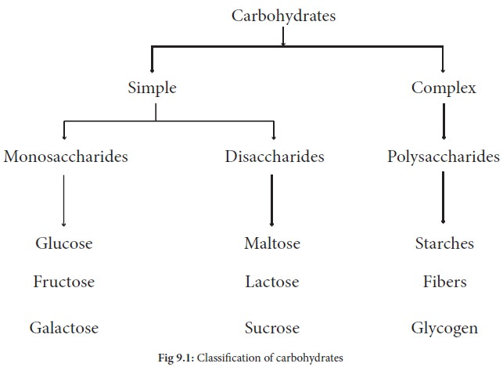

Slide 11
SIMPLE CARBOHYDRATES

Slide 12
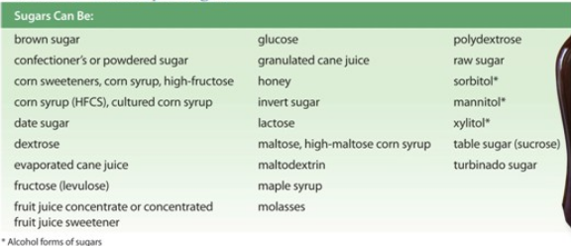
If one of these names is the 1st or 2nd ingredient in a product listing it means that product contains a high amount of added sugar

Slide 13
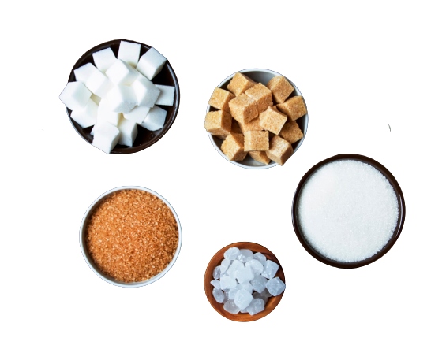
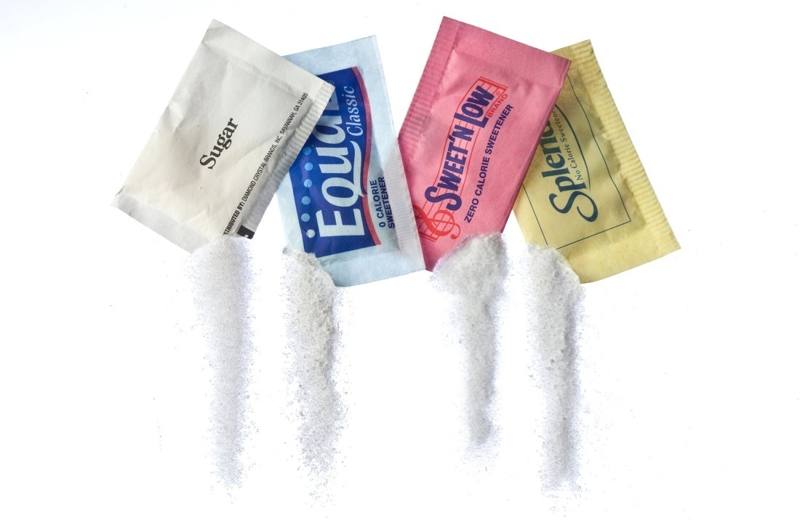
TYPES OF SWEETNERS
NUTRITIVE SWEETNERS
NON-NUTRITIVE SWEETNERS
Notes:
Nutritive: Contribute energy to foods Provide 4 kcal/g Added sugars Nutritive sweeteners added during processing or preparation e.g., sucrose and high fructose corn syrup
Non Nutritive: Intensely-sweet synthetic compounds that sweeten foods without providing kcalFDA approved nonnutritives:Saccharin, aspartame, acesulfame-K, sucralose, neotame, and “stevia”Saccharin used for >100 yrsMost scientific evidence supports its safety

Slide 14
An artificial sweetener is a food additive that is an artificial sugar substitute, which imparts a sweet taste similar to natural sugar, but with much fewer calories.
The FSSAI has approved five artificial sweeteners:
Saccharin
Aspartame
Acesulfame Potassium
Sucralose
Neotame

Slide 15
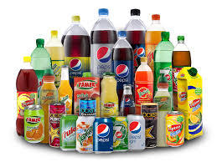
SACCHARIN
world’s oldest artificial sweetener,
Saccharin has been a low-calorie substitute to sugar for well over a century.
Due to its stability and low cost, it remains an important low-calorie sugar substitute even today.
Following ingestion, it is not absorbed or metabolised, excreted unchanged via Kidneys.
300-400 times as sweet as natural sugar
Saccharin sodium is recommended by FSSAI for use in the following foodstuff at the maximum permitted levels indicated within brackets:
Soft drinks (100 ppm)
Pan masala (8000 ppm)
Traditional sweets (500 ppm)
Chocolate (500 ppm)
Sugar based/ sugar-free confectionery (3000 ppm)
Chewing gum/bubble gum (3000 ppm)

Slide 16

ASPARTAME
Aspartame a combination of 2 amino acids-Phenyl alanine and aspartic acid, is a low-calorie, artificial sweetener that is 200 times as sweet as natural sugar.
It is used as a sugar substitute in many food items, including low-calorie soft drinks, sugar-free chewing gum, cereals and as a tabletop sweetener.
However, since its breakdown products include phenylalanine, aspartame must be avoided by phenylketonuria (PKU), and must be labeled “contains a source of phenylalanine”.
It acceptable daily intake is 40mg/kg body weight.

Slide 17

Aspartame is recommended by FSSAI for use in the following foodstuff at the maximum permitted levels indicated within brackets:
Soft drinks (700 ppm)
Biscuits, bread, cakes and pastries (2200 ppm)
Traditional sweets (200 ppm)
Jam, jellies and marmalades (1000 ppm)
Chocolate (2000 ppm)
Sugar based/sugar free confectionery (10000 ppm)
Chewing gum/bubble gum (10000 ppm)
Custard powder mix (1000 ppm)
Fruit/vegetable nectar (600 ppm)
Ice cream, frozen dessert and pudding (1000 ppm)
Flavored milk (600 ppm)
Ready to serve tea/coffee based beverages (600 ppm)
Yoghurt (600 ppm

Slide 18
ACESULFAME POTASSIUM
Calorie-free sweetener that is up to 200 times sweeter than natural sugar and as sweet as aspartame.
It is often blended with sucralose and used to decrease the bitter aftertaste of aspartame.
Currently, acesulfame K is regarded as safe and at recommended levels of consumption, is not toxic, nor carcinogenic, as earlier claimed by some critics.
Its acceptable daily intake is 9mg/kg body weight.
It is stable in high temperature, therefore often used in baked products.

Slide 19
Acesulfame potassium is recommended by FSSAI for use in the following foodstuff at the maximum permitted levels indicated within brackets:
Soft drinks (300 ppm)
Biscuits, bread, cakes and pastries (1000 ppm)
Traditional sweets (500 ppm)
Chocolate (500 ppm)
Sugar based/ Sugar-free confectionery (3500 ppm)
Chewing gum/ bubble gum (5000 ppm)
Ready to serve tea/coffee based beverages (600 ppm)
Ice lollies/ice candy (800 ppm)
Fruit nectars (300 ppm)

Slide 20
SUCRALOSE
Sucralose is a calorie-free artificial sweetener derived from sucrose and is up to 650 times sweeter than natural sugar.
Sucralose does not have any bitter aftertaste.
Sucralose does not have any appreciable effects on blood glucose levels and can be used by diabetics.
Its acceptable daily intake is 15mg/kg body weight.

Slide 21
Sucralose is recommended by FSSAI for use in the following foodstuff at the maximum permitted levels indicated within brackets:
Soft drinks (300 ppm)
Biscuits (including cookies), bread, cakes and pastries (750 ppm)
Traditional sweets (750 ppm)
Yogurt (300 ppm)
Ice cream/dried ice cream mixes/frozen dessert/kulfi (400 ppm)
Ice lollies/ice candy (800 ppm)
Jam, jellies, and marmalades (450 ppm)
Chutney (800 ppm)
Confectionery (1500 ppm)
Chocolate (800 ppm)
Chewing gum (1250 ppm)
Doughnuts /scones /muffins (800 ppm)
Ready to serve tea/coffee based beverages (600 ppm)
Vegetable juice/nectar (250 ppm)
Custard powder/ ready to eat custard dessert (260 ppm)

Slide 22
NEOTAME
Neotame is an artificial sweetener derived from aspartame that has been approved in 2002 for use in food and drink products, but its use has been largely limited.
It is extremely potent, rapidly metabolized, completely excreted from the body.
Neotame is 7,000-13,000 times sweeter than natural sugar and 30-60 times sweeter than aspartame.
Neotame is recommended by FSSAI for use in soft drinks only at a maximum permitted level of 33 ppm.

Slide 23
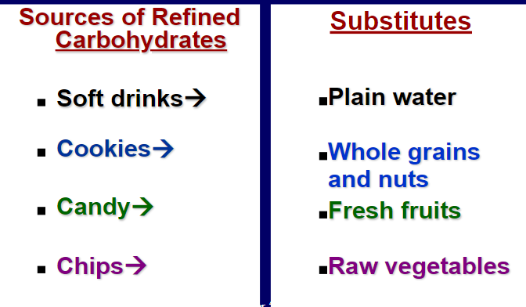
How can you reduce your intake of refined carbohydrates?

Slide 24
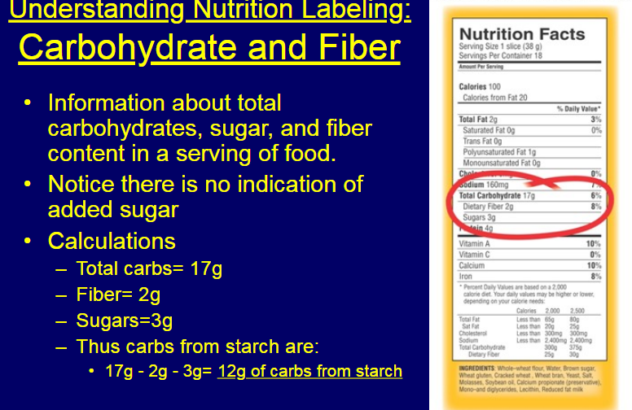

Slide 25
COMPLEX CARBOHYDRATES

Slide 26
DIETARY FIBRES
Fibers are also known as roughage or bulk
They are polysaccharides from plants.
Fruits, vegetables, whole grains and legumes, such as peas and beans.

Slide 27
Dietary Vs Functional Fibres
Dietary fiber :
consists of non digestible carbohydrates and lignin that are intrinsic and intact in plants.
Functional fiber :
consists of isolated, non digestible carbohydrates that have beneficial physiological effects in humans.

Slide 28
Classification
Fiber can be classified into two types:
Soluble (dissolves in water and may form a gel). Soluble fiber can help to lower cholesterol and regulate glucose levels as well as promote regularity. Examples :
Oats
Fruits and vegetables
Beans
Barley
Psyllium.

Slide 29
Classification
Insoluble (does not dissolve in water).
Insoluble fiber adds bulk to the stool and contributes to bowel regularity.
Examples are :
Whole-wheat flour
Wheat bran
Some vegetables
Virtually all plant foods contain soluble and insoluble fiber.

Slide 30
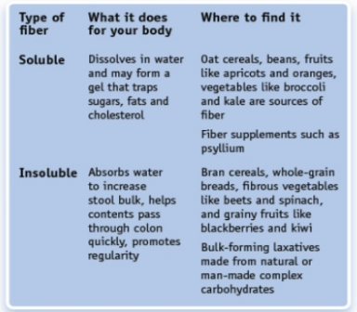

Slide 31
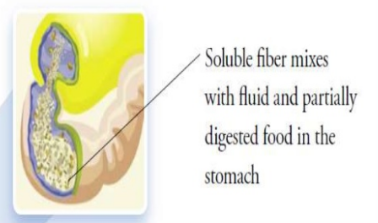
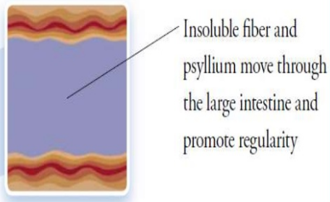
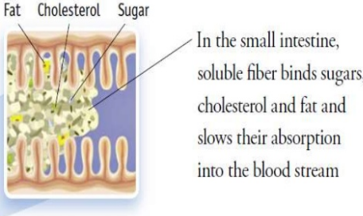
How fibres works?
After soluble ﬁbers are ingested, it absorbs water and turns into a gel which binds food, sugars, cholesterol and fats in the stomach and carries them through the digestive tract. Insoluble ﬁbers passes through the system largely intact.

Slide 32
Dietary fiber enhances satiety (feeling full while eating) and may prevent over eating.
High-fiber diets tend to have more volume and less calories than other types of diets.
In addition to promoting regularity, fiber lowers the risk of developing many life threatening diseases and conditions, such as heart disease, certain forms of cancer, diabetes, stroke and obesity.

Slide 33
Soluble fibers for instance, like those found in oat bran, oranges, apples, carrots and dried beans, entraps cholesterol components in the blood which can help lower cholesterol and prevent heart disease.
And because fiber is not digested, it keeps you feeling full for longer, which can minimize or eliminate unnecessary snacking that can lead to obesity and/or certain types of diabetes.

Slide 34
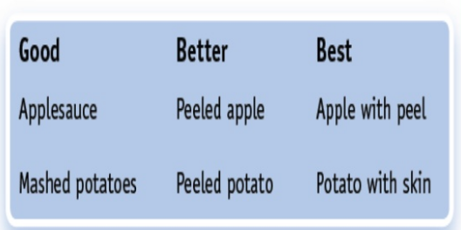
Not all fibers are equal

Slide 35
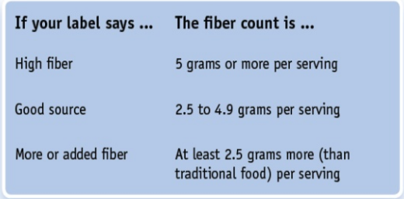
Fibre Requirements

Slide 36
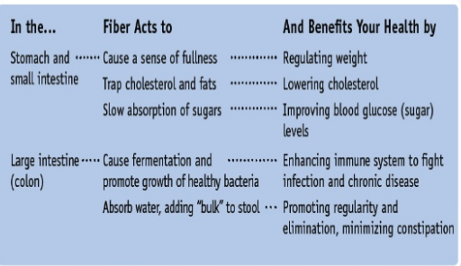
Benefits

Slide 37
Recommendations
Adding fiber to diet, remember to drink extra water as well. Fiber acts on its ability to absorb water and that helps to move it through the digestive tract.
Add fiber to your diet gradually. Increase the amounts of fruits, vegetables and grains as you decrease fat and sugar.
This reduces added calories and maintains a feeling of fullness.
Remember, a healthy diet is all about better food choices.

Slide 38
Are carbohydrates Fattening?
It depends on the type of carbohydrates
Probably fattening:
Adding sugars
Refined starches
High Fructose corn syrup
Healthier Choices:
Fiber Rich Foods- Insoluble Insoluble Fibres
Fruits, veggies, unrefined grains

Slide 39
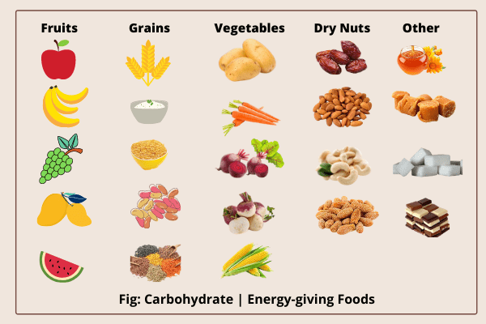

Slide 40

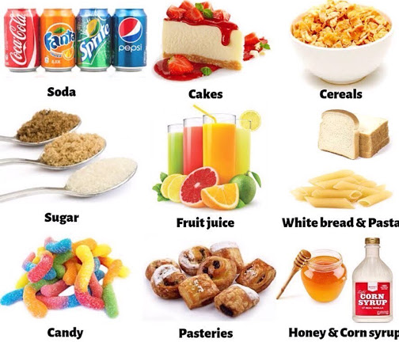
type of Carbohydrate

Slide 41
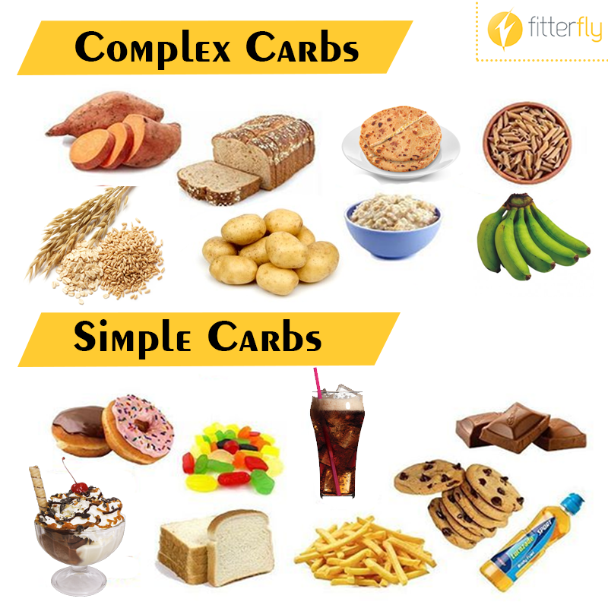

Any Difference

Slide 42


THANK YOU

