Slide 1
Indian Food and Diet in Retrospect
Dr. Sheetal Chhaya
Associate Professor
Department of Clinical Nutrition and Dietetics
SBKSMI&RC
Sumandeep Vidyapeeth

Slide 2
INTRODUCTION
Food culture is known to bring together families, communities, States, and Nation together.
The world’s food systems touch every aspect of human existence – making them not just essential but also valuable and important instruments of change.
The history of Anthropology which is a scientific discipline has been designed and influenced by cultural aspects.

Slide 3
Anthropology of food
It is a sub-discipline of anthropology that connects an ethnographic and historical perspective with contemporary social issues in food production and consumption systems.
Human Society its culture and tradition revolves around food and hence it can be considered as its essential component therefore the historical along with the cultural scene is essential to understand.
Consumption patterns are influences of physiological, social, political, economic, and aesthetic aspects too.
India is not only a land of diverse religions and culture but also a land of varied physiographic regions ranging from Himalayan Mountains, Peninsular plateau and Ghats, Indo-Gangetic Plains, Coastal Plains, Thar Desert, and Islands. Moreover, India is a diverse nation with many different cultures and each region’s cuisine is a result of many reasons such as its political and geographical history, variation in the local culture, geographical location (proximity to the sea, desert, or mountains), and economics.
Food consumption patterns are largely influenced by the regional traditional practices and passed on to generations from the primary unit of the family which is influenced by their communities and religion.

Slide 4
TRADITIONAL FOOD HABITS IN DIFFERENT REGIONS OF INDIA
Cultural practices vary in India with geographical region and religion.
India can be broadly divided into four major regions (North, South, East, and West), each with its distinctive language, cultural peculiarities customs, and food practices.
India has a rich and highly varied cuisine, varies from region to region and from season to season; and its various diets are strongly related to religion and other cultural factors, as well as local agricultural practices and availability of diverse foods.
Traditional food choices usually depend on regional preferences.

Slide 5
Indian food predominantly comprises wheat-based breads (roti and naan), basmati rice for special pulaos (rice-based dishes that include vegetables and/or meat), and legumes such as chickpeas and kidney beans.
In Northern India, the Punjabi cuisine typically represents foods of all the states north. Dairy products such as paneer, yoghurt, butter, and ghee are used extensively here.
Dietary patterns in the East and South are more likely to be defined by meat and fish consumption.
Diets in the North and West are more similar to one another, as are diets in the East and South.
Southern and North-Eastern parts of India are primarily a rice-eating region.

Slide 6
TRANSFORMATION IN FOOD HABITS
A shift from traditional to modern technologies, globalization, industrialization, constant travels across the world, evolving tastes, and increased demands for fast food and processed foods throughout the country.
On the one hand, there is a problem of poverty and hunger causing undernutrition and related disorders while on the other hand, a substantial increase in the intake of fats and refined foods such as white rice, maida based items, sugars, and salt leading to overnutrition related disorders such as obesity and hypertension.

Slide 7
With rapid urbanization, the eating habits are also rapidly changing and running with the real danger of losing the rich food heritage, built with the wisdom of centuries.
The decline of certain types of food entitlements, for instance, buttermilk that used to be widely available, often free of cost, in many Indian villages, particularly in the north-western region is a very relatable concern as to how the supply of basic nutritional food groups has vanished over time.
Back then during those days, large quantities of buttermilk were available as a by-product of ghee, butter, and other local milk products.
In many villages where there was no market for buttermilk - it was just consumed at home or given away to neighbors, friends, and visitors just like that.
Later with the growing commercialization, these local milk processing activities declined and so has the availability of buttermilk.

Slide 8
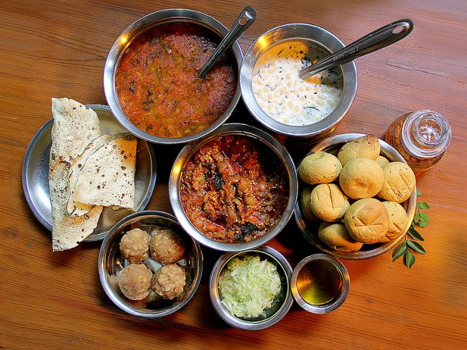
RAJASTHAN

Slide 9
FOOD AND CULTURE OF RAJASTHAN
The cuisine of Rajasthan is predominantly vegetarian but the royalty, particularly the men in the royal thikanas and states, have been relishing the non-vegetarian delicacies, primarily a result of their frequent hunting adventures and games.
Bejad ki Roti with added green leafy vegetables and Bajre ki raab are two recipes that should be popularized across the nation because these are tasty, millet-based preparations.
Millets are highly nutritious and offer nutrition security.
These millets are gluten-free, high in fiber, B vitamins, and many minerals.
They are also rich in health-promoting phytochemicals and function as antioxidants, immune modulators, detoxifying agents thus preventing age-related degenerative diseases like cancer, cardiovascular diseases, and diabetes. The recipes are time tested and have long been traditionally associated with good health.

Slide 10
Beliefs:
Basic to the hot-cold concept is the belief that heat and cold must be maintained in balance to maintain health.
Diseases result from an imbalance with either heat or cold being in excess. The hot- cold dichotomy is intimately tied to the reproductive cycle and numerous recommendations, as well as prohibitions, exist for women during menstruation, pregnancy, and lactation.
A woman is considered especially warm during menstruation and is, therefore, asked to avoid cold foods as they can cause cramps.
Infertility is treated by the use of hot concoctions made of different herbs as its cause is seen to be a cold womb.
Pregnant women are refrained from taking cold foods because of their vulnerability to cold. Hot foods are recommended to control postpartum bleeding.
Among lactating women, heat is believed to increase the supply of milk whereas cold decreases it

Slide 11
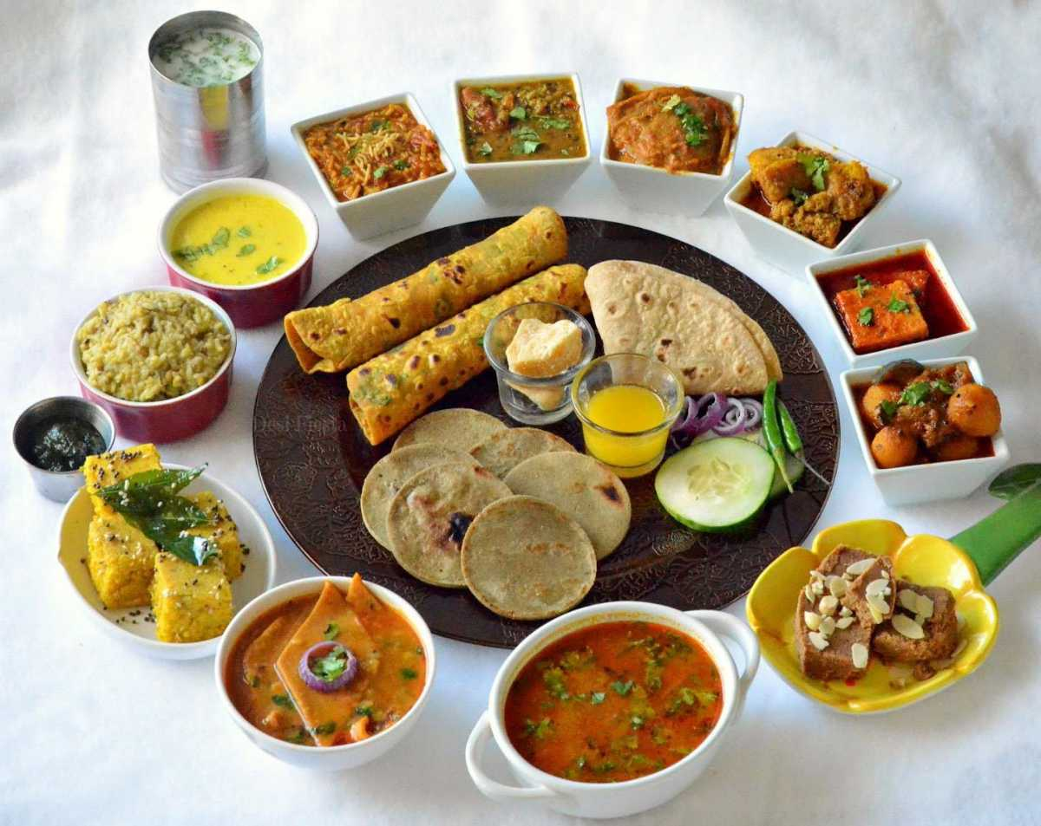
GUJARAT

Slide 12
FOOD AND CULTURE OF GUJARAT
Gujarati cuisines show a lot of variety not only in terms of food preparations but also in cooking styles and combination of spices used for preparing different dishes and are considered to have a good nutritional value.
As there is the incorporation of milk and milk products in good amounts in the daily diet, with the main meals of the day mostly ending with a glass of buttermilk, the dietary pattern can be termed as Lacto vegetarian.
But the number of vegetables being comparatively less, the Gujarati diet can be described as a vegetarian diet that lacks vegetables.

Slide 13
The cuisine of Gujarat can be broadly divided into four distinct categories depending on the geographic location and cooking styles i.e.
the cuisine of North and Central Gujarat (Ahmedabad, Vadodara);
the cuisine of South Gujarat (Surat, Valsad) wherein the use of green chilies is predominant;
the cuisine of Saurashtra region famously known as ‘Kathiyawadi’ cuisine which is quite influenced by Rajasthani cooking because of the proximity of the region with the state, and the food is also relatively spicier as compared to the rest of Gujarat;
and lastly the cuisine of Kutch region, the Kutchi cuisine, wherein a lack of green leafy vegetables and some other vegetables is quite evident in the food consumption pattern due to the agro-climatic conditions.

Slide 14
While each of these cuisines has distinct features, one common thing is that there is a hint of sweetness in most Gujarati preparations and some dishes even have a higher proportion of sugar as compared to salt and spices.
At times jaggery is used for sweetness instead of sugar.
There is age-old traditional dependence on the use of sugar/jaggery which is quite evident as dals; vegetable preparations; cereal- based preparations like ‘thepla’/ ‘dhebra’ which are flatbreads made with flour, spices, curd and sometimes fenugreek leaves; and even pickles – all of them mostly contain sugar/jaggery.
A popular belief about the inclusion of sugar or jaggery in most food items is that traditionally in earlier times, jaggery was incorporated to counter the saltiness in the water and to balance the sweet taste addition of lime juice or kokum was done, over the ages giving the cuisine its famous sweet-sour combination.
Gujarat’s ‘sweet tooth’ is a cause of concern with possible implications of obesity, diabetes, and cardiovascular diseases.

Slide 15
Khichdi
In Gujarat, Khichdi has a different trajectory.
It has evolved as a distinct and integral part of Gujarati cuisine.
The only staple that has remained unchanged for the last 600 years is Khichdi.
Actually, Khichdi and Kadhi may be described as a staple for vegetarian Hindu Gujaratis for their evening meal.
Quite likely the popularity of Khichdi as comfort food, its nutritive attributes, and its more elaborate rich versions eaten across social classes made it essential and popular for vegetarians Hindus.
Further, Khichdi Kadhi is a regular feature in the evening meals offered as Prasad by big temple organizations like the Swaminarayan sect BAPS, ISKON, and Jalaram temples as an outreach to devotees and the underprivileged poor. The Kadhi in Gujarat is a unique combination of salt, sweet-sour and spicy flavors.
Unlike in other regions of India, Khichdi knows no urban-rural nor caste, class divide, remaining an all-time favorite even in present times in Gujarat in a unique way.
It often figures in the rice options in the menu at all small and big city multi-cuisine restaurants in Gujarat. This is passionately relished by guests and in individual households with its age-old four companions- ghee, papad, pickle, and curd.

Slide 16
FESTIVALS
Makar Sankranti -Chikkis are made from peanut, dry fruits, coconut, sesame seeds (white and black), Roasted Gram dal (Dariya). Puffed rice balls popularly known as ‘Mamara Ladu’ are also prepared. They eat Jalebi and Undhiyu Shaak on this special day. Chikkis are very famous for their unique taste, crispiness, and aroma. The key ingredient or hero of all chikkis is Jaggery. It is a very good source of antioxidants and phytophenols and it plays a very important role in diluting blood clots and preventing nervous diseases like dementia and Alzheimer’s.
Holi -Patasa, Dates (Khajoor), Dried dates (Kahrek), Roasted Bengal Gram (Darriya), and Lapsi (broken wheat sweet dish) are eaten. Dates are an excellent source of essential vitamins, minerals, fiber and a great finger food.

Slide 17
Sitla Saatam and Janmashtami - A day prior to the birth of Lord Krishna is the Sitla Saatam festival where Shitla Maa, the Goddess who keeps the body cool, is worshiped and a special bajra flour- jaggery sweet ladoo called kuler is offered. Janmashtami day is fasting for most Hindus and the next day is celebrated as Nand utsav wherein many sweets and namkeens are prepared.
Diwali and Bestu varsh- Diwali festival is celebrated for five days including Dhanteras (Laxmi puja), Kali chaudas (millet vadas and sesame and wheat flour sweets are made), Diwali (sweets such as ghugra, gulab jamun and farsan such as bhakarwadi and padvali puri, etc. are made and exchanged among family and friends).
The next day of Diwali is the Gujarati New Year or the Bestu varsh where Rabdi or Basundi sweets are served along with the thali and the fifth day is the Bhaibeej wherein kheer is made (festival to celebrate brother by sisters).
Winter special sweet such as Adadiya Pak, which is made from urad dal flour, ghee, condiments, spices, and edible gum, which keeps your body warm, is commonly prepared in all households.

Slide 18
NUTRITIOUS, TRENDY AND UNIQUE KUTCHI MEALS
Dabeli: This is the worldwide famous dish and its western form ‘burger’ is also very famous globally. Dabeli contains all the essential nutrients in itself. The energy, carbohydrates, protein, fats, minerals and vitamins are included in the form of bun, peanuts, potatoes, imli, garlic, and green chutney. People of young age relish this item as a fast food- as healthy fast food.
Thumro: This nutrient-dense specialty requires very less cooking process. It is made from whole Jowar (sorghum) and or pearl millet grains. It can be either sweet or salty. The salty form can be consumed either with curd or plain and the sweet form can be consumed with milk. Thumro is a very nutritious food for all age groups, be it a 3-year-old kid or a 60-year-old man. This is a very nutritious pot of meal originated from Kutch.

Slide 19
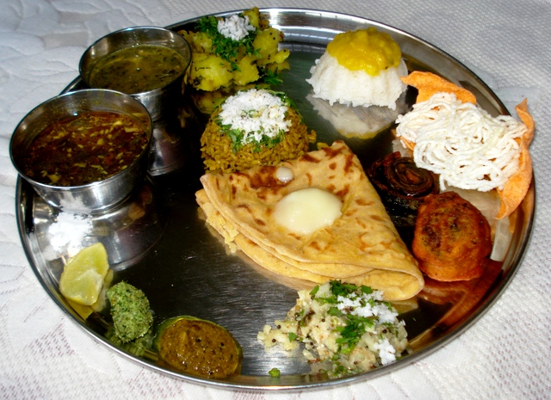
MAHARASHTRA

Slide 20
FOOD CULTURE OF MAHARASHTRA
Since Maharashtra occupies a vast area with distinct geographical differences and food availability, the Marathi people from different regions have produced a diverse cuisine.
Maharashtra cuisines are divided into many regions like Konkan, Vidharbha, Marathwada, Kolhapur, and Western Ghat of Maharashtra.
Konkani Cuisine- Seafood like prawns, crabs and fish, coconut, and local spices are some of the main ingredients used in their delicacies. You will also find a lot of fiery and spicy dishes with a hint of coconut. Amboli, Thalipith, Koshimbir (Raita), Sabudana Khichdi, and Aluchi Vadi are some of the traditional dishes.
Nutrition Aspects: Overall it is nutrition dense food as it includes lots of protein, good fat, and vitamins.

Slide 21
Kolhapuri Cuisine- The non – vegetarian dishes consumed are mutton and chicken items – Mutton Kolhapuri is the best–known of all. Desi chicken or gavthi kombdi is preferred to the regular broiler variety. Nutrition Aspect: Too spicy, contains good quality protein, good fat. Millets are used and use very few vegetables. SolKadhi is very nutritious as it is made up of Coconut Milk.
Vidarbha Cuisine- This region includes the districts of Nagpur, Chandrapur, and Yavatmal. The food is very spicy and is usually dry or mixed with ginger, green chilies, and lime. Jowar is a staple food and they made Bhakari. Vada bhaat or lentil fritters mixed with boiled rice are very commonly consumed in this region. The famous poha comes from this region of Maharashtra. Fruits like oranges grow in abundance here.
Nutrition Aspects: As we all know Millets are more nutritious than grains. Oranges are a good source of Vitamin C.

Slide 22
Western Ghat Cuisine- The important cities along the coastline are Nasik, Pune and Mumbai. Bombay duck or bombil is a dried variety of fish that is very popular. It is prepared in gravy or just stir-fried and served. Papad, pickle, chutney, and koshimbir (salad with some coconut, peanuts, and tempering) are popular accompaniments of food in this region. Pithal Bhakri is a famous dish of Nasik region. Main meals consist of chapati, one Veg, boiled rice; varan (plain toovar dal) with some ghee in it. Nasik Grapes and wine is very famous. Nutrition Aspect: Good source of protein, fat, and vitamins.
Marathwada Cuisine- This region comprises of Aurangabad, Nander and Latur. Moderately spiced food is preferred here. Freshly ground masalas are preferred here to flavour the food. Chutneys are prepared here out of the peels of vegetables such as doodhi and Groundnut. These chutneys have a flavour of their own and they are eaten along with the food for lunch as well as dinner.

Slide 23
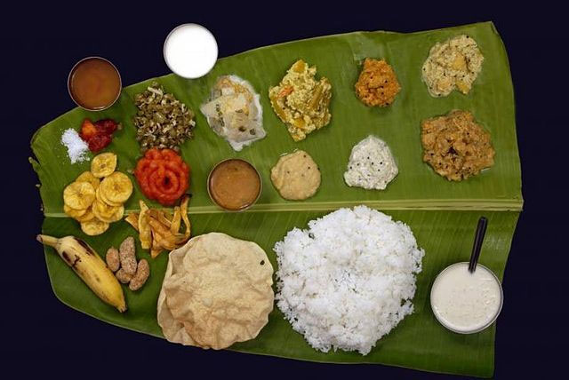
TAMIL NADU

Slide 24
FOOD AND CULTURE OF TAMILNADU
Over 70% of the population is engaged in agriculture for their livelihood.
Rice is the major crop and the state is the largest producer of banana and tapioca, second largest producer of mangoes, coconut and groundnuts and a major producer of turmeric in the country.
Other principal food crops such as maize, jowar, bajra, ragi, bengal gram, black gram, green gram and horse gram are grown here. Tapioca, drumstick, onion, tomato, brinjal and ladies finger are the important vegetables grown.

Slide 25
TRADITIONAL RICE VARIETIES OF TAMIL NADU
Local rice varieties such as Red and black Kavuni, Kichili samba, Seeraga samba, Poongar, Garudan samba etc. have been associated with many health benefits.
This was confirmed by scientific studies and nutritional profile of the traditional colourful and aromatic rice varieties have a higher nutritional profile than white rice.
Coloured rice varieties get their colour from anthocyanin deposits, which are a great source of phytochemicals and antioxidants.

Slide 26
Local health benefits and rice varieties are mentioned below:-
Red and black Kavuni – Possess anti-microbial activity
Kichili samba – Improves physical strength and complexion
Seeraga samba – Regulates excess vata, easy to digest and controls flatulence.
Milagu samba – Contains selenium, fights cancer and lowers cholesterol.
Kaivara samba – Lowers blood sugar
Poongar – Consumed by women after puberty and is believed to avert ailments associated with the reproductive system.
Kattu yanam – lowers blood sugar and imparts strength.
Mappillai samba – It has hypocholesterolemic and anti-cancer activity. Improves fertility in men. This variety from Tamil Nadu has the highest anthocyanin content compared to other red rice varieties of other countries.
Garudan samba – It contains a range of bioactive compounds that provide hypocholesterolemic, anti- arthritic and heart and liver- protective benefits

Slide 27
TRADITIONAL BANANA LEAF MEAL AND ITS BENEFITS
Eating food from the banana leaf using hands and seated down is not only an age-old practice followed in Tamil Nadu but also a healthier one.
When a person sits on the floor to eat, the majority of the muscles and nerves are activated.
There is better blood circulation and flow of digestive juices in the stomach.
Vagus nerve performs better at this position, hence, the brain recognises the feeling of fullness more effectively and prevents overeating
Banana leaves contain a lot of polyphenols that can prevent cancer. It improves the taste and flavour of the food when served hot.
This eco-friendly, chemical-free leaf stimulates appetite and the digestive fire, therefore helps indigestion. Banana leaf is also used in the treatment of toxicity, tiredness and gout. It also contains traces of zinc and magnesium.
A typical banana leaf meal starts with the rice, varieties or plain topped with ghee.

Slide 28
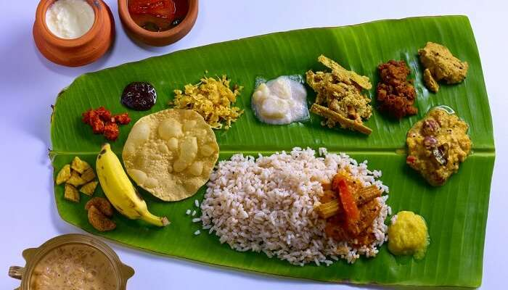
KERALA

Slide 29
FOOD CULTURE OF KERALA
The staple food of Kerala is rice and parboiled rice (Choru) (rice made nutritious by boiling it with rice husk) is preferred and the main start component of the meal.
Grated coconut and coconut milk are commonly used for thickening and flavouring.
Kerala’s long coastline and numerous rivers have made seafood a common part of meals.
Having been a major production area of spices for thousands of years, the region makes frequent use of black pepper, cardamom, clove, ginger, and cinnamon.

Slide 30
Nutritional benefits of important Ingredients of Kerala cuisine
  Important spices grown in Kerala are black pepper, cardamom, chilli, ginger, nutmeg, turmeric, garlic, tamarind, clove, cinnamon and vanilla. These Spices play a large part in Kerala’s food, spices and herbs are a major source of bioactive compounds having positive effects on health, an account of research studies on these are following:
Ginger has been used as a medicine for at least for the last 4400 years, Since then it has been used to treat arthritis, colic, diarrhoea, heart conditions, the common cold, flu like symptoms headaches and problems related to menstrual periods.
In India medicinal references in the Vedas to nutmeg indicate that the ancient Hindus knew of the spice from early times. They described it as warmth producing, stimulating, and good for digestion and also used for their medicinal preparations. In traditional Indian folk and domestic medicine, nutmeg is used in small quantities to induce hypnotic effects to irritable children.

Slide 31
Health Benefits of Coconut oil
  The literal meaning of Kerala is land of coconut.
  Coconut and its products such as coconut meat, coconut oil, water etc. are widely used as ingredients in Kerala dishes.
  Coconut oil contains 92% saturated fatty acids (SFA).
  The major fatty acid of coconut oil is lauric which is a medium-chain fatty acid (MCFA)
  MCFA are important as they act as inert sources of energy and are easier to absorb, metabolize, and store in the body.
  It is resistant to oxidation and polymerization than the oils with unsaturated fatty acids.
  Its resistance to oxidation and polymerization makes its stable oil for cooking
  consistent evidence, supports the topical use for prevention and treatment of atopic dermatitis, as well as in “oil pulling” for prevention of dental caries.
  Coconut oil products may also be useful in preventing hair damage due to protein loss during grooming processes and ultraviolet (UV) exposure.

Slide 32
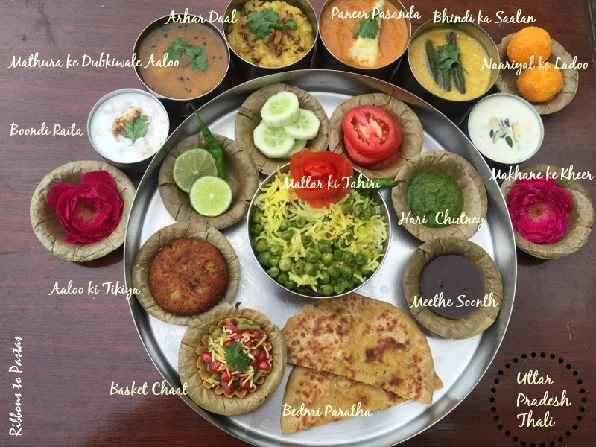
UTTAR PRADESH

Slide 33
FOOD CULTURE OF UTTAR PRADESH
An average Uttar Pradesh Thali includes arhar dal and chawal, rotis, vegetables, pickle, and salad as its routine food habit which is made extremely blissful by the addition of spices and mustard oil as cooking medium.
Overall, Uttar Pradesh cuisines can be categorized into four regions:-
Awadhi or Oudh cuisines of the central part of Uttar Pradesh,
Satvik bhojan of Paschimi Uttar Pradesh,
Recipes from Ghats of the holy Ganges i.e. Eastern Uttar Pradesh and
the Bundelkhand region.

Slide 34
Region of U.P. | Name of Recipe | Nutritional Aspects | Health Benefits.
Awadh | Dum Biryani | High in protein content, Lots of Flavonoids and polyphenols, Nutritive value of ingredients intact as cooking style is - very low fire cooking | Rich in immunity boosters, the perfect combination of complete proteins
Brijbhoomi | Anna Kut | One-Pot meal and has lots of seasonal locally available vegetables, cereals, pulses. | Can always be introduced in baalahar or mid-day meal program.
Moradabad | Moradabadi Dal | Rich source of protein and very easy to prepare snack | This dish with slight moderation in spices can always be suggested for Soft diet patients.

Slide 35
Moradabad | Moradabadi Dal | Rich source of protein and very easy to prepare snack | This dish with slight moderation in spices can always be suggested for Soft diet patients.
Mathura | Bedmi Poori | First class protein combination rich in calories and protein | Can be included in high calories and high protein meals
Banaras | Dal Ki Dulhan | Tasty cereal pulse combination with the perfect blend of spices and garlic. less oil recipe | One full meal which can be relished by all age groups.
Pratapgarh | Amla Burfi/Amla Laddoo | Rich source of Vitamin C | Eat simply as a fruit pickled in salt or process it in an acceptable from
Bundelkhand | Maheri | Rich source of Fibre and protein | Highly digestible and tasty soft recipe.
Kanpur | Bukhnu | High in nutraceutical value | Digestive powder that can be easily consumed along with chapathi, poori, etc.

Slide 36
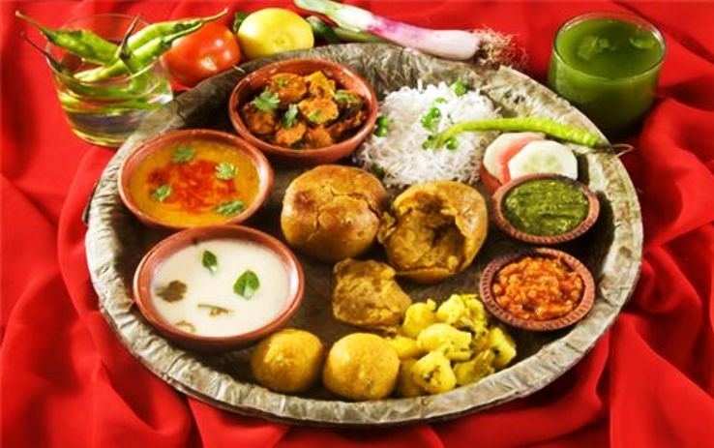
MADYA PRADESH

Slide 37
FOOD CULTURE OF MADYA PRADESH
Major crops of Madhya Pradesh that are cultivated in the region comprise of Paddy, Wheat, Maize and Jowar among Cereals, Gram, Tur, Urad and Moong among Pulses, while Soybean, Groundnut, and Mustard among Oilseeds.
The major crops are grown in this state of Central India also includes commercial crops like cotton and Sugarcane.

Slide 38
Myths and practices impacting the nutritional status
People of Madhya Pradesh usually follow a two meal pattern of eating in a day. In vulnerable groups like women, adolescents, this effectively reduces almost one-third of the food intake.
There are innumerable beliefs impacting food use.
  Foods classified as hot or cold without any scientific basis are adhered to. Unfortunately, this consists of the most nutritious foods. For example :
    Hot foods: Groundnut, Channa dal, Nonvegetarian foods, eggs, chilies in some areas even milk.
    Cold foods: All vitamin C-rich foods like oranges, guava as well as rice, radish, curd, etc. of course these beliefs vary from area to area.
In some areas, an infant is not fed at 6 months as it is believed that it stops them from walking. Also that the child gets a bloated stomach on eating.
In certain communities, it is believed that the child will eat by himself/herself when they grow up and there is no need to push for eating.

Slide 39
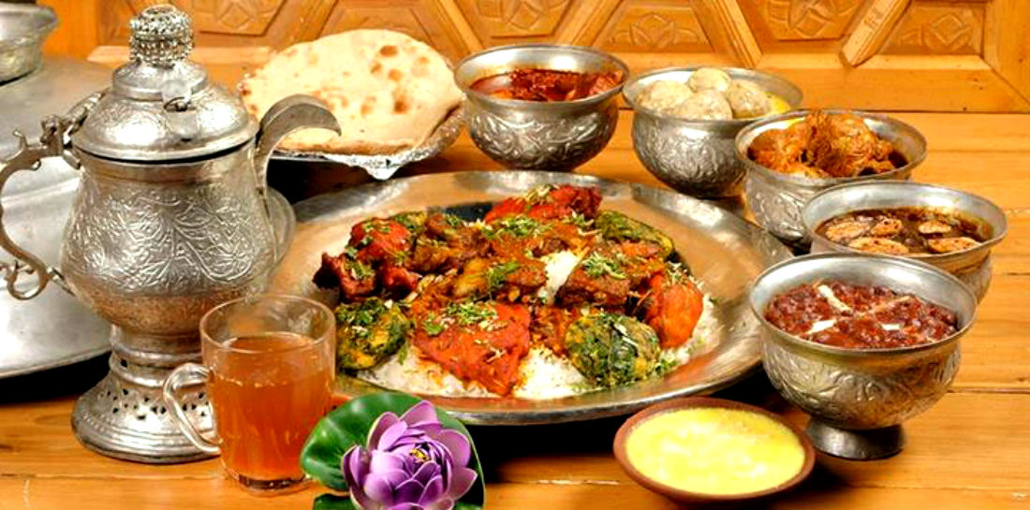
JAMMU AND
KASHMIR

Slide 40
FOOD CULTURE OF JAMMU KASHMIR
The culture, traditions, customs and food habits, and Dietary intake of the major parts of the region of Jammu & Kashmir are wide, varied, and diversified.
The major staple diet of Jammu is Rajma & Basmati Rice whereas in Kashmir the staple diet is Kashmiri Rice with meat.
Wheat is taken in the form of homemade chapattis in Jammu whereas in Kashmir Bakery Rotis made with Maida is consumed.
Different varieties of Dal is consumed in Jammu; the major protein comes from Pulses and legumes.
In the Kashmiri diet, the protein source is non-vegetarian food.

Slide 41
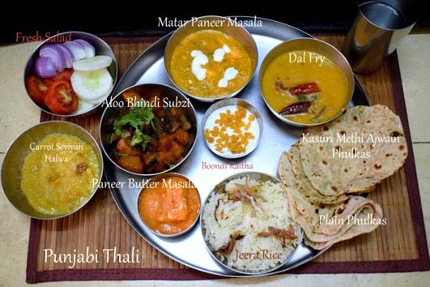
PUNJAB

Slide 42
FOOD CULTURE OF PUNJAB
Punjabi food has become known throughout the world as the ‘Indian food’ as it includes the best dishes brought by the invaders and travelers, who have influenced Punjab over the centuries
Punjabi cuisine contains large amounts of milk and milk products, used in various forms at every meal.
Desi ghee, butter or sunflower, or mustard oil are used to prepare most dishes.
Food is traditionally cooked and served in brass or copper utensils as they are believed to be beneficial for health.
Punjabi cuisine boasts of a great variety of popular vegetarian and non-vegetarian dishes like the iconic and globally represented ‘Butter chicken and naan’

Slide 43
NUTRITIONAL IMPORTANCE
The use of ghee; which is purported to be bad by modern health. However, the fact remains that ghee is one of the easily digestible fats, needed to keep the body warm during cold winters. It is locally produced, is a widely available source of energy and fat-soluble vitamins for the indigenous population.
Another benefit of traditional diets is their ability to create and maintain a delicate balance in the gut microbiota.
Traditional Punjabi cuisine is a tribute to this, as it involves a lot of fermented yogurt or dahi in almost every meal, creating a favourable microenvironment for the development and maintenance of gut bacteria, thus protecting from many ailments.

Slide 44
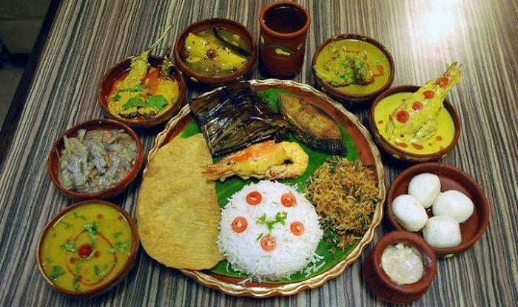
WEST BENGAL

Slide 45
FOOD CULTURE OF WEST BENGAL
A Bengali meal follows a multi-course tradition where food is served course-wise rather than all at once, usually in a specific format, marking it as the only meal of the subcontinent to have evolved such convention.
Daily meals are simple, geared to balance nutrition, and make extensive use of vegetables.
The courses progress broadly from lighter to richer and heavier and go through various tastes and taste cleansers.
Rice remains common throughout the meal.
Bengali cuisine is unique in the ingredients it has.
The dishes retain much of the fibre and a lot of proteins are eaten in every meal cooked with healing spices.
It is considered to be a perfect blend of various vegetarian and non-vegetarian preparations.

Slide 46
Bengalis prefer to eat parboiled rice, where un-milled rice (still in its rough outer husk) is boiled or steam-heated for a short time.
This drives the B vitamins (thiamin, riboflavin, and niacin) from the outer bran into the center of the grain.
Thus, parboiled white rice has more B vitamins than plain white rice, which loses those vitamins when its bran is removed.
Besides boiled rice, different kinds of puffed and parched rice such as muri, khoi, and flattened rice also fulfilled the daily needs of the common Bengalis.

Slide 47
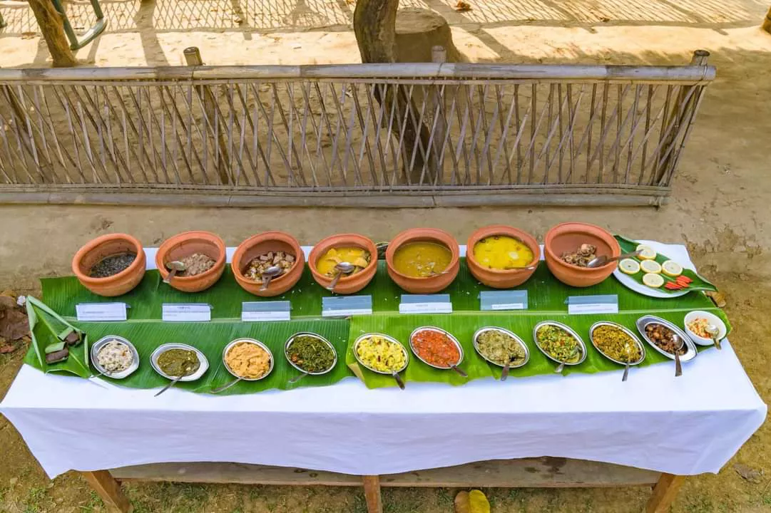
ASSAM

Slide 48
FOOD CULTURE OF ASSAM
Assamese cuisine is a confluence of cooking habits of the hills that favour fermentation and drying as forms of preservation and those from the plains that provide fresh vegetables and an abundance of fish and meat.
In Assam, a traditional meal begins with a khar, a class of dishes named after the main ingredient, and ends with a tenga, a sour dish.

Slide 49
THE PRIMARY CRITERIA OF ASSAMESE FOOD HABITS ARE
Less use of oil or use of mustard oil.
Use of boiled food.
More of roasting or roasting by wrapping with banana leaf, alpina leaf, or maranta leaf.
Few spices are used or restricted to the minimum.
Use of small fishes in various curries.
Use of fermented foods like fermented rice, fermented bamboo shoots, dried or semi-fermented & dried fishes, fermented mustard seed even fermented vegetables.

Slide 50
Extensive use of black gram which is a popular pulse, also among the tribals eating pounded rice as curry, or broken rice into curry is popular.
Eating lots of acidic food, most of the popular Assamese dishes are acidic
Use of bitter ingredients from time to time. It is considered that the use of bitter substances reduces the occurrence of fever and is considered as anti-helminthic.

Slide 51
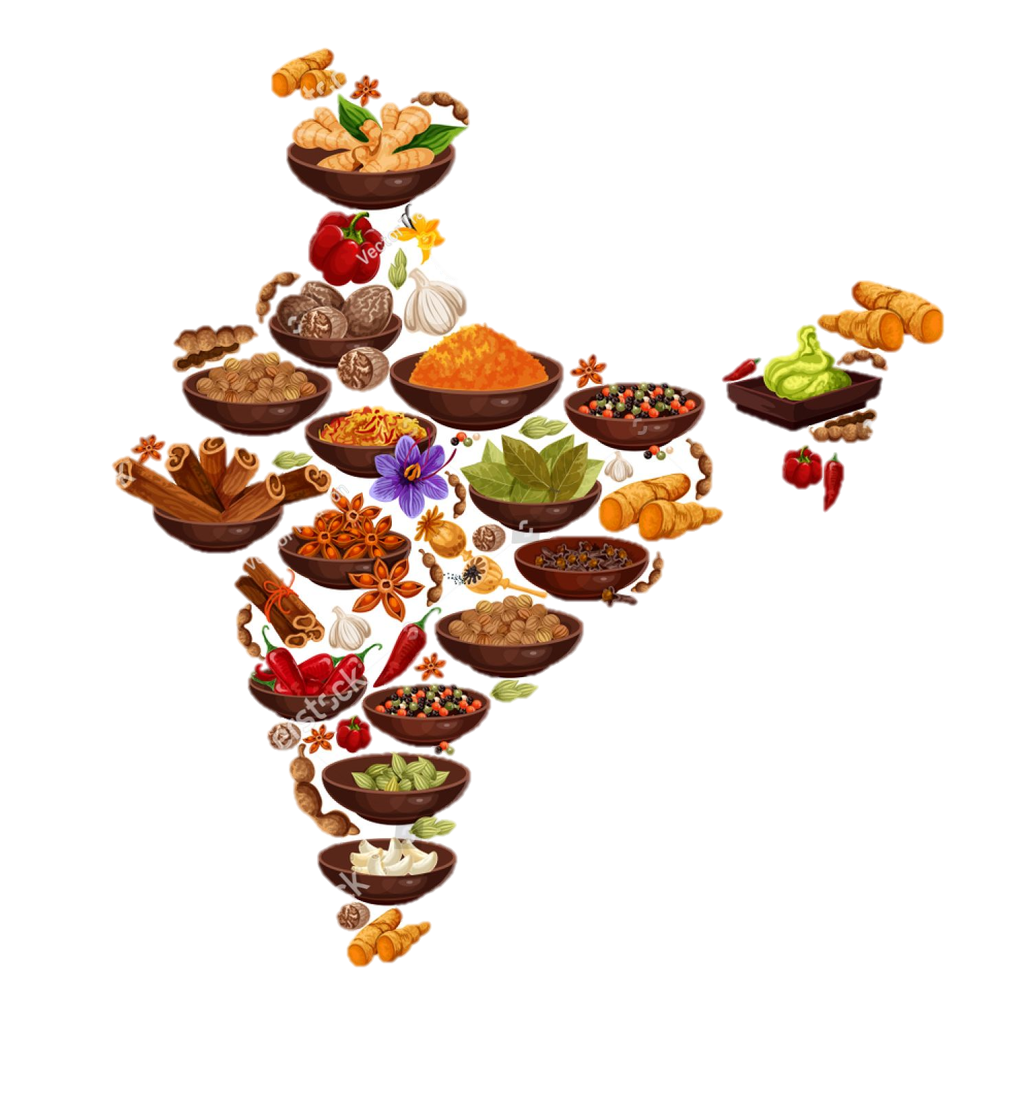
THANK YOU

