Slide 1
CULTIVATION OF BACTERIA
CONTENTS
BACTERIAL CELL
Microbial growth
Nutrition and Culture media
Culture methods
PRESENTATION BY:
Ms. Pooja Shashikant Chavan (2019-20)
F Y Microbiology for B. Sc Cardiac/Perfusion
Radio Imaging/Medical Laboratory Technology

Slide 2
Several classifications systems over time has been proposed for division of life.
Two Classification system-Proposed by Carrlous Linnaeus
All Living Organisms was classified in two kingdoms-Kingdom Plantae and Kingdom Animalia.
Based on their mode of nutrition nature-Plantae was autotrophic and Animalia was heterotrophic.

Slide 3
Classification of bacteria
1. On the basis of salt concentration
2.On the basis of mode of nutrition
3. On the basis of morphology
4.On the basis of flagella
5. On the basis of gaseous requirement
6. On the basis of gram staining
on the basis of optimum temperature requirement for growth
7. on the basis of optimal pH for growth

Slide 4
I] Classification of bacteria on the basis of salt requirement
1. Halophiles:
Those bacteria that require high concentration of NaCl for growth.
Cell membrane of halophilic bacteria is made up of glycoprotein with high content of negatively (-Ve) charged glutamic acid and aspartic acids. So high concentration of Na+ ion concentration is required to shield the –ve charge.
Example: Archeobacteria, Halobacterium, Halococcus
2. Halotolerant:
Most of the bacteria do not require NaCl but can tolerate low concentration of NaCl in growth media are called halotolerant

Slide 5
II] Classification of bacteria on the basis of mode of nutrition
1. Phototrophs:
Those bacteria which gain energy from light
Phototrophs are further divided into two groups on the basis of source of electron.
  Photolithotrophs: these bacteria gain energy from light and uses reduced inorganic compounds such as H2S as electron source. Eg. Chromatiumokenii
  Photoorganotrophs: these bacteria gain energy from light and uses organic compounds such as succinate as electron source.
2. Chemotrophs:
Those bacteria gain energy from chemical compounds
They cannot carry out photosynthesis
Chemotrophs are further divided into two groups on the basis of source of electron.
  Chemolithotrophs: they gain energy from oxidation of chemical compound and reduces inorganic compounds such as NH3 as electron source. Eg. Nitrosomonas
  Chemoorganotrophs: they gain energy from chemical compounds and uses organic compound such as glucose and amino acids as source of electron. eg. Pseudomonas pseudoflava

Slide 6
  3. Autotrophs:
  Those bacteria which uses carbon dioxide as sole source of carbon to prepare its own food.
  Autotrophs are divide into two types on the basis of energy utilized to assimilate carbon dioxide. Photoautotrophs and chemoautotrophs
  Photoautotrops: they utilized light to assimilate CO2. They are further divided into two group on the basis of electron sources. Ie. Photolithotropicautotrops and
  Photoorganotropicautotrops
  Chemoautotrops: they utilize chemical energy for assimilation of CO2

Slide 7
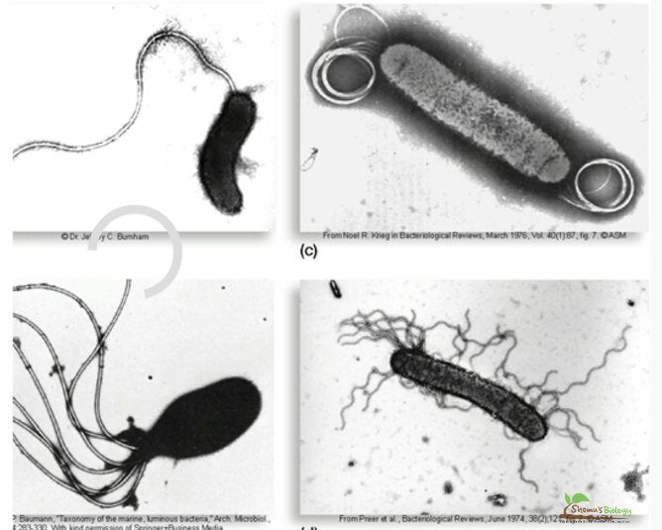
III] Classification of bacteria on the basis of Flagella
1. Monotrichous bacteria: bacteria having single flagella in one end of cell. eg. Vibrio cholera, Pseudomonas aeruginosa
2. Lophotrichous bacteria: bacteria having bundle of flagella in one end of cell. eg. Pseudomanas fluroscence
3. Amphitrichous bacteria: bacteria having single or cluster of flagella at both end of cell. eg. Aquaspirillium
4. Peritrichous bacteria: bacteria having flagella all over the cell surface.
Eg. E.coli, Salmonella, Klebsiella
5. Atrichous bacteria: bacteria without flagella.
Eg. Shigella

Slide 8
3. Mycoplasma
They are cell wall lacking bacteria
Also known as PPLO (Pleuropneumonia like organism)
Mycoplasma pneumoniae
4. Spirochaetes:
They are spiral shaped bacteria
Spirochaetes
5. Rickettsiae and Chlamydiae;
They are obligate intracellular parasites resemble more closely to viruses than bacteria
6. Actinomycetes
They have filamentous or branching structure
They resemble more closely to Fungi than bacteria
Example: Streptomyces

Slide 9
IV Classification of bacteria on the basis of Morphological Chracteristics
Bacteria can be classified according to their morpholoicalical characteristics like their cell shape ,size and structures and developmental forms, staining reactions, motility.
1. Coccus:
These bacteria are spherical or oval in shape
On the basis of arrangement, cocci are further classified as- i) Diplococcus: coccus in pair. Eg, Neissseriagonorrhoae, Pneumococcus ii) Streptococcus: coccus in chain. Eg. Streptococcus salivarius iii) Staphylococcus: coccus in bunch. Eg. Staphylococcus aureus iv) Tetrad: Coccus in group of four. v) Sarcina: Cocus in cubical arrangement of cell. Eg. Sporosarcina
2. Bacilli:
These are rod shaped bacteria
On the basis of arrangement, bacilli are further classified as- i) Coccobacilli: Eg. Brucella ii) Streptobacilli: chain of rod shape bacteria: Eg. Bacillus subtilis, iii) Comma shaped: Eg. Vibrio cholarae iv) Chinese letter shaped: Corynebacteriumdephtherae

Slide 10
V] Classification of bacteria on the basis of gaseous requirement
1. Obligate aerobes:
Those bacteria that require oxygen and cannot grow in the absence of O2.
These bacteria carryout only oxidative type of metabolism..Examples; Mycobacterium, Bacillus
2. Facultative anaerobes:
Those bacteria that do not require O2 but can use it if available.
Growth of these bacteria become batter in presence of O2
These bacteria carryout both oxidative and fermentative type of metabolism
Examples: coli, Klebsiella, Salmonella
3. Aerotolerant anaerobes;
Those bacteria do not require O2 for growth but can tolerate the presence of O2.
Growth of these bacteria is not affected by the presence of O2.

Slide 11
VI] Classification of bacteria on the basis of Gram staining
1. Gram positive bacteria:
Cell wall of these bacteria is composed of peptidoglycan layer only.
Eg. Staphylococcus, Streptococcus, micrococcus
2. Gram negative bacteria:
Cell wall of these bacteria is composed of Peptidoglycan and outer membrane.
Eg. E. coli, Salmonella

Slide 12
VII] Classification of bacteria on the basis of optimum temperature of growth
1. Psychrophiles:
Bacteria that can grow at 0°C or below but the optimum temperature of growth is 15 °C or below and maximum temperature is 20°C are called psychrophiles
Psychrophiles have polyunsaturated fatty acids in their cell membrane which gives fluid nature to the cell membrane even at lower temperature.
Examples: Vibrio psychroerythrus, vibrio marinus, Polaromonasvaculata, Psychroflexus
2. Psychrotrops (facultative psychrophiles):
Those bacteria that can grow even at 0°C but optimum temperature for growth is (20-30)°C
3. Mesophiles:
Those bacteria that can grow best between (25-40)C but optimum temperature for growth is 37C
Most of the human pathogens are mesophilic in nature
Examples: E.coli, Salmonella, Klebsiella, Staphulococci
I] Classification of bacteria on the basis of Spore
1. Spore forming bacteria:
Those bacteria that produce spore during unfavorable condition.
These are further divided into two group
i) Endospore forming bacteria:
Spore produced within the bacterial cell.
Bacillus, Clostridium, Sporosarcina etc
ii) Exospore forming bacteria:
Spore produced outside the cell
Methylosinus
2. Non sporing bacteria:
those bacteria which do not produce spore.
Eg. E. coli, Salmonella

Slide 13
4. Thermophiles:
Bacteria that can best grow above 45C.
Thermophiles capable of growing in mesophilic range are called facultative thermophiles.
True thermophiles are called as Steno thermophiles, they are obligate thermophiles,
Thermophiles contains saturated fatty acids in their cell membrane so their cell membrane does not become too fluid even at higher temperature.
Examples: Streptococcus thermophiles, Bacillus stearothermophilus, Thermusaquaticus,
5. Hyperthermophiles: Those bacteria that have optimum temperature of growth above 80C.
Mostly Archaebacteria are hyperthermophiles.
Monolayer cell membrane of Archaebacteria is more resistant to heat and they adopt to grow in higher temperature.
Examples: Thermodesulfobacterium, Aquifex, Pyrolobusfumari, Thermotoga

Slide 14
VIII] Classification of bacteria on the basis of optimum Ph of growth
1. Acidophiles:
Those bacteria that grow best at acidic pH
The cytoplasm of these bacteria are acidic in nature.
Some acidophiles are thermophilic in nature, such bacteria are called Thermoacidophiles.
Examples: Thiobacillusthioxidans, Thiobacillus, ferroxidans, Thermoplasma, Sulfolobus
2. Alkaliphiles:
Those bacteria that grow best at alkaline pH
Example: vibrio cholerae: optimum pH of growth is 8.2
3. Neutriphiles:
Those bacteria that grow best at neutral pH (6.5-7.5)
Most of the bacteria grow at neutral pH
Example: E. coli

Slide 15
ix Classification of bacteria on the basis of Spore
1. Spore forming bacteria:
Those bacteria that produce spore during unfavorable condition.
These are further divided into two group i) Endospore forming bacteria:
Spore produced within the bacterial cell.
Bacillus, Clostridium, Sporosarcina etc ii) Exospore forming bacteria:
Spore produced outside the cell
Methylosinus
2. Non sporing bacteria: those bacteria which do not produce spore.
Eg. E. coli, Salmonella

Slide 16
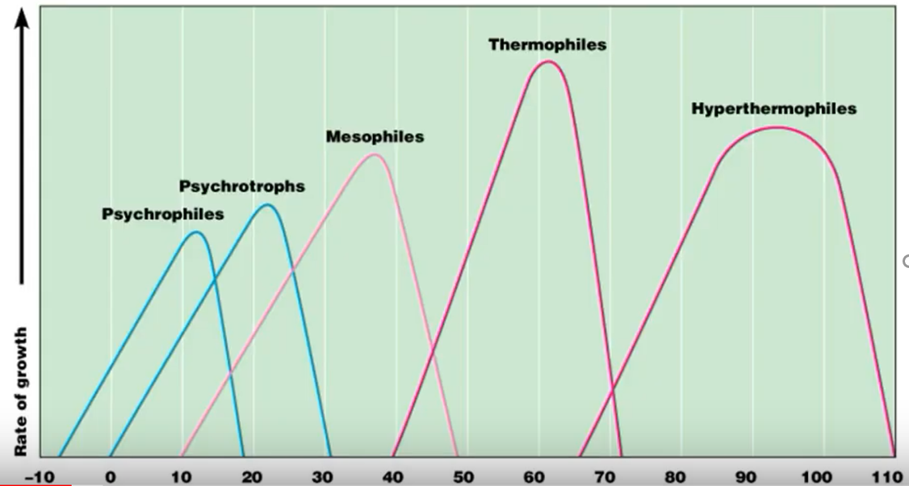
Temperature

Slide 17
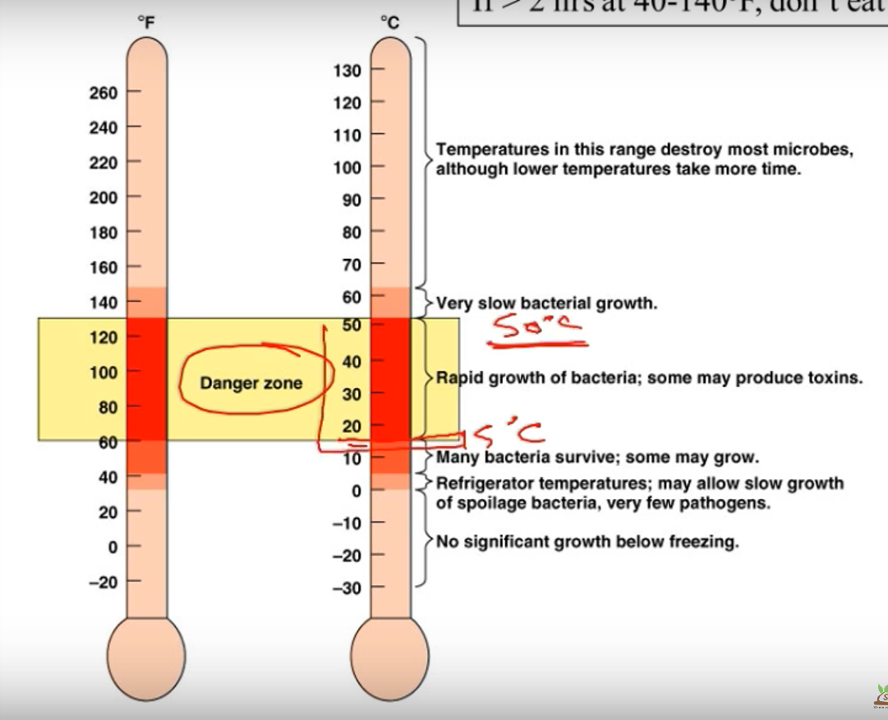
TEMPERATURE GROWTH RANGES AND FOOD SAFETY

Slide 18
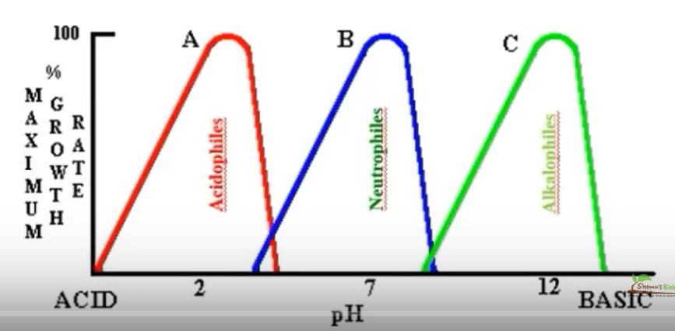

Slide 19
MICROBIAL GROWTH REQUIREMENTS
CHEMICAL REQUIREMENTS
1)Carbon Source in medium
2)Nitrogen, Sulphur, Phosphorous, trace elements
3)Oxygen Requirement
CULTURE MEDIA FOR MICROBES
1)Chemically defined Vs Complex media
2) Media types –Selective,
Differential
Enriched,
Enrichment
BACTERIAL POPULATION GROWTH
Growth Curve-lag, log, Stationary , Decline.
Quantifying Growth
PHYSICAL REQUIREMENTS OF MICROBES
1)Temperature
2)Ph
3)Buffers

