Slide 1
UNIT 1:GENERAL MICROBIOLOGY
TOPIC:CULTURE MEDIA
PRESENTATION BY:
Ms. Pooja Shashikant Chavan (2020-21)
F Y Microbiology for B. Sc Cardiac/Perfusion
Radio Imaging/Medical Laboratory Technology

Slide 2
CULTURE AND THE MEDIUM
CULTURE :
Is the term given to microorganisms that are cultivated in the lab for the purpose of identifying and studying them.

Slide 3
MEDIUM:
Is the term given to the combination of ingredients that will support the growth and cultivation of microorganisms by providing all the essential nutrients required for the growth (i.e. multiplication) in order to cultivate these microorganisms in large number to study them.

Slide 4
Microbiological culture: which are used for growing microorganisms, such as bacteria or yeast.
The most common growth media for microorganisms are nutrient broths and agar plates
Specialized media are sometimes required for microorganism and cell culture growth.

Slide 5

CULTURE MEDIA
Used to grow bacteria
Can be used to-
Enrich the numbers of bacteria.
Select for certain bacteria and suppress others.
Differentiate among different kinds of bacteria.

Slide 6
NEED FOR CULTURE MEDIA
It is usually essential to obtain a culture by growing the organism in an artificial medium.
If more than one species or type of organism are present each requires to be carefully separated or isolated in pure culture .

Slide 7
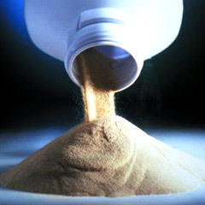
BASIC REQUIREMENTS OF CULTURE MEDIA
NUTRIENTS :
Energy source
Carbon source
Nitrogen source
MINERAL SALTS :
Sulphates, phosphates, chlorides and carbonates of K, Mg and Ca
A suitable pH- 7.2- 7.4

Slide 8
GROWTH FACTORS
ARGININE | E.COLI
GLUTATHIONE | GONOCOCCI
CHOLESTEROL | MYCOPLASMA
ARYL SULPHATE, AMIDE | ATYPICAL MYCOBACTERIA
GLYCEROL | MYCOPLASMA HOMINIS
SULFONAMIDES | RIKETTSIA
TRYPTOPHAN | SALMONELLA TYPHI
L-CYSTEINE | LISTERIA MONOCYTOGENS
SODIUM CHLORIDE | VIBRIO PARAHAEMOLYTICUS
FACTOR X & V | H.INFLUENZAE

Slide 9
CLASSIFICATION
BASED ON PHYSICAL STATE | BASED ON PRESENCE OF MOLECULAR OXYGEN AND REDUCING SUBSTANCES | BASED ON NUTRITIONAL FACTORS
LIQUID MEDIA | AEROBIC MEDIA | SIMPLE MEDIA
SEMISOLID MEDIA | ANAEROBIC MEDIA | COMPLEX MEDIA
SOLID MEDIA |  | SYNTHETIC MEDIA
 |  | SPECIAL MEDIA
Notes:
BASED ON PHYSICAL STATE
Solid medium
Liquid medium
Semisolid medium
BASED ON PRESENCE OF MOLECULAR OXYGEN & REDUCING SUBSTANCE
Aerobic medium
Anaerobic medium
BASED ON NUTRITIONAL FACTORS
Simple medium
Complex medium
Synthetic or defined medium
Semidefined medium
Special medium
Enriched medium
Enrichment medium
Selective medium
Differential medium
Indicator medium
Transport medium
Sugar medium

Slide 10
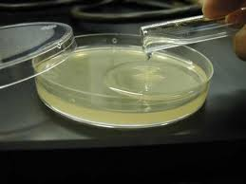
SPECIAL MEDIA
ENRICHED MEDIA
B. ENRICHMENT MEDIA
C. SELECTIVE MEDIA
D. DIFFERENTIAL MEDIA
E. INDICATOR MEDIA
F. TRANSPORT MEDIA
G. SUGAR MEDIA

Slide 11
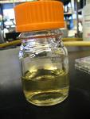
SIMPLE MEDIA
Simple or basal media are culture media which contain the minimum adequate nutrition for non fastidious organisms
Example:- Nutrient broth/agar
Peptone water
Composition:-
Lab-Lemco -10gm
peptone-10gm
NaCl- 5gm
Distilled water-1000ml
- When 2-3% agar is added ,then we have it as nutrient agar.
- For semisolid media – agar concentration is 0.2-0.4%
Uses:-
This is basis of most of the media used in the study at common pathogenic bacteria.
It is used for subcultures of certain organisms.

Slide 12

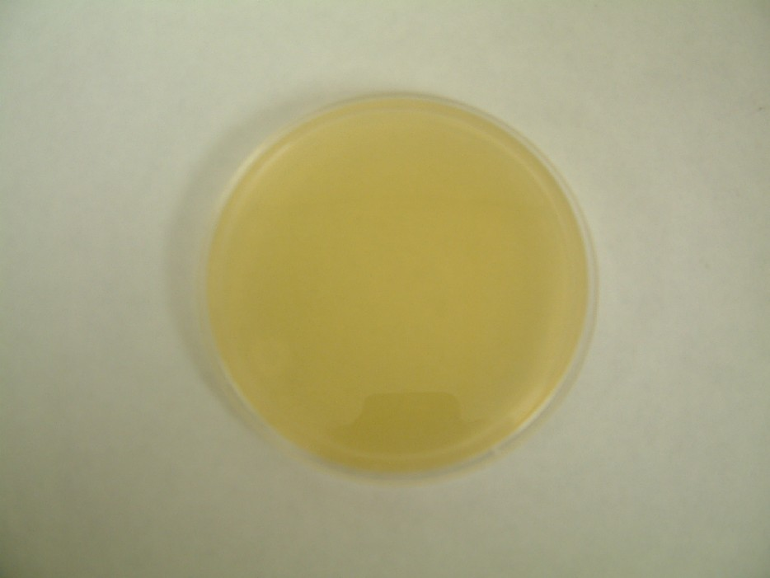
NUTRIENT AGAR
NUTRIENT BROTH

Slide 13
PEPTONE WATER
TYPE : Basic liquid media
APPEARANCE : clear, colorless, watery, usually in test tube
Composition :
PEPTONE | 10 g
SODIUM CHLORIDE, NaCl | 5 g
WATER | 1 litre
Notes:
pH – 7.4 to 7.5
Sterilization : sterilized by autoclaving at 121 degree C for 15 minutes
It is an enzymatic hydrolysate of animal tissues used as culture media ingredient in variety of media
Also useful for commercial production of enzymes, vaccines, antibiotics and other products.

Slide 14
USES OF PEPTONE WATER
The media is used chiefly as the basis for carbohydrate fermentation media.
Nutrient broths may contain a small amount of sugar derived from meat and it is essential that the basal medium to which various carbohydrates are added for fermentation tests should be free from natural sugars.

Slide 15
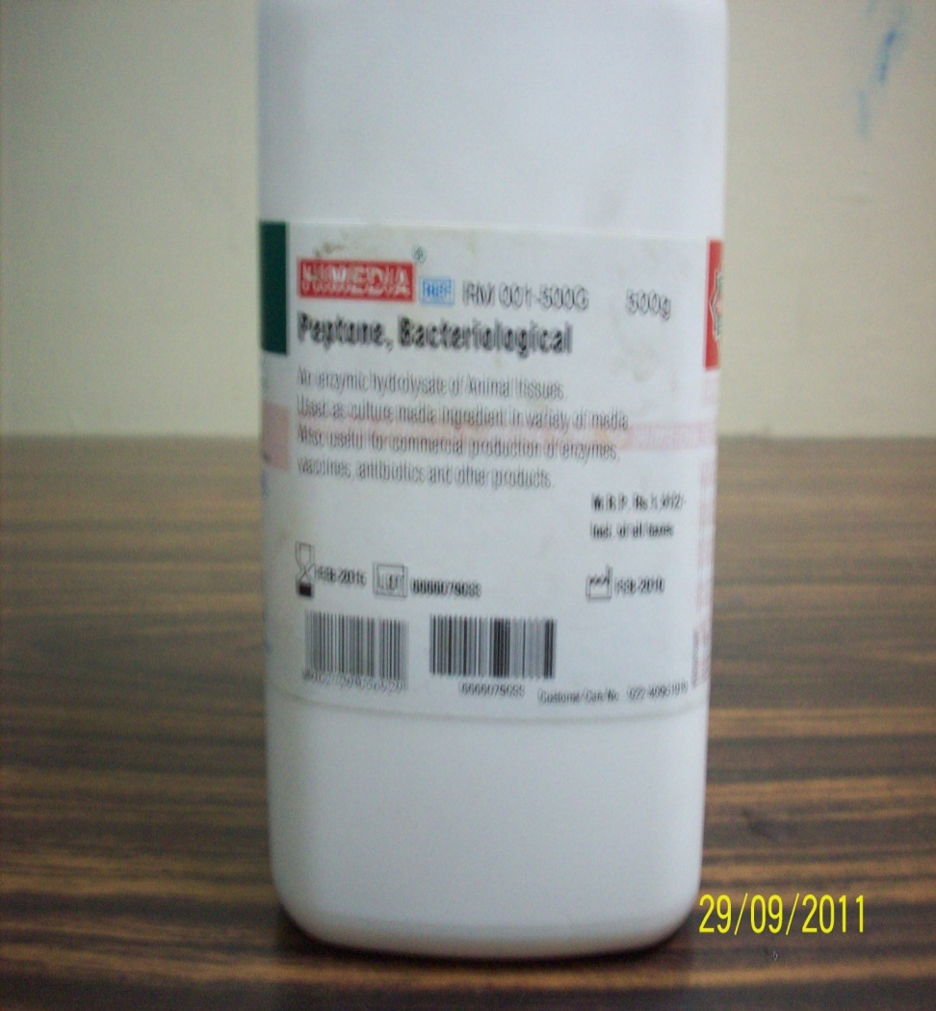
  It is also used to test the formation of indole.
  Culture of organisms for demonstration of motility

Slide 16
COMPLEX MEDIA
Complex media have added ingredients for bringing out certain properties for bringing out certain properties or providing special nutrients required for growth of the bacterium in question.
SYNTHETIC MEDIA
These are prepared from pure chemicals and the exact compositions of medium is very well known.
Example :- Dubo’s medium
SEMIDEFINED MEDIA
In these media the exact chemical composition of the constituents is not known because substances like meat and peptone are used.
Most of the culture media used for routine diagnostic work are semidefined culture media.

Slide 17

SPECIAL MEDIUM
ENRICHED MEDIA
  It is a medium which is able to enhance the growth of particular organism without inhibiting the growth of others is known as enriched media.
  Examples:-
      Dorset’s Egg Medium.
      It is a creamy coloured opaque
      slope kept in screw copped bottle
      Selective medium for isolation
      of Mycobacterium tuberculosis.
      Composition: Hen’s egg, Nutrient broth

Slide 18
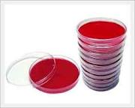
BLOOD AGAR
TYPE : Enriched media.
APPEARANCE : Red color.
COMPOSITION :
Sterile Nutrient agar + Defibrinated sheep blood
USES :
Routine culture
Widely used in medical bacteriology
It is also an indicator medium showing the haemolytic properties of bacteria such as Streptococcus pyogenes.

Slide 19
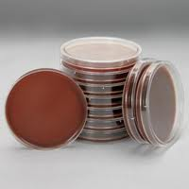
CHOCOLATE AGAR
Also called Heated blood agar.
TYPE : Enriched media.
APPEARANCE : Chocolate brown color.
PROCEDURE
Melt the desired amount of nutrient agar.
Cool it in a water – bath at 75º C .
Add 10 ml of sterile blood .
Allow the medium to remain at 75º C.

Slide 20
Mixing the blood and agar by gentle agitation from time to time until the blood become chocolate brown in color, within about 10 min.
Then pour in plates.
USES
CULTURE OF Neisseria
CULTURE OF Haemophilus influenzae
CULTURE OF Pneumococcus

Slide 21
ENRICHMENT MEDIA
These are normally liquid broth media which permit the increase of a given type of organism in comparison to the other organisms present in the inoculum.
An enrichment medium which may contain substances which encourage growth of the required organisms or which may inhibit the growth of other types of organisms.
This result in an absolute increase in the number of wanted bacteria related to other bacteria.
Example:- Selenite F broth
It is enrichment medium for culture of Salmonella typhi and paratyphi bacilli from stool sample
Principle:- at neutral pH solution acid salinity has high toxicity to coli form group of bacteria and not to most of the salmonella groups.

Slide 22
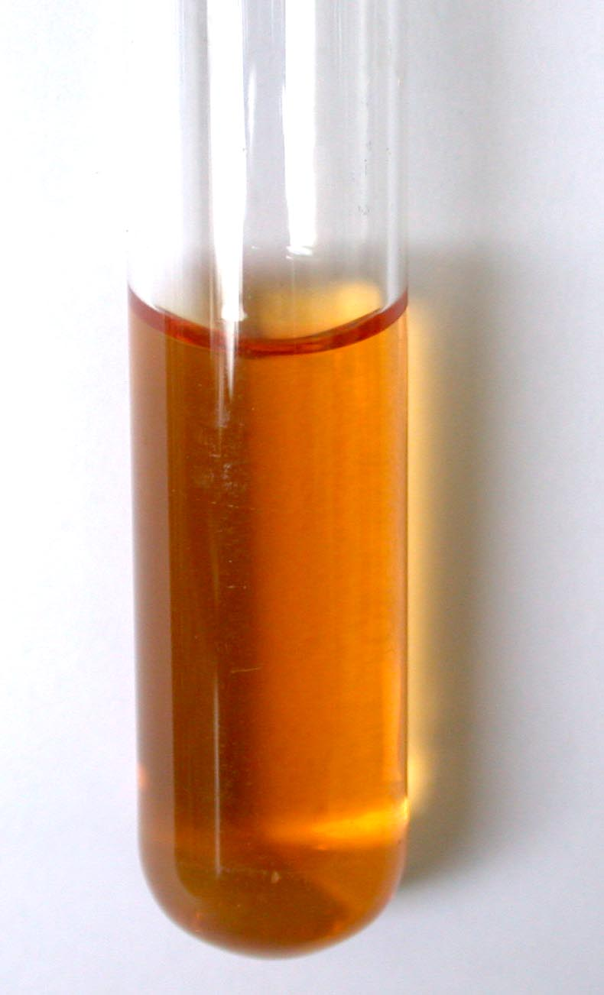
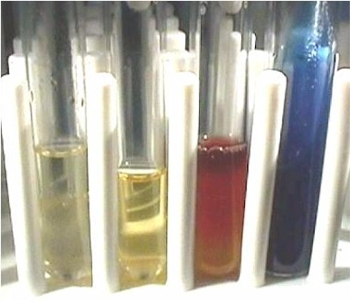
SELENITE F BROTH
Alkaline peptone water

Slide 23
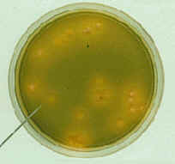
SELECTIVE MEDIA
It is a medium in which certain substances are present which inhibit all other bacteria except the desired bacteria.
It encourages the growth of particular species from a mixed inoculum.
These media contain components that select for the growth of particular microorganisms. often inhibiting the growth of others.
Example:- TCBS
-It is light green translucent medium kept in petridish
-It is selective medium for Vibrio cholera
-Principle:-
Bile salt inhibit the growth of normal
commensals (unwanted bacteria).
Vibrio chloerae produce acid by fermentation
of sucrose which acts on bromothymol blue
(indicator) producing yellow colonies.

Slide 24
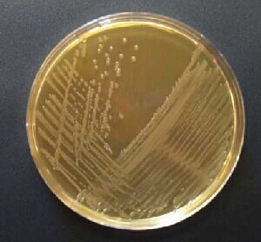
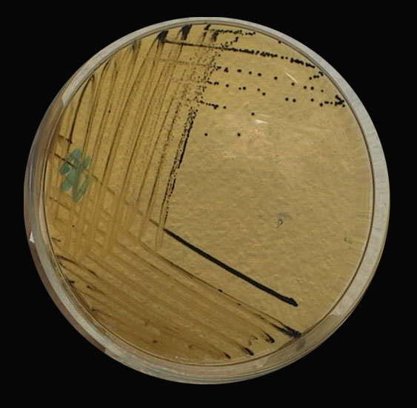
Salmonella Shigella Agar with DCA
Salmonella-Shigella agar plate (SS)

Slide 25
DIFFERENTIAL MEDIA
These are the media containing reagent or the supplements which allows to distinguish between different groups of bacteria. It may even permit tentative identification of organisms on the basis of their growth characteristics.

Slide 26
MAC CONKEY AGAR
MacConkey agar is a culture medium designed to grow Gram-negative bacteria. It is a useful medium for the cultivation of enterobacteriacea.

Slide 27
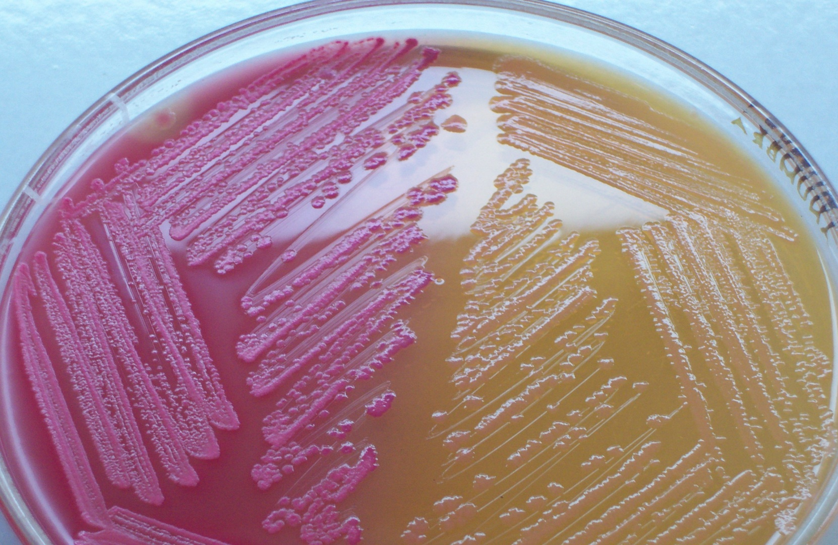
MacConkey agar showing both lactose and non-lactose fermenting colonies.
Lactose fermenting colonies are pink whereas non-lactose fermenting ones are colourless or appear same as the medium.

Slide 28
It contains lactose and neutral red to distinguish the lactose- fermenting coliforms from the lactose non –fermenting salmonella and shigella groups.

Slide 29
It contains Bile salts to inhibit non-intestinal bacteria and most Gram-positive bacteria, except Enterococcus and some species
of Staphylococcus i.e. Staphylococcus aureus.
Neutral red dye : which stains microbes fermenting lactose.
Crystal violet dye : which also inhibits certain Gram-positive bacteria).

Slide 30
Gram-negative bacteria growing on the media are differentiated by their ability to ferment the sugar lactose.
Lactose fermenter cause the pH to drop and is detected by neutral red, (red at pH's below 6.8.) which appear as bright pink to red colonies on the agar.

Slide 31
Uses
Acting as a visual pH indicator, the agar distinguishes those Gram-negative bacteria that can ferment the sugar lactose (Lac+) from those that cannot (Lac-).
This medium is also known as an
"indicator medium"
"low selective medium".
Absence of electrolytes serves to inhibit swarming by Proteus species

Slide 32
Lac+
By utilizing the lactose available in the medium, Lac+ bacteria such as
Escherichia coli
Enterobacter spp.
Klebsiella spp.
will produce acid, which lowers the pH of the agar below 6.8 and results in the appearance of red/pink colonies

Slide 33
CLED
(Cystine Lactose Electrolyte Deficient medium)
It is a valuable non-inhibitory growth medium used in the isolation and differentiation of urinary organisms.
Being electrolyte deficient, it prevents the swarming of Proteus species

Slide 34
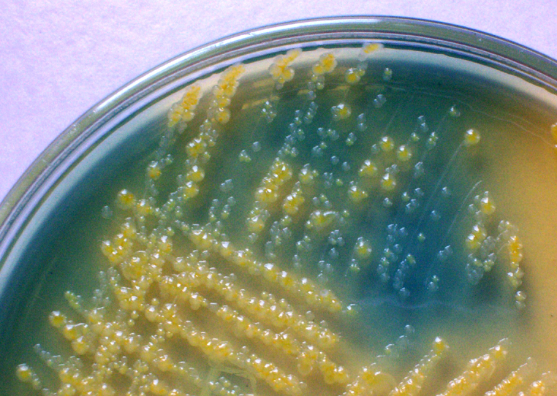
Description: Lactose & non lactose fermenters on CLED medium.

Slide 35
INDICATOR MEDIUM
These media contain an indicator which changes colour when bacteria grow on them.
Example:- Wilson and Blair medium
For isolation of Salmonella typhi and S. paratyphi
They appear as black colonies
Principle:- The black colour of colonies is due to the ability of these organisms to reduce bismuth sulphite to sulphide in the presence of glucose coliforms are inhibited by brilliant green and bismuth sullphite

Slide 36
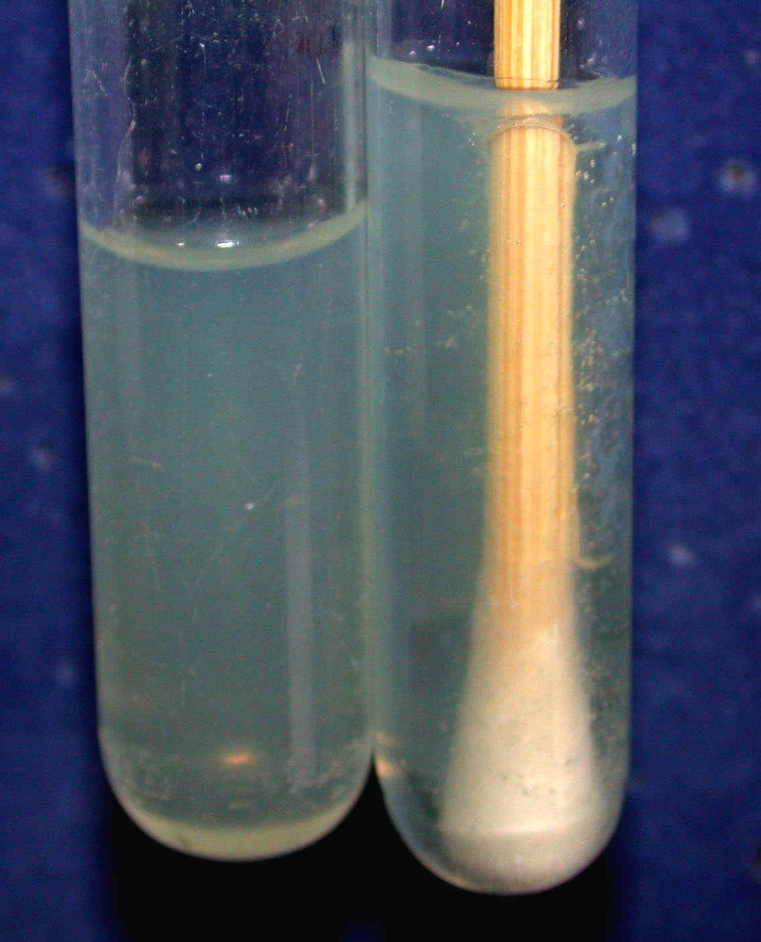
TRANSPORT MEDIUM
These are used for the temporary storage of specimens being transported to the laboratory for cultivation.
Such media ideally maintain the viability of all organisms in the specimen without altering their concentration.
Transport media typically contain only buffers and salt.
The lack of carbon, nitrogen, and organic growth factors prevents microbial multiplication.
Transport media used in the isolation of anaerobes must be free of molecular oxygen.
STUART TRANSPORT BROTH

Slide 37
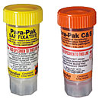
CHARACTERISTICS OF TRANSPORT MEDIA:
It should be non-toxic
It should not promote or inhibit the bacterial growth
It should be easy to carry and transport
Examples:
Venkatraman Ramakrishnan medium
Buffered glycerol saline transport medium
Cary and Blair medium
Cary and Blair medium

Slide 38
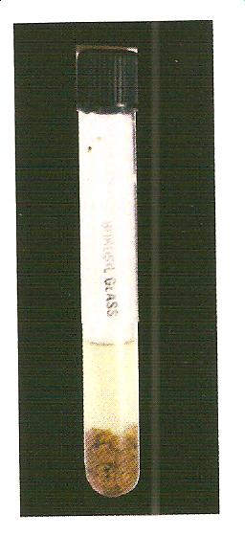
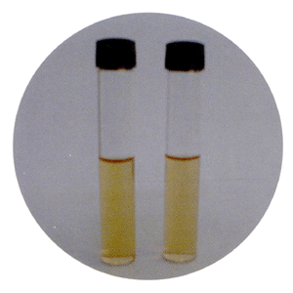
ANAEROBIC MEDIUM
These media are used to grow anaerobic organisms.
Examples:-
Thioglycollate broth
Robertsons Cooked Meat Medium
Notes:
Unsaturated fatty acid present in meat utilise oxygen for autoxidation this reaction is catalysed by haematin in the meat
Glutathione and cysteine present in meat also utilize oxygen
Sulphydryl compounds (present in cysteine) also contribute for a reduced oxidation – reduction potential
Procedure :- Before inoculation the medium is boiled in water bath at 80 degrees for 30 minutes to make oxygen free. For strict anaerobiosis the surface of CMB medium may be converted with a layer of sterile liquid paraffin
Interpretation:-
Sacchride anaerobes (Clostridium perfinges) turn the colour of meat pieces red while if become black in cases of proteolytic anaerobes (Clostridium tetani)

Slide 39
Mueller-Hinton agar

Slide 40
Mueller-Hinton agar is an microbiological growth medium that is commonly used for antibiotic susceptibility testing.
Originally formulated for isolation of Neisseria species.
It is also used to isolate and maintain Neisseria and Moraxella species.

Slide 41
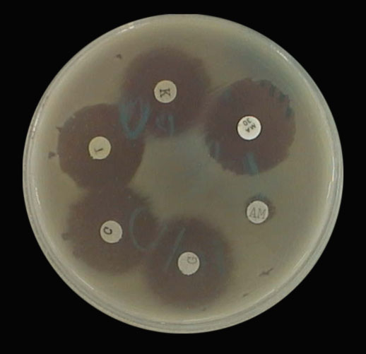

Slide 42
THANK YOU

