Slide 1

Types of Defensive Barriers of Innate Immunity
PRESENTATION BY:
Ms. Pranjali Bhuyar (2020-21)
F Y Microbiology for B. Sc Cardiac/Perfusion
Radio Imaging/Medical Laboratory Technology

Slide 2
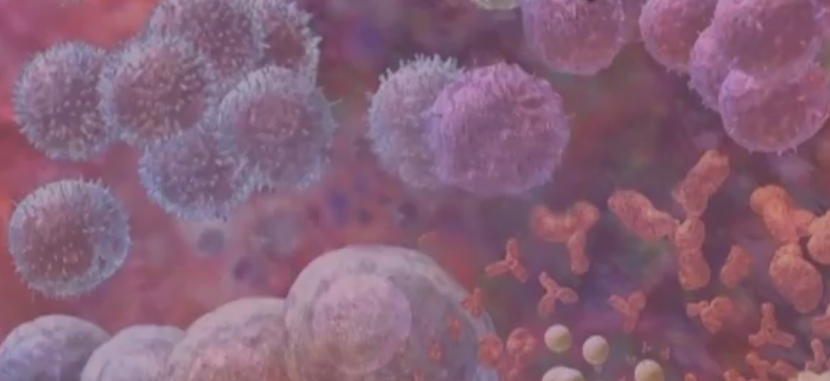
1.Anatomical Barriers
2.Physiological Barriers
3.Phagocytic or Endocytic Barriers
4.Inflammatory Barriers

Slide 3
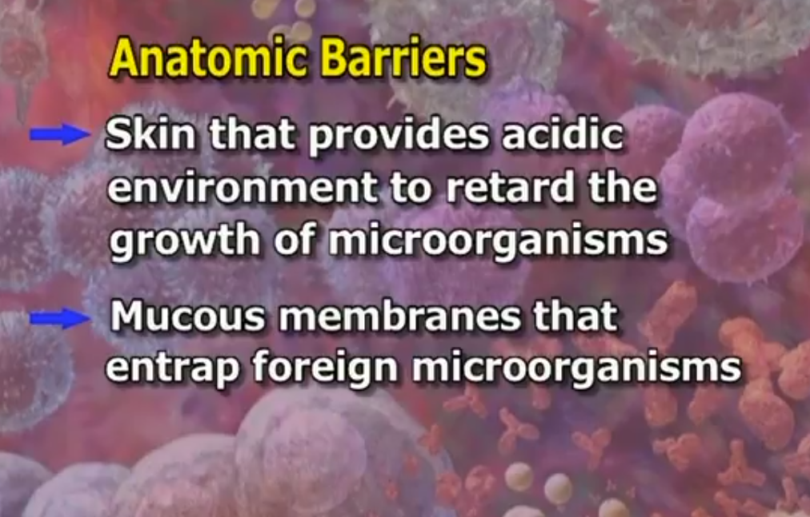

Slide 4
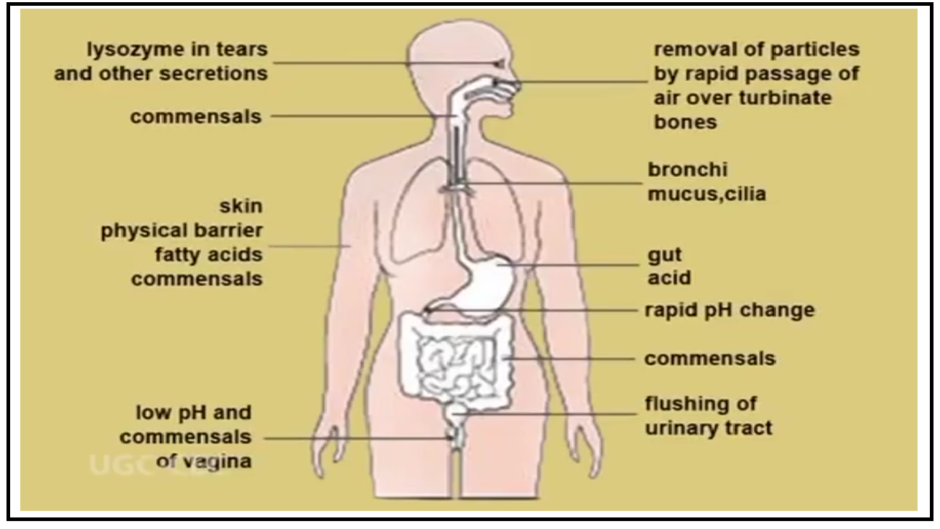

Slide 5
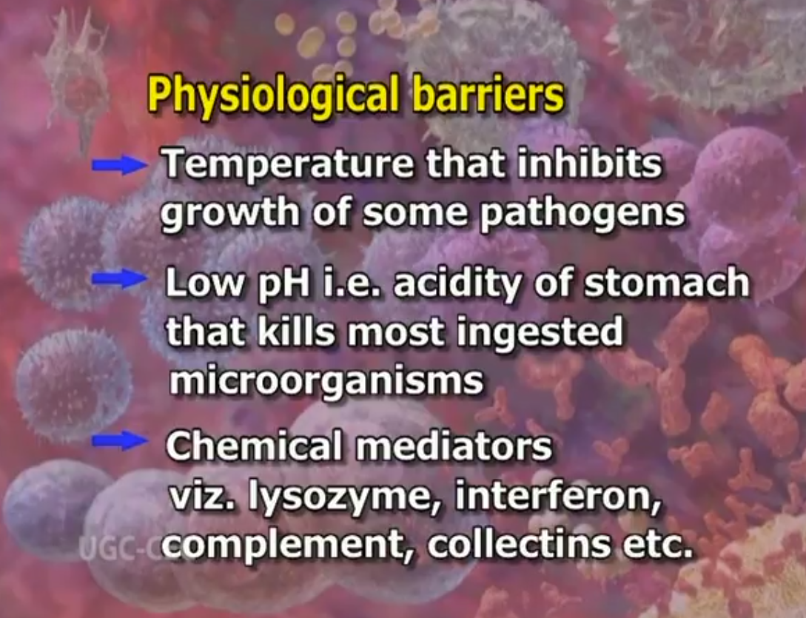

Slide 6
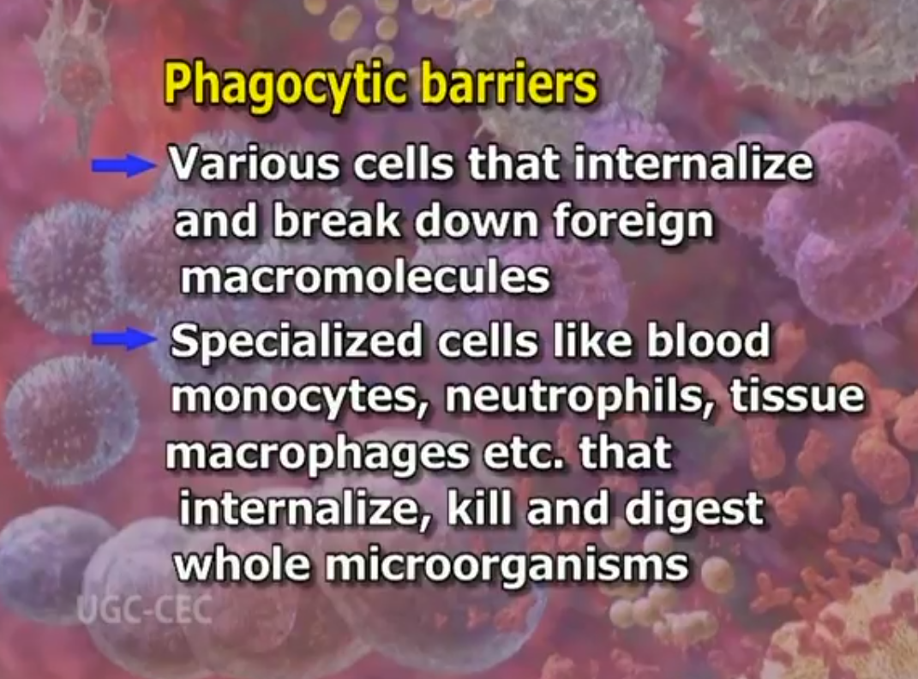

Slide 7
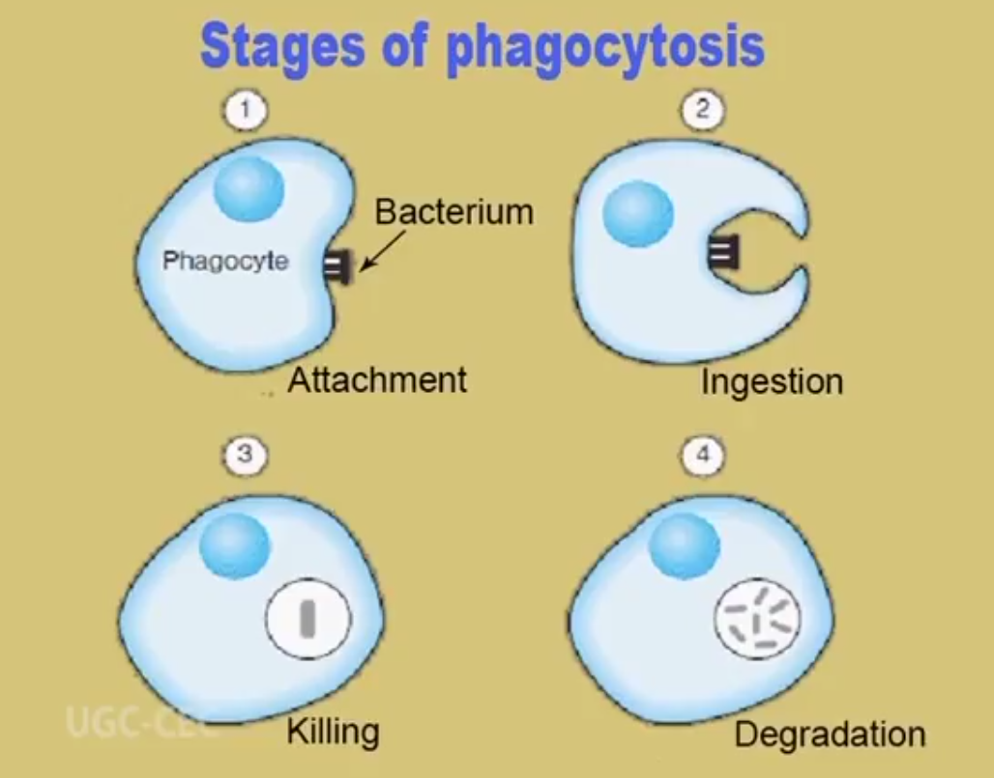

Slide 8
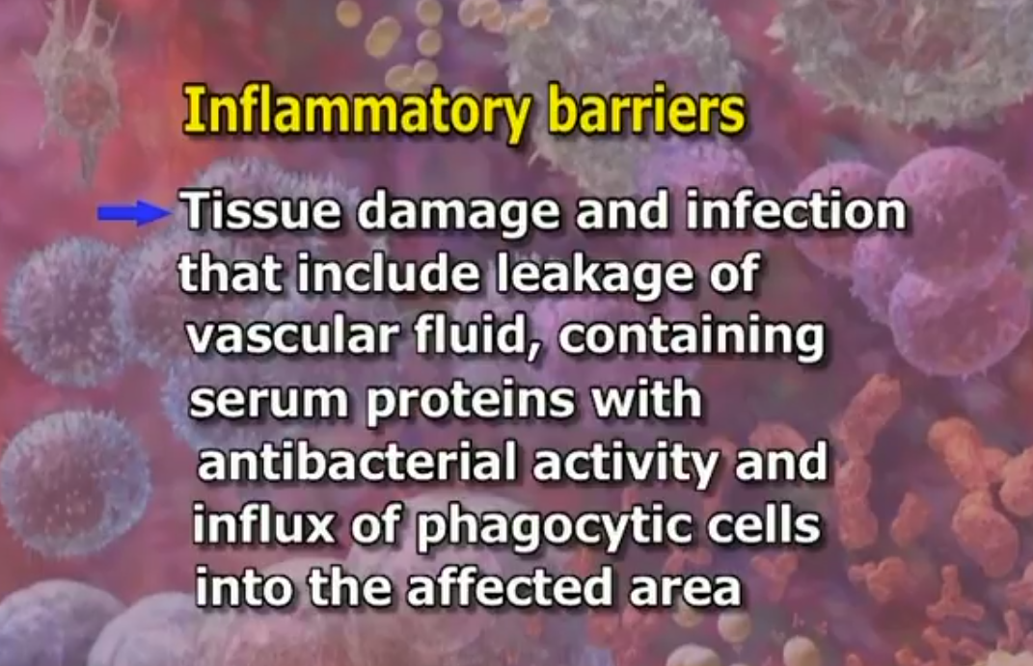

Slide 9
