Slide 1
BASIC LIFE SUPPORT
PRESENTED BY:
Dr POOJA PARIKH

Slide 2
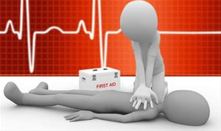
INTRODUCTION
Cardiac arrest is the most serious complication faced by medical personnel.
In cardiac arrest, circulation ceases & vital organs are deprived of oxygen
Cardiac pulmonary resuscitation (CPR) is most effective, when started immediately and should be initiated by any person present at time of cardiac arrest

Slide 3
Management of CPR depends on whether arrest occurred in hospital or outside the hospital & on availability of single or double rescuer.
-outside hospital- basic life support
- inside the hospital-BLS + advanced cardiac life support & postresuscitation life support(CPCR)

Slide 4
BASIC LIFE SUPPORT
AIM: major objective of BLS is to maintain oxygenation in lungs, brain & heart
Consist of 3 main parts-
A-B-C :
A-Airway maintenance
B- Breathing
C-Circulation
Now it change to C-A-B
Each part of ABC begins with an assessment phase to determine patient response ,pulse rate & state of respiration.

Slide 5
AIRWAY MAINTAINANCE:
When victim is unresponsive- position the patient & assess the airway
Position of Victim- supine, on firm flat surface.
Position of rescuer- at the victims side, at level of victim’s shoulder.
Triple maneuver;
-Open the mouth-clear the airway
-Head tilt-chin lift
-Jaw thrust

Slide 6
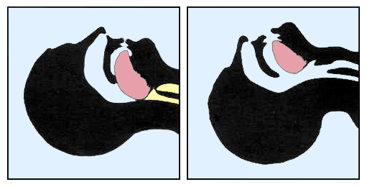
Opening the airway:
in unconscious patient , muscle tone is impaired resulting in obstruction of pharynx, by base of tongue & soft tissue of pharynx.
- moving the mandible forward will lift the tongue away & open the airway

Slide 7
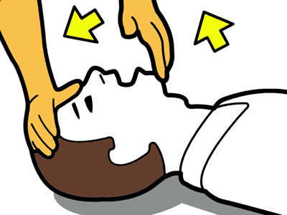
HEAD TILT & CHIN LIFT:
-place one hand on victim’s forehead & apply firm backward pressure to tilt head back.
-place fingers of other hand under chin
- Lift chin forward & support the jaw

Slide 8
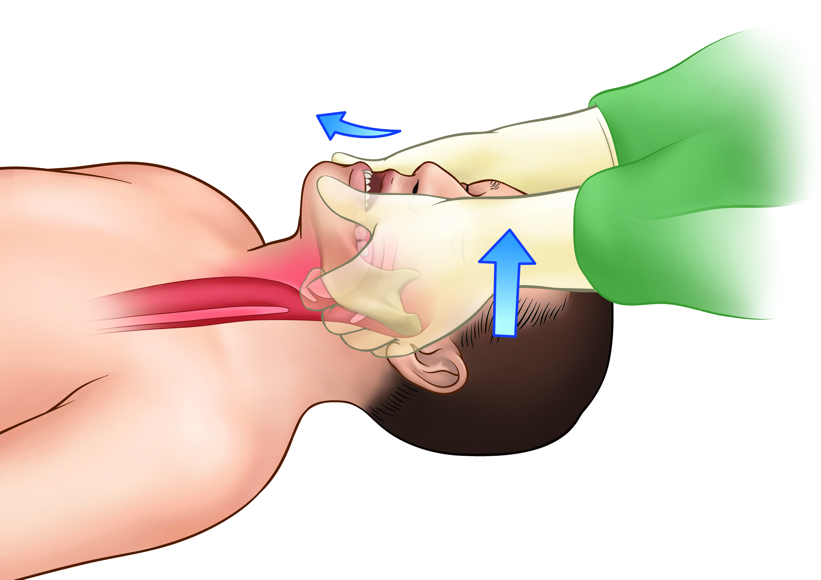
JAW THRUST:
- Grasp angle of victim’s lower jaw & lift with both hands, one on each side, displacing mandible forward, while tilting head backward
-if there is foreign material in mouth it should be removed

Slide 9
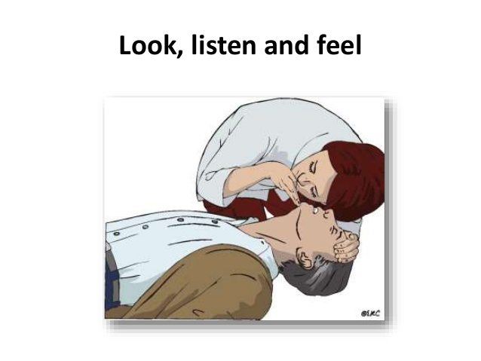
BREATHING:
First determine the presence or absence of breathing by-
-Placing ear near victim’s mouth or nose
-Looking for chest wall movement
-Auscultation of chest for breath sounds
Expired air resuscitation:
-Mouth-to-mouth breathing
-Mouth-to-nose breathing
-Mouth-to-mask breathing

Slide 10
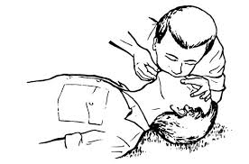
MOUTH TO MOUTH BREATHING:
- quick & effective way to provide oxygen to victim
1.open the airway with triple maneuver
2. close victims nostrils with the thumb & index finger
3. take deep breath and form seal with lips around victim’s mouth
4. two slow breaths (of ½ to 2 seconds per puff) are given

Slide 11
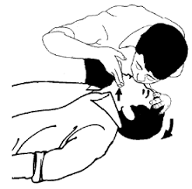
MOUTH TO NOSE BREATHING:
-when mouth to mouth breathing is not possible
1.Tilt victim’s head back with one hand over victim’s forehead
2. Close victim’s mouth
3.Take deep breath , form seal with lips around victim’s nose & blow.
4. Victim is then allowed to exhale

Slide 12
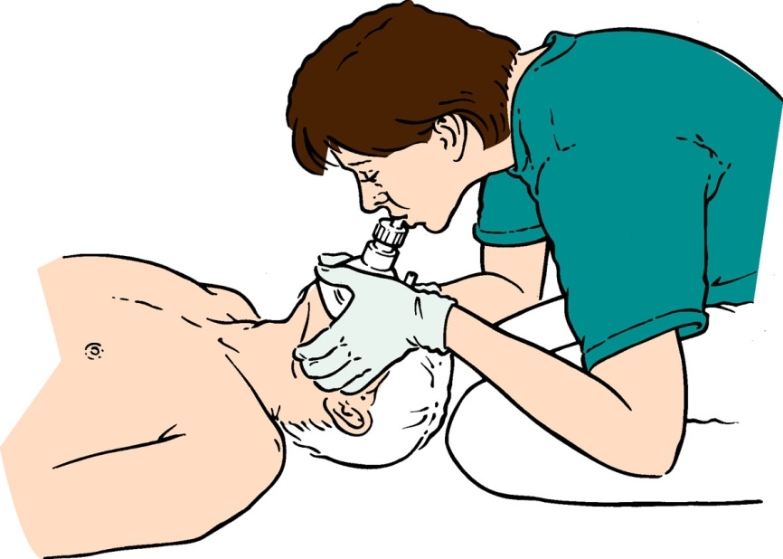
MOUTH TO MASK BREATHING:
-place mask around the patient’s mouth & nose
-seal the mask by placing heal and thumb of each hand along the border of mask and compress firmly to provide tight seal
-lift the jaw while performing a head tilt
-follow sequence of mouth to mouth breathing

Slide 13
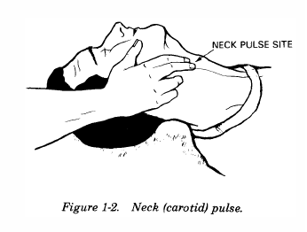
CIRCULATION:
Check pulse in peripheral & major artries (carotid, femoral)
If no pulse is palpated one should start External Cardiac Compression
Chest Compression Rate- 80-100/min

Slide 14
Compression technique:
Position of victim- supine, on firm flat surface.
Area of compression-lower half of sternum.
Put the heel of one of hand on lower half of sternum & other hand on top of first hand (fingers are interlocked at chest)
Straighten your arms & position your shoulder directly over your hand.
Push hard & fast. Press down 1 ½ -2 inch with each compression.
After each compression allow chest to re-expand.

Slide 15
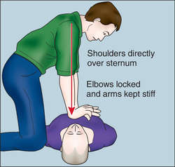
Chest compression technique for adult:

Slide 16
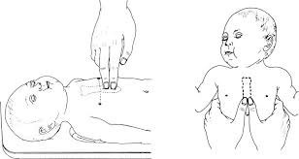
Chest compression technique for infant:
2 fingure technique 2 thumb encircling
technique

Slide 17
ASSESSMENT OF PATIENT DURING CPR:
Inspection:
-chest rise
-depth of compression
-position of rescuers hands
Palpation:
-check for return pulse
-assess peripheral pulse
Auscultation:
-Breath sounds
-heart sounds

Slide 18
Advanced cardiac life support:
ACLS include use of adjunctive equipment & technique available in hospital set-up to assisting ventilation & circulation such as ECG monitoring & defibrillation, establishment of IV inj. Access & drug therapy.
To achieve these goals following activities are carried out-
Intubation with endotracheal tube
Defibrillation
Insertion of an intravenous line

Slide 19
Thank You

