Slide 1
Local Anesthesia in Maxilla
Dr. Apurv Shah
Dept. of Oral & Maxillofacial Surgery

Slide 2
Contents
Types of L.A Injections
Types of Maxillary Injections
Nerve blocks
Anterior superior alveolar
Middle superior alveolar
Posterior superior alveolar
Greater palatine
Nasopalatine
Maxillary

Slide 3
Types of L.A Injections
Local Infiltration
Field Block
Nerve Block

Slide 4
Local Infiltration
Small terminal nerve endings in the area of the dental treatment are flooded with local anesthetic solution.
Incision (or treatment) is then made into the same area in which the local anesthetic has been deposited.

Slide 5
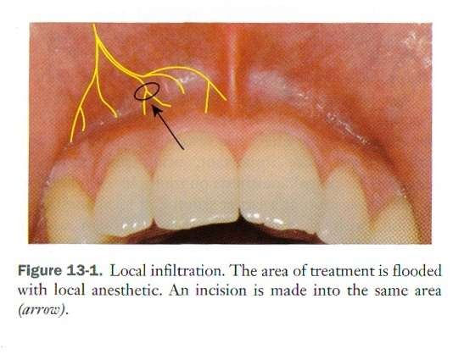

Slide 6
Field Block
Local anesthetic is deposited toward larger terminal nerve branches.
Treatment is done away from the site of local anesthetic injection.
Maxillary injections administered above the apex of the tooth to be treated are properly referred to as field blocks not local infiltrations.

Slide 7
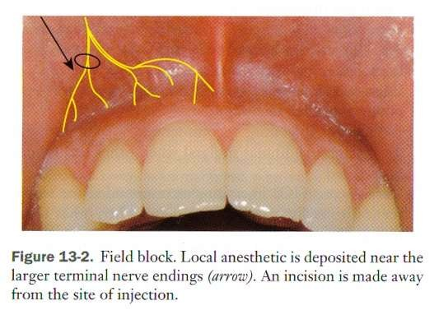

Slide 8
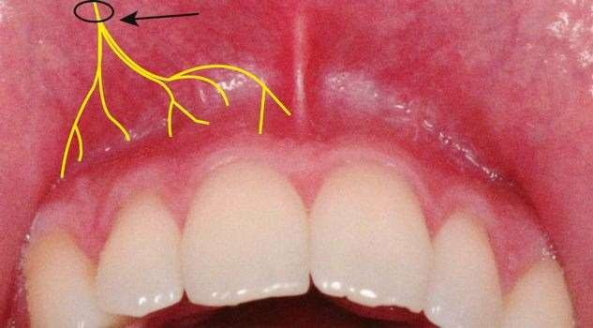
Nerve Block or Conduction Anesthesia
Local anesthetic is deposited close to a main nerve trunk, usually at a distance from the site of operative intervention.

Slide 9
Types of Maxillary Injections
Supraperiosteal Injection
Intraligamentary (PDL) Injection
Intrapulpal anesthesia
Intraosseous anesthesia
Intraseptal anesthesia
Nerve Blocks

Slide 10
Supraperiosteal Injection
More commonly (but incorrectly) called local infiltration, is the most frequently used technique for obtaining pulpal anesthesia in maxillary teeth.
Also called as paraperiosteal technique.
Anesthetizes large terminal branches dental plexus
Greater than 95% success rate.
Technically easy and atraumatic
of the

Slide 11
Indications
Pulpal anesthesia of one or two maxillary teeth
Soft tissue anesthesia when indicated for surgical procedures in a circumscribed area.
For hemostasis.
Contraindications
Infection or acute inflammation in the area.
Dense bone covering apices of teeth.

Slide 12
Technique
Prepare tissue at the injection site-Clean with sterile dry gauze,Apply topical anesthetic for minimum of 1 minute.
Orient needle, so bevel faces bone.
Hold the syringe parallel with the long axis of the tooth and Insert the needle into the height of the mucobuccal fold over the target tooth.
Advance the needle until its bevel is at or above the apical region of the tooth in soft tissue.
Aspirate, If negative deposit approximately 0.6 mL

Slide 13
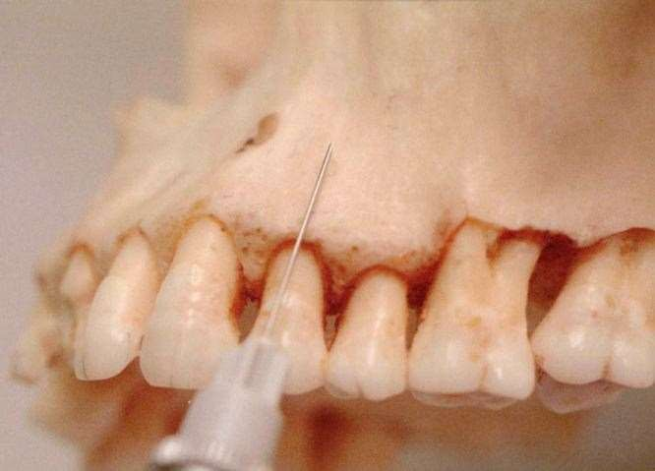

Slide 14
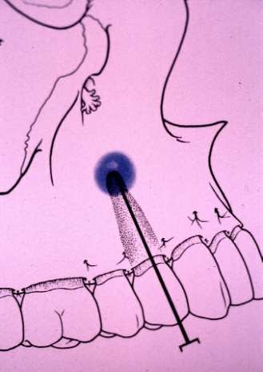
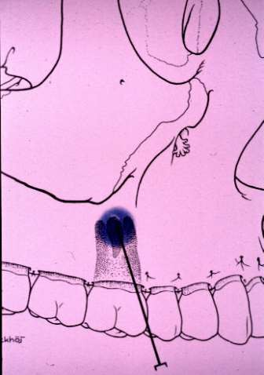

Slide 15
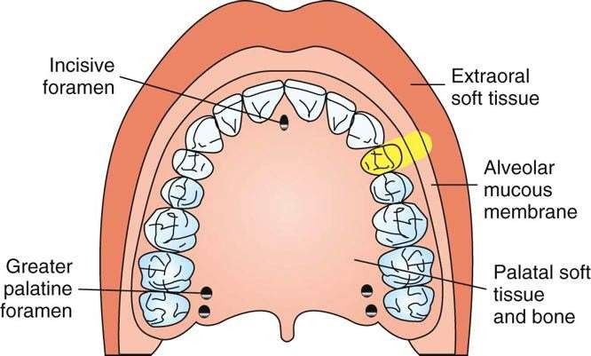
Areas Anesthetized
The entire region innervated by the large terminal branches of this plexus: pulp and root area of the tooth, buccal periosteum, connective tissue, and mucous membrane.

Slide 16
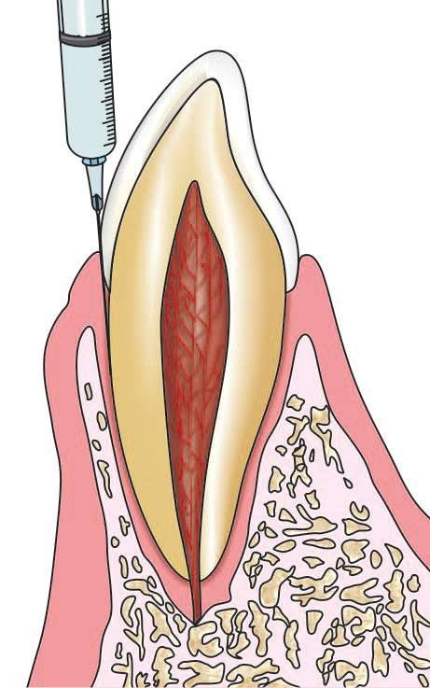
Intraligamentary injection
Local anesthetic solution is deposited into the periodontal ligament space via specifically designed system, which comprises of high pressure syringes and ultrafine needles

Slide 17
Indications
Indicated for pulpal anesthesia of 1 or 2 teeth in a quadrant,frequently in mandible.
Patients for whom residual soft tissue anesthesia is undesirable, ie in children.
Situations in which regional block anesthesia is contraindicated Eg :hemophiliacs
As a possible aid in the diagnosis (e.g. localization) of mandibular pain.
As an adjunctive technique after nerve block anesthesia if partial anesthesia is present.

Slide 18
Contraindications
Infection or inflammation at the site of injection
Primary teeth when the permanent tooth bud is present- Enamel hypoplasia has been reported to occur in a developing permanent tooth when a PDL injection was administered to the primary tooth above it.
Patient who requires a “numb” sensation for psychological comfort.

Slide 19
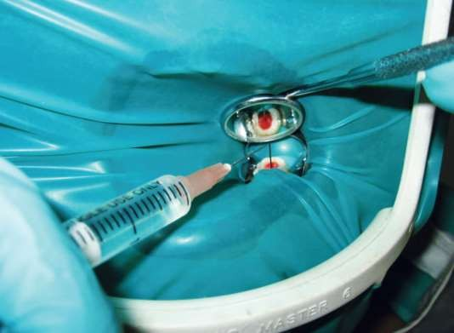
Intrapulpal Anesthesia
This technique is indicated for obtaining anesthesia for procedures which require direct instrumentation of the pulpal tissue like RCT.
Here the needle is inserted directly into the pulp chamber or the root canal and LA is injected.

Slide 20
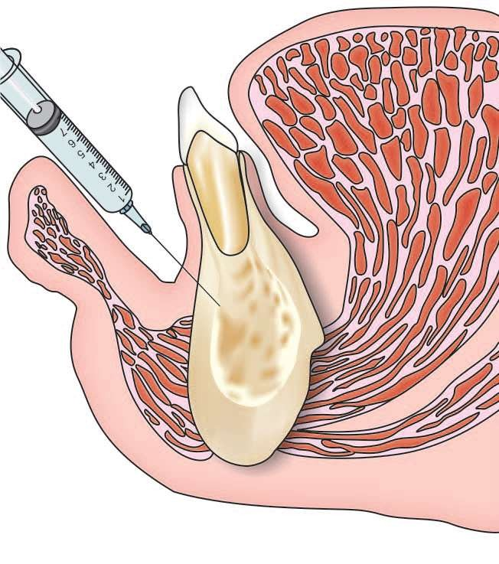
Intraosseous (IO) injection
LA solution is deposited directly into the cancellous bone adjacent to the tooth to be anesthetised.
Recommended for single teeth (primarily mandibular molars) when other techniques have failed.
Disadvantage: Specialised equipment and technique is needed.

Slide 21
Intraseptal Anesthesia
It is considered as a variation of intraosseous anesthesia.
A needle is forced gently into the porous interseptal bone on either side of the tooth to be anesthetised. The local anesthetic solution is then forced under pressure into the cancellous bone.
Recommended primarily for periodontal surgical techniques.

Slide 22
Nerve Block for maxillary nerve
Intraoral nerve blocks:
Anterior superior alveolar
Middle superior alveolar
Posterior superior alveolar
Greater palatine
Nasopalatine
Maxillary
Extraoral nerve blocks:
Infraorbital Nerve Block
Maxillary Nerve Block.

Slide 23
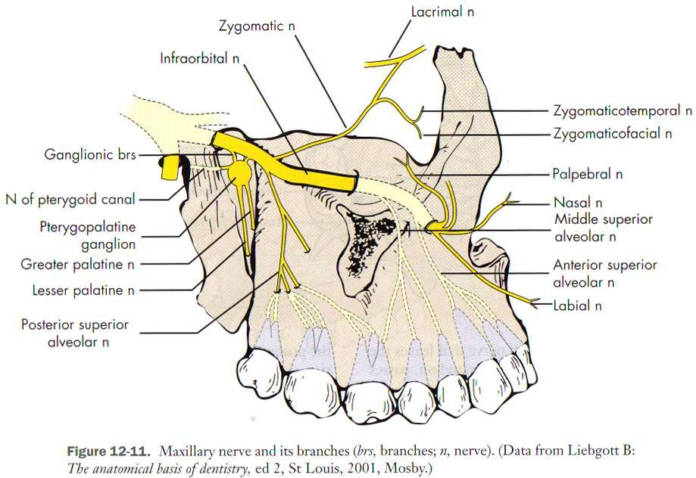

Slide 24
Anterior Superior Alveolar Nerve Block
Highly successful and extremely safe technique
Also known as the Infraorbital Nerve Block which is inaccurate.- as the infraorbital nerve provides anesthesia to the soft tissues of the anterior portion of the face only and not to the teeth.
Nerves Anesthetized-
Anterior superior alveolar
Middle superior alveolar
Infraorbital nerve
  a Inferior palpebral
  b Lateral nasal
  c Superior labial

Slide 25
Areas Anesthetized
Pulps of the maxillary central incisor through the canine on the injected side
In about 72% of patients, pulps of the maxillary premolars and mesiobuccal root of the first molar
Buccal (labial) periodontium and bone of these same teeth
Lower eyelid, lateral aspect of the nose, upper lip.

Slide 26
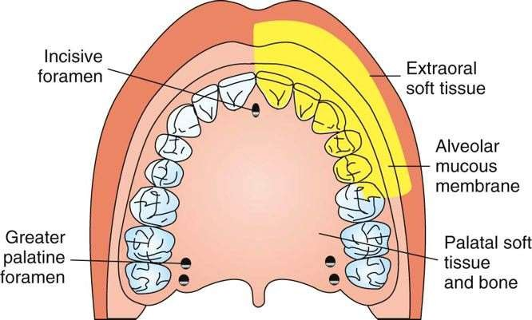

Slide 27
Indications
Dental procedures involving more than two maxillary teeth and their overlying buccal tissues
Inflammation or infection (which contraindicates supraperiosteal injection).
When supraperiosteal injections have been ineffective because of dense cortical bone

Slide 28
Technique
2 approaches--Bicuspid and Incisor approach Anatomical Landmarks
Bicuspid approach:
infraorbital margin,depression,foramen
first bicuspid
mucobuccal fold
pupil of the ipsilateral eye in the forward gaze
angle of the mouth
mental foramen
Incisor approach: additionally central incisor and canine and mucobuccal fold in the region of canine.

Slide 29
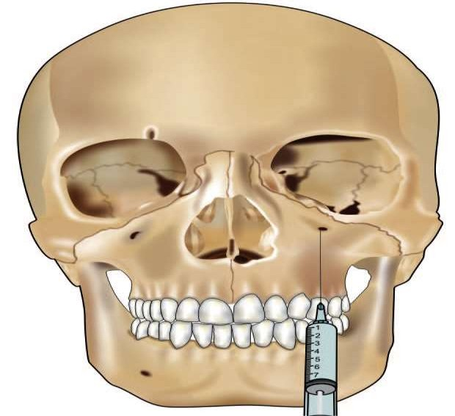
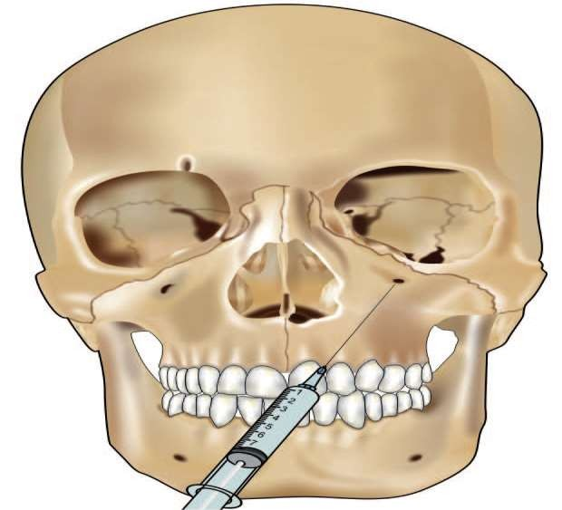
Bicuspid approach
Incisor approach

Slide 30
Position of the patient: The patient is placed in the chair so that the maxillary
comfortably
occlusal plane is at an angle of 45° to the floor.
Position of the operator: The operator stands on the right side of patient for right-sided block; and stands in front of the patient for the leftsided block.
Preparation of the tissues: The tissues at the site of injection are prepared with an antiseptic.
Needle: Long and 25-gauge needle is recommended.
Bevel: The bevel is positioned in such a way that it is facing the bone

Slide 31
Target area: infraorbital foramen
Area of insertion
(Bicuspid approach) At the height of mucobuccal fold, or 4-5 mm away from the buccal cortex of maxilla in the region of first bicuspid.
(central incisor approach) At the height of mucobuccal fold, or 4-5 mm away from the labial cortex of maxilla in the region of ipsilateral canine.

Slide 32
Procedure
Palpate anatomical landmarks-Locate the infraorbital margin,Move your finger downward from the margin, applying gentle pressure to the tissues, a concavity will be felt. This is the infraorbital depression.The deepest part of the depression is the infraorbital foramen.
Maintain your finger on the foramen.Retract the
the
lip,and insert the needle into the height of
mucobuccal fold over the first bicuspid or the canine.
Orient the syringe towards the foramen.Advance the needle until bone is contacted.
Care should be taken to protect the eye with thumb to limit the passage of the needle towards the eye.

Slide 33
The needle should not penetrate more than 3/4th of an inch. Apprx:, 1 ml is deposited in this area and the thumb is held in position until the injection is completed.
The surgeon will be able to feel the solution, as it is deposited beneath the finger on the foramen, if the needle tip is in the correct position.
Maintain firm pressure over the injection site both during and for at least 1 minute after the injection.
Massage the tissue postero-superiorly so that the solution can easily diffuse through into the foramen.
Wait for 3-5 minutes.

Slide 34
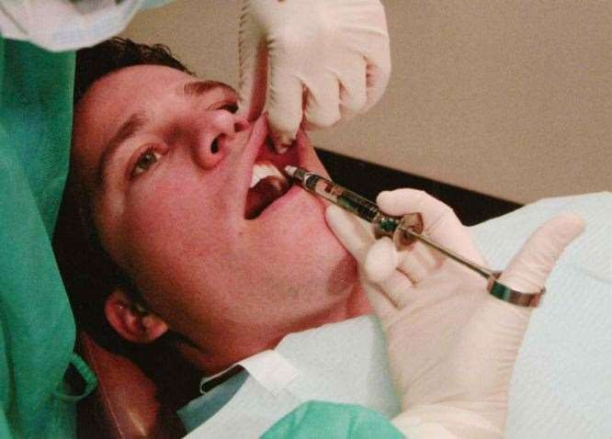
Using a finger over the foramen, lift the lip, and hold the tissues in the mucobuccal fold taut

Slide 35

Signs and symptoms:
Subjective: Tingling and numbness of the lower eyelid, side of the nose and upper lip.
Subjective and Objective: Numbness in teeth
and soft tissue along distribution of ASA and MSA.
Complications
Hematoma: It may rarely develop.
Paresis of face: It occurs when the injection is given superficially, when the needle lies in the vicinity of muscles of facial expression or the nerves innervating them.

Slide 36
Failure to obtain anesthesia:
Poor injection technique:
If needle contacts bone below the infraorbital foramen. To correct, withdraw the needle a little, keeping the tip of the needle inside the soft tissues, redirect upwards towards the infraorbital foramen.
Intravascular administration: Deposition of the local anesthetic solution into a vessel.

Slide 37
Middle superior alveolar nerve block
MSA nerve is present in only about 28% of the population-so limited clinical use.
Areas anaesthetised: Pulps of max Ist and 2nd premolars, mesiobuccal root of Ist molar. Buccal pdl tissues and bone over these teeth.
Indications: When infraorbital nerve block fails to provide pulpal anaesthesia distal to maxillary canine.
Dental procedures involving both premolars only.
Contraindication
Infection or inflammation in area of Injection
Complications (rare): Haematoma - apply pressure at site of swelling with sterile gauge for 60s.

Slide 38
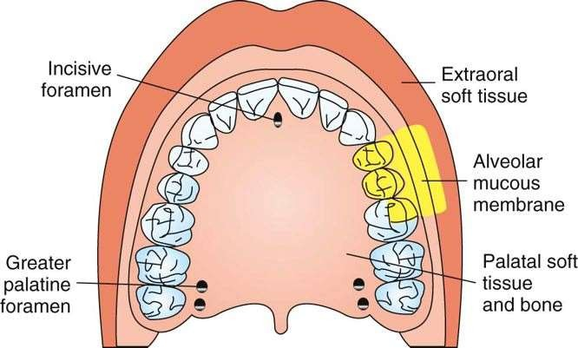
Area anesthetized by MSA nerve block

Slide 39
Technique:
27 gauge short or long needle.
Area of insertion: Height of mucobuccal fold above maxillary 2nd pm.
Target area : maxillary bone above apex of maxillary 2nd pm.
Landmark: mucobuccal fold above max. 2nd pm.
Bevel should be towards bone.

Slide 40
Procedure
Assume the correct position
For a right MSA nerve block, a right-handed administrator should face the patient from the 10 o'clock position.For a left block, 8 or 9 o'clock position.
Prepare the tissues at the site of injection.
Stretch upper lip
Insert needle to ht of mucobuccal fold above max 2nd pm with bevel towards bone.
Aspirate.If -ve , deposit 0.9 to 1.2 ml of solution over 10 to 40 S.
Withdraw syringe Wait for 3 to 5 min.

Slide 41
Posterior superior alveolar nerve block
Common names - Tuberosity or zygomatic block
Nerves Anesthetized-Posterior superior alveolar and its
branches
Areas Anesthetized-Pulp of max 3rd , 2nd and 1st molars
[except mesiobuccal root of 1st molar in 28 %] Buccal
periodontium and bone overlying these teeth.
Indications
o When treatment involves 2 or more maxillary molars
o When supraperiosteal injection is contraindicate (e.g., with infection or acute inflammation)
o When supraperiosteal injection has proved ineffective

Slide 42
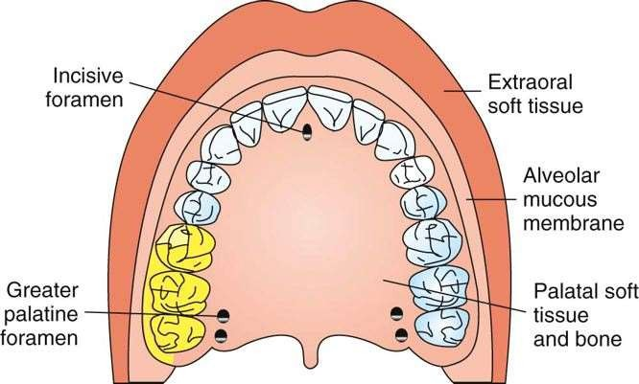
Area anesthetized by a PSA nerve block.

Slide 43
Contraindications-When the risk of hemorrhage is too great (as with a hemophiliac), in which case a supraperiosteal or PDL injection is recommended.
Advantages
Atraumatic -if administered properly no pain is experienced by patient beause of relatively large area of soft tissue into which L.A is applied and bone is not contacted.
High success rate (>95%)
One injection compared with option of 3 infiltrations.
Minimises total volume of LA administration

Slide 44
Disadvantages
Risk of hematoma
Technique is somewhat arbitrary, as there are few bony landmarks during insertion.
Second injection is required for anesthetising the first molar.
Alternatives
Supraperiosteal or PDL for pulpal and root anaesthesias.
Infiltration for buccal periodontium and hard tissues
Max nerve block

Slide 45
Technique
A 27-gauge short needle recommended
Area of insertion: height of the mucobuccal fold above the maxillary second molar
Target area: PSA nerve—posterior, superior, and medial to the posterior border of the maxilla
Landmarks:
a Mucobuccal fold
b Maxillary tuberosity
c Zygomatic process of the maxilla
Orientation of the bevel: toward bone during the injection.

Slide 46
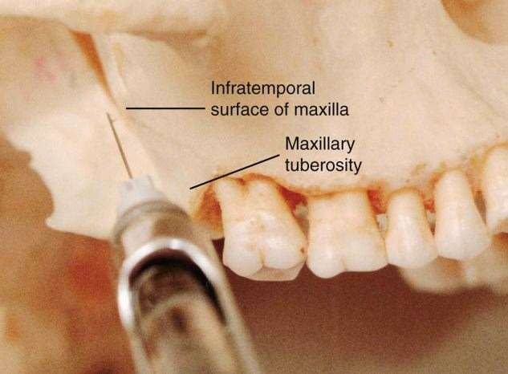
Needle at the target area for a PSA nerve block.

Slide 47
Procedure :
Assume correct position
For a left PSA block, a right-handed administrator should be at the 10 o'clock position and for a right block - 8 o'clock position.
Prepare tissues at the site of penetration.
Orient the bevel of the needle toward bone.
Insert the needle into the height of the mucobuccal fold over the 2nd molar
Advance the needle slowly in an upward, inward, and backward direction in one movement (not three).
  Upward: superiorly at a 45-degree angle to the occlusal plane
  Inward: medially toward the midline at a 45-degree angle to the occlusal plane
  Backward: posteriorly at a 45-degree angle to the long axis of the second molar

Slide 48
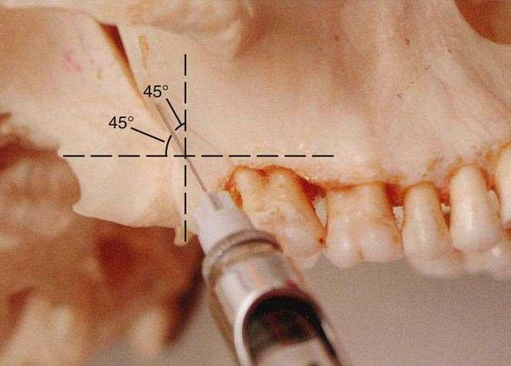

Slide 49
Advance needle into soft tissue to desired depth;16mm in adult of normal size, 10 to 14 mm for smaller adults and children.
Aspirate in 2 planes.
If both aspirations are -ve,Slowly inject 0.9 to 1.8 ml of LA over 30 to 60 s.
Slowly withdraw the syringe and make needle safe .
Wait for 3 to 5 min.

Slide 50
Complications:
Hematoma- If inserted too far posteriorly to pterygoid plexus of veins or perforation of maxillary artery.Use of short needles reduces risk of puncture.
Visible Intraoral haematoma in buccal tissues of mandibular region.
Mandibular anaesthesia –mandibular nerve is located lateral to PSA. Deposition of local anesthetic agent lateral to the desired location can produce varying degrees of mandibular anesthesia.

Slide 51
Greater Palatine Nerve Block
Common name: Anterior palatine nerve block.
Nerve Anesthetised: Greater palatine
Area Anesthetised: The posterior part of the hard palate and its overlying soft tissues, anteriorly as far as the canine/first premolar and medially upto the midline.
Indications:
For pain control during oral surgical or periodontal surgical procedures involving the palatal soft and hard tissues.
When palatal soft tissue anesthesia is restorative therapy on more than two teeth.
Sub gingival insertion of matrix band
required for

Slide 52
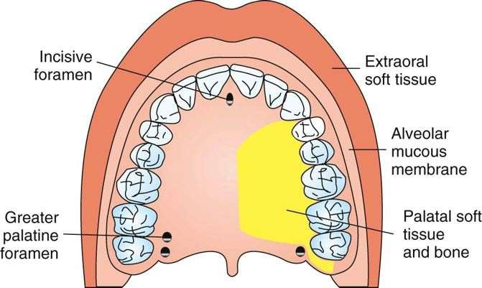
Area anesthetized by greater palatine nerve block

Slide 53
Contraindication:
Inflammation or infection at injection site
Smaller areas of therapy.
Advantages
Minimizes volume of solution,needle penetration and patient discomfort
The technique is simple and easy.
Success rate is very high.
Disadvantages:
No hemostasis in immediate area of injection.
Potentially painful.
Alternatives: Local infiltration,Maxillary nerve block.

Slide 54
Technique:
27 gauge short needle used.
Area of insertion: soft tissue slightly anterior to the greater palatine foramen
Target area: greater palatine nerve as it passes anteriorly between soft tissues and bone
Landmarks: Greater palatine foramen,Maxillary second and third molars,junction of the maxillary alveolar process and palatine bone, Median palatine raphe
Path of insertion: advance from opposite side of mouth at rt angle to target area.
Bevel oriented toward palatal soft tissue.

Slide 55
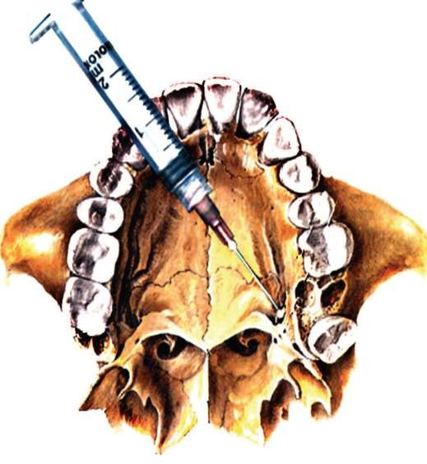
Target area for a greater palatine nerve block.

Slide 56
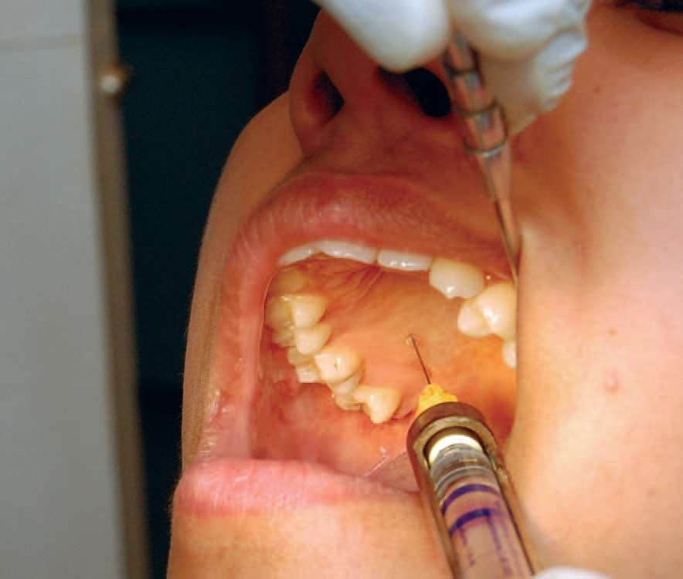

Slide 57
Procedure:
Assume correct position. For a right block, a right-handed administrator should be at 7 or 8 o'clock position and for left-11 o'clock position.
Request patient in supine position to Open mouth wide, Extend the neck and turn head to rt or left.
Locate greater palatine foramen.
Place a cotton swab at junction of max. alveolar process and hard palate.Start at the region of max Ist molar and palpate posteriorly by pressing firmly into tissues.Swab falls into depression of foramen.Usually Foramen located distally to max 2nd molar.
Prepare the tissue at the site.

Slide 58
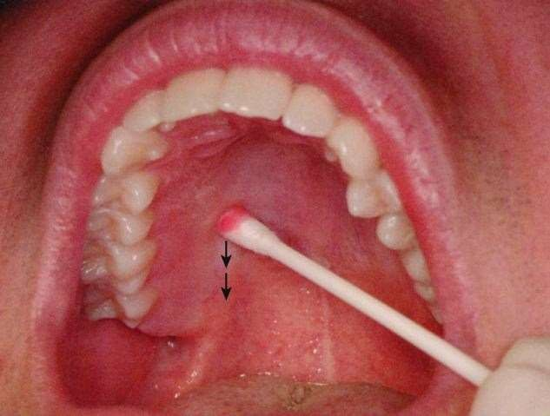

Slide 59
Move swab over foramen.Apply pressure.
Note ischemia at the injection site for 30s.
Direct syringe from opposite with needle at rt angles to the site.Place bevel against the area.
Deposit a small volume of anaesthesia .
Ischaemia spreads into adjust tissues as LA is deposited.
Continue to apply pressure anaesthesia.
Slowly advance needle until palataine bone is gently contacted.Depth of penetration: less than 10 mm.
Aspirate.If -ve , slowly deposit 0.45 to 0.6 ml.
Withdraw syringe.Make needle safe.
Wait for 2 to 3 minute.

Slide 60
Signs and Symptoms:
Subjective: numbness in post portion of palate.
Objective: no pain during dental therapy.
Complications:
Ischemia and necrosis of soft tissues: When highly concentrated vasoconstrictor is used for hemostasis, or if excessive amount of L.A solution is used.
Discomfort: It can cause discomfort to the patient if the soft palate becomes anesthetised.
Hematoma: It is rare, as the palatal mucoperiosteum is firmly adherent to the bone of the hard palate.

Slide 61
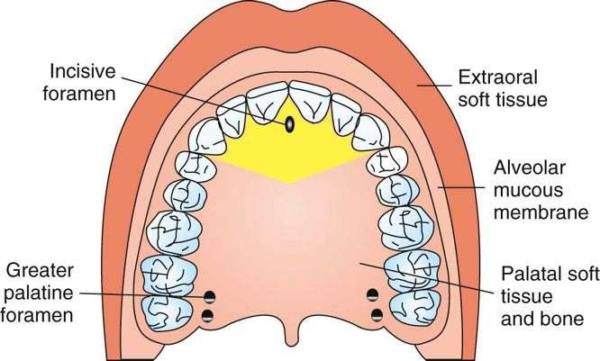
Nasopalatine nerve block
Other names: Incisive nerve block, Sphenopalatine block
Nerves Anesthetized: Nasopalatine nerve
Areas anesthetized Anterior portion of the hard palate (soft and hard tissues) bilaterally from the mesial of the right first premolar to the mesial of the left first premolar

Slide 62
Techniques
27 gauge short needle is recommended
Area of penetration: The palatal mucosa or the halo surrounding the incisive papilla.
Target area: The nasopalatine nerve as it comes out of incisive foramen
Path of insertion: Making an angle of 45º to the incisive papilla.
Bevel: It is facing the palatal soft tisses
Landmarks: Central incisor and incisive papilla

Slide 63
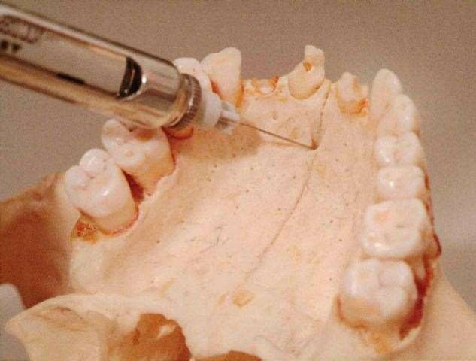
Target area for a nasopalatine nerve block

Slide 64
Procedure:
The nasopalatine nerve block is an extremely painful injection and hence a preparatory injection is necessary.
Preparatory Injections
Labial approach-The preparatory injection is made by inserting the needle into the labial intraseptal tissues in between the maxillary central incisors.0.25 ml of L.A solution is deposited.
Palatal approach : The tip of the needle should be placed in the halo or the depression surrounding incisive papilla and few drops of L.A solution is injected until papilla blanches.

Slide 65
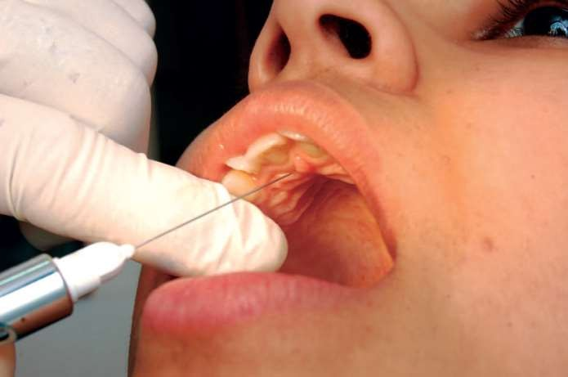
After the preparatory injections the needle is reinserted slowly into the crest of the papilla and is advanced into the incisive foramen until bone is gently contacted and about 0.25 - 0.5 ml of L.A solution is injected.

Slide 66
Complications:
Hematoma possible but rare.
Necrosis of soft tissues when highly concentrated vasoconstricting solution (e.g.,norepinephrine) is used for hemostasis over a prolonged period.
Because of the density of soft tissues, anesthetic solution may “squirt” back out the needle puncture site during administration or after needle withdrawal.

Slide 67
Maxillary Nerve Block
Intraoral and Extraoral Maxillary Nerve Block.
These blocks are used for achieving anesthesia of half of the maxilla.
Intraoral Nerve Block
There are two approaches:High tuberosity , and Greater palatine canal approach.
Both the approaches are technically difficult.

Slide 68
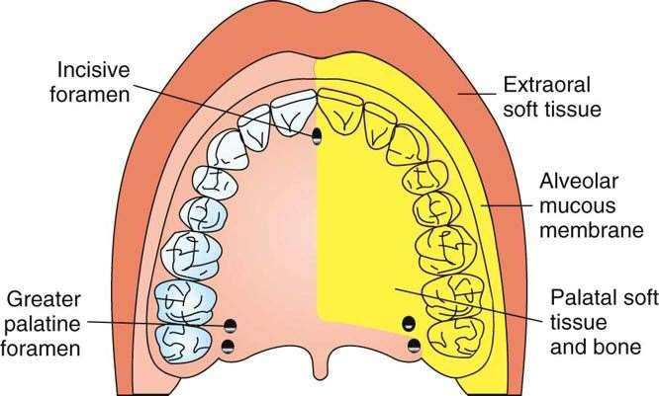
Areas anesthetized by a maxillary nerve block.

Slide 69
Areas Anesthetized
Pulpal anesthesia of the maxillary teeth on the side of the block
Buccal periodontium and bone overlying these teeth
Soft tissues and bone of the hard palate and part of the soft palate, medial to midline
Skin of the lower eyelid, side of the nose, cheek, and upper lip

Slide 70
Indications
Pain control before extensive oral surgical, periodontal, or restorative procedures requiring anesthesia of the entire maxillary division
When tissue inflammation or infection precludes the use of other regional nerve blocks (e.g., PSA,ASA, AMSA, P-ASA) or supraperiosteal injection
Diagnostic or therapeutic procedures for neuralgias of the second division of the trigeminal nerve.

Slide 71
Contraindications
Inexperienced administrator
Pediatric patients
are more difficult because of smaller
anatomical
dimensions, less cooperative. Usually
unnecessary
in
children because of the high
success rate of other techniques
Uncooperative patients
Inflammation or infection of tissues overlying the injection site
When hemorrhage is risky (e.g., in a hemophiliac)
In the greater palatine canal approach: inability to gain access to the canal; bony obstructions may be present in 5% to 15% of canals

Slide 72
Technique (High-Tuberosity Approach)
A 25-gauge long needle is recommended.
Area of insertion: height of the mucobuccal fold above the distal aspect of the maxillary 2nd molar
Target area:
Maxillary nerve as it passes through the pterygopalatine fossa
Landmarks:
Mucobuccal fold at the distal aspect of the maxillary 2nd molar,Maxillary tuberosity, Zygomatic process of the maxilla
Orientation of the bevel: toward bone

Slide 73
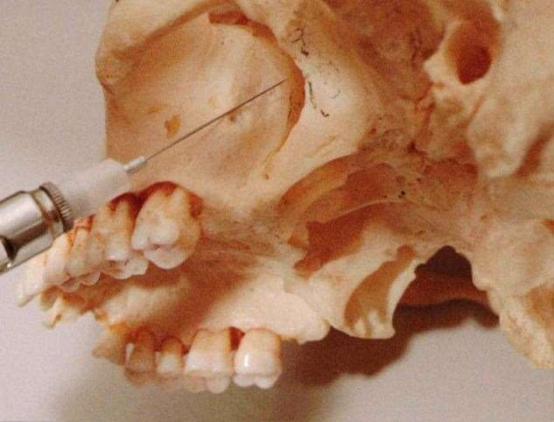

Slide 74
Procedure:
Assume the correct position.
left high-tuberosity injection, a right-handed administrator should be at the 10 o'clock position and for right 8 o'clock position.
Prepare the tissue
Partially open the patient's mouth; pull the mandible toward the side of injection.Retract the cheek.
Place the needle into the height of the mucobuccal fold over the maxillary second molar.

Slide 75
Advance the needle slowly in an upward, inward, and backward direction as described for the PSA nerve block
Advance the needle to a depth of 30 mm.At this depth the needle tip should lie in the pterygopalatine fossa in proximity to the maxillary division of the trigeminal nerve.
Aspirate in two planes.If negative,Slowly deposit 1.8 mL.
Aspirate several times during injection.
Withdraw the syringe.Make the needle safe.

Slide 76
Technique (Greater Palatine Canal Approach)
A 25-gauge long needle is recommended.
Area of insertion: palatal soft tissue directly over the greater palatine foramen
Target area: the maxillary nerve as it passes through the pterygopalatine fossa
Landmark: greater palatine foramen, junction of the maxillary alveolar process and the palatine bone
Orientation of the bevel: toward palatal soft tissues

Slide 77
Procedure:
Assume the correct position.For a right block- 7 or 8 o'clock position.For left 10 or 11 o'clock position.
Locate the greater palatine foramen. Penetrate the needle into the mucosa, Advance the needle slowly into the greater palatine canal to a depth of 30-35 mm.
Aspirate and deposit about 1 ml of local anesthetic solution slowly.
Withdraw the needle slowly, and keep it safe.
Wait for 3-5 minutes.

Slide 78
Complications
Hematoma
Penetration of the orbit may occur during a greater palatine foramen approach if the needle goes in too far
Complications produced by injection of L.A into the
orbit- periorbital swelling and proptosis,Regional block of the sixth cranial nerve, producing diplopia,Classic retrobulbar block, producing mydriasis, corneal anesthesia, and ophthalmoplegia, Possible optic nerve block with transient loss of vision,Retrobulbar hemorrhage
Penetration of the nasal cavity

Slide 79
Extraoral Nerve Blocks
Indications
When the opening of the mouth is
very painful or
impossible in conditions like
Wounds sustained due to accidents.
Swellings of head and neck, etc.
Presence of trismus due to various reasons.

Slide 80
Extraoral Maxillary Nerve Block
Nerves Anesthetised
Maxillary nerve and all of its branches peripheral to the site of injection.
Anatomical Landmarks
  Midpoint of zygomatic arch
  Zygomatic notch
  Coronoid process of the ramus of the mandible
  Lateral pterygoid plate.

Slide 81
Technique
Palpation of
zygomatic
the landmarks: The midpoint of the
arch is located and the depression in its
inferior surface is marked with a 25-gauge needle, a skin wheal is raised just below this mark.
Mark the needle: Using a 4”, 22-gauge needle the operator measures 4.5 cm and marks with a rubber marker.

Slide 82
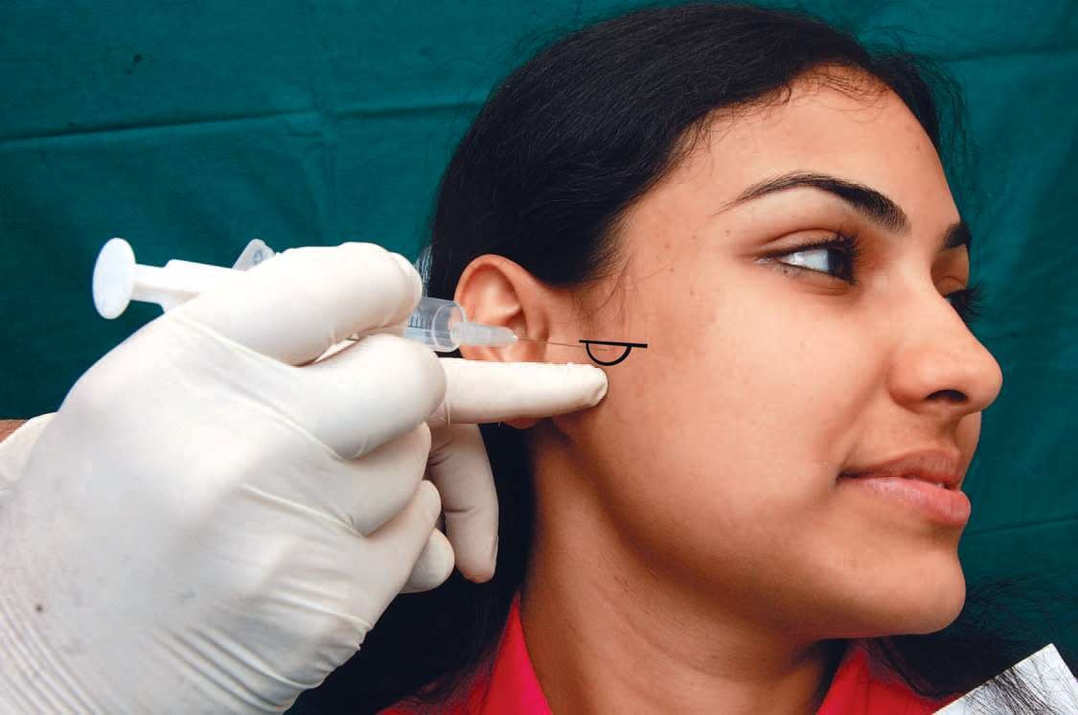

Slide 83
Insertion of the needle: The needle is inserted through the skin wheal,perpendicular to the skin surface and to the median sagittal plane. Inject a few drops of L.A solution as the needle penetrates deeper into the tissues, until the needle point gently contacts the lateral pterygoid plate. The needle should never be inserted beyond the depth of the marker.
The needle is withdrawn, with only the point left in the tissues, and redirected in a slight forward and upward direction until the needle is inserted to the depth of the marker.
Aspirate and inject 1 – 2 ml LA

Slide 84
Extra oral infra orbital nerve block
Anatomical Landmarks
Infraorbital margin, Infraorbital depression, Infraorbital foramen,Pupil of the ipsilateral eye.
Technique
Preparation of skin: The skin is prepared with an antiseptic.
Locate of the infraorbital foramen:
Anesthesia of the skin and the subcutaneous tissue: It is achieved by deposition of a few drops of local anesthetic agent below the skin.
Needle: Long or short 25-gauge needle is used.

Slide 85
Procedure
It is introduced through the marked anesthetised area into infraorbital canal. The needle is inserted at an angle of about 45° through the skin medially and inferiorly to the foramen to compensate for the thickness of overlying tissues.
With a slight probing action with the tip of the needle, the opening of the foramen is located.
Once found, needle is slowly advanced into the canal.
The foramen and the canal, normally open downwards, forwards and medially.
Carefully aspirate, and slowly deposit 1 ml of local anesthetic solution.
Wait for about 10 minutes.

Slide 86

Extraoral infraorbital nerve block technique

Slide 87
References:
Handbook of Local Anesthesia- Stanley F. Malamed
Monheim’s Local Anesthesia and pain control practice
Manual of local anesthesia in dentistry by A P Chitre
in dental

