Slide 1

IMPRESSION COMPOUND
Dr. Sameer Chauhan
Senior Lecturer,
Department of Prosthodontics and Crown & Bridge
K. M. Shah Dental College and Hospital
Notes:
‹#›

Slide 2
CONTENTS OF TOPIC
Introduction
Ideal requirements of impression compound
Composition
Mode of supply
Classification

Slide 3
CONTENTS OF TOPIC
Setting reaction
Properties
Manipulation
Copper tube technique
Advantages

Slide 4
CONTENTS OF TOPIC
Disadvantages
Disinfection
Conclusion
References

Slide 5
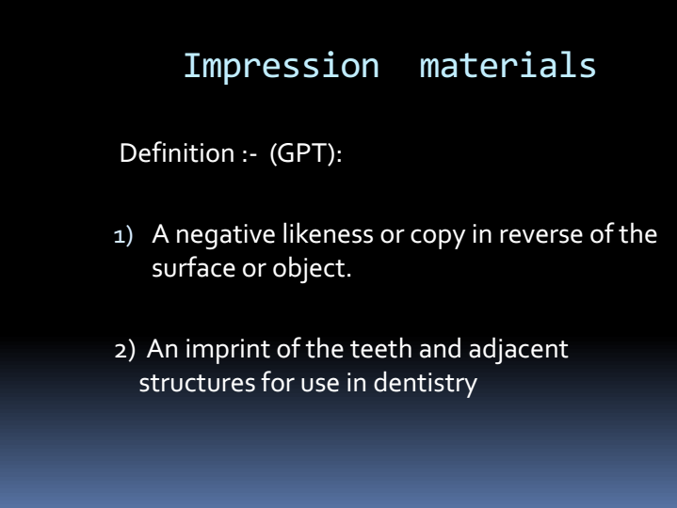

Slide 6
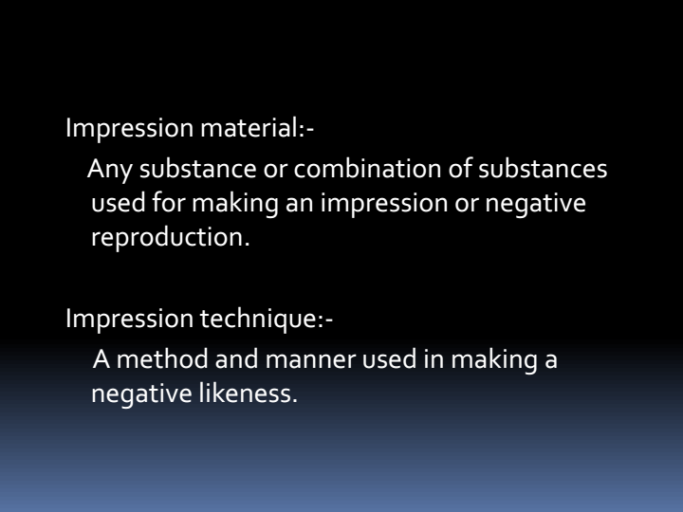

Slide 7
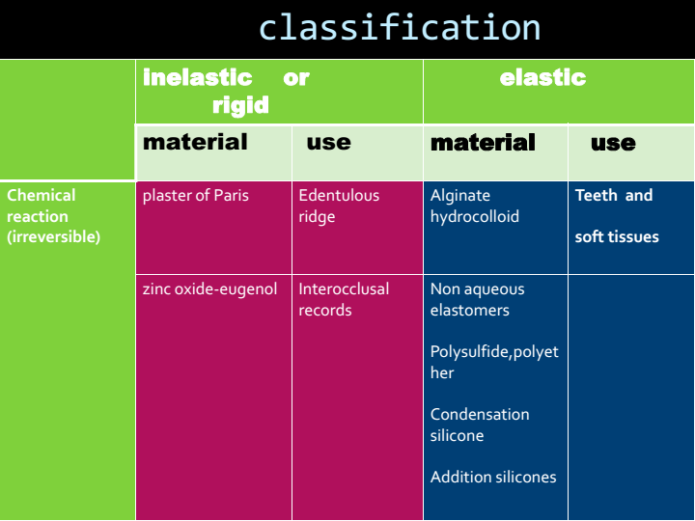

Slide 8
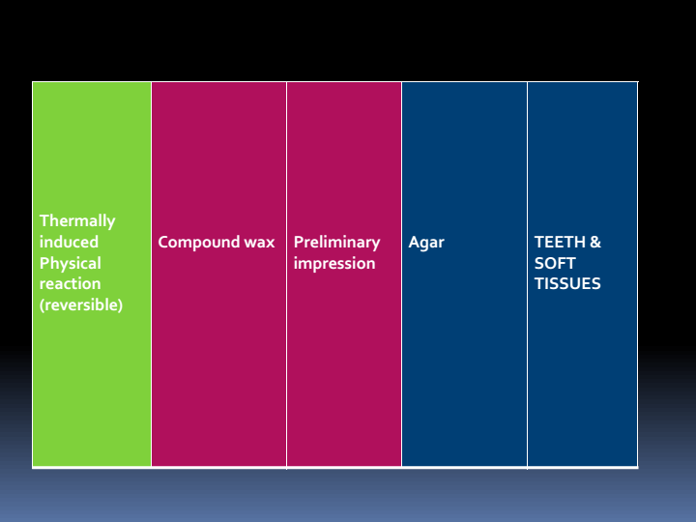

Slide 9
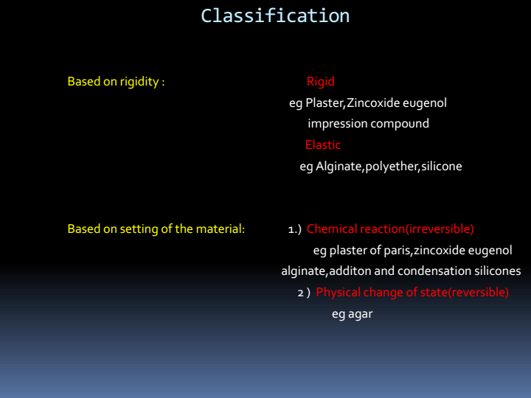

Slide 10
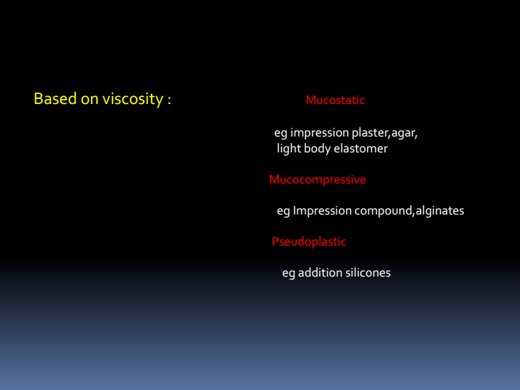

Slide 11
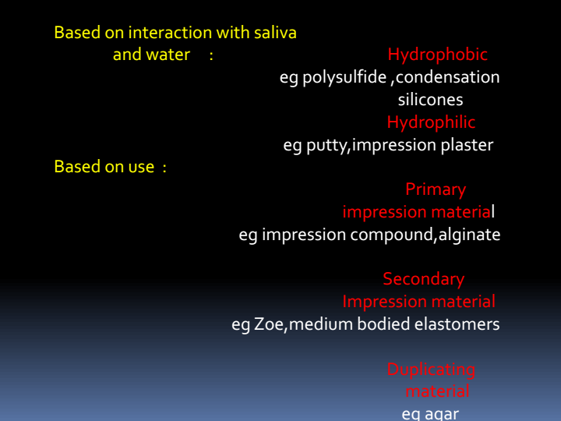

Slide 12
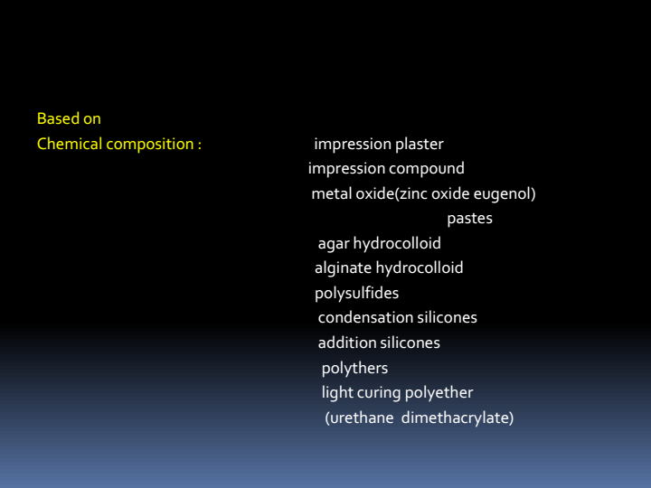

Slide 13
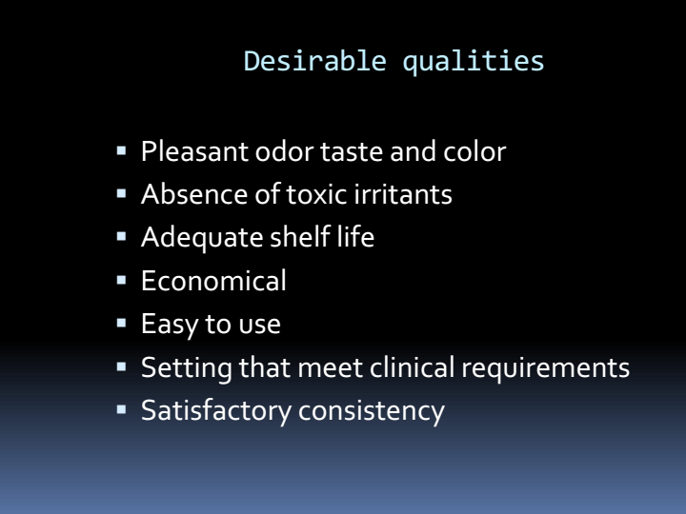

Slide 14
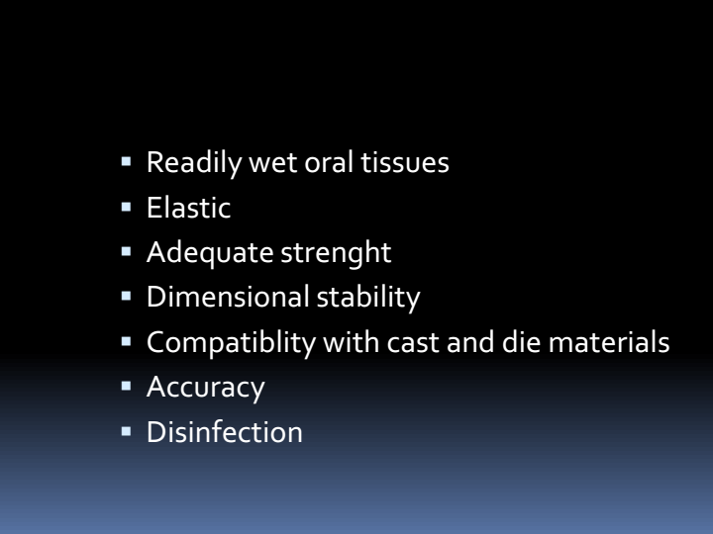

Slide 15
INTRODUCTION
Impression compound – it is a thermoplastic,
reversible type of impression material also
known as modeling compound used mainly for
making primary impression of edentulous ridges,
border moldings of special tray and as a special
tray for maxiollofacial prosthesis.

Slide 16
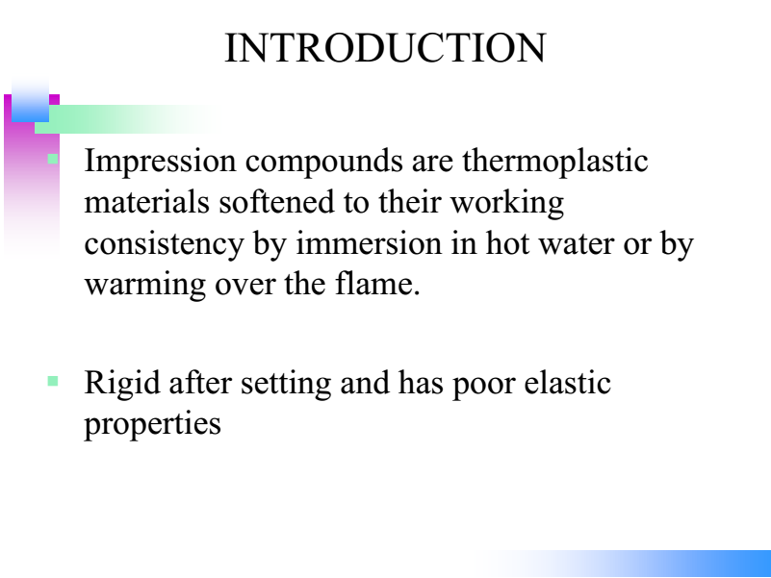

Slide 17
IDEAL REQUIREMENTS OF IMPRESSION COMPOUND according to Ansi-ADA specification
Manufacturer should supply details about manipulation temperature.
Should have a minimal thermal contraction of 0.3 %.
Should be homogeneous on mixing.

Slide 18
IDEAL REQUIREMENTS OF IMPRESSION COMPOUND according to Ansi-ADA specification
4. Should have smooth glossy surface on flaming.
5. Should have a firm surface after trimming during final refinement of the impression.

Slide 19
COMPOSITION
CONTENT | % | FUNCTION
Rosin Steric acid, shellac or gutta percha Talc & chalk | 20 3 50 | Forms matrix, Flow thermo plasticity Plasticizers Reduce brittleness Filler viscosity strength

Slide 20
COMPOSITION
CONTENT | % | FUNCTION
Copal resin Carnauba wax Bee wax Coloring agent (ferric oxide) | 20 Trace amount | Thermo plasticity flow, cohesion First substance used To differentiate borders from tissues, reddish brown color

Slide 21
MODE OF SUPPLY
Cakes
Cones
Sheets
sticks
TRADE NAMES Kerr’s compound, Compo, Peribar, Replica, Stents

Slide 22
CLASSIFICATION OF IMPRESSION COMPOUND
According to ADA specification no 3
Type 1-
a) Low fusing compound - green stick compound
b) Medium fusing compound –impression compound
Type 2-
High fusing compound -tray compound

Slide 23
SETTING ACTION
Sets by physical change i.e soften by heating and hardens by cooling

Slide 24
PROPERTIES
BIOLOGICAL PROPERTY
Non toxic non irritant to oral tissues.
RHEOLOGICAL PROPERTY
Highly viscous and mucocompressive material

Slide 25
PROPERTIES
Flow –it goes under plastic deformation under the influence of its own weight
Measured by formula
flow = x/6 X 100%
A cylindrical sample of 10mm diameter is
used with 6mm of ht and load of 2kg for 10
min
Dec in height x is measured
in mm

Slide 26
Types | Flow as per ADA specification At 37°c | At 45°c
Type1 Type2 | <6% <2% | >85% >70-85%

Slide 27
Factors affecting flow
Temperature - temp flow
Wet kneading- cause water trapping,
act as plasticizer, flow
temp flow

Slide 28
THERMAL PROPERTY
Fusion temp-43.5 °c
Thermal conductivity- poor conductor of heat, outer part soften 1st then the inner part
2. Co-efficient of thermal expansion-high
thermal expansion and contraction
200-500PPM/°C

Slide 29
DIMENSION STABILITY
Dimensionally unstable mechanical stresses incorporate during impression procedure
So cast should be poured as soon as possible

Slide 30
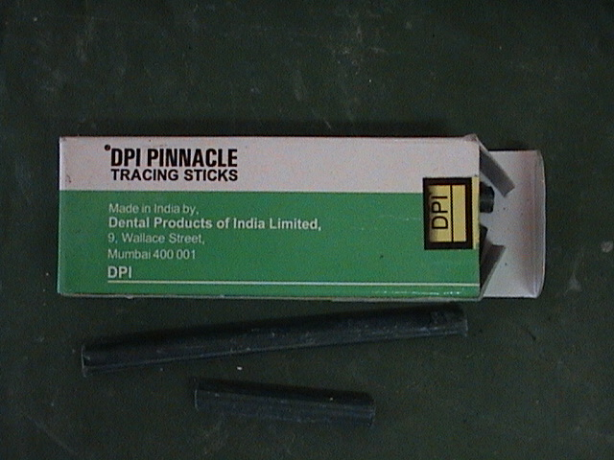
Type 1 low fusing –green stick compound
Supplied in cylindrical form about 10cm in length and 6mm in diameter
Fusion temperature - 43°c-45°c
Used for -
Border molding of special tray
Copper tube impression technique

Slide 31
Border molding technique
Used for recording depth of sulcus
2 methods – single step border molding
- sectional

Slide 32
PROCEDURE
Green stick is heated uniformly over flame
Applied over special tray borders
Tempered in water bath and put inside
patient mouth
4. Different movements of jaw is done
5. Removed after it hardens

Slide 33
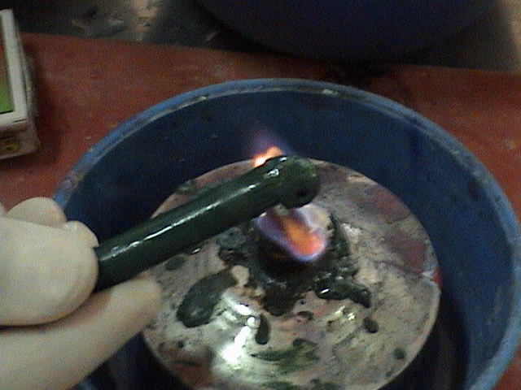
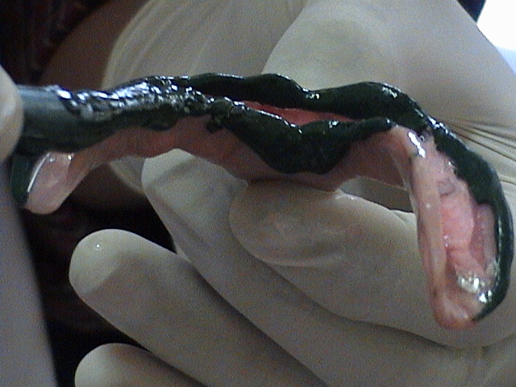
Heating of green stick
over flame
Adapting green
stick over special tray

Slide 34
Copper tube technique
Done for single tooth preparation
Gives strength to copper tube to obtain final impression
Procedure
– a thin cylindrical copper tube is prepared and fitted over the prepared tooth
-Impression compound is then poured over it, it is allowed to cool until it hardens

Slide 35
Copper tube technique
-Then it is removed and impression of prepared cavity is obtained
-Then finally elastomeric impression material is poured for final impression
Purpose is to save final impression from getting squeezed in fingers.

Slide 36
Copper tube technique
Green stick
compound
Copper tube
Light body
elastomer
Tooth preparation

Slide 37
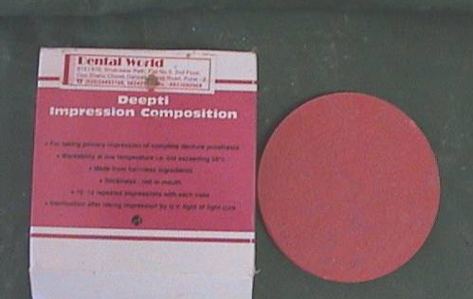
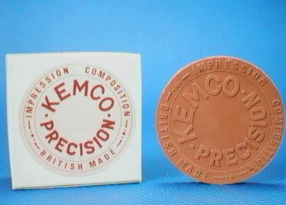
Type 1- Medium fusing
-Supplied in cake form
-used for primary impression of
edentulous ridge
Wet kneading- water bath
Dry kneading – direct flame

Slide 38
REQUIREMENTS
Rubber bowl
Gauge piece
Non perforated stock metal tray
Water bath
Impression compound cake
Flame
Thermometer

Slide 39
Steps to follow
A rubber bowl with gauge piece is used
Water from water bath at 60°-65°c is poured in to the bowl
Impression compound is broken into small pieces & is then put into the water to allow it to soften

Slide 40
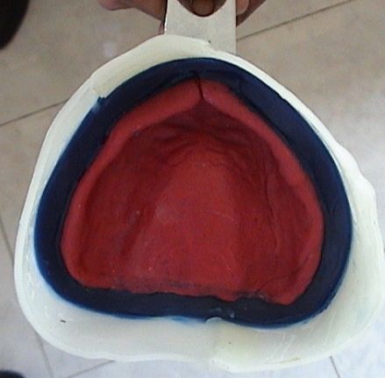
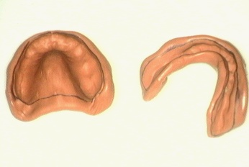
Steps to follow
4. Kneading of compound is
done with fingers
5.The compound is loaded
on to the tray and
firm pressure is used
to seat the tray in the
mouth
6. Different jaw movements are done
to record tissue details

Slide 41
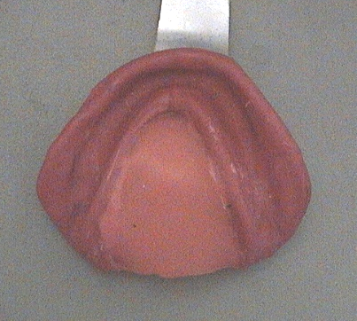
Steps to follow
7.The impression is retained
in mouth until it cools down to37°c
8. It is removed from the
mouth after it becomes hard uniformly
9. It is then washed, dried, trimmed and
cast is poured

Slide 42
Type 2-High fusing
Tray Compound
Used mainly as a special tray to hold secondary impression
Fusion temperature more than 65- 70°c
Not used now regularly, replaced by cold cure acrylic resin

Slide 43
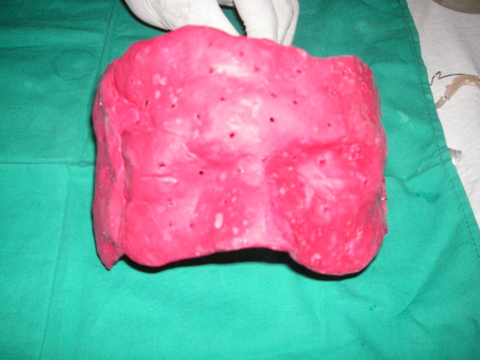
Other uses
Used as a special
tray for maxillofacial
prosthesis
As a material for tray extension
As occlusal rims for extra oral tracing
To stabilize shellac record bases

Slide 44
ADVANTAGES
It is non irritating to patient if used at proper temperature
Can be modified and re softened again until accurate impression is obtained
It is reusable for lab procedures
Has a long shelf life of 5 years
Cost effective

Slide 45
DISADVANTAGES
It is inaccurate because of high viscosity .
Soft tissues are compressed due to pressure
applied while impression making.
3.Distortion due to poor dimension stability.

Slide 46
DISADVANTAGES
4. Difficult to remove from undercut
5. Can be uncomfortable for patient if used at high temperature
6. If it is left in hot water for long, some of the constituents may be leached out into the water bath, altering the properties of the material (it is often the plasticizer stearic acid that is leached out).

Slide 47
DISINFECTION
Recommended disinfectants-
Iodophors or chlorine compound
Phenolic sprays can also be used

Slide 48
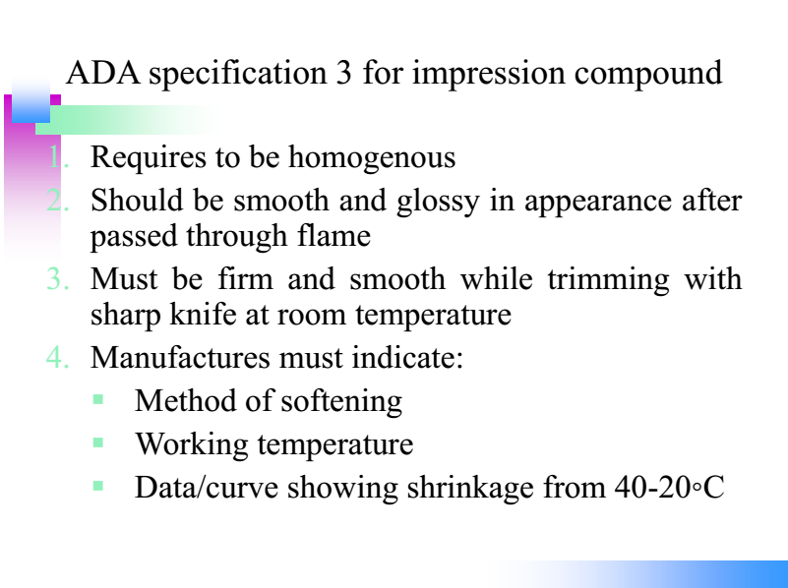

Slide 49
CONCLUSION
As more and more advances are taking place in field of impression materials older materials like impression compound are loosing its place due to there incompetence with recent materials in terms of elasticity and surface details
Still impression compound is 1st choice of material as a primary impression for beginner and mass practices

Slide 50
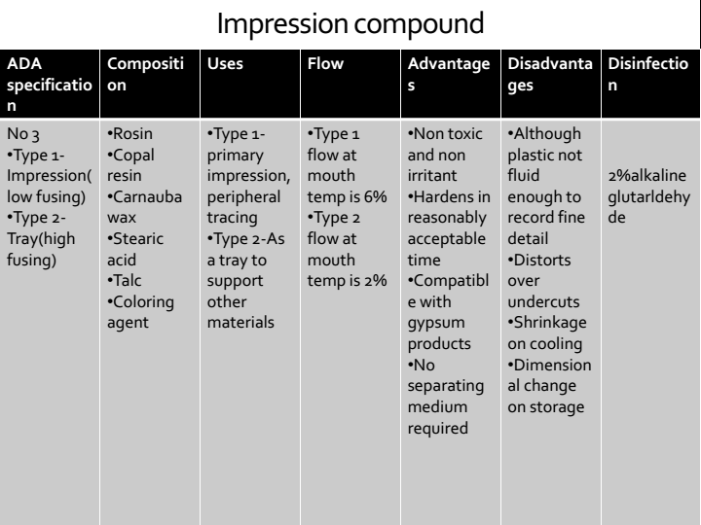

Slide 51
REFERENCES
Craig R G. Restorative Dental Materials. 10th ed. pp.281-332. London: Mosby, 1997.
Lin C, Zeiber G J. Accuracy of impression materials for complete dentures. J Prosthet Dent 1988; 59: 288-291.
Brown D. An update on impression materials. Br Dent J 1981; 150: 35-40.

Slide 52
REFERENCES
E .C COMBE Notes on dental material
6th edition pg 115-117
an

Slide 53
Thank you

