Slide 1
INTERNATIONAL HONETIC ALPHABET (IPA)
BY
SARITA RAUTARA

Slide 2
Phoneme | VOICING | PLACE OF ARTICULATION | MANNER OF ARTICULATION | Examples:
p | Voiceless | Bilabial | Plosive/stop | I-pet; M-topmost; F-chip
f | Voiceless | Labiodental | Fricative | I-first; M-selfish; F-roof
pʰ | Voiceless | Bilabial | Plosive/stop
b | Voiced | Bilabial | Plosive/stop | I-book ;M-lobby; F-cab
bʰ | Voiced | Bilabial | Plosive/stop | I-bʱalu
m | Voiced | Bilabial | Plosive/stop- Nasal
t̪ | Voiceless | Dental | Plosive/stop
t̪ʰ | Voiceless | Dental | Plosive/stop fricative
d̪ | Voiced | Dental | Plosive/stop fricative
d̪ʰ | Voiced | Dental | Plosive/stop
n | Voiced | Alveolar | Nasal stop
ʈ | Voiceless | Palato-alveolar | Plosive
ʈʰ | Voiceless | Palato-alveolar | Plosive
ɖ | Voiced | Palato-alveolar | Plosive
ɖʰ | Voiced | Palato-alveolar | Plosive
ɳ | Voiced | Palatal | Nasal plosive

Slide 3
Phoneme | VOICING | PLACE OF ARTICULATION | MANNER OF ARTICULATION | Examples:
tʃ/t͡ʃ | Voiceless | Palatal | Affricative | I-; M-; F-
tʃʰ/t͡ʃʰ | Voiceless | Palatal | Affricative | I-; M-; F-
dʒ/ d͡ʒ | Voiced | Palatal | Affricative
dʒʰ/ d͡ʒʱ | Voiced | Palatal | Affricative | I-;M-; F-
k | Voiceless | Velar | Plosive
kʰ | Voiceless | Velar | Plosive
g | Voiced | Velar | Plosive
gʰ | Voiced | Velar | Plosive
ŋ | Voiced | Velar | Plosive
s | Voiceless | Palato-alveolar | Fricative
ʃ | Voiceless | Palato-alveolar | Fricative
h | Voiced | Glottal | Fricative
l | Voiced | Alveolar | Lateral
r | Voiced | Post-alveolar | Retroflex, approximant, trill
j | Voiced | Palatal | Approximant/glide

Slide 4
Phoneme | VOICING | PLACE OF ARTICULATION | MANNER OF ARTICULATION | Examples:
ʋ | Voiceless | Labiodental | Plosive/stop
z | Voiced | Palato-alveolar | Fricative
d͡z | Voiceless | Palato-alveolar | Fricative
d͡zʱ | Voiced | Palato-alveolar | Fricative

Slide 5
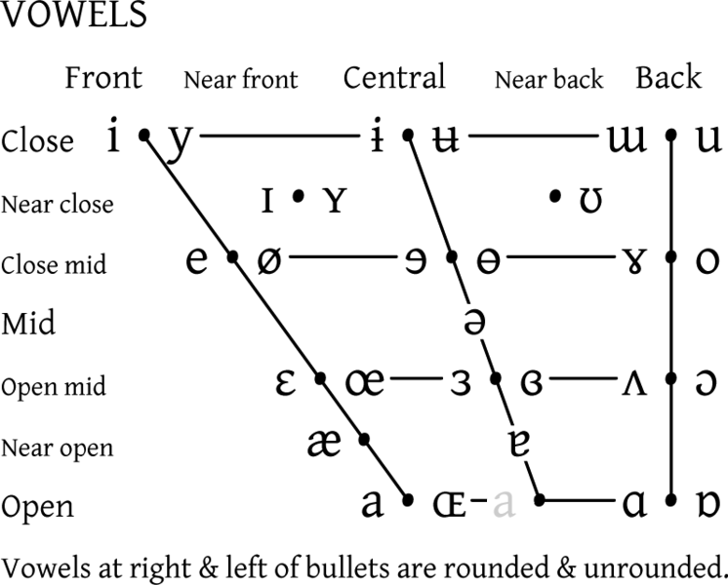

Slide 6
Vowel height- open/ close- Close; Near-close; Close- mid; Mid; Open-mid; Near-open & Open
Position- front /central or middle/ back

Slide 7
 | VOICING | IPA | PLACE OF ARTICULATION
अ | a | ə | Mid
आ | aa | a: | Low front open
इ | I | ɪ | Front near close
ई | ee | i: | High front close
उ | u | ʊ | High back close
ऊ | oo | u: | Back near close
ए | e | e: | Front close mid
ऐ | ai | ɛ:/æ | Front open mid/near open
ओ | o | o: | Back close mid
औ | au | ɔ: | High front mid back close
अँ | an | ə̃ | Centralized nasal

