Slide 1
Motor Treatment Approaches
Submitted to – sarita mam
Presented by – geeta alimchandani

Slide 2
Traditional treatment approach
In 1939 Van Riper first formulated it , often called as stimulus approach.
It emphasizes auditory training or speech perception training that precedes and accompanies sound production.
After the sound is elicited in isolation , it is produced at various levels , including nonsense syllables , words , phrases , sentences and spontaneous speech.

Slide 3
Rationale
Auditory perception training is emphasized and sound production begins in isolation rather than in more complex articulation movements involved in syllable , word and sentence production.

Slide 4
Goals and Procedures
To become aware of characteristics of standard phoneme
To recognise characteristics of misarticulation and how they differ from the target sound
To produce the standard sound at will and to stabilize or strengthen the use of the target sound in isoslation,syllables,words,phrases and sentences
To use the standard sound in spontaneous speech of all kinds and under all conditions , that is to achieve carry over.

Slide 5
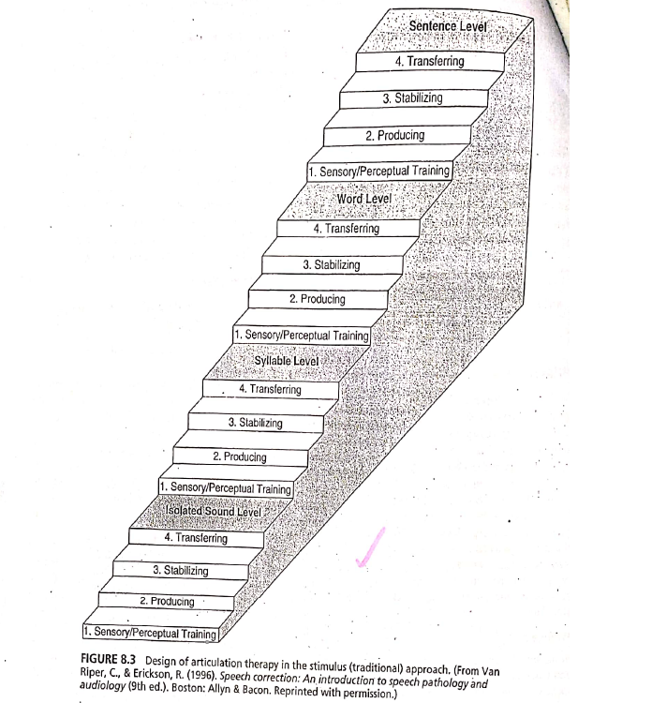

Slide 6
The first two goals of the treatment involve auditory training (speech perception training ).
The third goal of treatment involves elicitation of the target sound through the process of varying and correcting clients attempted productions.

Slide 7
Five alternate methods for evoking the sound were specified by van riper –
  Progressive approximatrion or shaping
  Auditory stimulation
  Phonetic placement
  Modification of other sounds
  Key word in which production begins

Slide 8
The fourth treatment goal is stabilising the target sound. The new sound must be strengthened before it will be produced correctly in conversation.
The final step includes transfer and carryover. At this point client develops a feedback system , first consciously and later subconsciously, that will scan utterances and automatically identify and correct any errors that occur.

Slide 10
Motor Kinesthetic approach
In this approach slp directly manipulates externally parts of the clients speech mechanism(external mouth , jaw , nose and neck regions) especially the articulators.
A subsequent derivation of approach is PROMPT

Slide 12
Rationale
Articulation learning requires cordination of muscular activities used in speech , control of the air current and facial expression. Individuals who have misarticulation need to learn the feel of articulation movements.
Through clinicians manipulations and productions of the sounds, the client associates the articulation movements with the auditory input and learns to articulate sounds.

Slide 13
Goals and procedure
To prevent incorrect articulation learning and to aid in the correction of misarticulations.
The motor kinesthetic approach can be used only with individual not with groups. It is appropriate for children and adults.
Young and Hawk recommended this approach for categories of sound substitutions, delayed speech , speechlessness, cleft palate, hard of hearing , deaf , blind , cerebral palsy and aphasia and for the development of infant speech.

Slide 14
PROMPT
It is based on neurological , anatomical , cognitive – linguistic and motor theories.
Producing speech sounds involves the speech mechanism reaching a phonetic target within a three dimensional space cordinate system
It is hypothesized that the neuromotor control of the speech system occurs through a combination or closed loop and open loop systems.
The PROMPT system provides tactile stimulation using touch , pressure , kinesthetic and proprioreceptives cues for the phonetic targets as well as for the feed forward or sequential movement needed to go from one target to the next.

Slide 15
Goals and procedures
The goal for the client is to approximate phonemes,independently produce word /phrases and produce conversational speech, depending upon the clients capabilities.

Slide 17
Stages of motor speech hierachy-
  Level 1 focuses on attaining the postural support for speech
  Level 2 stresses control of phonation including voicing so that the duration of speech for/a/,/h/,and /m/ is 2 to 3 seconds.
  Level 3 involves movement on a single plane with voicing focused on jaw movement that is limited to vertical movement with the anterior-posterior movement controlled by the clinician.
  level IV, additional planes of movement are added with an emphasis on control of lip retraction and rounding and symmetry and coordination of lip movements. There is integration of voicing, jaw, facial contrac tion, and lip rounding.
  Level V involves control of tongue height and location and integration of... tongue movement with jaw and lip movements.
  Level VI includes sequenced movement on multiple planes, encompassing voicing, jaw and facial contraction, tongue control, and timing.
  Level VII focuses on suprasegmentals, including intona tion, stress, juncture, and speech rate in sequenced motor movements.

Slide 18
There are three phases of treatment with motor speech and interaction and language goals specified for each phase:
  Phase I-Single plane of movement (vertical or horizontal)
  Phase II-Two planes of movement (vertical and horizontal across two syllables)
  Phase III-Three planes of movement (vertical, horizontal, and anterior-posterior)
In Phase I of treatment, levels I, II, and III of the motor-speech hierarchy are addressed; Phase II,.level IV; and, Phase III, levels V, VI, and VII

Slide 19
Prompts provide information about several speech parameters including place of contact, ex tent of mandibular excursion, resonance and phonation, number of muscles in the contracted state, duration of segments relative to one an other, manner of production, and coarticulation. There is a standard prompt specified for each En glish vowel, diphthong, and consonant.
Nasal resonance and voicing features are cued by touching the nose and the laryngeal area, respectively

Slide 21
Co-articulation is addressed using the PROMPT system by working at the phrase level with the clinician dynamically using surface prompts to move from one sound to the next.
There are three levels of prompts:. Parameter
    Complex
Surface

Slide 22
Parameter prompts provide the base support and are the large organizing gestures (such as voicing, rounding, retracting). Complex prompts are multidimensional and specify as many components as possible. Surface prompts are noncomplex cues that signal place, timing, and transition (such as omission of voicing and jaw excursion cues)

Slide 23
Paired stimuli approach
The paired-stimuli approach was initially devised by Weston and Irwin (1971) who later devised ar ticulation treatment kits (Irwin & Weston, 1971-1975) based on the paired-stiniuli method.

Slide 24
Rationale
The basis of the paired stimuli approach is operant conditioning principles (Weston & Irwin, 1971). Weston and Irwin noted that while operant condi tioning focuses on symptoms, it has been shown to be effective in modifying behavior in the realm of communication as well as in other areas.

Slide 25
Goals and procedure
The goal is correct production of the target sounds in conversational speech. One sound is targeted at a time. There are three stages in the paired-stimuliapproach:• Word levelSentence levelConversation level

Slide 29
The paired stimuli approach was designed for children, but could be used with adults if modified to use written words rather than pictures. It is most appropriately used with individual clients and not with groups. It is most appropriate for clients who have only a few misarticulations because only one sound is targeted at a time. The advantages of the approach are that clients begin treatment with a task that they are able to do, they progress at their own pace, they receive considerable practice on their target sound in successively more complex tasks, and they achieve success.

