Slide 1
Aerodynamic and Myoelastic Theory
PRESENTED BY- UDIT PANDEY
ARJUN VISHWAKARMA
MANASVI THUMMAR

Slide 2
INTRODUCTION
Myo = muscle, elastic = elasticity, aerodynamic = air pressures and flows (Bernoulli principle
Myo- Means Muscle; The Vocal Folds, After All, Are Mostly Comprised Of Muscle Tissue
The -Elastic Suffix Serves To Remind Us That The Vocal Fold Is Elastic And That We Have Active Control Over Its Elastic Properties.

Slide 3
Aerodynamic Means That The Theory Deals With The Motion Of Air And Other Gaseous Fluids, And With The Forces Active On Bodies In Motion (Such As The Vocal Folds) In Relation To Such Fluids.

Slide 4
Vocal Fold
The Vocal Folds Are Shelf-like Elastic Protuberance Of Tendon Of Tendon, Muscle And Mucous Membrane That Lie Behind The “Adams’s Apple” And Run In An Anterior-posterior Direction.
Their Tension And Elasticity Can Be Varied; They Can Be Made Thicker Or Thinner, Shorter Or Longer; They Can Be Opened Wide, Closed Together, Or Put Into Intermediate Positions And They Can Be Elevated And Depressed In Their Vertical Relationship To The Cavities Above. All These Adjustments Occur At Very Rapid Rates While Speaking

Slide 5
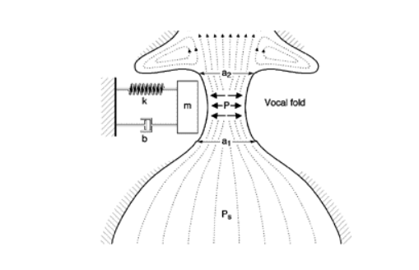

Slide 6
Myoelastic Aerodynamic Theory
The Currently Accepted Theory Of Phonation, However, Is Essentially That Proposed By Both Helmholtez And Muller In The 19th Century And Amplified By Van Den Berg In A Series F Papers In The 1950s, The Myoelastic Theory Of Phonation.
The Key Word Is Aerodynamic. The Vocal Folds Are Activated By The Airstream From The Lungs Rather Than By Nerve Impulses. “Myoelastic” Refers To The Ways In Which The Muscles (Myo-) Change Their Elasticity And Tension To Effect Change In Frequency Of Vibration.

Slide 7
Process
Two Stage Process
Stage One – Myoelastic Phase Elasticity Of Vocal Fold Helps Them To Close
Stage Two –Aerodynamic Phase
Sub-glottal Pressure Forces Vocal Folds Apart
Bernoulli Effect Helps Vocal Fold Close

Slide 8
Bernoulli Effect
The Bernoulli Effect Is A Statement Of Relationship Between Flow Speed And Pressure In A Fluid System In Essence, When The Speed Of Horizontal Flow Through A Fluid Increases, The Pressure Decreases

Slide 9
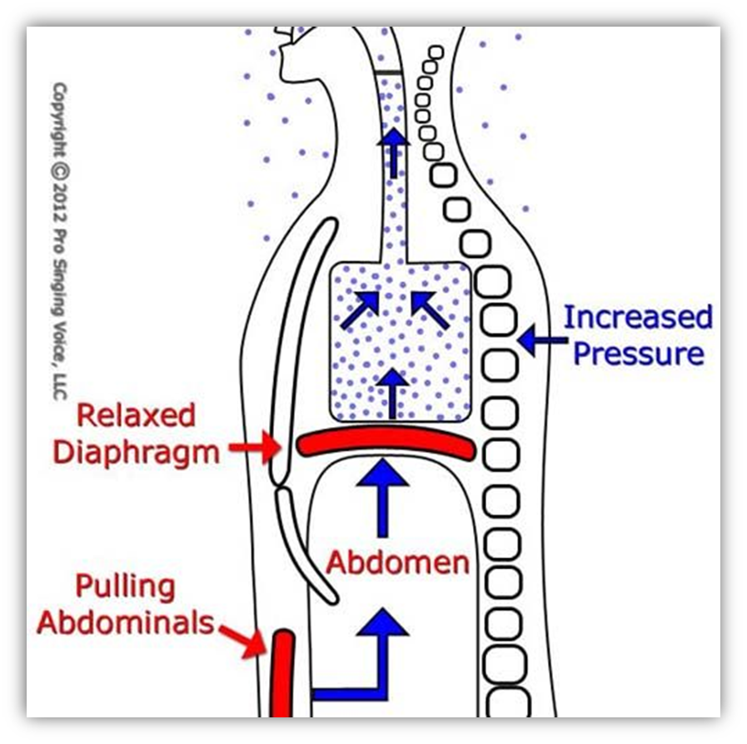
Subglottal Air Pressure

Slide 10
Air Pressure Build Up From Expiration
Pressure Opens Vocal Folds
Air Rushes Through
Vocal Folds Close Off Due To
Elasticity
Decrease In Pressure(bernoulli Effect)

Slide 11


Slide 12
REFERENCE
SPEECH AND SCIENCE HEARING SCIENCE (Willard r. zemlin)
Clinical voice pathology(sixth edition)
https://image.slidesharecdn.com/cfakepathphoneticsphonology-100501165244-phpapp01/95/phoneticsampphonology-14-728.jpg?cb=1272732789

Slide 13


