Slide 1


PERCEPTUAL EVALUATION OF VOICE: GRBAS, CAPE-V
SUBMITTED BY-: HIMANSHU KANT
3RD SEM B.ASLP
SUMANDEEP VIDYAPEETH

Slide 2
TOPIC AT GLANCE..
INTRODUCTION
GRBAS
CAPE-V

Slide 3
INTRODUCTION
GRBAS was developed by the committee for phonatory function tests of the Japan society of Logopedics and Phoniatrics.
This scale evaluates five components of voice production : grade(G), rough(R), breathy(B), asthenic(A), and strained(S). Each component is rated on a 4-point scale where “0” is normal, “1” is slight, “2” is moderate, and “3” is extreme.

Slide 4
Grade (G) representation the overall degree of hoarseness of voice abnormality.
Rough (R) represents the perceptual impression of the irregularity of vocal fold vibration.
It corresponds to the irregular fluctuations in the fundamental frequency, the amplitude of vibration, or both.
Breathy (B) represents the perceptual impression of the extent of air leakage through the glottis.

Slide 5
Asthenic (A) denotes weakness or lack of power in the voice.
Strained (S) represents the perceptual impression of vocal hyperfunction.

Slide 6
Grade
Grade (G), represents the overall degree of hoarseness or voice abnormality.

Slide 7
Roughness
Roughness (R) quantifies the degree to which the listener detects the effect of irregular fluctuations in pitch-frequency and amplitude either cycle to cycle or in the short term energy of the vocal tract excitation. Roughness is also affected by perceived randomness or ‘noisiness’ of the spectrum.
Any perception of roughness might take into account the possibility of severe irregularity due to vocal fry [Hir81, HMWM66] and double excitation (diplophonia)

Slide 8
Breathiness
Breathiness (B) arises from non-periodic sound generate air which leaks through the glottis when it is supposed to be closed.
The turbulence is created by the constriction of a partially closed glottis. Its energy will be correlated to the vocal cord activity; i.e. its energy will decrease as the glottis becomes fully open and increase again as the vocal cords try to close. d by a turbulent flow of

Slide 9
Asthenia
Asthenia (A) is weakness or lack of energy in the voice. The asthenic variety of hoarse voice is mostly characterised by weak intensity.
It can be because of an impaired energy distribution in the glottal excitation with a spectral damping which is a sign of a lack of elasticity in the vocal cords. The higher harmonics in the perceived sound will then have a lack of brightness and richness.

Slide 10
Strain
Strain(S) is indicative of undue effort needed to produce voiced sound due to an inability to employ the normal functionality of vibrating vocal cords.
Strain(S) is indicative of undue effort needed to produce voiced sound due to an inability to employ the normal functionality of vibrating vocal cords.
Strain due to speaking with abnormality functioning vocal cords is perhaps the most subjective GRBAS measurement and the most variable effect.

Slide 11
 | 0 | 1 | 2 | 3
Grade | Non hoarse or normal | Slight | Moderate | Extreme
Rough | Non hoarse or normal | Slight | Moderate | Extreme
Breathy | Non hoarse or normal | Slight | Moderate | Extreme
Asthenic | Non hoarse or normal | Slight | Moderate | Extreme
Strained | Non hoarse or normal | Slight | Moderate | Extreme
G R B A S TOTAL- _____________/15 =

Slide 12
Consensus Auditory-Perceptual Evaluation of Voice (CAPEV)
The Consensus Auditory-Perceptual Evaluation of Voice (CAPE-V) was developed as a clinical tool for perceptual assessment of voice by the American Speech-Language-Hearing Association’s (ASHA) Division 3

Slide 13
In an attempt to further improve the perceptual evaluation of voice, a committee of the American Speech Language-Hearing Association Special Interest Group 3, voice and voice Disorders, developed the consensus Auditory-perceptual evaluation of voice (CAPE-V).
CAPE-V uses a 100mm visual analog scale to assess voice quality at the vowel, sentence, and conversational speech levels.

Slide 14
The parameter of voice assessed include overall severity , roughness, breathiness, strain, pitch and loudness. Area for describing additional features such as diplophonia, fry, falsetto, asthenia, Aphonia, pitch instability, tremor, wet/gurgly, or other relevant terms are provided.
The CAPE-V is this author’s audio perceptual evaluation tool of choice.

Slide 15
As with all perceptual rating scales, GRBAS and the CAPE-V are subjective and depend on the trained clinical ear.
Securing an audio recording of the pretreatment voice using a standard reading passage , such as “the rainbow passage for post treatment comparison is advisable at this time.
REFERENCE FROM-: STEMPLE & COMPUTERISED GRBAS ASSESSEMENT OF VOICE QUALITY

Slide 17
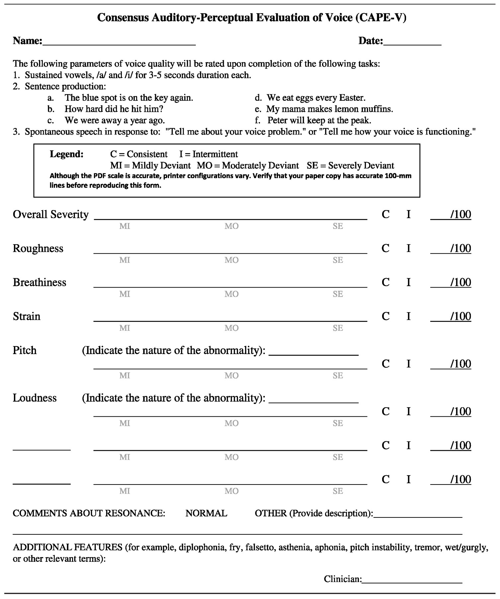

Slide 18


Slide 19


