Slide 1
MUSCLE TENSION DYSPHONIA
Submitted To :-Sarita Mam
Presented by :-Manasvi Thummar from 2ND year B.ASLP

Slide 2
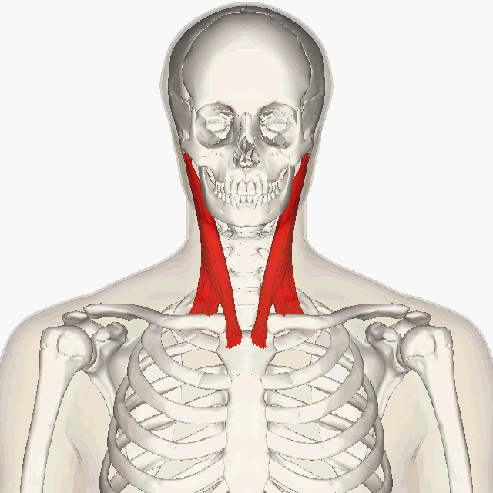
Muscle tension dysphonia (MTD) is a persistent dysphonia that results from excessive laryngeal and related musculoskeletal tension and associated hyperfunctional true and/or false vocal fold vibratory patterns (Dworkin and colleagues, 2000).

Slide 3
Morrison and colleagues (1983) first described MTD as the occurrence of vocal dysfunction in the absence of laryngeal structural abnormalities.
In patients with MTD, the larynx is often noted to be elevated in the neck due to increased extrinsic laryngeal muscle tension (Van Houtte and colleagues, 2011), and pain is often reported in the neck, jaw, and shoulders (Stemple and colleagues, 2000).

Slide 4
Muscle tension dysphonia can be categorized as primary or secondary based on whether organic pathologic conditions contribute to trigger the muscle tension behavior (Rosen and Murray, 2000a).
Primary MTD occurs in the absenceof current organic pathology, without obvious psychogenic or neurologic etiology.

Slide 5
Patients with primary MTD represent up to 40% of the dysphonias seen in voice clinics (Altman and colleagues, 2005; Dromey and colleagues, 2008).
Secondary muscle tension dysphonia occurs in the presence of current or recent organic pathology, or psychogenic or neurologic etiology.
Secondary MTD is believed to originate as a compensatory response to the primary etiology.
Muscle tension dysphonia may be seen in both children and adults (Lee and Son, 2005).

Slide 6
Auditory-perceptual features of MTD can include strained or effortful voice quality, aberrant pitch, breathiness, and vocal fatigue (Roy and colleagues, 2008).
Physiologic features considered core traits of MTD are generally based on subjective measures and include laryngeal elevation, decreased space between the hyoid bone and larynx, increased extrinsic laryngeal muscle tone, and the presence of one or more patterns of excessive laryngeal or supralaryngeal constriction (Lowell and colleagues, 2012).

Slide 7
Constriction patterns include anterior-posterior compression, medial compression, and a sphincter-like combination of these two (Koufman and Blalock, 1991).
Excessive vocal fold tension resulting in an underapproximation of the vocal folds may also be observed (Hillman and Verdolini, 1999).
In some patients, medial compression may be a normal configuration, however, and must be interpreted in light of other laryngoscopic findings (Behrman and colleagues, 2003).

Slide 8
Numerous factors may contribute to the development of MTD, including deviant body posture and misuse of neck and shoulder muscles, high stress levels, excessive voice use, persistently loud voice use, and laryngopharyngeal reflux disease (Altman and colleagues, 2005; Van Houtte and colleagues, 2011).
Patients frequently demonstrate significant emotional stress or conflict (Deary and Miller, 2011) suggesting an interaction between personality and psycho-emotional status and the voice (Seifert and Kollbrunner, 2005; Dietrich and colleagues, 2008; Mersbergen, 2011).

Slide 9
Understandably, voice-related quality of life is diminished in persons with MTD (Kooijman and colleagues, 2005).
For the inexperienced and experienced voice clinician alike, MTD can sometimes be difficult to differentiate from other forms of dysphonia, such as adductor spasmodic dysphonia and vocal tremor.
This is because some patients with adductor spasmodic dysphonia, vocal tremor, or MTD present with symptoms that overlap to such a degree that a correct diagnosis is not easy.

Slide 10
Findings from a number of recent studies examining diagnostic elements such as patient interview, visualization of the larynx, acoustic and aerodynamic evaluation, and perceptual judgments may help the clinician arrive at the correct diagnosis in a timely manner (see Barkmeier and Case [2000], Dworkin and colleagues [2000], and Roy [2010] for reviews).

Slide 11
For example, comparison of laryngeal behaviors during quiet breathing, counting from 1 to 10 in usual voice compared with falsetto and whispered speech, comparison of all-voiced versus all-voiceless utterances, variation of pitch and loudness during sustained phonation versus connected speech, and singing or crying may elicit differing patterns between adductor spasmodic dysphonia and MTD.

Slide 12
The key difference between laryngeal behaviors in individuals with adductor spasmodic dysphonia versus MTD is the consistency of laryngeal postures across and within each of the examination tasks.
Patients with MTD maintain hyperadduction of the involved laryngeal structures across all tasks, whereas those with adductor spasmodic dysphonia tend to demonstrate more intermittent hyperadduction (Leonard and Kendall, 1999).

Slide 13
In patients with adductor spasmodic dysphonia, voice severity is perceived to be worse for connected speech than sustained vowels.
this is not the case in patients with MTD, where no difference is usually heard (Roy and colleagues, 2005) .
In patients with MTD, voice severity is generally perceived to be the same on connected speech regardless of whether the sentences are all voiced or all voiceless; this is not the case for patients with adductor spasmodic dysphonia (Roy and colleagues, 2007).

Slide 14
Reference
The voice and voice therapy ninth edition [stephen C. Mcfarlane]

Slide 15

ANY QUERY?

Slide 16
THANKS

