Slide 1

Physiologic correlates
Submitted to – Vikash Sir, assist. Professor
Prepared by – Shubham Tiwari
B.ASLP, 3rd semester

Slide 2
Correlates..
acoustic
aerodynamic
physiologic

Slide 3
The mechanics of sound generator
During normal breathing, the vocal folds are spaced rather widely apart, and contrary to what is often stated, their spacing is not somewhat less during exhalation than it is during inhalation. At any rate, the air stream is unim peded as it flows in and out of the lungs.
Later,when the structural and behavioral characteristics of the larynx have been discussed, we will be in a position to examine closely how the unimpeded air stream may be set into vibration to produce the glottal tone. Very briefly, the larynx produces glottal tones by generating a rapid series of short-duration air pulses, which excite the supralaryngeal air column so as to produce a complex tone.

Slide 4
During normal vowel production such vibration occurs at a rate of about 125 complete vibrations per second for men, about 210 vibrations per second for women, and even higher for children.

Slide 5
The Prephonation Phase
The prephonation phase is the period during which the vocal folds move from an abducted to either an adducted or a partially adducted position.
when the vocal folds are viewed prior to the onset of phonation, they are usually seen to be in an abducted position; that is, the subject is breathing During quiet breathing.
the adult male glottis is about 13 mm wide at its broadest point, and according to Negus (1929), this value may almost double during forced exhalation.
Most persons maintain a rather constant glottal aperture during quiet breathing.

Slide 6
Vocal Fold Approximation
The duration of the pre- phonation phase and the extent to which the vocal folds approximate are highly variable, depending largely upon the utterance to be emitted.
,If the forces of exhalation are released and the vocal folds approximate or nearly approximate, they begin to obstruct the outward flow of air from the lower respiratory tract, and subglottal pressure, the pressure beneath the folds, begins to build up.
In addition, the velocity of the air as it flows through the glottal constriction is raised sharply, which is an important point to remember.
The extent to which the vocal folds are approximated is referred to as medial compression, which is brougbt about by the action of the adductor muscles.

Slide 7
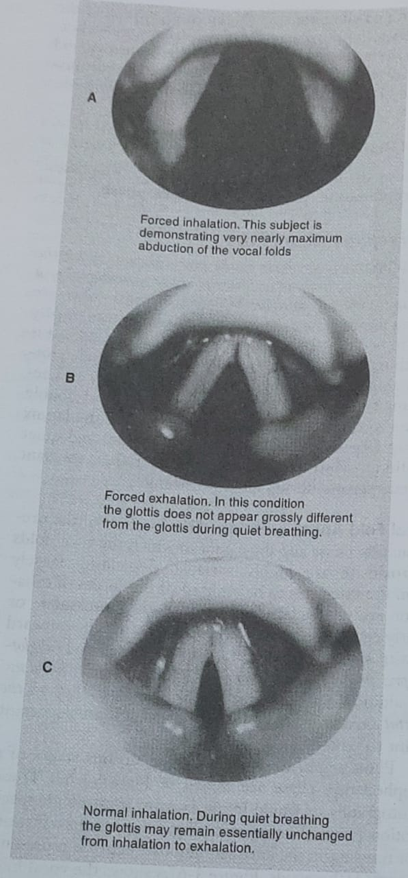

Slide 8
The attack phase
The attack phase begins with the vocal folds adducted or nearly so, and extends through the initial vibratory cycles This phase is also highly variable in is depending primarily upon the extent to which vocal folds are adducted during the prephonation phase del the manner in which the air stream is released Often the vocal folds are not completely adducted during the prephonation phase, complete obstruction of the air airpassagway not necessary to initiate phonation.
If the glottal chink is narrowed to about 3 mm, amin amount of air flow will set the vocal fold into be vibration Air-pressure requirements under these condition also be minimal According to von Leden (1 witl a subglottic pressate equal to 20 to 40 mm of wine sufficient.)

Slide 9
High-speed laryngeal photography show the like initial movement in completely adducted vocal fold in medialward. This point will be emphasized later in discussion of theories of vocal fold vibration. Medical movement can be adequately accounted for by the Bernoulli effect.

Slide 10
Glottal attacks and Glottal stops occur with great frequency in some languages other than English. In parts of Germany, for example, glottal attacks and stops are used with great regularity, but they do not enjoy phonemic siganificance. In Turkey, on the other hand, glottal attacks are used phonemically. In the English language, glottal arrests and releases are used far more often than one might suppose.

Slide 11
Physiologic correlates
Electroglottography
Electroglottography (EGG) is a technique for the measurement of vocal fold-contact a based on the principle that tissue conducts current.
A high-frequency, low-current signal passed between the vocal folds via electrodes located on the external neck over the thyroid lamina.
When the vocal folds touch, greater current flows than when they are open.
There is a proportional Variation of current when the vocal folds are less than maximally open or closed.
Electroglottographic recordings can be used to determine when the vocal folds are closed and how fast they are closing.

Slide 12
If carefully interpreted, it is possible to determine characteristics of the opening of the vocal folds from an electroglottographic recording.
Devices to record the electroglottographic signal are readily available. Currently there include the Voiscope and Laryngograph (Laryngograph, Ltd.), the single channel Sc 1 or the EG2-Standard or EG2-PCX (Glottal Enterprises), and the unit from FJ Electronics.
The electrical output of the electroglottograph can easily be converted to hard copy using an oscillograph or similar graphic recording device, or from a computer-generated display.

Slide 13
The literature on EGG is primarily qualitative in nature, based on interpretation waveform.
EGG reflects the state of the vocal folds in a way that can be easily demonstrated and interpreted to patients.
However, a limitation of the technique is that it cannot be used with all patients. Because the technique depends on vocal fold contact, the signal is considerably diminished or even absent in patients with lack of good contact, such as those with unilateral paralysis, or aphonia.

Slide 14
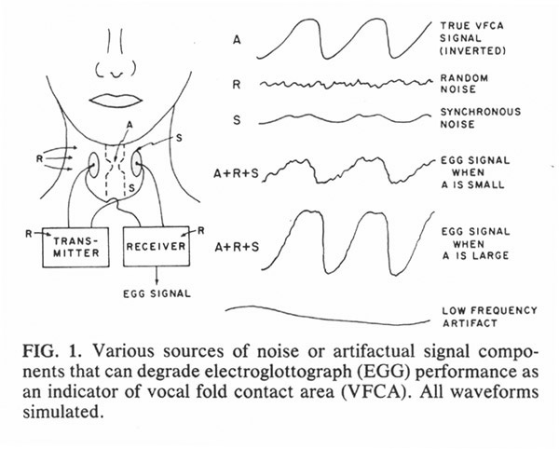

Slide 15
Photoglottography
Photoglottography is a technique designed to obtain estimates of variations of glottal area during phonation.
Light is directed from above, usually from a fiberoptic light source passed through the nose. The light passes through the glottis and is detected by a light-sensitive device usually positioned over the skin of the trachea immediately beneath the vocal folds.
As the vocal folds vibrate, their area of opening will vary and so will the amount of light passing through the glottis.
It is a simple, relatively noninvasive device that yields a good, but not exact, approximation of glottal area.
The photolithography technique is complementary to the EGG signal (Baer et al., 1983a. 1983b).

Slide 16
There are several measurements that can be made from photoglottographic recordings.
The first, speed quotient (SQ), is the speed of the opening phase of the vocal folds divided by the speed of their closing phase.
The second, open quotient (OC)is the time of the open phase of the vocal folds divided by the total period of vibration.
open quotient and speed quotient reflects efficient vocalizations, although it is unclear which values are produced with maximally efficient phonations. Titze concluded that an OQ around 50 resulted in efficient vocalization (1994).

Slide 17
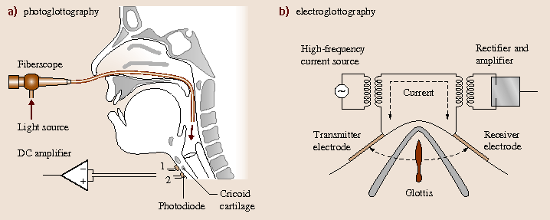

Slide 18
Electromyography
Electromyography (EMG), a technique in which electrodes are inserted into specific muscles to measure their electrical activity, is used routinely by neurologists for the study of peripheral muscle function in various neuromuscular and neurological diseases.
EMG is invasive and requires expertise, precautions must be taken to safeguard the patient's well-being.
For these reasons, EMG has enjoyed limited use in the diagnosis and management of voice disorder EMG of the vocal muscles requires detailed knowledge of head and neck anatomy, alone with considerable experience in manipulating needles or needle carriers within the pharynx and larynx.

Slide 19
Electromyographic recording equipment is available from a variety of manufacturers and has been engineered to be medically safe.
The output of the equipment, an electromyogram, is a detailed tracing of muscle activity.
Interpretation of electromyographic recordings requires experience and practice. Onset or offset of muscle activity, the pattern of muscle activity, and the overall amplitude of muscle activity are the parameters that provide the most valuable information.
.

Slide 20
Electromyographic patterns of neurologically disordered patients will show greater- or lesser-than-normal amplitudes muscle activity, extraneous bursts of muscle activity, and slower or faster-than-normal muscle activation.
Laryngeal electromyogram may be helpful in those patients with voice problems of suspected neurological or neuromuscular etiology

Slide 21
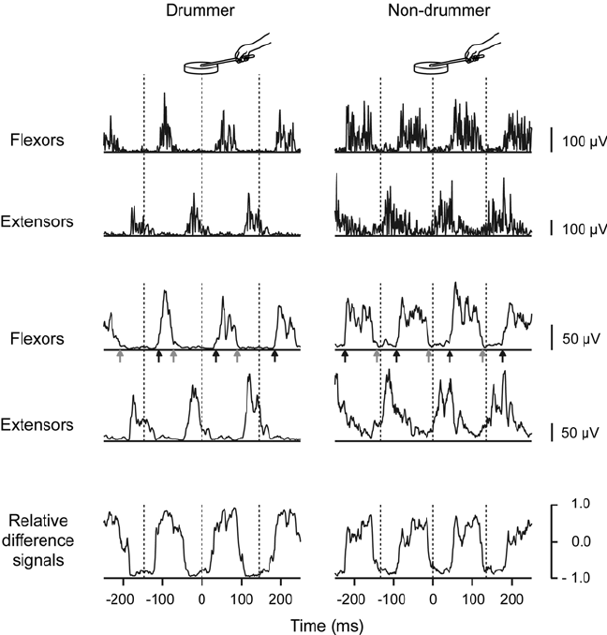

Slide 22
References
Understanding voice problems (a physiological perspective for diagnosis and treatment) – RAYMOND H. COLTON
Clinical voice pathology (theory and management) – Sixth edition- JOSEPH C. STEMPLE

Slide 23

Any question……..

Slide 24


