Slide 1

Congenital voice disorders
Prepared by:- Shubham Tiwari
Submitted to :- Vikash kumar

Slide 2
content
Types of congenital anomalies
congenital mass-size lesions of larynx
  congenital subglottic hemangiomas/granulomas(firm granulated)
  Congenital laryngeal papilloma
  Congenital structural anomalies of larynx
  laryngomalacia (congenital chondromalacia and inspiratory stridor)
  cri-du- chat syndrome
  congenital laryngeal webs and laryngeal atresia
  congenital subglottic stenosis
  Laryngocele
  congenital laryngeal cyst
  laryngeal cleft

Slide 3
classification
Congenital anomalies of larynx – 3 groups of symptoms
1) respiratory difficulties due to airway obstruction
2) hoarseness or weak aphonic cry
3) Dysphagia
Congenital laryngeal anomalies:
1) mass-size lesions
2) structural anomalies

Slide 4
I. congenital mass-size lesions of larynx
A. congenital subglottic hemangiomas/granulomas(firm granulated)
  Appear in children as purplish-red, sessile/plaible tumors that tend to be subglottic.
  Rare but curable may cause episodes of airway obstruction in infants
  Intubation, abuse-misuse, LPR

Slide 5
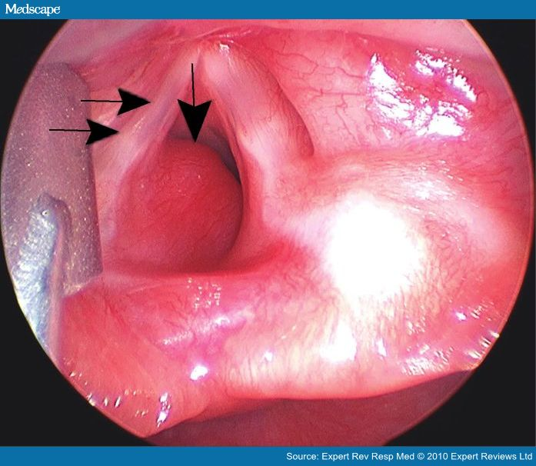

Slide 6
Symptoms
  Some infants with subglottic hemangiomas – asymptomatic- lesion does not affect vocal fold vibration- does not obstruct airway
  In others , symptoms seen only in reclining position
A. inspiratory stridor
B. dyspnea and cyanosis- due to airway obstruction
C. hoarseness- seen ocassionally
D. excessive coughing
E. dyaphagia

Slide 7
b. Congenital laryngeal papilloma
  Most common laryngeal growth in children
  Common age of children who present with tumor – 6 months to 6 years
  Laryngeal pappillomas- hormonally dependent
    1) juvenile form of disease usually resolves as patient approaches puberty
    2) when it appears in adult females- tumor regresses during pregnancy

Slide 8
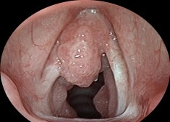
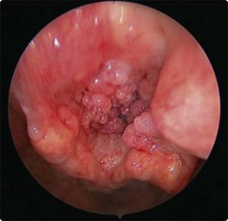

Slide 9
The juvenile form of laryngeal papilloma usually begins as a benign epithelial tumor that appears at the anterior portion of the vocal folds and then spreads across the laryngeal epithelium to include, either singly or in combination, the aryepiglottic folds, the ventricular folds and various subglottic regions
Can be removed with medicosurgical methods, frequently recur after being removed

Slide 10
1. etiology.
  Caused by a DNA virus of the papova group
  Virus specific to laryngeal region
2. symptoms
A. voice quality – hoarse if papilloma involves the vocal folds
B. aphonia may result if vocal fold involvement is severe
C. respiratory stridor- common
D. dyspnea may occur

Slide 11
3. laryngoscopic findings
  Arise from anterior part of larynx and may spread to involve supraglottic and/or subglottic regions.
  Lesions rarely arise from posterior part of larynx
  Lesions are sessile or pedunculated and exhibit numerous wart-like papillae
  Pale pink or red in colour

Slide 12
II. Congenital structural anomalies of larynx
A. laryngomalacia (congenital chondromalacia and inspiratory stridor)
  Most common congenital laryngeal anomaly
  Symptoms appear in infancy
  Cause of 75% of cases with congenital stridor
  Excessive flaccidity of supraglottic larynx with inspiratory stridor
  Prognosis for spontaneous recovery in 12 to 18 months- good

Slide 13
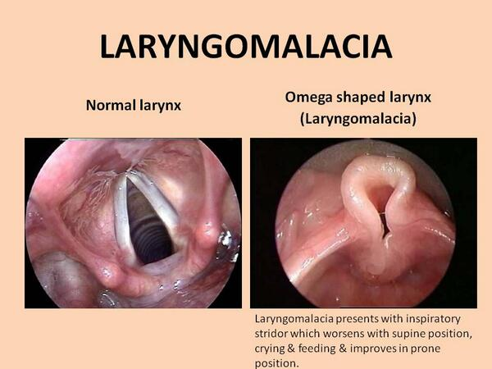

Slide 14
1. Etiology
  Caused by insufficient or delayed calcium deposition in infants- results in excessive flaccidity of the cartilaginous structure of larynx
  Lack of calcium- inadequate support for cartilaginous epiglottis – consequently collapses over the glottis during inspiration
  Reduction of calcium may also be present in tracheal cartilages

Slide 15
2. symptoms
  Present at birth
  primary symptom- noisy inspiratory stridor that sounds like “crowing”
  Stridor may be accompanied by suprasternal and intercostal retraction during inspiration
Because supine or feeding positions frequently allow the flaccid epiglottis to block the airway, infants in these positions may exhibit dyspnea or cyanosis
C. cry- normal

Slide 16
3. laryngoscopic findings
  Since the inspiratory stridor involved makes the diagnosis clear, direct laryngoscopy usually omitted
  If laryngoscopy is performed- reveals an omega-shaped epiglottis that is collapsed over glottis during inspiration
  The aryepiglottic folds are in close approximation to each other and usually sucked into the glottis during inspiration and blown away from the glottis on expiration

Slide 17
B. cri-du- chat syndrome
  Characteristic weak, wailing cry like that of a kitten
  Larynx –identical appearance as laryngomalacia
1. etiology
  Caused by partial deletion of a number 5, group B chromosome

Slide 18
2. symptoms
In addition to distinctive high pitched kitten like cry found in infants, and the weak, high-pitched voice accompanied by vocal fold aperiodicity in older children, the syndrome is characterised by following features
A. severe mental retardation
B. beak-like profile
C. microcephaly
D. hypotonia
E. hypertelorism (widely spaced eyes)
F. downward slanting eyes
G. epicanthal folds (a vertical fold of skin on either side of nose)
H. strabismus (asymmetrical eye movement)
i. medial oral clefts
J . visceral anomalies
K .Severe to moderate articulation delay
L. language delay

Slide 19
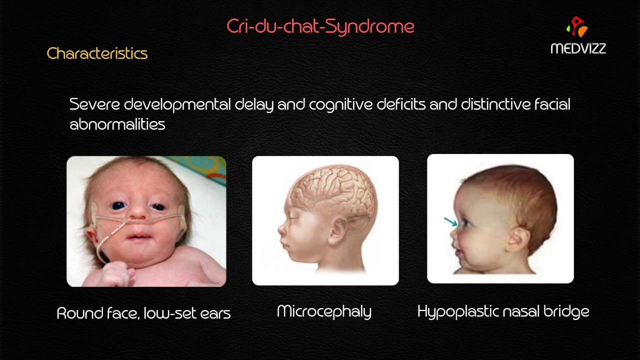

Slide 20
3. laryngoscopic findings
  Epiglottis-omega shaped and collapsed over the glottis
  Aryepiglottic folds in close approximation to each other and sucked into the glottis during inspiration and blown away during expiration
4. medicosurgical management
  Nothing specific required for management of patient’s voice

Slide 21
C. congenital laryngeal webs and laryngeal atresia
  Laryngeal occlusion that are caused by webs of connective tissue in subglottic, glottic and suraglottic regions
  If webbed tissue completely occludes the larynx at birth (congenital laryngeal atresia), immediate action should be taken to provide airway

Slide 22
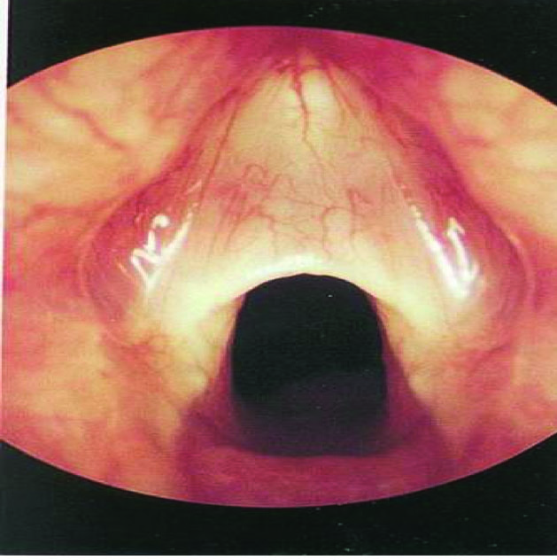
congenital laryngeal webs and laryngeal atresia

Slide 23
1. etiology
  Results from failure of vocal fold primordia (embryologic tissue) to partially or completely separate during the first trimester of embryologic development
2. symptoms
  Vary depending on the location and extent of opening in the web
  Webs at the level of glottis (75% of all laryngeal webs are interglottic) affect vocal fold vibration- affect phonation

Slide 24
  Laryngeal webs at any level in the larynx (subglottic, glottic or supraglottic) – have effect on respiration depending on extent of opening in the web
Phonatory and respiratory symptoms associated with laryngeal webs
Phonatory symptoms
1. voice – asymptomatic if web is not located at level of glottis
2. effect of interglottic laryngeal web on vocal pitch varies with extent of web
  Small webs located at anterior commisure – little effect on vocal pitch
  Larger webs which involve greater degrees of vocal folds – can cause vocal pitch elevation- since effective vibrating portion of the vocal folds is shortened due to presence of the web

Slide 25
3. laryngoscopic findings
  Web of connective tissue that partially occludes the larynx
  Laryngeal webs at the level of glottis are located at anterior commissure and grow posteriorly
  Thickness of web varies from thin and transparent to thick

Slide 26
D. congenital subglottic stenosis
  Narrowing of airway between the glottis and the first tracheal ring
  Occurs twice as often in females as males
1. etiology
a. thickening of subglottic tissue and occasionally the vocal folds
B. cartilagenous narrowing of the cricoid cartilage in an anterior posterior direction, leaving a small posterior opening

Slide 27
2. Symptoms
A. inhalatory and exhalatory stridor
B. phonation generally normal although it may be reduced in intensity if stenosis severely limits airflow
3. laryngoscopic findings.
A. soft tissue stenosis- concentric narrowing or bilateral subglottic swelling
B. cartilagenous stenosis

Slide 28
E. laryngocele
  Air-filled or fluid-filled dilation of anterior appendix of laryngeal ventricle, space between the false and true vocal folds
  3 types
  Internal- inflated sac remains entirely within the thyroid cartilage
  External- sac protrudes above the thyroid cartilage
  Combination type- has features of both internal and external types
1. etiology
  Result from congenitally enlarged laryngeal ventricle that is firther enlarged by activities that increase intralaryngeal air pressure like
A. straining
B. coughing
C.Vocal abuse
D. playing wind instruments

Slide 29
2. symptoms
  Laryngoceles usually asymptomatic in infancy
  Symptoms appear in adulthood, exclusively in males, usually in their 50s
common symptoms
  hoarse voice if internal type of laryngocele is present and is affecting vibration of true vocal folds
B. inspiratory stridor
C. external bulge in the may be present with external and combination types
  Direct pressure on the neck frequently decreases the size of the mass
  As the mass is pressed on, a small rush of air or gurgling sound may be heard in hypopharynx as sac deflates
D. dysphagia – may occur if laryngocele is sufficiently large

Slide 30
F. congenital laryngeal cyst
  Small fluid- filled sacs that are found in the larynx, primarily in the ventricle
  Difference between cyst and laryngocele- cyst does not have an opening directly into the interior of larynx
1. etiology
  Results from accumulation of secretions from glands in the submucosa of saccule
2. symptoms.
  May be asymptomatic
A. hoarseness results if true vocal folds are displaced
B. inspiratory stridor if sufficient airway obstruction occurs

Slide 31
3. laryngoscopic findings
  Located primarily in the ventricle
  Appear as marked swellings of false vocal folds, aryepiglottic folds or arytenoids

Slide 32
G. laryngeal cleft
  Vertical opening between the larynx (cricoid cartilage) and the esophagus
  Cleft may also be a complete laryngotracheoesophageal cleft
1. etiology- results from failure of fusion of cricoid lamina (signet portion)
2. symptoms
A. respiration obstruction
B weak cry or aphonia
C. repeated pnewmonia

Slide 33
3. laryngoscopic findings- cleft located between the arytenoids extending to the lamina of cricoid cartilage

Slide 34
Any doubt?

Slide 35
references
Understanding voice problems (a physiological perspective for diagnosis and treatment) – RAYMOND H. COLTON.
Clinical voice pathology (theory and management) – Sixth edition- JOSEPH C. STEMPLE.

Slide 36
Jee thank you

