Slide 1
Non organic voice disorders

Slide 2
Functional Voice Disorder
No organic or physical cause of the voice disorder is identified , the resulting physiological imbalance may produce a voicing problem classified as a functional voice disorder.

Slide 3
Functional voice disorder can be divided into 2 parts on the basis of :
Excessive muscle tension disorder(hyperfunctional) (EMTD)
Psychogenic voice disorder(PVD)

Slide 4
Functional Voice Disorders
After talking awhile, the individual may begin to experience some pain and discomfort in the throat area along with fatigue and effort that increases with voice use. As well as more hoarseness after prolonged voice use.
Children’s loud voices and yelling over time seems to produce some hoarseness of voice
Physical examination of the larynx shows no organic pathologies, and the voice problem is considered functional in origin.
With continued misuse of the voice over time, however, children and adults may develop secondary tissue changes related to this vocal hyperfunction, such as vocal fold changes (swelling, thickening, nodules, polyps, etc.).

Slide 5
Vocal cord pathology :
Muscle tension dysphonia
Reinke’s edema
Vocal fold nodules
Vocal fold polyps
Traumatic laryngitis
Ventricular dysphonia
Diplophonia
Phonation breaks

Slide 6
MUSCLE TENSION DYSPHONIA
Definition:
Muscle tension dysphonia is caused by hyperfunctional of true and/or false vocal fold of vibration due to excessive laryngeal musculoskeletal tension.
Muscle Tension Dysphonia. Muscle tension dysphonia (MTD) is the most common voice disorder seen in both children and adults and the most common manifestation of vocal hypertension—using too much muscular effort to phonate. This overuse of the respiratory, laryngeal, and supralaryngeal systems when voicing usually begins gradually.

Slide 7
Etiology :
Factors for the development of muscle tension dysphonia includes following:
Deviant body posture and misuse of neck and shoulder muscles.
High stress levels.
Excessive voice use.
continue loud voice use.
Laryngopharyngeal reflux disease.
Emotional stress and depression

Slide 8
REINKE’S EDEMA
Acute or Chronic diffuse swelling of the superficial lamina propria of the vocal fold is known as Reinke’s Edema.
In Reinke’s Edema, a gelatinous material develops in Reinke’s space, usually seen bilaterally.

Slide 9
Etiology :
It is associated strongly with smoking, frequently with chronic vocal hyperfunction and occasionally with Laryngopharyngeal reflex.

Slide 10
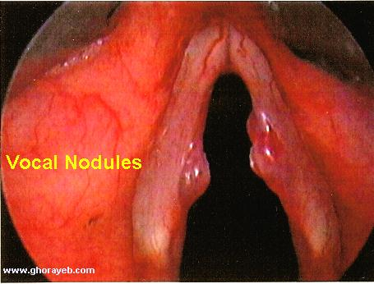
VOCAL FOLD NODULES
Vocal fold nodules are the most common benign lesions of the vocal folds in both children and adults.
They are caused by continuous abuse of the larynx and misuse of the voice.
Nodules are generally bilateral, whitish protuberances on the glottal margin of each vocal fold.
In the early of stages of development, the nodule is soft and pliable.

Slide 11
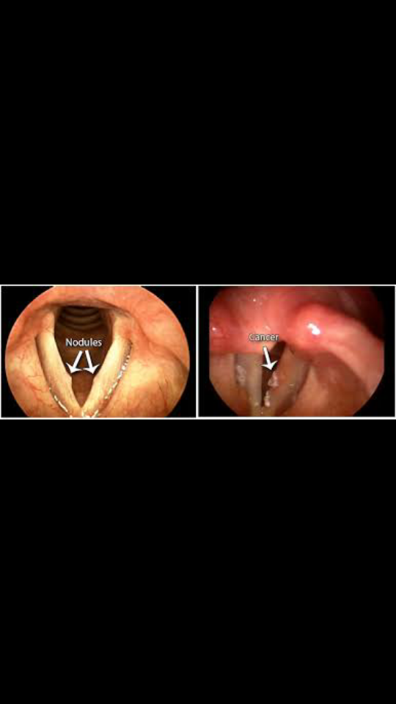
Etiology
Vocal cord nodules usually develop due to chronic abuse of the voice over time, such as straining, yelling and frequent singing. Ongoing friction between the vocal cords creates callous-like growths.

Slide 14
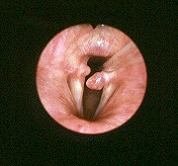
VOCAL FOLD POLYPS
Definition :
A vocal fold polyp is a vocal abnormality of the superficial lamina propria, usually at the same site where vocal fold nodules occur.
Vocal fold polyp are usually unilateral, but a reactive lesion is often found on the vocal fold immediately across from the polyp.

Slide 15
Etiology
Most of the time, vocal abuse or misuse causes nodules. Long-term vocal abuse can cause polyps, too. But polyps may happen after just one instance of vocal abuse, like yelling at a concert. Smoking cigarettes for a long time, thyroid problems, and reflux may also cause polyps.
Vocal abuse can happen in many ways, including from:
allergies
smoking
tense muscles

Slide 16
singing
coaching
cheerleading
talking loudly
drinking caffeine and alcohol, which dries out the throat and vocal folds

Slide 17
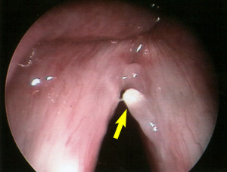

Slide 18
TRAUMATIC LARYNGITIS
Definition :
Traumatic laryngitis is swelling of the vocal folds as a result of excessive and strained vocalization.

Slide 19
Etiology :
Phonotrauma such as yelling, screaming, abrupt and strained voice usage, chronic coughing, habitual throat clearing and forceful singing are common causes of traumatic laryngitis.

Slide 20
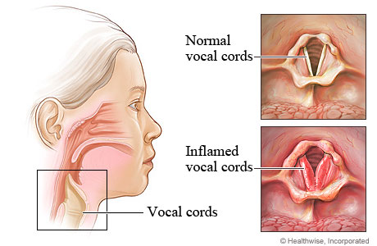
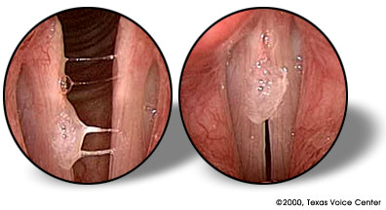

Slide 21
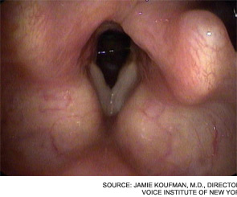
VENTRICULAR DYSPHONIA
Definition :
The ventricular voice is usually low-pitched because of the large mass of vibrating tissue of the ventricular bands or from the combined mass of the true and false vocal fold.

Slide 22
Etiology :
While ventricular dysphonia may be produced by the vibration of the approximating ventricular folds, it more often is produced by the true vocal folds vibrating in an abnormal fusion due to the false folds riding the true folds.

Slide 24
DIPLOPHONIA
Definition :
The term diplophonia means “double voice”.
Diplophonia is the consequence of irregular vocal fold vibration.

Slide 25
Etiology :
It may be produced by some normal speakers voluntarily, but it is heard in patients with mass lesions, vocal fold paralysis, vocal fold scarring, laryngitis and other inflammatory conditions, muscle tension dysphonia or paradoxical vocal fold movement.

Slide 26
PHONATION BREAKS
Definition :
A phonation break is a temporary loss of voice that may occur for only part of a word, a whole word, a phrase, or a sentence .

Slide 27
Etiology :
Such patients usually struggle to find their voice by coughing, clearing their throat, or taking a drink of water.
Fortunately, the treatment of phonation breaks is relatively simple:
Taking the work out of phonation and eliminating inappropriate vocal behaviors such as excessive coughing and violent throat clearing.

Slide 28
Any question

Slide 29
Dhanywaad

