Slide 1
Classification and types
Of Hearing aid
Submitted by:
Neha Thakur
2nd yr BASLP

Slide 2
Hearing Aid:
A hearing aid is a small electronic device that you wear in or behind your ear. It makes some sounds louder so that a person with hearing loss can listen, communicate, and participate more fully in daily activities.
Its essential components are:
Microphone
Amplifier
Receiver
Battery
Add title
Add title

Slide 3
Types of Hearing Aid:
Body aid
Ear level
ITC
ITE
CIC
Add title
Add title

Slide 4
RIC
IIC
Binaural hearing aid
Implantable hearing aid
Modular hearing aid
Master hearing aid
Directional hearing aid
Programmable hearing aid
Digital hearing aid
Add title
Add title

Slide 5
Body aid or body level:
The largest type of hearing aid is the body aid. These aids are
typically about 60 x 40 x 15 mm (very approximately)
2 x 2 x 0.5 inch.
As implied by their name, they
are worn somewhere on the body: in a pocket, in a pouch around the neck or on the belt.
They are connected, via a cable containing two or three wires, to a receiver, from which the amplified sound emerges.
The receiver usually plugs into an earmold custommade for the individual’s ear canal and concha.
Add your title
Add your title

Slide 6
Cords:
➢ Generally, two types of cords are available - “S” cord and "V”cord.
➢ The cord has plugs with pins at either end.
➢ One of the pins is thinner than the other.
➢ Similarly, on the hearing aid, one socket is smaller than the other.
➢ The thicker pin goes into the larger socket, and the thinner pin into the smaller
socket.
Add title
Add title

Slide 7
➢ Do not unplug the cord frequently as the cord and the pins may become disconnected.
➢ Do not wind the cord tightly around the hearing aid, pull it, twist it or knot it, as this may cause the delicate wires to break.
➢ If the sound is heard intermittently, it can be due to broken cord and so replace the cord.
➢ Cords often break at the plugs. Be careful when connecting the cord to the hearing aid or receiver and when disconnecting it.
➢ Grasp the cord by the hard-plastic part at the end and pull.
➢ Clean the pins regularly with a small brush.
Add title
Add title

Slide 8
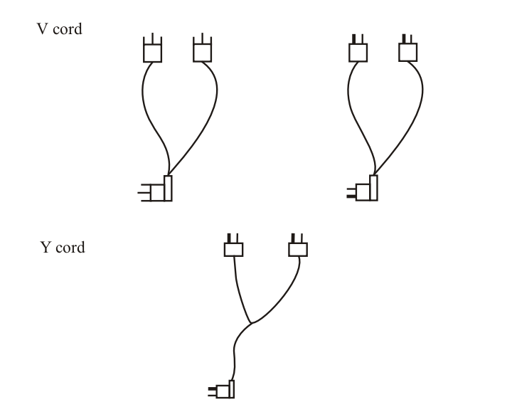
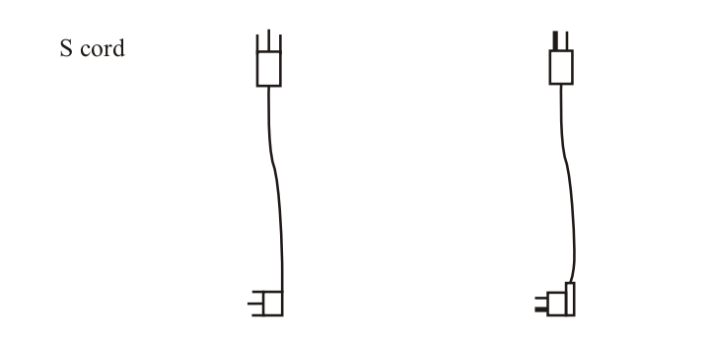
Add your title
Add your title

Slide 9
Advantage:
Body aid hearing aid are less expensive and easy to maintain.
Larger battery and control allow the paitnet to handle easily.
These are more sturdy and durable.
Add your title
Add your title

Slide 10
Disadvantage:
Add your title
The microphone placement is not very ideal as it is chest mounted.
The cords are difficult to manage and can get damage easily.
There is difficulty in eleminating the effect of cloth rubbing noise.
Add your title

Slide 11
Candidacy:
Battery: A4 size and voltage is 1.5V
Frequency range: Moderate to severe hearing loss.
Add your title
Add your title

Slide 12
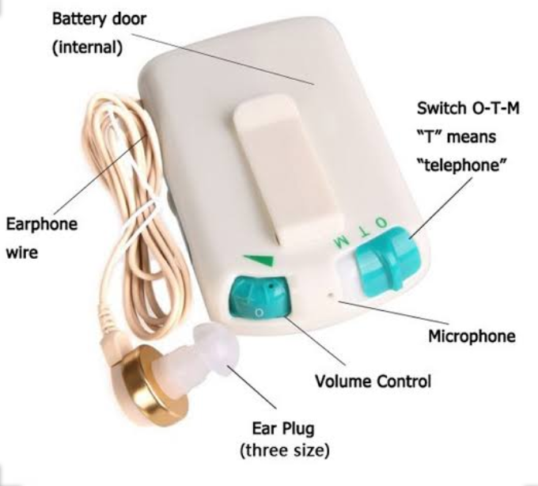
Add your title
Add your title

Slide 13
BTE (behind the ear):
A behind-the-ear (BTE) hearing aid is considerably smaller. BTEs are also two-piece hearing aids. The microphone and electronics are mounted in the characteristic banana-shaped case, or in some artistic variations of it.
Add your title
Add your title
In the long established form of BTE the receiver is also mounted in the case. The sound
from it is conveyed acoustically via a tube to a custom earmold or to a soft dome that retains the open end of
the tube within the ear canal.

Slide 14
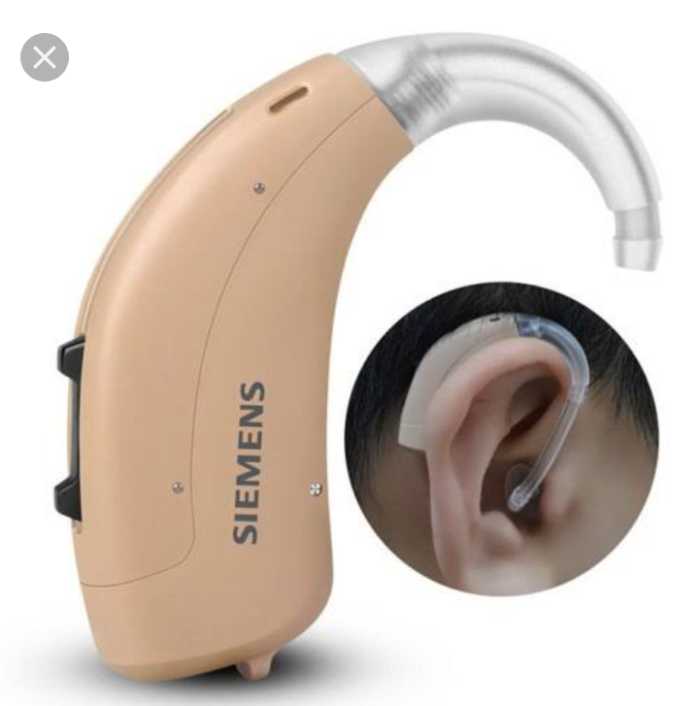
Add your title
Add your title

Slide 15
Advantages:
1. This type of digital hearing aid is pretty much ideal for most people, no matter what your degree of hearing loss is.
2. This type of device rarely needs repair.
Add your title
Add your title

Slide 16
Disadvantages:
1. This style can be larger than others, however since micro BTEs have been introduced they are very hard for others to see, especially if they are able to be covered with the wearer’s hair.
2. They may have either ear buds or ear molds. Ear molds will more than likely need to be remade every two to four years to help preserve the acoustic seal, they will also need to be re-tubed periodically. Ear tips and tubes on open fit micro BTEs will have to be changed periodically.
Add your title
Add your title

Slide 17
Candidacy:
Frequency range: Mild to profound hearing loss
Battery: High power battery (675,13)
Average power output: 123 db
Add your title
Add your title

Slide 18
RIC (reciever in the canal):
A more recent variation of the BTE is the receiver-in the-ear canal (RITE), in which the receiver is located
within the ear canal rather than in the BTE case, and
an electrical cable rather than an acoustic tube runs from the electronics to the ear canal.
RITE BTEs are
also known as RIC, RITC and CRT (canal receiver
technology).
Add your title
Add your title
BTEs are known as standard-tube or thin-tube BTEs,
and RITE BTEs are known as thin-wire BTEs.

Slide 19
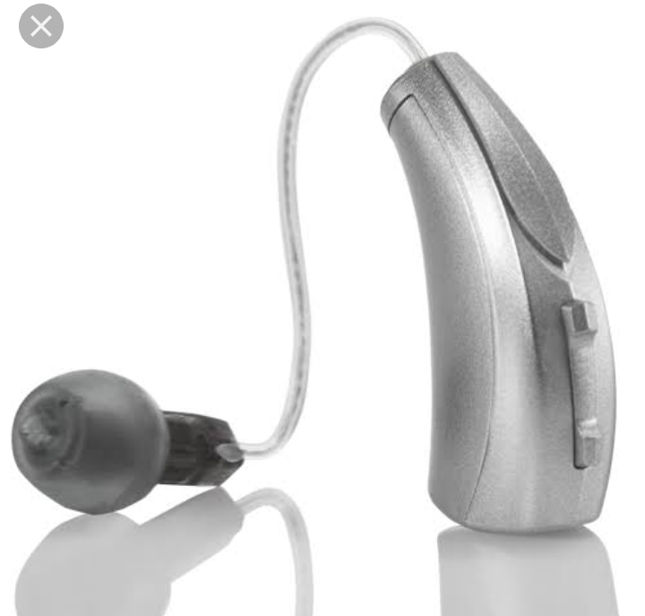
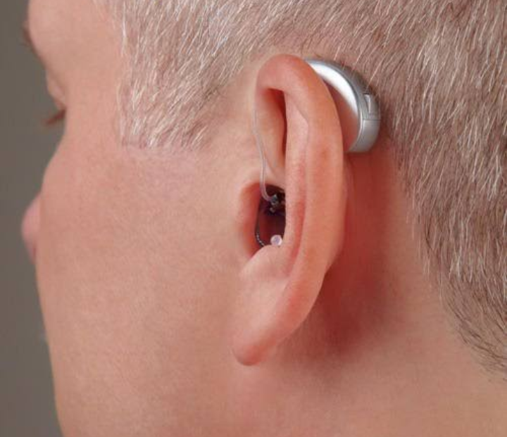
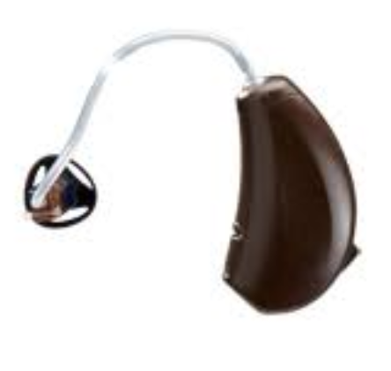
Add your title
Add your title
RIC
Mini RIC

Slide 20
Advantages:
1. This type of digital hearing aid is pretty much ideal for most people, no matter what your degree of hearing loss is.
2. There are less feedback problems with this style because there is far greater seperation between the microphones and receivers.
3. This type of device can be exceptionally discrete even for severe to profound losses.
Add your title
Add your title

Slide 21
Disadvantages:
1. They may have either ear buds or ear molds. Ear molds will more than likely need to be remade every two to four years to help preserve the acoustic seal. Ear tips will have to be changed periodically.
2. Because the receiver is in the ear canal, they are more prone to failure than traditional type BTEs. However, changing the receiver in RIC devices is an easy job that can be done in the office rather than a repair lab.
Add your title
Add your title

Slide 22
Candidacy:
Add your title
Battery: 312,10
Frequency range: higher frequency loss
Average power output:103db
Add your title

Slide 23
ITE ( in the ear):
These vary in size from full concha styles that, as their name implies, fill the entire concha as well as about half the length of the ear canal. A smaller variation of the ITE hearing aid is the half-concha or half-shell
ITE, which fills only the lower portion of the concha
(the cavum) up to the crus-helias.
Another variation fills only the upper portion of the concha (the cymba ITE) and connects to the ear canal with RITE technology. A further variation is the low profile ITE, which does not extend outwards from the ear canal sufficiently to fill the concha.
Add your title
Add your title

Slide 24
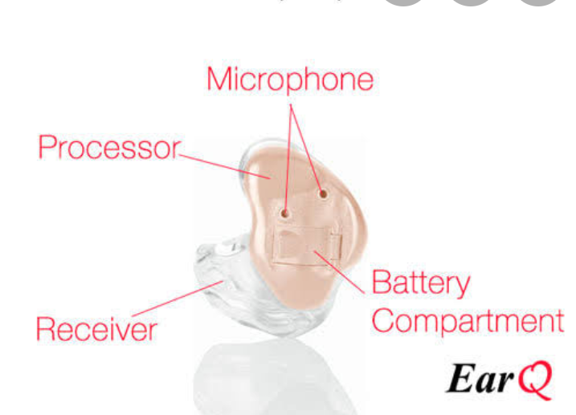
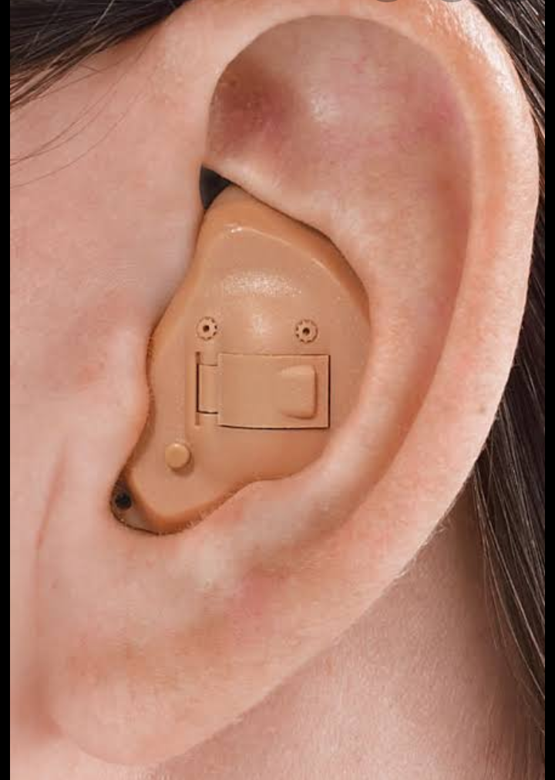
Add your title
Add your title

Slide 25
The Advantages:
1. There should always be twin microphones, twin microphones deliver much better clarity when you are in an environment that is noisy.
2. Because of the size of the aid, they may fit a more severe loss.
Add your title
Add your title

Slide 26
Disadvantages:
1. These type of hearing aids are more open to problems with moisture and ear wax. Cleaning them on a daily basis is necessary to prevent problems.
2. These type of hearing aids are more prone to repairs than BTE Behind The Ear Devices.
3. There could be feedback problems with this style because the receiver and microphone are closer together than in other styles of hearing devices.
Add your title
Add your title

Slide 27
Candidacy:
Add your title
Battery:13
Average power output:111db
Frequency range: severe hearing loss.
Add your title

Slide 28
ITC (in the canal):
Add your title
When an ITE hearing aid occupies a sufficiently small portion of the cavum concha and its outer face is parallel to the ear canal opening, it is referred to as an in the-canal (ITC) hearing aid.
Add your title

Slide 29
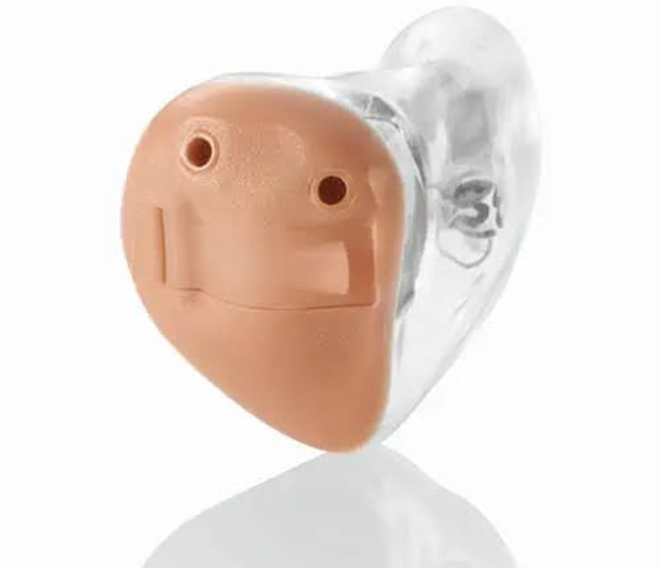
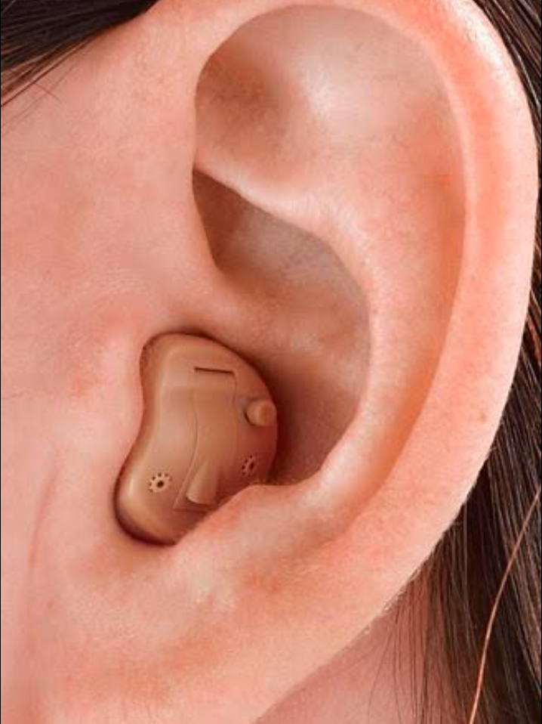
Add your title
Add your title

Slide 30
Advantages:
1. This style of hearing device is more discrete than the ITE ones are. This is a good style for anyone that may be self conscious about wearing a hearing aid.
2. Again, this aid may well fit dual mics so they can do well in noise, however, this is only if the person’s ear size allows enough room for dual microphones.
Add your title
Add your title

Slide 31
Disadvantages:
1. Again, you can have feedback problems because of the close distance between the receiver and the microphone.
2. The hearing device is more susceptible to ear wax and moisture damage since it is worn in your ear canal.
3. The devices more prone to repairs.
Add your title
Add your title

Slide 32
Candidacy:
Add your title
Frequency range: Mild to moderately Severe hearing loss
Battery:312
Average power output:102
Add your title

Slide 33
CIC (complete in the canal):
Hearing aids that do fit entirely within the ear canal are known as completely-in-the-canal (CIC) hearing aids. These hearing aids use components small enough that none of the hearing aid need protrude into the concha.
Removing these hearing aids from the ear can be difficult, so often a small handle, similar to nylon fishing line with a small knob on the end, is attached to the hearing aid and this does extend into the concha.
Add your title
Add your title
When the medial end of a CIC hearing aid is within a few millimeters of the eardrum, the CIC is referred to as a peri-tympanic CIC.

Slide 34
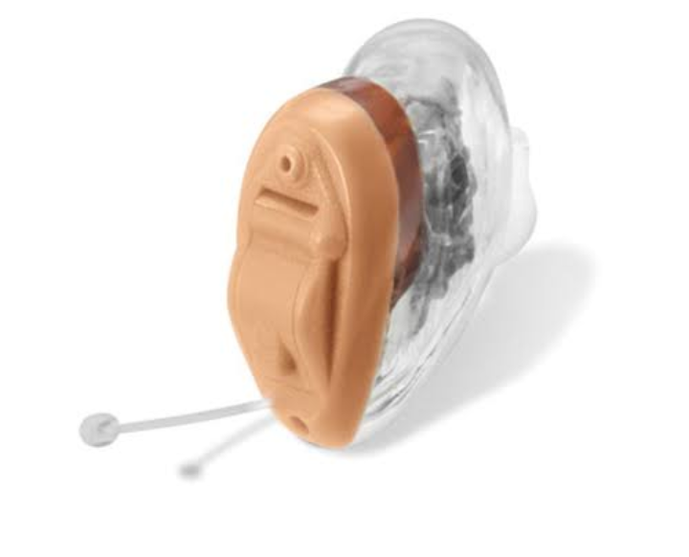
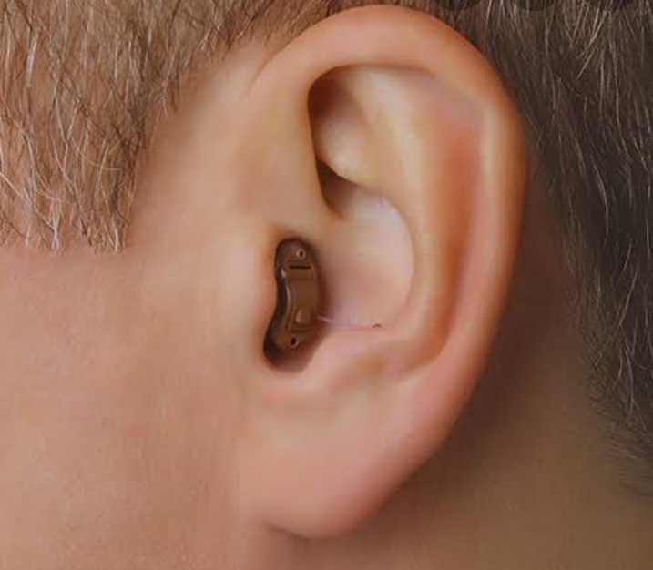
Add your title
Add your title

Slide 35
Advantages:
1. Small and very discreet; which makes them perfect for anyone that doesn’t want others to know you are using a hearing device.
2.Overall sound quality should be good because of its position in their ears.
Add your title
Add your title

Slide 36
Disadvantages:
1. The size of this hearing device makes it hard for some people to handle and use easily, especially people that have arthritis.
2. Feedback issues again
3. Because of the device's placement, it is probably one of the most prone to needing repair.
4. Occlusion, the feeling of talking in a bucket, can be a significant problem with this type of hearing aid fit.
Add your title
Add your title

Slide 37
Candidacy:
Battery:10,5
Frequency range: Mild to moderately severe hearing loss
Average power output:102
Add your title
Add your title

Slide 38
IIC ( invisible in canal):
Invisible-in-canal (IIC) hearing aids are the smallest custom hearing aids that are available. This kind of hearing aid is designed and sculpted to fit entirely insides your ear canal. This makes them almost invisible to those around you.
Add your title
Add your title
A deep fitting IIC hearing aid can really reduce the sensation of occlusion, such as hearing your own voice louder in your head, which can sometimes occur when an IIC hearing aid fits in the outer portion of your ear canal.
The location of the microphone in the ear canal, as opposed to behind the ear, can help with using the telephone and the preservation of the natural acoustics provided by the external ear.

Slide 39
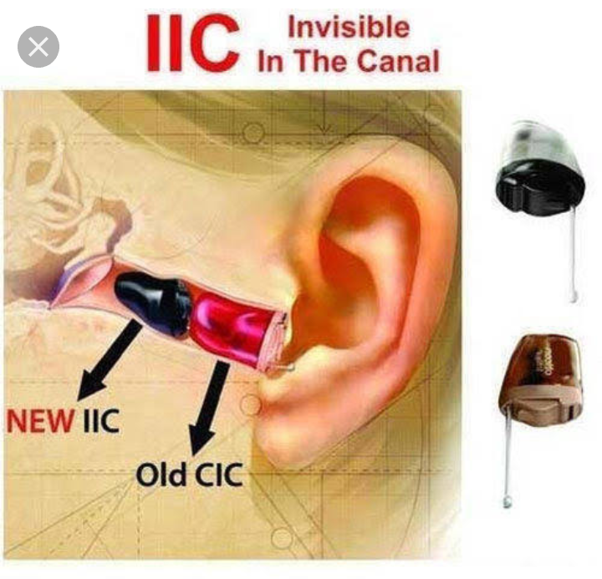
Add your title
Add your title

Slide 40
Advantage:
The most important advantage of the invisible Hearing aid is its small size. Some people avoid using Hearing aids because of the visibility factor. These people can now comfortably use an IIC. Since the Hearing aid fits beyond the second bend of the ear canal, it is not visible.
Add your title
Add your title
Since the IIC Hearing aid fits deep in the canal, the sound picked up by the microphone is more natural. The microphone does not pick up wind noise and other unwanted sounds.

Slide 41
Disadvantage:
The IIC does not suit people with a very narrow ear canal. People having a collapsed or a deformed ear canal cannot use this style of Hearing aid.
Add your title
Add your title
People having profound Hearing loss cannot use an IIC. Due to the small size of the amplifier components, the amplification is less compared to a BTE. New invisible Hearing aids are available for severe to a severely-profound category of Hearing loss.

Slide 42
Some users might get the plugged up or occluded feeling. Due to the small size of the Hearing aid venting is not possible. Venting is a method to release the pressure to reduce the occlusion or plugged in feeling.
Add your title
Add your title

Slide 43
Fitting:
Add your title
Based on the ear number of ear provided the hearing aid and the manner in which application is provided hearing aid can be classified in three ways:
Add your title
1 Monoaural fitting:
When the hearing aid is used only in one ear the fitting is called Monoaural fitting thus the aid has one microphone,one amplifier and one reciever.

Slide 44
2 Binaural fitting:
When application is provided to two ears by the way of two different hearing aid it is reffered as binaural fitting.
This hearing aid has thus two microphone, two amplifier and two reciever.
Binaural fitting hepls to locate a sound and improve speech intengibilty in noisy environment.
Add your title
Add your title

Slide 45
3 Pseudonaural fitting:
One body hearing aid fitted with V or Y cords give application simultaneously to both ears then this aid is called Pseudonaural fitting.
This type of fitting is still preferred in indian scenario as it is economical compared to Binaural fitting.
Add your title
Add your title

Slide 46
Implantable hearing aid (BAHA):
A Baha is a surgically implantable system that improves hearing by conducting sound through the bone to a functioning inner ear. It can be used for conductive or mixed (middle ear) hearing loss in one or both ears. It can also be used for single-sided deafness with normal hearing in the opposite ear.
Add your title
Add your title
After the implant becomes stable in the bone, an external sound processor is connected to either the abutment in the Connect system or external magnet in the Attract system. Sound then travels into the skull through vibrations, stimulating the inner ear and allowing for improved hearing.

Slide 47
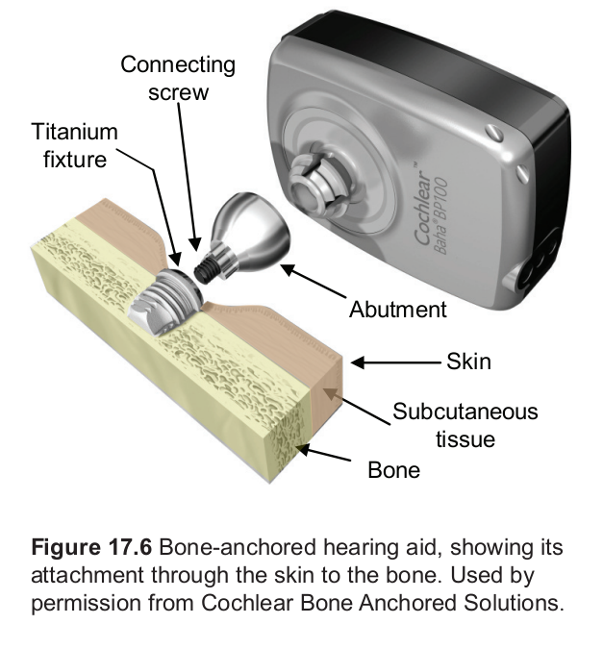
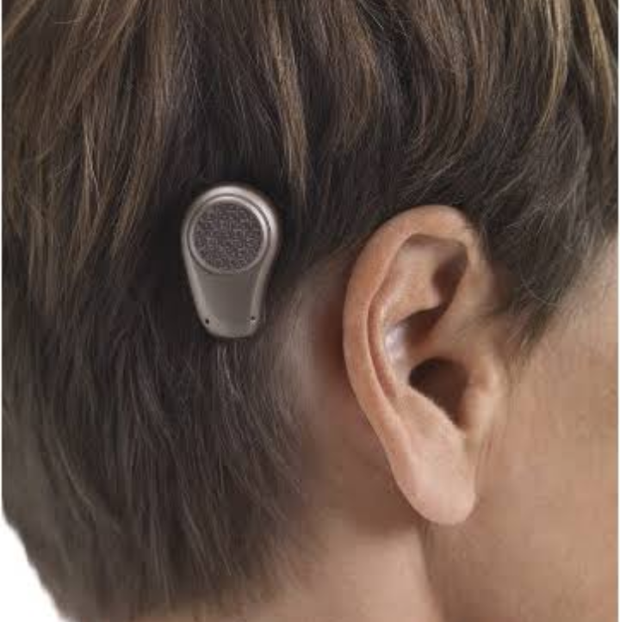
Add your title
Add your title

Slide 48
2. Middle ear implant:
Add your title
Middle ear implants are used where conventional hearing aids or bone conduction hearing devices are not an option due to medical reasons.
The devices are surgically implanted hearing aids. They send a signal to the middle ear which mechanically vibrates the middle ear bones. This increases the sound vibrations entering the cochlea where the vibrations are converted into electrical signals sent to the brain.
They can be an option for children (five years and above) who have conductive, sensorineural or mixed hearing loss and are unable to use conventional hearing aids.
Add your title

Slide 49
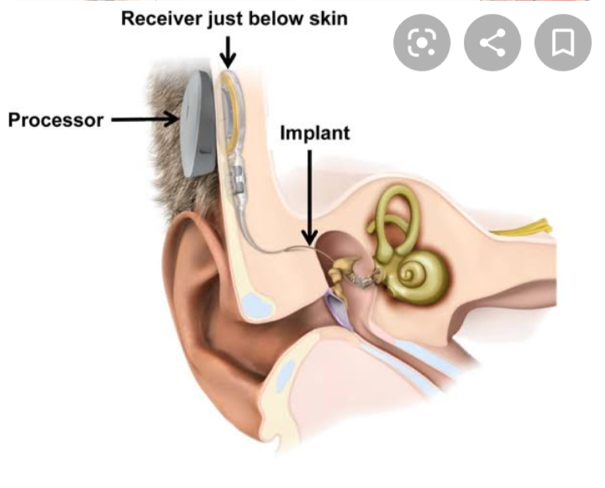
Add your title
Add your title

Slide 50
3. Auditory brainstem implants:
Auditory brainstem implants (ABIs) could be considered for deaf children who receive little or no benefit from hearing aids and aren’t suitable candidates for cochlear implants.
ABIs are still a very new development. Working in a similar way to a cochlear implant, an ABI stimulates the auditory brainstem directly, bypassing the ear and auditory nerve, to provide a sensation of hearing.
ABIs are mostly used by adults who have suffered trauma to their hearing nerve and would therefore not benefit from hearing aids or a cochlear implant, but a small number of congenitally (born) deaf children have an ABI.
Add your title
Add your title

Slide 51
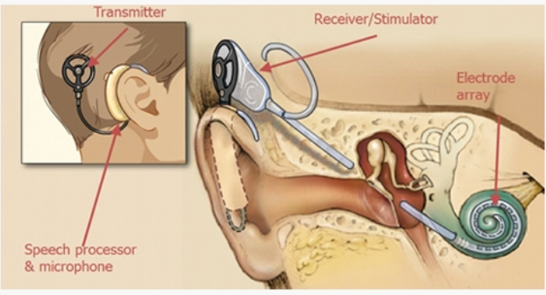
Add your title
Add your title

Slide 52
4. Cochlear implant:
A cochlear implant is a small, complex electronic device that can help to provide a sense of sound to a person who has severe to profound hearing loss. The implant consists of an external portion that sits behind the ear and a second portion that is surgically placed under the skin
Add your title
Add your title
An implant has the following parts:
A microphone, which picks up sound from the environment.
A speech processor, which selects and arranges sounds picked up by the microphone.

Slide 53
A transmitter and receiver/stimulator, which receive signals from the speech processor and convert them into electric impulses.
An electrode array, which is a group of electrodes that collects the impulses from the stimulator and sends them to different regions of the auditory nerve.
An implant does not restore normal hearing. Instead, it can give a deaf person a useful representation of sounds in the environment and help him or her to understand speech.
Add your title
Add your title

Slide 54
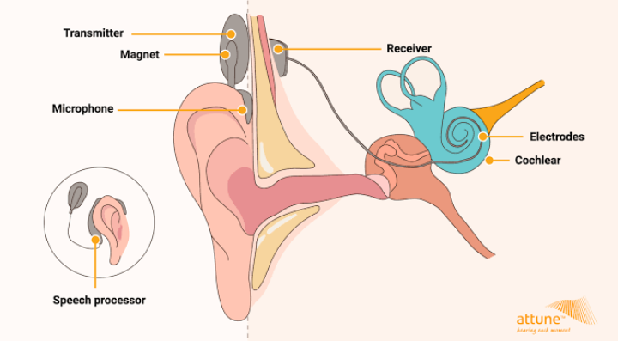
Add your title
Add your title

Slide 55
Directional hearing aid:
Add your title
Directional hearing aids can improve the signal-to-noise-ratio (SNR) of speech occurring in a noisy background. Amplification of background noise is one of the most significant consumer-based complaints associated with hearing aids. Although other technologies (FM systems, direct audio input, assistive listening devices, etc.) can improve the SNR, directional microphones are the only "hearing aid option" proven to improve speech understanding in noise (Killion, 2004 and Dillon, 2001).
Add your title

Slide 56
Binaural hearing aid:
Enhanced sound localization.
Better perception of speech, even when there are background noises present.
It is easier to listen and hear the way we naturally do.
Improved phone conversations with hearing aids.
Add your title
Add your title
Increased brain power for processing and interpreting sounds. When sound enters your left ear, it is processed on the right side of your brain; conversely sounds that enter your right ear are processed on the left side of your brain.
Less amplification is required when you wear two hearing aids vs. one.

Slide 57
Programmable hearing aid:
Add your title
These aids have a circuitry that functions in same fashion as analog circuitry, however the parameters of signals are controlled digitally.
These aids are more comfortable and compatible with the person's hearing loss as they can be programmed as per the needs of the client.
Add your title

Slide 58
Digital hearing aid:
Add your title
Fully digital hearing aids have most advanced and expensive type of circuit called digital signal processing (DSP).
These aids are nothing but a wearable computer in which analog signal is converted to digital signal. All function of this aid are programmed by software.
These type of aid can be fitted for all types of Hearing loss.
Add your title

Slide 59
Add your title
Add your title
Any queries...????

Slide 60
Add your title
Add your title
Thank you

