Slide 1
CROS HEARING AID
Presented by :-Arjun vishwakarma
B.ASLP 3th semester

Slide 2
CROS Hearing Aids
A Contralateral Routing Of Signals (CROS) hearing aid is a type of hearing aid that is used to treat a condition in which the patient has no usable hearing in one ear and minimal hearing loss or normal hearing in the other ear.
This is referred to as Single Sided Deafness.
The CROS hearing Aid takes sound from the ear with poorer hearing and transmits to the ear with better hearing.

Slide 3
The major disadvantage of all types of CROS aids
is that a connection must be made between the two
sides of the head.
The most common solution is wireless
transmission, for which the major disadvantage
is decreased battery life compared to self-contained
hearing aids.
Wireless CROS hearing aids look no
different from other BTE or ITE hearing aids, but
of course one of the hearing aids contains a wireless
transmitter and the other contains a wireless receiver.

Slide 4
CROS aids: the essentials
For patients with a unilateral hearing loss:
A CROS aid merely transfers sound from one
side of the head to the other.
A CROS fitting should not amplify sound,but if it does, the disadvantages are likely to outweigh the advantages.

Slide 5
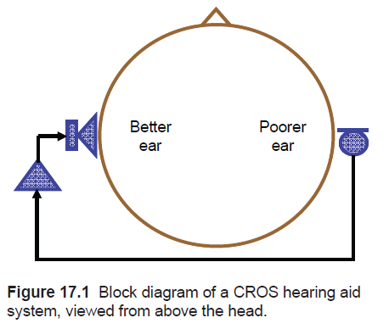

Slide 6
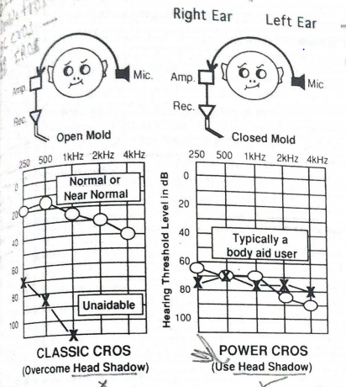

Slide 7
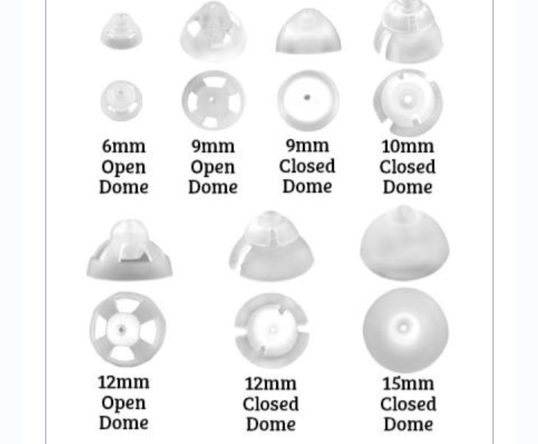

Slide 8
ADVANTAGES
The major advantage of this arrangement is that sounds can be heard in the ear with the better residual hearing ability no matter which direction they come from.
The head acts as a baffle for high-frequency sounds, boosting those sounds that come from the near side of the head and attenuating those that come from the far side.
If the signal comes from one side of the listener and the predominant noise comes from the other side

Slide 9
Candidacy for simple CROS aids
Patients who may benefit from a CROS fitting are those with a unilateral hearing loss, where the loss in the poorer ear is so great that aiding it will be of no benefit.
The better ear should have normal hearing or
at most a mild high-frequency hearing loss. Patients will particularly benefit if they frequently need to listen to signals arriving from the side of the head with the deaf ear.

Slide 10
patients require open earmolds to avoid occlusion but also require substantial high-frequency gain. Feedback cancellation

Slide 11
Fitting procedure for CROS aids
The better ear receives the sounds that arrive directly at that ear mixed with an amplified version of the sounds that arrive at the poorer ear.
When the sound source is on the better ear side, it is advantageous for sounds that enter the better ear directly to dominate this mixture.
Conversely, when the sound source is on the poor ear side, it is advantageous for sounds picked up by the satellite microphone to dominate the mixture.

Slide 12
Bilateral CROS (BICROS) aids
If the better ear has a hearing loss, the patient is likely to benefit from amplification no matter which side of the head the wanted sound comes from.
The only way to always pick up the clearer signal is to have a microphone mounted on each side of the head.
If each of these microphones is connected to the same amplifier and receiver,

Slide 13
The BICROS system also works effectively for signals coming from directly in front of the listener.
In this case, the wanted signal reaches the two microphones simultaneously and so the outputs of the two microphones are added together.
Sounds coming from other directions reach the two microphones out of phase by different degrees.

Slide 14
The BICROS system confers only a minor advantage in defeating feedback, because one of the two microphones is near the ear canal receiving the amplified sound,
Candidacy for BICROS aids:-
Patients can benefit from a BICROS hearing aid if they have an asymmetric bilateral hearing loss such that the poorer ear has too great a hearing loss to benefit from a hearing aid

Slide 15
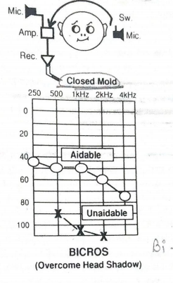

Slide 16
IROS hearing aid
Ipsilateral routing of signal is merely a conventional monoaural or binaural fitting
The microphone mounted on the ear with decrease hearing feeds it's output to the amplifier on the same ear

Slide 17
When the use without the crossover mechanics , the fitting is referred to as an IROS (ipsilateral routing of single) fitting and is a standard hearing aid with a nonoccluding or ‘’free field ‘’ earmold on the same side not truly a CROS variation , IROS can be beneficial for mild - to – moderate , sensory neural hearing loss

Slide 18
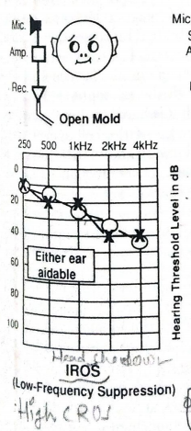

Slide 19
Head Shadow Effect ,Baffle effect , Head Diffraction

Slide 20
Introduction
A head shadow or acoustic shadow is a region of reduced amplitude of a sound because it is obstructed by the head (diffracted).
Sound may have to travel through and around the head in order to reach an ear.

Slide 21
Example
To appreciate how directional differences are represented acoustically at the ears, let us suppose that a loudspeaker is located at an azimuth of 45° to the right,
even though the original sound is the same, it reaches the left (“far”) ear differently than it does the right (“near”) ear.

Slide 22
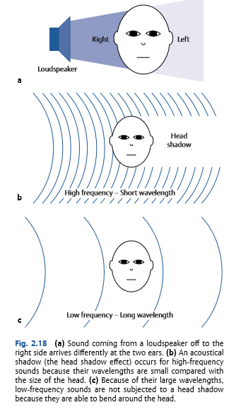

Slide 23
As a result, the sound reaches the far ear at a softer level than it reaches the near ear. This level disadvantage at the far ear is called the head shadow effect.
The head shadow occurs for frequencies that can be obstructed by the head. This occurs for sounds with wavelengths that are short compared with the size of the head
Recall that wavelength gets shorter as frequency increases. Hence, the head shadow affects relatively higher frequencies, especially those over ~ 1500 Hz.

Slide 24
This level difference between the ears is called an inter-ear (interaural) intensity difference

Slide 25
Diffraction effects
Introduction:-
Diffraction is the bending of sound waves in the presence of obstacles.
Dependent on the wavelength of sound and the size of the obstacles
A small obstacles dose not produce any hindrance in the path of sound waves or does not leave any shadow
When an obstacles which is much larger than the wavelength of sound wave , diffraction occurs .

Slide 26
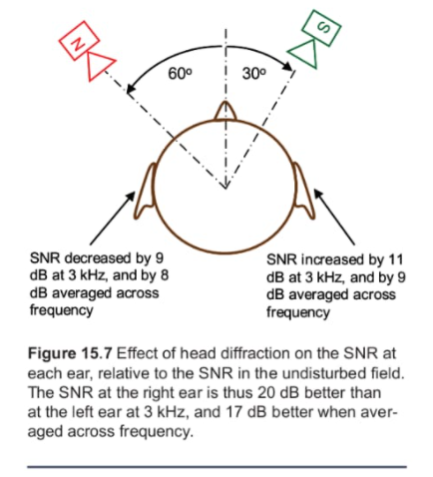

Slide 27
Head Baffle
Refers to the fact that sound waves impinging on the surface head will be reflected
The incident and reflected waves may then combine near the side of the head to create greater sound pressure than that without the head

Slide 28
Any Query

Slide 29
Thank you

