Slide 1
Group amplification
Submitted to: Muneer Sir
Presented by: Jay Mehta
BASLP 3rd sem

Slide 2
HARDWIRE DIGITAL PROCESSING
• Hardwire system provides a direct connection between the sound source and the individual.
• In hardwire system a wire connects the microphone to the amplifier, which is connected directly to the receiver (headphones, ear buds).
• The teachers (speaker’s) microphone is connected to an amplifier and the resulting amplifier signal is then delivered to a series of headsets located in fixed positions.

Slide 3
Cont.
• A wireless microphone may be used to give speaker more mobility. Microphone has to be placed close to the lip of the teacher. The individual headset has the volume control (gain control) and the balance control boxes. This control allows adjusting the individual gain independently to each ear according to the degree of hearing loss of the child (listener).
• Additional microphone wired to the amplifier may also help the other children to hear and to hear himself which helps in self-monitoring and child to child communication (Bess, 1981).
• The number of headphones to be connected to the system is depending on the capacity (power) of the amplifier. 10, 12, 16, numbers of students can be connected with the hardwire system.

Slide 4
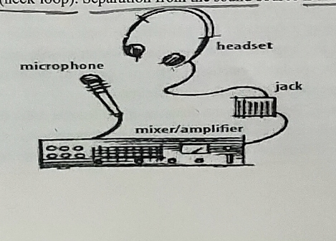
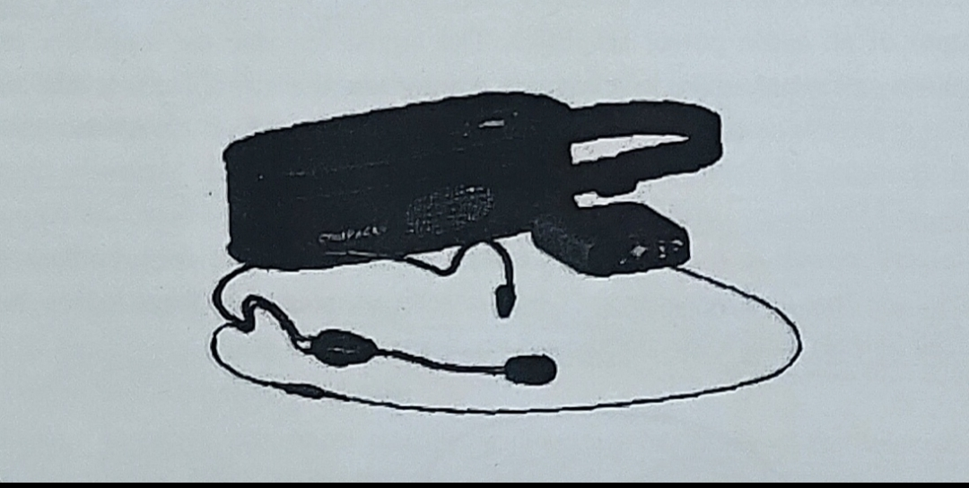
Pictures

Slide 5
Advantages
• These systems generally provide a wide frequency range, low distortion and high sound pressure output under the headsets
• They may be adapted to the child’s hearing loss and are fairly reliable and simple to operate (Bess, 1981).
• The cost of hardware is very less.
• Most of the Indian Deaf schools use hardware systems because of their usefulness and cost effectiveness and simplicity.

Slide 6
Limitations
•Unfavorable S/N Ratio may occur due to the presence of monitoring microphone. (Bess, 1981).
• Lack of mobility for student and teachers.
• They lack flexibility, in that they seldom allow for individual adjustment of frequency Repair service is not readily available.
• They are not specified as medical devices by Food and Drug Administration (FDA), therefore there are no standards for the EAC (gain, frequency response).

Slide 7
INDUCTION LOOPS
• The audio induction loop technology is as old as transformer technology. Loops have been used to help the hearing impaired for about 40 years. The loop induction system makes use of electro-magnetic leakage to transmit signals.
• The components of a "loop" induction system are a microphone, an amplifier, and a length of copper wire that loops the seating area. The microphone pick-up the acoustic voices and generates a magnetic field that couples with the telecoil in the hearing aids (Vaughn and Lightfoot, 1987).

Slide 8
CONT.
• Some loops are connected to standard public address systems. The electric current flowing through the loop creates a magnetic field that can be picked up by a hearing aid set on the T-Switch. Portable receivers are available for hard of hearing individual without a hearing aid T-switch. To pick up the signals, listener must sit within or near the loop.

Slide 9
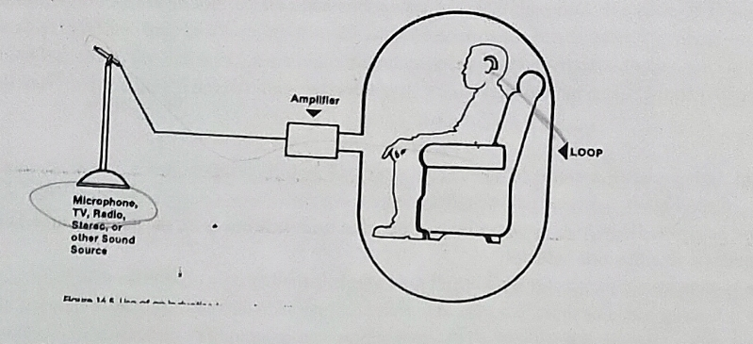
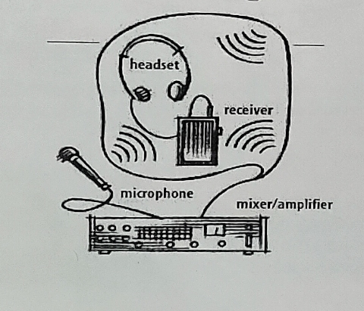
PICTURES

Slide 10
Advantages
•Gives better SNR.
• Mobility of children is not affected in the classroom.
• Frequency range is large.
• Constant and equal distribution of teacher’s SPL in classroom.
• Same hearing aid can be used inside and outside the class. So the kind of output he gets inside the class and outside is same.
•It is relatively inexpensive and easy to install.

Slide 11
Disadvantages
• Require the HA or some device with Telecoil.
• There might be a time delay in the signal received through M-position and T-position. This can affect intelligibility of speech by the child.

Slide 12
FREQUENCY MODULATION
• FM systems, benefiting hard of hearing users in general society. They work in this way: Sound is picked up at the source by a microphone, the speech is frequency modulated into radio frequency carrier wave and transmitted through air by FM transmitter. The FM receiver worn by the HI person receives the signal and demodulates the speech, amplifies it and delivers it to the ear via earphone or listener’s hearing aid.

Slide 13
Cont.
• Since transmission can occur over a 300-foot range, this system is ideal for group situations, including meetings in dining rooms and lounges, church services, and theatres. The FM system can be used in conjunction with an individual's hearing aid. To work in tandem with the FM system, the hearing aid must have a T-switch turned to the "T" position, or there must be a means for direct audio input to the hearing aid. In the first instance, a small "necklace" loop worn around the neck connects to the individually worn FM receiver.

Slide 14
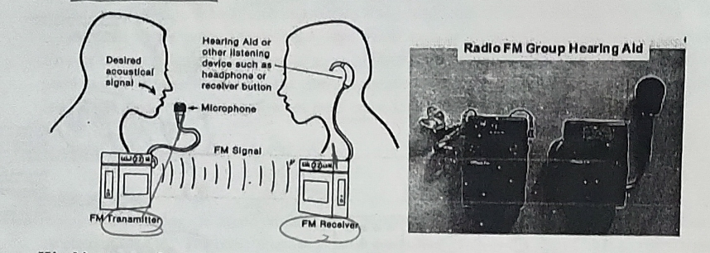
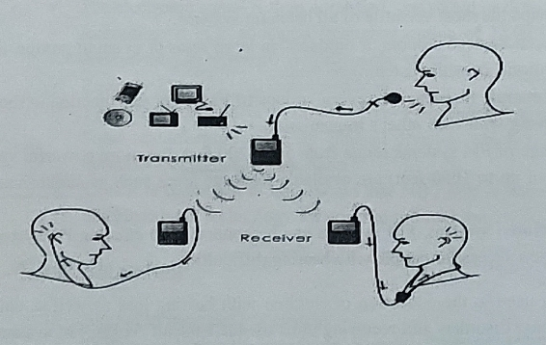
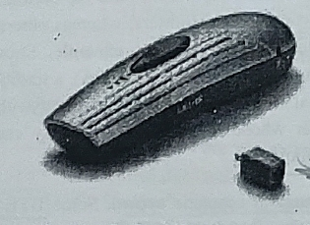
PICTURES

Slide 15
INFRARED TRANSMISSION
•Infra-red transmission means that the transmission of signals by infra-red light. In Infrared Systems the sound picked up by the microphone is converted into infrared light waves, which are then dispersed throughout the listening environment through IR transmitter. A special IR receiver is worn by the listener, which converts these light waves’ backs to sound. Like FM systems, infrared systems are useful in-group situations and may be adapted for individual use as well.
• These large area systems require the installation of an infrared light emitter that is plugged into the existing public address system. Harmless infrared light rays transmit the sound to portable infrared receivers, which are available headphone form.

Slide 16
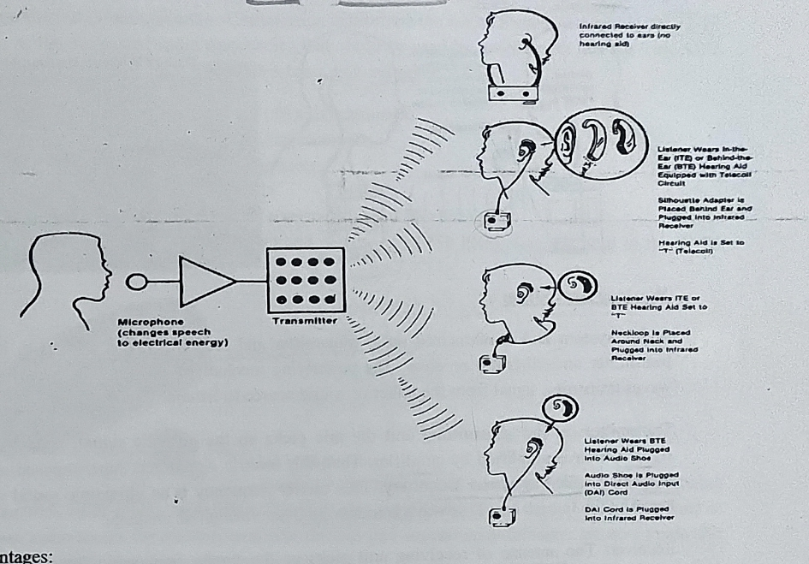
PICTURE

Slide 17
ADVANTAGES
It offers a high fidelity signal to broad frequency range. The frequency range extends from 100 Hz to 8000Hz.
Gives high output, about 120 dB.
SPL can be controlled by individual listener.
Reliable and durable.
The IR receiver is universal and can be used with any IR transmitter
Mobility is not affected.
IR commonly used in courtrooms, movies theaters and live performance theaters, conventions and with TVs.

Slide 18
DISADVANTAGES
•It can’t be used outdoors or in a room without emitter.
• Susceptible to interference from bright sunlight or fluorescent lights
• Typically requires line-of-sight between the IR transmitter and the receiver i.e any obstruction in front of receiver affect signal.

Slide 19
Any queries

Slide 20
REFERENCE
HEARING AIDS – HARVEY DILLON SECOND EDITION

Slide 21
Thank you

