Slide 1
Binaural interaction tests
Presented by:- Geeta Alimchanadani and Thummar Manasvi from 2nd year B.ASLP
Submitted to:- Muneer sir

Slide 2
Introduction
The 2005 ASHA technical report on central auditory processing disorder (CAPD) identified binaural interaction as one of the main central processes that may need to be assessed as part of the evaluation for a CAPD, particularly if the referring complaint or clinical information indicates that there may be a deficit in this domain ( eg- difficulty with sound localisation or hearing in background noise).

Slide 3
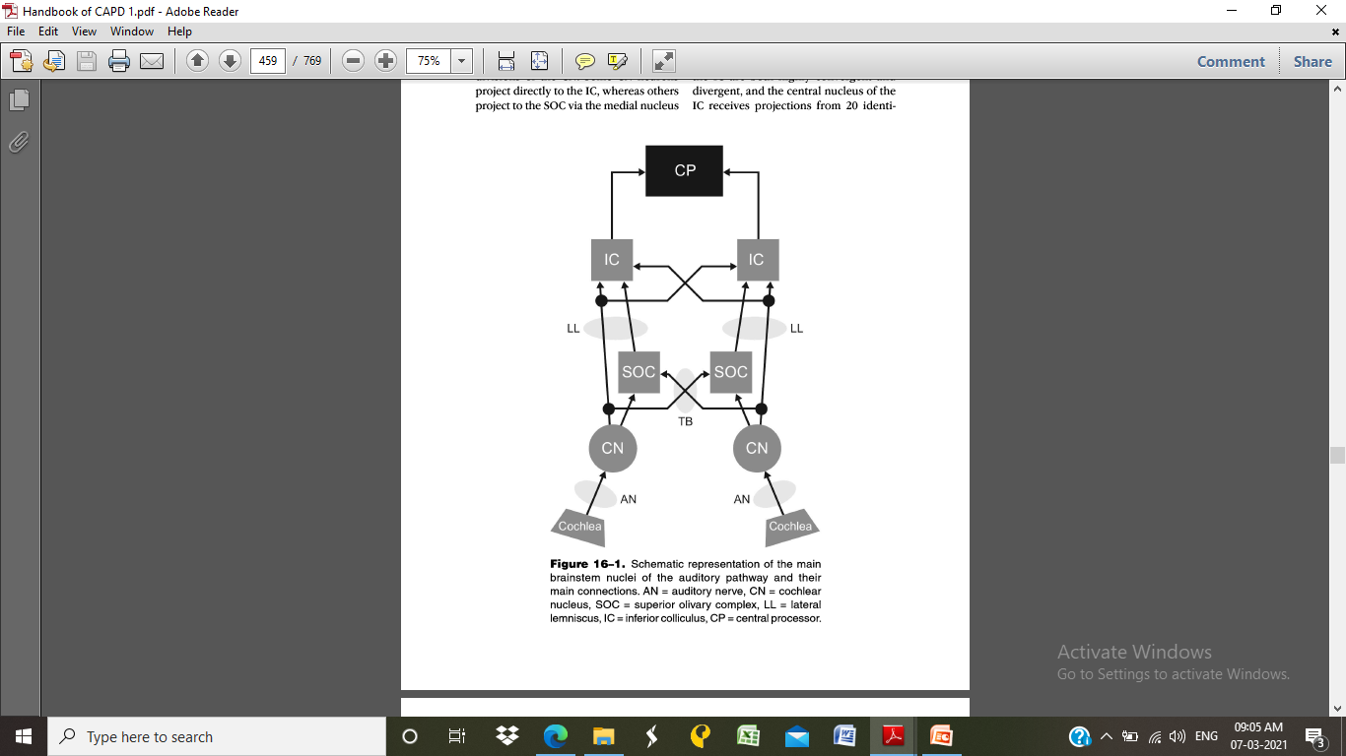

Slide 4
MASKING LEVEL DIFFERENCE
Masking level difference (MLD) refers to the difference in intensity (dB) between signal detection thresholds in two binaural masking paradigms, which differ in phase attributes.
The masking paradigms are termed as
-Homophasic
- Anaphasic

Slide 5
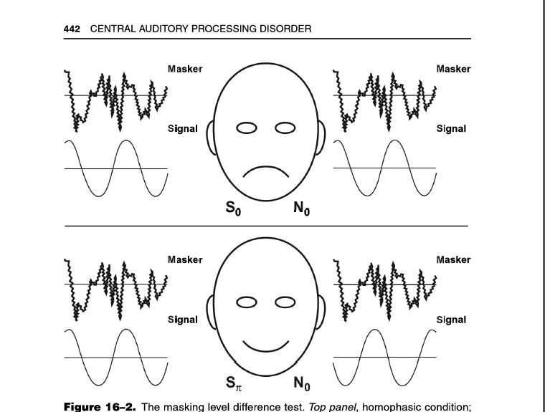

Slide 6

Masking Level Difference refers to the improvement in detecting a tone or speech in noise when the phase of the tone or the noise is reversed by 180 degrees. It aims to assess central auditory function and is specifically sensitive to brainstem lesions, but peripheral changes (like a hearing loss) may also affect the MLD.
The MLD is a low frequency phenomenon, related to the ability of the auditory system to perceive differences in timing of a sound reaching the two ears. This helps to localise low frequency sounds that reach the ears at different times due to the longer wave length.
The MLD is usually referred to as the difference of improvement in dB between a “homophasic” (in-phase) condition and an “antiphasic” (out of phase) condition. Homophasic means that both the signal and the noise are in phase with each other when reaching the two ears. Antiphasic means that either the signal or the noise (not both) is out of phase with each other when reaching the two ears.

Slide 7



The three test conditions for the MLD are:
S0N0: Signal and Noise are IN PHASE when reaching the two ears (Homophasic condition).
SπN0: Signal is OUT OF PHASE, noise is IN PHASE when reaching the two ears (Antiphasic condition)
S0Nπ: Signal is IN PHASE, noise is OUT OF PHASE when reaching the two ears (Antiphasic condition)

Slide 8
The MLD is measured by presenting a low frequency pulsed tone with simultaneous presentation of the corresponding narrow band noise, starting at an intensity of 60 or 65dB to both ears. The first condition should be to find the threshold for the homophasic condition (referred to as S0N0). The next step is to measure the antiphasic condition, either presenting the tone out of phase or the noise out of phase and the masked threshold is determined again. If the brainstem is functioning normally, there will be an improvement in the masked threshold from the homophasic condition to the antiphasic condition. The condition that will yield the greatest MLD is the SπN0 condition, that is, the condition where the signal is out of phase when reaching the two ears but the noise is still in phase.

Slide 9
Test Procedure
Press and hold the Tests button on the audiometer and use the scroll wheel on the audiometer to select MLD: Masking Level Difference.
Before mounting the headphones on the patients, explain to them that they will now hear tones (identical to the ones from the air conduction audiometry) and noise through the headphones. Emphasize that they should only focus on the tones and press the response button whenever it is audible.
Select the frequency that you would like to test; 250Hz or 500Hz is a good starting point.
Select S0N0 and set the intensity level for both channels at 60dB.
Ensure that the decibel steps are set to 2dB.
S0N0: The signal will be presented to both ears in phase (S0N0). Narrow band noise is also presented at a fixed level.
Make a masked threshold search. The threshold will typically be equal to the noise in the S0N0 condition.
When you have established a threshold, click in the Store button.
SπN0: Select the SπNo button, leaving the narrow band noise intensity level at 60dB. The pulsed tone detection should lower significantly.
The difference between the S0N0 threshold and the SπN0 threshold will be the MLD.
S0Nπ: If desired, you can also establish the threshold for the S0Nπ condition.

Slide 10
MLD Result
The masked threshold for the S0N0 condition is 60dB and we reverse the phase of the signal by 180 degrees the threshold for this phase reversed condition (SπN0) improves to 44dB. Then the masking level difference (MLD) from SoNo to SπN0 is 16dB.
Most research having been done on the MLD indicates that in general, if the MLD is less than 7dB, this will indicate a problem with the brainstem and binaural interaction. There will also be a decrease in the hearing MLD if there is a peripheral hearing loss or if the hearing aid is asymmetrical. A normal result for MLD is usually around 12dB (Brown & Musiek, 2013).

Slide 11
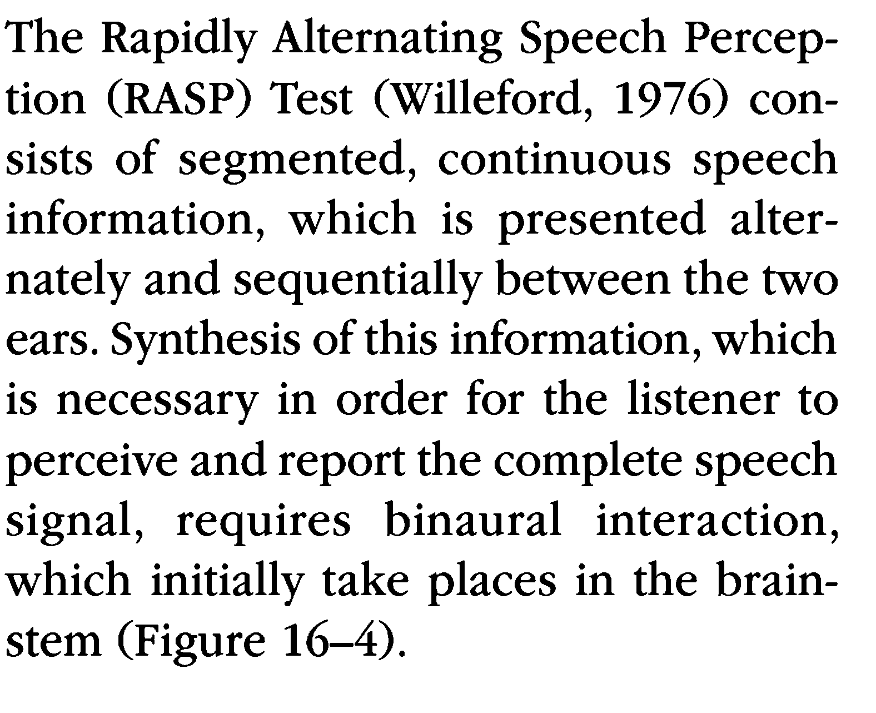
RASP

Slide 12
Procedure
In this test segments of a sentence with approximately 7 words are presented alternately between the two ears , at a 300 ms alternation rate and at 40 db SL referenced to the PTA. Twenty sentences are presented in total, 10 with the right ear receiving the initial sentence segment first , and 10 with the left ear receiving the sentence segment first.
Since it is a binaural interaction , a single score rather than separate left and right ear scores is sufficient to identify deficits.

Slide 13
Result of RASP in different populations must BE Interpreted with caution as this test may also be affected by peripheral hearing loss.
This test is abnormal for lower motor neurons , not upper motor neuron.
This test shows poor sensitivity to brainstem lesions.
.

Slide 14
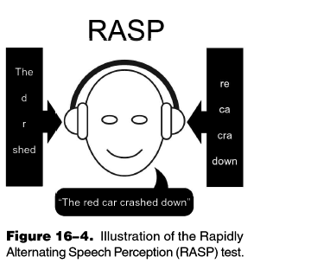

Slide 15
BFT(binaural fusion test)
The binaural fusion test (BFT) involves presentation of different segments of band-pass filtered speech to the two ears with a low-band-pass filtered speech stimulus presented to one ear and a high- band-pass filtered presentation of the same speech stimulus to the other ear (i.e., dichotic presentation).

Slide 16
The patient must fuse the information from each channel in order to report the word . katz and Ivey (1994) proposed that these tests should be more aptly termed "binaural resynthesis "since the listener must combine simultaneous and complementary segments from the two ears into one composite item, rather than fuse or join equal signals into one midline image.

Slide 17
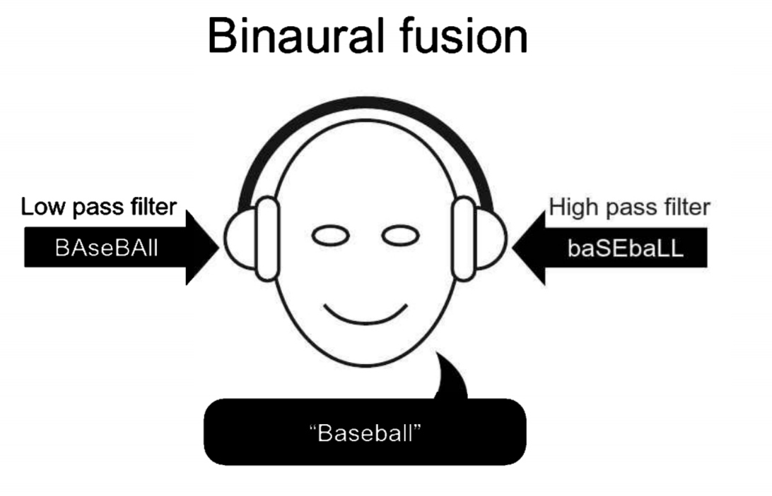
Probably the most well-known test of binaural fusion was included in Will- eford's (1977) test battery.
Figure 16-5. Illustration of the binaural fusion paradigm

Slide 18
In this BFT, 20 spondees filtered through a low-band- pass (500-700 Hz) filter and a high-band- pass (1900–2100 Hz) filter are presented at 30 dB SL referenced to the listener's 500 Hz threshold (low-band) and 2000 Hz threshold (high-band) (Willeford, 1977) (Figure 16-5).
Interpretation for an Indicated disorder
Subjects with a central auditory processing (CAP) disorder have marked difficulty on this task under all test conditions .

Slide 19
They have difficulty with both single and binaural presentations.
The score for binaural presentation may increase as sensation level (SL) increases above 30 dB SL re: PT threshold, but it will not reach the 75th percentile.
Interpretation for Normals
Normals have difficulty with each track when presented monaurally, especially with the high band.

Slide 20
However, normals are able to integrate the two bands together when presented simultaneously.
Scores progressively increase as sensation level (SL) increases. Normal performance is 75% or better.
Numerous five-year-olds perform within normal limits .
Older adults perform normally in the absence of processing difficulties.

Slide 21
Listening in Spatialized Noise (LisN)
Test Description
Binaural interaction may also be assessed using the recently developed Listening in Spatialized Noise-Continuous Discourse Test and subsequent version of Listening in Spatialized Noise-Sentences which shows a good correlation with MLDS (Cameron et al., 2006).

Slide 22
The test represents a new and different approach to assessing binaural interaction and is administered by special computer soft- ware via headphones and produces a virtual three-dimensional auditory envi- ronment.
The three-dimensional effect is achieved by processing the speech stimuli with head-related transfer functions (HRTFS), so that the target sentences in LİSN-S are perceived as coming from directly in front of the listener (0° azi- muth), while the competing speech (chil- dren's stories) is manipulated in respect to its location (0° versus + 90° azimuth).

Slide 23
In addition, the vocal quality of the speaker(s) is manipulated (same as, or different to, the speaker of the target sen- tences).
Thus, four listening conditions exist, same voice target and competing speech at 0° azimuth (SVO), same voice at + 90° azimuth (SV90), different voices at0° azimuth (DVO), and different voices at + 90° azimuth (DV90).

Slide 24
The listener's perfor- mance in each of the listening conditions is measured in dB (signal-to-noise-ratio; SNR) and the speech reception threshold is thus adaptively determined.
Further- there are three derived "advantage" that include talker advantage, spatial advantage, and total advantage, that represent the benefit in dB gained when the maskers contain either vocal (DV0), spatial (SV90), or both vocal and spatial cues (DV90), compared with the more, measures, baseline (SV0) condition in this figure.

Slide 25
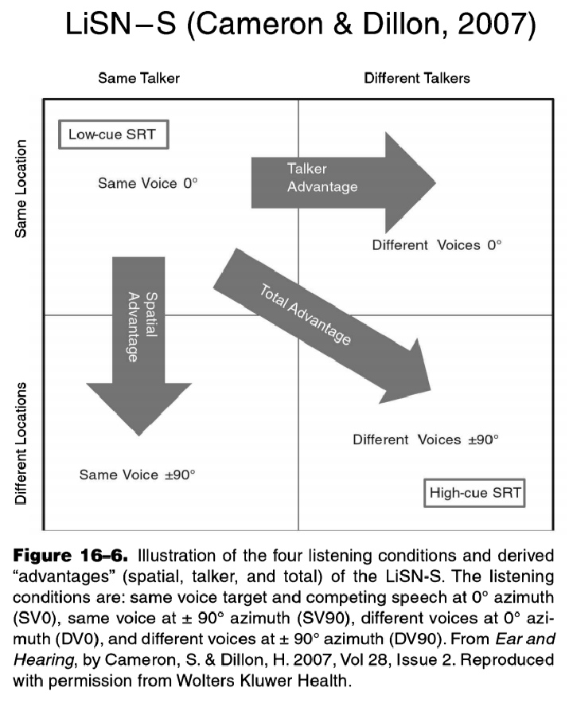

Slide 26
Results
There were no significant differences between the CAPD, LD, or control groups on the conditions of the LISN-S where both the target and maskers emanated from 0° azimuth (low-cue SRT, p= 0.978; talker advantage, p =0.307).
However, there were significant differences between groupson the performance measures where the maskers were separated from the target by + and -90°. Post hoc tests revealed that there were no significant differences between the LD group and controls on any of these measures.

Slide 27
There were, however, significant differences between the CAPD group and the controls on all the conditions where the maskers were spatially separated from the target (high-cue SRT, p =0.001; spatial advantage, p <0.0001; total advantage, p<0.0001).
The LISN-S did not correlate significantly with any test in the traditional test battery, nor were the nonspatial and spatial performance measures of the LISN-S correlated.

Slide 28
Any doubts?

Slide 29
Reference
Handbook of Central auditory processing disorder; volume1; Frank E. Musiek , phD

Slide 30
Thanks

