Slide 1
ASSISTIVE LISTENING DEVICES
Submitted to: Muneer Sir
Presented by: Jay Mehta
BASLP 3rd sem

Slide 2
ASSISTIVE LISTENING DEVICES
An assistive listening device (ALD) is any type of device that can help you function better in your day-to-day communication situations.
An ALD can be used with or without hearing aids to overcome the negative effects of distance, background noise, or poor room acoustics.
So, even though you have a hearing aid, ALDs can offer greater ease of hearing (and therefore reduced stress and fatigue) in many day-to-day communication situations

Slide 3
Cont.
Assistive Listening Devices (ALDs), essentially they are amplifiers that bring sound directly into the ear. They separate the sounds, particularly speech, that a person wants to hear from background noise
They improve the "speech to noise ratio".
Research indicates that people who are hard of hearing require increasing the signal to noise ratio of about 15 to 25 dB in order to achieve the same level of understanding as people with normal hearing.
They can be categorized into those that improve intelligibility and those that detect environmental events.

Slide 4
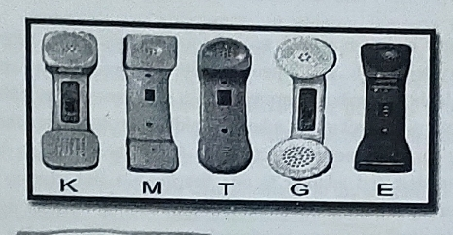
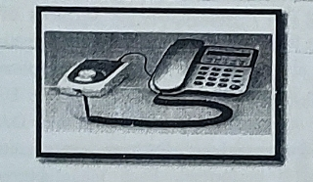
Pictures

Slide 5
ALDs that improve intelligibility.
Intelligibility is improved by locating a microphone closer to the source than is usually possible for the user to be or by directly connecting a source device (e.g. TV) to a transmitter. ALDs that improve speech intelligibility can be further categorized according to their purpose:1678
● One-to-one communication, such as for listening to a conversation partner in a car or in a noisy or reverberant place. An example is a personal wireless system (e.g. infra-red or radio-frequency FM) with the receiver coupled to a hearing aid or coupled to headphones and used without a hearing aid.

Slide 6
Group listening systems, such as sound-field systems, infra-red systems, and magnetic loop systems. While in principle it should be possible for a user to purchase a receiver and use it with transmitters available in public places like theatres, the variety of system types (infra-red and radiofrequency), carrier frequencies, and modulation types, makes it unlikely that any single receiver will be compatible with multiple venues that the user frequents. Magnetic induction systems do not have this disadvantage, provided the hearing aid has a telecoil.

Slide 7
● Television devices, which either pick up the television audio via a plug-and-socket, or use a microphone placed very close to the television loudspeaker. The signal can be delivered to the user via hard-wired connection or a wireless link, which in turn can be either radio-frequency transmission or magnetic loop induction. The loop can be room-sized, chair-sized, or ear-sized. Of course, radios, home stereos, or any other electronic media source can, in principle, be connected in the same way. Clinicians should also make the patient aware of the very significant intelligibility advantage that closed captioning provides for TV watching.

Slide 8
Telephone devices, which include:
an amplified telephone;
an amplifier that is inserted between a regular telephone and its wall socket; or
a coupler that picks up the acoustic signal coming from the receiver and amplifies it, to create either a stronger acoustic output, a stronger magnetic output, or an electrical signal that can drive a neck loop or a silhouette coil.

Slide 9
The most ALDs that alert the user to environmental events.
Alerting ALDs comprise a sensor of some type linked to an output that can be easily detected by the hearing impaired person (flashing light, vibrator, or intense low-frequency sound). common sensors/ detectors or triggers are
a telephone ring sensor;
a baby cry sensor;
a smoke detector;
an alarm clock; and
a doorbell.

Slide 10
The ALD comprises one or more of these detectors or sensors, plus one or more output transducers, the most common of which are:
a loud sound with low, or adjustable pitch;
a bright flashing light; and
a vibrator that can be placed under the mattress or pillow, or carried in the pocket in the form of a pager.

Slide 11
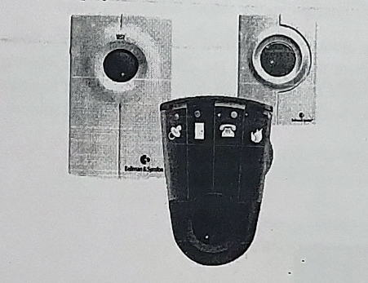
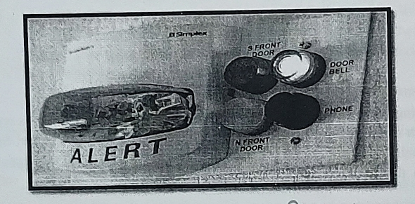
Pictures

