Slide 1

Presentation on:
Routing of signals
Presenters:
Pratibha Nagalakshmi
Vimala Jayakrishna
Rakshita Gokula

Slide 2

Single sided deafness
Minor inconve-nience
Hearing from only one ear
Many disadvantages

Slide 3

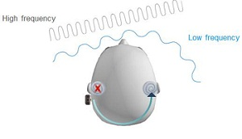
HEAD SHADOW EFFECT

Slide 4

Binaural summation of sounds not possible
Squelching of noise not possible
High frequency sound perception very bad.

Slide 5
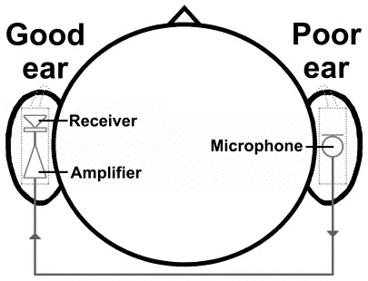
Satellite microphone
Basic CROS

Slide 6

Bilateral CROS
Patient benefits from amplification no matter which side the sound is coming from.
Microphones present on both sides of the head.
Both microphones are connected to the same amplifier and receiver.
The wanted signal reaches both the microphones effectively and are added up before they are amplified.
Sounds from behind are also amplified and signals reaching the two microphones which are out of phase are cancelled.

Slide 7
Stereo CROS
Two separate CROS aids
Left Mic feeds receiver on the right and vice versa
Higher gain than conventional HAs
Less likely to suffer from feedback oscillations
Better than wearing two separate hearing aids

Slide 8
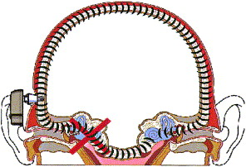
Trans-cranial CROS
Also known as Power CROS, Internal CROS.
Transmits signal from one side of the head to the other side using Bone conduction.
The receiver creates an intense SPL in the residual ear canal volume of the dead ear and this vibrating air generates vibrations within the temporal bone
The fitting cannot be verified with a real-ear gain analyzer since no there is no sound pressure relevant to the fitting goal in either ear canal.
The hearing aid should be adjusted so that sounds at all frequencies are as loud when they are presented from 45° on the poor side as when they are presented from 45° on the better side.

Slide 9

Other variants in Contralateral Routing of Signal:
Wired & Wireless - One unaidable ear and one ear that is either normal or has at most a mild high frequency hearing loss.
2. Trans-cranial CIC CROS: This CROS system works for individuals with mild-moderate high frequency hearing loss. The CIC is responsible for vibrating the bony part of the ear canal. This can furthermore be supported with a trans-cranial receiver which will vibrate the entire temporal bone.

Slide 10
Classic CROS
Housed in either eye-glass or ear level casings.
Microphone on the poorer side and receiver on the better side.
Optimally used in unilateral hearing loss with a mild high frequency hearing loss in better ear.
High CROS
Uses high-frequency emphasis (HFE) instruments to reduce low frequency response.
Intended for bilateral hearing loss for which Classic CROS will not provide appropriate gain.
Utilizes head shadow by using the natural attenuation of the head to provide more amplification for the high frequencies without feedback.
An open mold is used with this.

Slide 11
Mini CROS
Developed when it was discovered that the original CROS arrangement was not adequate for better ear exhibiting normal responses.
Same as Classic CROS except that there is no tubing from the receiver nozzle.
Sound escapes from the nozzle and directly enters the chonca.
There is lesser feedback problem due to greater distance between the receiver and the nozzle.
Focal CROS
Individuals with precipitous high frequency hearing loss cannot successfully use the High CROS due to insufficient high frequency amplification.
This CROS has a nozzle at the microphone port and a tubing from this nozzle extends to the opposite ear canal meatus.
This reduces the need for high frequency gain since the meatus enhances frequencies between 2500 Hz and 5000 Hz by 8 – 12 dB.

Slide 12
CROS PLUS
It’s a combination of Trans-cranial CROS and either Classic CROS or BiCROS.
Trans-cranial CROS adds dimensions of distance and direction.
Classic CROS or BiCROS provides clarity.

Slide 13
Power CROS
People with severe-profound hearing loss receive a body aid in order to utilize maximum gain and output.
But even with a tight fitting ear mold, an ipsilateral ear level aid cannot provide the needed output without feedback problems.
This CROS system utilizes the head shadow effect by employing a powerful post-auricular aid in a CROS mode and using an occluding ear mold in the aided ear.
Open BICROS
This is the same as BICROS except for the fact that it utilizes an open ear mold or tubing alone rather than an occluding mold.
It is the most appropriate for cases exhibiting one un-aidable ear and the other ear with high frequency hearing loss.
An open ear mold is necessary to comfort an effective amplification use derived from the resulting low frequency damping.

Slide 14
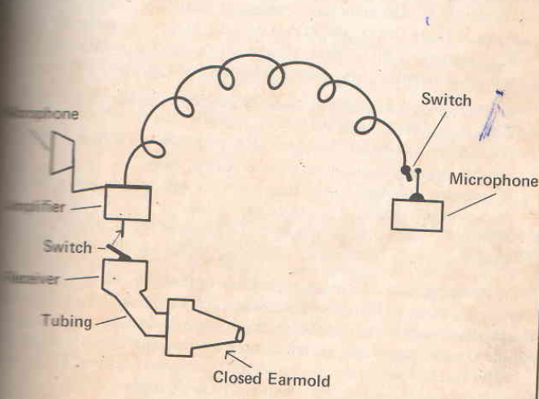
BICROS

Slide 15
UNI CROS
Dunlavy (1968) reported on the development of CROS for individuals with asymmetrical hearing loss.
It consists of two receivers, two volume controls and one microphone located on the side of the poorer ear.
It is a combination of a monaural instrument for the poorer ear and a Classic or High CROS for the better ear.
Multi-CROS
It is considered when an individual has one aidable and one un-aidable ear and a wide variety of listening needs.
Harford and Dodds (1974) call this the “epitome of flexibility”.
This can be used as Classic CROS, BICROS, Open-BICROS or conventional aid.
This system has a separate on-off switch for both the microphones.

Slide 16
IROS: Ipsilateral Routing of Signal
These are monaural hearing aids which use an open ear mold.
The term was coined by Green (1969) to differentiate it from monaural hearing aids which uses a closed ear mold.
It can be used in instances which required relatively low gain.
The rationale for this instrument is that, if adequate gain can be achieved ipsilaterally without feedback, there is no reason to locate the microphone on the contralateral ear.
CRIS-CROS
Ross (1969): when two body aids are worn by an individual with severe hearing loss, the instruments don’t provide true binaural hearing.
He suggests using two separate hearing aids in a CRIS CROS arrangement.
The user can take advantage of the head shadow to obtain maximum gain in each ear and still retain the two ear differences.

Slide 17
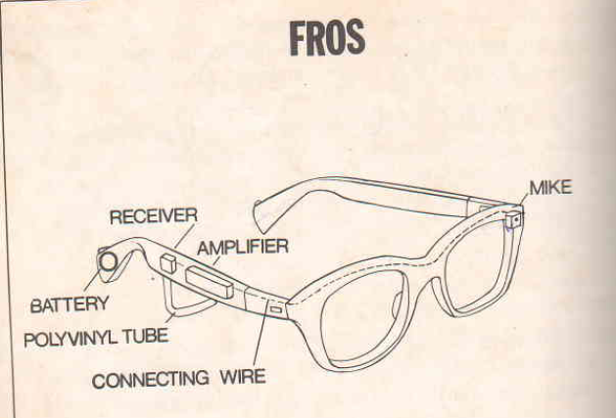
FROS: Front Routing of Signal
This is the refinement of IROS. The microphone is located in the frame than the temple piece f the eye-glass.
This increases the separation of the microphone and the receiver.
This also allows the user to look at the speaker and have the microphone facing the speaker.

Slide 18
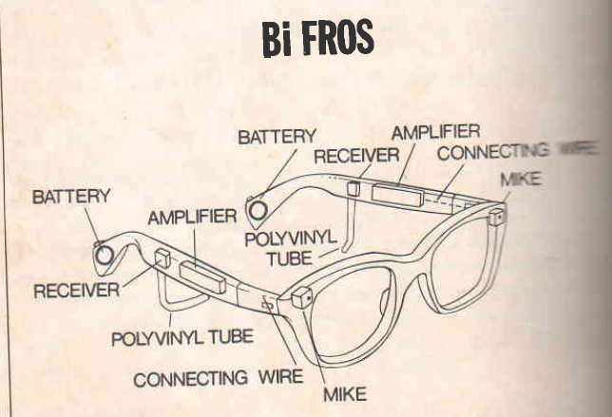
BiFROS: Binaural Front Routing of Signals
It utilizes two microphones, one on each side of the frames, each of which sends signals to a receiver in the temple on the same side.
BiFROS is a true binaural system; it has the advantages of greater gain capability, directional characteristics and open mold if necessary.

Slide 19
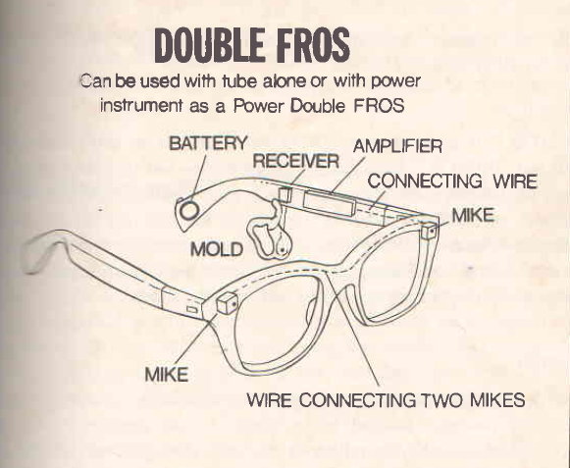
Double FROS
There are two microphones but only one receiver.
It can take the place of BiCROS to fit some cases.

Slide 20
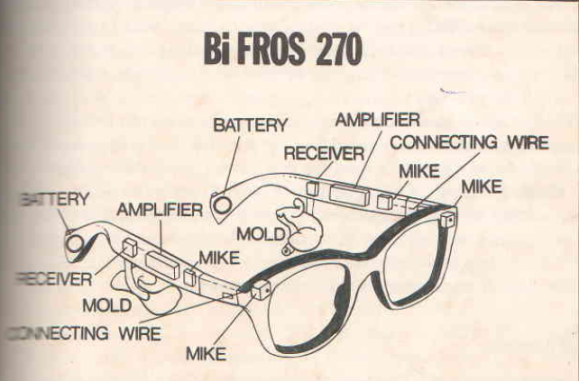
BiFROS 270
It is the newest FROS variation.
It uses four microphones and two receivers.
Two microphones are located in the frame and one in each temple.
Dunlavy (1974b): the 270ᵒ sound stimulation provides a more full-rounded sound and potentially allows front-back localization, which is not often demonstrable with most hearing aid configurations.

Slide 21


