Slide 1
HEARING AID COMPONENTS
Submitted to:- muneer sir
Presented by:- Thummar manasvi from lll- semester B. ASLP

Slide 2
Block Diagrams
Two decades ago, the operation of most hearing aids, for any setting of an aid's controls, could be understood just by looking at a few graphs of gain versus frequency and maximum output level versus frequency.
Hearing aids are now more complicated, and the only way to understand how a more complex hearing aid changes a signal is to understand its block diagram.

Slide 3
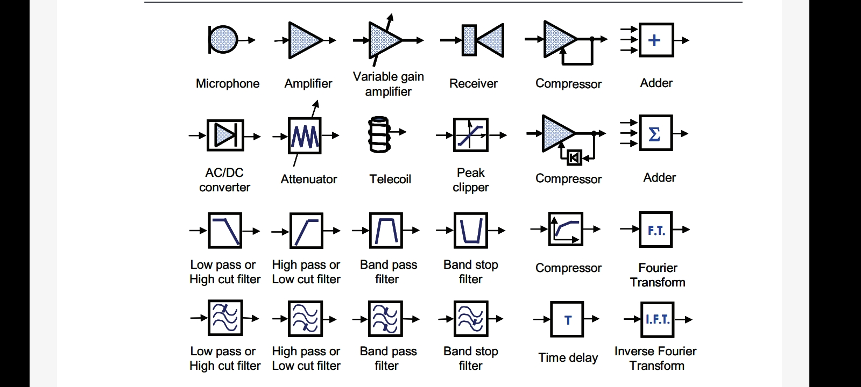

Slide 4
Analog Signal Processing
The incoming acoustic signal is changed into an electric signal and back into an audible acoustic signal.
Analog aids convert sound waves into electrical signals, which are amplified. Analog/adjustable hearing aids are custom built to meet the needs of each user.
The aid is programmed by the manufacturer according to the specifications recommended by your audiologist.

Slide 5
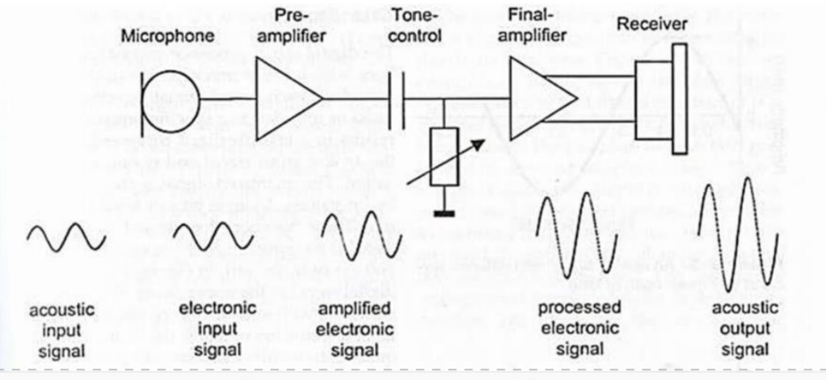

Slide 6
Analog/programmable hearing aids have more than one programor setting.
Anaudiologist can programthe aid using a computer, and you can change the program for different listening environments—from a small, quiet room to a crowded restaurant to large, open areas, such as a theater or stadium.
Analog/programmable circuitry can be used in all types of hearing aids. Analog aids usually are less expensive than digital aids.

Slide 7
Digital Signal Processing
The incoming acoustic signal is changed into an electric signal (analog) signal which is then converted into numbers (Binary Code) for further processing.
Digital aids convert sound waves into numerical codes, similar to the binary code of a computer, before amplifying them.
Because the code also includes information about a sound’s pitch or loudness, the aid can be specially programmed to amplify some frequencies more than others.

Slide 8
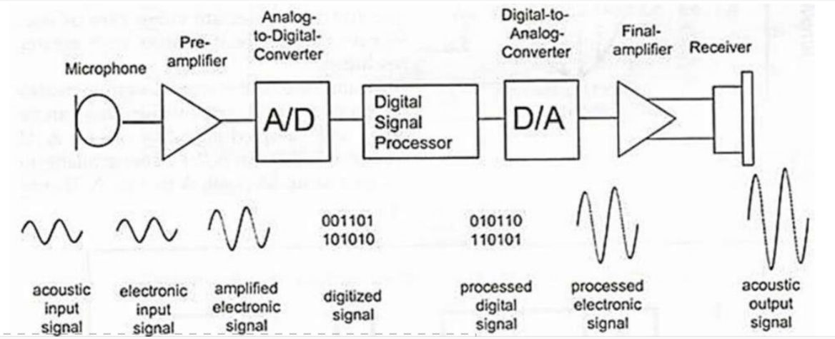

Slide 9
Digital circuitry gives an audiologist more flexibility in adjusting the aid to a user’s needs and to certain listening environments.
These aids also can be programmed to focus on sounds coming from a specific direction.
Digital circuitry can be used in all types of hearingaids.

Slide 10
Microphones
The function of the microphone is to convert sound into electricity.
Because it changes energy from one form to another it is known as a transducer.
For a perfect microphone (and microphones are close to perfect), the waveform of the electrical

Slide 11
signal coming out of the microphone is identical to the waveform of the acoustical signal going into the microphone.
Microphones act in a linear fashion, so every time the pressure of the input signal doubles, for instance, the output voltage also doubles, until the output reaches the highest voltage that the microphone can deliver.
The ratio of the size of the output voltage to the size of the input sound pressure is known as the sensitivity of the microphone.

Slide 12
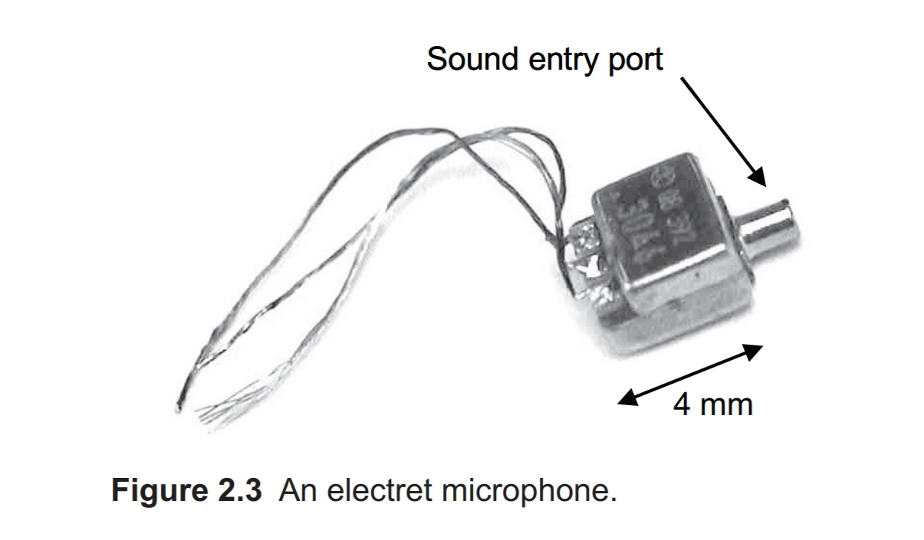
Typical hearing aid microphones have a sensitivity of about 16 mV per Pascal, which means that sounds of 70 dB SPL produce a voltage of around 1mV.

Slide 13
Principle of operation
Microphones can be made using several fundamen- tally different types of technology, but since the 1980s hearing aids have used only one type of microphone:
Figure 2.3 shows the external appearance of an electret microphone, although some electret microphones are cylindrical in shape.

Slide 14
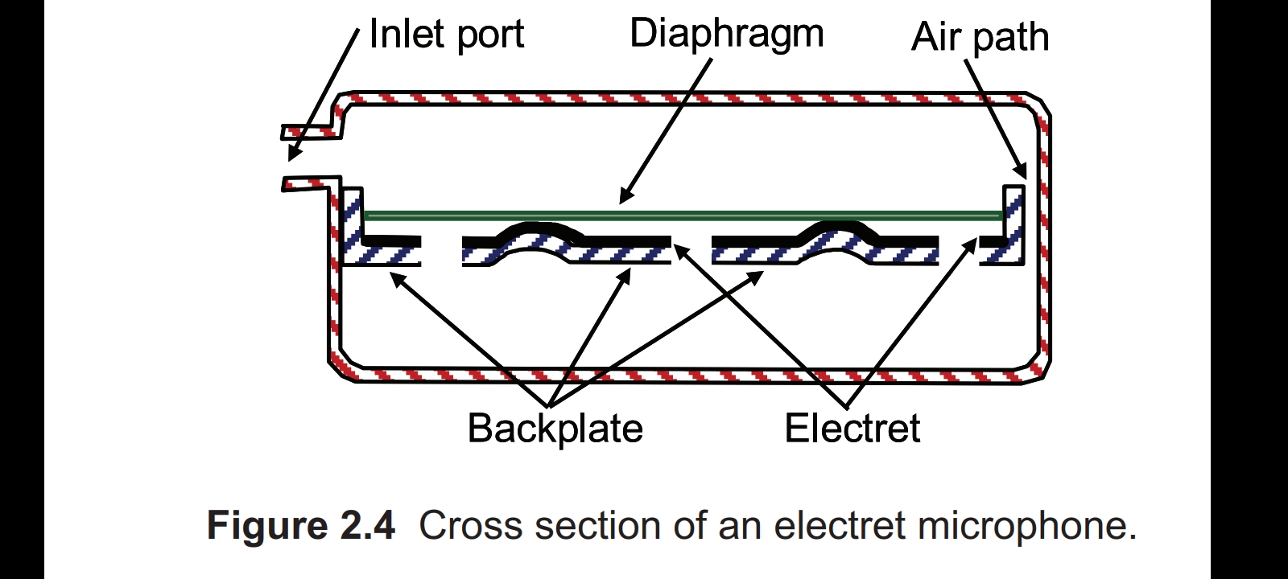
Figure 2.4 shows a cross-section to illustrate the operating principle.

Slide 15
Sound waves enter through the inlet port and reach one side of a very thin, very flexible plate with a metallized surface, called the dia- phragm.
Pressure fluctuations within the sound wave cause the diaphragm to move up and down (by an extremely small amount, invisible to the naked eye).
A small air space separates the diaphragm from a rigid metal plate, called the back-plate. Coated onto the back-plate is some thin teflon material called an elec- tret.

Slide 16
The diaphragm is held away from the back-plate by some bumps in the back-plate. The back-plate has holes in it to allow movement of air through it.
The electret material gets its name from the fact that it has a permanent electric charge comprising an excess of electrons on one side of it, and a shortage of electrons on the other.
These electrical charges attract opposite electrical charges onto the diaphragm and the back-plate.

Slide 17
When sound pressure forces the diaphragm towards or away from the electret, the chang- ing distance between the diaphragm and the electrets changes the electrical force between the opposing charges, which is another way of saying that the voltage between the back-plate and diaphragm varies.
This, of course, is the point of the device, because the vibrating diaphragm has turned a sound wave into an electrical voltage.
An amplifier is built into the same container as the rest of the microphone.

Slide 18
Its job is to allow this voltage to deliver a larger current to the main hearing aid amplifier than would other- wise be possible.
The microphone amplifier is some- times referred to as a FET, because it is made using a type of transistor known as a Field Effect Transistor.

Slide 19
Polar Patterns
A microphone's directionality or polar pattern indicates how sensitive it is to sounds arriving at different angles about its central axis.
The polar pattern of a microphone is the sensitivity to sound relative to the direction or angle from which the sound arrives, or easier worded how well the microphone “hears“ sound from different directions.

Slide 20
The most common types of directionality are:
Omnidirectional,
Cardioid and
Supercardioid
Hypercardiod
Bidirectional

Slide 21
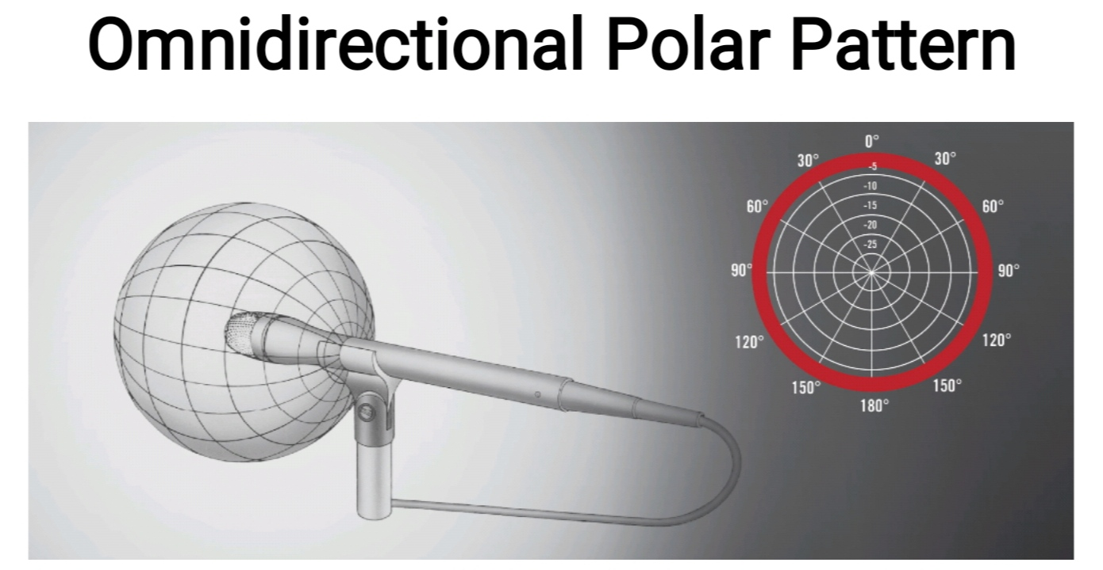
The omnidirectional microphone has equal sensitivity at all angles. This means it picks up sound evenly from all directions. Therefore, the microphone need not be aimed in a certain directions.

Slide 22
A disadvantage is that an omni cannot be aimed away from undesired sources such as PA speakers, which results in less headroom for feedback.

Slide 23
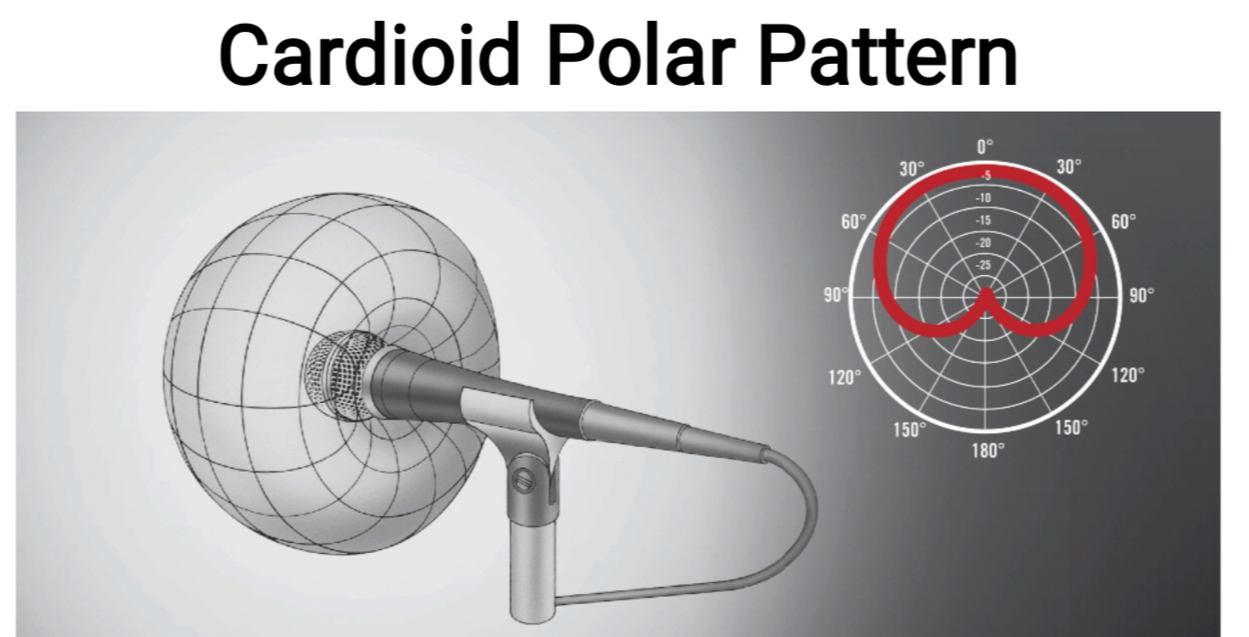
A cardioid microphone has the most sensitivity at the front and is least sensitive at the back. This isolates it from unwanted ambient sound and gives much more resistance to feedback than omnidirectional microphones.

Slide 24
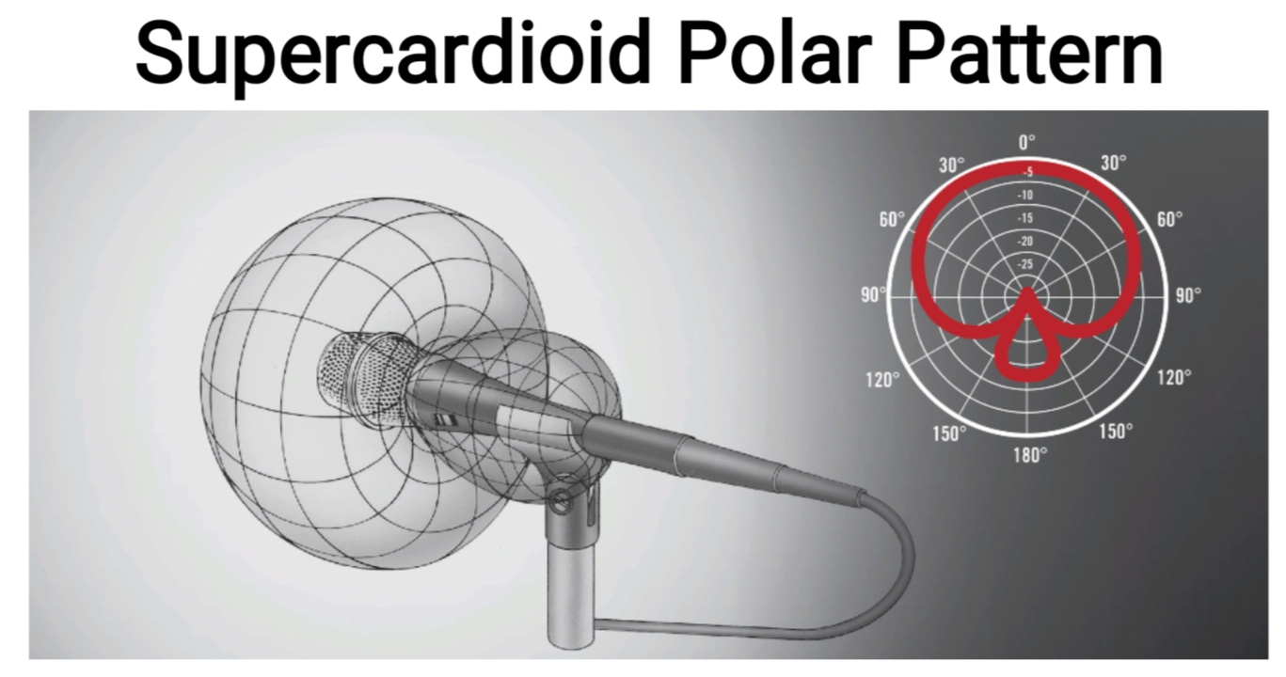
Supercardioid microphones offer a narrower pickup than cardioids and a greater rejection of ambient sound. But they also have some pickup directly at the rear, hence it is important to place monitor speakers correctly.

Slide 25
Supercardioids are most suitable when single sound sources need to be picked up in loud environments.

Slide 26
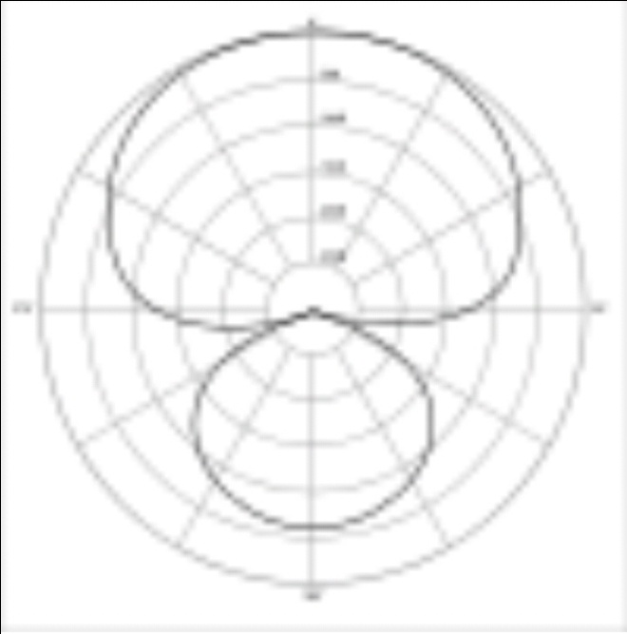
Hypercardioid polar pattern
Hypercardioid microphones offer an even narrower pickup than supercaidioids and a greater rejection of ambient sound. But they also have some pickup directly at the rear, hence it is important to place monitor speakers correctly.
Hypercardioids are most suitable when single sound sources need to be picked up in loud environments.

Slide 27
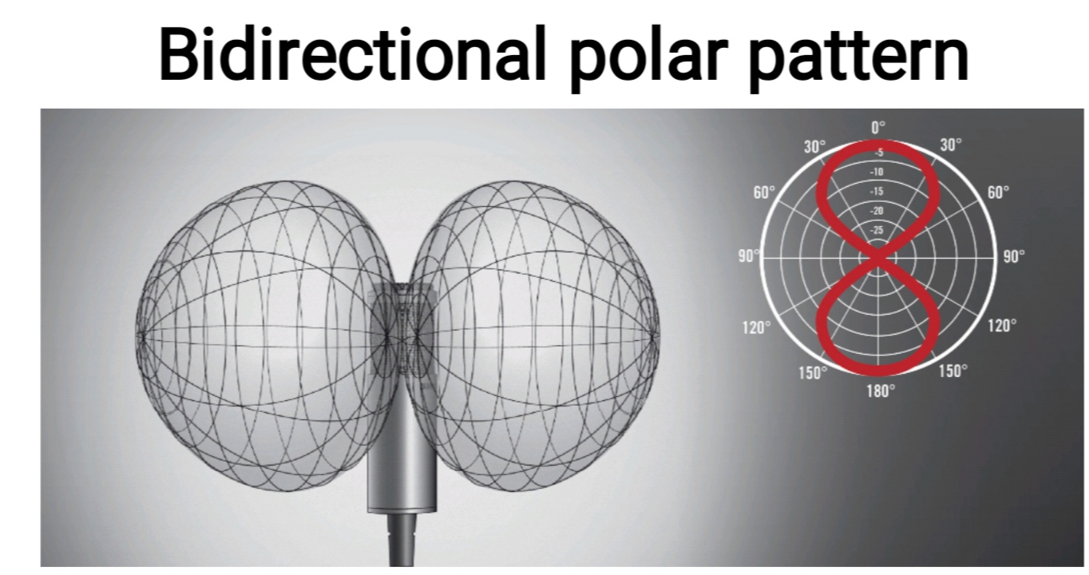
A microphone with a Figure of Eight polar pattern picks up the sound from in front of the microphone and from the rear, but not the side (at a 90 degree angle). Microphones with this Figure of Eight polar pattern are typically ribbon or Large Diaphragm Microphones.

Slide 28
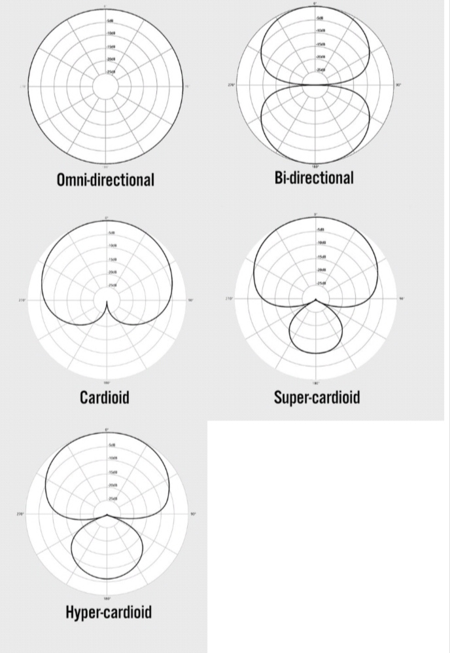

Slide 29
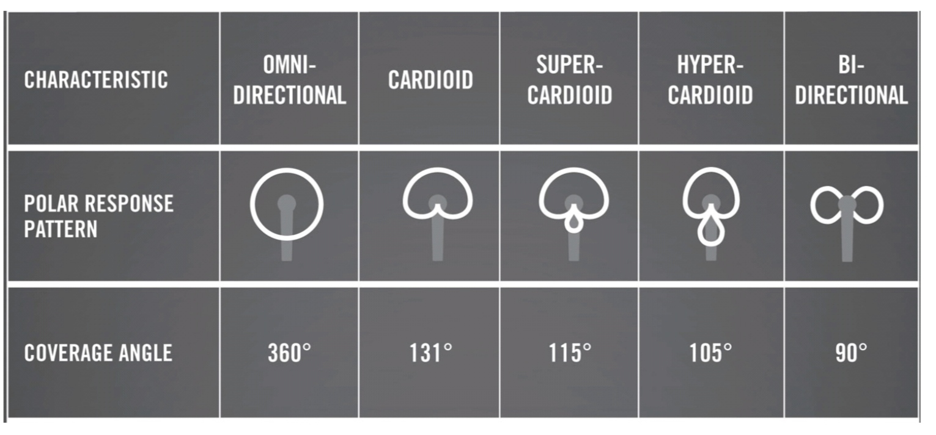

Slide 30
Types of microphone
CARBON MIC:
this mic contains carbon dust.
The sound hitting diaphragm of the mic displaces the carbon This causes variations in the electrical resistarce of the microphone, which generates a current resulting fluctuating magnetic field delivered to the receiver.

Slide 31
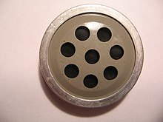

Slide 32
Sound level generated by this mic is 20-30 dB greater than input.
Advantages
Long life & inexpensive
Disadvantages
Norrow frequency response range & less gain -
Works imperfectly when there is gross body movement.

Slide 33
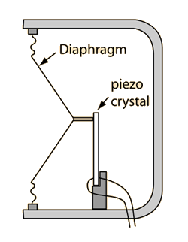
Crystal microphone :
Crystal microphones or ceramic microphones are generally low cost units offering a high output voltage into a high impedance.

Slide 34
The main use of crystal microphone technology is within transducers used for a variety of monitoring applications and for automotive transmitters / sensors.
The terms crystal microphone and ceramic microphone are virtually interchangeable as they describe microphones using crystal or ceramic piezoelectric technology.
Piezoelectric Effect is the ability of certain materials to generate an electric charge in response to applied mechanical stress. The word Piezoelectric is derived from the Greek piezein, which means to squeeze or press, and piezo, which is Greek for “push”.

Slide 35
Advantages
Wide freq response & inexpensive
Useful with vacuum tube HA
Disodvantages
Low freq response poor
Influenced by changes in temperature & pressure

Slide 36
MAGNETIC MIC:
Also known as dynamic microphone. This microphone works on the principle of electromagneti inducțion which is the process of producing electrical effect by magnetic means & vice versa.
Two magnetic rod are placed on either sides of a magnetic plate, which has a coil wound around it.

Slide 37
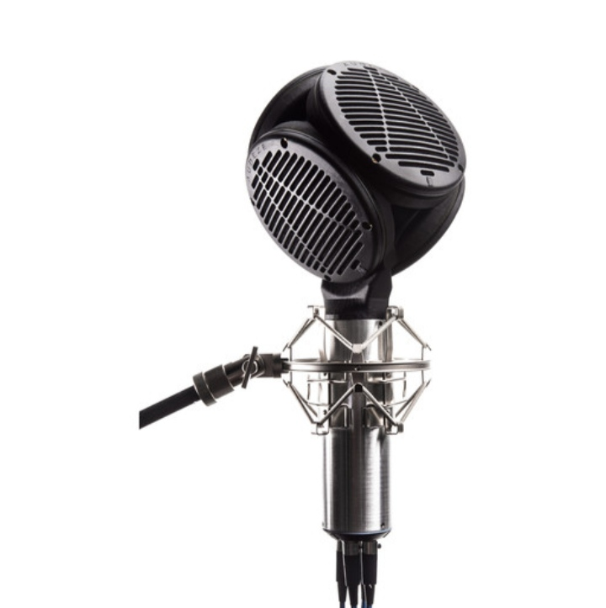

Slide 38
The plate is connected to diaphragm. When sound bump into on the diaphragm, magnetic induction is created which generates electrica potential.
Advantages:
Typical frequency response curves
Low impedance & insensitive to humidity & temperature changes
Disadvantages:
Rapid cut-off for the low & high frequencies

Slide 39
CERAMIC MIC:
Some semiconductors have the property, when under mechanical tension or stress of generating an electrical voltage at right angles to the stresses.
In the ceramic microphones, the pressure changes that occur the ceramic mic is due to the sound impinging on the diaphragm & are mechanically transmitted to piezo-electri ceramic material.

Slide 40
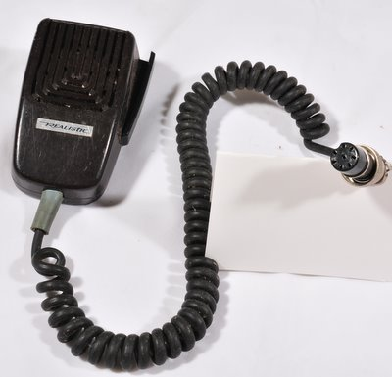

Slide 41
Advantages:
They have high electrical impedance and function best with high impedance amplifiers.
Insensitive to changes in humidity & temperature. > Less susceptible to damage.
Disadvantage:
Very high impedance, hence, not connected to amplifiers in hearing aids

Slide 42
ELECTRET CONDENSER MIC:
Electret is a foil with extremely good insulating qualities .
Sound waves enter through the inlet port & reach one side of a very thit diaphragm. Pressure variations within the sound wave cause the diaphragm to move up & down.
A small separates the diaphragm from the rigid metal plate called back plate coated with Teflon.

Slide 43
The back-plate has hole in it to allow movement of air through it.
Since electret has a permanent charge comprising excess electrons or one side & shortage on the other, When the diaphragm moves up & down over the back-plate, the acoustic input is converted to electrical signal.
Advantages:
Wide frequency band Improvement in SNR

Slide 44
Low internal noise/mechanical feecback
Commonly used in HA
Small size

Slide 45
SILICON MIC:
A new type of microphone is currently under development.
The silicon microphone (as solid state or integrated microphone) is made by etching away parts of block silicon and depositing other materials into it, using techniques similar to those used to make an integrated circuit.

Slide 46
Advantages
Small size & inexpensive
Limitations of microphones:
• Microphones can produce an output signal when shaken.
• The electrical signal may be slightly distorted representation of the input acoustic signal.
• In addition, some unwanted filtering of acoustic signal may occur.

Slide 47
AMPLIFIER
The amplifier increases the amplitude of the weak electric AC voltages picked up by the microphone. It may have number of stages of amplification.
An amplifier is an electronic device that can increase the power of a signal (a time-varying voltage or current).
The basic function of an amplifier is simple. Its job is to make a small electrical signal into a larger electrical signal.

Slide 48
Today's hearing aids achieve amplification primarily through the use transistors.
Although a single transistor will provide amplification, amplifiers usually are made up of several transistor and resistors connected together to provide a better performance than is achievable with a single transistor.
These multiple transistors and resistors are placed on the integrated circuits (IC).

Slide 49
Amplifier does 3 things;
First, they can make the voltage larger, but not affect the current.
Second they can make the current larger, but not affect the voltage.
Third and most commonly, they can make both the voltage and the current larger.

Slide 50
Classification
Audio power amplifiers are classified in an alphabetical order according to their circuit configurations and mode of operation.
Amplifiers are designated by different classes of operation such as class “A”, class “B”, class “AB”, etc.
These different amplifier classes range from a near linear output but with low efficiency to a non-linear output but with a high efficiency.

Slide 51
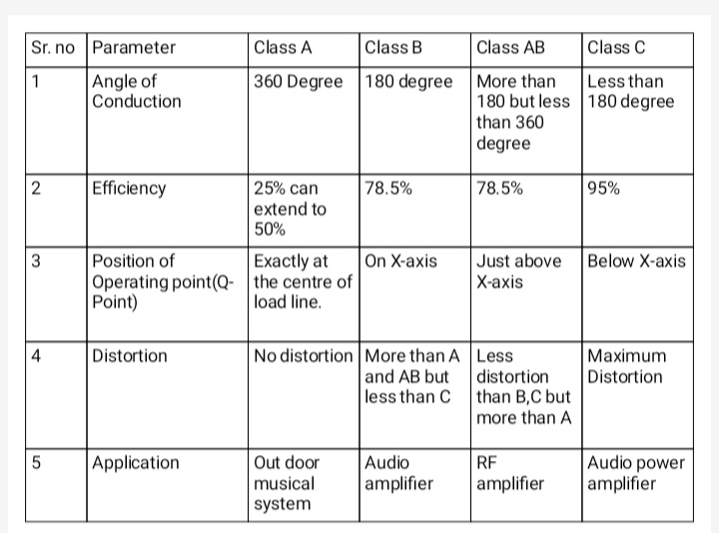

Slide 52
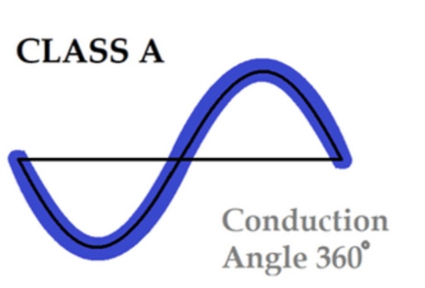
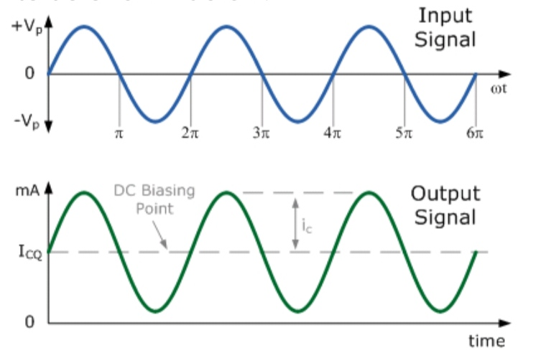
Class A Amplifier Operation

Slide 53
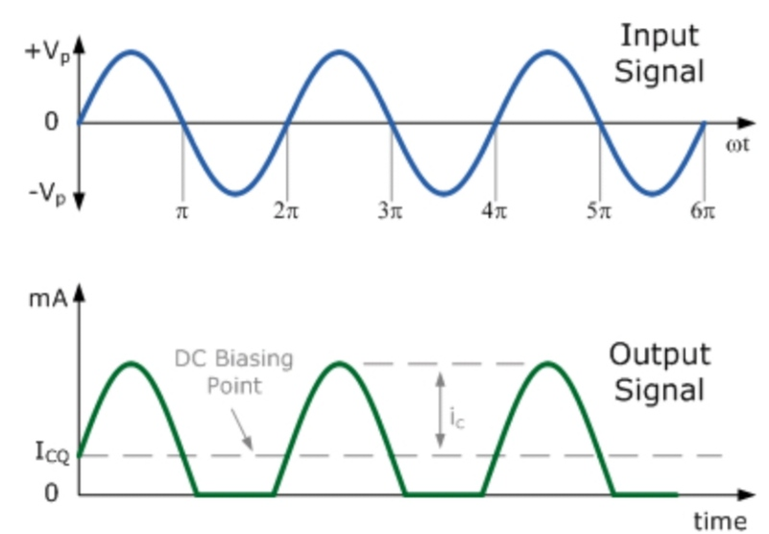
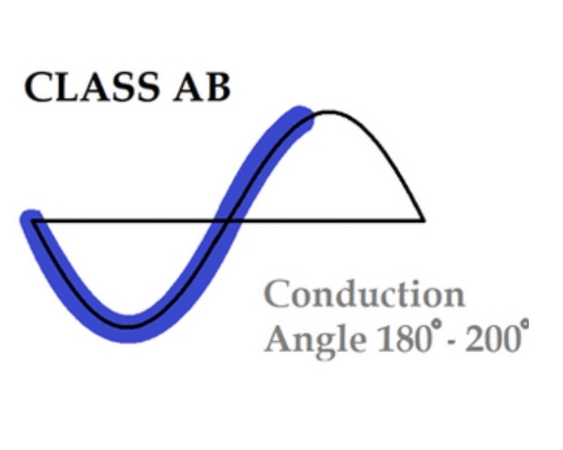
Class AB Amplifier Operation

Slide 54
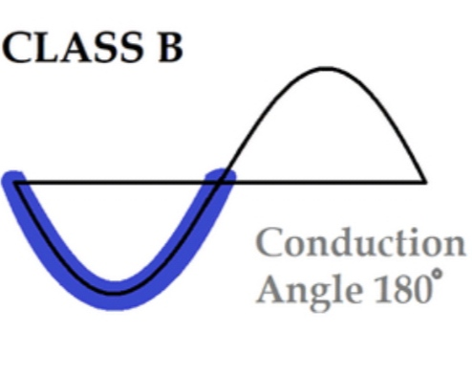
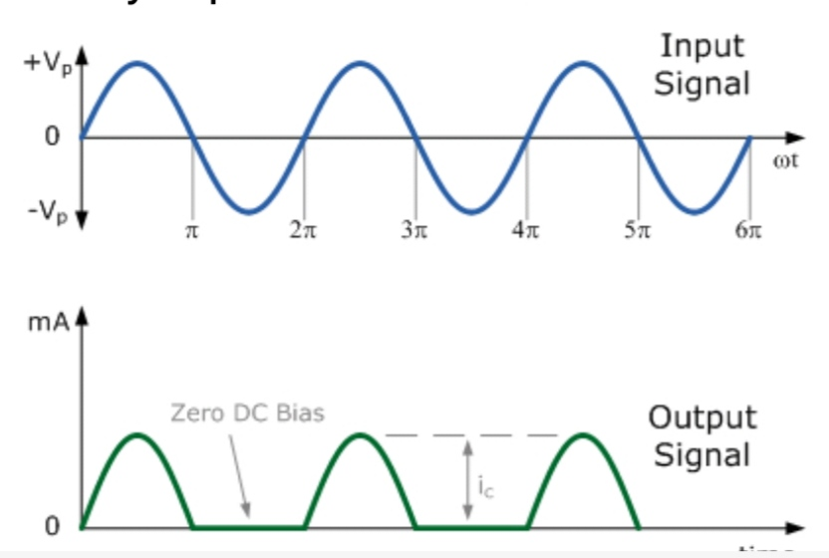
Class B Amplifier Operation

Slide 55
Receivers
The receiver, which externally looks just like the microphone shown earlier in Figure 2.3, converts the amplified and modified electrical signal into an acous- tic output signal.
Principle of operation
The receiver operates by magnetic forces. Figure 2.18 shows the receiver's operating principle and the basis of construction.

Slide 56
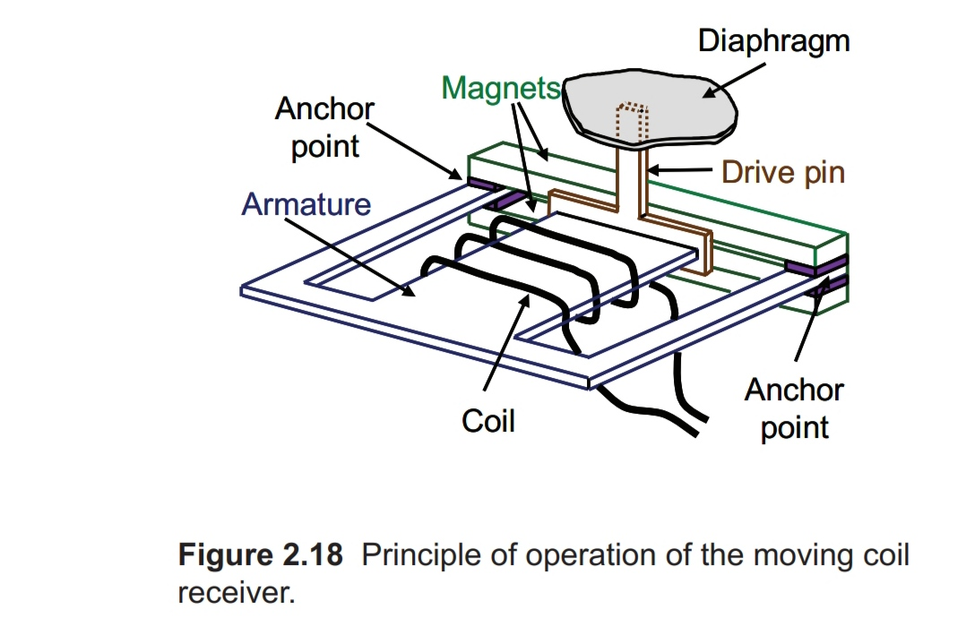

Slide 57
Current passes through a coil that encloses a piece of metal, temporarily turning it into a magnet.
As the current alternates in direction, this piece of metal, called an armature, is alternately attracted and repelled by two permanent magnets.
The armature is very thin and can bend, so the end of the middle arm of the armature is free to move up and down between the magnets.

Slide 58
The free end of the arma- ture is linked by a drive-pin to the diaphragm, so that the diaphragm also vibrates backwards and forwards, and this produces the sound.
Only a portion of the diaphragm is shown in Figure 2.18. This transducer seems simple, but making all this in such a way that it has a wide frequency response, consumes little power,leaks little magnetic field outside the case.

Slide 59
Greater output can be obtained only by using a receiver with a bigger diaphragm, which increases the size of the receiver, or with the magnets further apart, which then requires greater electrical power for the receiver to operate.

Slide 60
Cords
Generally, three types of cords are available - "v" cord ""y" , and "s" cord.
The cord has plugs with pins at either end. One of the pins is thinner than the other.
Similarly, on the hearing aid, one socket is smaller than the other.
The thicker pin goes into the larger socket, and the thinner pin into the smaller socket.

Slide 61
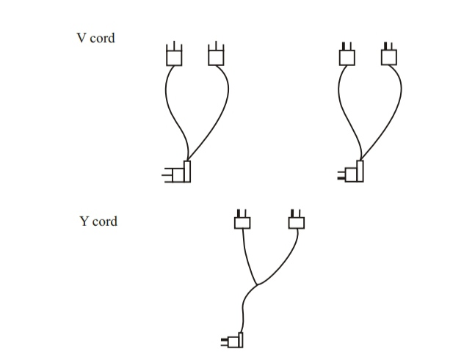

Slide 62
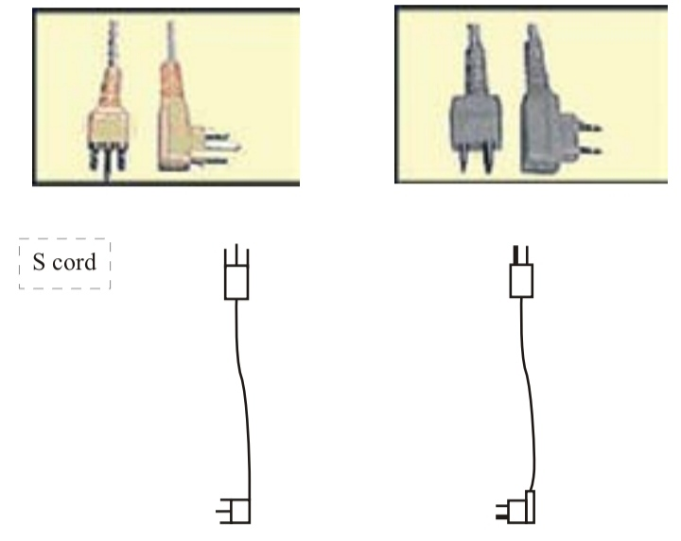
The hearing aid cord or wire is made of fine metal wires, enclosed in soft plastic or rubber.
It connects the body of the hearing aid to the receiver. The cord has i plugs with pins at either end, as shown in the figure. The cord may be:

Slide 63
Do not unplug the cord frequently as the cord and the pins may become disconnected.
Do not wind the cord tightly around the hearing aid, pull it, twist it or knot it, as this may cause the delicate wires to break.
If the sound is heard intermittently, it can be due to broken cord and so replace the cord.
Cords often break at the plugs. Be careful when connecting the cord to the hearing aid or receiver and when disconnecting it.

Slide 64
Grasp the cord by the hard-plastic part at the end and pull.
Clean the pins regularly with a small brush.

Slide 65
Batteries
The battery is the source of the increased signal power
that the hearing aid delivers to the aid wearer.
The important characteristics of the battery are its voltage, its capacity, the maximum current it can supply,its electrical impedance and its physical size.

Slide 66
Principle of operation
Batteries (which are really called cells) generate electricity by putting two different materials (called the electrodes) in close proximity in a medium (called the electrolyte) that conducts electricity in the form of ions.
Charged particles are attracted from one of the
materials to the other via the electrolyte, and this can continue only if electrons can get from one electrode to the other via an external electrical circuit.

Slide 67
This external current of electrons, is of course, the current that the hearing aid amplifier makes use of.
The process continues until one of the electrodes is used up, in that it can no longer supply charged particles and electrons: the battery is “flat”.
Capacity and physical size
Batteries last longer the more electrode material they contain.

Slide 68
Bigger batteries therefore last longer than smaller batteries with the same chemistry.
The electrical capacity of a battery is measured in milliamphours (mAh). A battery with a capacity of 100 mAh, for example, can supply 0.5 mA for 200 hours, 1 mA for 100 hours, or 2 mA for 50 hours.
There is an upper limit to how much current battery can supply at any instant.
If the current gets too high, even for a fraction of a second, the battery voltage will drop excessively because of the internal resistance of the battery.

Slide 69
Momentary intense noises will therefore cause the voltage to momentarily decrease, perhaps so much that the hearing aid temporarily ceases to operate, giving a very distorted sound.
Bigger batteries can generally supply bigger maximum currents, as well as having a larger mAh capacity. AA and AAA bat- teries have typical capacities of 2000 and 800 mAh, respectively.
High-powered hearing aids need the greatest current, and some batteries are advertised as being more able to supply the high currents these hearing aids need without losing too much voltage.

Slide 70
These are referred to as HP (High Performance or High Power) batter- ies, and may have the prefix H in their name. These are also zinc-air cells, but have bigger holes to allow oxygen in at a faster rate and use an electrolyte that causes less voltage drop during high current demand.
HP batteries should give a longer life than a standard battery if the hearing aid has a high peak-current demand, but will give a shorter life if the hearing aid has a low peak-current demand.

Slide 71
HP batteries should be used if a hearing aid draws more than about 8 mA (for a size 13 or 312 battery) or more than about 18 mA (for a size 675 battery) when the hearing aid is saturated.
Peak-current demand can be assessed in a test box equipped with a battery pill, by applying a500 Hz signal at 90 dB SPL with a high volume control setting. Read the current as soon as you switch on the sound.
For hearing aids intended for open-fit
applications, also test with a higher frequency, say
2000 Hz, as the hearing aid may be configured to give no output for low-frequency sounds.

Slide 72
Table 2.3 shows the capacity of good zinc-air batteries of various sizes. Some brands claim greater capacity than those shown, and some have less capacity.
Mercuric oxide batteries have capacities about half that of zinc-air batteries of the same size.
Two labeling systems are used: the labels in the first column are most common, while those in the second column are specified in international standards.795 Figure 2.24 shows each of the batteries drawn full size.

Slide 73
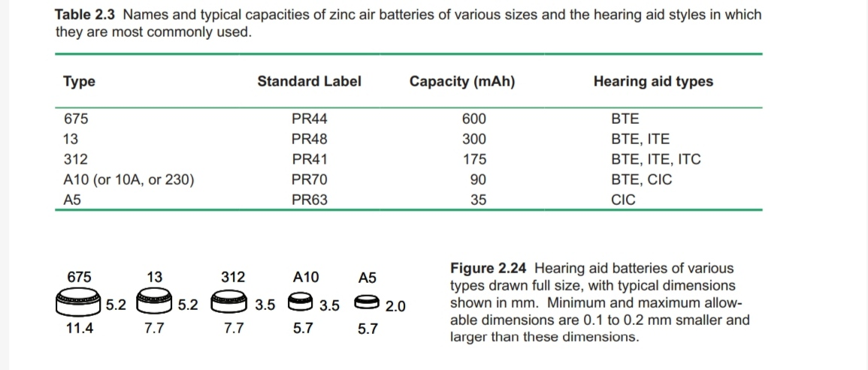

Slide 74
Life of Hearing aid battery
675(BTE): - 9-20 days
312(miniBTE, RITE, ITC):- 3-10days
10(miniRITE, CIC) :- 3 -7days
13(BTE, ITE) :- 6-14days

Slide 75
Zinc-air batteries are the preferred type of nonrechargeable cell because they are the cheapest (per mAh), they do not have to be changed as often as
mercury or silver batteries, and they have less adverse environmental consequences than mercury batteries when they are discarded.
Mercuric oxide batteries are now rarely used because the hazardous nature of mercury when discarded, and especially if ingested.

Slide 76
In the past, all zinc-air batteries contained small
amounts of mercury, but mercury-free varieties are
increasingly available and may colloquially be called green batteries.

Slide 77
Telecoils
A telecoil is a small coil of wire that produces a volt- age when an alternating magnetic field flows through it.
The magnetic field to be picked up by the telecoil is generated by an electrical current that has the same waveform as the original audio signal.

Slide 78
This magnetic field may occur as a by-product of some device, such as from a loudspeaker or a receiver in a telephone, or may be generated intentionally by a loop of wire around a room or other small area.
The process of an electrical current inducing a voltage in a coil some distance away is called induction.
To increase the effectiveness of a telecoil, the wire is coiled around a rod made of ferrite material. Like iron, but even more so, ferrite provides an easy path for magnetic fields to flow through.

Slide 79
It thus "attracts" and concentrates the magnetic flux. If more flux flows through the coil, then more voltage is generated by the coil, which is desirable so that the audio signal is large compared to the internal noise generated by the hearing aid.
Coils can also be made more sensitive by increasing the cross-sectional area or by increasing the number of turns, but both of these increase the physical size of the coil, and hence of the complete hearing aid.
Not all hearing aids include a telecoil, although nearly all high-powered BTE hearing aids and many other

Slide 80
BTE and ITE hearing aids do. The hearing aid user can select the coil, instead of the microphone, for amplification by switching the hearing aid to the T (for Telecoil) position.
Most hearing aids now have a program selector switch, rather than a separate M-T switch.
The telecoil is selected by switching to the telephone program. In other programs, (or on older hearing aids, in the M position) only the microphone is connected to the hearing aid amplifier.

Slide 81
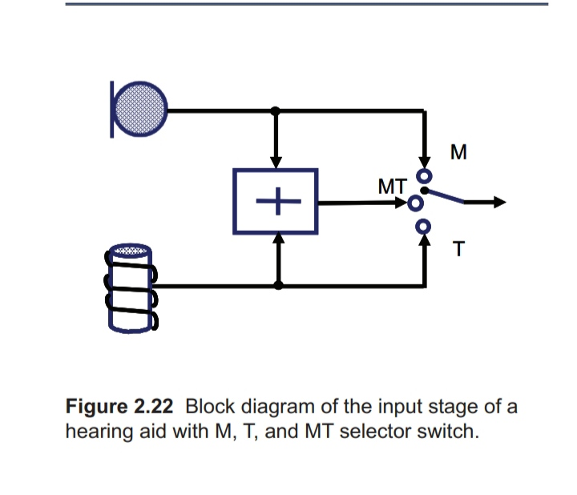

Slide 82
Some hear- ing aids can be set up to have a program in which the microphone and coil provide signals at the same time, which is also achieved in the MT position of an older hearing aid, as shown in Figure 2.22.
The MT combi- nation is useful if the aid wearer wants to receive both the acoustic and magnetic signals simultaneously or in quick succession, but has the disadvantage that any acoustic noise present will be amplified even if the aid wearer is trying to listen only to the magnetic signal.

Slide 83
When the hearing aid is switched to the T program and the input comes from a room loop, the only sounds amplified will be magnetic signals reaching the hearing aid.
Although this is also true when the input comes from a telephone, the microphone of the telephone will pick up any sounds reaching it, and the telephone side-tone will cause all these sounds to emerge as magnetic signals, which the hearing aid will sense and amplify.

Slide 84
To reduce local noise while listening to the telephone in the T program, the hear- ing aid wearer should therefore cover the telephone microphone (when not speaking!).

Slide 85
Any Questions?

Slide 86
Reference
Hearing Aids-Second Edition ,Harvey Dillon, chapter no:- 2.HEARING AID COMPONENTS

Slide 87
Thanks

