Slide 1
TECHNICAL ASPECTS IN HEARING AIDS
Submitted to – Muneer sir
Presented by – Geeta Alimchandani

Slide 2
Input
  The signal in dB SPL coming into the microphone of the hearing aid.
Gain
  Gain is the amount of amplification added to the input signal. Output minus input equals gain.
Output
  The signal in dB SPL which is delivered into the patient’s ear.

Slide 3
Methods of Output Limiting
One of the first advancement in hearing instruments technology is improved circuits to limit excessive sound o/p or limiting the o/p.
The main purpose of o/p limiting is to prevent the o/p sound pressure level of hearing aid from exceeding the hearing impaired listeners discomfort.

Slide 4
The following are the methods of output limiting
Peak Clipping
Compression Limiting

Slide 5
PEAK CLIPPING
Peak clipping occurs when electrical signals exceed the maximum o/p of hearing aid circuit which causes numerous forms of distortion. This effect will cut off the peaks converting sine wave to a complex wave form (square wave).

Slide 7
Since the original shape of the waveform is changed when peak clipping occurs it causes distortion.
Distortion is defined as anything present in the o/p which is not there in i/p signal. Increase in distortion leads to poor sound quality.

Slide 8
There are 3 ways in which peak clipping can occur.
Asymmetrical or Hard peak clipping
Symmetrical peak clipping
Soft peak clipping or peak rounding

Slide 9
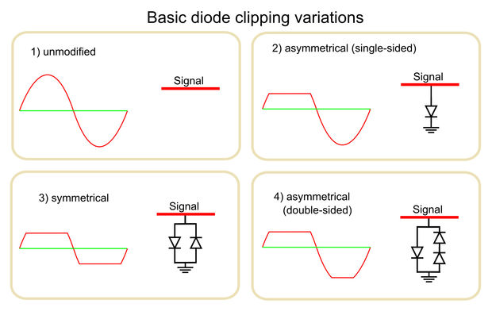

Slide 10
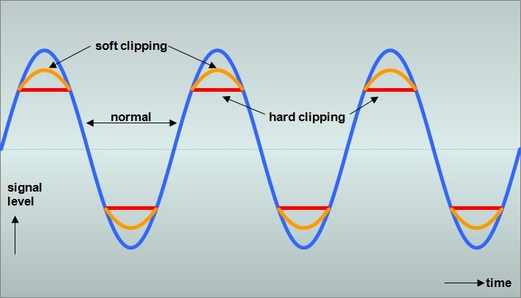

Slide 11
Asymmetrical or Hard peak clipping
One side of the waveform the signal is clipped. This results in distortion harmonics.
It is the instantaneous electronic removal of one amplitude direction (asymmetric) as the hearing aid goes into saturation.

Slide 12
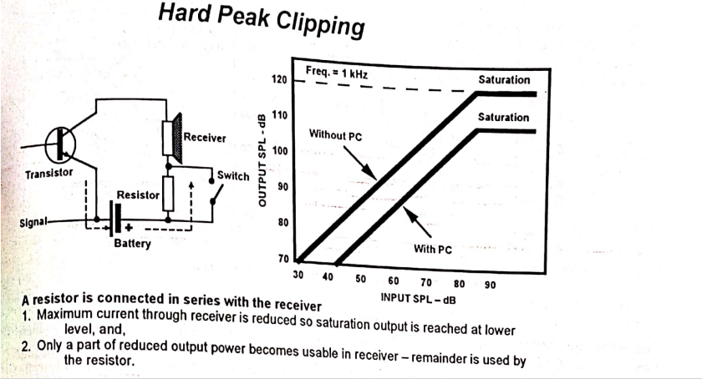

Slide 13
Symmetric peak clipping
It is the removal of amplitude in both directions of the signal and occurs at a predetermined level. Class A amplifiers produce even and odd harmonics. Push pull amplifiers produce odd harmonics. While higher harmonics are usually more objectionable , the reason for the perceived improvement in push pull amplifier.

Slide 14
Soft peak clipping
A peak clipper with diode in the feed-back of the output amplifier reduces second harmonic distortion. Such a circuit could be called “diode compression” or “soft peak clipping”.Soft PC reduces the harmonic distortion, especially in noisy environment and gives the user a more comfortable and better sound quality.

Slide 15
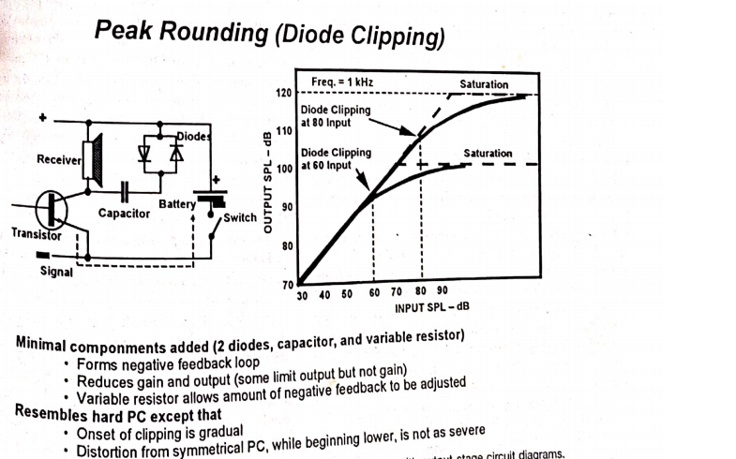

Slide 16
Compression
The major role of compression is to decrease the dynamic range of the signals in the environment so that all signals of interest can fit within the restricted dynamic range of a hearing-impaired person”
Harvey Dillon, Ph. D.

Slide 17
COMPRESSION
Compression is commonly referred to as the Automatic Gain Control (AGC) because it changes the gain of the Hearing aid as the input intensity SPL changes.
Compression has many faces that are there is no one simple way in which it can be described. It can be viewed in three ways:
Input v/s output compression
Conventional compression - control v/s threshold knee point control
Output limiting v/s WDRC

Slide 18
RATIONALE BEHIND COMPRESSION:The general aim in a hearing aid system is to give higher amplification for soft sounds and lower amplification for loud sounds - Dillon (1996)
All of the following rationales include the desire to reduce the dynamic range of the signal in some way.
1) Discomfort and distort avoidance (compression limiting).
2) Loudness normalization.
3) Noise reduction.
4) Reduction of signal dynamic range.

Slide 19
TYPES OF COMPRESSION
INPUT V/S OUTPUT COMPRESSION
With input-controlled compression , the level detector is located before the volume control and compression acts on the input to the hearing aid. That is, once the input exceeds the limit, the compressor is activated and gain is reduced at the preamplifier. Therefore, the volume control setting has no impact on the compression parameters.
In output-controlled compression , the level detector is located after the volume control and compression acts on the output of the hearing aid. That is, the compressor is activated once the output exceeds the Threshold control. . More importantly, however, it results in an increase in the Threshold control.

Slide 20
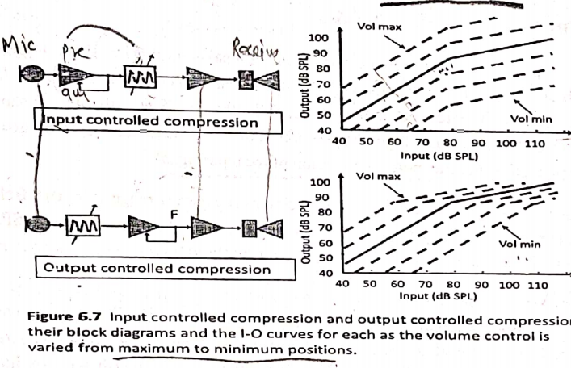

Slide 21
Clinical utility of input and output compression
Input and output compression are not superior or inferior to one another . they are just different and they have different clinical applications.
Output compression maybe more appropriate for severe to profound hearing loss where the dynamic range is restricted. For these patients, the clinician might be concerned that excessive voltage current settings might cause damage to the remaining hair cells or residual hearing.
Input compression may be more appropriate for mild to moderate SNHL for which the dynamic range is larger and consequently more room to manipulate the maximum power output.

Slide 22
Conventional compression - control v/s threshold knee point control
Compression threshold (CT) is defined as the point on the I/O function at which the output level is 2dB lower than it would be if no compression had occurred (i.e., if the processing were linear). Thus, in Figure 2-4, the CT is 40 dBSPL. Because it looks like the knee of a bent leg, the point at which the slope of the I/O function changes is referred to as the threshold knee point (TK). These two terms are used interchangeably.

Slide 23
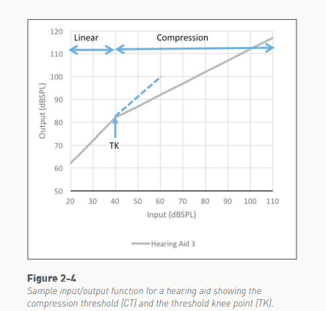

Slide 24
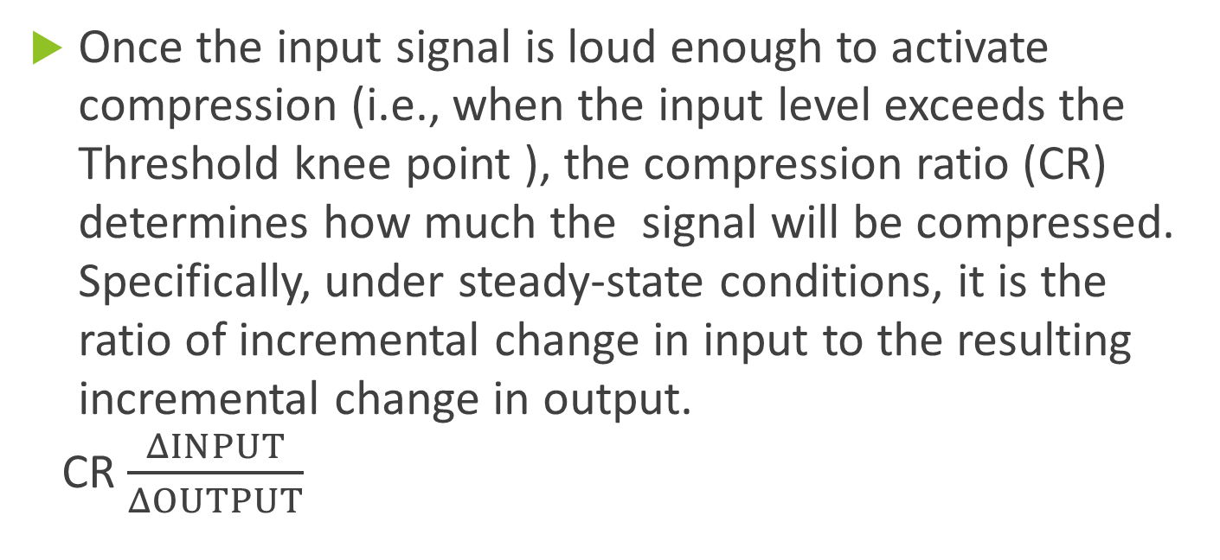
Once the input signal is loud enough to activate compression (i.e., when the input level exceeds the Threshold knee point ), the compression ratio (CR) determines how much the signal will be compressed. Specifically, under steady-state conditions, it is the ratio of incremental change in input to the resulting incremental change in output.
CR $\frac{ΔINPUT}{ΔOUTPUT}$

Slide 25
ATTACK TIME AND RELEASE TIME
When the incoming signal changes abruptly in level from below the TK to above it, the compressor is unable to change the gain instantaneously. The dynamic characteristics of a compressor refer to the length of time required for the compression circuit to respond to a sudden change in the input.
Attack time (AT) is the time delay that occurs between the onset of an input signal loud enough to activate compression (i.e., input signal exceeds the TK) and the resulting reduction of gain to its target value. Specifically, ANSI (2014) defines AT as the time between the abrupt increase in input level from 55 to 90 dBSPL and the point where the output level has stabilized to within 3dB of the steady value for an input of 90 dBSPL.
Release (or recovery) time (RT) is the time delay that occurs between the offset of an input signal sufficiently loud to activate compression (i.e., input signal falls below the TK) and the resulting increase of gain to its target value. Specifically, ANSI (2014) defines RT as the interval between the abrupt drop in input level from 90 to 55 dBSPL and the point where the output level has stabilized to within 4dB of the steady value for an input of 55 dBSPL.

Slide 26
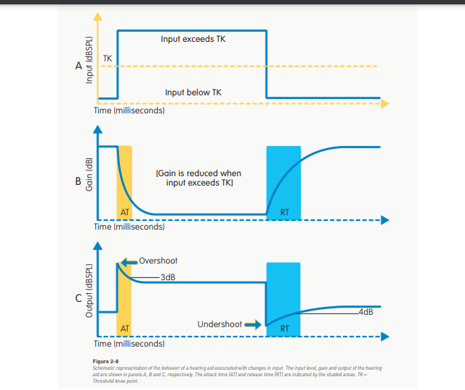

Slide 27
In Figure 2-8, the gain of the hearing aid does not change immediately (Figure 2-8B) when the input decreases to a level below the threshold knee point (Figure 2-8A). The result is an undershoot in the output (Figure 2-8C), until both the gain and output reach their target – i.e., to within 4dB of their final values.
Depending on the purpose, a compression system may have fast or slow attack and release times. The faster the AT, the shorter the duration of the overshoot and the shorter the period of time that the individual has to listen to sounds louder than desired. Indeed, ATs as fast as 5 ms are especially desirable when compression is used to limit the maximum output of a hearing aid. Although RTs may also be a few milliseconds in duration, the consequences when combined with a fast AT may be undesirable because the gain will vary in response to each cycle of the incoming signal resulting in a distorted waveform. Thus, the RT is generally longer than the AT. An RT of 20 ms is considered fast.

Slide 28
Output limiting compression
This type of compression has two important features
1) High compression knee point –means the hearing aid begins to compress at high I/P SPL 55 o 60dBSPL or more.
Below the knee point the hearing aid provides a linear gain.
2) High compression ratio –means greater than 5:1 and is mostly used to limit the O/P of the hearing aid.
Higher compression ratio means more compression on the I/P signal.

Slide 29
Wide Dynamic Range Compression
It has two important features
WDRC is associated with low compression knee points thresholds below 55 dBSPL and low compression ratio less than 5:1).
WDRC is almost always in compression from very soft speech to very loud speech.
WDRC reduces the gain for wide range of Input SPLdue to its low knee point.

Slide 30
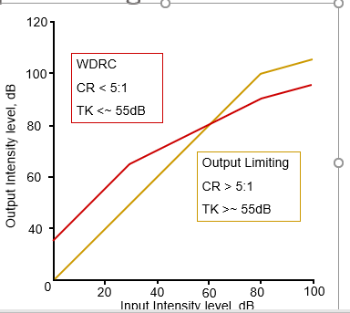
Output Limiting vs. WDRC

Slide 31
Clinical application of O/P limiting and WDRC
The focus of O/P limiting hearing aid is to prevent the ceiling of sound output from becoming too loud.
WDRC is to lift or amplify the soft I/P sounds so they become audible.
There is a overshoot of normal loudness growth with O/P limiting. At hign intensity i/p levels
WDRC restores the normal loudness growth because the soft I/P signals ate given more gain and
loud sounds are given less gain
O/P limiting works above knee point
WDRC works below knee point

Slide 32
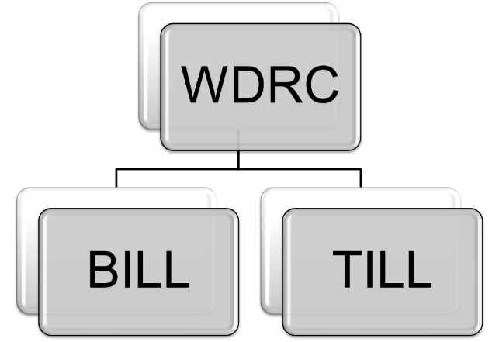

Slide 33
Concept and use of compression in hearing aids: BILL, TILL, PILL
BILL
Bass will be increased for low level of signals
Implemented in opposite way. i.e., for high level input, the bass is decreased, by reducing the low frequency energy (background noise).
This will improve listening in unfavorable listening condition.
TILL
The logic of TILL is exact opposite of BILL.
TILL devices provide greater treble response(increase in gain at HF) for low level inputs than for high.
These instruments provide significant HF gain for soft sound and minimal HF gain for loud sounds.

Slide 34
PILL
These circuitries can provide either a bill or a till response.
A hearing should have a minimum of two channel compression; for soft sound in low channel, it can work as BILL and high channel it can work as TILL.
Low channel it can increase the gain at low frequency and at high channel it will increase gain at high frequency.

Slide 35
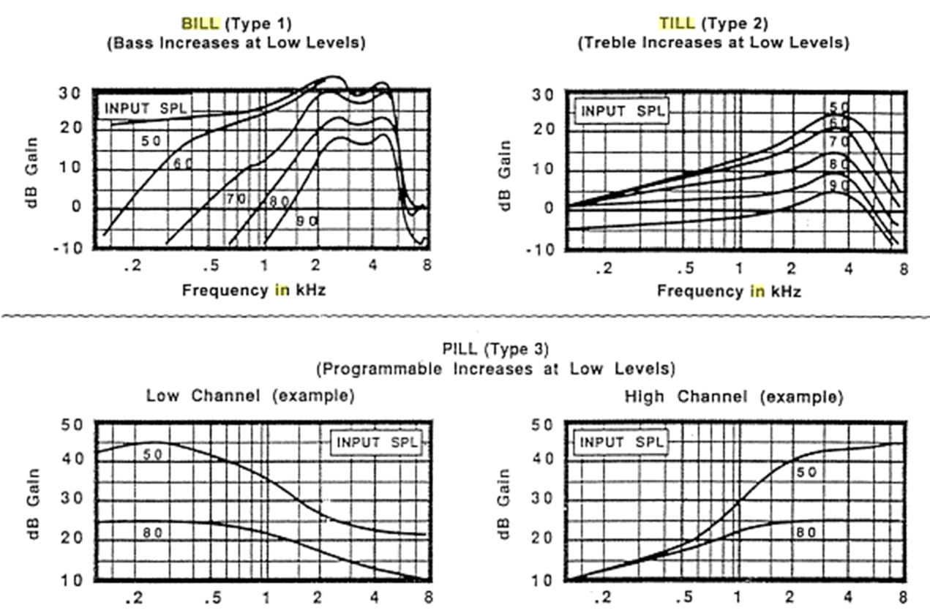

Slide 36
Signal enhancing technology
Adaptive Noise Reduction
Noise in the real world, however, may come from different locations and the relative locations of speech and noise may change over time. A directional microphone with a fixed polar pattern may not provide the optimal directional effect in all situations. With the advances in digital technology, directional microphones with variable polar patterns (i.e., adaptive directional microphones) are available in many digital hearing aids. These adaptive directional microphones can vary their polar patterns depending on the location of the noise. The goal is to always have maximum sensitivity to sounds from the frontal hemisphere and minimum sensitivity to sounds from the back hemisphere in noisy environments (Kuk et al., 2002a; Powers and Hamacher, 2004; Ricketts and Henry, 2002).
For example, the adaptive directional microphone should adopt the bidirectional pattern if the dominant noise source is located at the 90° or 270° azimuths and adopt the cardioid pattern if the dominant noise source is located at 180° azimuth.

Slide 37
The adaptive ability of the adaptive directional microphones is achieved in three to four steps:
signal detection and analysis;
determination of the appropriate operational mode (i.e., omni-directional mode or directional mode);
determination of the appropriate polar pattern; and
execution of the decision.

Slide 38
1.Signal Detection And Analysis
Level Detector
Modulation Detector
Wind Noise Detector
Front-Back Detector
2.Determination of Operational Mode
3.Determination of Polar Pattern(s)

Slide 39
DIRECTIONAL MICROPHONES
These are designed to take advantage of the spatial differences between speech and noise.
Directional Microphones are more sensitive to sounds coming from the front than sounds coming from the back and the sides.

Slide 40
First-Order Directional Microphones
First-order directional microphones are implemented with either a single-microphone design or a dual/twin-microphone design. Since the sound in the posterior port is delayed by the traveling time between the two microphone ports (i.e., external delay) and the acoustic delay network (i.e., the internal delay), the sound from the front is minimally affected. Therefore, the directional microphones have high sensitivity to sounds from the front. the sensitivity of the directional microphone to sounds from the back is greatly reduced.
Directional microphones exhibit four distinct types of polar patterns: bipolar (or bidirectional, dipole), hypercardioid, supercardioid, and cardioids.

Slide 41
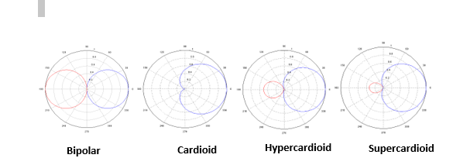

Slide 42
Working with Directional Microphones
First, the performance of directional microphones decreases near reflective surfaces, such as a wall or a hand, or in reverberant environments. Hearing aid users therefore need to be counseled to move away from reflective surfaces or to converse at a place with less reverberation, if possible.
Second, the polar patterns of a directional hearing aid and the locations of the nulls when the hearing aid is worn on the user's head can be very different from an anechoic chamber measurement in which the directional microphone is free-hanging in space (Chung and Neuman, 2003; Neuman et al., 2002). Depending on the hearing aid style, the most sensitive angle of the first-order directional microphones may vary from 30° to 45° for in-the-ear hearing aids to 90° for behind-the-ear hearing aids (Foutune, 1997, Neuman et al, 2002; Ricketts, 2000b). If possible, clinicians need to use the polar patterns measured when the hearing aids are worn in the ear so they can counsel the hearing aid users to position themselves so that the most sensitive direction of their directional microphone points to the direction of the desired signal and the most intense noise is located at the direction with the least sensitivity, if possible.

Slide 43
Second-Order Directional Microphones
Although first-order directional microphones generally provide 3 to 5 dB of improvement in SNR for speech understanding in real-world environments, people with hearing loss often experience a much higher degree of SNR-loss. This means that the benefits provided by first-order directional microphones are insufficient to close the gap between the speech understanding ability of people with hearing loss and that of people with normal hearing in background noise. This limitation prompted the development of a number of instruments, such as second-order directional microphones and array microphones, to provide higher directionality.
Second-order directional microphones are composed of three matched omni-directional microphones, and they usually have a higher directivity index than the first-order directional microphones. The only commercially available second-order directional microphones to date are implemented in the behind-the-ear.

Slide 44
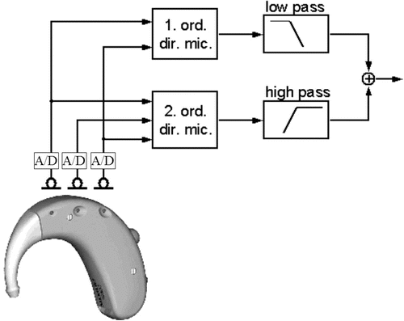

Slide 45
Noise reduction algorithms
Noise reduction algorithms are designed to take advantage of temporal separation and spectral differences between speech and noise.
These basically detect modulations in the incoming signal to infer the presence or absence of speech.
With the advent of DNR began the evolution of increasingly more complex algorithms that employ decision rules capable of defining what constitutes noise, how much gain reduction is appropriate, and in which frequency ranges the gain reduction should be implemented.

Slide 46
Noise Reduction Algorithms are divided into two categories
a) Multi channel Adaptive Noise Reduction
b) Synchrony Detection Noise Reduction

Slide 47
The first step is to classify speech and noise in the incoming signal. It has detectors to estimate modulation rate and modulation depth within each frequency channel to infer the presence of speech, noise, or both.
The assumption is that level of noise is relatively stable and speech varies rapidly within and across frequency channels. Another important test is to estimate SNR within each freq channel. If modulation depth is high, it assumes high SNR and moderate or low SNR when modulation depth is moderate or low in frequency channel
Multichannel adaptive noise reduction algorithms have been evaluated for their effectiveness in improving speech understanding and perceived sound quality of hearing aid users. Many research studies reported that the noise reduction algorithms implemented in hearing aids increased subjective listening comfort, naturalness of speech, sound quality, and/or listening preference in background noise.

Slide 48
Synchrony Detection Noise Reduction Algorithm
These algorithms detect the fast modulation of speech across frequency channels and takes advantage of temporal separation between speech and noise. The rationale is that energy of speech sound is co modulated by opening and closing of vocal folds during the voicing of vowels and voiced consonants (i.e., fast modulation of speech). Noise on the other hand is rarely modulated.
Working
This makes use of co modulated or synchronous nature of speech sounds to detect presence of speech
The signal detection unit monitors the incoming signal at high frequency bands
If no synchronous energy is detected it assumes no speech signal and reduces overall gain by decreasing gain at high input levels at all frequency bands
When synchronous energy is detected it allows the signal to pass without attenuation. In another word’s synchronous energy across the frequency bands deactivates the actions of noise reduction algorithms
Demerit:The major limitation is that it cannot differentiate between desired signal and unwanted signal when speech itself is competing noise.

Slide 49
Frequency Transposition
Hearing Impaired mostly have a high frequency loss than a low frequency loss.
For some individuals this loss is so great that they don’t get sufficient information even after amplification.
For individuals with sloping hearing loss and high frequency thresholds greater than 70dB HL or greater, high frequency parts of speech gives no information.
For such individuals in order to access information high frequency part of speech should be moved down to some other frequency region where person is able to analyze sounds.
For eg: a high frequency speech sound like S would be transposed into low frequeny region.
This is the basics for frequency transposition

Slide 50
The downward shifting follows many rules.
In one approach I/P range 4-8 kHz can be moved down to some lower range such as 0- 4 kHz that is by one octave.
The problem with this approach is for sounds energy below and above 4 kHz such as voiced fricatives (eg: th- them, v- vote, zh- Vision, z- zoo) the results may be confusing.
Many people with sever high frequency hearing loss considrs that this scheme improves speech clarity.
The ability to identify transposed high frequency components improves only with training.
Subjects with hearing thresholds greater than 70dBHL from 4-8kHz region will benefit from transposition. They could discriminate easy phonemes but not certain high frequency contrast.
Widex Inteo includes a unique, patent-pending linear frequency transposition algorithm called the Audibility Extender (AE) which allows people with an unaidable high frequency hearing loss to hear the missing high frequencies in the lower frequency region.

Slide 51
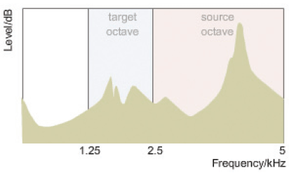
Figure I: Frequency region to be transposed (Source octave) and where it should be transposed (target octave).

Slide 52
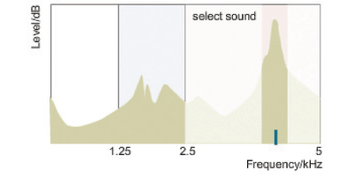
Figure II: Audibility Extender identifies the frequency at 4 kHz in the source octave region to have the highest peak

Slide 53
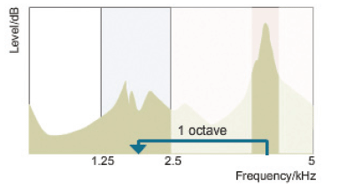
Figure III: Sound with the peak at 4 kHz transposed down by one octave to 2 kHz.

Slide 54
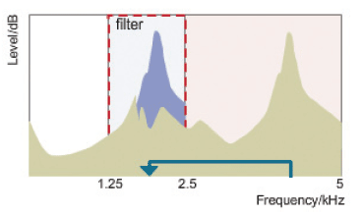
Figure IV: Sounds beyond the one octave band width of the 2000 Hz signal will be filtered out.

Slide 55
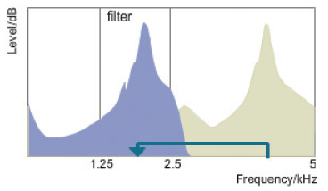
FigureV: The filtered and transposed signal is amplified and mixed with original signal

Slide 56
BASIC HEARING AID TECHNOLOGY
Directional microphone systems
Digital noise reduction
Impulse noise reduction
Wind noise reduction
Telecoil
FM compatibility
Data logging

Slide 57
New And Advanced Hearing Aid Technology
Binaural processing
This feature is often (but not always) available on basic hearing aids, too. Binaural processing means a pair of hearing aids communicate wirelessly with each other. This technology mimics the brain's ability to process information coming from both ears and helps reduce manual adjustments. It is most commonly used to keep the hearing aids operating synchronously (such as switching from program 1 to 2 at the same time) or to stream auditory signals from one hearing aid to the other.
Tinnitus masking features
The most sophisticated hearing aids come with tinnitus masking features. An audiologist or other hearing care provider can program them to emit sounds that mask the tinnitus or ringing in your ears. (But for many people with tinnitus, simply amplifying the sounds you've been missing with a hearing aid can help minimize tinnitus, which often develops when a person experiences age-related hearing loss.

Slide 58
Artificial intelligence
Some hearing aids have a feature that allows them to “learn” your preferences, a type of AI or artificial intelligence. By logging volume control settings and program preferences for certain sound environments, the hearing aids can begin to make these changes automatically when the environment is detected. Over time, this reduces your need to make manual adjustments.
Rechargeable batteries
Increasingly, hearing aids have rechargeable batteries, allowing a person to stop swapping out tiny button batteries every few days or weeks. It's anticipated that these will be widely available with most hearing aid models in the next few years.
Bluetooth compatibility
Bluetooth compatibility is a wireless feature that enables hearing aids to connect to mobile phones and other devices that use Bluetooth, often through an intermediary device. Bluetooth technology has the ability to improve the signal-to-noise ratio and eliminate feedback from the microphone because the signal bypasses the microphone and directly enters the hearing aid’s processor.

Slide 59
THANK YOU

