Slide 1
TEST BATTERY APPROACH
Submitted to :- Muneer Sir, Assist. Professor, SVDU
Made by :- Sushant salunkhe 3rd sem B.ASLP

Slide 2
Definition :
Test battery approach is bunch of audiological test which are useful for diagnosis , assessment, identification of individuals hearing and hearing loss and hearing disorder which may be able to identify or differentiate the cochlear loss and retro cochlear loss.
The test battery approach recommended the following points
Case history
Observation of auditory behavior
Audiological test procedure

Slide 3
THE BATTERY APROACH
Pure tone audiometry
Impedance audiometry
Short increment sensitivity index
Tone decay test
Alternate binaural loudness balance test
Monaural loudness balance test
Otto acoustic emission
Auditory brain stem response
Speech audiometry
Supra threshold adaption test

Slide 4
Need of test battery :
The needs for to understanding statistical properties of test that are chosen for the auditory testing.
The test battery approach are useful for processing or auditory ability of individuals.

Slide 5
From the several score of special auditory test that have been proposed from time to time over the past few decades ,only these techniques and procedures that seem to have some possibility of enduring value , especially suitable for the diversified audiological set ups in India , have been selected for comprehensive discussion.

Slide 6
Peripheral vs. central disorders:
It is important to distinguish at the onset between tests especially suited to the evaluation of the peripheral auditory system and the test more appropriate to the evaluation of the central auditory system.
The lesions distal to this boundary may be said to affect the peripheral system.
The principal location of disorders in the peripheral system are the middle ear , cochlear ,and eighth nerve.

Slide 7
Lesion proximal to the boundary at the first synapse may be said to affect the central auditory system.
Sensory neural loss is a term used to describe any hearing loss originating medial to the footplate of the stapes , though it is not usually considered to include the central auditory system.

Slide 8
When the results of auditory tests allow the site of lesion to be specified sensory neural hearing impairments are described as being cochlear or retro cochlear.
Although cochlear impairments can result from otosclerosis, the term “cochlear” usually refers to hair cell damage of the organ of corti.

Slide 9
Therefore, cochlear impairments are sometimes referred to as sensory losses.
A retro cochlear lesion refers to damage to the auditory portion of the eighth cranial nerve (neural loses).

Slide 10
1 .Pure tone audiometry
PRINCIPLE :
Define type & degree of hearing loss.
INTERPRETATION :
There are three types of hearing loss.
Conductive hearing loss :
Here the lesion lies in the outer/middle ear or both i.e. AC pathway.
BC is normal
AC is abnormal
ABG is > 10 db

Slide 11
2 Sensory neural hearing loss:
Here the lesion is in the inner ear and/or the auditory nerve.
The transmission of sound is affected in both AC as well as the BC pathway.
AC affected
BC affected
A-B gap <10 dB
3 Mixed hearing loss :
Here the lesion lies in the outer/middle & the inner ear/nerve.
AC and BC both are affected
A- B gap >10 dB

Slide 12
PTA (DBHL) DEGREE OF HEARING LOSS
10 to 25 dB Normal hearing sensitivity
26 to 40 dB Mild hearing loss
41 to 55 dB Moderate hearing loss
56 to 70 dB Moderately severe hearing loss
71 to 90 dB Severe hearing loss
90 above dB Profound hearing loss

Slide 13
2. IMPEDANCE AUDIOMETRY
Impedance audiometry include the TYMPANOMETRY and REFLEXOMETRY.
1 TYMPENOMETRY :
PRINCIPLE : Define the middle ear abnormality and middle ear pressure.
INTERPRETATION :
TYPE A : Normal ,sensory neural hearing loss, early otosclerosis
TYPE B : Flat tympenogram, otitismedia, tympanicmembrane perforation, cholestroma.

Slide 14
TYPE C :Eustachian tube dysfunction.
TYPE AS :Otoscelorosis.
TYPE AD : osscicular chain dyscontinuety.
2 REFLEXOMETRY :
PRINCIPLE : Define stapedial muscle contraction.
INTERPRETATION :
(I) Conductive hearing loss :
-In right ear middle ear is affected

Slide 15
(ME) Epsi Contra
(RE) absent absent
(LE) present absent/Elevated
Mild problem –Elevated
Severe problem -absent
(II)Cochlear problem :
In right ear inner ear is affected
(IE) Epsi Contra
(RE) absent absent
(LE) present present

Slide 16
(III)Retro cochlear loss :
Extra axial
Intra axial

Slide 17
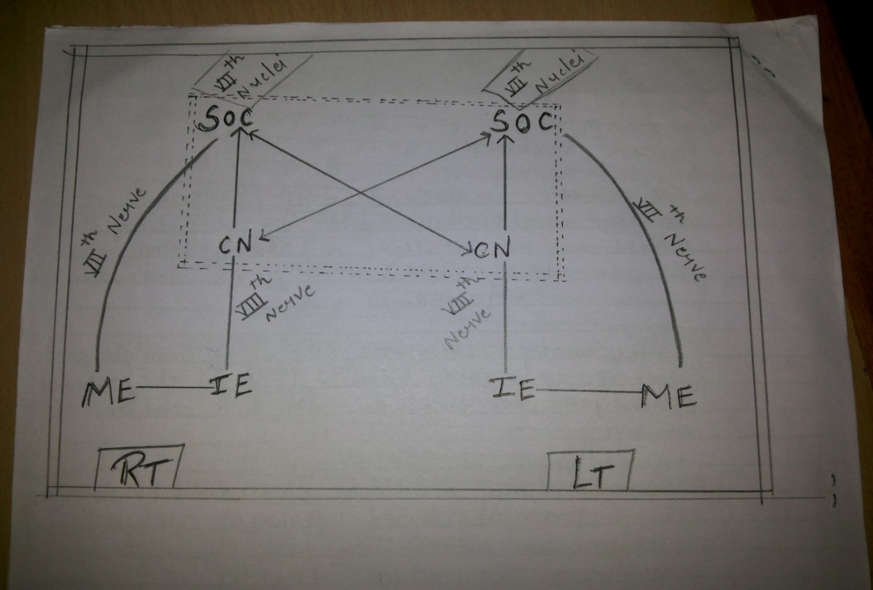

Slide 18
3. SHORT INCRENMENT SENSITIVIY TEST
          PRINCIPLE:
Difference limens for intensity (DLI)
DLI = Smaller difference in between two
intensity as known as DLI.
INTERPRETATION :
0 to 20 % = Negative, normal & Conductive
retro cochlear pathology.
25 to 65 %=“Questionable”
70 to 100%=Cochlear pathology “positive”, or high SISI
scores.
Jerger et al.(1959)

Slide 19
4.TONE DACAY TEST
PRINCIPLE :
“ Adaptation”.
The decrease in the tone’s loudness over time is usually called loudness adaptation ,and the situation in which it dies out completely is called “threshold adaptation” or “tone decay”.
INTERPRETATION :
decay is generally from 0 to10 db , and in some cases ,it increases to 25 db toward the higher frequencies.
Decay is greater than 30 db seen in cochlear losses.

Slide 20
Maximum decay is seen in retro cochlear disorder (e.g., in patient with an eighth nerve lesion)and more likely seen at both low and high frequencies.
Decay usually will be 30 to 35 db up to the audiometer limits, with slightly more decay at the higher test frequencies.

Slide 21
5.ALTERNATE BINAURAL LOUDNESS BALANCE TEST
PRINCIPLE :
Recruitment”.
Recruitment is defined as an abnormal growth of loudness for signals at suprathreshold intensities.
INTERPRETATION :
A. Complete recruitment :
Complete recruitment is present when reference and variable ears are judged equally loud at equal dbhl +_10 db.
Cochlear pathology.
Same Dbhl +- 10 db

Slide 22
b . Partial recruitment :
Partial recruitment is shown if equal loudness judgments full between those of complete and no recruitment.
Cochlear pathology.
In between dBhl & dbsl.
C . No recruitment :
If equal loudness judgments are made at equal dbsl +_ 10 db ,then no recruitment is shown.
Retro cochlear pathology.
Same dbsl +-10 db

Slide 23
De recruitment :
De recruitment has been noted less frequently than the other patterns.
Retro cochlear pathology
More than 15 db in dbsl.

Slide 24
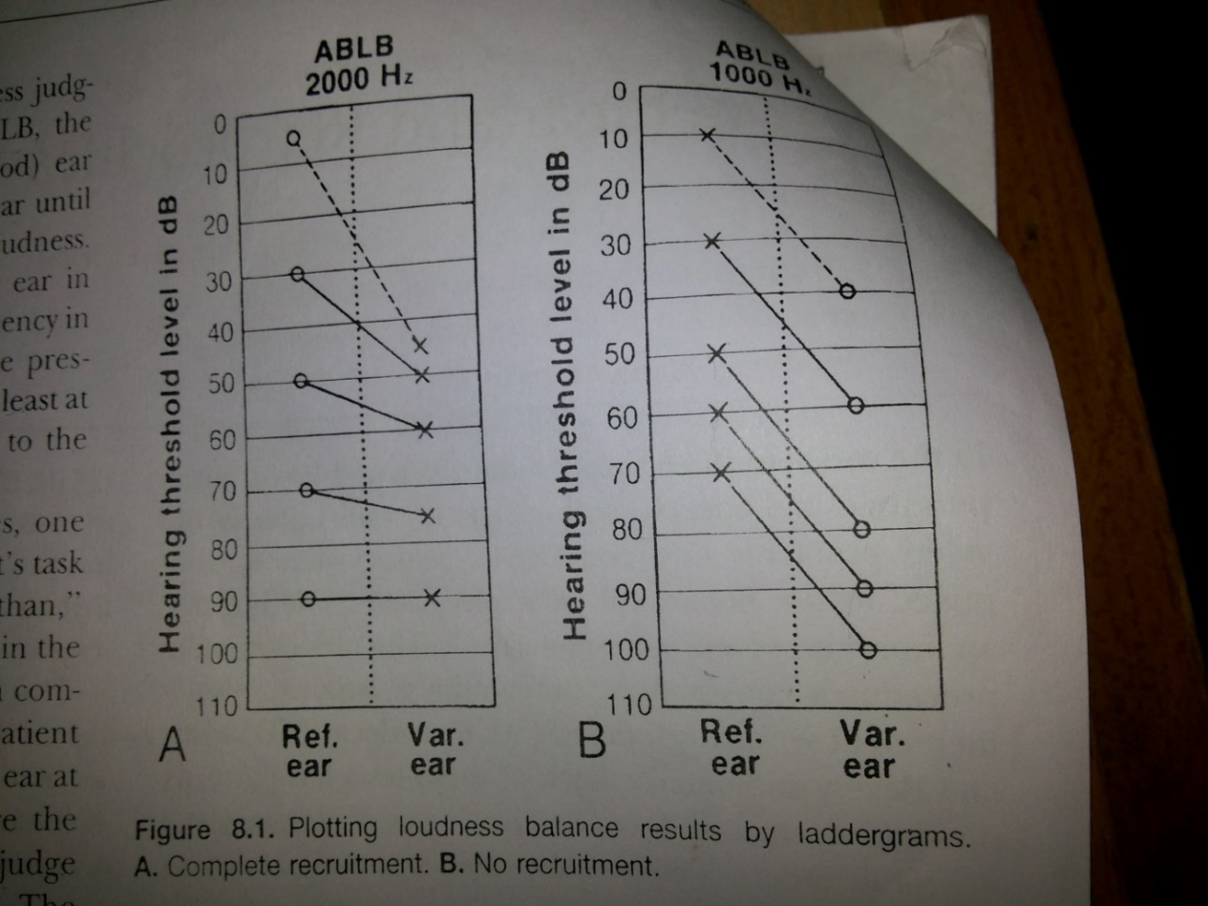

Slide 25
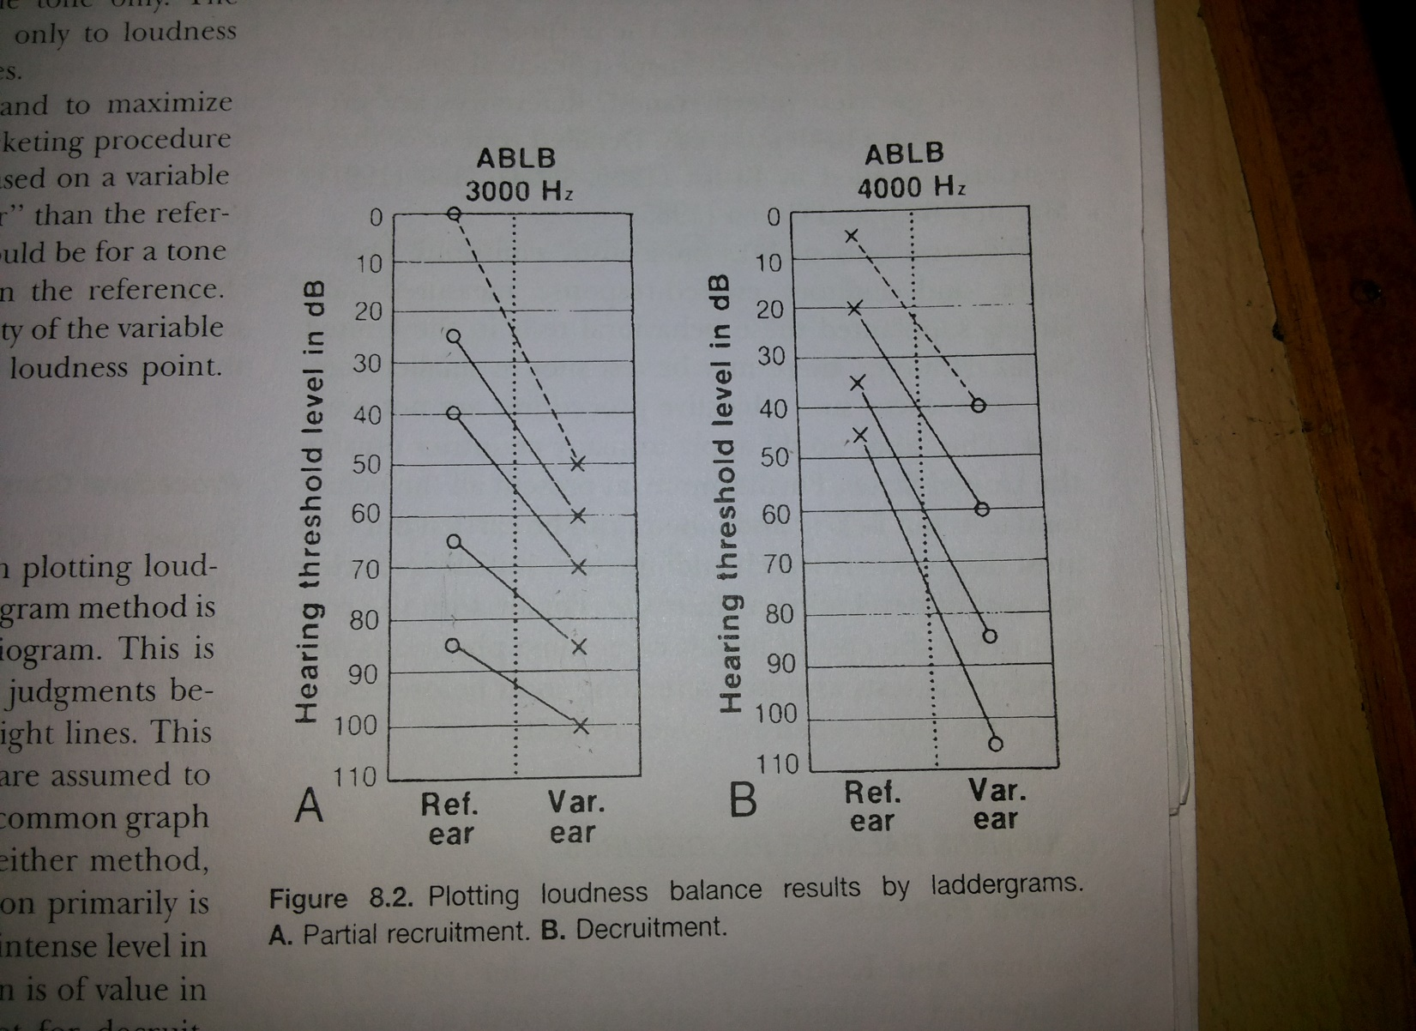

Slide 26
6.MONAURAL LOUDNESS BALANCE :
PRINCIPLE : “Recruitment”
Interpretation is same as of interpretation of ABLB.

Slide 27
7.OTOACOUSTIC EMMISION
PRINCIPLE :
Define outer hair cells function.
INTERPRETATION :
Sensory neural hearing loss =O.A.E absent
Conductive hearing loss = O.A.E absent
In tinnitus= O.A.E absent
Normal = O.A.E present

Slide 28
8.AUDITORY BRAIN STEM RESPONSE
PRINCIPLE :
Define the brain stem & auditory dysfunction.
INTERPRETATION :
1.Normal :All latencies WNL
Good morphology
2.CHL : wave I latency markedly delayed
-Interweave latency WNL
-Good morphology

Slide 29
3.SNHL :wave I latency slightly delayed
-wave I smaller absent
-Interweave latencies WNL
-poor morphology
4.Neural loss : wave I normal
- wave I to III latency delayed
- Interweave latency delayed
- poor morphology.

Slide 30
9.SPEECH AUDIOMETRY
PRINCIPLE :
To find how a patient hears speech involves testing him with speech stimuli, and this process is called speech audiometry.
INTERPRETATION :
Determinate an index of hearing sensitivity :
SRT of 20 dBHL or less suggests normal by hearing sensitivity for speech sound.
25 dBHL - slight loss
30 to 40 dBHL - mild
45 dBHL - moderate

Slide 31
60 dBHL -severe
90 dBHL –profound
Speech discrimination score :
Mild -80 to 100 %
Moderate -50 to 80 % in better ear
Severe – 40 to 50 % in better ear
Profound -<40 % in better ear
Total or near total deafness –no discrimination

Slide 32
10. SUPRATHRESHOLD ADDAPTION TEST :
PRINCIPLE : “ADDAPTATION”.
Jerger and Jerger”s (1975) suprathreshold adaptation test begins at high levels (e.g.,100 dB HL) , with a total test time per frequency of 1 minute ,with one of two results:
tone still heard (presumed non retrocochlear loss)
Tone not heard (presumed retrocochlear problem).

Slide 33
Thank you

