Slide 1


Terminologies related to efficiency of tests
Submitted to :- Muneer sir, assist pro.
Presented by :- Sourav kumar, 3rd sem

Slide 2
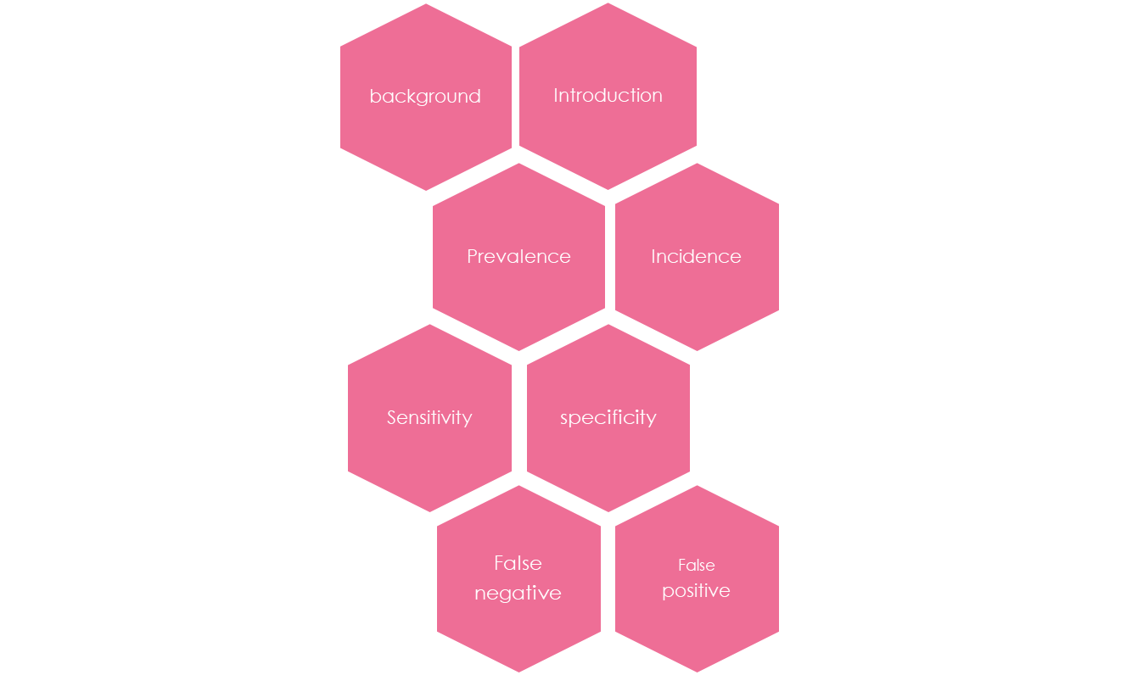
content

Slide 3
Background
The fundamental goal of a screening test is to identify the individuals in a population who have a specified disorder or group of disorders.
In a perfect screening test every abnormal person would fail and every normal case would pass.
In spite of our best intentions, no screening test (or any test, for that matter) can separate all normal and abnormal individuals with complete accuracy.
For this reason we must consider the screening process in terms of the percentages of correct and incorrect results.
Complicating matters is the issue of what constitutes the “gold standard” used to determine the patient’s “real status.”
This is often established by another test, which itself may not be perfect.

Slide 4
Introduction
A person who passes a screening test is considered to be free of the problem, whereas one who fails is thought to have the problem.
on a perfect screening test, everyone who is really normal would pass and everyone who is really abnormal would fail.
even though screening tests seem to have two results (pass and fail), there are really four possible outcomes from the standpoint of whether the pass and fail results are right or wrong.
The two correct outcomes are called sensitivity and specificity.
The terms "sensitivity" and "specificity" were introduced by American biostatistician Jacob Yerushalmy in 1947
The two incorrect screening outcomes are false negatives and false positives.

Slide 5
Prevalence
Prevalence in epidemiology is the proportion of a particular population found to be affected by a medical condition (typically a disease or a risk factor such as hearing loss) at a specific time.
It is derived by comparing the number of people found to have the condition with the total number of people studied, and is usually expressed as a fraction, a percentage, or the number of cases per 10,000 or 100,000 people.
Prevalence answers "How many people have this disease right now?" or "How many people have had this disease during this time period“.
Incidence is the number of new cases that develop during a specified time period.

Slide 6
Incidence
Incidence in epidemiology is a measure of the probability of occurrence of a given medical condition in a population within a specified period of time. Although sometimes loosely expressed simply as the number of new cases during some time period.
Incidence answers "How many people acquired the disease during [a specified time period]".
It is better expressed as a proportion or a rate with a denominator.

Slide 7
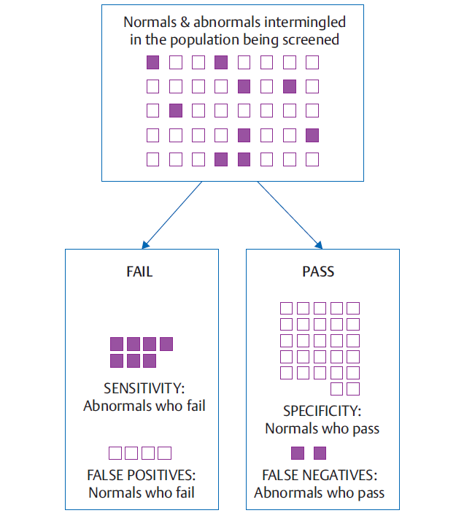
Hypothetical case

Slide 8
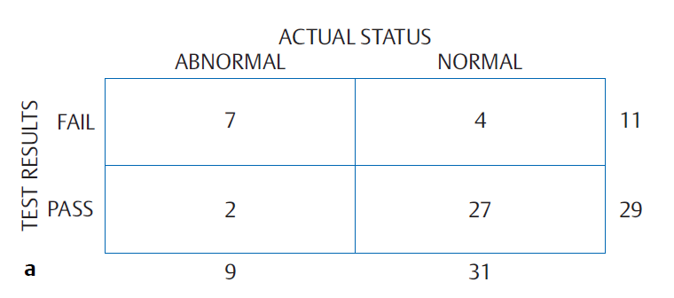
Numerical representation

Slide 9
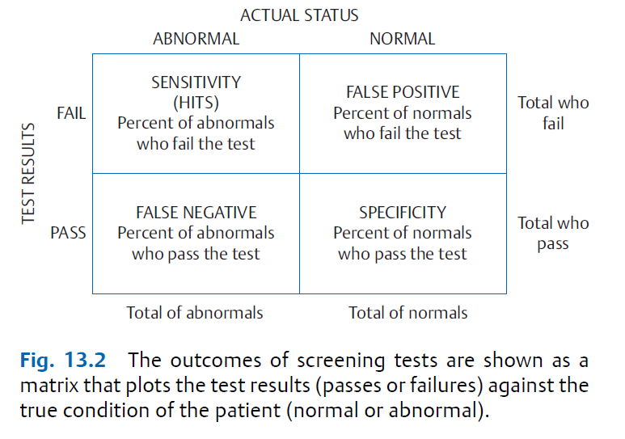
Matrix

Slide 10
Sensitivity
Sensitivity is the proportion of abnormal people who fail the screening test, and is also known as the hit rate.
It is obtained by dividing the number of abnormals who fail by the total number of abnormals.
Or,
It is the percentage, or proportion, of true positives out of all the samples that have the condition (true positives and false negatives).
sensitivity (or the hit rate) tells us how well the screening test correctly identifies people who have the problem.
In a diagnostic test, sensitivity is a measure of how well a test can identify true positives.

Slide 11
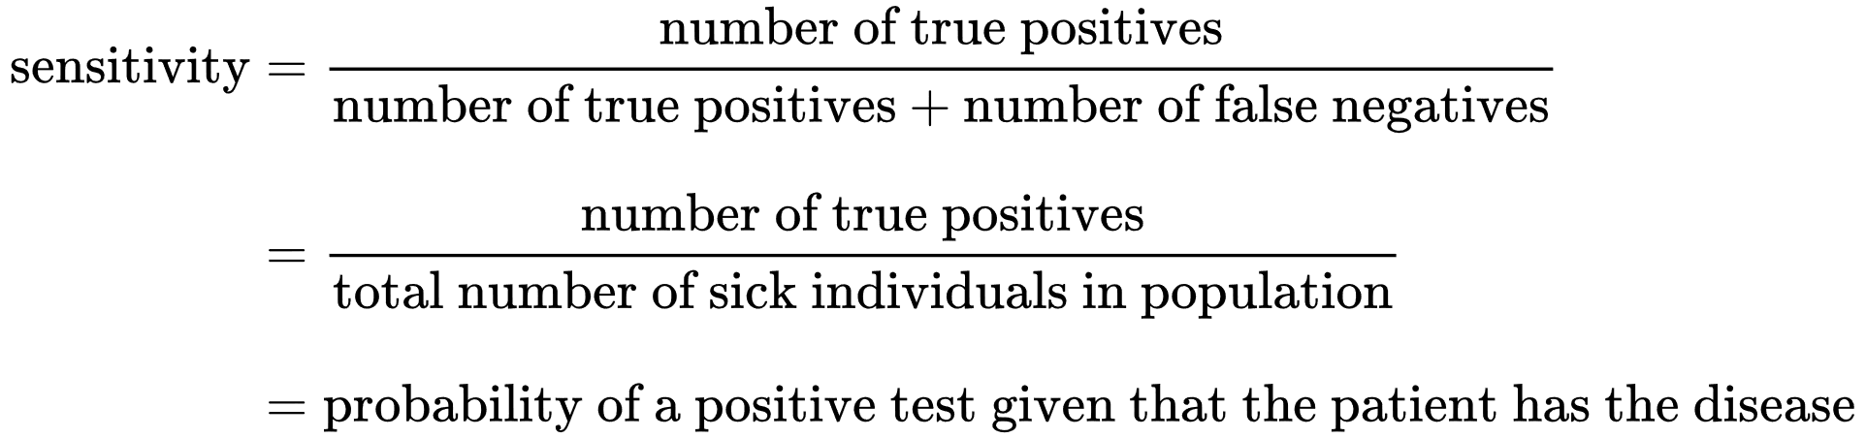
Cont…

Slide 12
Specificity
Specificity is the proportion of normal individuals who pass the screening test.
It is calculated by dividing the number of normals who pass by the total number of normal cases.
Or,
it is the percentage, or proportion, of the true negatives out of all the samples that do not have the condition (true negatives and false positives).
specificity shows how well the test correctly identifies those who are normal.
In a diagnostic test, specificity is a measure of how well a test can identify true negatives.

Slide 13
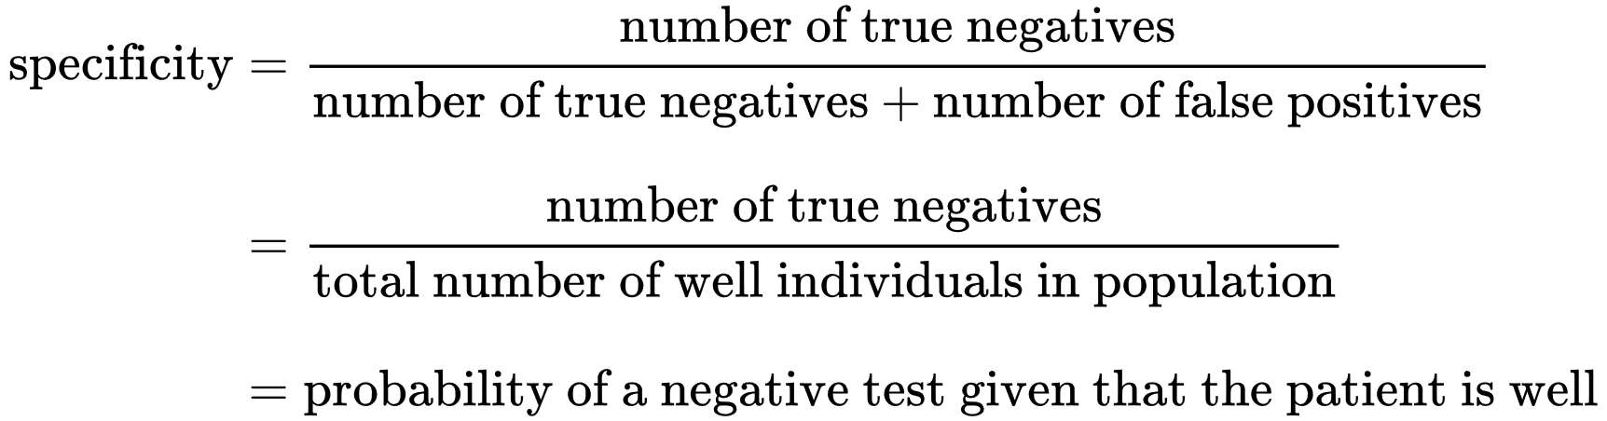
Cont…

Slide 14
False Negative
Passing the screening test is a “negative” result because it implies the person does not have the problem.
A false-negative result, or a miss, occurs when an abnormal person passes the screening test.
The false-negative rate is the proportion of abnormal cases who pass the test, that is, the number of misses divided by the total number of abnormals.
The false-negative (miss) rates are the errors associated with sensitivity.

Slide 15
False positive
failing the screening test is a “positive” result because it suggests the person does have the problem.
a false-positive result occurs when a normal person fails.
The false-positive rate is the proportion of normals who fail the screening test. It is obtained by dividing the number of false positives by the total number of normals.
false-positive rates are the errors associated with specificity.
In a "good" screening test (one that attempts to identify with precision people who have the condition), the false positives should be very low.

Slide 16
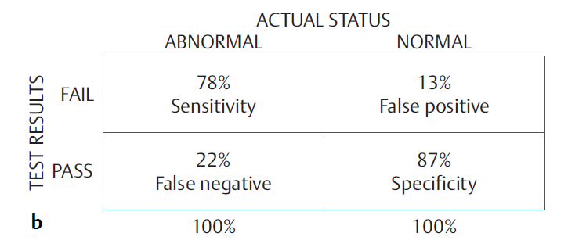
Results

Slide 17
Conclusion
The goal is to have a screening test with both good sensitivity and good specificity.
Even a very sensitive screening test would be useless if it is also failed by too many people who are normal.
And a test with great specificity would be useless if it is also passed by too many people who are abnormal.

Slide 18
Any query?

Slide 19
References
Essentials of Audiology, Fourth Edition, Stanley A. Gelfand, PhD Professor Department of Linguistics and Communication Disorders Queens College of The City University of New York.
https://en.wikipedia.org/wiki/Sensitivity_and_specificity
https://en.wikipedia.org/wiki/Prevalence

Slide 20
Dhanywaad

