Slide 1
Recruitment
COLLEGE OF REHABILITATION SCIENCE, SUMANDEEP VIDYAPEETH
GUIDED BY:- Mr. Muneer Ahmad, Asst. professor
SUBMITTED BY:- Shreeya Trivedi
3rd Semester BASLP
CRS, Sumandeep Vidyapeeth

Slide 2

TOPICS AT A GLANCE
Introduction
What is Recruitment?
Theories of Recruitment
Different theories.
ABLB, MLB
What are those test, principle and diagnosis.

Slide 3
INTRODUCTION
Loudness is the perceptual correlate of the intensity of the acoustic stimulus.
An aberration of the intensity–loudness relationship is found in patients with cochlear disorders.
Once the signal is increased above the impaired threshold of such an ear, the loudness grows at a faster rate than normal in response to increasing stimulus level. This is called loudness recruitment.

Slide 4
RECRUITMENT (THEORY AND PHYSIOLOGY)
Lorente de nó’s Theory of Recruitment:-
In 1937 – suggested if either the hair cells/cochlear fibers were affected, the near-threshold stimuli, appear weak in loudness.
With high-intensity stimuli, non-affected hair cells/ nerve fibers are maximally excited, result - limited number of impulses/second generated at impaired ear.
Consequently both, impaired and normal-hearing ears would similarly perceive the loudness of a high-intensity tone.
Although later studies indicate that recruitment is - phenomenon originating in the hair cells, this theory holds the concept restricted to hair-cell and not to nerve-fibre damage.

Slide 5
Lurie’s Theory of Recruitment
In 1940, she described it by suggesting that outer hair cells play a minor role in responding to intense sounds, inner hair cells are responsible for it.
Thus damage to outer hair cells would elevate the pure tone thresholds and as intensity increases, the inner hair cells get excited.
This results in loudness sensation, equals that in impaired ear.
Absence of recruitment – damage to both outer and inner hair cells. This theory, however, does not account for over recruitment.

Slide 6
Simmons and Dixon’s Theory of Recruitment
In 1966, they suggested summation theory, meaning, the loudness recruitment depends on the area of basilar membrane excited.
The larger the area excited, the greater the nerves activated and the greater the loudness sensation.
Hall pike and Hood (1959) noted, if this theory was held, loss of a few receptors could affect loudness response at low intensities.
At high intensities, the contribution of these affected receptors to the loudness response would be minimal so, normal loudness sensation in the affected ear would occur for high-intensity stimuli.

Slide 7
Tonndorf’s “Centre – Clipping” Theory of Recruitment:-
Cilia of the hair cells loose stiffness due to cochlear dysfunction.
Decoupling from tectorial membrane occurs.
The decoupling occurs as cilia pass through their centre points as they move from side to side during the shearing action. At the moment of decoupling, there is an amplitude loss in the response waveform.
Amplitude reduction has fixed magnitude.
As the intensity increases, the proportion of amplitude loss with respect to the total amplitude becomes smaller and smaller and eventually disappears.

Slide 8
Evans, Kiang, Moxon, & Levine’s Theory of Recruitment:-
Based on the rate at which nerve fibers are activated and the shape of the tuning curve-narrow at low intensities and broad at high intensities.
In the normal ear, as the intensity increases, the number of nerve fibers activated per dB increases.
The tuning curves in pathological ear are significantly wider than those in normal ears.
Therefore as intensity increases above threshold in pathological ear, the nerve fibres activated per dB is greater than normal ear.
Therefore, at a given intensity above hearing threshold – in pathological ear – number of nerve fibers activated per dB is greater than in a normal-hearing ear. But total number of fibres < fibres activated in normal hearing (i.e. hearing impairment).

Slide 9
Most logical theory but still lacks some support from psychoacoustic data.
In summary, many theories of loudness recruitment exist. Further research is needed before a single theory of loudness recruitment can be accepted which accounts for the phenomena of decruitment and over-recruitment as well as complete recruitment.

Slide 10
Alternate Binaural Loudness Balance (ABLB) Test
A tone is presented alternately between the two ears (binaurally). The level of the tone stays the same in one ear (the “fixed” ear), but is varied up and/or down in the other ear (the “variable” ear).
The patient reports – the tone sounds louder in the right ear, when it is louder in the left ear, and when it sounds equally loud in both ears.
We say that a loudness balance has been obtained when tones sound equally loud in both ears.

Slide 11
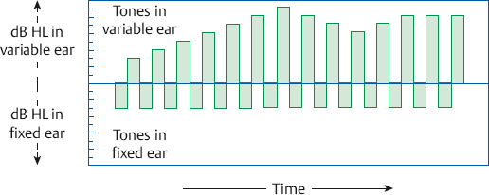
Schematical Representation

Slide 12
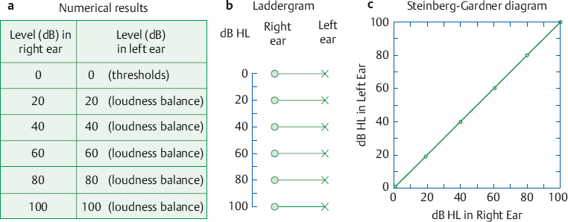
Procedure
ABLB is given to a normal-hearing person, same thresholds in both ears.
The results of loudness balances at the same frequency in 20 dB intervals are shown.

Slide 13
We assume that 0 dB HL in right ear and left ear are equally loud because they are both at threshold.
Notice that 20 dB HL in the right ear = 20 dB HL in the left ear, 40 dB HL in the right ear = 40 dB HL in the left etc.
Results can be recorded numerically, more convenient to show them diagrammatically. The diagram in the middle panel of Figure is called a laddergram.

Slide 14
For each loudness balance,
we draw a circle at the hearing level in the right ear.
X at the hearing level for the left ear.
Join the two symbols with a line to show they are equally loud.
The horizontal lines (“rungs”) indicates, equal loudness occurs at the same intensity

Slide 15
We can also show the results on a Steinberg-Gardner plot like the one in the right panel of the figure.
Here, each point shows the coordinates of the levels in the two ears that sound equally loud.
In this example, all of points fall along diagonal line because there was a one-to-one relationship between the equally loud levels.
Whenever points fall along this 45° line, it means, equal intensities sound equally loud.

Slide 16
Clinical Use of the ABLB
To determine whether loudness recruitment is present in abnormal ear (unilateral hearing loss).
Normal thresholds are needed in the better ear because the ABLB works by comparing loudness between the two ears.
Further, the threshold of the abnormal ear should be at least 35 dB HL at each frequency tested.

Slide 17
Types of Recruitment
Suppose take, 0 dB HL = normal right ear and 45 dB HL = left ear at the frequency we are testing.
Therefore, 0 dB HL in the right ear = 45 dB HL in the left ear.
Left ear – fixed ear, right ear – variable ear, loudness balances – 20 dB increments.

Slide 18
TYPES OF RECRUITMENT
COMPLETE RECRUITMENT
INCOMPLETE RECRUITMENT
NO RECRUITMENT
DECRUITMENT

Slide 19
Complete Recruitment
Occurs when – loudness balances at higher levels occur at the same intensities in both ears, that is, when equal intensities sound equally loud.
Here, even though the thresholds are 0 dB HL and 45 dB HL, equal loudness is eventually obtained when both ears receive 105 dB HL.
In practice, recruitment is generally considered complete if equal loudness occurs at equal hearing levels (dB HL) ± 10 dB (Jerger 1962).

Slide 20
This is shown by the flattening of the rungs on the laddergram.
In this example, a 60 dB rise (from 45 to 105 dB HL) in the abnormal ear sounds like a 105 dB rise (from 0 to 105 dB HL) in the normal ear.
In terms of sensation level, 60 dB SL in the bad ear is experienced as being just as loud as 105 dB SL in the good ear.

Slide 21
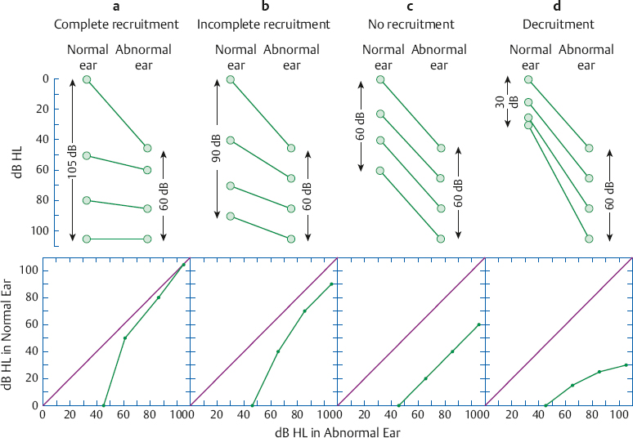

Slide 22
Incomplete Recruitment
Occurs when the results fall between complete recruitment and no recruitment.
This is shown as a partial flattening of the laddergram or by a line that rises toward but does not quite reach the diagonal on the Steinberg-Gardner plot.

Slide 24
No Recruitment
Occurs when the relationship between the levels at two ears is the same for the loudness balances as it is at threshold.
Here, the same 45 dB spread that exists between the left and right thresholds is also found for each of the loudness balances.
This is seen as parallel lines on the laddergram. The situation is even clearer on the Steinberg-Gardner plot.

Slide 25
In spite of the threshold difference between the ears, the line showing equally loud levels rises at a 45° angle just like the normal line. This shows that the spread between the two ears is maintained at high levels.
It also means that a 20 dB increase in the abnormal ear sounds just as loud as a 20 dB increase in the normal ear.
As a practical guideline, no recruitment if equal loudness occurs at equal sensation levels (dB SL) ± l0 dB (Jerger 1962).

Slide 27
No recruitment is the expected result when the loss in the abnormal ear is conductive.
In fact, Fowler (1936) conceived ABLB as a test to distinguish between otosclerosis and sensorineural hearing losses.
However, it is not used with conductive losses because its purpose is to help to distinguish between cochlear and retro-cochlear disorders.

Slide 28
Decruitment
When loudness grows at a slower than normal rate as intensity increases in the abnormal ear, it is called decruitment or loudness reversal.
In the example, 105 dB HL in the bad ear sounds only as loud as 30 dB HL in the good ear. In other words, 60 dB SL in the abnormal ear sounds like only 30 dB SL in the normal ear.
In effect, loudness is lost rather than gained as intensity is raised.

Slide 29
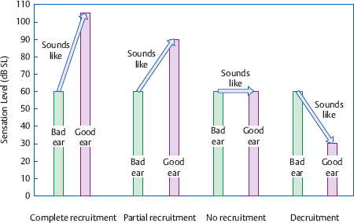

Slide 30
ABLB Testing Approaches
Different procedures have been suggested for administering the ABLB.
In Jerger’s (1962) protocol, the tone alternates in the ears automatically every 500 milliseconds with the fixed level in the abnormal ear and the variable signal in the normal ear.
The patient changes the intensity of the tone in the variable ear using the method of adjustment until it sounds equal in loudness to the tone in the fixed ear.

Slide 31
Loudness balances are made at 20 dB intervals above the bad ear’s threshold, and are plotted on a laddergram.
One should note that because the tone alternates between the two ears every 500 milliseconds, it will be off for 500 milliseconds in each ear.
This off-time ensures that the test tones will not be subject to adaptation. This requirement is met if the tone is off for at least a certain critical off-time, which is ~ 200 to 250 milliseconds
Hood (1969, 1977) suggested manual control over the presentation of the tones according to the method of limits.

Slide 32
Others have suggested presenting the fixed-level tone to the bad ear and testing according to Hood’s method (Priede & Coles 1974; Coles & Priede 1976), or randomizing the use of the good and bad ears as the fixed-level ear under computer control (Fritze 1978).
An interesting ABLB modification by Miskolczy-Fodor (1964) uses the Bekesy tracking method to keep the level in the variable ear equally loud as the one in the reference ear, and the results are automatically plotted on paper.

Slide 33
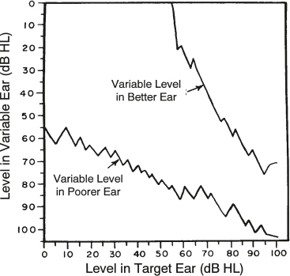
Two sets of results must be combined for accurate loudness balances with this method, one using the good ear as the reference and one using the bad ear (Carver 1970; Gelfand 1976)
Otherwise, it over- or underestimates the loudness balance points. Other variations have also been reported (Sung & Sung 1976).

Slide 34
Monaural Loudness Balance Test
The ABLB often cannot be done because
(1) it requires a normal ear (or at least an ear with normal hearing at the frequency being tested).
(2) most people with sensorineural losses have bilateral impairments.
This dilemma was addressed with the alternate monaural loudness balance (MLB) test (Reger 1935).

Slide 35
Procedure
The AMLB is similar to the ABLB except that the loudness balance is done for two different tones within the same ear.
Consider a patient with a bilateral loss that slopes sharply above 1000 Hz. The thresholds in one of her ears might be 0 dB HL at 500 Hz and 50 dB at 2000 Hz.
In such a case, 500 Hz and 2000 Hz tones might be alternately presented to the same ear.

Slide 36
The level would remain fixed at one frequency, and the level at the other frequency would be varied up and down until the two tones sound equally loud.
The results are interpreted in the same general way as for the ABLB, but a correction is needed to account for loudness level differences between frequencies (Denes & Naunton 1950).
Moreover, the inter-frequency loudness balance task tends to be difficult for many patients. The MLB is rarely used because of these problems.

Slide 37
Diagnostic Accuracy of the ABLB
The ABLB has been found to identify the correct site of lesion in ~ 90% of cases for cochlear disorders and only ~ 59% for retro-cochlear pathologies across studies (Turner et al 1984).
These figures show that many acoustic tumor cases are misclassified as cochlear on the basis of having positive recruitment.
It is possible that some retro-cochlear cases might have recruitment or other characteristics of cochlear disorders (e.g., high SISI scores) because of secondary damage to the cochlea.

Slide 38
The basic concept involves these two steps:
(1) the tumor damages the cochlea by putting pressure on its blood supply and/or adversely altering the chemistry of the cochlear fluids.
(2) the resulting cochlear disorder then produces positive recruitment.
Also, there may well be a coexisting cochlear disorder having nothing to do with retro-cochlear pathology. For example, a patient with an acoustic tumor may well have a noise-induced cochlear impairment.
These points apply to the results of other site-of-lesion tests as well.

Slide 39
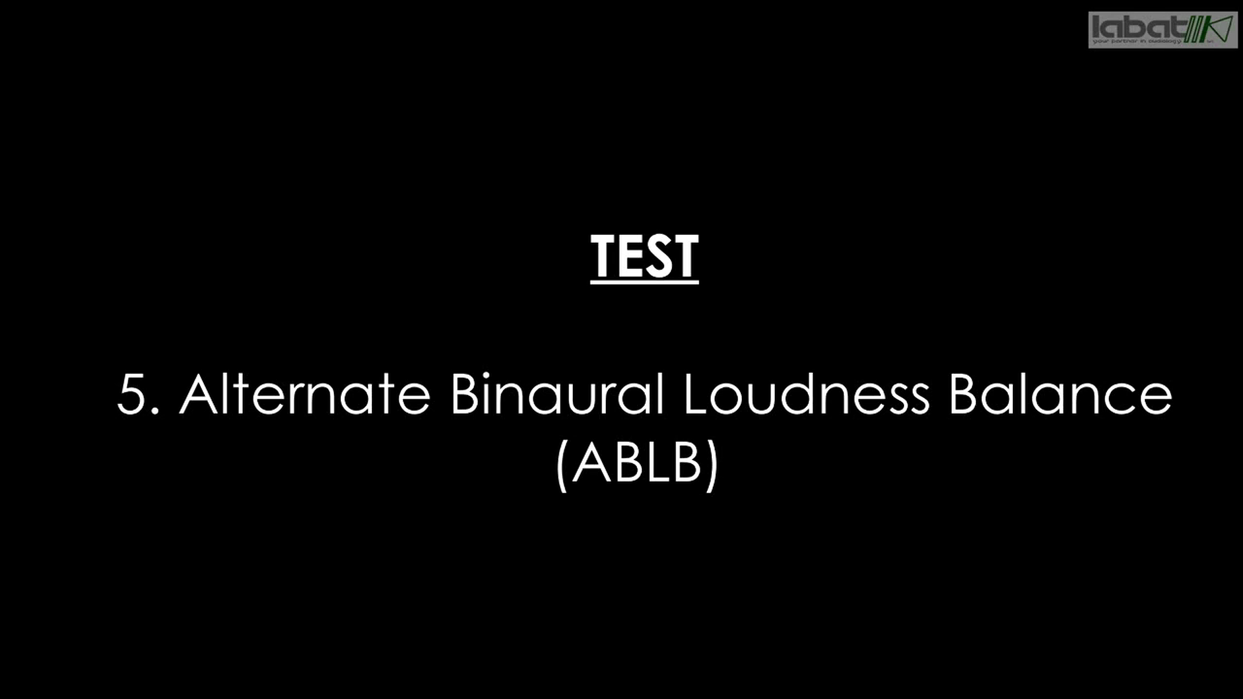
video

Slide 40

REFERENCE AND DOUBTS
Hearing: An Introduction to Psychological and Physiological Acoustics 5th Edition Stanley A. Gelfand.
Essentials of Audiology, 4th ed. Stanley Gelfand.
ANY DOUBTS?

Slide 41
THANK YOU

