Slide 1

Bekesy Ascending-
Descending Gap Evaluation (BADGE)
UDIT PANDEY
3RD SEM B.ASLP

Slide 2
CONTENT
INTRODUCTION
PROCEDURE
RESULTS
CONCLUSION
REFERENCES

Slide 3
INTRODUCTION
One way to help identify patients with functional losses is to use techniques that cause their exaggerated thresholds to be even more variable.
This can be done by testing the threshold for the same tone separately with an ascending approach and with a descending approach
The difference between these two thresholds is usually called the ascending-descending gap, and the testing itself can be done by either manual or Bekesy audiometry.
When Bekesy audiometry is used, the method is known as Bekesy Ascending-Descending Gap Evaluation (BADGE)

Slide 4
PROCEDURE
The use of both an ascending and descending approach to puretone threshold measurements has long been recommended as a rapid and simple procedure.
The common feature of these methods is that one threshold is obtained by starting at a low hearing level and increasing the intensity, whereas the other threshold is obtained by starting at a high hearing level and decreasing the intensity.
This test is adminstered same as we earlier studied in topic method of threshold estimation (method of limits)

Slide 5
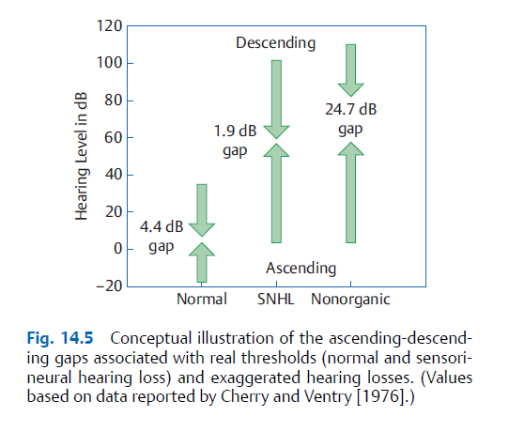

Slide 6
RESULTS
The ascending-descending gap is narrow for real thresholds and wide for exaggerated hearing losses.
A greater than 10-dB difference between these two measurements suggests a nonorganic problem because the two thresholds should be identical.
Personal use of this procedure indicates that this difference is often as large as 30 dB for patients with nonorganic hearing loss.
Functional patients have wide ascendingdescending gaps because it is hard to maintain the same frame of reference for the exaggerated threshold “target” when it is being approached from below as when it is being approached from above.

Slide 7
conclusion
The comparative ascending/descending threshold test is quick and easy to perform withthe simplest puretone audiometer and serves as the basis for the BADGE test (Békésy ascending–descending gap evaluation: Hood et al., 1964). This test has been found to be an excellent screening tool for nonorganic hearing loss.

Slide 8
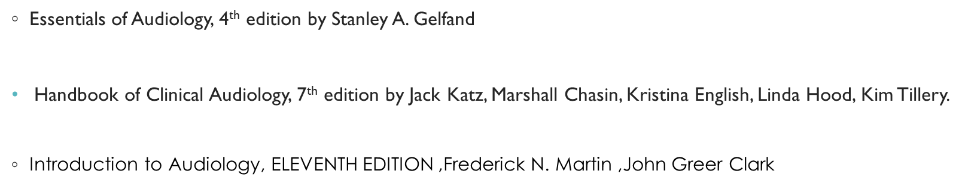
REFERNCES

Slide 9
Any query

Slide 10
SHUKRIYA

