Slide 1
STENGER TEST
PRESENTED BY :- Arjun Vishwakarma
3rd semester B.ASLP

Slide 2
CONTENT
INTRODUCTION
PRINCIPLE
PROCEDURE
DIAGNOSIS
REFERENCES

Slide 3
introduction
Stenger test is a test of hearing, primarily used to confirm non-organic hearing loss. It is also used to detect subjects who falsely claim to have hearing loss in one ear.

Slide 4
PRINCIPLE
The Stenger test was designed for use with unilateral hearing losses.
This test is based on the Stenger principle; that is, when two tones of the same frequency are introduced simultaneously into both ears, only the louder tone will be perceived

Slide 5
CRITERIA
Inconsistent response in pure tone audiometry.
Gap between better ear and worse ear must be greater than 25 dB.
In case of unilateral hearing loss.

Slide 6
PROCEDURE
The test works best when there is a large difference (at least 25 dB) between the admitted thresholds of the two ears.
Using a two-channel audiometer, a single pure-tone source may be split and controlled by two separate attenuators, or tones may be generated by two separate oscillators.

Slide 7
The thresholds of each ear for the desired frequencies are obtained first. Then, using one channel of the audiometer, a tone is introduced 10 dB above the threshold of the “better” ear.
A response should always be obtained. A tone is then presented 10 dB below the admitted thresholdof the “poorer” ear.
A response will be absent for one of two possible reasons. The first, obviously, is that the patient does not hear it since it is below threshold

Slide 8
The second is that the patient may be unwilling to respond to a tone that he or she does in fact hear.
At this point, both tones are introduced simultaneously, 10 dB above the better-ear threshold reading and 10 dB below the poorer-ear threshold reading.
If patients fail to respond, it is because they hear the tone in the poorer ear, which they do not wish to admit.

Slide 9
DIAGNOSIS
They will be unaware of the tone in the better ear, owing to the Stenger effect, and so will not respond at all. This is called a positive Stenger.
If the patient responds when both ears are stimulated, this is called a negative Stenger and suggests the absence of erroneous behavior, at least at the frequencies tested.

Slide 10
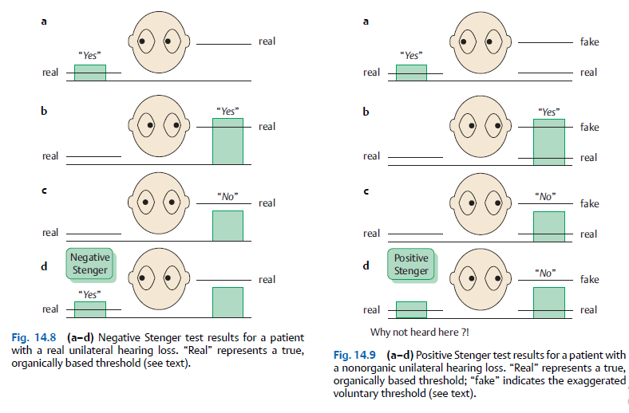

Slide 11
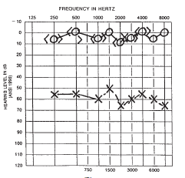

Slide 12
Tuning forks producer
The test can be done using tuning forks in the clinical setting. The individual is blindfolded before the test starts.
Two tuning forks of the same frequency are stricken and kept at a distance of 25 cm from each ear. When asked, the individual will claim to hear it in the normal ear.

Slide 13
Then, the tuning fork is brought as close as 8 cm near the feigned ear while maintaining the tuning fork at the normal side at the same distance
The individual will deny hearing anything if he/she is a malingerer. An individual with true deafness should continue to hear the sound on the normal side

Slide 14


Slide 15
ANY QUERY?

Slide 16

REFERENCES
Essentials of Audiology, 4th edition by Stanley A. Gelfand
Handbook of Clinical Audiology, 7th edition by Jack Katz, Marshall Chasin, Kristina English, Linda Hood, Kim Tillery.
Introduction to Audiology, ELEVENTH EDITION ,Frederick N. Martin ,John Greer Clark
https://youtu.be/g2UJPnWlSNk

Slide 17


