Slide 1
Modified Stenger's test
PRESENTED BY :- SHREEYA TRIVEDI
3RD SEMESTER

Slide 2
TOPICS AT A GLANCE
Introduction
Principle
Procedure & Example
Diagnosis & Conclusion
Reference & Doubt session

Slide 3
INTRODUCTION
One responsibility that Audiologists bear is to determine the organic hearing thresholds for all their patients, including those with the nonorganic hearing loss.
This may be readily achieved through behavioural means, after the potential underlying motivators for the exhibited nonorganic behaviour is been addressed.

Slide 4
PRINCIPLE
One of the best ways to rule out unilateral nonorganic hearing loss is the stenger’s test.
The Stenger’s principle states that when two tones of the same frequency are introduced simultaneously into both ears, only the louder tone will be perceived.
Stenger’s test was introduced as a tuning fork test, but it has been modified quite a lot times to be in form of pure tone test as well as speech test.

Slide 5
Procedure & example
The Speech Stenger’s test uses Spondee words as a stimuli.
There must be a unilateral or asymmetrical hearing loss in which two ears differ by each other by at least 30dB (preferably ≥ 40dB) at each frequency where the pure tone stenger has been performed.
The Speech Stenger test requires a similar difference between two SRT’s.

Slide 6
This test can be administered immediately after finding the voluntary thresholds of both the ears, as this test is a part of Stenger’s Pure tone threshold test.
The subjects are instructed to simply repeat every spondee they hear. The words are presented 10dB above the better ear SRT and 10dB below the poorer ear SRT.

Slide 7
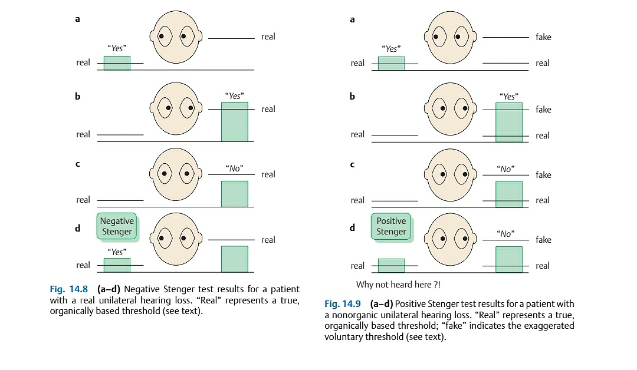
example

Slide 8
Diagnosis
A patient with real hearing loss would not hear the below-threshold tone in poorer ear, and would thus respond to the above-threshold tone in the better ear. This is called Negative Stenger.
But when a patient with nonorganic hearing loss is presented a tone lower then his exaggerated threshold, but higher then his better ear threshold, he pretends that he didn’t hear the tone as it is lower then his exaggerated threshold.
Hence, a nonorganic hearing loss is suspected, and this is called Positive Stenger.

Slide 9
conclusion
When it is performed as described, the Stenger test shows that a unilateral hearing loss is present.
It can also be used to approximate the organic threshold of the poorer ear.

Slide 10
Reference & doubt session
Essentials of Audiology, 4th edition by Stanley A. Gelfand.
Handbook of Clinical Audiology, 7th edition by Jack Katz, Marshall Chasin, Kristina English, Linda Hood, Kim Tillery.
ANY QUESTIONS ?

Slide 11


